Slide 1

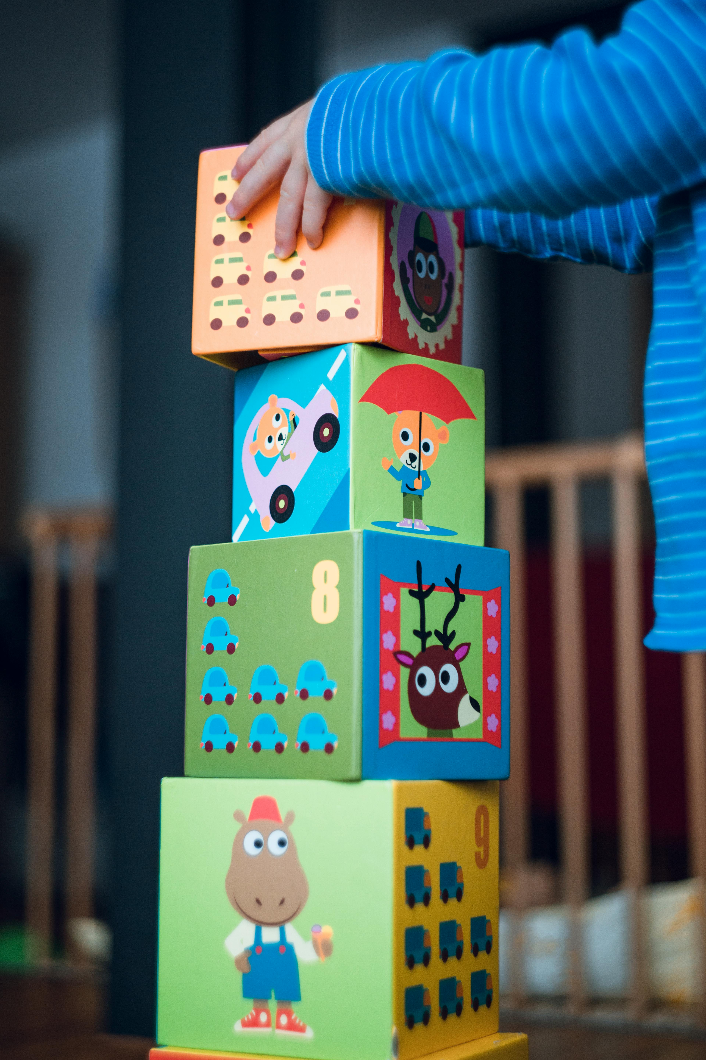
Differences in the process for acquiring your family childcare and childcare center license

Slide 2

Maria Ramirez-España.
Associate in Early Childhood Education.
School-age credential.
Credential in daycare administration.
Infant and kindergarten credential.
Notes:
Presentacion (mia).
Actividad entre las participantes.
¿Cuántas de las presentes son maestras?
¿Cuántas personas aquí presentes están interesadas en abrir una guardería familiar?
¿Cuántas personas aquí presentes están interesadas en abrir una guardería de Grupo?

Slide 3
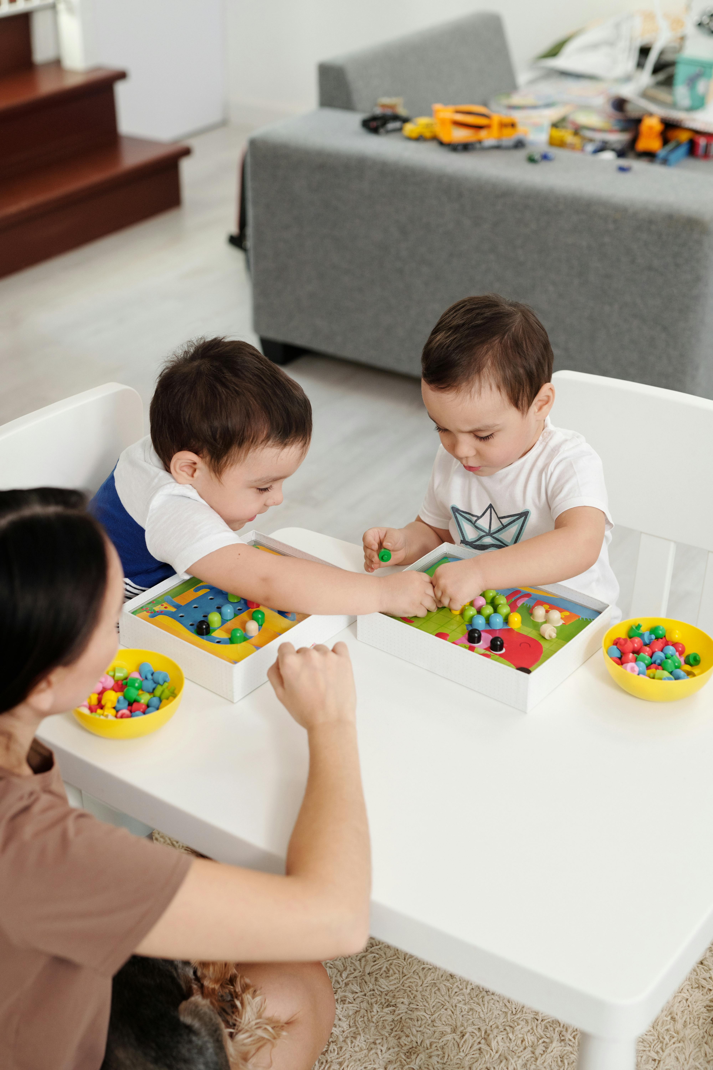
Agenda
DCF 250 Family Child Care.
DCF 251 Group Child Care.
Inform
Differences
Analyze and compare
What type of Child Care License should I get

Slide 4
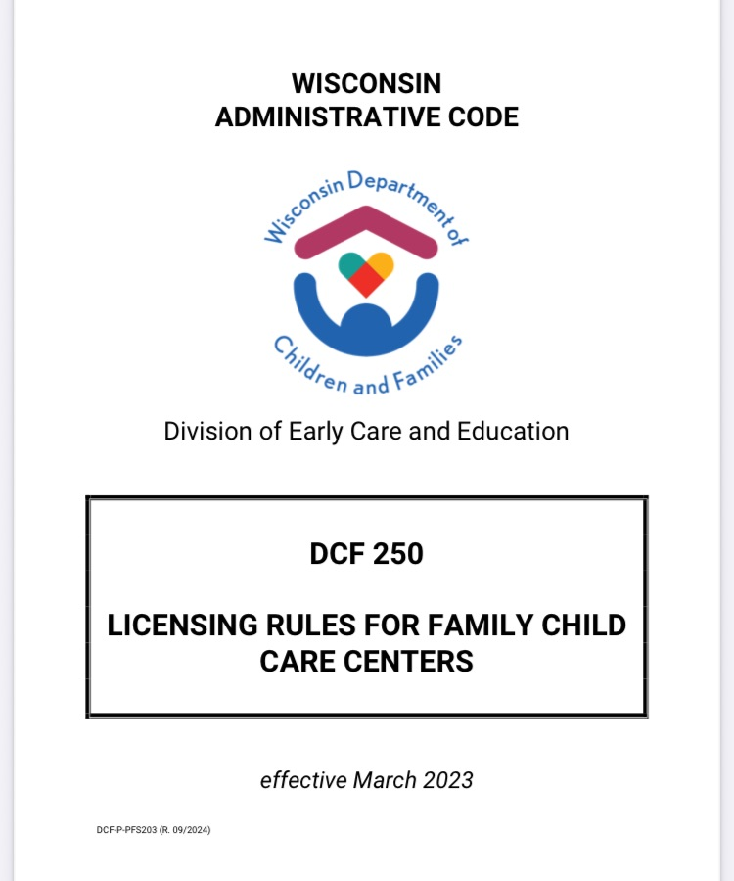


Slide 5

Family Child Care

Slide 6

Group Child Care

Slide 7

WECA. The Wisconsin Early Childhood Association.
(608) 240-9880 or
(800) 783-9322.
4C. For Children.
(414)562-2650.
Link to express interest
https://dcf.wisconsin.gov/files/publications/pdf/5762s.pdf

Slide 8

Education required....
Family Child Care Center.
GED
Introduction to child care.
Fundamentals in family daycare.
Fundamentals in infants and infants.
CPR.
Sids.
Head trauma due to abuse.
Abuse and neglect.

Slide 9
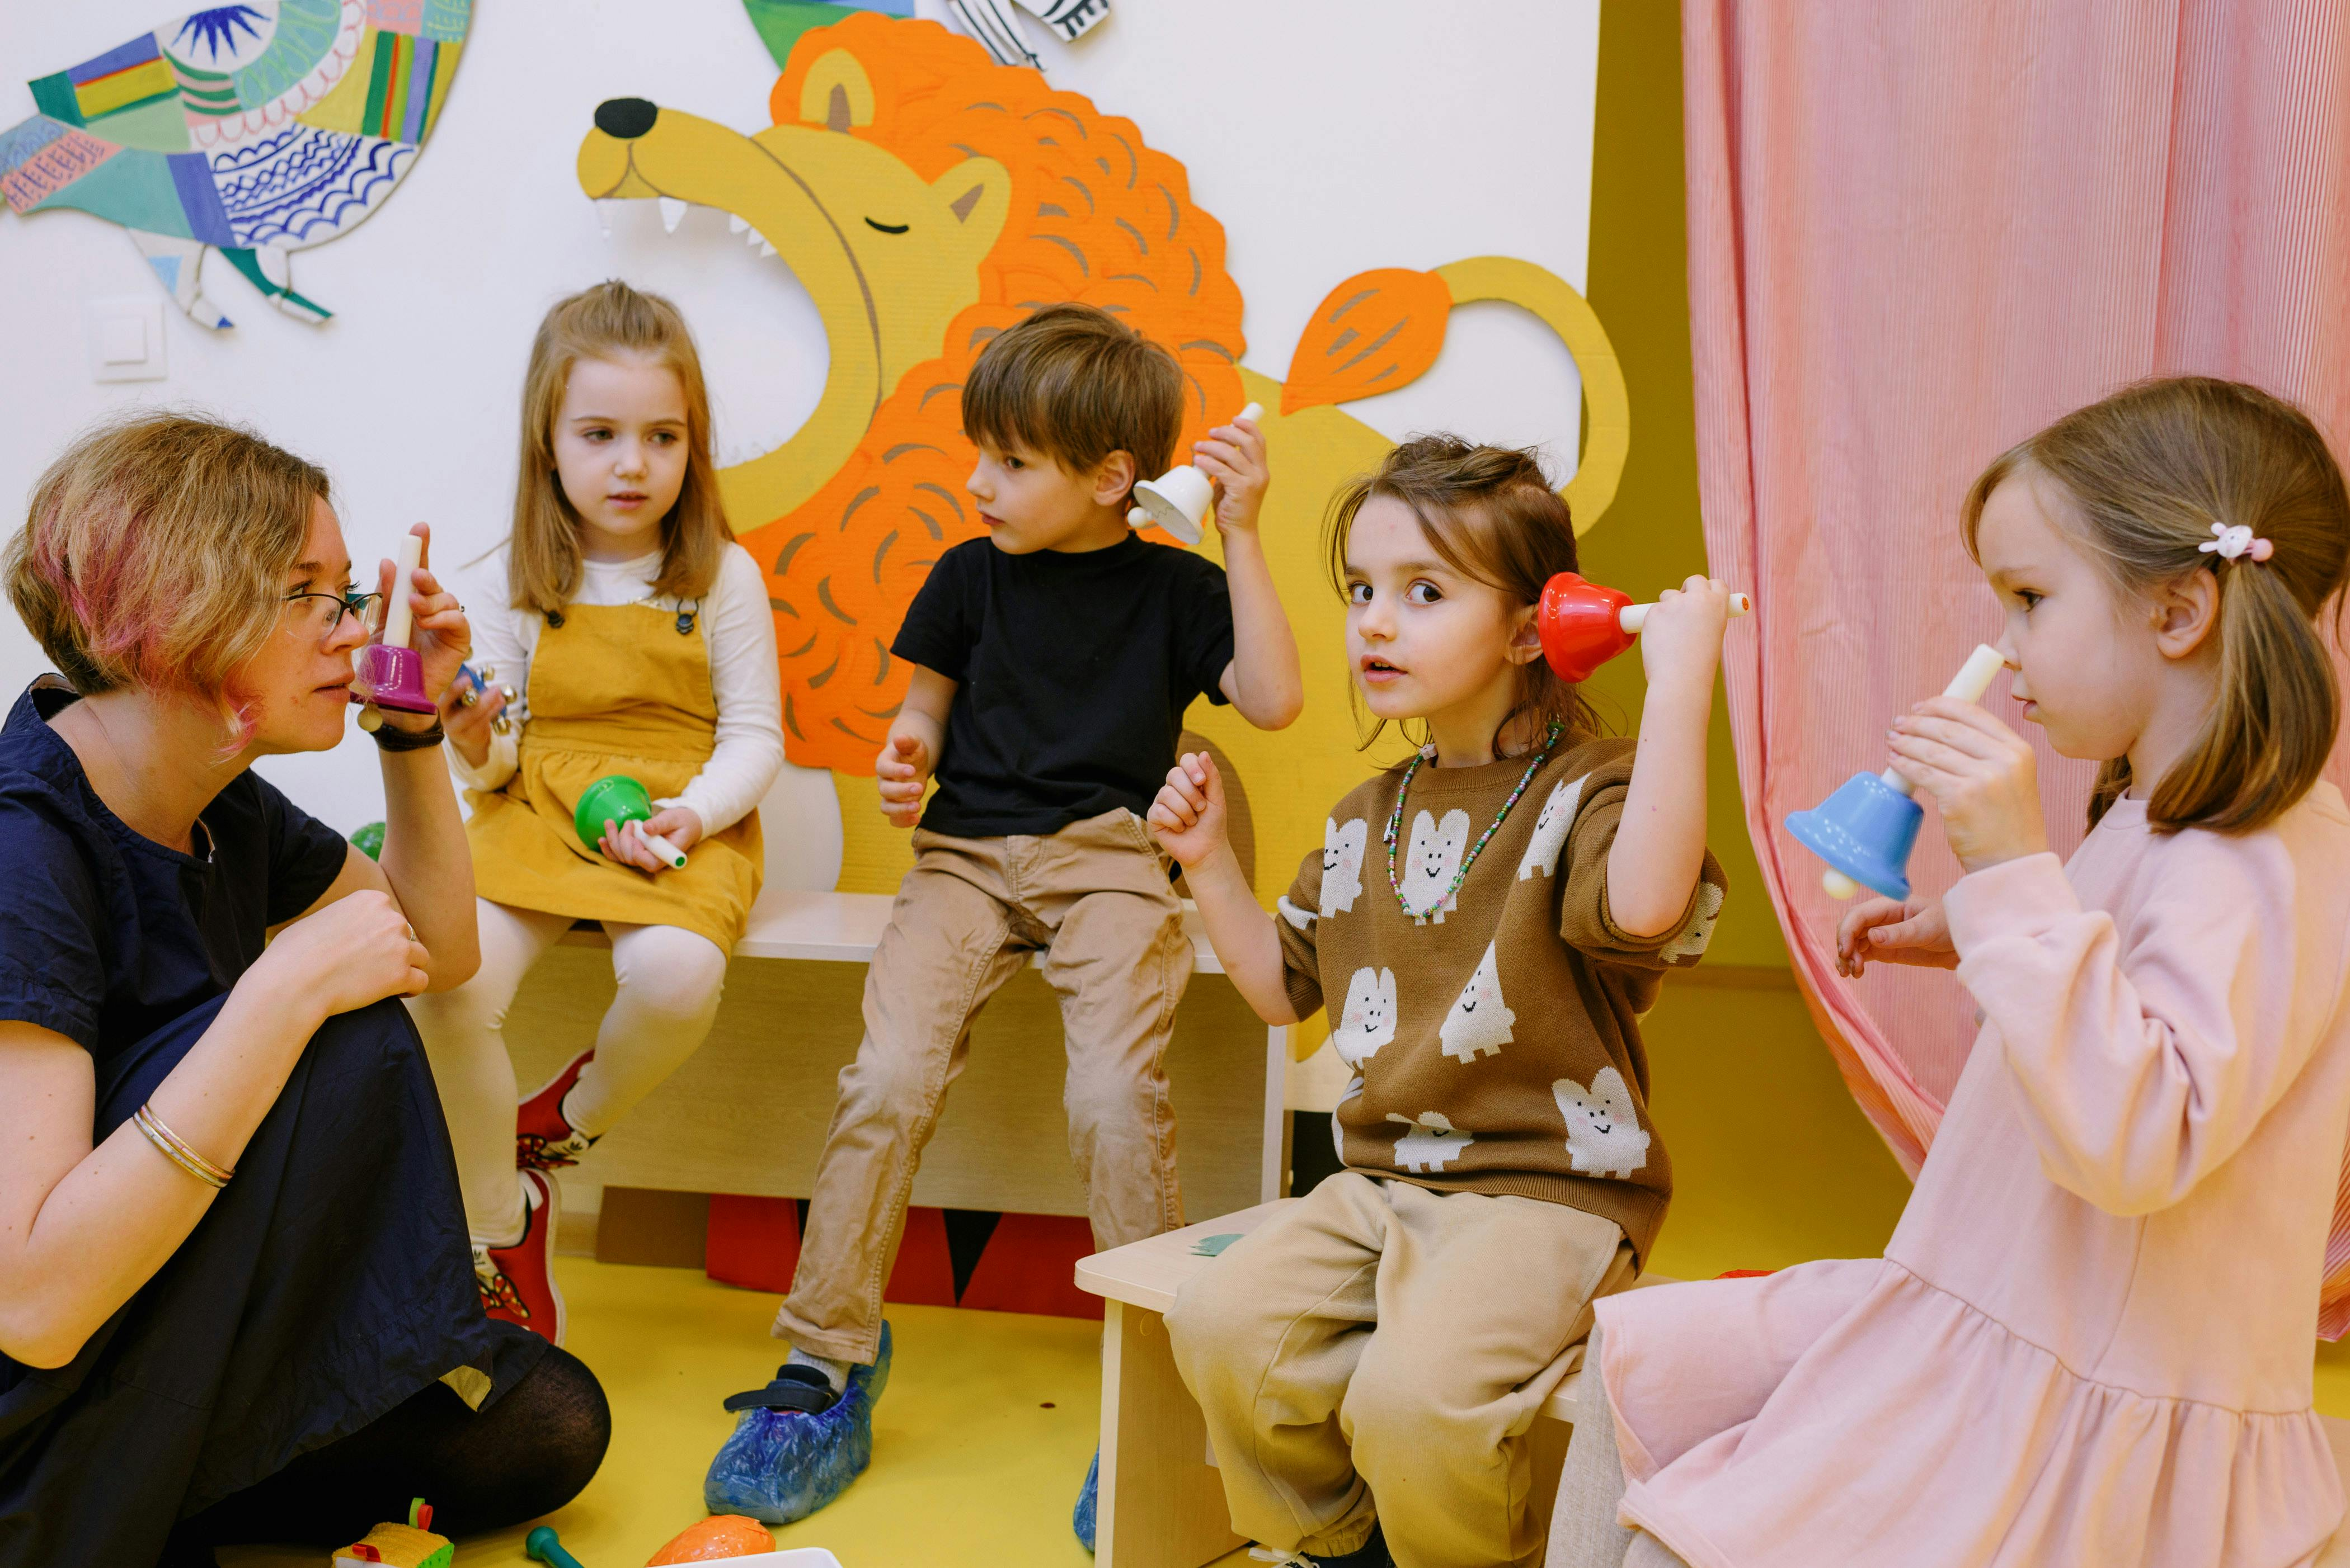
Education required...
Group child care center.
GED or High School Diploma or equivalent.
Introduction to Child Care
Fundamentals in Infants and Preschoolers
CPR
SIDS
Head trauma due to abuse
Abuse and neglect
Skills and strategies
Credentials in Child Care Administration.

Slide 10

Differences
Family Child Care Center:
The child grows and develops within a home environment different from his or her family.
Group Child Care Center:
The child has a more academically focused preparation since they are separated by groups of the same age, with activities which are for their maximum development in their entirety.

Slide 11
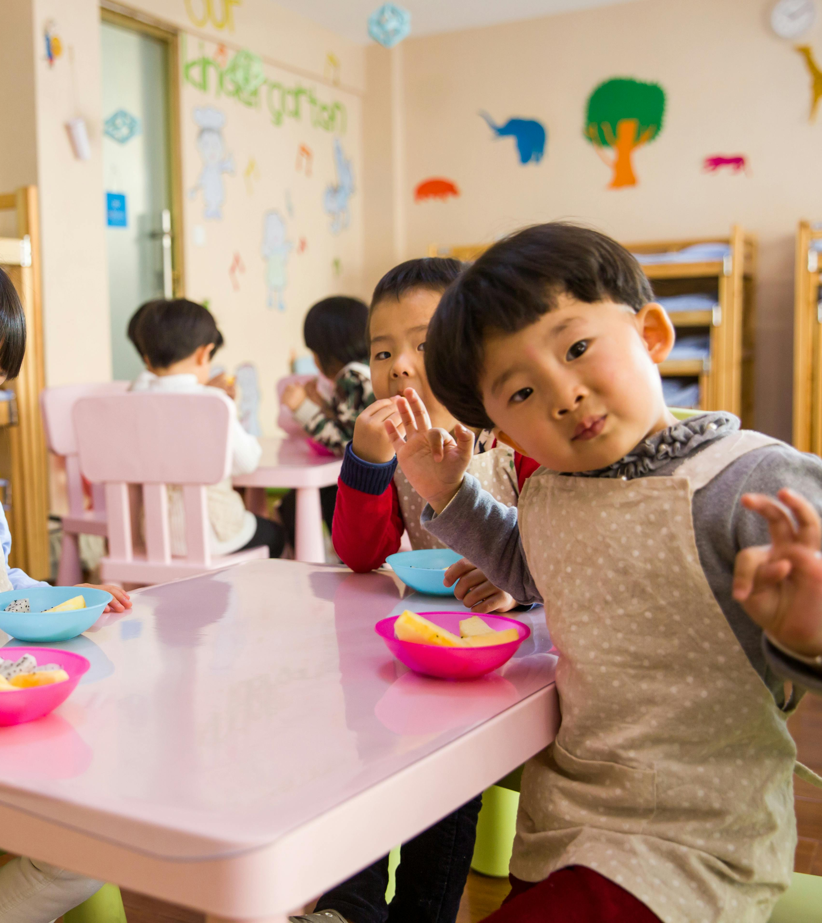
The process of obtaining a
Family or group child care licensing requires a commitment of time and effort to ensure that your child care facility meets the safety and quality standards set by DCF.

Slide 12
Contact
María Ramírez-España
414-369-0254.
merazramirez@yahoo.com

