Slide 1


Setting professional and personal goals for your well-being in early childhood education.
http://www.youtube.com/watch?v=Cij1tmJm8Zc
Notes:
Bienvenidos todos, un placer tenerles aquí el día de hoy, antes de comenzar les quiero expresar que este entreno está diseñado para que adquiera o refuerce conocimiento pero a la vez sientase comodo de poder levantarse al baño si es necesario, estos están localizados al salir del salón a mano izquierda, por favor poner en silencio sus celulares, a continuación se les proporcionará material que se utilizará casi que al final, así que bueno empecemos la diversión.
English: Welcome everyone, it's a pleasure to have you here today. Before we begin, I want to express that this training is designed for you to gain or reinforce knowledge, but at the same time, feel comfortable to get up to go to the bathroom if necessary. These are located to the left as you exit the room. Please silence your cell phones. Next, you will be provided with material that will be used almost at the end, so let's get the fun started.

Slide 2

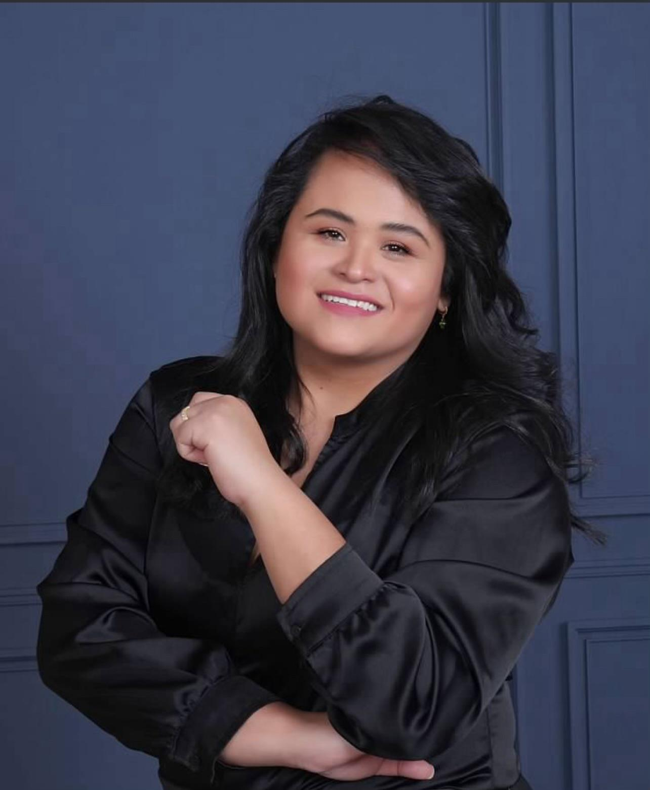
Facilitator
Ivonne Cáceres
Notes:
Hola a todos ! Buen dia, para quienes no me conocen, mi nombre es Ivonne Caceres, abogada en mi pais natal, inicie en educación infantil desde 2018. mi viaje comenzó con el nacimiento de mis hijos, lo que me inspiró a pasar de derecho de familia a nutrir las mentes jóvenes. Comenzando como asistente en un entorno de cuidado infantil familiar, Luego navegando en diferentes roles dentro de un centro grupal como maestra principal, subdirectora , Directora, actualmente soy proveedora de mi propio cuidado familiar, además entrenadora Bilingüe certificada por el registry . Con esto en mente, pasemos a la siguiente actividad.
English
Hello everyone! Good morning, for those who don't know me, my name is Ivonne Caceres, a lawyer in my home country. I started in early childhood education in 2018. My journey began with the birth of my children, which inspired me to move from family law to nurturing young minds. Starting as an assistant in a family childcare setting, then navigating different roles within a group center as a lead teacher, assistant director, director, I am currently a provider of my own family childcare, as well as a certified bilingual coach by the registry.
With that in mind, let’s move on to the next activity

Slide 3





Agenda
Introduction
Activity
Why is it important to set goals?
Using the SMART Lens Tool
Visual Goal Board Activity
Notes:
Esta es nuestra agenda para hoy:
Introduccion
Actividad
Porque es importante establecer metas?
Utilización de la herramienta de objetivos SMART
English:
Our Agenda for today:
1 Introduction
2 Activity
3 Why Goal Setting Matters?
4 SMART Goal Setting
5 Vision Board Activity

Slide 4
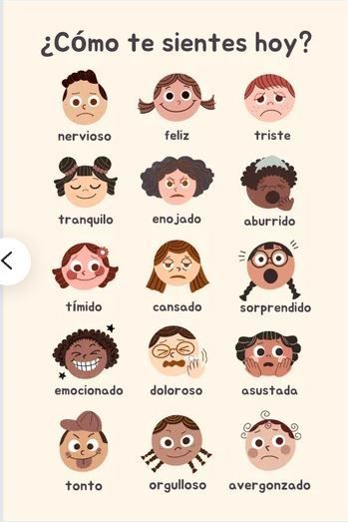
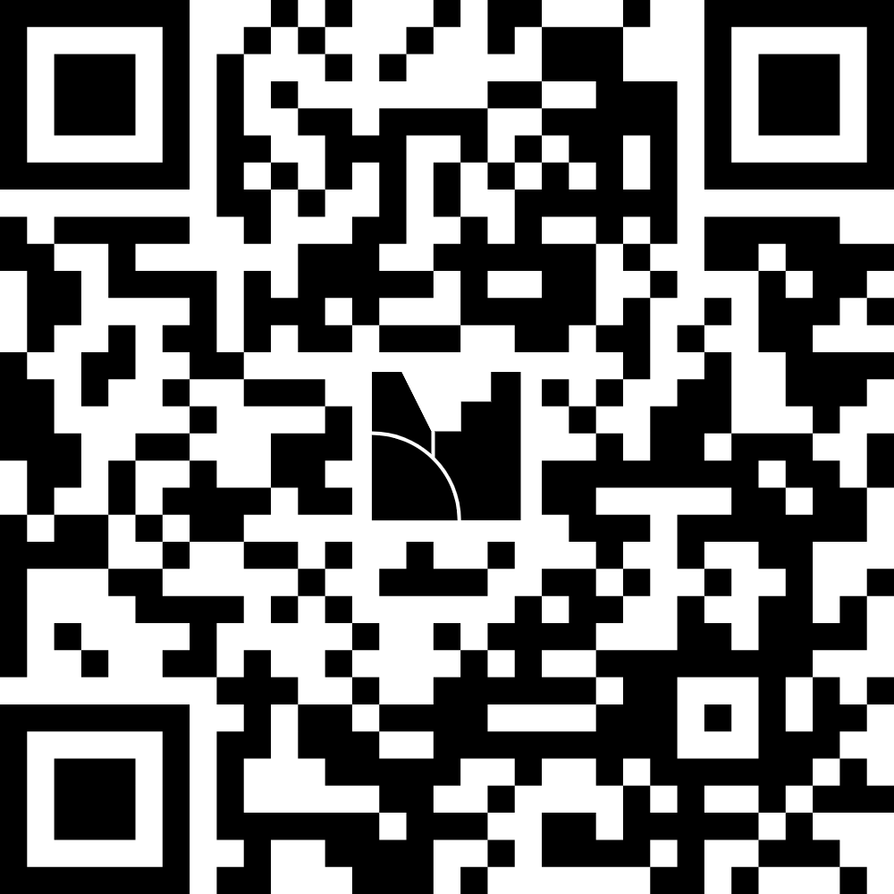
Activity
What are the three words that describe how you feel today? What three words describe how you're arriving today?
https://www.menti.com/alfgerjgdabu
Notes:
“Vamos a sacar nuestros teléfonos, abrir la cámara y escanear este código QR. Al hacerlo, vamos a responder la siguiente pregunta:
¿Cuáles son tres palabras que describen cómo te sientes hoy?
Todos los sentimientos son válidos y bienvenidos. En la pantalla veremos una nube de palabras: la palabra más grande será la que más personas en esta sala tienen en común, mientras que la más pequeña será la menos compartida. Esta actividad nos ayuda a reconocer cómo llegamos hoy, y a honrar el espacio emocional que cada uno de nosotros ocupa.
English:
Let’s take out our phones, open the camera, and scan this QR code. Once you’re in, you’ll be prompted to answer the following question:
What three words describe how you’re arriving today?
All feelings are valid and welcome. On the screen, you’ll see a word cloud: the largest word will represent what most of us have in common, while the smallest word will reflect the least shared feeling. This activity helps us acknowledge how we’re showing up today and honor the emotional space each of us occupies

Slide 5

Why is it important to set goals?
Notes:
Continuemos con una pregunta clave: ¿Por qué es importante establecer metas? Como educadores, nos dedicamos a nutrir las mentes jóvenes, pero ¿con qué frecuencia reflexionamos sobre cómo nutrirnos a nosotros mismos? Establecer metas claras nos ayuda a mantener la motivación, el equilibrio y la intencionalidad tanto en nuestra vida profesional como personal. Las investigaciones demuestran que quienes establecen metas definidas tienen más probabilidades de experimentar mayor satisfacción y menos estrés.
Antes de profundizar en el marco SMART y nuestra actividad del Tablero de Visión, dediquemos un momento a conectar con el propósito más profundo que subyace al establecimiento de metas. Las metas no son solo tareas, sino semillas de intención. Guían nuestra energía, aclaran nuestras prioridades y nos ayudan a crecer con propósito.
English:
Let’s continue by engaging in a powerful question: Why does setting goals matter? As educators, we dedicate ourselves to nurturing young minds—but how often do we reflect on nurturing ourselves? Establishing clear goals helps us stay motivated, balanced, and intentional in both our professional and personal lives. Research shows that those who set defined goals are more likely to experience greater satisfaction and lower stress.
Before we dive into the SMART framework and our Vision Board activity, let’s take a moment to connect with the deeper purpose behind goal-setting. Goals aren’t just tasks—they’re seeds of intention. They guide our energy, clarify our priorities, and help us grow with purpose.

Slide 6

Examples of Career Goals
Improve classroom management strategies.
"I will implement a new behavior management strategy, such as a positive reinforcement system, and track its effectiveness over the next eight weeks."
Seek additional professional development.
“I will sign up for an early childhood education webinar or workshop every two months for the next year to stay up to date on best practices in Early Childhood Education.”
Notes:
Aquí tenemos algunos ejemplos de Metas Profesionales
Yo puedo escribir o decir bueno quiero Mejorar la gestión del aula:
O buscar Desarrollo profesional adicional.
Suena simple no?
Levanten su mano quienes han escrito o por lo menos pensado a la ligera algo así?
Muy bien , continuamos ahora bien qué tal si les digo que podemos escribir esta meta de la siguiente manera:
“Implementará una nueva estrategia de gestión del comportamiento, como un sistema de refuerzo positivo, y haré un seguimiento de su eficacia durante las próximas 8 semanas.”
o
Me inscribire en un seminario web o taller de educación infantil cada 2 meses durante el próximo año para mantenerse al día sobre las mejores prácticas.
Alguien quiere compartir otro ejemplo de meta profesional?
Si nadie contesta decir:
Mejorar la comunicación con los padres. Alguien me podria decir con mas detalle esta meta? O asi esta bien? respuesta: Enviaré una actualización semanal por correo electrónico o aplicación de comunicación a los padres durante los próximos 3 meses para mejorar la participación y la transparencia.
English:
Here we have some examples of Professional Goals.I can write or say, well, I want to improve classroom management:Or seek additional professional development.Sounds simple, right?Raise your hand if you have written or at least thought lightly about something like this?Very well, let's continue. Now, what if I tell you we can write this goal in the following way:"I will implement a new behavior management strategy, such as a positive reinforcement system, and I will track its effectiveness over the next 8 weeks."or"I will enroll in a webinar or workshop on early childhood education every 2 months over the next year to stay updated on best practices."Does anyone want to share another example of a professional goal?If no one responds, say:Improve communication with parents. Could someone tell me more about this goal? Or is this fine? Response: I will send a weekly update via email or communication app to the parents over the next 3 months to improve participation and transparency.

Slide 7
Examples of Personal Goals
I aim to prioritize self-care routines.
“I will set aside 15 minutes each morning to practice meditation - reflection or deep breathing exercises during the month of October to reduce stress."
I aim to establish healthy habits.
“I'll pack a nutritious lunch the night before work at least 4 days a week for the next two months to keep my energy up throughout the day”.
Notes:
Ahora pasamos a ver algunos ejemplos de metas personales como:
Me propongo Priorizar el autocuidado:
O
Me propongo establecer hábitos saludables.
De la misma manera Suena sencillo no?
Levanten su mano quienes practican algún método para cumplir sus metas? Muy bien,
Pero que tal si re-escribimos una meta asi como esta:
“Reservaré 15 minutos cada mañana para practicar meditacion - reflexion o ejercicios de respiración profunda durante el mes de octubre para reducir el estrés”.
“Prepararé un almuerzo nutritivo la noche anterior al trabajo al menos 4 días a la semana durante los próximos 2 meses para mantener la energía durante todo el día”.
Alguien quiere compartir otro ejemplo de meta personal?
En caso que nadie diga nada Decir: Balancear lo personal con lo profesional. Ahora bien quien podria darme esta meta con mas detalle?
English: Here we observe some examples of personal goals such as: I aim to prioritize self-care: Or I aim to establish healthy habits. Sounds simple, right? Raise your hand if you've use or practice any method to accomplish your goals? Pretty good, But what if we write a goal like this: "I will reserve 15 minutes each morning to practice meditation, reflection, or deep breathing exercises during the month of October to reduce stress." "I will prepare a nutritious lunch the night before work at least 4 days a week for the next 2 months to maintain energy throughout the day."
Does anyone want to share another example of a personal goal? If nobody answer say: balance personal and professional. Now can somebody tell me this goal with more details?

Slide 8
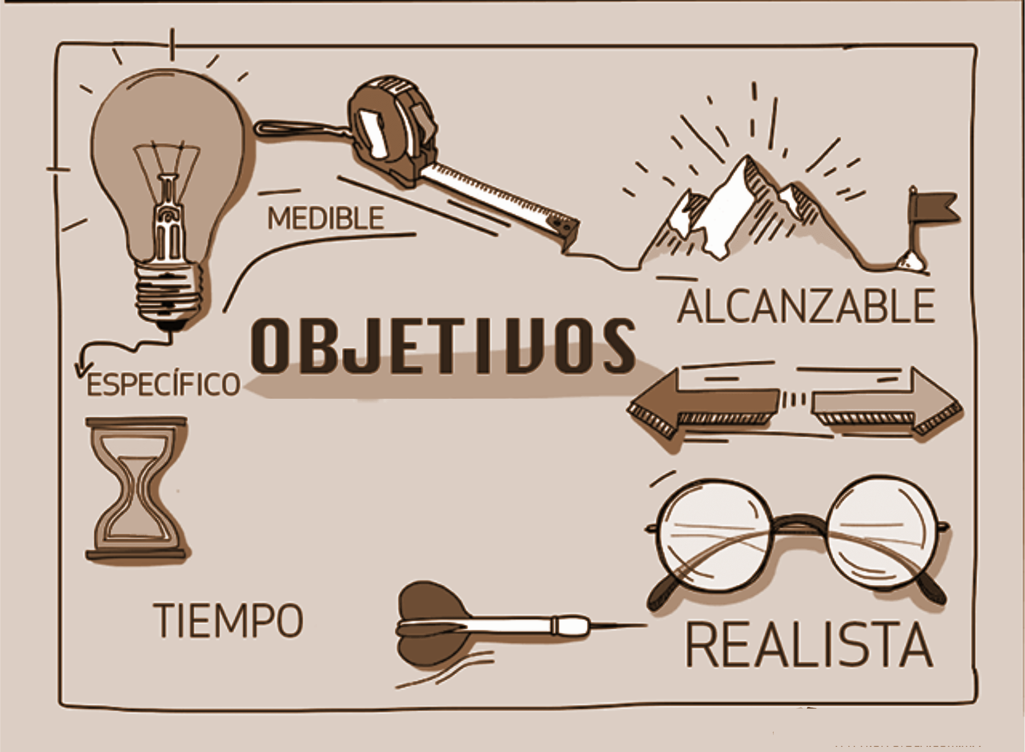
SMART Goal-Setting Framework
              S Specific
              M Measurable
              A Attainable
              R Relevant
              T Time-limited
Notes:
Keeping that perspective, we're now going to explore a method called the SMART goal framework, which helps us create clear, measurable, and achievable goals.
Raise your hand, who is already familiar with this method?
Very well. But some of you may be wondering: What does SMART mean? SMART is an acronym that stands for five key criteria for setting effective goals:
S for Specific: Clearly states the goal (e.g., leaving work on time to achieve work-life balance).
M for Measurable: Defines how often (e.g., three days a week).
A for Achievable: Realistic within work expectations.
R for Relevant: Supports well-being and reduces burnout.
T with time limit: Established deadline to observe results.
As we can see, the above examples follow the SMART framework: ✔ Specific: Clear and focused. ✔ Measurable: Defined to monitor progress. ✔ Achievable: Realistic considering the workload. ✔ Relevant: Promotes professional or personal well-being. ✔ Time-limited: You have a deadline to see results
English
Keeping that perspective, let's now explore a method called the SMART framework, which helps us create goals that are clear, measurable, and achievable.
Raise your hand if you're already familiar with this method
Great! But some of you may be wondering: What does SMART stand for? SMART is an acronym that represents five key criteria for effective goal setting:
S for Specific: Clearly states the goal (e.g., leaving work on time for better work-life balance).
M for Measurable: Defines how often (e.g., three days a week).
A for Achievable: Realistic within your work expectations.
R for Relevant: Supports well-being and reduces burnout.
T for Time-bound: has a deadline to observe results.
As we can see, the examples above follow the SMART framework: ✔ Specific: Clear and focused. ✔ Measurable: Defined so progress can be tracked. ✔ Achievable: Realistic given workload and commitments. ✔ Relevant: Supports personal or professional well-being. ✔ Time-bound: Has a deadline to observe results.

Slide 9


Vision Board Activity
Notes:
“Having already clear this concept, we will now carry out a vision board activity, where we are going to project ourselves into the future. We will declare our intentions, visualize our growth, and shape the goals that really matter to us.
Every image, every word we choose will be a representation of our path. It's not just about creating a pretty collage, but about sowing the seed of intention and aligning with the SMART framework: goals that are Specific, Measurable, Achievable, Relevant, and Time-bound.
Let's allow ourselves to dream big and build with purpose."
English
Now that we've clarified the concept, we'll move into a Vision Board activity, where we'll project ourselves into the future. We'll declare our intentions, visualize our growth, and shape the goals that truly matter to us.
Each image, each word we choose will represent our path. This isn't just about creating a beautiful collage—it's about planting the seed of intention and aligning with the SMART framework: goals that are Specific, Measurable, Achievable, Relevant, and Time-bound.
Let's allow ourselves to dream big and build with purpose.

Slide 10
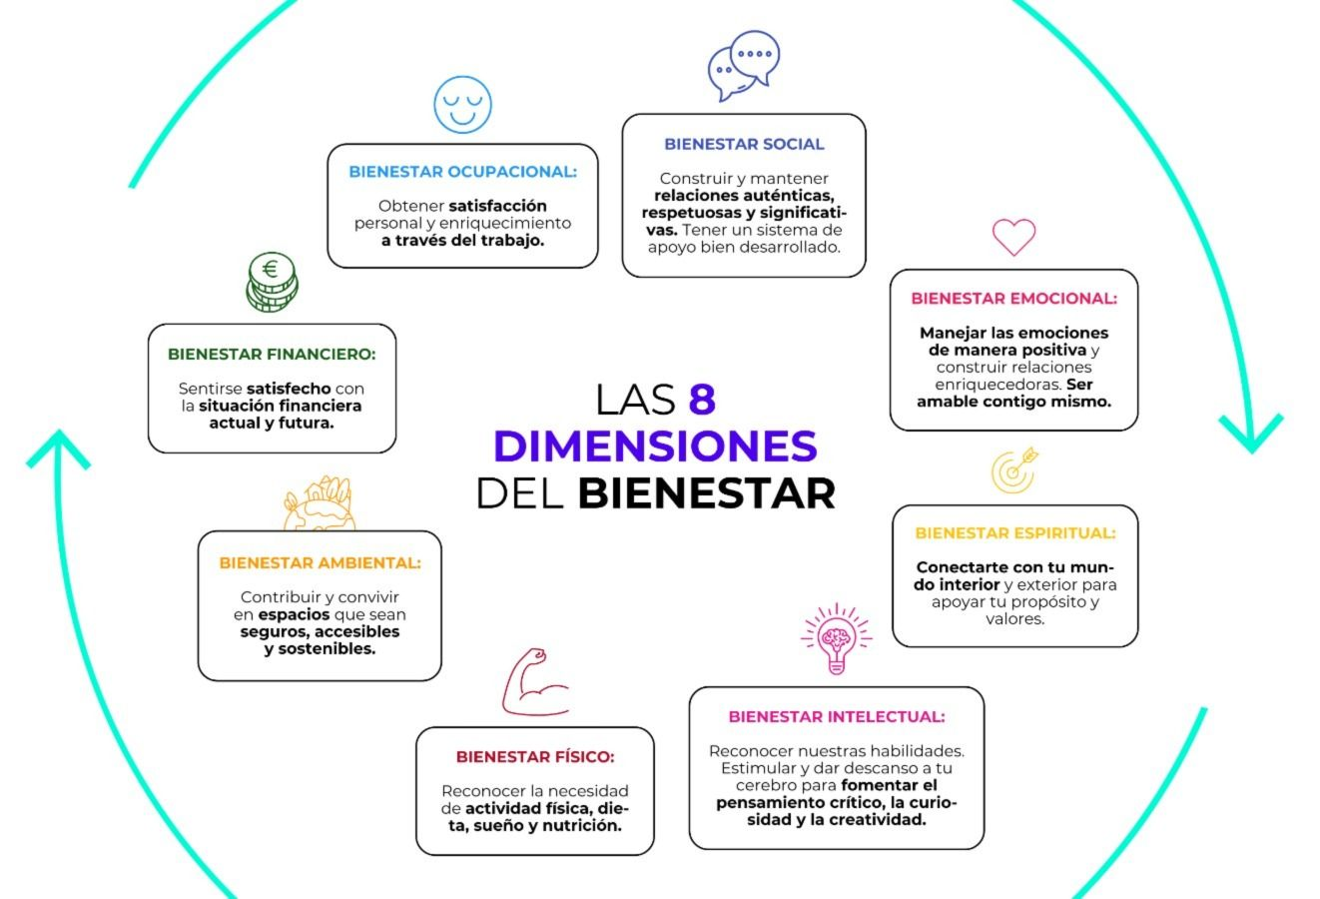
Keep growing,
Keep Shining🌿
Thank you for sowing the seed of intention today.
May your goals flourish with purpose and joy.
For more information: blossomlanefamilycare@gmail.com
Notes:
Para cerrar me despido con esta frase "Sigue creciendo, sigue brillando, gracias por sembrar la semilla de la intención hoy. Que tus metas florezcan con propósito y alegría. Para preguntas y más, mi correo electrónico es:
English
To close, I say goodbye with this phrase: "Keep growing, keep shining. Thank you for planting the seed of intention today. May your goals blossom with purpose and joy. For questions and more, my email address is:

