Slide 1
Signed, sealed and protected
Notes:
Ablemos de polisas, contratos, acuerdos, estos documentos son legales regulados por el estado, otras agencias ya sea Lisencia o certificacion.
Let's talk about policies, contracts, agreements, these are legal documents regulated by the state and other agencies

Slide 2
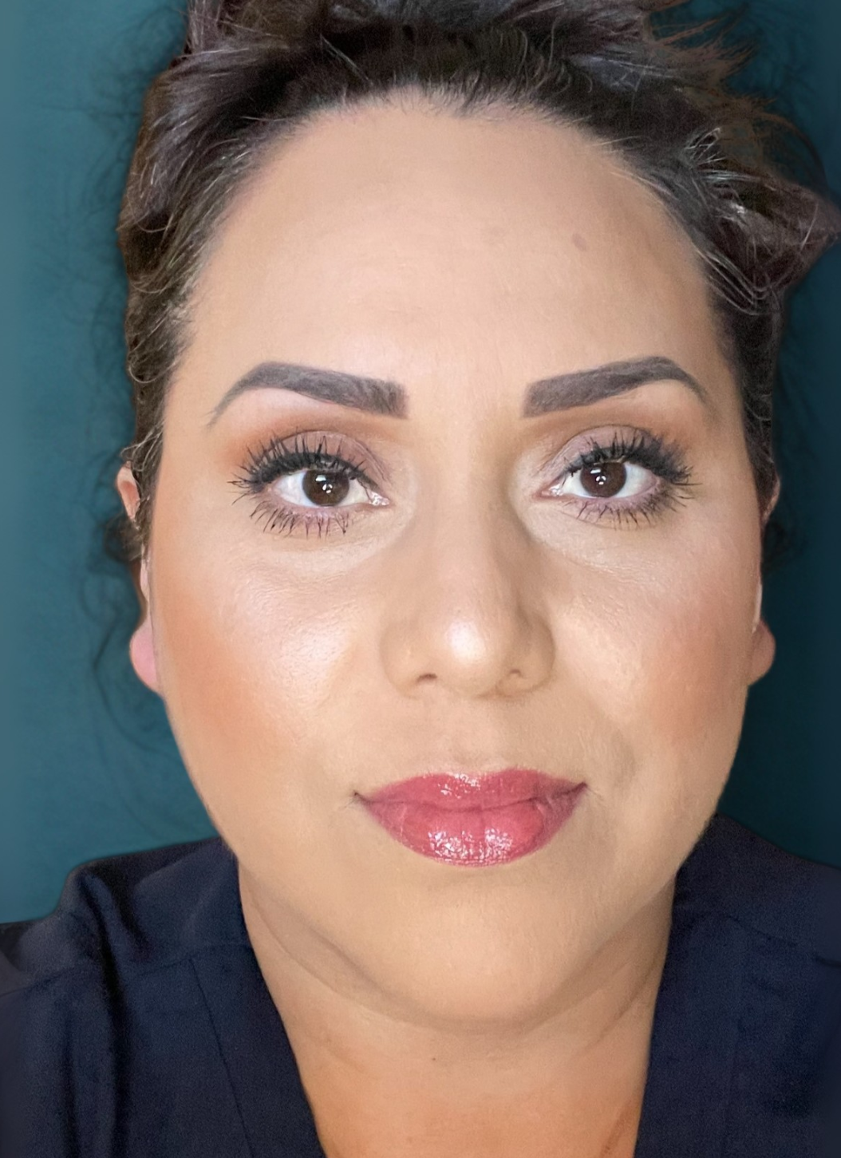
Introduction:
Anita Ramirez, Dueña
Notes:
Un Poco quien soy y que me a llebado a estar en esta area del Desarrollo infantil, los años de trabajo
24 años.
Tell a story
A little bit about who I am and what led me to be in this area of child development.

Slide 3
Agenda
Introduction
Sample contracts and policies
Activity to apply at your child care center
Notes:
Desglosamos un poco que contenido tienen estos documentos para hacer las practicas ya sean diarias, semanales, mensuales, o anuales. Protejiendo a niños Familias a Nuestro hogar, nuestra persona en general, tener un trabajo adicional ser dueños de umn negocio.
Let's break down a little what content these documents have.

Slide 4

Review Sample Contract Agreement
Notes:
Revisar minuciosamente todo,
que las familias entiendan las responsabilidades de cumplir estos documentos, pagos dias feriados, vacaciones,
Las consecuencias que tu como dueña de una Guarderia tendrias, ya sean economicas o en licencia.
Review everything thoroughly and ensure families understand their responsibilities in complying with these documents.

Slide 5
What should a policy manual contain??
Notes:
Que encontraremos en todos los documentos y si se pueden ser cambiables a tus nesecidades. Revisar que clase de negocio quieres tener
What will we find in all documents and if they can be changed?

Slide 6
Philosophy, Mission, and Vision
Describe your work as a child care center.
Your beliefs about child care.
How they will ensure the safety of children.
How they will support children's growth, learning, and development.
Notes:
Importante esta informacion para que tu como educadora siempre sigas tus principios, y de esta manera los padres Sabran que Guarderia es donde dejan a sus hijos.
This information is important so that you as an educator always follow your principles, and in this way parents will know which daycare is
Describe who you are as a childcare center
What you believed about caring for children
How you will ensure safety for children
How you will support children’s growth, learning and development

Slide 7

Sample Statement
Talk at your table about your philosophy, mission, and vision.
Notes:
Compartir en grupo que parte de estos documentos a sido mas dificil de enforzar o creen que se les dificultaria mas? Nunca olvidar tu motivacion de trabajo es por eso tu mision
Share as a group which part of these documents has been the most difficult to enforce or which do you think would be difficult?
Talk at your table other about their philosophy, mission and vision

Slide 8

General information in the Policy Manual
Forms Needed Before Enrollment
Hours of Operation
Child Care Standards
State Licensing and Regulations
Provide DCF Information
Ages
Nutrition
Activities
Emergency Contact
Paid Vacation
Contagious diseases
Notes:
Entender y dejarles saber a familiars y amistades que seguimos reglas del estado para trabajar bajo licencia, los herrores mas comnunes son? Dialogar en grupo cual creen que seria?
Understanding and letting family and friends know that we follow state rules for working under license. What are the most common mistakes? Discuss in a group what you think they would be?
Forms needed prior to enrollment
Hours of operation
Childcare rules
Licensing and state regulations
Provide DCF information
What ages
Nutrition
Activities
Emergency contact
Paid vacation

Slide 9
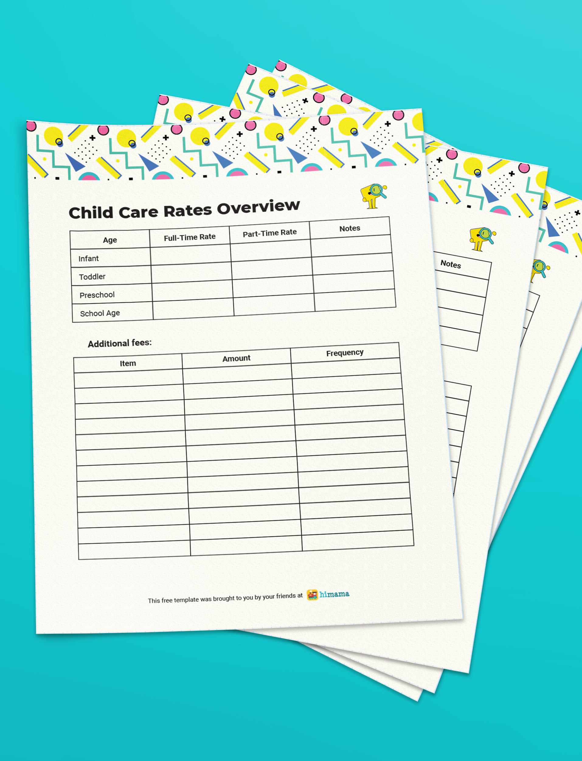
Rate Sheet
Part-time and full-time pay rates
Rates for different ages
Late pickup payments
Notes:
Tener claro quien, cuando se paga el servicio de cuido
Rate sheets
Be clear about who and when you pay for the care service

Slide 10

Parent-Provider Contract
Provider Information
Hours of Operation
Who pays?
Costs
Notes:
Para tener alta Calidad temenos que alinear y cubrir mas reglamentos
Parent- Provider Contract
Provider information
Hours of care provided
Who will pay
Charges
To have high quality we have to align and cover more regulations

Slide 11
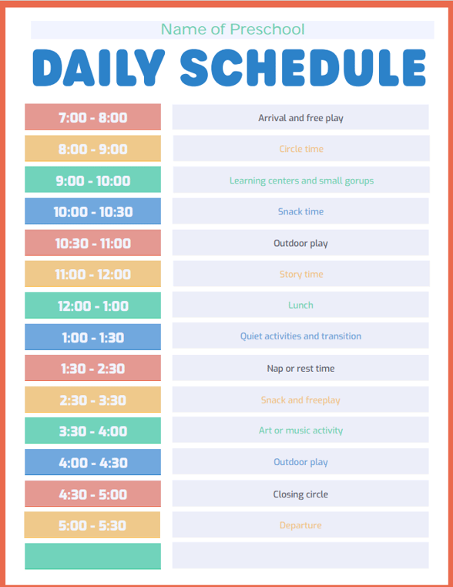
Daily Schedule
Why do we need a schedule?
State Licenses
Feeding Program
Parents
Notes:
Recordarles a los padres los horarios de los alimentos, los niños menores de 18 mese son diferentes muy variables
Why we need a schedule?
State licensing
Food program
Parents
Remind parents about meal times, children under 18 months are very different

Slide 12

Ensure that all documents are aligned with each other
Notes:
Making sure all documents are consistent with each other
MEDICAL LOG BOOK, mencionar todos los medios de comunicacion
MEDICAL LOG BOOK, mention all means of communication

Slide 13

Questions?
Notes:
Abierta al tema
Open to the topic

Slide 14
Contact Information
Anita Ramirez España 414-439-5375 ramirezanita@sbcglobal.net

