Slide 1
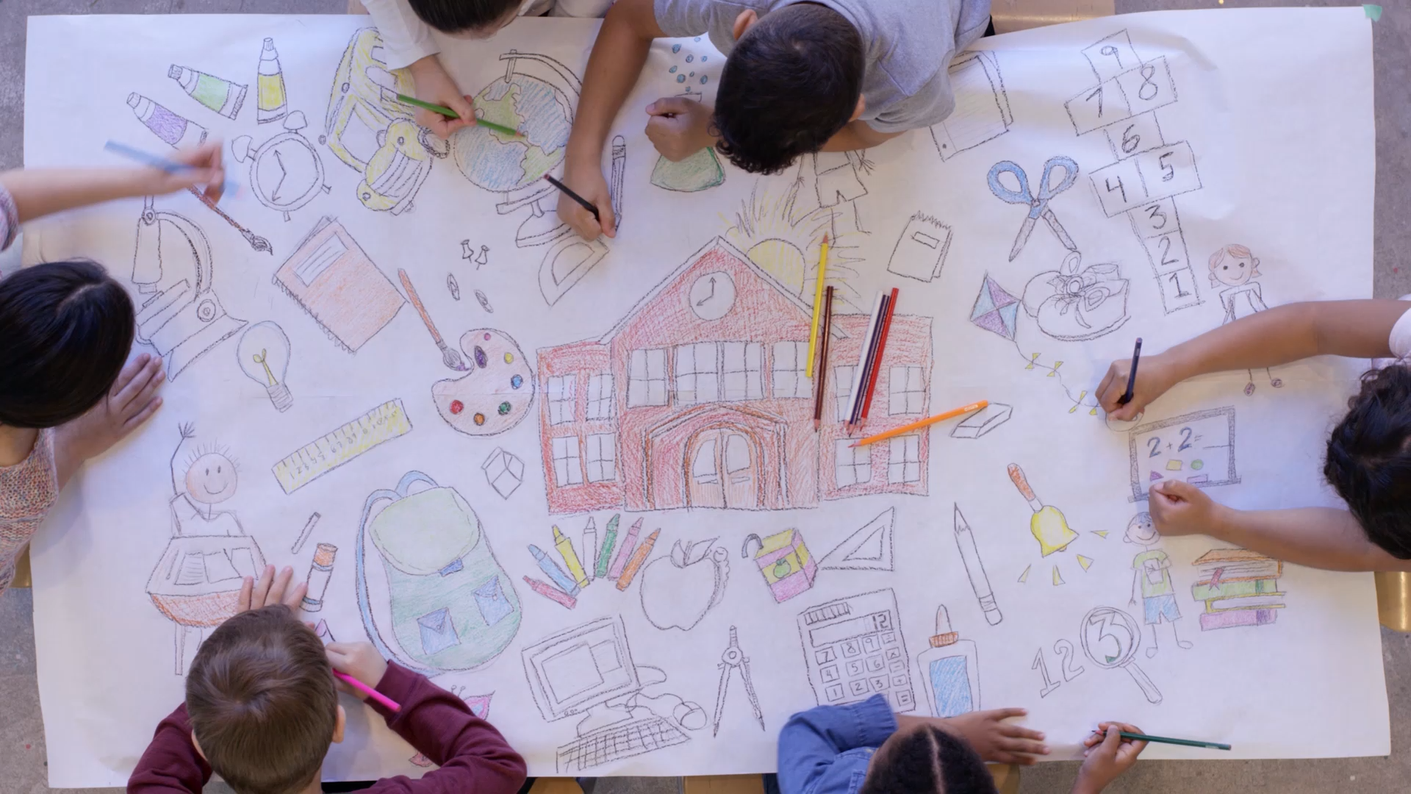
Classroom Community culture
Strengthening Home School Connections
Notes:
Classroom, Community, Culture

Slide 2
Objectives
Brainstorm five strategies to strengthen the home-school connection for the shared benefit of the child
Gain an understanding of the home-school connection and explore its benefits for students, families, and educators."
Recognize and reflect on the roles of expert, children, and professionals in the home-school connection, the impact each has, and how they collaborate and relate to one another
Notes:
The objectives for this training are:
Click to appear/disappear: Gain an understanding of the home-school connection and explore its benefits for students, families, and educators."
Click to appear/disappear: Recognize and reflect on the roles of experts, children, professionals, in the home-school connection, the impact each has, and how they collaborate and relate to one another.
Click to appear/disappear: Brainstorm four strategies to strengthen the home-school connection for the shared benefit of the child.
Click to next slide

Slide 3
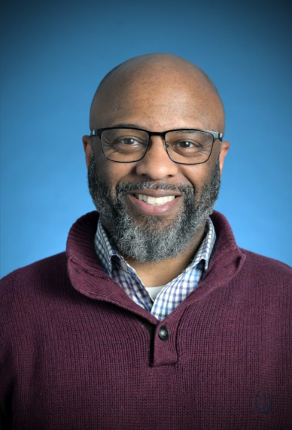
INTRODUCTION
24 Years working in Early childhood education
14 years in the classroom
2 years instructional coach
Notes:
Introduction:
Hi everyone! I’m excited to be here with you today. I’ve been working in early childhood education for 16 years. I spent 14 of those years in the classroom, and for 2 years, I served as an instructional coach, supporting educators and programs. My passion is helping create environments where all children and families feel seen, valued, and supported."

Slide 4
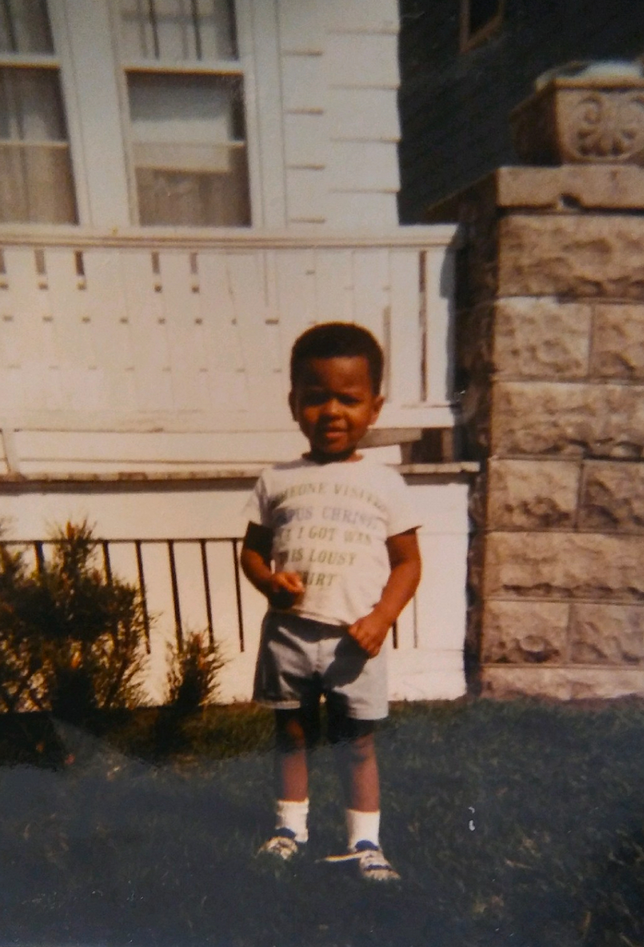
Notes:
Meet 4-year-old Jeremy.
What do you think he wished his teachers or caregivers knew about him and his family before his very first day at the center or school?
And what do you think he might have been curious or even nervous to know about them before stepping into their care?
Four-year-old Jeremy enjoys playing with insects, bugs, dinosaurs, going to the park, playing with his older brother helping his mom do laundry. He has a younger sister and likes watching his dad work on his car. He goes to church with his family on Sunday and sits down to watch television with his family in the evening before bedtime. He likes his mother to read books to him before he goes to bed. His favorite food is grilled cheese and chili. His favorite character is the Incredible Hulk because his favorite color is green and he wants big muscles. His favorite dessert is chocolate cake. He sleeps with his incredible hulk toy.

Slide 5
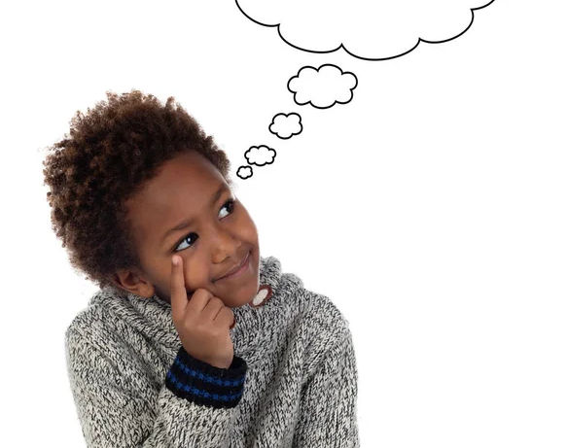
Think. Pair. Share.
What did you wish your teachers knew about you when you were young?
Notes:
Ice Breaker: Reflecting on Our Early Experiences
This activity invites participants to reflect on their own early childhood experiences.
As a young child, did you feel seen? Heard? Like you truly belonged?
If so, what helped you feel that way?
If not, what may have contributed to those feelings?
Remind participants:
How we feel in the presence of others shapes how we see ourselves—our sense of worth, ability, and confidence.
This emotional foundation is key to culturally responsive teaching. When we understand our own experiences, we’re better prepared to build meaningful home-school connections and create inclusive, affirming environments for all children.

Slide 6
What is Culture?
For me, culture is…
Notes:
Let participants know that today we’re going to explore the topic of culture and how it builds the bridge for effective home school connection. ( hold on to your answers we will revisit them later in the presentation.)
Give each participant a sticky note and give them 1-2 minutes to jot down aspects of their own culture that are meaningful to them. T
hey can jot down as many answers as they want. When time is up, invite people to share their responses. Ask Participants:
Did you find it difficult to produce answers to jot down on the sticky note? Why or why not?
What do you see your culture as?
Ask Participants to find another partner and answer the question on the slide. discuss what they believe culture is. Ask for volunteers to share their definition.

Slide 7
What is Culture?
Culture is a broad concept that refers to the customs, values, beliefs, and practices of a group of people. It incorporates family roles, rituals, communication styles, emotional expression, social interactions, and learned behavior. Culture also refers to a shared way of life that includes social norms, rules, beliefs, and values that are transmitted across generations (Hill, McBride-Murry, and Anderson 2005, 23).
Notes:
Explain that Culture permeates all aspects of a young child’s life, including eating, sleeping, playing, and communicating. In the family and in early education settings, children gain cultural information as they form relationships, participate in daily routines, and get involved in learning activities. Culture is a way of being and doing; It’s How move in the world and how we come to see the world.

Slide 8
Funds of knowledge
Home language
Family values and traditions
Caregiving
Friends and family
Family outings
Household chores
Educational activities
Favorite TV shows
Family occupations
Scientific knowledge
Other aspects of family life, such as
favorite foods and playthings
Notes:
Please remind participants about the culture activity from slide 6 (“For me, culture is…”).
It’s important to remember that each of us carries our own Funds of Knowledge shaped by our upbringing and family culture. These personal experiences can either support or sometimes unintentionally interfere with children’s learning. Early childhood professionals must be able to recognize and reflect on how their own Funds of Knowledge influence their culturally responsive practices.
Keep in mind, this list is not exhaustive! Everyone holds different thoughts, feelings, and values, even within families. We often take what we’ve been taught and decide what still serves us and what doesn’t. Cultural knowledge is constantly evolving through new learning and the ways our personal, professional, and social selves connect

Slide 9
Funds of Knowledge
Reflect on your own Funds of Knowledge.
How do your personal experiences, skills, and cultural background help you connect with and support the Funds of Knowledge that families and children bring? Are there any ways your own perspectives might unintentionally limit your ability to create a curriculum that meaningfully reflects the lived experiences of the children and their families?
Notes:
Teachers bring their own Funds of Knowledge shaped by their upbringing and family culture. These personal experiences can either enhance or unintentionally hinder children’s learning. It’s important for early childhood professionals to recognize and reflect on how their own Funds of Knowledge influence their ability to practice culturally responsive teaching.
Now, consider this:
Think about four-year-old Jeremy—you’ve gotten to know him and his family well. What are some of Jeremy’s Funds of Knowledge? How could you integrate his unique experiences and strengths into the goal of school readiness or more broadly within your program? What steps would you take to identify and understand his Funds of Knowledge?

Slide 10
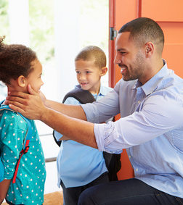
What the expert can provide
The child’s sleep habits or routines
Dietary preferences, restrictions, or allergies
Favorite character/or stories
Medical history or health considerations
Developmental milestones and physical abilities
Activities the child enjoys most
How the child prefers to be comforted and held
Notes:
Strong home–school partnerships start with honoring families as the experts on their children.
An expert is someone who has a large amount of knowledge on a subject matter. This knowledge can be gained through either education or a lot of hands-on experience about the subject matter.
By taking time to truly listen to families and learn from their perspectives, we build a foundation of mutual trust, respect, and collaboration.
Discussion prompt:
In what specific ways can families share their knowledge about their child’s needs, strengths, cultural background, or daily routines? How can these insights help us more effectively support each child’s learning and development?

Slide 11
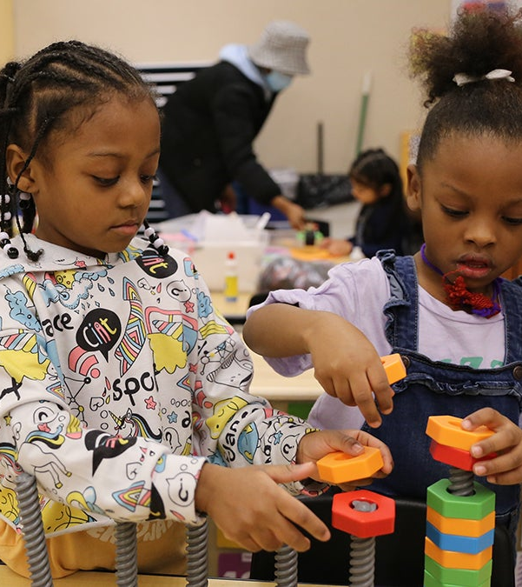
What the child can provide:
How they like to play
What they’re interested in
Thing they don’t enjoy
Signs that they’re tired
How they express hunger
Ways they show affection
People they feel most comfortable with
held
Notes:
Strong home–school partnerships start with honoring that children carry their home culture with them everywhere they go. By taking time to truly listen and learn from their perspectives, we build a foundation of mutual trust, respect, and collaboration.
Discussion prompt:
In what specific ways can children share their knowledge with us about their needs, strengths, cultural background, or daily routines? How can these insights help us more effectively support each child’s learning and development?

Slide 12
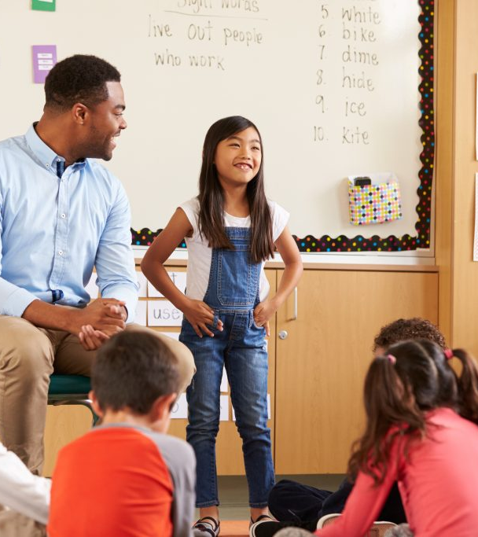
What the professional can provide
What the professional can provide:
Information on developmental milestones
Insights into each child’s learning style
Regular updates on the child’s day
Personalized learning strategies
Support for social and emotional development
A clear overview of the daily routine
Opportunities for collaborative decision- making
Notes:
To build strong home–school connections, educators begin by honoring parents as the experts on their children. This recognition lays the groundwork for trust and helps create a safe, supportive environment for each child. When professionals take time to genuinely listen to families and learn from their perspectives, they strengthen collaboration and foster meaningful partnerships.
Discussion prompt:
What are some practical ways teachers can both share information with families and invite parents to share about their child’s needs, strengths, cultural background, or routines? How might these exchanges help deepen the home–school connection and support each child’s sense of belonging, development, and learning?

Slide 13

Partnership
The goal of the experts (parents) and professional (teachers) is to work and communicate as partners for the objective benefit of the child.
What does this look like?
How can we develop this partnership?
How can we strengthen this partnership?
Notes:
We are all partners in this work.
We all participate in multiple cultures: ethnic, national, professional, among others.
We are trying figure out how we develop and extend community within all our environments, and the impact it has how we communicate view and relate people from our own and other cultures.
Culture helps determine our behavior!

Slide 14
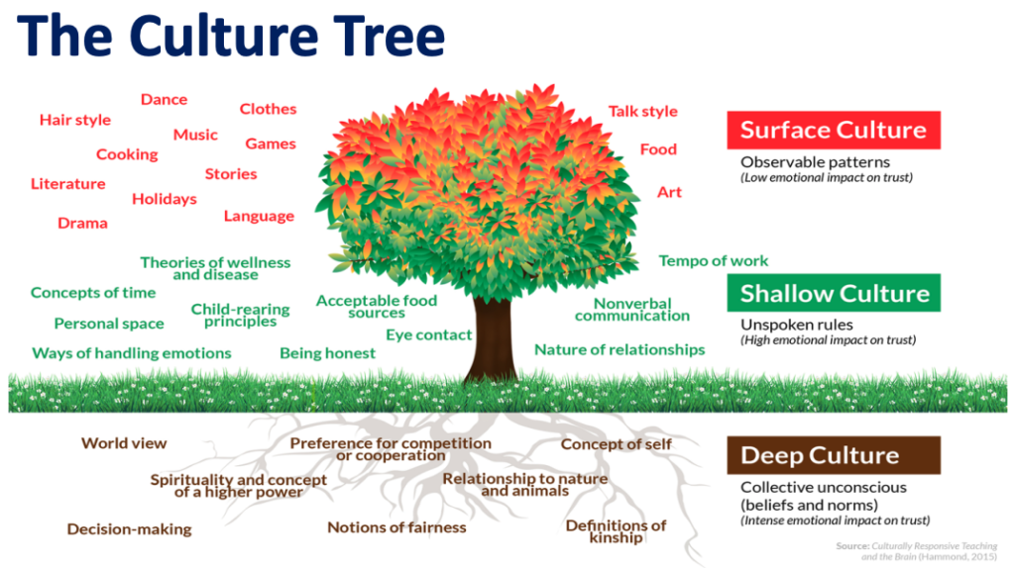
Notes:
Presenter:
Take a moment to reflect on this tree. We see trees everywhere—different kinds, shapes, and sizes. In many ways, people are just like trees. We each have unique traits that are visible on the surface—some that are shared, and others that are distinct. Everyone can observe a tree’s bark, the shape and color of its leaves, the size, and even the fruit it bears. These visible traits represent what we call surface culture. Surface culture includes things like customs, traditions, behaviors, and other outward expressions that are easy to see. These are some of the examples illustrated on the tree slide.
Presenter:
Now, think about the parts of a tree that aren’t visible—the roots beneath the soil. No one can see how deep they run or how far they spread. In the same way, much of who we are lies beneath the surface—this is deep culture. Deep culture isn’t immediately visible and is often developed over time. It includes our values, beliefs, morals, attitudes, and unspoken rules that guide our behavior. These aspects of our identity are deeply rooted, just like the tree’s roots.
Ask the group:
Revisit what you wrote earlier about the cultural elements from slide 6 (What is culture?)that are most meaningful to you. When you look at the tree graphic, would you say those elements fall under surface culture or deep culture?
Do you typically think of them as part of deep culture? Why or why not?
We often interpret others' actions through our own cultural lens. Most of the time, we’re reacting to surface culture. But it’s deep culture that gives those actions their meaning. For example, if a parent or child avoids eye contact, we might assume they’re being rude or disrespectful. However, in some cultures, not making direct eye contact is a sign of respect, especially toward authority figures.
So how can we pause and reflect before making assumptions?
How can we check our perceptions and distinguish between impact and intent?

Slide 15
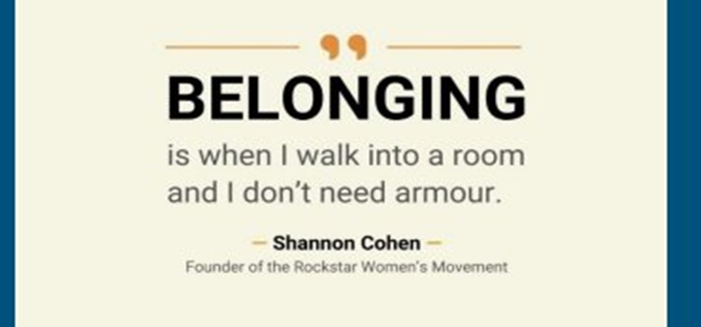
Notes:
"Belonging means walking into a space without needing to put on armor.”
In early childhood settings, we create belonging by honoring each child and family's identity, culture, and experiences. It's about more than inclusion—it's about making sure every person feels safe, seen, and valued just as they are. When we build authentic relationships, reflect the community in our environment, and invite voice and choice, we foster a place where everyone can thrive.
What are some examples of Armor:
Sending an older sibling to pick up
Wearing a hoodie over their head
Wearing ear buds
Talking on the phone
Always in a rush
What are some other examples of experiencing armor

Slide 16
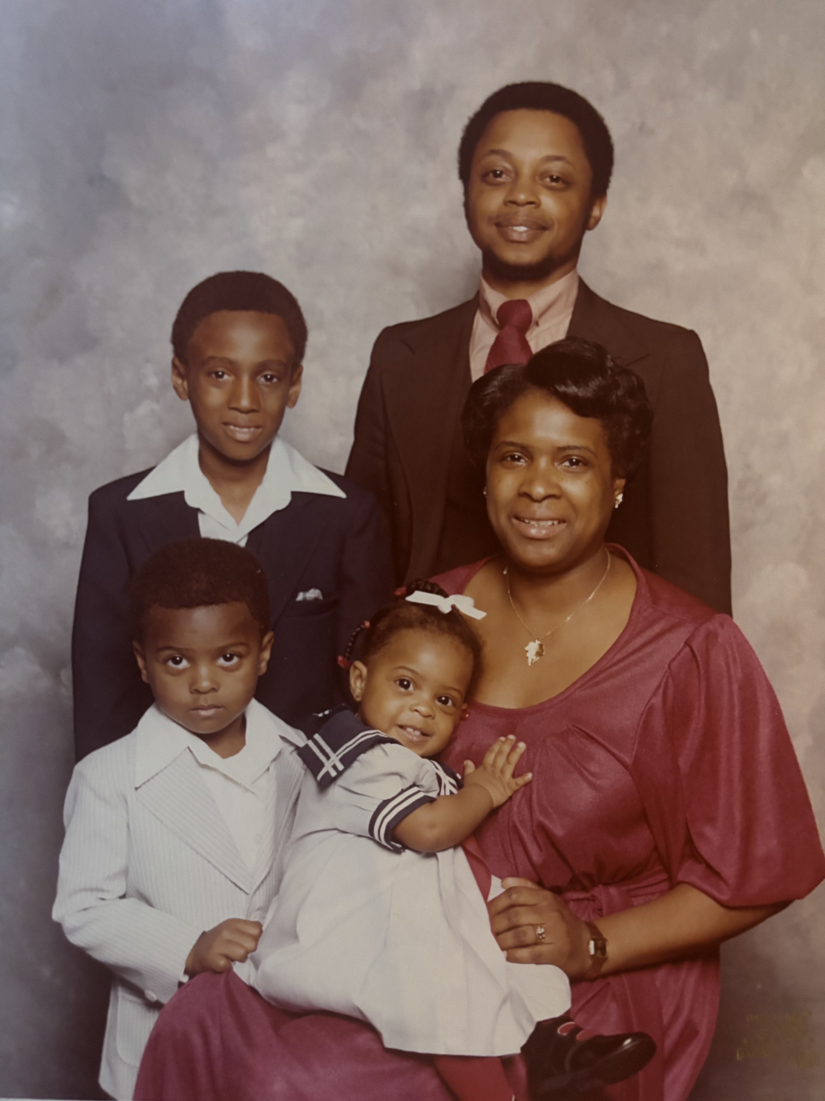
Lastly,…
We must engage in the process of constant reflection, of constant learning, to ensure that every family we serve feels seen, heard, and valued for being exactly as they are.
All families deserve the opportunity to reach their full potential.
Notes:
Try this!
What is one strategy you’re planning to take with you and apply in your work?
Please take a note card and write down your strategy along with a specific goal. Label it: "Do not open until January 1, 2026." When you open it, let it serve as a gentle reminder—an opportunity to reflect on whether you’ve implemented it, are in progress, or still need to begin.
As educators and caregivers, our commitment to continuous reflection and growth ensures that every family we serve feels seen, heard, and genuinely valued—just as they are.

Slide 17
Strategies for Developing a strong Home school connection.
Take the time to build meaningful relationships with your students and their families or primary caregivers.
Recognize and incorporate the lived experiences of children and their families into your teaching practice.
Foster a supportive and inclusive classroom environment where everyone feels valued and involved.
Maintain high expectations for all students, while actively partnering with families and caregivers in the learning journey.
Reflect on your own cultural background and understand how it influences your teaching and interactions with families.
Notes:
Commit to knowing your students and their families / primary caregivers well - academically, socially, and emotionally.
Learn about their families, cultures, and interests.
Ask questions, and talk with parents, community members, and colleagues.
Read books, watch movies, and listen to music.
Make home visits, or create opportunities for students their and families to share and celebrate their traditions and cultures.
Be aware of different worldviews, and learn about the 'collectivistic-individualistic continuum’.
Build on the life experiences of your students and their families and consistently bring them into the classroom. Current, real-world examples help students connect to the curriculum, allow for deeper engagement and help students make connections with their individual, community, national, and global identities.
Create a classroom learning community. Encourage students to care for one another and be responsible for each other inside and outside of the classroom. Provide consistent routines that help students feel valued and safe, and accountable to one another. Design a safe and welcoming classroom environment-students respond cognitively and emotionally to classroom aesthetics. (remember a sense of belonging)
Hold high academic standards and expectations for all of your students, and include parents and primary caregivers in the process, and enthusiastically encourage all students to reach those standards and beyond. Treat all students as competent and developing-focus on fostering a 'growth mindset'. Design lessons with your most underserved students in mind. (intentional teaching)
Understand your own cultural identity and its consequences. We must rigorously examine our own cultural behavior patterns, especially when it comes to building a strong home school connection. its ok to be ourselves with our students and their families - honest, caring, and human.

Slide 18
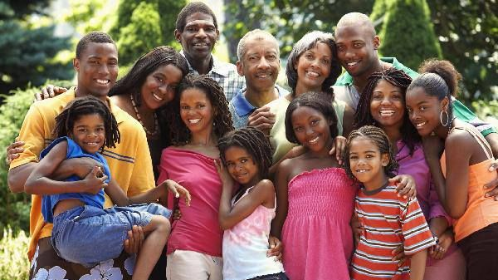
Thank You!

