Slide 1

https://www.youtube.com/watch?v=9ekY8EvrZmM

Slide 2

Relax, Recharge, Revive: Self-care for the Heart of ECE
Presented By : Sandra Hernandez
Sweet Home Family Daycare, LLC
(414) 324-7968

Slide 3

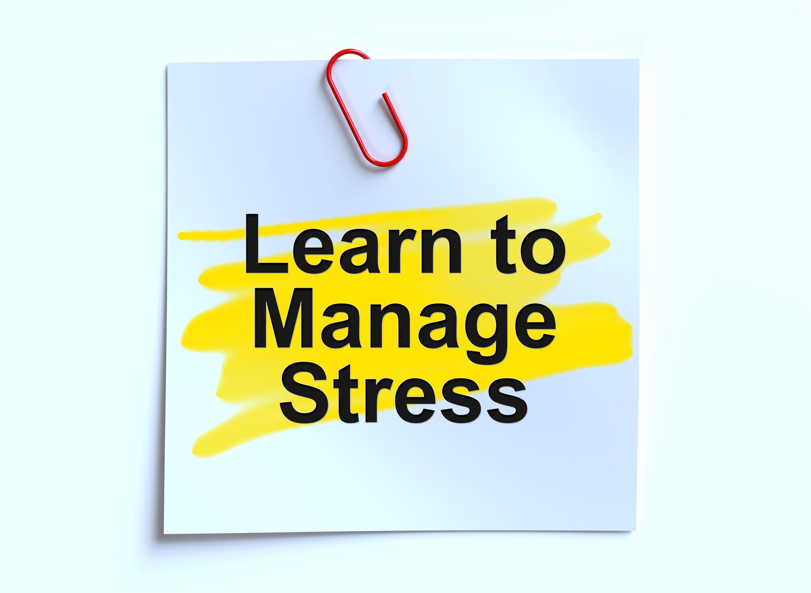
Managing stress

Slide 4
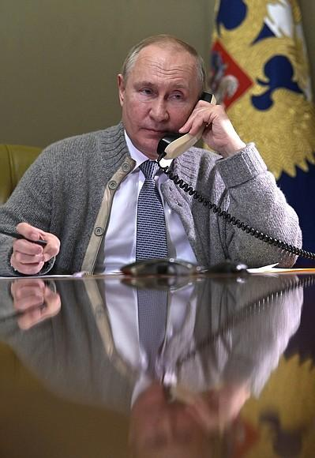
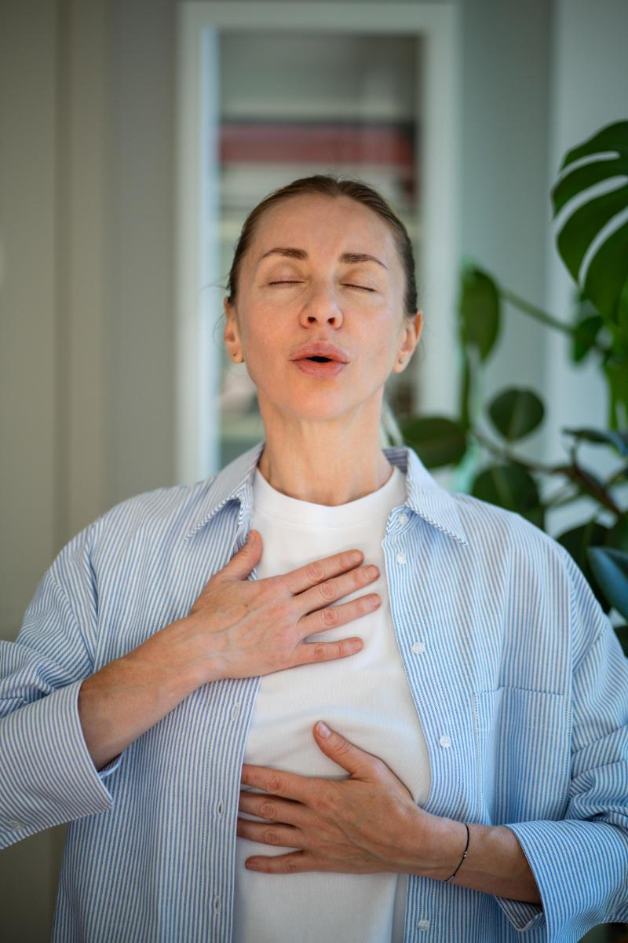
How stress can show up
Imagine your heart racing, your stomach in knots and your thoughts out of control just because you opened your email or you get an unexpected call.

Slide 5



Identify what is causing your stress
Work
Relationship
Health
Something else
Understanding the roots of the problem will help us addressing it properly.
Notes:
Journal and write what is causing you stress

Slide 6

Stress in Early Childhood Education
Finances and resources
Collaboration with parents
Behaviors of children
Communication
Licensing and regulations
What else?

Slide 7

When was the last time you think you were stressed about a situation and couldn’t explain it ?
Stress can become constant that it starts to feel normal. It’s like carrying a heavy backpack every day, after a while you forget how heavy it is until you finally put it down and feel the relief.
Overwhelmed
Stuck and don’t know what to do
Tough situation (Family, Work)
Financial circumstances
Society
Many more…

Slide 8

What is Compassion Fatigue?
Compassion Fatigue
Is the emotional and physical exhaustion that can develop in professionals who are exposed to the suffering, trauma, or emotional needs of others.
It may result from a single intense incident or accumulative exposure overtime, especially when emotional labor is high and recovery time is limited.

Slide 9

Burnout?
Is a state of physical, emotional and mental exhaustion caused by prolonged and unmanaged workplace stress. It can result from chronic exposure to stressors such as:
long hours
lack of control
excessive workload
unclear expectations
inadequate support
persistent pressure to perform without time to recovery.

Slide 10
Signs & Symptoms of Burnout and Compassion Fatigue
Burnout and compassion fatigue can develop in their effects particularly in high stress, emotionally, demanding professions. It’s important to recognize early warning signs is essential for preventing long term consequences to health and job performance.
Common Emotional & Physical Symptoms:
Persistent physical and emotional exhaustion
Feelings of being drained and overwhelmed
Reduced ability to feel empathy or compassion for others
Difficulty coping with everyday responsibilities

Slide 11
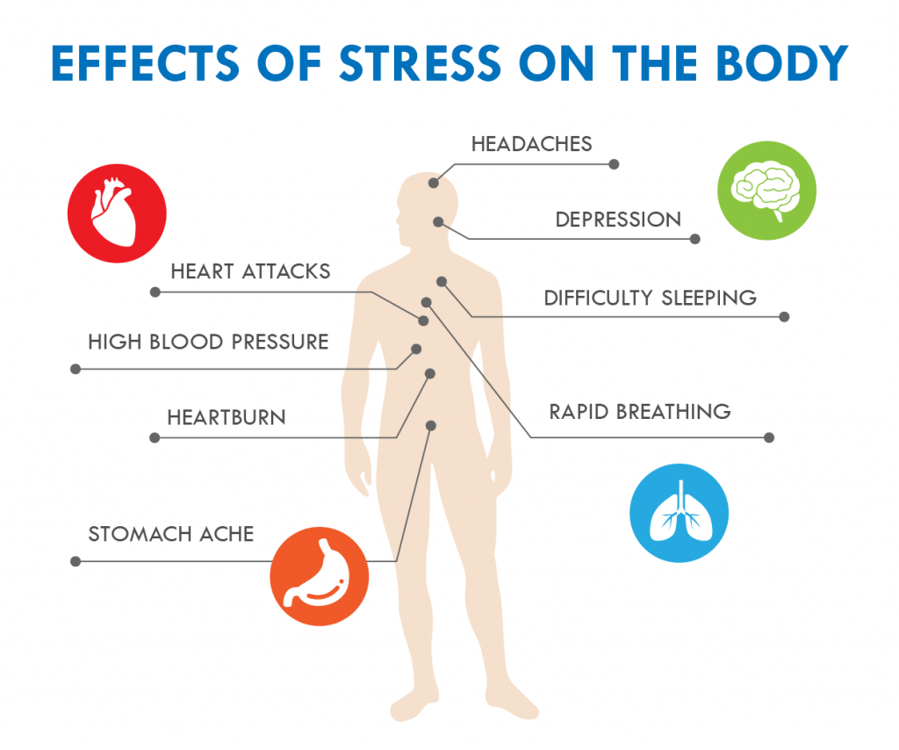

Take action today, Don't wait until Tomorrow !!!
Stress can affect all systems of the body, when muscles are tense for a long period of time this may trigger other reactions of the body and it promotes related disorders.
Headaches
Upset Stomach
Elevated Blood Pressure
Chest Pain Problem
Problems Sleeping
Stroke

Slide 12
Transition from work to home activities:
Close work related application, power down tools.
Relaxing reset: a warm shower, brief break.
Write down your achievements to acknowledge your efforts and shift focus toward personal time.
Change clothes after work, wear your favorite clothes or get comfortable.
Take a short walk to create a clear boundary between work and personal life.
Set limits on checking messages or task after work hours to give yourself dedicated down time.
Do one personal activity: read, write a note to someone special or stretching before engaging with family.

Slide 13

Setting boundaries with compassion
Policy review
Resetting expectations
Work hours vs off time
Schedule breaks intentionally
Clarify your role
Identify triggers and plan accordingly

Slide 14

Policy Review
Parents Handbook
A comprehensive handbook clarifies expectations.
Drop-off / Pick up times
Health & safety procedures
Discipline and behavior guidelines
Communication methods and updates
* Understanding your role limits and ensure families know what to expect.
* Define where friendly behavior ends and being a friend begins.
* Handbooks should be updated annually and/or if any changes occur make it available to all parents.

Slide 15
Work Hours vs Off Time
Schedule & contact boundaries
Set clear communication and office hours to manage availability.
(Example : verval, phone call, tx message, email, meeting. )
Define communication office hours (Example: 6:00am to 6:00pm
Monday - Friday.)
Be respectful to after work hours and weekends unless there’s an emergency.
Engage families, staff and community through surveys and meetings.

Slide 16

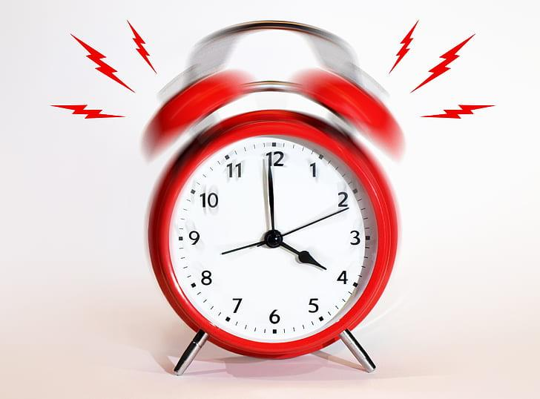
Techniques to help relieve stress !!!
We all suffer the daily pressure of juggling family, work, social engagements and extracurricular activities.
It seems that we never have enough time during the day to get everything done that needs to be accomplished.
Learn to prioritize
Organize
Follow Routine
Notes:
Examples of each

Slide 17

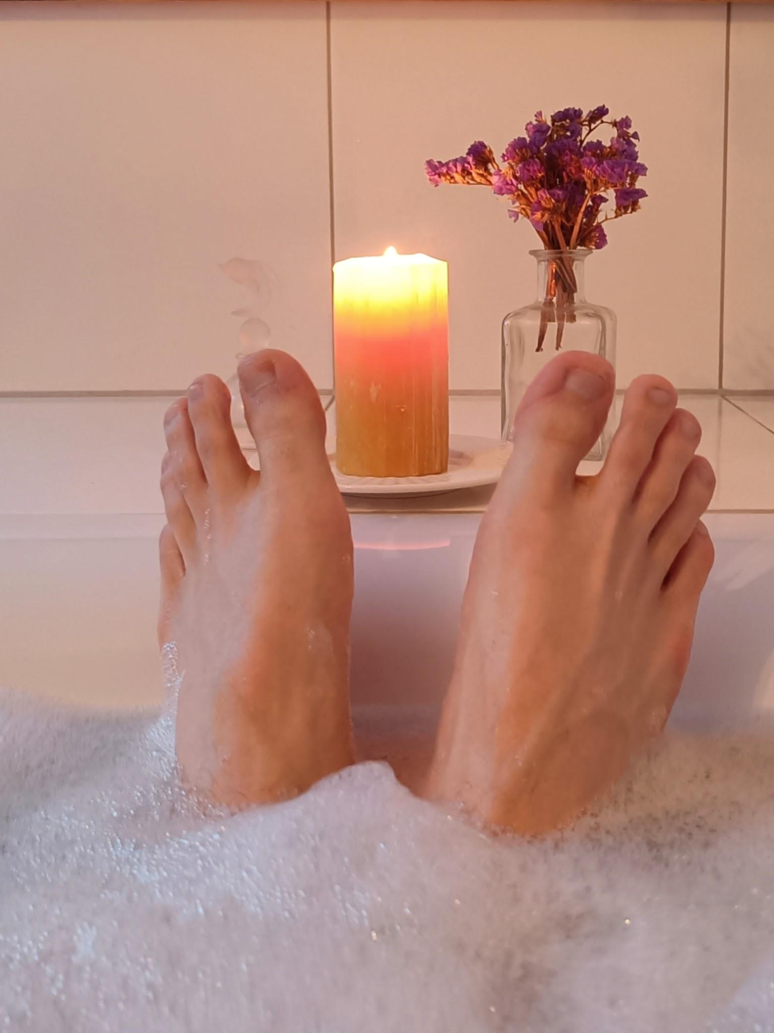
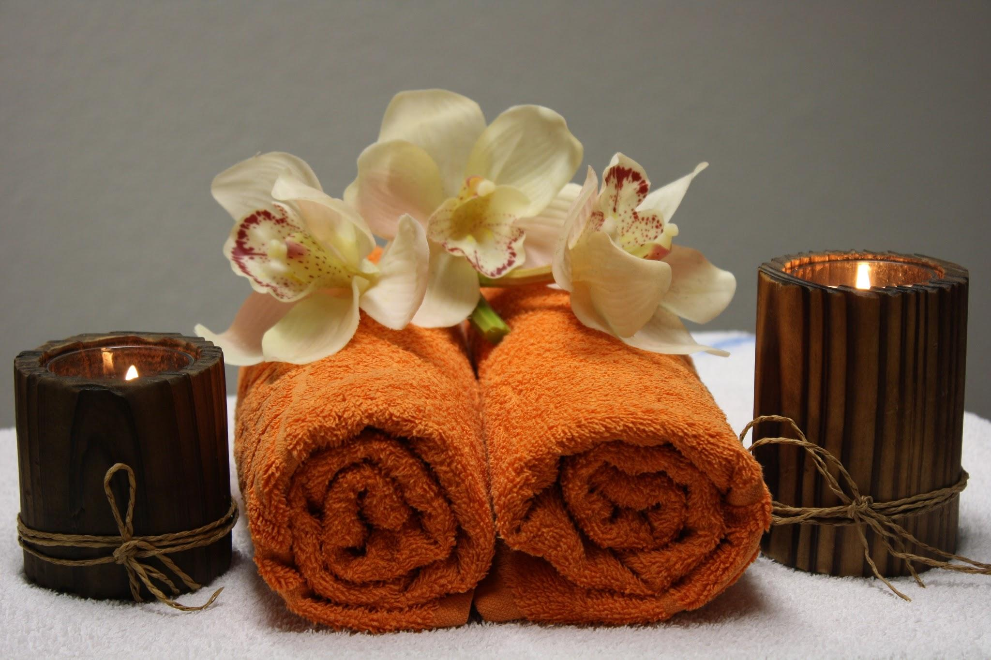

Take care of your self starting today.
Exercise
Meditation
Walking
Reading
Breathing
Music
Dance

Slide 18


Resources
Ask for Help !!
Stress: Understanding its Impact on Your Body and Mind
https://youtu.be/3UmLIkckZqg?feature=shared
Stress and anxiety support | calming support for stress
CDC
American Institute of Stress
Mayo Clinic,
BetterHelp
MDLIVE
Sixteenth Street

Slide 19
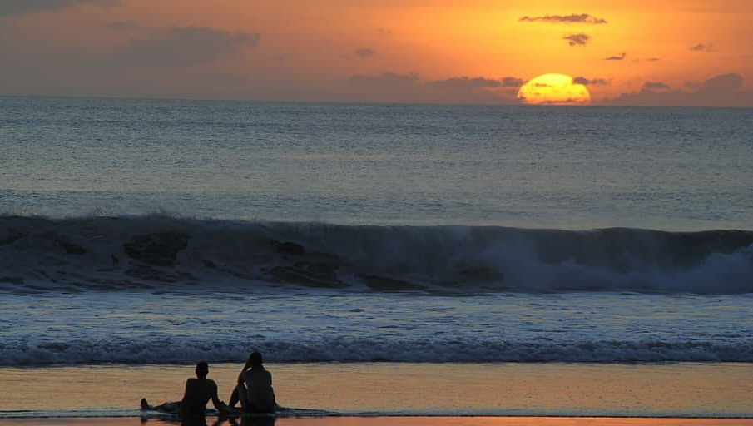
Conclusion
In conclusion stress is always our companion and sometimes it can be challenging to control it and find the way out, but it’s important to always remember that we can take control of the situation by just finding what works best for you. Be positive, confident, have faith and believe in yourself. Today is the best day to find the way out of stress. Thank you

Slide 20



Resources:
Meditation resources to relieve stress
Box breathing relaxation technique: how to calm feelings of stress or anxiety:
https://www.bing.com/videos/riverview/relatedvideo?q=box+breathing+relaxation+techniquehow+to+calm+anxiety&qpvt=box+breathing+relaxation+techniquehow+to+calm+anxiety&view=riverview&mmscn=mtsc&mid=239E803326A1B5468D96239E803326A1B54
Rainbow Relaxation:
https://www.bing.com/videos/riverview/relatedvideo?&q=rainbow+relaxation&&mid=C3AC7BDABF8227E4F44AC3AC7BDABF8227E4F44A&&FORM=VRDGAR#:~:text=3%3A47-,Rainbow%20Relaxation%3A%20Mindfulness%20for%20Children,-YouTube
5 Minute Meditation for Relaxation & Positive Energy | 30 Day Meditation Challenge
15 Minute Deep Meditation Music for Positive Energy • Relax Mind Body, Inner Peace

Slide 21

Thank You

