Slide 1

2020 REBUILD- Status update
Campaigns for the Future of NYSCC

Slide 2

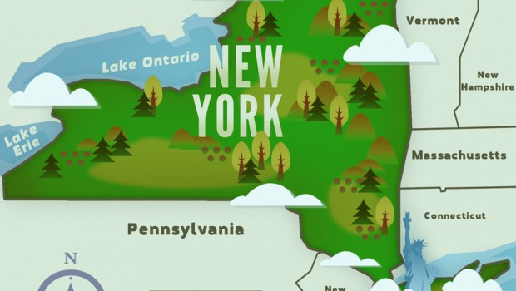
We aid in the formulation and establishment of sound policies and practices designed to conserve, protect, restore and perpetuate forests, wildlife and scenic and recreational areas with especial regard to the state of New York, to the general end that the present and succeeding generations may continue to enjoy and to use these great natural resources.

Slide 3
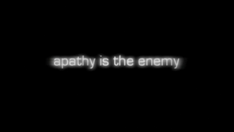

Slide 4



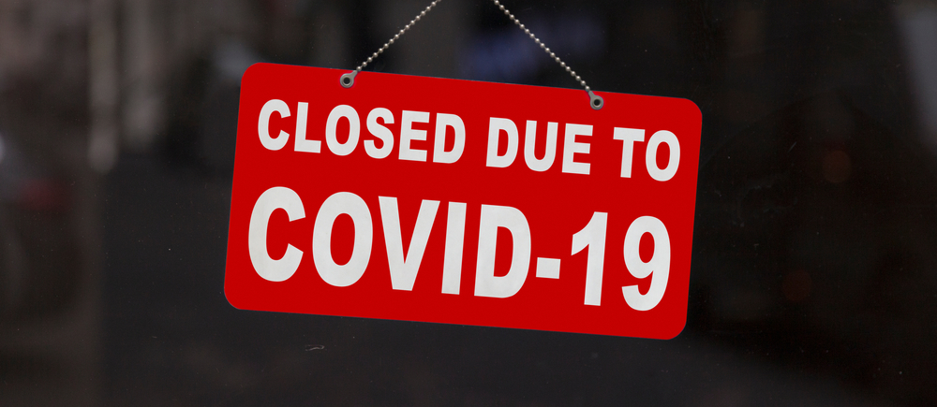


Slide 5

Three Pronged Attack
NYSCC
2020
Awareness/Education Campaign
Fundraising Campaign
Business Efficiency
Campaign

Slide 6
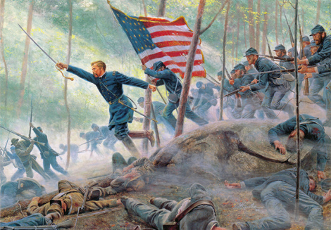
NYSCC
2020
Awareness/Education Campaign
Fundraising Campaign
Business Efficiency
Campaign
AWARENESS/EDUCATION Campaign – THREE P’s
Our Process - Develop Infographic for use in social media, website, presentations at Regional Organizations and County Federations, and fundraising efforts
Our Productivity - Produce an Infomercial/video including historical origins and great victories of NYSCC from beginning to today
Our Participation – Redesign recruitment and retention approach, to include more opportunities and venues for information sharing, technologies for interaction, and recognition and reward for participants.

Slide 7
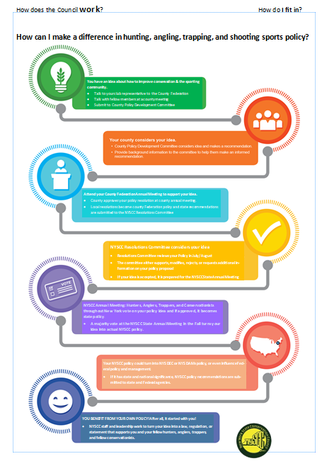

Slide 8
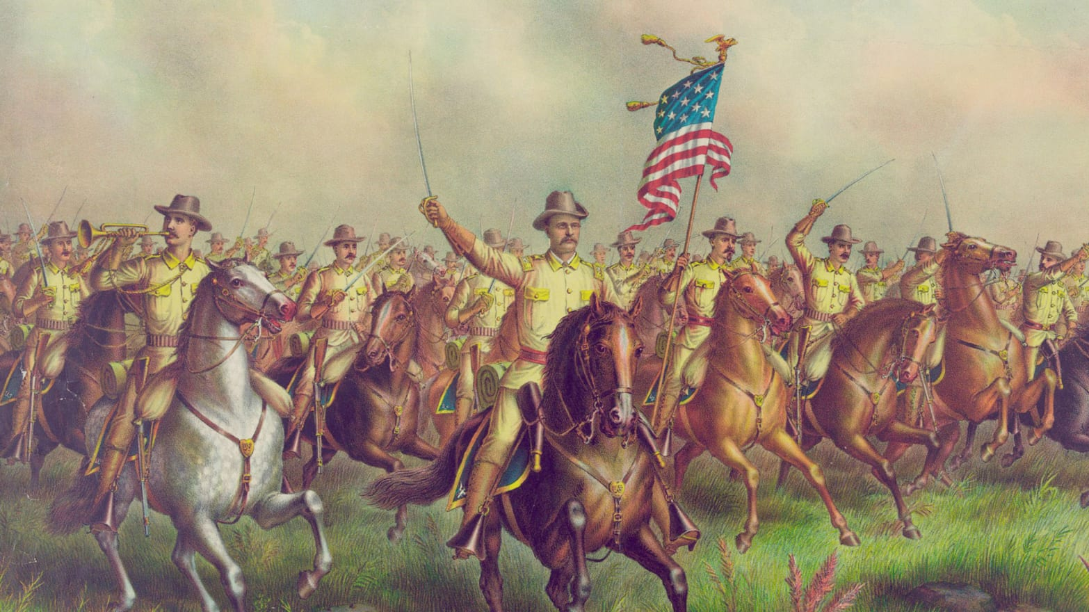
NYSCC
2020
Awareness/Education Campaign
Fundraising Campaign
Business Efficiency
Campaign
FUNDRAISING Campaign – FUN = FUNDS
Annual fundraising cycle that locks in participation
Revise Buck-a-Member to become a series of contests for membership recruitment
  Prizes awarded for individual sportsmen’s club with most new individual members each year
  Prizes awarded for County Federations and Regional Councils for highest levels of funds raised in fundraisers of their choosing
Fundraising Cycle concludes each year at a NYSCC State Shoot
  Held at a club, conduct events such as sporting clays, 5 stand, rifle, handgun – prizes for participants
  Solicit station sponsors and donors for prizes
  Synchronize annual meeting and awards banquet with this shoot (last weekend in Aug?)
Conduct high-end, multi-gun gun raffle on-line and across state, also drawn at state shoot

Slide 9
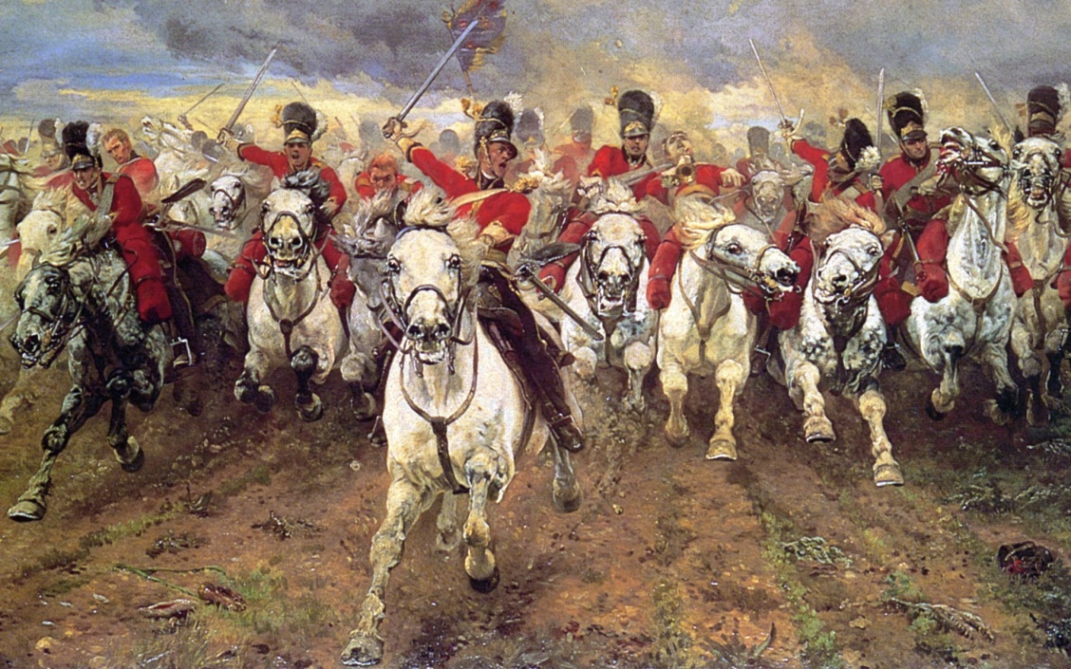
NYSCC
2020
Awareness/Education Campaign
Fundraising Campaign
Business Efficiency
Campaign
BUSINESS EFFICIENCY Campaign – Leverage technology to do more with less
Work with office staff to itemize areas needing streamlined, new technologies needed, new tools required
Modernize GrassRoots News – color, redesign, more images, less text
Enhance and improve website – more than information – a TOOL FOR AUDIENCE to engage in our mission
Bill tracking software, and “mail your legislator” software to automate actions

Slide 10

We are gaining on it!
New website!
New Social media!
Improved article quality of GrassRoots News!
New infographic!
New legislative bill tracking technologies!
New partners & relationships!

