Slide 1
ADA Investigation Training Americans with Disabilities Act & Section 504 Complaints
Notes:
Introduction Bios: Todd
How many people are with Local Public Agencies such as cities, towns, and counties?
How many are with State Transportation Agencies?
Where are you from and what do you do?
How many are ADA Coordinators?
How many are Engineers?
How many are field Technicians?

Slide 2
Disclaimer
Federal Highway Administration Office of Civil Rights​
The contents of this presentation do not have the force and effect of law and are not meant to bind the public in any way. This presentation is intended only to provide clarity regarding existing requirements under the law or agency policies.

Slide 3
What you will learn about…..
Complaint Process
Intake
Investigation
Closure
Monitoring
Voluntary Compliance Agreement (VCA)

Slide 4
Americans with Disabilities Act (ADA)
The Americans with Disabilities Act of 1990 (ADA) prohibits discrimination against individuals with disabilities in all areas of public life. 42 U.S.C 12101 et seq.
Title II, Subtitle A, of the ADA prohibits disability discrimination by public entities, including State and local governments, in the provision of services, programs or activities, including provision of pedestrian facilities in the public right-of-way
ADA regulations can be found at 28 CFR Part 35 (USDOJ).

Slide 5
Section 504
Section 504 of the Rehabilitation Act of 1973 prohibits discrimination on the basis of disability in Federally assisted programs or activities. 29 U.S.C. 794.
Section 504 regulations are found at 49 CFR Part 27 (USDOT), Nondiscrimination on the Basis of Disability in Programs and Activities Receiving or Benefiting from Financial Assistance.

Slide 6
Title II/Section 504 – State and Local Governments
Requirements:
Complete a Self-Evaluation
Development & post an ADA Policy Statement
Development of a Transition Plan
Designate an ADA Coordinator
Development & post Grievance/Complaint Procedures
Notes:
Self-Evaluation:
A self-evaluation is a public entity's assessment of its programs, services, and activities; facilities; and current policies, practice and procedures. The self-evaluation identifies and corrects barriers to access that are inconsistent with its title II requirements. 28 CFR 35.150(d)(3)(i) and 28 CFR 35.105(a)
2. Provide an opportunity to interested persons, including individuals with disabilities or organizations representing individuals with disabilities, to participate in the self-evaluation process by submitting comments.
3. A public entity that employs 50 or more employees must retain its self-evaluation for three years following completion of the self-evaluation, maintain on file and make available for public inspection:
A list of the interested persons consulted;
(2) A description of areas examined and any problems identified; and
(3) A description of any modifications made.
ADA Policy Statement: A public entity shall make available to applicants, participants, beneficiaries, and other interested persons information regarding the provisions of Title 28 Chapter 1 Part 35 Subpart A and its applicability to the services, programs, or activities of the public entity. (28 CFR 35.106)
If you have 50 or more employees…
Transition Plan:
A public entity shall provide an opportunity to interested persons, including individuals with disabilities or organizations representing individuals with disabilities, to participate in the development of the transition plan by submitting comments. A copy of the transition plan shall be made available for public inspection. (28 CFR 35.150 (d))
If a public entity has responsibility or authority over streets, roads, or walkways, its transition plan shall include a schedule for providing curb ramps.
The plan shall, at a minimum
Identify physical obstacles in the public entity's facilities that limit the accessibility of its programs or activities to individuals with disabilities;
(ii) Describe in detail the methods that will be used to make the facilities accessible;
(iii) Specify the schedule for taking the steps necessary to achieve compliance with this section and, if the time period of the transition plan is longer than one year, identify steps that will be taken during each year of the transition period; and
(iv) Indicate the official responsible for implementation of the plan.
ADA Coordinator: Designation of responsible employee. They are responsible for investigation of any complaint communicated to it alleging noncompliance The public entity shall make available to all interested individuals the name, office address, and telephone number of the employee or employees designated pursuant to this paragraph. (28 CFR 35.107(a))
Complaint/Grievance Procedure: Complaint procedure. A public entity that employs 50 or more persons shall adopt and publish grievance procedures providing for prompt and equitable resolution of complaints alleging any action that would be prohibited by this part. (28 CFR 35.107(b))
Why are we sharing this information? These are the questions that will be asked during an investigation.

Slide 7
Effective Communication
28 CFR §35.160 (a)(1) - A public entity shall take appropriate steps to ensure that communications with members of the public with disabilities are as effective as communications with others.
28 CFR §35.160 (b)(1) - A public entity shall furnish appropriate auxiliary aids and services where necessary to afford individuals with disabilities . . . an equal opportunity to participate in, and enjoy the benefits of, a service, program, or activity of a public entity.
Notes:
The ADA requires that title II entities communicate effectively with people who have communication disabilities. The goal is to ensure that communication with people with these disabilities is equally effective as communication with people without disabilities.
The purpose of the effective communication rules is to ensure that the person with a vision, hearing, or speech disability can communicate with, receive information from, and convey information to, the covered entity.
Covered entities must provide auxiliary aids and services when needed to communicate effectively with people who have communication disabilities.
The key to communicating effectively is to consider the nature, length, complexity, and context of the communication and the person’s normal method(s) of communication.
The rules apply to communicating with the person who is receiving the covered entity’s goods or services as well as with that person’s parent, spouse, or companion in appropriate circumstances.

Slide 8
How does Headquarters Civil Rights (HCR) Receive Complaints?
U.S. Department of Justice
Departmental Office of Civil Rights (DOCR)
FHWA Division Office
E-mail from the Complainant
Electronic Correspondence to HCR ADA Email
Phone Call from the Complainant
Notes:
Do you have an ADA Coordinator? 28 CFR 35.107(a)
How do you receive complaints? Ex. 311
Are your complaint forms available in accessible formats?
Does anyone want share how they are the accessible?

Slide 9
Intake
Intake process is completed by Headquarters
Review the complaint
Establish jurisdiction
Verify information
Acknowledgment package

Slide 10
Establish jurisdiction
Are the subject locations in the public right-of-way?
Is the allegation covered by the ADA and/or Section 504?
Does the allegation fall under FHWA authority?
Notes:
What is your complaint grievance process? 28 CFR 35.107(b)
How to establish jurisdiction?

Slide 11
Investigation
Investigative plan (IP)
Interviews
On-site Review
Report of Investigation (ROI)
Notes:
Investigations handled by Division Office

Slide 12
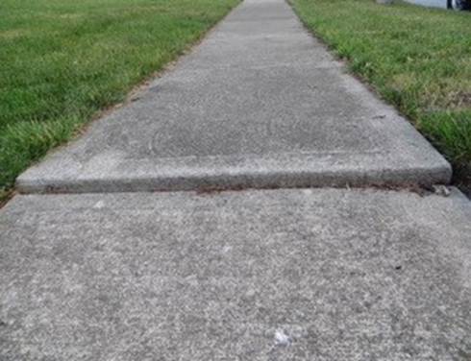
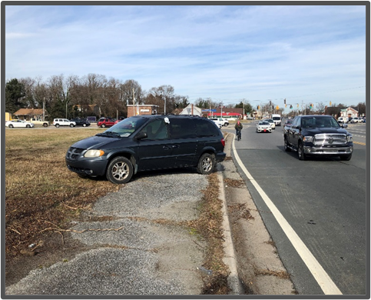
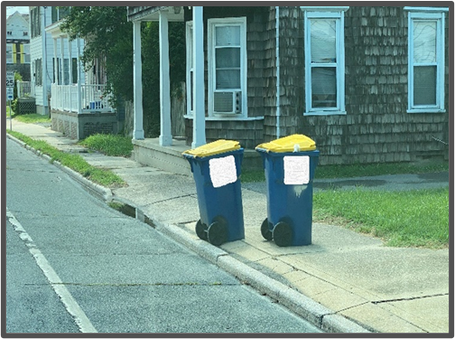
Common types of Complaints
Sidewalks
Curb ramps
Obstructions
Pedestrian signals
Picture: T. Webb
Picture: T. Webb
Picture: T. Webb

Slide 13
Alterations
Department of Justice/Department of Transportation Joint Technical Assistance on the Title II of the Americans with Disabilities Act Requirements to Provide Curb Ramps when Streets, Roads, or Highways are Altered through Resurfacing.
Notes:
https://www.fhwa.dot.gov/civilrights/programs/doj_fhwa_ta.cfm#_ftn1

Slide 14
Investigative Plan
Internal document for use by the investigator to keep the investigation on track and focused on the issues and evidence .
Based on the complaint.
It’s a living document and can be updated as the investigation proceeds.

Slide 15
Interviews
Interviews may be conducted with the complainant and other witnesses during the investigative process.
An interview with the respondent is required.
Establish methods of communication - interpreter, LEP, alternate format needs
Obtain information from witnesses who can provide information that will either support or refute the allegations.
The complainant, respondent, and witnesses have the right to have a representative present during interviews.
Notes:
Gain a better understanding of the allegations outlined in the complaint of discrimination
Respondents are interviewed to provide an opportunity to respond to the allegations raised by the Complainant. Investigators should summarize the allegations and provide the summary to the Respondent.
Don’t provide the Complainant’s name or other personal identifiable information to the Respondent.
Individuals who have information relevant to the allegations raised in the complaint of discrimination should be interviewed

Slide 16
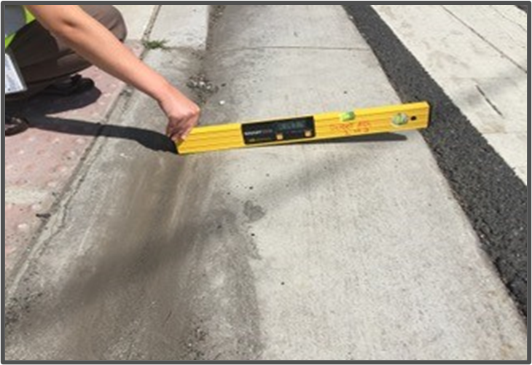
On-site review
Taking pictures and/or videos
Taking and documenting measurements
Picture: T. Webb
Notes:
Send a Request for Information (RFI), conduct interviews, on site review

Slide 17
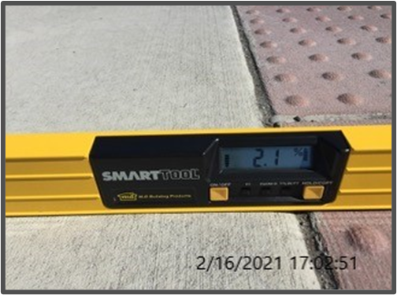
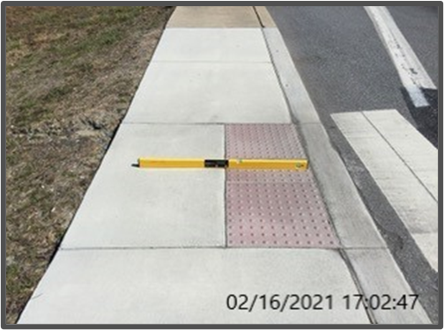
On-site review - Pictures and videos
Close up picture
Pan out picture
Date & time stamp
Label picture with facility type and location
Audio description of video
Picture: T. Webb
Picture: T. Webb

Slide 18
On-site review - Measurements
Smart level, tape measure, ruler, measurement wheel, and other tools used to measure.​
Dimensions​
Slopes​
Obstructions​
Discontinuities
Notes:
Based on this image what are you going to document? (10 minutes)
https://www.google.com/maps/place/Lone+Mountain+Dr+%26+E+Winnie+Ln,+Carson+City,+NV+89706/@39.1792091,-119.7632047,217m/data=!3m1!1e3!4m6!3m5!1s0x80990a9519d48051:0x2b9905b6c4b2a881!8m2!3d39.179169!4d-119.763573!16s%2Fg%2F11gdvm3jcf
2. What do you use when you conduct a site visit? Ex. Templates, tools, etc.
Notes: Caliper tool, construction crayons
Dimensions – length and width of the sidewalk
Slope – cross slope and running slope
Obstructions – trash cans, scooters, etc.
Discontinuities – tape measure

Slide 19
Report of Investigation 1 of 3
What is an ROI?​
A document outlining the findings of the investigation. ​
Completed at the end of the investigation. ​
Provides an analysis of the facts found during the investigation.​
Recommends a determination.
Notes:
The CR Specialist has received the IP
Conducted interviews
Received the request for information
Conducted a site-visit
Now they have to analyze the documentation and put it in this format.

Slide 20
Report of Investigation 2 of 3
What is in an ROI?​
Parties names and addresses​
Allegations and Issues​
Applicable laws and regulations​
Respondent’s response to the allegations​
Name of ADA Coordinator ​
Respondent’s relevant policies​
Does Respondent receive federal funds​
Number of employees – includes part time and seasonal. Each one counts as one full employee.
Notes:
If do not have 50 or more employees must have self-evaluation plan and a plan to address barriers in the public right of way

Slide 21
Report of Investigation 3 of 3
Transition plan status ​
Grievance procedure ​
Results of On-site review, if conducted​
Include pictures and/or measurements ​
Standard used by Respondent (ADAAG, PROWAG or other standard applied)​
Recommendations for voluntary compliance
Notes:
ADA Accessibility Guidelines (ADAAG)
Proposed Public Right of Way Accessibility Guidelines (PROWAG)
PROWAG is 48 minimum continuous pedestrian access route. ADAAG – 36 inches
Group conversation:
How do you analyze the findings of the investigation? Ask audience (10 minutes)
Plan B: Todd can give examples from past employment

Slide 22
ADA Accessibility Guidelines (ADAAG)
Developed primarily for buildings and on-site facilities
Does not address all situations
Notes:
Only share if the audience ask.
https://www.access-board.gov/ada/
Curb ramps: ADAAG 406
Does not cover public right of way except for curb ramps
Where does it apply? Does apply to public meeting spaces, welcome centers

Slide 23
Public Right of Way Accessibility Guidelines (PROWAG) Update
Final PROWAG provides minimum accessibility guidelines​
DOT and DOJ must adopt PROWAG guidelines to make them enforceable standards.
Notes:
How many of you have adopted PROWAG as an accessible pedestrian design?
Do you have a measurement template to document pedestrian facility?

Slide 24
Closure
Letter of Finding (LOF)
Closure Letter
Voluntary Compliance Agreement (VCA)
Notes:
Now that the Division office has analyzed the completed and submitted the ROI.
The closure process may include the LOF, Closure, VCA
LOF- compliance, non-compliance or both

Slide 25
Letter of Finding 1 of 2
What is an LOF?​
A document outlining the findings and conclusion of the investigation. It is completed after an ROI and finds compliance or non-compliance.​
The LOF should state recommendations for voluntary compliance if Respondent is found in non-compliance.
Notes:
Upon completion of the investigation, the Division Office will forward the report of investigation (ROI), and we (FHWA) draft letter of finding (LOF)
Verify the information in the ROI to ensure that it is accurate.

Slide 26
Letter of Finding 2 of 2
What is in an LOF? ​
Parties’ names and addresses (protect complainant’s identity)​
Allegations and Issues​
Applicable laws and regulations​
Findings of fact from the investigation (including measurements)​
Conclusions of compliance or non-compliance supported by the findings of fact​
Voluntary compliance action items if Respondent is found in non-compliance
Notes:
Group Conversation
How do you wrap up the findings of the investigation? Ex. Letters? (10 minutes)

Slide 27
Voluntary Compliance
Where non-compliance is found action items for voluntary compliance should be provided.​
Respondent submits action plan and schedule to remediate deficiencies.​
Civil Rights Specialist monitors action plan through compliance.

Slide 28
Voluntary Compliance Agreement (VCA)
Voluntary agreement entered into and signed by Respondent and FHWA.​
The Agreement does not constitute a finding of compliance or non-compliance.​
Make sure there are sufficient details and timeframes.​
Consult with HCR prior to sending out agreement for signatures.​
FHWA Division office will monitor the agreement for compliance.​
Efficient way to process complaints.
Notes:
Group conversation
Do you have an agreement for resolution? (10 minutes)

Slide 29
Monitoring
Voluntary Compliance Agreement​
LOF of non-compliance
Notes:
What are your steps for closing out complaints?

Slide 30
Contact:
Todd Webb​
ADA Program Analyst​
FHWA Office of Civil Rights​
James.Webb@dot.gov

Slide 31
U.S. Department of Transportation Federal Highway Administration. U.S. Department of Transportation Logo and picture of the Bixby Bridge in Big Sur, California.

