Slide 1
Americans with Disabilities Act (ADA) More than a Transition Plan
Patrick Gomez, Team Leader/Civil Rights Specialist
Note: Except for the statutes and regulations cited, the contents of this presentation do not have the force and effect of law and are not meant to bind the public in any way. The presentation is intended only to provide information and clarity regarding existing requirements under the law and agency policies.

Slide 2
Facilitator
Patrick Gomez
FHWA Resource Center
Team Leader/Civil Rights Specialist
708-625-4316
patrick.gomez@dot.gov

Slide 3
Legal Background
Section 504 of the Rehabilitation Act (1973) – DOT Implementing regulations at 49 CFR Pt 27
Americans with Disabilities Act (ADA) (1990)
Notes:
Title I Employment – 28 CFR 35.140
Title II State & Local Governments - 28 CFR 35
Title III Public Accommodations - 28 CFR 36
Title IV Telecommunications – 28 CFR 35.161
Title V See Below
The United States Code is divided into titles and chapters that classify laws according to their subject matter. Titles I, II, III, and V of the original law are codified in Title 42, chapter 126, of the United States Code beginning at section 12101

Slide 4
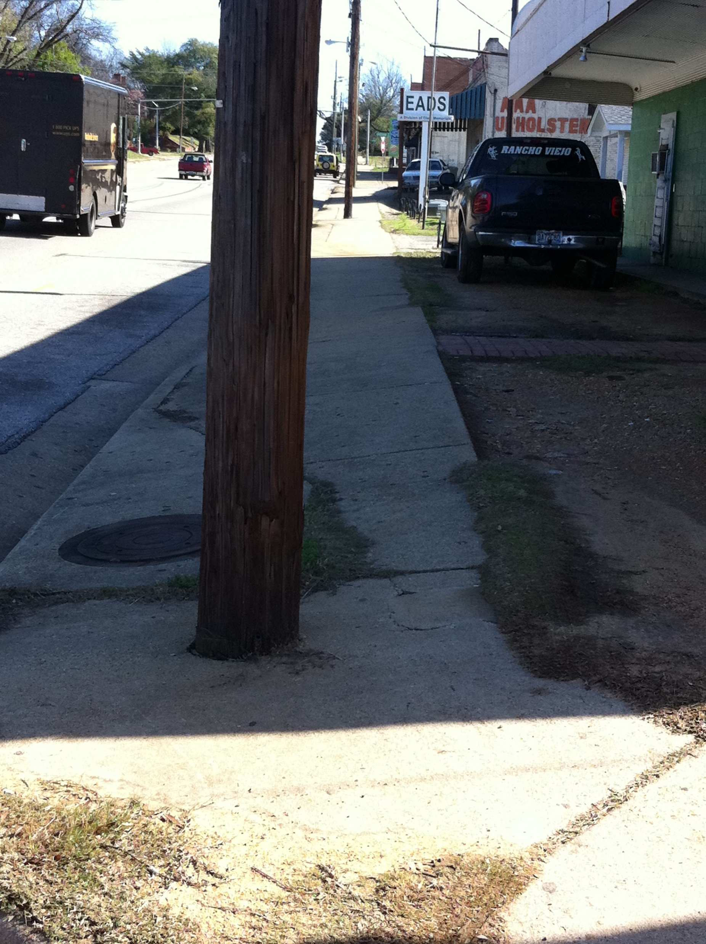
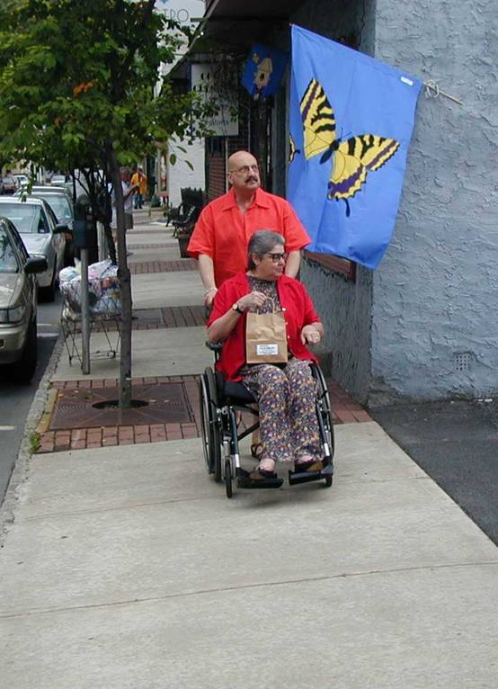
Title II - State and Local Governments
Basic Requirements:
Must ensure that no person, on the basis of disability, is excluded from participation in or denied the benefits of programs, services, and activities of a government entity or is subjected to discrimination by a government entity. [28 CFR 35.130] (provision of pedestrian facilities is a government service or program)
Notes:
Photo Permission/Credit (sidewalk with Pole): Robert Hoggler, Alabama DOT
General prohibitions against discrimination.
(a) No qualified individual with a disability shall, on the basis of disability, be excluded from participation in or be denied the benefits of the services, programs, or activities of a public entity, or be subjected to discrimination by any public entity. 28 CFR 35.130

Slide 5
Title II/Section 504 – State and Local Governments
Basics:
Designate an ADA Coordinator (28 CFR 35.107(a)) (public entities with 50 or more employees. However, recipients of DOT financial assistance need to appoint a coordinator under DOT Section 504 regulations (49 CFR 27.13(a))
Development & Notice of an ADA Policy Statement (28 CFR 35.106)
Development & posting of Grievance/Complaint Procedures (28 CFR 35.107(b)) (public entities with 50 or more employees. However, recipients of DOT financial assistance need to appoint a coordinator under DOT Section 504 regulations (49 CFR 27.13(a))
Public Involvement (considered in decision making processes) (28 CFR 35.105)
Complete a self-evaluation (28 CFR 35.150(d)(3)(i) and 28 CFR 35.105(a))
Development of a Transition Plan (Official Resp., Inventory, Schedule, Methods)
(28 CFR 35.150 (d)) (public entities with 50 or more employees)
Notes:
Changed from Basic Requirements to “Basics”
Make sure to mention all information needs to be translated into different languages as needed and upon request.
ADA Coordinator – 28 CFR 35.107(a)
ADA Policy Statement - 28 CFR 35.106
Complaint/Grievance Procedure - 28 CFR 35.107(b)
Public Involvement 28 CFR 35.105
Self-Evaluation - 28 CFR 35.150(d)(3)(i) and 28 CFR 35.105(a)
Transition Plan – 28 CFR 35.150 (d)

Slide 6

Transition Plan Elements
Identify/list physical obstacles and their location
Describe in detail the methods the entity will use to make the facilities accessible
Provide a schedule for making the access modifications
Provide a yearly schedule if the transition plan is more than one year long
Name/position of the official who is responsible for implementing the Transition Plan
Notes:
28 CFR 35.150(d)(3)

Slide 7
Transition Plan Elements
Pedestrian right-of-way facilities
  Curb ramps
  Sidewalks
  Parking lots
  Pedestrian signals
  Bus stops
  Shared use trails
  Parks/recreational facilities

Slide 8
Good Self-Evaluation Practices:
Dedicate adequate budget and staff to make progress on developing inventory over time
Use of Internship Programs
Prioritize “high pedestrian” areas first, thus being able to make impacts prior to completing the full inventory
Use scale (1-5) or colors (Red, Yellow, Green) to help prioritize non-compliant facilities for modification
Do not Duplicate work
Notes:
Changed from Key to Success for Your Inventory/Self Evaluation to “Important Considerations Self Evaluation”
The term intern is in reference to a college intern. In this example, a college gave credit and they were paid for their services by a State DOT. This is just a way to think outside of the box and find ways to get help with your Transition Plan.

Slide 9
Good Self-Evaluation Practices:
  Clarify which entity is responsible for which facilities in PROW (STA or LPA)
    Sidewalks along/on state roads are noted as “problematic”
    COORDINATION IS CRITICAL (who is responsible?)
    Transit facilities owned by a DOT but operated by others were also noted as “problematic”
Notes:
We see many problems with the maintenance of sidewalks, as States and Local Public Agencies need to coordinate to determine who is responsible for sidewalks so that they both do not include the sidewalk in their transition plan. It would depend on the ownership, jurisdiction, maintenance agreement (if there is one), etc.

Slide 10

Monitoring the Progress
Track progress from Initial Inventory (baseline)
Transition Plan is a “Living Document”
  UPDATE Regularly: whenever changes are made to the plan – preferred; annually; semi-annually (take credit for achievements)
Remember: all changes in the pedestrian environment (i.e., adding street furniture, landscaping) may have impacts on your current and future transition plan.
States and Public Agencies are required to have a self-evaluation, and if they have 50 or more employees, are required to have a transition plan.
Notes:
Changed from Doing nothing is not acceptable to “States and Public Agencies are required to have a self-evaluation, and if they have 50 or more employees, are required to have a transition plan. They do not have the discretion not to do this.”
28 CFR 35.105 and 28 CFR 35.150(d)

Slide 11
Transition Plan: Proactive Actions to Consider
Be specific about what, exactly, was the nature of the public’s involvement in the self-evaluation and transition plans. (Ex: Were there public hearings, and if so, when and at what time of the day/night and how was the public made aware of the meetings? Were the plans posted on the State’s website? By what other means was the public made aware of the plans? Were the plans translated into languages other than English?)
Be sure to consult with individuals with disabilities as well as the advocacy organizations that may represent them prior to conducting the inventory of facilities and developing the transition plan; always ask for feedback and describe in the plan how public input was used in decision making; and establish an on-going relationship.
Ensure transparent and easy to find and follow information without the need to have specialized knowledge in Civil Rights, Engineering, Law
Make materials available in electronic and hard copy forms.
Distinguish between Title VI and ADA on website and in documents
Notes:
Changed from Doing nothing is not acceptable to “States and Public Agencies are required to have a self-evaluation, and if they have 50 or more employees, are required to have a transition plan. They do not have the discretion not to do this.”

Slide 12





ADA Accessibility Guidelines (ADAAG)
Developed primarily for buildings & on-site facilities
Do not address all situations (especially those that are unique to the public right-of-way)
Notes:
Credit/Permission: Ted Green

Slide 13
Proposed Public Right-of-Way Accessibility Guidelines (PROWAG)
Originally intended to supplement the ADAAG to provide standards specific to public rights-of-way; most recently formatted as a stand-alone document
Applicable to new construction and alterations (of existing facilities)
Undergoing the rulemaking process (2011 Notice of Proposed Rule Making published w/ updated guidelines.)

Slide 14
Equivalent Facilitation
Nothing in these requirements prevents the use of designs, products, or technologies as alternatives to those prescribed, provided they result in substantially equivalent or greater accessibility and usability
Notes:
Source added: definition from ADAAG (2.2), as amended through January 1998:
2.2* Equivalent Facilitation. Departures from particular technical and scoping requirements of this guideline by the use of other designs and technologies are permitted where the alternative designs and technologies used will provide substantially equivalent or greater access to and usability of the facility.
Also, the 2010 ADAAG:
103 Equivalent Facilitation
Nothing in these requirements prevents the use of designs, products, or technologies as alternatives to those prescribed, provided they result in substantially equivalent or greater accessibility and usability.
Advisory 103 Equivalent Facilitation. The responsibility for demonstrating equivalent facilitation in the event of a challenge rests with the covered entity. With the exception of transit facilities, which are covered by regulations issued by the Department of Transportation, there is no process for certifying that an alternative design provides equivalent facilitation.
2010 DOJ ADA Standards, https://www.ada.gov/regs2010/2010ADAStandards/2010ADAstandards.htm

