Slide 1
Office of Innovation Implementation –
Resource Center
SOUTHERN TRANSPORTATION CIVIL RIGHTS EXECUTIVE COUNCIL (STCREC) SYMPOSIUM
On-the-Job (OJT) Training Program Overview
April 23, 2024

Slide 2


OJT Program Overview
Notes:
Let’s take a look at the OJT program.

Slide 3
FHWA OJT Program
Federal Regulation 23 CFR Part 230, Subpart A, Equal Employment Opportunity on Federal and Federal-aid Construction Contracts.

Slide 4
FHWA OJT Program 23 CFR 230.107
It is the policy of the FHWA to:
Require full utilization of all available training and skill-improvement opportunities to assure the increased participation of minority groups and disadvantaged persons and women in all phases of the highway construction industry.
Encourage the provision of supportive services which will increase the effectiveness of approved on-the-job training programs conducted in connection with Federal-aid highway construction projects.

Slide 5
Types of OJT Programs
Contract/Project-Based Program
Contractor-Based Program
Hybrid Program

Slide 6
What type of OJT Program does your State have?

Slide 7
OJT Program Challenges
Difficult to enforce contract sanctions.
Difficult to successfully complete a Contract/Project based program.
Tracking the success of the OJT Programs.
Retainage of individuals once the OJT program is complete (journeymen level).

Slide 8
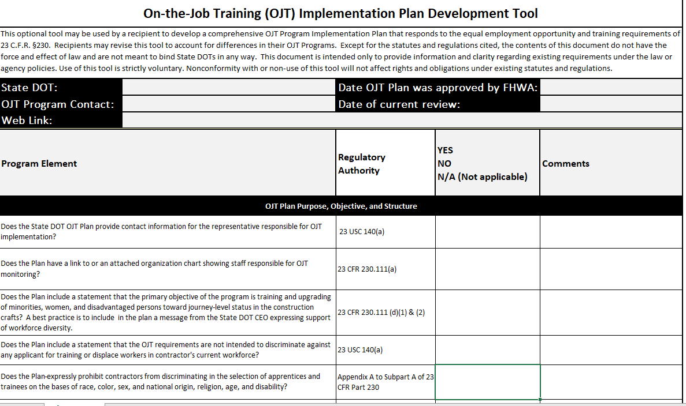
Resource: On-the-Job Training (OJT) Implementation Plan Development Tool

Slide 9


Questions/ Comments?
Disclaimer: The contents of this presentation do not have the force and effect of law and are not meant to bind the public in any way. This presentation is intended only to provide clarity regarding existing requirements under the law or agency policies.
Sandy Talbert-Jackson
Civil Rights Technical Director
FHWA Resource Center
Sandy.Talbert-Jackson@dot.gov 410-598-7736
Sandy Talbert-Jackson
Civil Rights Technical Director
FHWA Resource Center
Sandy.Talbert-Jackson@dot.gov 410-598-7736
Camille Robinson
Civil Rights Specialist
FHWA Resource Center
Camille.Robinson@dot.gov (502) 223-6743
Notes:
Mention Andrea Kirk in HQs is the point of contact for more information regarding OJT/SS Program

