Slide 1
Title VI: What’s New and What’s Next?
Southern Transportation Civil Rights Executive Council (STCREC) Symposium
FHWA Office of Civil Rights

Slide 2
Discussion Topics
Introduction
New DOT/FHWA initiatives involving Title VI
USDOT Equity Action Plan
Meaningful Public Involvement Promising Practices
New Tools
New FHWA Title VI Reviews and Analysis Course
Notes:
The purpose of this talk is to discuss some new initiatives at FHWA and the USDOT related to Title VI. We would like to go over a few initiatives today and also answer your questions about Title VI. We would like this to be a discussion – hearing from you about what you are seeing and hearing is experts in the field.

Slide 3
Housekeeping
We will take questions throughout the presentation. Please raise your hand with a question or comment.
STCREC will make the slides available after the conference.
Photo by furkanfdemir from Pexels.com

Slide 4
Disclaimer
Except for any statutes or regulations cited, the contents of this presentation do not have the force and effect of law and are not meant to bind the public in any way. This presentation is intended only to provide information to the public regarding existing requirements under the law or agency policies.
The Federal Highway Administration (FHWA) does not endorse any entity and the appearance of our presentation material in this template should not be interpreted as an endorsement or statement exhibiting any preference, support, etc.
Photo by Cytonn Photography from Pexels.com

Slide 5
Introduction
Title VI of the Civil Rights Act of 1964 provides that:
“No person in the United States shall, on the ground of race, color, or national origin, be excluded from participation in, be denied the benefits of, or be subjected to discrimination under any program or activity receiving Federal financial assistance.”
Title VI of the Civil Rights Act of 1964; 42 U.S.C. § 2000d, et seq.
Photo by furkanfdemir from Pexels.com
5
Notes:
Let’s start by defining what Title VI is, in case you are new to it.
Title VI was the first US law that predicated receipt of federal assistance upon nondiscrimination based on race, color, and national origin. Congress’ intent was further clarified by the Civil Rights Restoration Act of 1987, which amended Title VI to make clear that Title VI applies to all of a recipient agency’s programs or activities, whether they are specifically federally-assisted or not. The USDOT’s Title VI regulations can be found at 49 C.F.R. Part 21 and FHWA’s are found at 23 C.F.R. Part 200.
Title VI generally does not apply to employment, except in narrow exceptions as described in 49 C.F.R. 21.5(c). https://www.ecfr.gov/current/title-49/part-21#p-21.5(c).
Finally, FHWA’s Title VI regulations provide that the FHWA Title VI Program includes discrimination on the basis of sex, through 23 U.S.C. 324 of the Federal-Aid Highway Act of 1973. See 23 C.F.R. 200.5(p), https://www.ecfr.gov/current/title-23/part-200#p-200.5(p).

Slide 6
Equity and Nondiscrimination
Laws and Regulations
Executive Orders and Initiatives
Civil Rights Act
of 1964
ADA/Section 504
Executive Order 13985: Advancing Racial Equity and Support for Underserved Communities Through the Federal Government
Age Act of 1975
Title VI
Title VII
Executive Order 12898: Federal Actions to Address Environmental Justice in Minority Populations and Low-Income Populations
49 C.F.R. Part 21
49 C.F.R. Part 27
45 C.F.R. Part 90
Executive Order 13166: Improving Access to Services for Persons with Limited English Proficiency
Notes:
Let’s start by talking about the new DOT initiatives and how Title VI fits into them.
Equity and nondiscrimination are ideas. They are goals we want to achieve. We can think of those ideas as a structure like a bridge. How we get achieve those goals is through laws, regulations, and initiatives that support the ideas.
Laws and regulations provide the legal foundation for supporting Equity and Nondiscrimination. They are clear, enforceable authorities.
Executive Orders direct federal agencies in carrying out the enforcement of laws and direct agencies to invest resources. They are also sets of ideas that can support equity and nondiscrimination.
It is important to understand that each law that supports equity has its own regulations and requirements. In our Equity bridge, all of the legal pillars support the idea of Equity, but each law has its own requirements—that is legal authorities that support equity are not interchangeable. Title VI is one supporting pillar to Equity, but there are others.

Slide 7
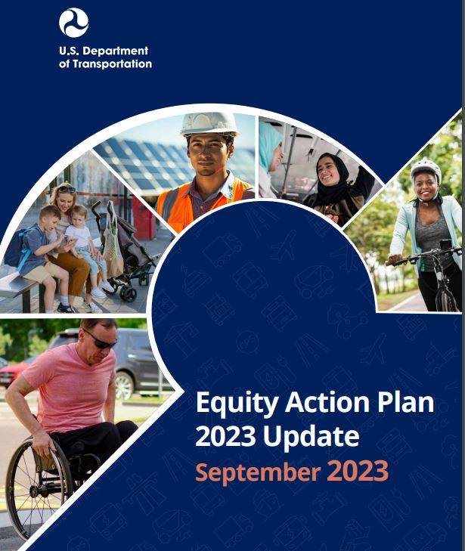
Equity Action Plan
Created in response to Executive Order 13985 – Advancing Racial Equity and Support for Underserved Communities Through the Federal Government (January 20, 2021).
Five Pillars of the USDOT Plan:
Wealth Creation
Power of Community
Interventions
Expanding Access
Institutionalizing Equity
Notes:
You can read the EO here: https://www.federalregister.gov/documents/2021/01/25/2021-01753/advancing-racial-equity-and-support-for-underserved-communities-through-the-federal-government.
Equity and Underserved Communities are defined in the Executive Order broadly:
Sec. 2 . Definitions. For purposes of this order: (a) The term “equity” means the consistent and systematic fair, just, and impartial treatment of all individuals, including individuals who belong to underserved communities that have been denied such treatment, such as Black, Latino, and Indigenous and Native American persons, Asian Americans and Pacific Islanders and other persons of color; members of religious minorities; lesbian, gay, bisexual, transgender, and queer (LGBTQ+) persons; persons with disabilities; persons who live in rural areas; and persons otherwise adversely affected by persistent poverty or inequality.
(b) The term “underserved communities” refers to populations sharing a particular characteristic, as well as geographic communities, that have been systematically denied a full opportunity to participate in aspects of economic, social, and civic life, as exemplified by the list in the preceding definition of “equity.”
It’s important to understand that the EO involves a whole-of-government approach—and the USDOT/FHWA are one part of that. You can read much more about these efforts, including goals, metrics, and reporting on the USDOT Equity Action Plan website:
https://www.transportation.gov/priorities/equity/equity-action-plan

Slide 8
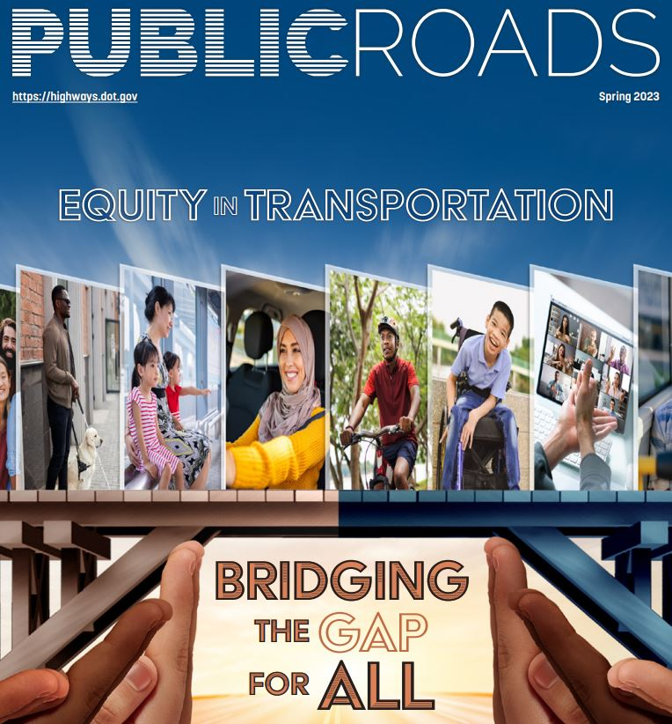
Equity Action Plan continued
FHWA created trainings and shared information on how recipients can integrate equity into their programs.
Spring edition of Public Roads magazine featured articles on equity and highway programs.
In 2024 FHWA began webinar series on integrating equity into roadway safety. Next webinar, covering data, on May 22, 2024.
8
Notes:
FHWA’s role has been to integrate and enhance Equity principles in different aspects of planning and project development. In 2023, FHWA began a series of national webinars to disseminate information on integrating equity into roadway safety. The topics include meaningful public involvement, data and analysis, design tools and strategies, and more. You can find more information, including registration information, resources, and recordings of past webinars, on the equity in safety website:
https://highways.dot.gov/safety/zero-deaths/equity-roadway-safety-webinar-series

Slide 9
Promising Practices for Meaningful Public Involvement
Part of Institutionalizing Equity pillar from Equity Action Plan
Contains promising practices from around the country.
Describes methods for measuring and ensuring equity in decision-making.
Notes:
Public involvement isn’t just a requirement of some of FHWA’s programs, such as the planning and environment, but it is critical to ensuring equity as well. To that end, USDOT released its Promising Practices document to assist recipients in fulfilling both their regulatory requirements and furthering equity goals. This document contains examples of practices that can help recipients to do this. You can find more information on the USDOT website: https://www.transportation.gov/priorities/equity/promising-practices-meaningful-public-involvement-transportation-decision-making.
Title VI does not carry with it a requirement to engage in public involvement. However, (1) everything a recipient agency does is covered by Title VI and (2) the only way to establish an agency’s programs and activities are nondiscriminatory is by demonstrating that through procedures and data. FHWA regulations (23 CFR 200.9(b)(4)) require that state DOTs collect demographic data on affected communities. Taken together, it means that recipients must create processes to collect data and ensure nondiscrimination in public involvement.
We encourage you to read this document, use it, and see if your own state’s practices can benefit from these tips. As civil rights professionals, you have an opportunity to help marry Title VI and equity principles with planning and project development.

Slide 10
Promising Practices for Meaningful Public Involvement continued
Public involvement is more than simply following legislation and regulations. In a democratic society, people have opportunities to debate issues, frame alternative solutions, and affect final decisions. Knowledge is the basis of such participation. . . [t]hrough continued interaction with the entire community, agencies and project sponsors can build support and, more importantly, assure that the public has the opportunity to help shape the substance of plans and actions. In summary, public agencies must act as public servants.
-FHWA Environmental Review Toolkit.
https://www.environment.fhwa.dot.gov/nepa/pi_role_in_project_dev.aspx
10
10
Notes:
This is a long quote that comes from the FHWA Environmental Review Toolkit website. It states very clearly why public involvement is so critical.
https://www.environment.fhwa.dot.gov/nepa/pi_role_in_project_dev.aspx

Slide 11
Title VI and Equity Data Tools
USDOT, FHWA, and other federal agencies have created new mapping tools for demographic analysis.
These tools provide easy access to a wealth of information relevant to Title VI and equity, without prior GIS training.
Today, we will discuss two of them.
Photo by fauxels from Pexels.com
11
11
Notes:
Currently, there are many free, federal websites that can help you with preliminary demographic research. Of course, the U.S. Census provides data and some mapping resources at data.census.gov, and many of you may already be familiar with the EPA’s EJ Screen website. The BEST data and analysis will come from gathering data straight from the source, such as the U.S. Census.
However, if you want a resource that is quick and easy to use, for the purposes of screening an area for potential concerns, what follows are some helpful resources.

Slide 12
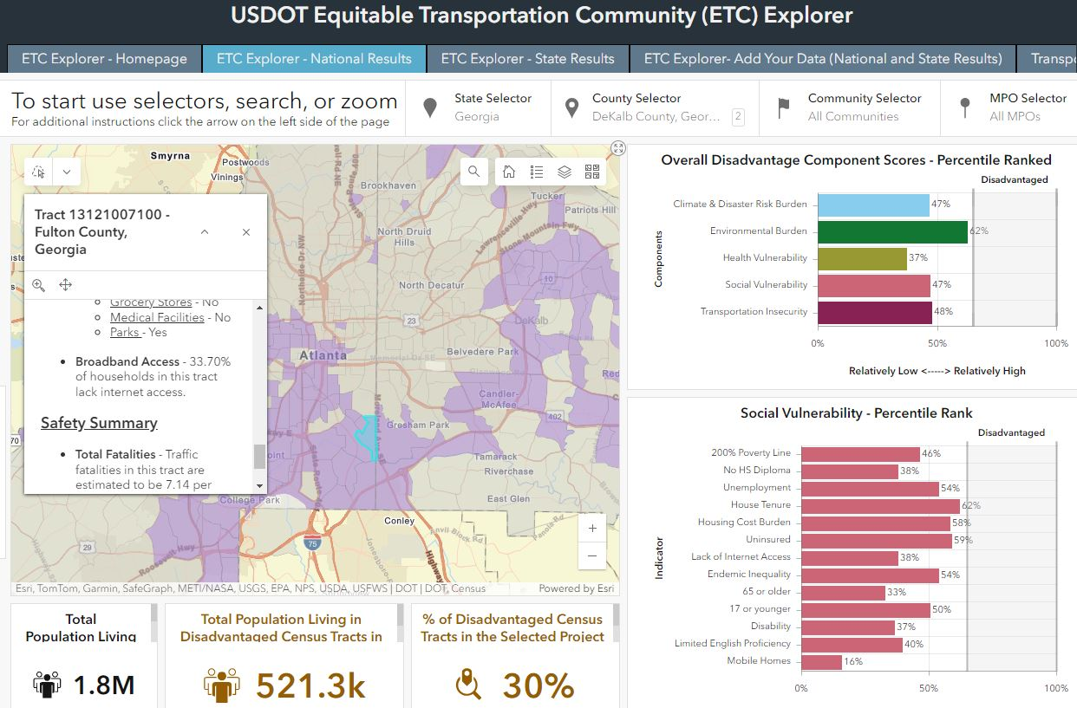
Title VI and Equity Data Tools continued
USDOT Equitable Transportation Community (ETC) Explorer
Interactive map and dashboard of equity, transportation, and climate metrics.
Created for Executive Order 14008 (Justice40 initiative), Tackling the Climate Crises at Home and Abroad
Notes:
The USDOT’s Equitable Transportation Community (ETC) explorer is a tool that allows the public to view data related to equity, transportation, and climate as both a map and a dashboard. It is designed to highlight (in purple), Census tracts that meet the Justice 40 criteria for climate and social disadvantage. This site is easy to use, fast, and provides some metrics on these topics. Some of the limitations are that it does not easily provide the data for download, and it only goes down to the tract level, which is the Census geography level just below county level—fairly large areas. Nonetheless, it can be useful for finding quick facts and metrics related to equity. Here is a link in the notes to this presentation: https://experience.arcgis.com/experience/0920984aa80a4362b8778d779b090723/page/ETC-Explorer---Homepage/.

Slide 13
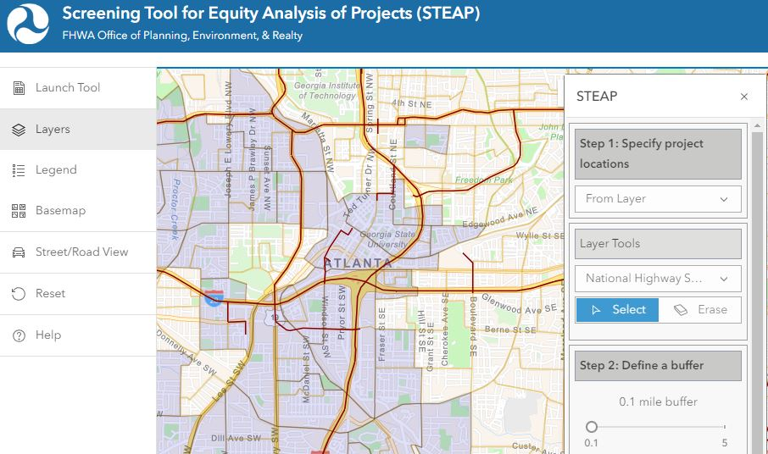
Title VI and Equity Data Tools continued
FHWA Screening Tool for Equity Analysis of Projects (STEAP)
Mapping tool to screen areas for data on Title VI, environmental justice, and other socioeconomic factors.
Outputs a downloadable report of the data for user-defined area.
13
Notes:
Another very useful tool for equity and Title VI is the FHWA Screening Tool for Equity Analysis of Projects, or STEAP. This site allows users to define an area and download a report that describes in detail numerous data points from the U.S. Census. While this tool doesn’t provide data on environmental factors, it does provide detailed statistics on race, ethnicity, education level, language, employment status, and more. Like the ETC Explorer site, the STEAP is fast and easy to use and it provides more detailed data from the Census, down to the Census Block level. It also provides a downloadable report for users in pdf or excel format. The only thing it doesn’t do is provide the raw Census data, to identify the specific block groups identifiers and data. Nonetheless, this is a fast and powerful tool for screening an area to gather basic demographic data.
Also note that FHWA provides other mapping tools for planning areas, MPO air quality data, and more. A link to these is found in the notes to this presentation.
List of mapping tools: https://hepgis-usdot.hub.arcgis.com/
STEAP Page: https://maps.dot.gov/fhwa/steap/

Slide 14
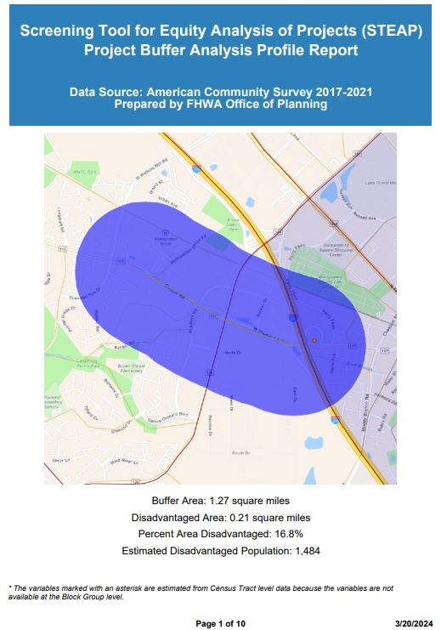
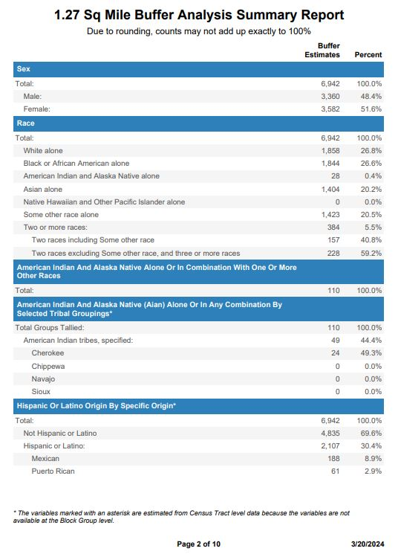
Example of Report Output
Notes:
Here is an example of the report output. On the left, you can see the .2 mile buffer zone created by a user and to the right is some of the data.

Slide 15
New NHI Title VI Reviews & Analysis Course
In 2023, FHWA launched a new NHI course on Title VI reviews and analysis.
Title: Civil Rights: Risk Mitigation Through Title VI Reviews (FHWA-NHI-361032B)
Intermediate-level. Audience is planning and project development and civil rights practitioners.
Notes:
In 2023, FHWA launched a new NHI course on Title VI reviews and analysis.
Description: this intermediate-level course provides foundational knowledge in the application of Title VI in conducting reviews. This includes the types of discrimination, how Title VI relates to certain transportation programs, and how to collect and analyze data for reviews.
Audience: State DOT, LPA, and MPO engineers, planners, environmental, right of way, and civil rights specialists responsible for ensuring transportation programs and projects are compliant with Title VI.
Goal: mitigate Title VI risks through practical, hands-on training with an emphasis on data-driven reviews.
https://www.nhi.fhwa.dot.gov/course-search?tab=0&key=title%20vi&sf=0&course_no=361032B

Slide 16
New NHI Title VI Reviews & Analysis Course continued
Web Based Training (WBT; ~10-20 hours):
Self paced
Videos
Web quests
Downloadable pdf case studies and infographics
Online assessments
Virtual Instructor Led Training (VILT; ~9 hours)
Online through AdobeConnect. Moving to new system in future
1 full day + 2 half days
Group project
Final assignment and presentation
Notes:
The course is split into a self-paced web portion and a live, virtual, instructor-led portion at the end. It will take approximately 6 weeks to complete.
We want to tell you up front that the course is designed for ACTIVE learning, with tests and homework – and it can be challenging for some folks. We’ve found that, if you do the work, and reach out for help when you’re stuck, you WILL be successful. Students aren’t punished for merely being stuck on a tricky concept. When you’re done, we believe students will take away something new that they can use in their Title VI work.

Slide 17
New NHI Title VI Reviews & Analysis Course continued
How to sign up?
Demand is high! Currently, only accepting pre-arranged group sessions.
If interested, reach out to your FHWA Division office.
Info we need:
Start – End date for training (~6 week span)
Number of students (20 max)
Photo by Moose Photos from Pexels.com
17
Notes:
Right now, we have a good problem – demand is higher than availability. So, in our first year we are ONLY accepting groups that are arranged ahead of time. Do not try to register through the NHI website.
If you are interested, reach out to the FHWA Division Office for your state. They will put you in touch with the trainers. We’ll need two pieces of information. First, we need a rough start and end date, and keep in mind the course takes about 6 weeks, including the web-based material and the final instructor-led portion. Second, we need to know how many students are in the group – with a max of 20. If you have fewer than 10 students, we can try to match you with another smaller group in the timeframe.
Finally, we’ll note that this is a time commitment, and students should consider whether their schedules will allow them time to complete the class. To get a completion certificate, students will need to complete all of the web material, the homework, and attend the instructor-led portion.

Slide 18
What are your questions?

