Slide 1
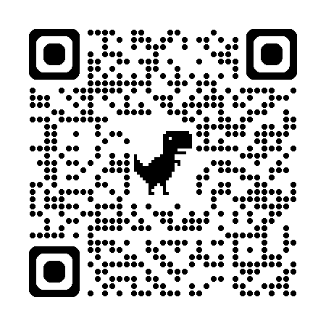
Smallbore Rifle Shooting
Intro Camp Fundamentals Olympic-Style 50-Meter 3-Position Shooting

Slide 2
Governing Bodies
Civilian Marksmanship Program (CMP): The CMP is a U.S. government-chartered program focused on promoting firearms safety training and marksmanship, particularly for youth. Official Website: https://thecmp.org/
USA Shooting (USAS): USAS is the national governing body for Olympic and Paralympic shooting sports in the United States. Official Website: https://usashooting.org/
National Rifle Association (NRA): The NRA is gun rights advocacy group in the U.S. that once held the National Championships. They still continue to sanction some competitive shooting disciplines, Official Website (Competitive Shooting Portal): https://competitor.nra.org/

Slide 3
Hygiene Guidelines
Lead Exposure Hazard: Shooting or cleaning firearms can expose you to airborne lead particulate, powder residue, solvents, and other chemicals.
During Shooting: limit or refrain from eating, drinking, smoking, or placing hands near your mouth
After Shooting: Wash hands and face thoroughly with soap and water before eating or drinking
Proper hygiene practices protect your health

Slide 4
Safety Brief & Rules
Brief: Always keep your muzzle pointed in a safe direction. Keep your finger off the trigger until ready to fire. All firearms must have an Empty Chamber Indicator inserted at all times except during the firing period. Follow all range officer commands immediately. If you experience a malfunction you cannot clear, keep the muzzle downrange and raise your hand for assistance. Safety is everyone's responsibility on this range.
Safety Rules:
Always keep the firearm pointed in a safe direction
Always keep your finger off the trigger until ready to shoot
Always keep the firearm unloaded until ready to shoot.
Always use your Empty Chamber Indicator (ECI) when not in use
Safety is the highest priority in all shooting activities

Slide 5
Range Commands
Shooters to the firing line - Bring rifle and gear to your position
Preparation period begins - Assume position, apply sling, dry fire, may remove the ECI
Is the Line Ready?- Rhetorical Question,
Load - Load one cartridge into the rifle
Start - Begin firing
Cease Fire- Cease firing immediately
Stop - Cease firing immediately: The Stop Command was introduced IAW 2017 CMP & USA Shooting Rifles Rules and is a supplemental Command of “Cease Fire” and is typically used in a more calm ending of the string of fire.
Unload – Following the Stop or Cease Fire athletes will be asked to unload and make their equipment safe.
Is the line clear? - Do not handle firearms, All firearms must be unloaded with ECIs inserted. Athletes step back from the firing line.
Always listen carefully and follow all range commands

Slide 6
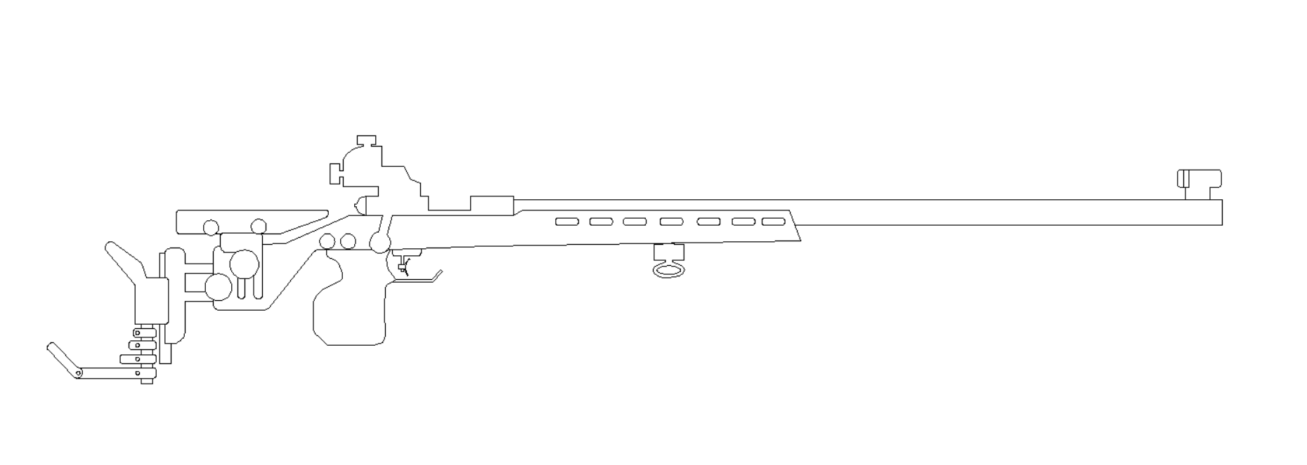

Bolt Action Operation
Rear Sight
Front Sight
Cheek Rest
Loading Port
Action
Barrel
Muzzle
Bolt
Butt Plate
Opening the Bolt: Lift the bolt handle upward, then pull straight back smoothly.
Loading a Round: Place one cartridge in the projectile facing the target.
Closing the Bolt: Push the bolt forward smoothly, then press down on the handle.
After Firing: Open bolt to extract spent casing, insert ECI when finished shooting
Always operate the bolt smoothly and safely

Slide 7
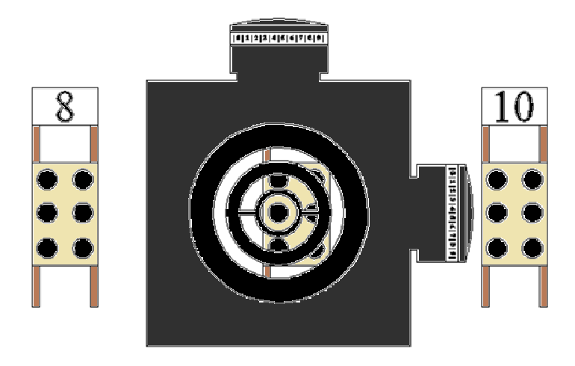
Sight Alignment & Sight Picture
Sight Alignment: The relationship between the eye, rear sight, and front sight. The eye must align with the sights consistently in the same position for every shot.
Correct Alignment: • Front sight centered in rear aperture
• Equal light on all sides
• Consistent sight picture
Proper sight alignment is the foundation of accurate shooting

Slide 8
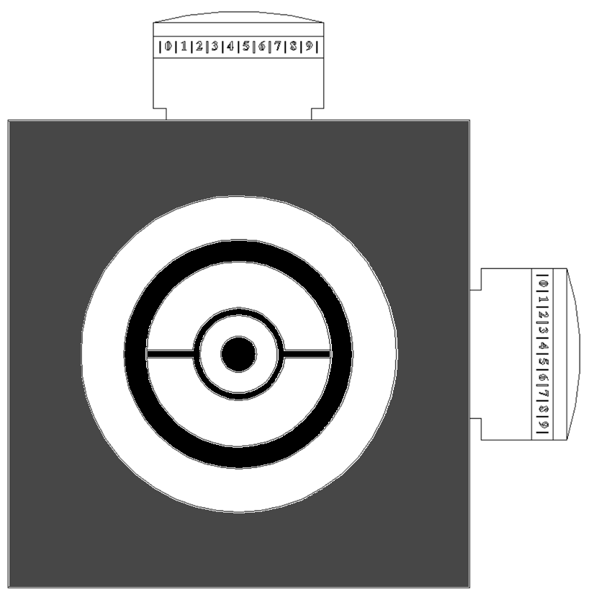
Adjusting the Sights
Elevation Knob
Clockwise is Down and Left; (Match Sights): Turning the Elevation sight adjustment knob clockwise moves POI down or Turning the windage sight adjustment knob clockwise moves the POI Left. Center Aperture Hold Place the target center of the front aperture, inside of the Front Sight, centered in the rear aperture. It should become a series of circles & Rings. Note: Not all rifles have cross Bars in the front iris.
Front Sight Housing Front Sight Insert
Target
Windage Knob
Always shoot a group before adjusting sights - never adjust based on one shot

Slide 9
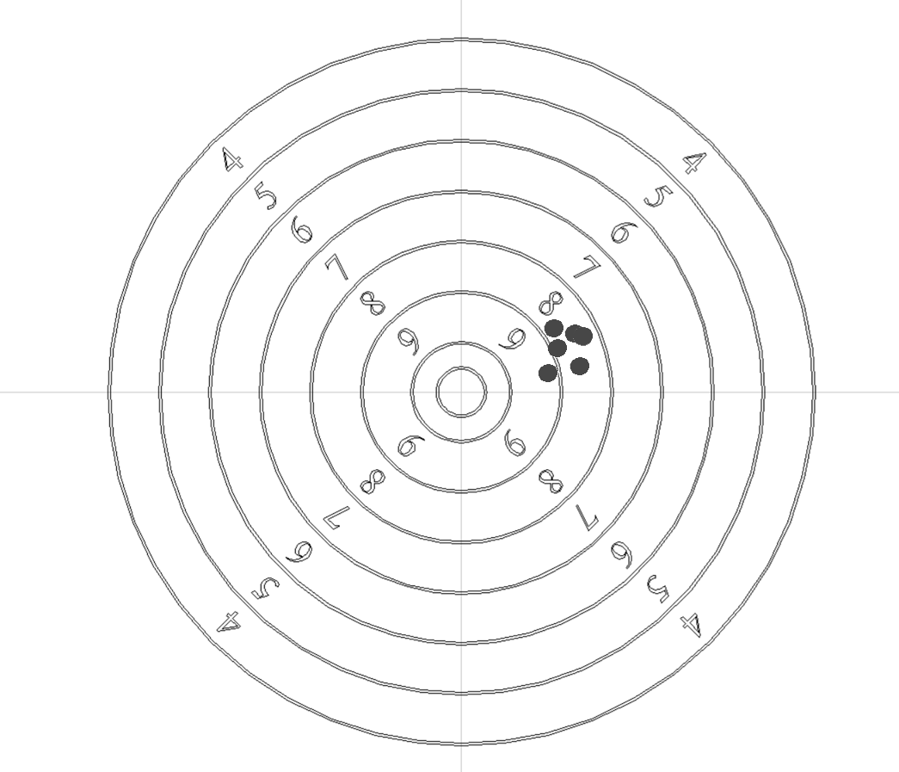
Sight Adjustment Example
Sight Adjustment Process: 1. Shoot a group of shots (~3-5 shots)
2. Identify the center of your group
3. Determine direction and distance to move Point of Impact (POI)
4. Adjust sights accordingly Click Value: Approximately 20 clicks (1 rotation) to move one score ring. (Varies by sight model)
Always shoot a group before adjusting sights - never adjust based on one shot

Slide 10
Natural Point of Aim & Breathing
Natural Point of Aim (NPA): Is the bodies natural resting point with minimal Muscle involvement and the body position is naturally aligned on target . Its the ability to minimize movement of the rifle while maintaining proper sight picture.
Stability: Build a solid shooting platform - bone support over muscle
Breathing: Managing your breathing pattern to minimize rifle movement during the shot.
Respiratory Pause Technique:
Take a normal breath and exhale partially
Pause naturally at the bottom of your breath
Shoot during this natural pause (6-8 seconds maximum)
If the shot was not taken, breathe normally and restart
Relax and let your body find its natural alignment

Slide 11
Trigger Control
Trigger Control: The ability to apply slow steady pressure to the trigger straight to the rear without disturbing sight alignment. Note: These Light 2-Stage Triggers.
Correct Technique: • Smooth, steady rearward pressure
• Trigger breaks as a surprise
• No anticipation of the shot
• Maintain sight picture
Common Errors: • Jerking the trigger
• Flinching in anticipation
• Pushing or pulling
• Stopping mid-press
Trigger control is often the difference between a good and great shot

Slide 12
Follow-Through
Follow-Through: Maintaining your shooting position and mental focus after the shot breaks for 2-3 seconds. Key Elements: 1. Continue aiming for 2-3 seconds after the shot
2. Maintain sight picture and body position
3. Call your shot - note where sights were before & after the rifle fired
4. Analyze what you did correctly & repeat, this is the start of a Shot Process Why It Matters: Prevents anticipation and flinching on future shots
Follow-through ensures consistency and builds good shooting habits

Slide 13
About The Development Plan
Participants will move through the program by executing fundamentals in order to achieve the appropriate advancement score to progress on to the next position.
Rating | Position | Advancement Score | Repetitions
F-Class Marksman | Supported | 184 | 2 Times
Marksman | Prone | 170 | 2 Times
Sharpshooter | Prone | 185 | 2 Times
100 Yard Sharpshooter | Prone | 185 | 1 Time
Marksman | Kneeling | 160 | 2 Times
Sharpshooter | Kneeling | 175 | 2 Times
Marksman | Standing | 150 | 2 Times
Sharpshooter | Standing | 165 | 2 Times
Sharpshooter | 3x20 | 522 | 1 Time

Slide 14
Additional Resources
Online Communities & Organizations:
Target Talk: www.targettalk.org
The CMP: www.thecmp.org
USA Shooting: www.usashooting.org
U.S. National Rifle Team (Long Range): https://usnrt.com/
Accurate Shooter: https://forum.accurateshooter.com/
South Texas Marksmen: www.STMTC.org
Continue Your Training:
Practice regularly, focus on fundamentals, and seek coaching to improve your skills in all rifle shooting disaplines.
Questions? Contact your coach for personalized guidance

