Slide 1
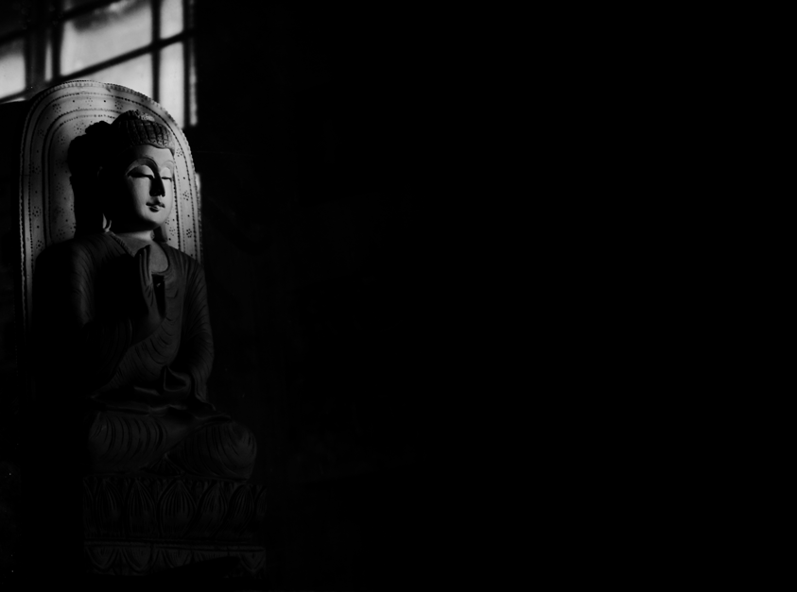
Buddhism
The Basic User’s Guide
Presented by: Rev. Dr. Sean H. Thompson
Facilitated by: Rev. Monty Edwards (Dhammarichi)

Slide 2
History of Buddhism
Buddhism was a way of living, which began over 2,600 years ago, in what is now Southern Nepal (Northern India).
There are over 500,000,000 Buddhists world wide.
‘THE’ Buddha (an actual person) was Siddhartha Gautama of the Sakya Clan.

Slide 3
Buddhist History
After the death of the Buddha, Buddhism spread…
India
Nepal
Tibet
China
Sri Lanka
Thailand
Cambodia
Afghanistan
Myanmar
Vietnam
Korea
Japan
Mongolia
The West…
And more….

Slide 4
Buddhist History
Who was ‘The Buddha’???
The person who became the Buddha was a prince named Siddhartha Gautama of the Sakya Clan of Northern India. He was a man, not a God, Deity or even a prophet…
He developed the system of moral living we now call Buddhism.

Slide 5
Buddhist History
Who was ‘The Buddha’???
Siddhartha Gautama’s mother died shortly after he was born. He was born under a tree.
It was prophesized after his birth that he would be a great king or a great teacher (Guru).
His father tried to prevent him from becoming a mere Guru…

Slide 6
Buddhist History
When did he become the Buddha?
He was a very thoughtful and compassionate child.
He was given every luxury so he would stay and be a great king..
Then, he went out with his chariot driver Channa....

Slide 7
Buddhist History
Who was ‘The Buddha’???
On his excursions with Channa, he saw four things that made him think…
A sick person
An old person
A dead person
An acetic

Slide 8
Buddhist History
Who was ‘The Buddha’???
He later renounced his life of luxury for one of reflection…
He studied many forms of liberation from the suffering he saw…
At the age of 35 while sitting under a tree he attained ‘Enlightenment’ becoming “The Awakened One” :
THE BUDDHA …

Slide 9
Buddhist History
Who was ‘The Buddha’???
Once a young Brahmin came to the Buddha and asked…
“Are you a god?”
His answer was … “no”
“Are you a demon?”
His answer was … “no”
“Are you a man?”
His answer was … “no”
“Not a god, not a demon, not a man, WHAT ARE YOU?”
His answer was … “I am ‘Budha” (I am AWAKE)

Slide 10
Buddhist History
Who was ‘The Buddha’???
His first teaching was to his friends.
He almost did not continue…
He traveled throughout India teaching…
At the age of 88, he died lying under a tree…
We celebrate his birth, enlightenment and death all on one day called Vesak…

Slide 11
Buddhist Teachings
What is Buddhism about?
We have three main parts of Buddhism known as The Triple Gem: (basically The Buddhist Trinity)
The Buddha (the awakened teacher)
The Dharma (The teachings)
The Sangha (The community of monks) It has changed recently into the group of studiers…

Slide 12
Buddhist Teachings
Buddhist basic teachings…
The first ‘sermon’ that the Buddha gave was on what is called the Four Noble Truths…
That stress (suffering) exists…
That there is a cause of stress/suffering which is attachment, craving, desire…
That there is a way to stop it…
The Eight Fold Path is the way to end this suffering/stress

Slide 13
Buddhist Teachings
Buddhist basic teachings…
Kinds of suffering as defined in Buddhist thought.
The suffering of pain
The suffering of change
The suffering of conditionality…
(Not being with those you wish to be with or being with those you do not want to be with)

Slide 14
Buddhist Teachings
Pain is inevitable, suffering… optional
The Eight Fold Path
Right View
Right Intention
Right Speech
Right Action
Right Livelihood
Right Effort
Right Mindfulness
Right Concentration

Slide 15
Buddhist Teachings
Buddhist basic teachings…
The five precepts that lay Buddhists take.
Refrain from taking a life
Refrain from taking what is not given
Refrain from sexual misconduct
Refrain from harmful speech
Refrain from intoxicants that make you heedless…
A monk or nun will take on over 250 more rules to live by.

Slide 16
Buddhist Teachings
Buddhist basic teachings…
The three Dharma Seals…
The three marks of existence-
1. Suffering
2. Impermanence
3. Non-self

Slide 17
Buddhist Teachings
Buddhist basic teachings…
Buddhism is known for meditation and mindfulness, also known as Samatha and Vipassana meditations.
We sit in contemplation and cultivation of-
Loving Kindness
Compassion
Sympathetic Joy
Equanimity (even mindedness)

Slide 18
Buddhist Development
Buddhism is a fluid religion…
“If you come across something in the Buddhist teachings that flies in the face of your own sense of reason, you are not obligated to accept it”… (Narada Thera)
The Advice to the Kalamas is a core concept and foundation of Buddhist practice…
Teachings are not accepted until they have been tested…
See, Missouri is the “Show me State”!!!

Slide 19
Buddhist Development
The flavors of Buddhism…
As Buddhism moved throughout the world, it began to evolve and change with the cultures it came in contact with…
Theravada (the way of the elders)
Mahayana (the greater way)
Vajrayana (the Diamond vehicle)
Zen (The way of no way)

Slide 20
Buddhism today…
The West, America and Europe.
There are now Buddhist centers, Temples, monasteries, and churches throughout the world.
Locally in Missouri-
Vipassana Buddhist Church
(Center for Buddhist Development (Jefferson City)
Mid American Buddhist Association (MABA) Augusta, MO.
‘Show me Dharma’ a meditation group in Colombia, MO.

