Slide 1
Introduction to NERC Terms 2
Electric System Consulting

Slide 2
Objectives
Describe
UFLS/UVLS
Remedial Action Scheme (RAS)
Remedial Action Plan (RAP)
Ancillary Services
SOL/IROL (Tv = 30 min)
Transmission Loading Relief (TLR)
Locational Marginal Pricing (LMP)

Slide 3
UFLS (Under-frequency Load Shedding)
The tripping of customer load (FIRM) based on magnitudes of system frequency. Example
5% at 59.3 hz
10% at 58.9 hz
10% at 58.5 hz.
These three steps of load shedding would form this utility’s UFLS plan. The purpose of UFLS is a final effort to arrest a frequency decline.
Done by a control system, Without human operator initiation, of 300 MW or more.
“...last ditch efforts to save the Bulk Electric System”

Slide 4
UVLS Under-Voltage Load Shedding
The tripping of customer load (FIRM) based on magnitudes of system voltage. For example, a utility may dump
5% at 92% of nominal and
10% at 90% of nominal.
In the utilities UVLS plan.
Purpose: avoid a VOLTAGE COLLAPSE.
Done by a control system, Without human operator initiation, of 300 MW or more.
“...last ditch efforts to save the Bulk Electric System”

Slide 5
RAS - Remedial Action Scheme (Special Protection System - SPS)
An automatic protection system designed to detect abnormal or predetermined system conditions, and take corrective actions other than and/or in addition to the isolation of faulted components to maintain system reliability.
Such action may include changes in demand, generation (MW and MVAR), or system configuration to maintain system stability, acceptable voltage, or power flows. An sps does not include (a) UFLS or UVLS or (b) fault conditions that must be isolated or (c) out-of-step relaying (not designed as an integral part of an sps).
If this specific condition, then this specific automatic action.

Slide 6
RAP Remedial Action Plan
Same as RAS, but action is not automatic
Approved plan/procedure for a specific contingency.
If this happens
Then we will do this

Slide 7
Ancillary Services
Regulating Reserves (frequency control)
Normal: Generators
Quick Response: Batteries
Operating Reserves/Contingency Reserves
Spinning Reserves
Non-Spinning Reserves
Load Resources (Interruptible Load)
(Can be counted as spinning or non-spinning)
FERC defines it as: “Those services necessary to support the transmission of electric power from seller to purchaser given the obligations of control areas and transmitting utilities within those control areas to maintain reliable operations of the interconnected transmission system."

Slide 8
SOL-System Operating Limit IROL- Interconection Reliability Operating Limit
IROL
Not just a single line, a combination of lines in an entire area
Based on studies for instability and voltage collapse
Could be a loss of a certain amount of load
Operate outside the IROL for time greater than IROL Tv: 30 minutes

Slide 9
TLR Transmission Loading Relief
A procedure to manage congestion of the transmission system.
IRO-006-5: You must comply with requests to curtail eTags (interchange) for TLR procedures unless there is a valid reliability reason to deny the request.

Slide 10
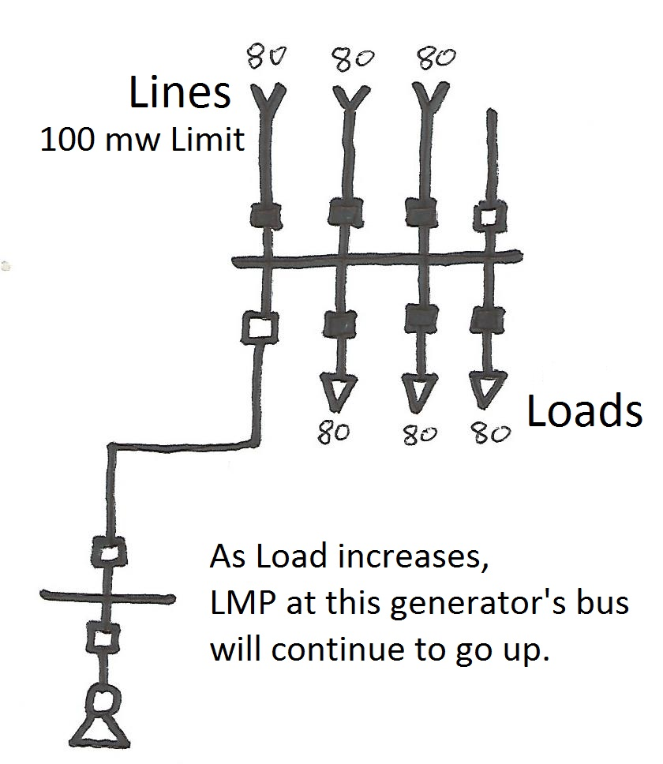
LMP Locational Marginal Price
Locational marginal pricing is a way for electric energy prices to reflect the value of electric energy at different locations in real-time, accounting for the patterns of load, generation, and the physical limits of the transmission system.
Prices at each bus change to reflect the need (or lack there of) of generation for the system at that bus.

Slide 11
Review
Describe
UFLS/UVLS
Remedial Action Scheme (RAS)
Remedial Action Plan (RAP)
Ancillary Services
SOL/IROL (Tv = 30 min)
Transmission Loading Relief (TLR)
Locational Marginal Pricing (LMP)

