Slide 1
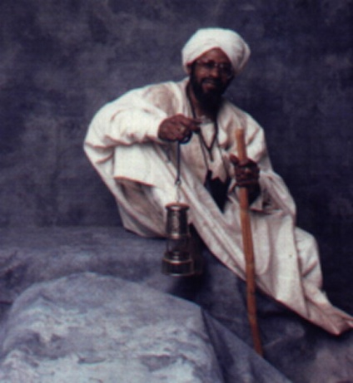
Proposal Overview
Music Appreciation
By Muntheru S.M. Shah
Community Cultural Awareness Center

Slide 2
Proposed Goals
Stimulate better understanding of music
Development of good study habits
Establish a sense of order
Create a positive mental attitude
Encourage cultural awareness
Performance and achievement

Slide 3
Description
Music can be a bright and shining light of knowledge, culture, and tradition that is indicative of the life, growth, and achievements of our society.
It can be expressive of the values, morals, and disciplines that we hold sacred for our human existence.
FOR MORE INFO...
Elamin Life Productions Cultural Institute Muntheru S.M. Shah
1501 E. Central Road, Suite 318 Arlington Heights, Illinois 60005-3373
(847) 690-1532 Website URL http://members.aol.com/ElAmin97/Index.html

Slide 4
Description
Our world can be filled with the melodies, harmonies, and rhythms that reflect the concern and attention that we devote to the intellectual and artistic development of the young mind that are fostered by our community.
With the proper guidance and direction upcoming generations of future leaders, builders, and administrators may have a better sense of purpose due to an enlightened awareness of how music and civilization are bound by similar rules, laws and disciplines.

Slide 5
Competitive Analysis
Competitors
This will not be an academic or accredited course that is accepted or recognized by any school system.
Strengths
It will be more like a workshop where students can come to get a better understanding of the world of music.
The class size will allow each member to receive the special attention that they may need.
Weaknesses
No musical instruments will be required for the students participation; however, in some assignments inexpensive learning aids may be necessary for the student to grasp independent techniques.

Slide 6

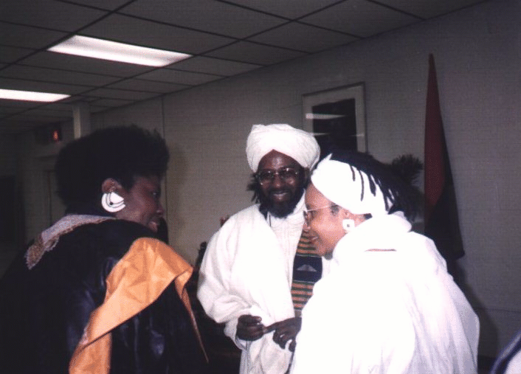
Music Adds Quality To Life
Self-Esteem
Confidence
Discipline
Teamwork
FOR MORE INFO...
NET Effect Consultant Director, Nettie E. Shah P.O. Box 5489 Evanston, Illinois 60204 1(847) 640-1227 e-mail Nettie4725@aol.com

Slide 7
Projects
Choir, Percussion Ensemble, Concert Band, Group Music
Stimulate young mind towards achievement through active involvement.
Exhibit Progress made by the student;
Performances, Recitals, & Shows conducted at the end of the year.
Students’ Talents & Abilities will have an opportunity to be displayed.

Slide 8
Team/Resources
  People
  Maximum class size (15) students total number of enrollment (45)
  Equipment
  Audio Cassette Tape Recorder, Video Cassette Recorder, Television
  Field Trip Locations
  Chicago Cultural Center, Orchestra Hall, American Conservatory Of Music
  Professional Support & Outside Services
  Nelson Gill, Primal Connection, Harry Grant, Mantuila Nyomo, Abdul Hakeem

Slide 9
Class Schedule
Elementary Class ages 8-12 years old 4:00-5:00 P.M. Monday and Wednesday
Adolescent Class ages 13-17 years old 5:30-6:30 P.M Tuesday and Thursday
Adult Class ages 18 and older 7:00-8:00 P.M. Tuesday and Wednesday
FOR MORE INFO...
E-mail: Shah1948@aol.com

Slide 10
Course Terms
Winter 1st Quarter January through March
Spring 2nd Quarter April through June
Summer 3rd Quarter July through September
Fall 4th Quarter October through December
Upon the completion of each year of this course participants will receive a certificate of achievement

Slide 11
Financial Considerations
Budgetary Allowances $31,500.00
  Program Director’s Salary -25,000.00
  Support & Assistance Compensation -3,000.00
  Activities Expense Account -1,500.00
  Equipment and Materials Cost -2,000.00
Programs Income $41,500.00
  Registration Fees +31,500.00
  Grants +10.000.00

Slide 12
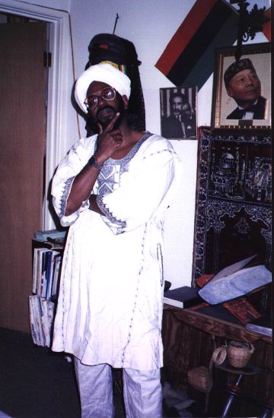

Program Director
Muntheru S. M. Shah
Professional Musician Yabba Griffiths & Traxx Reggae Band
Attended
American Conservatory Of Music
Executive Director Of El-Amin Life Productions Cultural Institute

Slide 13
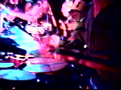
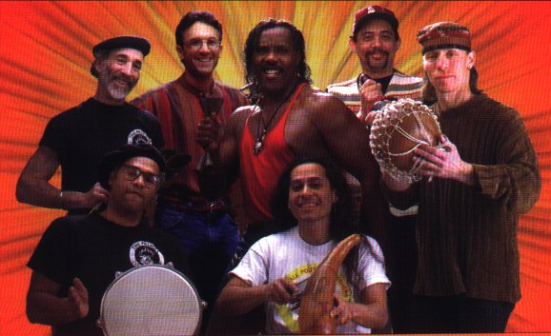
Music The Universal Language
Outside Assistance and Support By
World Beat Music
Percussion Instruments
Improvisation
Music Therapy
Algebra Project
Primal Connection
©1997 Primal Connection

Slide 14
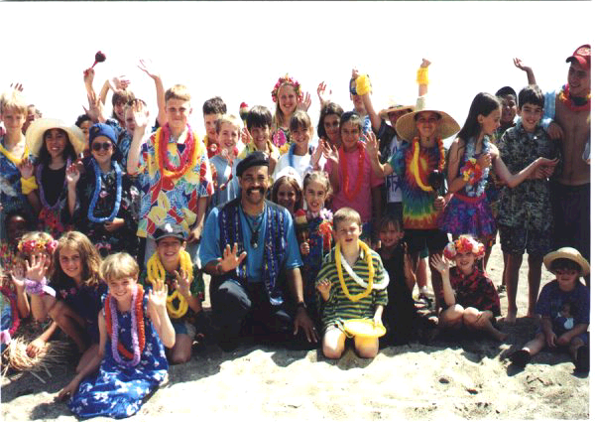
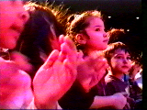
Unity through song and dance
Outside Assistance and Support By
Traditional
Folk
Ceremonial
Festive
Contemporary
Nelson Gill
MUSIC
NELSON GILL “We’re Gonna Have Some Fun Today”
©1995 Etcetera Records

