Slide 1

INSERT FRONT ENTRY PHOTO
Notes:
ARRIVAL SCREEN. Insert current front-entry photograph and leave displayed while homeowners arrive.

Slide 2

Welcome & Board Introductions
Meet your Board — seven positions serving White Cedar Gardens
Your Board
Tonight’s Agenda
Todd Snyder - President
(OPEN Position) - AC1
• Election of 2027 Board
• Hurricane Update
• Year in Review
• Website & Neighborhood Updates
• Financial Overview
• Entrance improvements / Funding
• Homeowner Discussion
pres@wcghoa.com
ac1@wcghoa.com
Rick Wheeler – Vice President
Will Gilliam – AC2
vpres@wcghoa.com
ac2@wcghoa.com
Kari Dunham - Secretary
Jimmy Greer – AC3
secretary@wcghoa.com
ac3@wcghoa.com
You don’t have to be on the Board to help your neighborhood.
Carol Madison - Treasurer
treasurer@wcghoa.com
WHITE CEDAR GARDENS | 2026 ANNUAL MEETING
2
Notes:
TARGET: 4 minutes. Position AC-1 is shown as open. Review the agenda briefly.

Slide 3
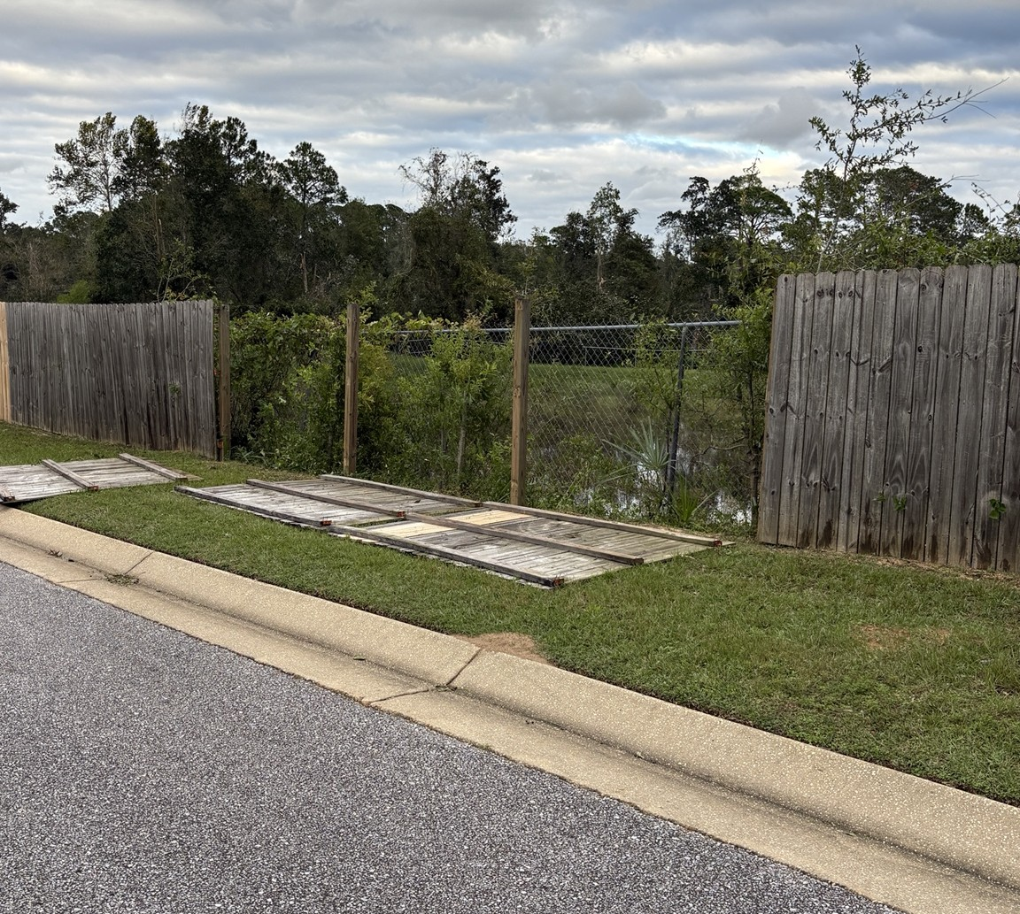
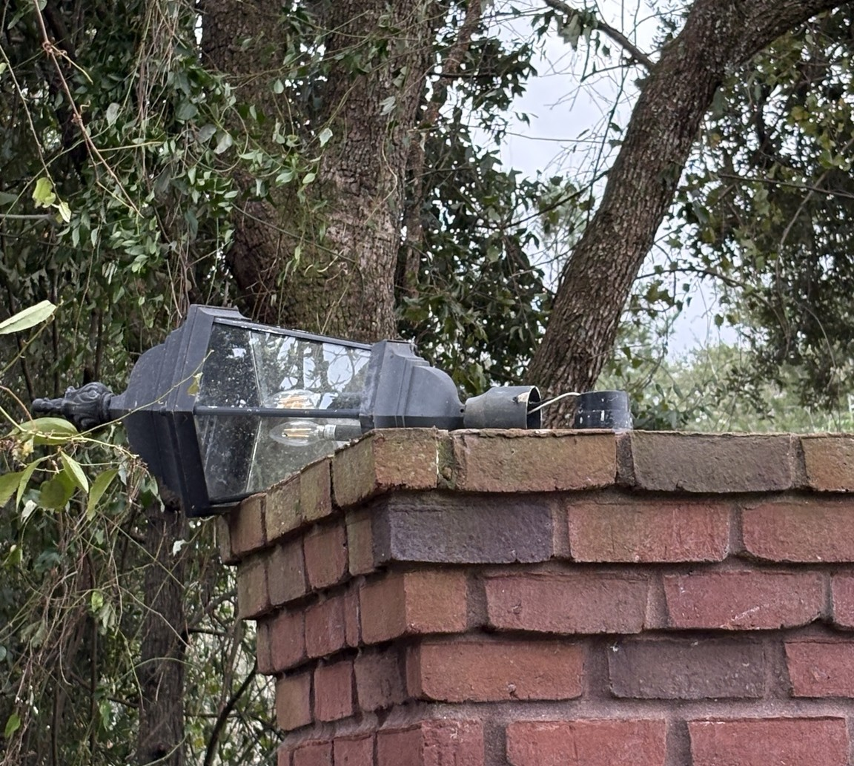
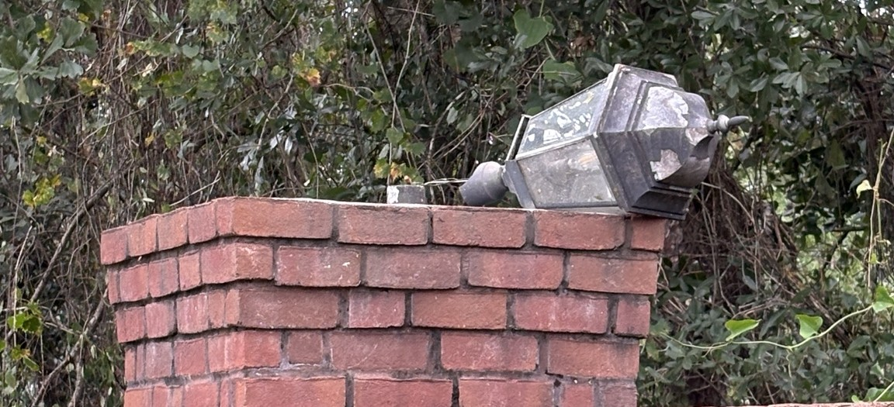
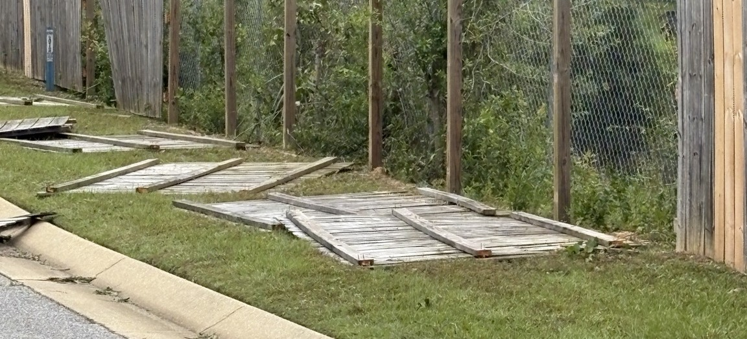
Hurricane Damage & Debris Collection
Neighborhood impacts | Escambia County residential debris pickup guidance
COUNTY PICKUP GUIDELINES
DO NOT BAG DEBRIS
Residential storm debris only — no commercial debris. – Debris pickup has begun, will take weeks, please be patient.
Separate into two categories:
1. Vegetative: trees, stumps, branches, trunks and leafy material.
2. Construction / demolition: damaged lumber, wallboard, glass, metal, roofing, tile, furnishings and fixtures.
County debris information: 850-332-1226 (7am – 7pm)
Photos: neighborhood fence and entrance-light damage
Discussion: damage, cleanup and next steps
Notes:
TARGET: 3–4 minutes. Discuss neighborhood storm damage, especially damaged fence sections and entrance column lights. Escambia County guidance from the supplied county announcement: do not bag debris; residential debris only; separate vegetative from construction/demolition debris. County information line 850-332-1226 (7 a.m.–7 p.m. per supplied announcement). Avoid implying the county will repair HOA structures.

Slide 4
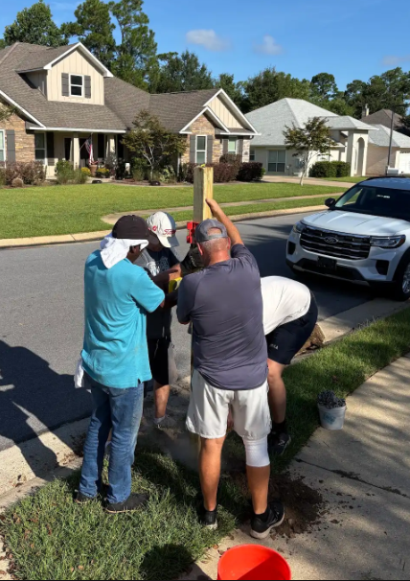
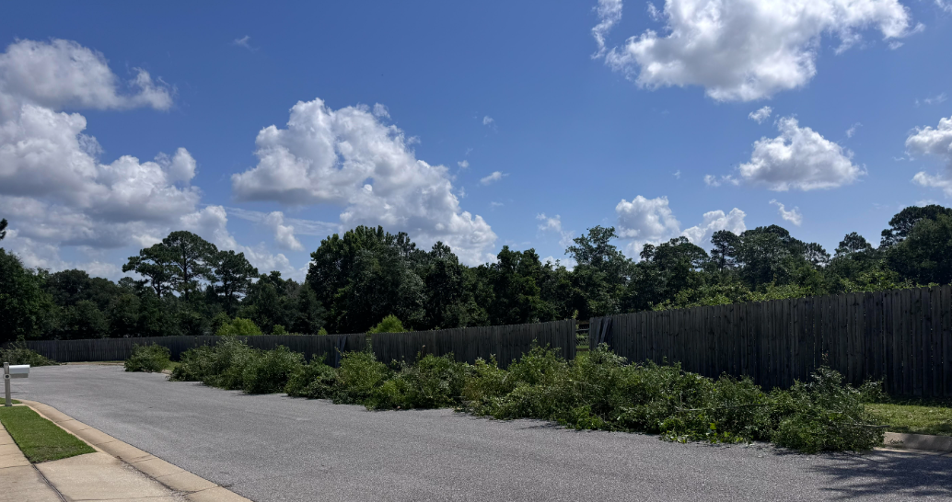
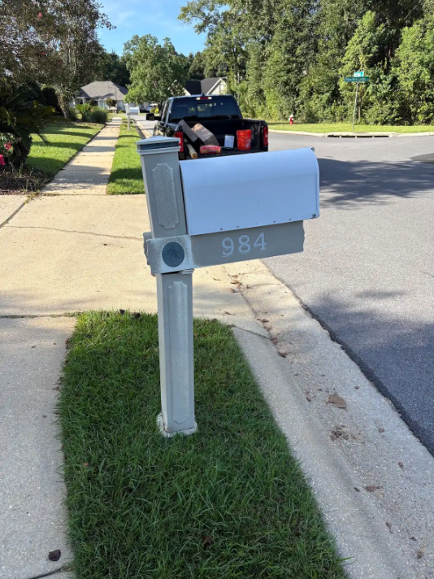
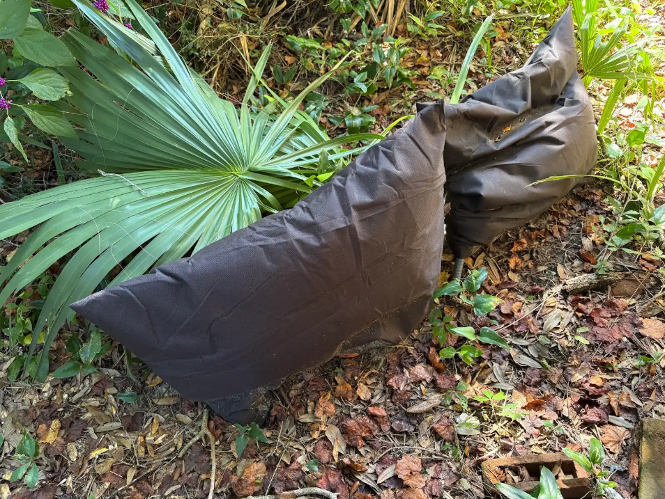
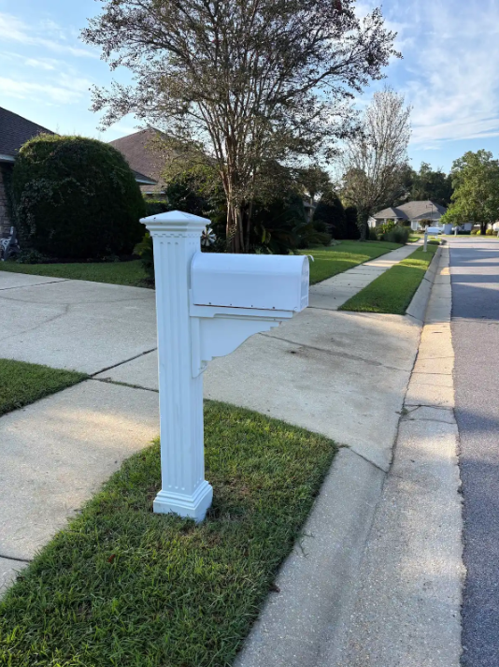
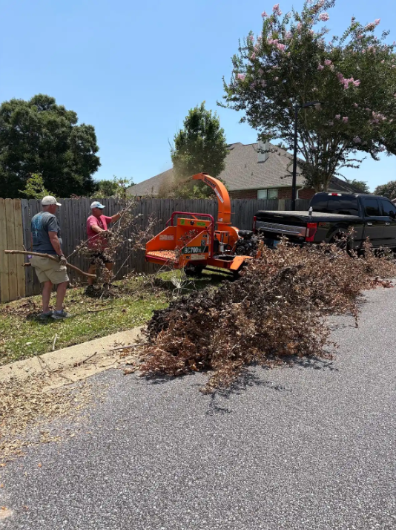
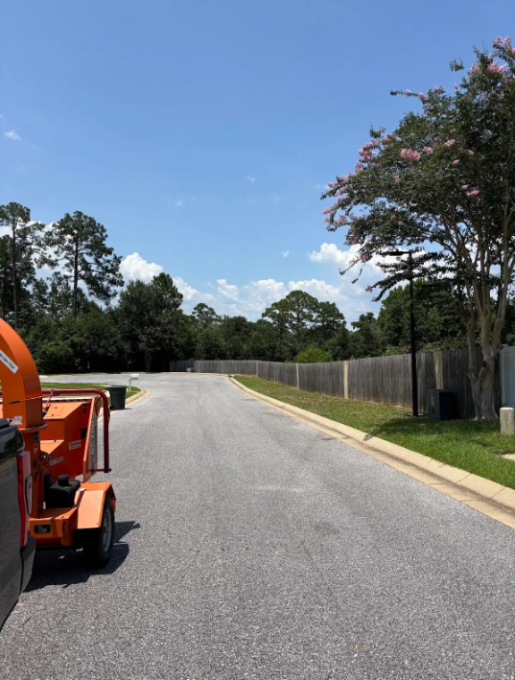
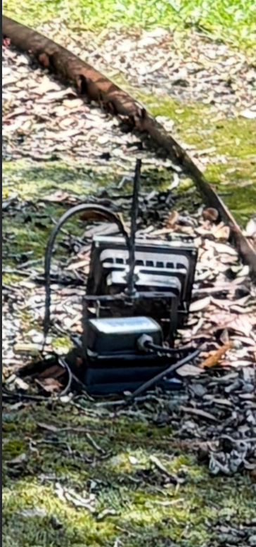
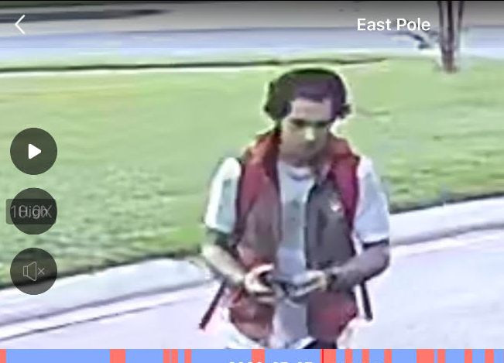
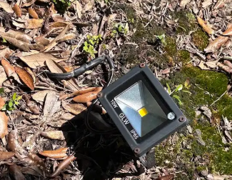
2026 — Getting Things Done Together
Projects completed, problems solved and HOA dollars stretched further
PHOTO — Entry Trees
PHOTO — Retention Pond
PHOTO — Well Repair
PHOTO — Lights / Mailboxes
Tree trimming
$3,200 savings
Fence cleanup
$1,900 savings
Well repairs
$700+ avoided
Mailbox Install – Volunteer
Vandalized lights Repair
$250 value / $48 cost
$9,000+
identified savings / avoided costs, including approximately $3,000 per year in outside website-management expense
The point isn’t who gets credit — it’s what neighbors can accomplish when we work together.
4
WHITE CEDAR GARDENS | 2026 ANNUAL MEETING
3
WHITE CEDAR GARDENS | 2026 ANNUAL MEETING
Notes:
TARGET: 4 minutes. Use the photos to tell the story quickly and move on.

Slide 5
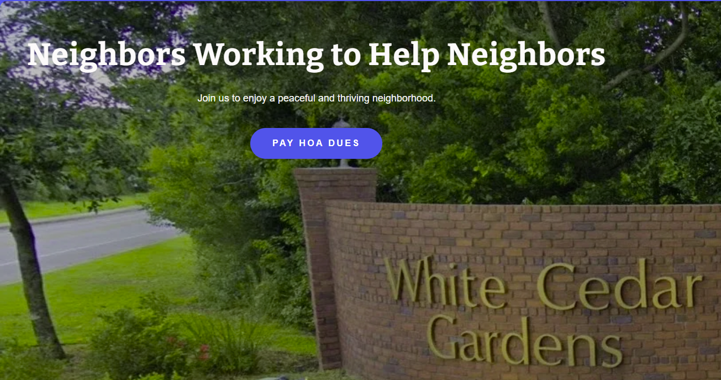
Our New HOA Website
A first step — and we want homeowner feedback to make it better
Why We Built It
A central place for HOA information, documents, events and neighborhood communication.
Stay Involved
SCREENSHOT — www.wcghoa.com HOME PAGE
You do not need to be on the Board to help. Check the website for upcoming neighborhood events and opportunities.
Help Us Improve It
This is our first HOA website. What information, navigation or features would make it more useful?
www.wcghoa.com
5
WHITE CEDAR GARDENS | 2026 ANNUAL MEETING
4
WHITE CEDAR GARDENS | 2026 ANNUAL MEETING
Notes:
TARGET: 5 minutes. Jump to the live website. Have it already open. Show the home page, events, contacts/emails and key information. Ask for feedback on navigation and improvements.

Slide 6
Maintaining Our Neighborhood
A few reminders — shared responsibility, consistent standards and communication first
• Lawns & landscaping
• Grass clippings / street debris
• Mailboxes & posts
• Curbs & sidewalks
• Trash / yard debris / bulk pickup
• General exterior maintenance
• Same standards for everyone
• Communication before escalation
Friendly Reminder → Second Notice → Final Notice → Further Action if Required
The objective is compliance — not punishment.
8
WHITE CEDAR GARDENS | 2026 ANNUAL MEETING
5
WHITE CEDAR GARDENS | 2026 ANNUAL MEETING
Notes:
TARGET: 3 minutes. Keep this brief and respectful. Recommend showing an image of the actual Property Review form on this slide during the final homeowner version; for Board review, the current process graphic keeps the slide cleaner. The process begins with a Friendly Reminder.

Slide 7
Financial Overview
2023–2026 | White Cedar Gardens Homeowners Association
2026 Bank Balance
2026 Income
2026 Expenses
2026 Excess / Carryover
$42,547
$33,989
$23,185
$10,804
Checking + CD Reserve
Total income
Estimated through year-end
Projected
Bank Balances
2023
2024
2025
2026
Checking
$28,494
$8,621
$11,939
$12,000
CD – Reserve
—
$28,887
$29,785
Electricity
Insurance
$30,547
Total
$28,494
$37,508
$41,724
$42,547
15%
40%
Income
increase
increase
Dues
$32,850
$32,850
$31,970
$33,287
Total Income
$32,850
$35,930
$33,317
$33,989
Expenses
• Recurring operating costs are increasing.
• Carryover cash helps show our starting position and ability to plan for the future.
• HOA Dues for 2027 will remain at $450/per lot
Electricity
$8,603
$9,579
$11,054
$11,427
Insurance
$969
$1,123
$1,396
$1,965
Landscaping
$11,695
$8,076
$8,186
$6,746
Total Expense
$34,756
$27,858
$29,495
$23,185
Excess / Shortage
($1,906)
$8,072
$3,822
$10,804
* 2026 expenses through year-end are estimated. Detailed budget will be provided as a handout.

Slide 8
2026 Financial Overview
Broad overview only — attendees will receive the detailed budget as a handout
Carryover Cash
Electricity
Insurance
2023
2025
2026
$ 1,906.00
$ 3,822.00
$ 10,000.00
15%
40%
2024
Projected
$ 8,072.00
What homeowners should take away
• Recurring operating costs are increasing.
• Carryover cash helps show our starting position and ability to plan ahead.
• The detailed 2027 budget will be provided as a handout for review.
WHITE CEDAR GARDENS | 2026 ANNUAL MEETING
6
Notes:
TARGET: 5–6 minutes. Fill in 2024, 2025 and projected 2026 carryover cash. Attendees receive the detailed budget separately.

Slide 9
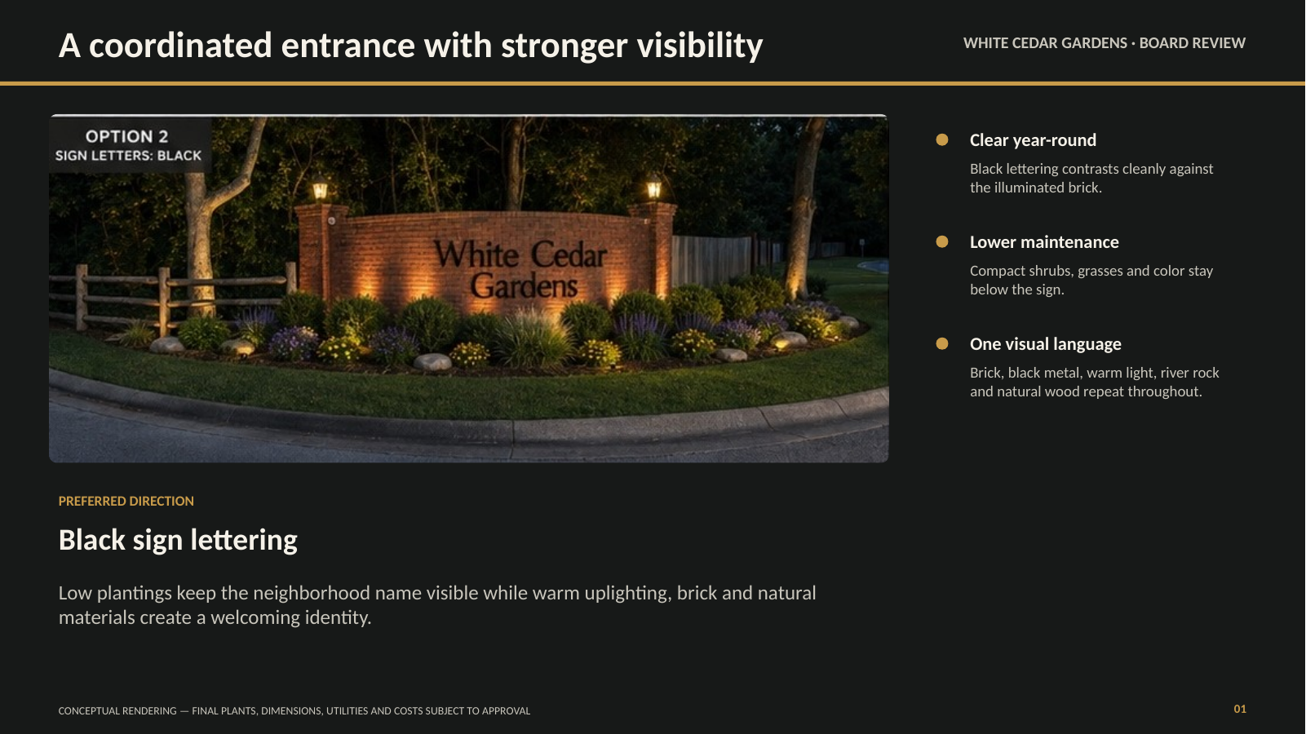
Front Entry Revitalization
Preferred direction: stronger visibility, coordinated landscaping and warm lighting
DISCUSSION
• Existing lettering & column lights repainted black
• Large rocks at edge of curved entry?
9
WHITE CEDAR GARDENS | 2026 ANNUAL MEETING
7
WHITE CEDAR GARDENS | 2026 ANNUAL MEETING
Notes:
TARGET: 3 minutes. Discussion: existing lettering and column lights will be repainted black. Ask about large rocks at the edge of the curved entry.

Slide 10
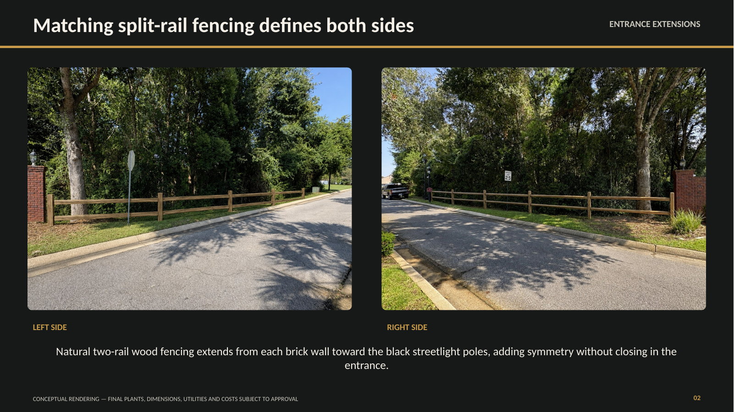
A Coordinated Entrance — Both Sides
Matching split-rail fencing extends the entrance without closing it in
10
WHITE CEDAR GARDENS | 2026 ANNUAL MEETING
8
WHITE CEDAR GARDENS | 2026 ANNUAL MEETING
Notes:
TARGET: 2 minutes. Show how matching two-rail fencing can visually connect both sides of the entrance. Keep this visual; do not get into construction details.

Slide 11
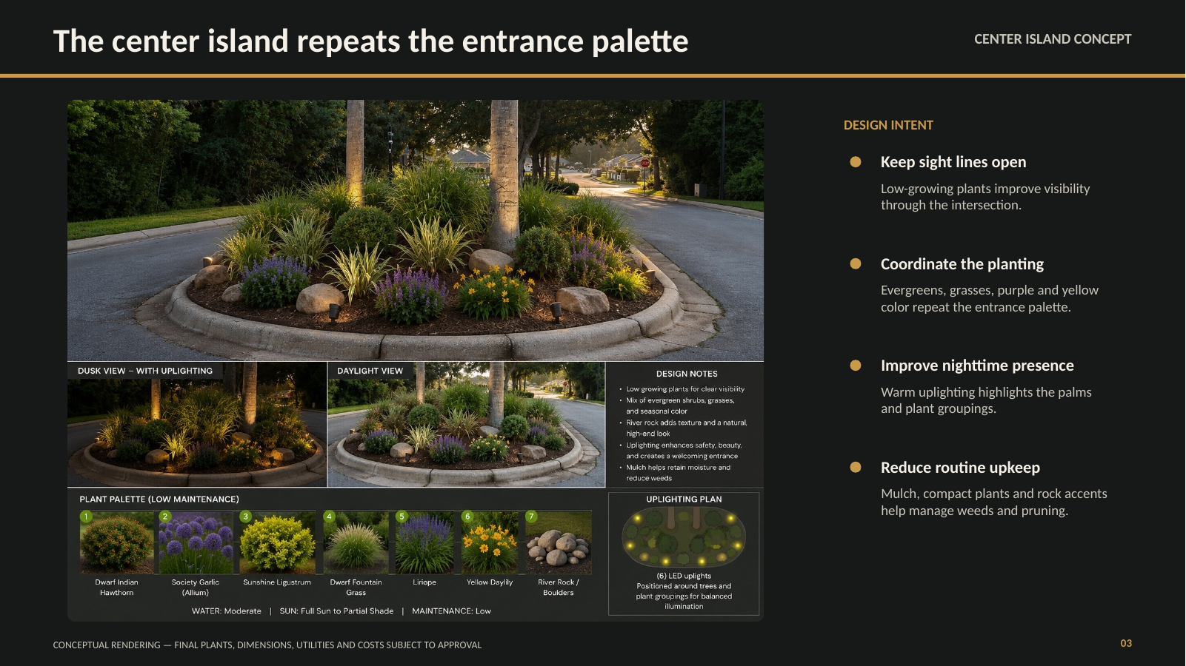
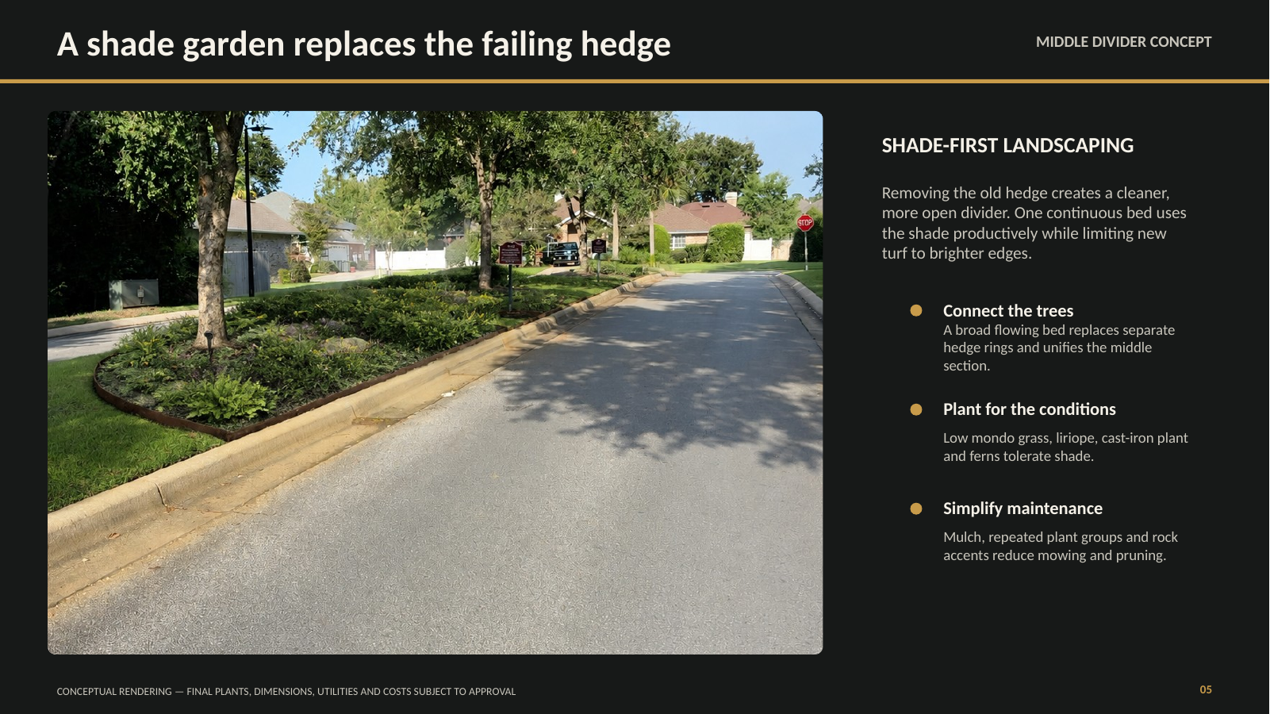
Carrying the Look Through the Entrance
Center island and shaded middle divider concepts
DISCUSSION
• Rust stain on concrete
• Help areas where grass won’t grow
• Remove old-looking hedges
11
WHITE CEDAR GARDENS | 2026 ANNUAL MEETING
9
WHITE CEDAR GARDENS | 2026 ANNUAL MEETING
Notes:
TARGET: 3 minutes. Discuss rust staining on concrete, areas where grass will not grow, and removing old-looking hedges.

Slide 12
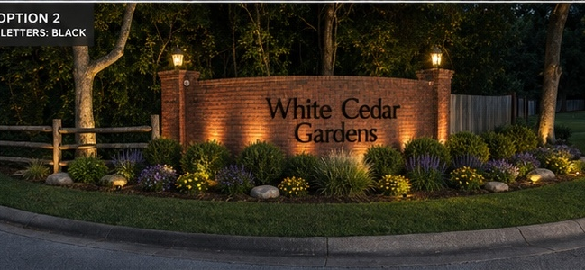
Proposed 2027 One-Time Assessment
Now that we’ve seen the improvement concepts — here is the funding proposal
$100
$7,200
≈ 1 SIDE
one-time assessment
additional project funding
estimated landscape cost
PASTE ENTRY PROJECT BUDGET / COST BREAKDOWN
(Estimates were due last Thursday, due to hurricane, response on returned quotes is slow)
Goal: make it possible to revitalize both sides of the entrance rather than completing only one side.
WHITE CEDAR GARDENS | 2026 ANNUAL MEETING
10
Notes:
TARGET: 5 minutes. Explain proposed one-time $100 assessment, approximately $7,200 in added funding, and show the project budget.

Slide 13
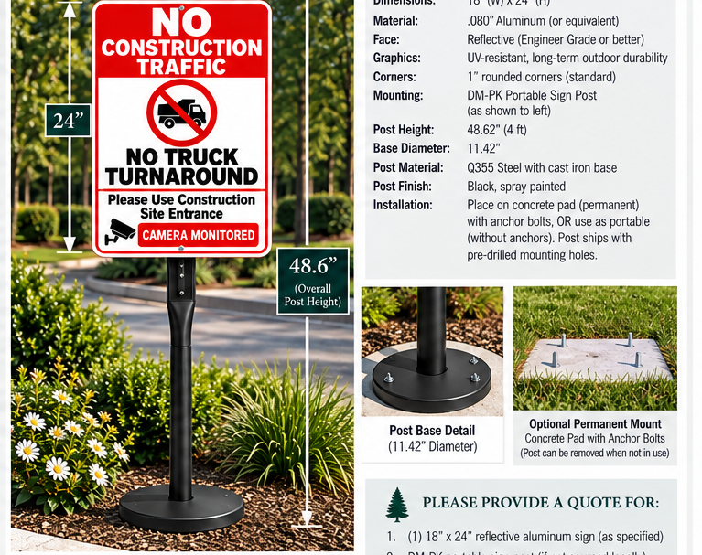
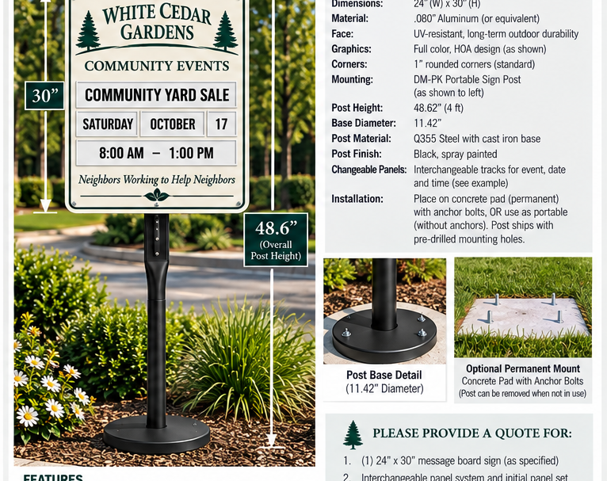
Entrance Communication & Protection
Installed construction control + proposed removable community message board
DISCUSSION
Construction sign removed after local construction • Report construction vehicles • Message board vs. current announcement signs • Portable / removable but secured • Discuss cost
WHITE CEDAR GARDENS | 2026 ANNUAL MEETING
11
Notes:
TARGET: 4 minutes. Construction sign: remove following completion of local construction projects and ask residents to report construction vehicles. Message board: ask whether homeowners prefer it to current announcement boards; explain portable boards can be removed when not in use but secured to the ground; discuss cost.

Slide 14
Looking Ahead — 2027
Need • Cost • Board review • Homeowner input
MAINTAIN
IMPROVE
PROTECT
CONNECT
Common areas & HOA assets
Retention pond fence clean/ replace and maintaining area behind it
Fence along Cody needs addressed from hurricane damage
Entrance & landscaping
Neighborhood Engagement
Common area at entrance needs addressed due to fallen trees from hurricane
Finances, roads & standards
Document Retention
Website, events & participation
Do the right projects — in the right order — while spending responsibly.
WHITE CEDAR GARDENS | 2026 ANNUAL MEETING
12
Notes:
TARGET: 2–3 minutes. Highlight retention pond fence/area maintenance, neighborhood engagement and document retention.

Slide 15
We’re Here to Help Each Other
You do not have to be on the Board to make a difference
If you need something — or see a neighbor who may need a hand — please reach out to a Board member.
TOOLS
KNOWLEDGE
CONNECTIONS
WEBSITE
We may already have the equipment needed.
A neighbor may know how to handle it.
We may know someone who can help.
Check upcoming events and ways to participate.
Discussion Topics
• Recommended contractors on website
• Homeowner Businesses
Neighbors Working to Help Neighbors
www.wcghoa.com
WHITE CEDAR GARDENS | 2026 ANNUAL MEETING
13
Notes:
TARGET: 2–3 minutes. Discuss recommended contractors on the website and homeowner businesses as ideas, not finalized features.

Slide 16
HOMEOWNER DISCUSSION
Questions • Ideas • Feedback
What can we do better together?
Neighbors Working to Help Neighbors
Maintain • Improve • Protect • Connect
www.wcghoa.com
Thank you for helping make White Cedar Gardens a community we are proud to call home.
WHITE CEDAR GARDENS | 2026 ANNUAL MEETING
14
Notes:
TARGET: 15–18 minutes. Leave this slide on screen. Adjourn by 7:30 so cleanup can be completed by 7:45.

