Slide 1


NorWest Community Health Centres
Juanita Lawson, CEO
Elaine Peters, Coordinator – Kakabeka Site

Slide 2

Purpose of Meeting with Nolalu - Municipal Council
Services offered at NorWest CHC – Kakabeka site:
Supported hosting a monthly respiratory clinic.
Weekly walk-in clinics.
Nurse Practitioner travels to Upsala 12 times per year
providing primary care.
Good Food Box providing many clients with limited incomes fresh fruits and vegetables on a monthly basis.
Options for community: Fly the Coop Walking Program, Chair Yoga, Rural Dementia Café.
Data for Kakabeka Site
May 2024 to 25: 339 New Clients
2024/25: 58.87% increase in Breast Cancer Rates
2024/25: 35.34% increase of Cervical Screening Rates
2024/25: 44.53% increase in Colorectal Screening Rates

Slide 3

Health Care for All: Dr. Philpott
Dr. Philpott is serving as chair and lead of a new primary care action team.
“Goal will be for 100 per cent of Ontarians to be attached to a family doctor or nurse practitioner, working in a publicly funded team, where they receive ongoing comprehensive primary health care, and, people can access that care in a timely way.”

Slide 4
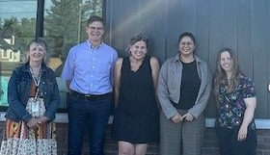
What Does this Mean
2nd Call for primary care funding applications will be in the fall 2025.
Goal would be to expand inter professional team care services.
Goal would be to expand services for residents residing in:
Nolalu
O’Connor
Neebing
Oliver Paipoonge
Murillo
Hymers
Kakabeka Falls
Rosslyn
Kaministiquia
Gillies
Slate River
Shabandowan
Shabaqua
Conmee

Slide 5

Planning
NorWest CHC will be seeking feedback from residents about:
Gather information about residents access to services.
Gather information about residents need for primary health care.
Gather information about need for inter-professional care team services (foot care, dietitian, therapy, midwifery, social supports).
Satisfaction with current services.
Gather information about barriers being experienced (transportation, financial, mobility).

Slide 6
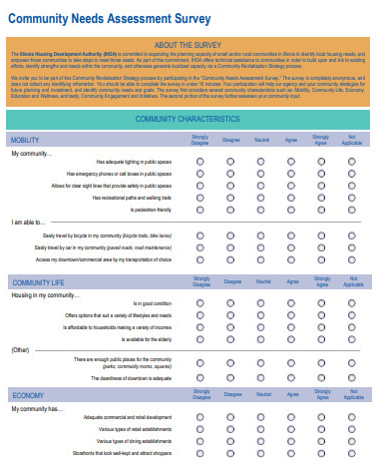
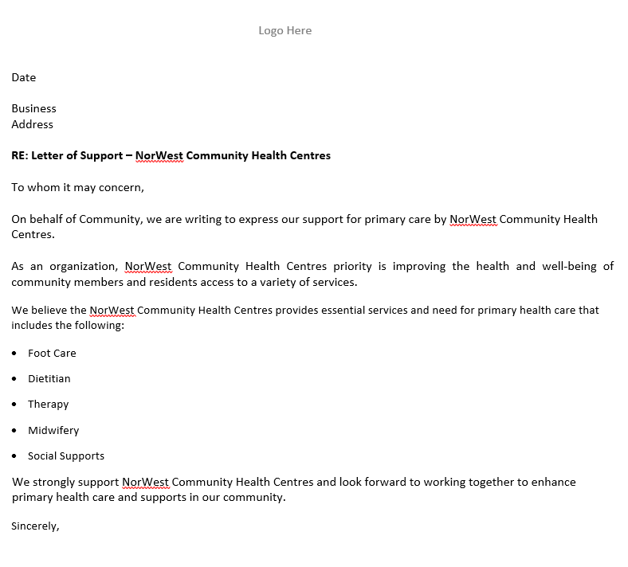
Next Steps
Hear from Municipal leaders about resident needs.
Would Municipal council support distribution of a survey and survey link?
Would Municipal council offer a letter of support that supports a primary care application by NorWest CHC?

Slide 7
THANK YOU
Questions?

