Slide 1

ELECTION TRUTH ALLIANCE
2024 Presidential Election
Feb 4, 2025

Slide 2
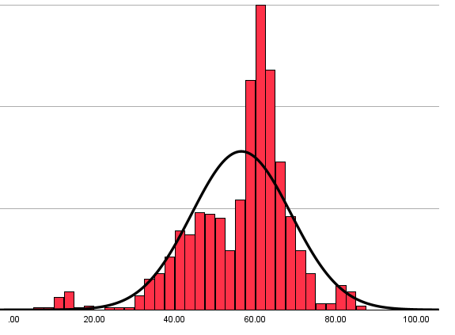
WHO WE ARE
As a data-driven team, we are committed to the principle that every eligible voter has the right to vote and have their vote counted accurately.
Our current priority is sharing our analysis of the 2024 U.S. Presidential Election and seeking to #VerifyTheVote in key counties.
We are a group of passionate volunteers with a broad skillset that includes data analysis, statistics, and cybersecurity backgrounds.
Our non-partisan organization is run by a three-person board with personal backgrounds in cybersecurity, political science, auditing, and fraud detection.
We are a non-profit organization founded in December 2024 and incorporated in January 2025. Our membership has grown to over 20 part-time volunteers.

Slide 3
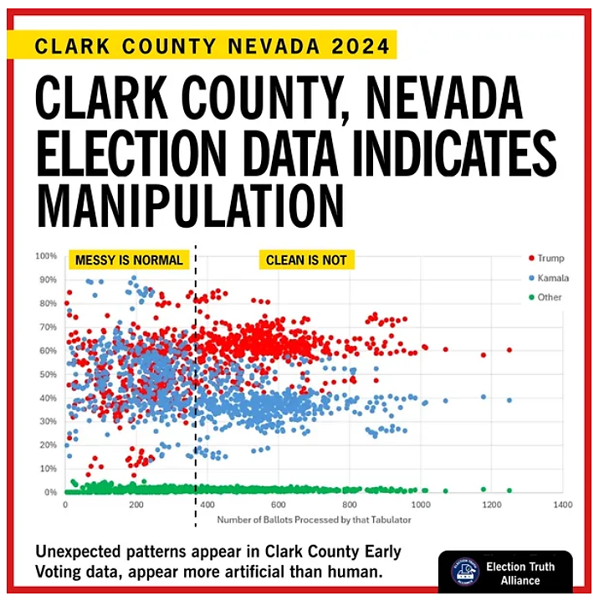
WHAT WE DO
ANALYSIS – Analyze election result data, visually represent that data, and assess the information for any concerning or unexpected patterns.
COMMUNICATION – Convey complex technical findings about potential election manipulation in a more accessible manner to a broader, non-technical audience.
ADVOCACY – Use appropriate mechanisms to urge for hand recounts of paper ballots and/or investigations into results that are statistically improbable or otherwise concerning.

Slide 4




WHAT PROMPTED
OUR ANALYSIS?
Over 200 BOMB THREATS
ON Election day, particularly in swing states
70% of VOTING EQUIPMENT
COMprOMISED in 2020-2024 SECURITY BREACH
ALL SEVEN SWING STATES
won by one party, ALL outside recount margins
ALL 88 COUNTIES THAT FLIPPED
won by one party FOR FIRST TIME SINCE 1930s

Slide 5

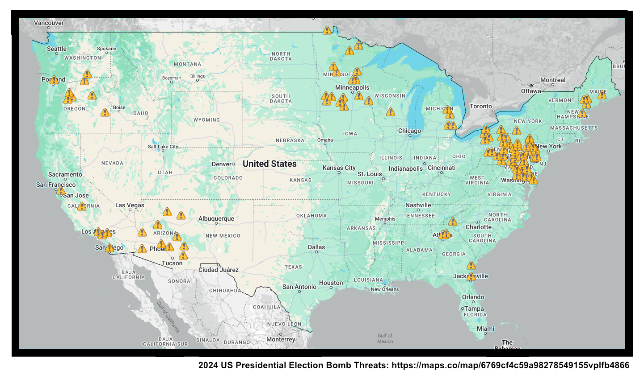

HOAX BOMB THREATS ON ELECTION DAY
The FBI confirmed that multiple bomb threats were made to polling places on Election Day. These threats appeared to originate primarily from Russian email domains.
The number of bomb threats was initially under-reported. Post-election, over 200 bomb threats were documented impacting PA (34 counties), AZ (10 counties), GA (5 counties), MI (4 counties), and WI (2 counties).
The intended purpose of these threats remains unclear, but could this include disruption of the paper ballot chain of custody?
= Bomb Threat

Slide 6

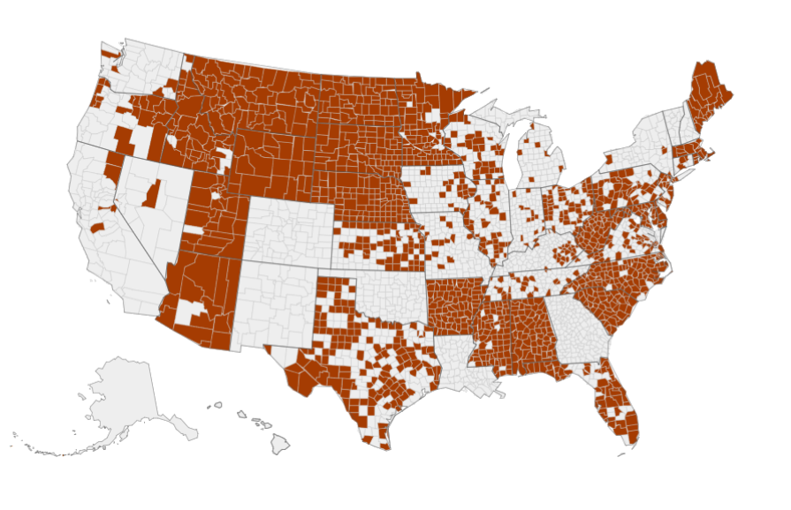
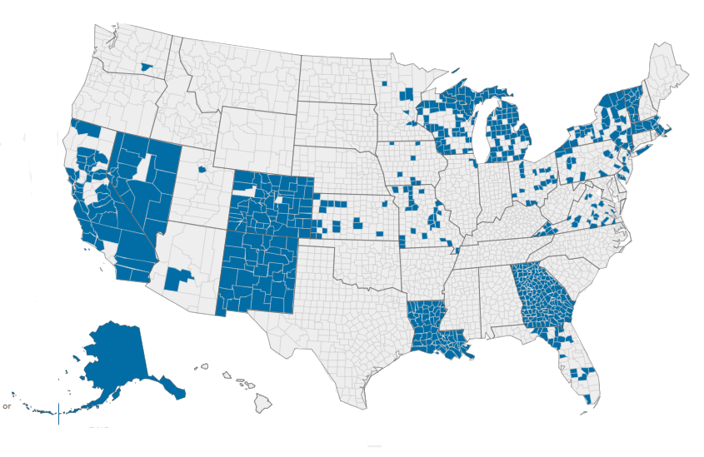
70% of Voting equipment compromised
2020-2024 security breaches affected two major brands
VOTING TECHNOLOGY BRAND 1 PREVALENCE
VOTING TECHNOLOGY
Brand 2 PREVALENCE
Source: Nov 13, 2024 Letter - Cybersecurity Experts - Free Speech for People
Map Source: VerifiedVoting.Org

Slide 7
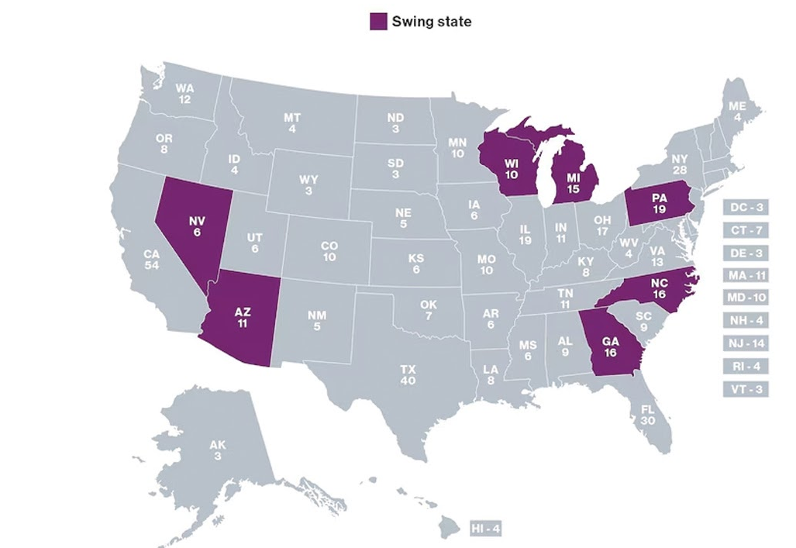
'CLEAN SWEEP' OF THE SWING STATES
In the 2024 U.S. Presidential Election, there were 7 'swing states'.
The Republican candidate for President won 30 of 50 states, including all 7 swing states.
All 7 swing states were won with a large enough margin of votes between the two main candidates that no state mandatory recount laws were triggered.
The last time a candidate won all 7 swing states was 1984 in Ronald Reagan's landslide victory, in which he won 49 of 50 states.
2024 Swing States
2024 Non-Swing States

Slide 8
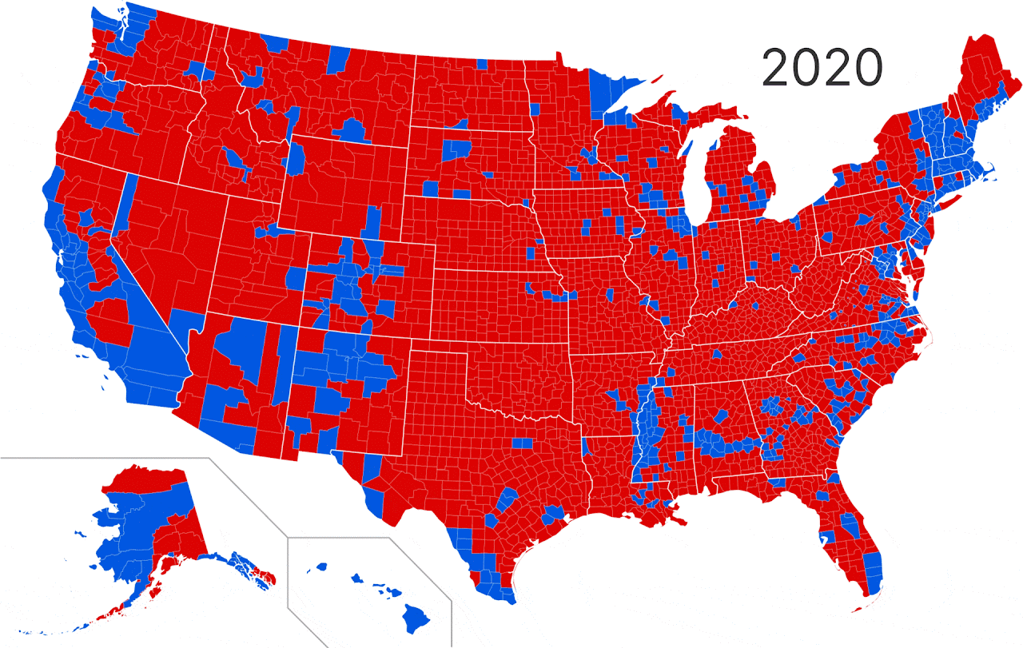
88 of 88 FLIPPED COUNTIES WON BY ONE POLITICAL PARTY
In the 2024 U.S. Presidential Election, the Republican candidate flipped 88 counties while the Democratic candidate flipped 0 counties.
  This is despite the winning candidate receiving less than half (49.8%) of the popular vote.
The last time a candidate flipped 0 counties in a presidential race was almost 100 years ago in 1932, when Franklin D. Roosevelt carried 42 of 48 states with 57.4% of the vote.
Even in 1984, when Ronald Reagan won 49 of 50 states, around 30 counties flipped blue for Mondale.

Slide 9

HOW YOU CAN HELP
FINANCIAL SUPPORT
We are a non-profit organization and do not accept political donations.
Financial resources are critical to advancing our work efficiently.
ORGANIZATIONAL PARTNERSHIPS
We are enthusiastic about collaboration and leveraging each other's strengths.
We want to partner with other like-minded groups to advance shared objectives.
Check out our website at www.ElectionTruthAlliance.Org or email us.
PRO-BONO LEGAL SUPPORT
Targeted lawsuits may be needed to obtain key data or compel hand recounts.
Pro-bono legal expertise helps us make the best use of limited resources to verify the vote.

Slide 10
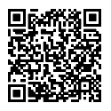
#VERIFY
Scan to Donate
VOTE
THE
#TRUTH
MATTERS
ElectionTruthAlliance.Org
Board@ElectionTruthAlliance.Org

