Slide 1

Addressing/recording incidents of ‘unkind’ behaviour

Slide 2
Session Objectives:
To create our own definition of bullying
To understand how the new system for recording/addressing incidents of ‘unkind’ behaviour will work
To share strategies on how to deal with incidents of ‘unkind’ behaviour
To understand how to log incidents on PARS for both victim and perpetrator

Slide 3
Starter
What takes priority?
As a tutor how would you address the issue?
Who would you involve?
Notes:
Card sort activity

Slide 4


Slide 5
Define Bullying
There is no legal definition of bullying
However, it’s usually defined as behaviour that is:
repeated
intended to hurt someone either physically or emotionally
often aimed at certain groups, for example because of race, religion, gender or sexual orientation
It takes many forms and can include:
physical assault
teasing
making threats
name calling
cyberbullying - bullying via mobile phone or online (for example email, social networks and instant messenger)

Slide 6

Our Definition of Bullying
Notes:
In groups discuss and come up with an agreed definition

Slide 7
Examples:
use superior strength or influence to intimidate (someone), typically to force them to do something

Slide 8
How will we now record/address incidents of ‘unkind’ behaviour?

Slide 9
RECORDING INCIDENTS OF ‘UNKIND’ BEHAVIOUR
Tutor
BI1
First incident of ‘unkind’ behaviour– unkind comment/text messages/social media
Refer to team leader if physical harm has occurred
Team leader
BI2
Tutor to refer to team leader if it’s a second incident of ‘unkind’ behaviour
Team leader to liaise with parents (V/P)
VP
BI3
Team leader to refer to CC if it’s a third repeated bullying incident
Tutor to log on PARS (BI1) (P)– email team leader
Team leader to apply consequence (P) as appropriate and inform tutor of (P/V)
(BI3) Central bullying log and PARS updated with all details
Tutor to apply consequence if appropriate (P)
CC to apply consequence (P)
CC to inform MC
Principal
BI3+
CC to inform MC if a fourth repeated incident occurs
MC to apply appropriate consequence (P)
CC to update Central Bullying log and PARS with all details (BI3+)
Tutor to record on PARS for (V)Neutral for info
Tutor to call parents of (P)
Team leader to log on PARS (BI2) (P)
Team leader to log on PARS Neutral for info (V)
CC to liaise with parents (P/V) – parent meeting with parents of (P)
MC to liaise with parents (P)
CC to liaise with parents of (V)
ALL STAFF TO REFER INCIDENTS OF ‘UNKIND’ BEHAVIOUR TO TUTORS OF VICTIM AND PERPETRATOR

Slide 10
Scenarios – Activity
1. For each scenario say what stage of the flow diagram they link to
2. Why?
3. What needs to be done to address the issue?

Slide 12
Recording on PARS -Perpetrator
Category drop down
BI1
BI2
Grounds
Physical violence
Outcome
Counselled
Lunch time detention
BI3
BI3+
Verbal abuse
Emotional abuse
Social media incident
Incident on bus
Other
Parents called
Meeting with parents
After school detention
Apology given
Exclusion
Meeting with Principal

Slide 13
Recording incident - Victim
Neutral section on PARS – For Info
Ground section: ‘Victim of verbal abuse etc..
Please add comments if needed
Notes:
Just as important to record for victim to build a picture
Parents in the past saying this has happened several times – this way of recording allows us to track incidents against victim also

Slide 14
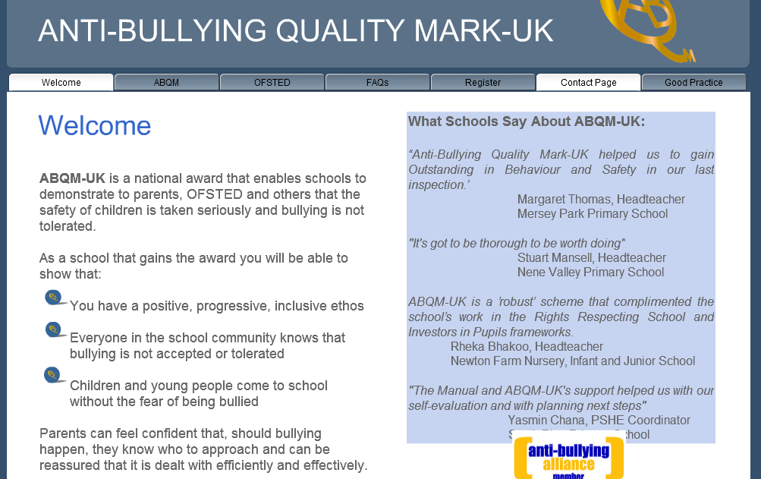
What next……

Slide 15
