Slide 1


JOB APPLICATION PACK
Success Academy Trust

Slide 2
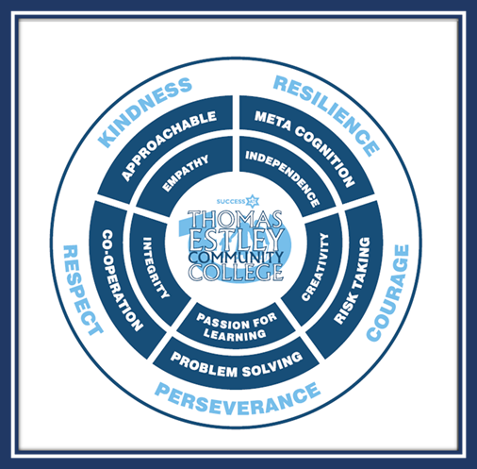
Community of Courage & Commitment to Success
Aiming to achieve our best.
Taking full advantage of every learning opportunity.
Showing resilience through our experiences and challenges.
Seeking out our talents and following our dreams.
Reaching out for opportunities to lead and encourage others.
Making a positive difference and celebrating success.
Including the whole community, sharing, caring and giving time as needed.
Treating each other with kindness, fairness and respect.
Finding space in our lives for fun, joy, praise and laughter.

Slide 3

Station Road, Broughton Astley, Leicestershire, LE9 6PT Tel: 01455 283 263
admin@thomasestley.org.uk - www.thomasestley.org.uk
Dear Applicant, January 2026
CLEANING ASSISTANT
Thank you for your interest in this post. The College is looking for a cleaning assistant to work time only between 3pm – 5.30pm each day, with 50 hours to be worked across the school holidays each year. Working as part of an established team to achieve high standards of cleanliness and hygiene throughout the school environment.
At Thomas Estley, we Build Leadership and Character Together as part of a community of courage and commitment to success. We are part of a successful multi academy trust which provides excellent quality, comprehensive, non-selective and inclusive education through primary and secondary education in Leicestershire, and the lead school in TELA learning alliance. We collaborate to provide mutual support, share good practice and learn from each other, whilst retaining and developing our own distinctive character. Our ethos is to be a welcoming, inclusive family community college that provides the best for, and expects the best from all students and staff, and we are well known locally for our warm family
atmosphere, as well as our commitment to growing leadership at all levels for students and staff.
The College is strongly committed in principle and practice to its role as a Community College, including adult learning, before and after school clubs and an onsite preschool and primary aged out of school club. We are proud to have received many awards for excellent practice, we regularly welcome local and national visitors, and our practice in leading training, from Initial Teacher Training to middle and senior
We have a strong family ethos and are looking for an enthusiastic and committed applicant who wants to work with our warm, welcoming team to further our mission statement of Building Leadership and Character Together. Should you decide to apply for this role, please ensure that you use the Personnel Specification for guidance when completing your application form.
Registered in England – Company No: 8135389 VAT Reg: 153227431
College Principal: Mandi Collins - College Manager: R Wheller

Slide 4

Featuring additional entitlement to our
‘Three Steps to Success’ for all our
Success Academy Trust staff...
ENTITLEMENT TO OUR TRUST TRAINING PACKAGE AS APPROPIATE TO CAREER STAGE DEVELOPMENT, ROLE AND EXPERIENCE
TALENT MANAGEMENT DEVELOPMENT ROUTES WITHIN THE TRUST WITH A PERSONALISED CEREER PLAN
WELLBEING FOR SUCCESS – OUR OWN PERSONAL WELLBEING AND SUPPORT PACKAGE TO HELP YOU FLOURISH
Please visit Success Academy Trust to view 'Who we are'

Slide 5
Job Title: CLEANING ASSISTANT
Grade: 2 - £24,423 FTE (Actual £7,605.02)
Hours: 2.5 hours per day, 12.5 hours per week starting from 3PM, term time only, plus an additional 50 hours to be worked in the college holidays.
Responsible to: Site manager
Key relationships with: Premises Officers, College Manager, wider cleaning team
Job purpose:
DUTIES AND RESPONSIBILITIES
A DUTIES
- To undertake general cleaning duties (e.g. wiping down surfaces, sweeping, mopping, dusting, glass cleaning, emptying of bins, wall washing, toilet cleaning, use of vacuum cleaners and floor polishing equipment) to an agreed schedule and to a required standard and in line with Cleaners induction booklet.
- To comply with health and safety legislation, College policy/procedures and good health and safety working practices in relation to use of College premises and own duties and responsibilities. Report any 'breaches' of safety regulations/policies or other safety concerns noticed to the Premises Officer.
- To ensure that cleaning equipment and materials are safely maintained, stored and used.
- To move furniture and other items of equipment as necessary to allow for the effective performance of cleaning duties. Where practical, to ensure that windows and doors are closed and locked when leaving rooms.

Slide 6
B GENERAL
Undertake duties elsewhere within the Support Team as required, Such other duties as required commensurate with the grade of the post
This job description sets out the duties of the post at the time when it was drawn up. Such duties may vary from time to time without changing the general character of the duties or the level of responsibility entailed. In fact the make up and emphasis of duties will be one area covered in annual review of the post and rewritten accordingly. Such variations are a common occurrence and cannot in themselves justify a reconsideration of the grading of the post.
It is vital to the ethos of the Support Team that the postholder is flexible in taking on additional tasks, willing to offer help to and cover for other members of the Team and treats co-operation and support for colleagues as a top priority.
SPECIAL INSTRUCTIONS
To ensure a safe working environment in accordance with Health and Safety Regulations
To attend fire drills and staff meetings as required
To attend training events as required
To respect the confidential nature of personal information
Participation in, contribution to and evaluation of training and development opportunities including those arising from annual staff review.
COMMUNICATIONS
In consultation and partnership with the College Manager and other members of the Support Team, support and sustain effective communications throughout the College arising from clerical and reception duties.
WHOLE COLLEGE RESPONSIBILITIES:
Support current policies and recognised good practice within the college
Be aware of the importance of confidentiality and data protection
Participate in annual Performance Reviews with your Line Manager, based on agreed objectives.
Willingness to be flexible in both approach and use of time.
All tasks should be undertaken with due regard to Health & Safety regulations.
To undertake such other duties which are within the scope of the job purpose, title of the job and its grade.

Slide 7
THOMAS ESTLEY COMMUNITY COLLEGE -
PERSONNEL SPECIFICATION
Job Title: CLEANER
Scale: Grade 2 - £24,423 FTE (Actual £7,605.02)
APPEARANCE/HEALTH
Tidy
Good standard of spoken English, clear and comprehensive
QUALIFICATIONS
Able to read written instructions clearly
SKILLS/ATTRIBUTES
Ability to respond flexibly to changing demands
Able to follow written and verbal instructions
Be able to work using own initiative to ensure all task are complete.
Work well as part of a team
Demonstrate good communication skills
Able to complete tasks to a high standard
Experience of working in a similar environment or role
KNOWLEDGE
Understanding of Equal Opportunities in a school context and be able to recognise discrimination in its many forms
ESSENTIAL










DESIRABLE


Slide 8
THOMAS ESTLEY COMMUNITY COLLEGE -
PERSONNEL SPECIFICATION
GENERAL CIRCUMSTANCES
Attendance - evidence of regular attendance at work
An understanding of, and commitment to, Equal Opportunities, and the ability to apply this to strategic work and day-to-day situations
Factors not already covered
Must be able to perform all duties and tasks with reasonable adjustment, where appropriate, in accordance with the provisions of the Disability Discrimination Act 1995.
Must be eligible to work in the UK
ESSENTIAL




DESIRABLE

Slide 9
All Thomas Estley Community College employees are expected to promote and safeguard the welfare of students at this school.
The job description sets out the responsibilities of the post at the time it was drawn up. Such responsibilities may vary from time to time without changing the general character and requirements of the post or the level of responsibility entailed.
Variations are a common occurrence and do not necessarily constitute additional responsibilities or warrant a higher grade.

