Slide 1


Welcome to our Thomas Estley Preschool Virtual Tour!
Summer 2021

Slide 2
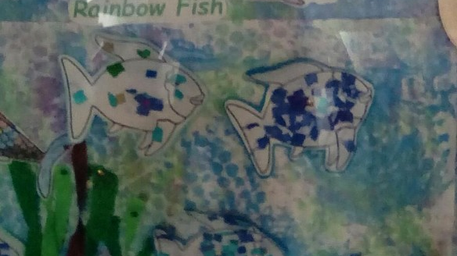
Welcome!
Enter our preschool lobby and prepare to meet us!

Slide 3
What do our Parents say? May 2021
I cannot recommend enough for the care my daughter has had at Pre-school. It was hard to leave her especially with Covid restrictions in place but she settled in so well. She always asks when her pre school days are and always has lots to tell me when she comes home. We are regularly updated with things they are doing in preschool. So happy we chose Thomas Estley Pre-school!
Thomas Estley preschool is fantastic!
The staff go above and beyond to ensure the children get the best out of their early learning journey.

Slide 4
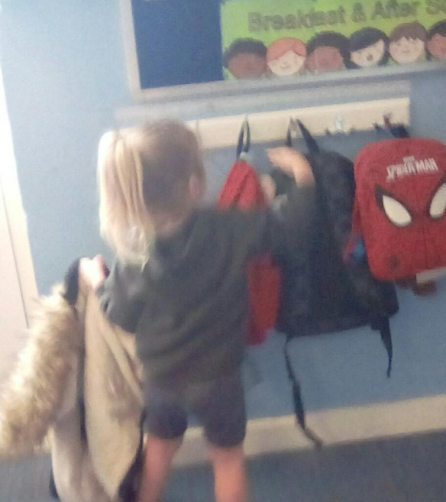
Time to hang your coat and bag up…

Slide 5
What do our Parents say? May 2021
My son really enjoys attending Thomas Estley preschool, he is always happy to hear he's going to 'school' and as a parent, there's nothing better to know than that your child wants to go and enjoys attending, this speaks volumes in itself. His individual progress has been amazing and supported exceptionally.
Staff at the preschool have done so much for my child and for us as a family. Through the ups and downs, they truly enjoy their job and do their utmost best. There will never be enough gratitude for what they do.

Slide 6
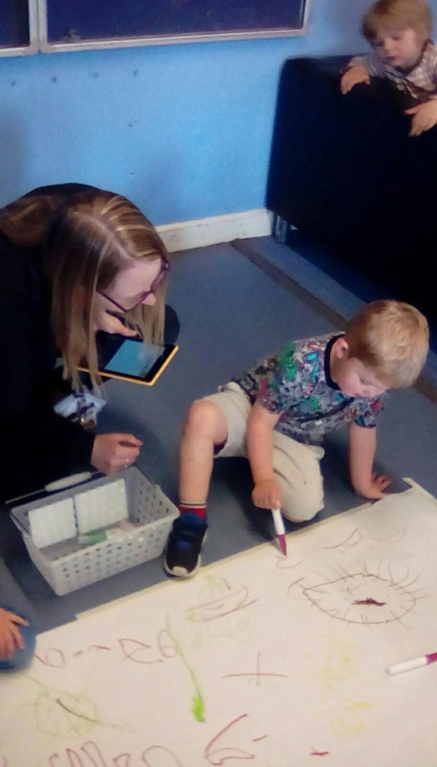
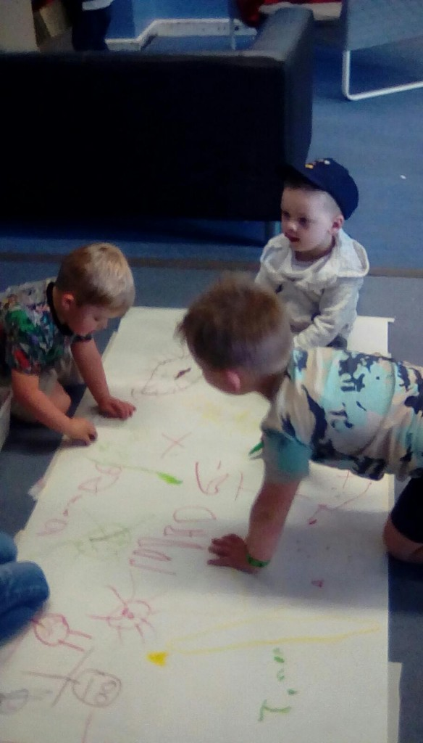
Let’s draw on the floor!

Slide 7
What do our Parents say? May 2021
I can not sing Thomas Estley preschool praises enough. All the staff are dedicated to making the children’s experience both an enjoyable and fulfilling one. My granddaughter has been lucky enough to have been with the preschool for the last 2 years. Not only has she grown in confidence, but has academically progressed beyond our expectations. The preschool is so creative and is always coming up with new fun projects. Lockdown was a very challenging time for the school, but thanks to the staff's dedication the children continued to have fun packed days. Over Christmas although the children could not put a show on for the parents. The children still learned lots of Christmas songs and performed a concert in the classroom, which we could see on tapestry. The children still had the Pre Christmas buzz and did not miss out despite the restrictions.
Thanks to tapestry you will get daily updates on all the fun things the children are doing.

Slide 8
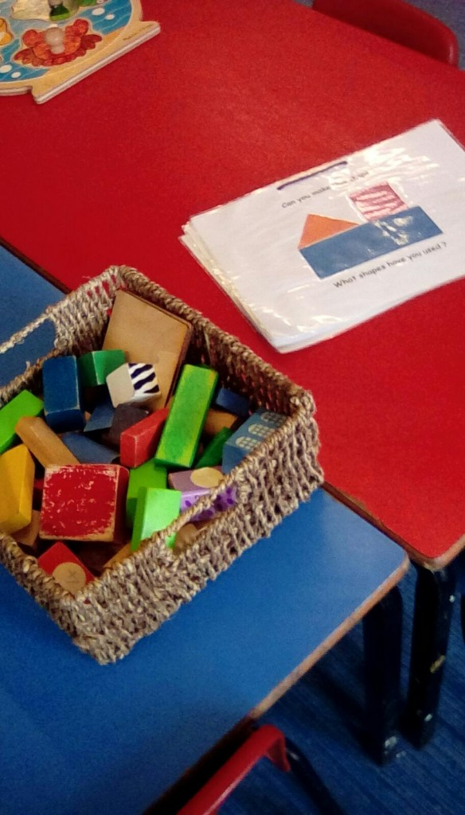
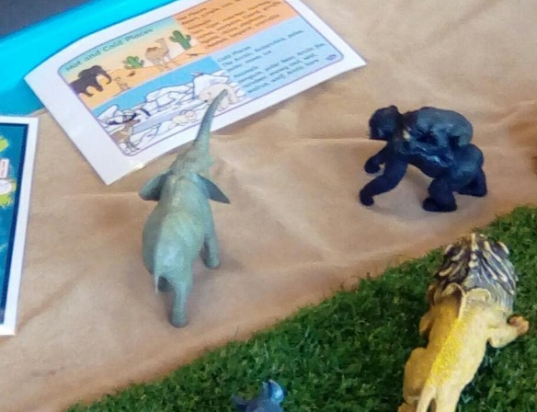
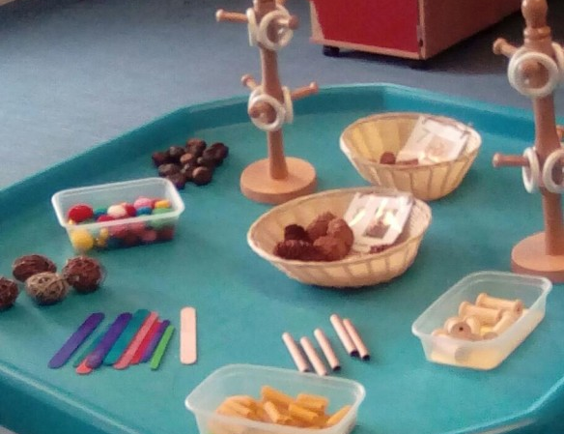
What shall we choose to play with today?

Slide 9
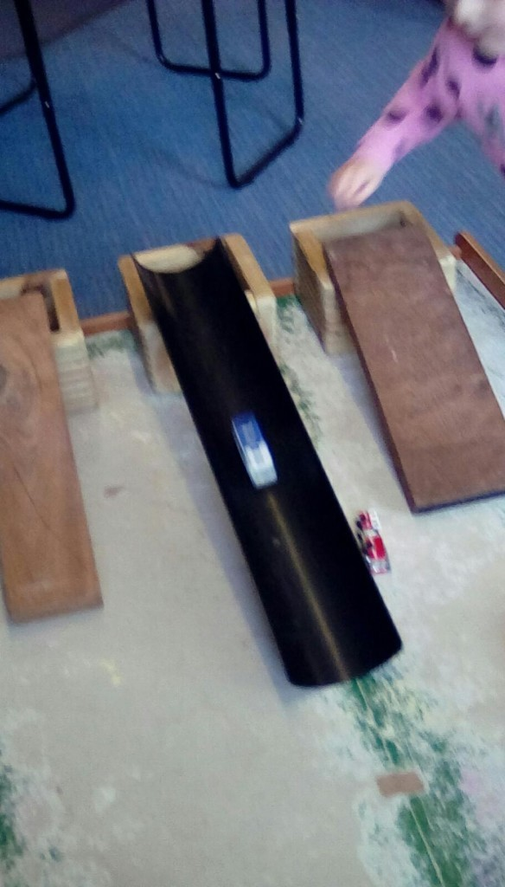
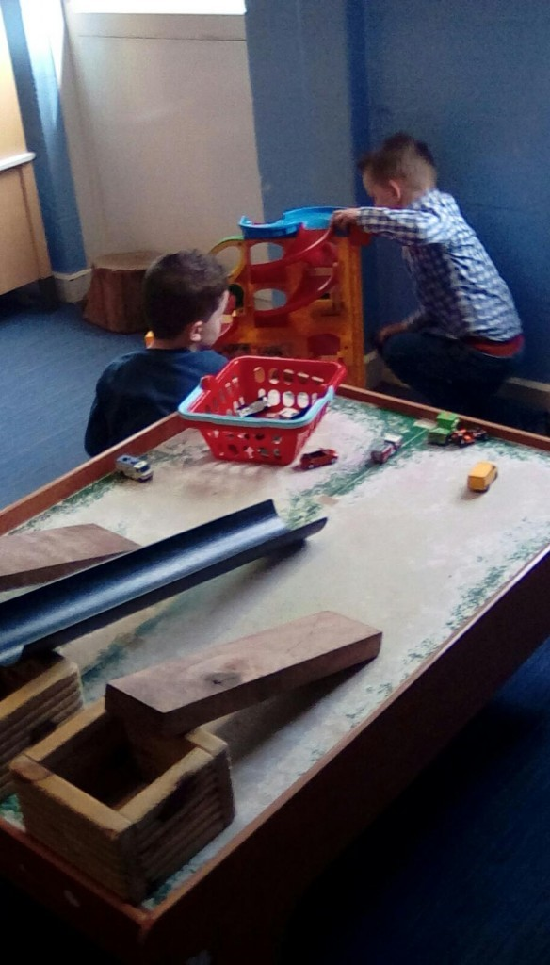
Or how about making our own toy?

Slide 10
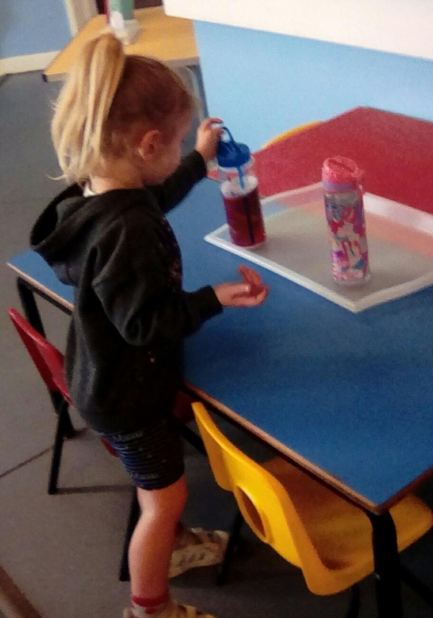
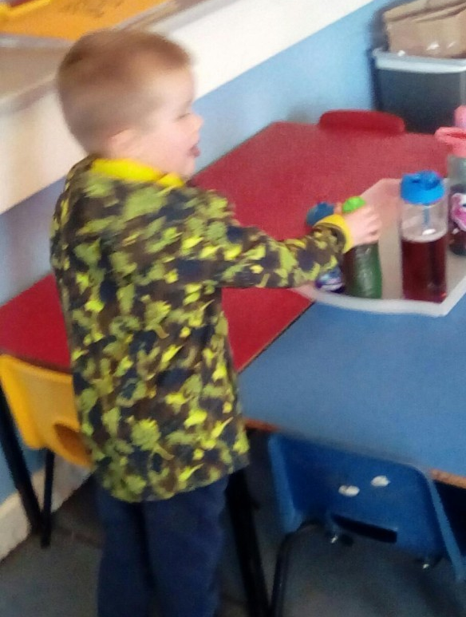
Time for a drink!
Staff are very friendly, listen, approachable, supportive and helpful and the relationship between key workers and child is beautiful and heart-warming.
The preschool environment is safe and fun and they provide a brilliant range of activities, whilst also providing structure and routine to assist independence, set boundaries and prepare your child for transition. Guaranteed, your child will never have a 'boring' day.

Slide 11
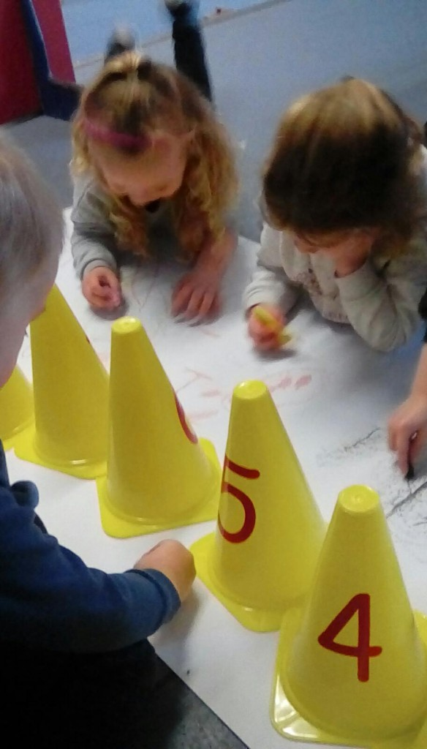
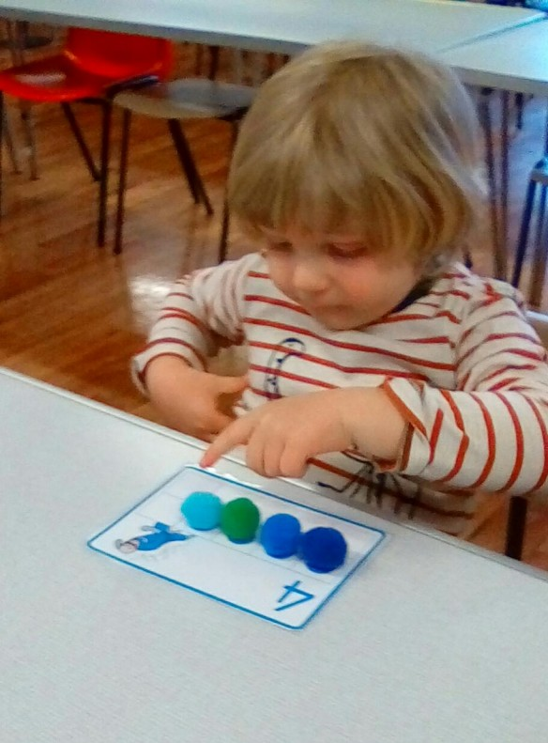
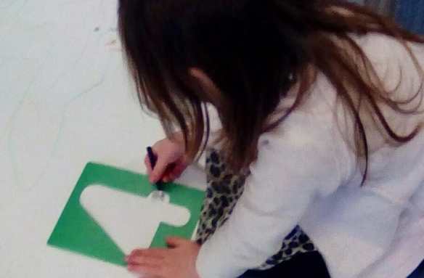
Let’s count together.

Slide 12
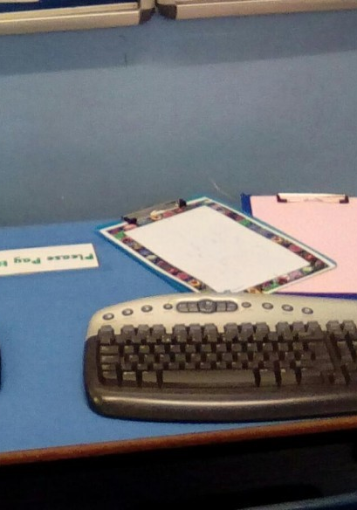
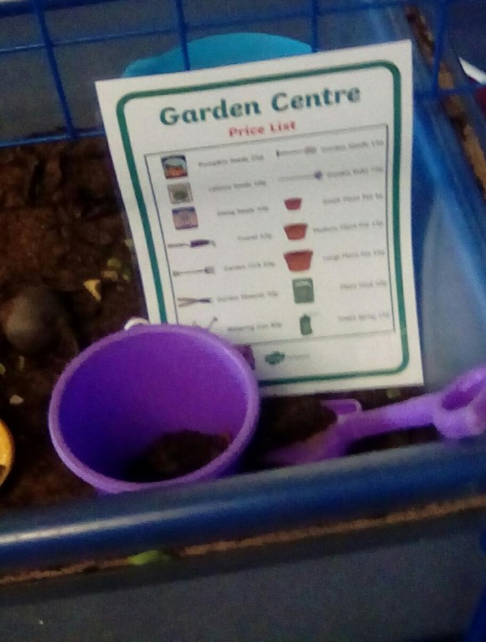
Let’s visit a garden centre!
The wide and vast opportunities preschool offers will be sure to inspire, create an inquisitiveness, capture their imagination and their heart. Developing skills and learning has never been more fun and creative. Daily child-led activities enable and promote your child not only to be imaginative and independent but also how to work with and share with their peers, promote teamwork creating strong friendships.' I could sing praises about you and your team all day! Thank you for everything Nikki.

Slide 13
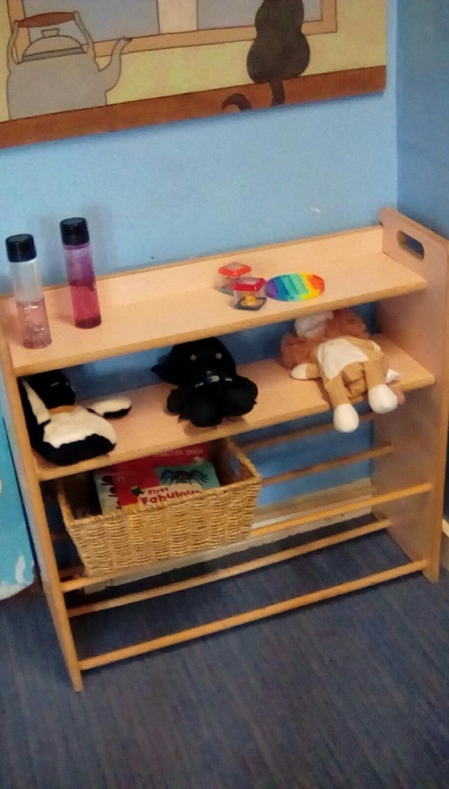
Staff at the preschool have done so much for my child and for us as a family. Through the ups and downs, they truly enjoy their job and do their utmost best. There will never be enough gratitude for what they do.
My son will be upset to part ways, but I highly recommend Thomas Estley Preschool!
My little boy has been going to Thomas Estley preschool for nearly a year now and he has learnt so much, the staff go above and beyond with activities and keep learning fun. The most important part for me is being able to leave the most precious thing to me in the world in the hands of the staff with full confidence and absolutely no concerns. Wouldn’t hesitate even for a second to recommend this preschool.

Slide 14
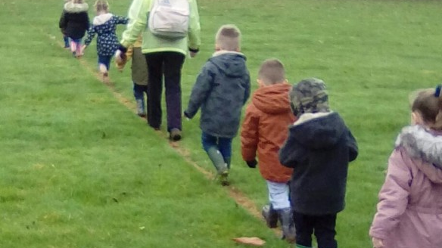
Time to go out!

Slide 15
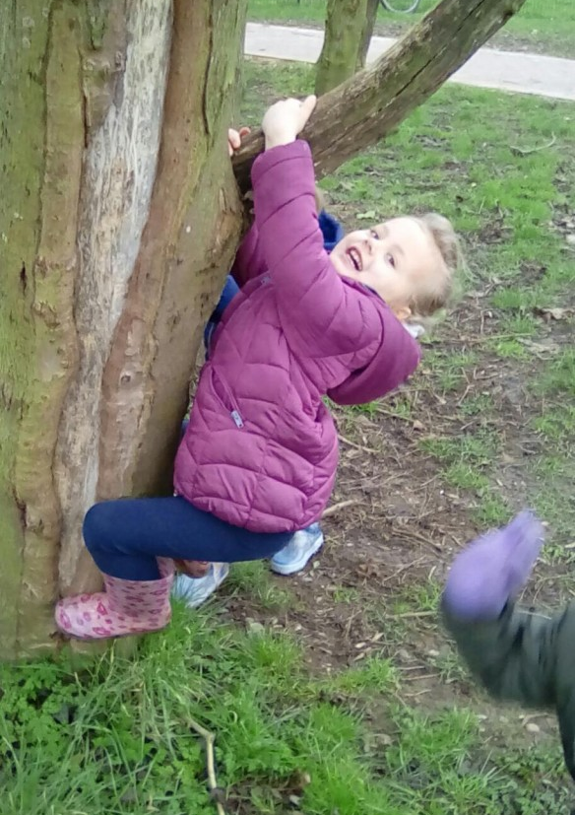
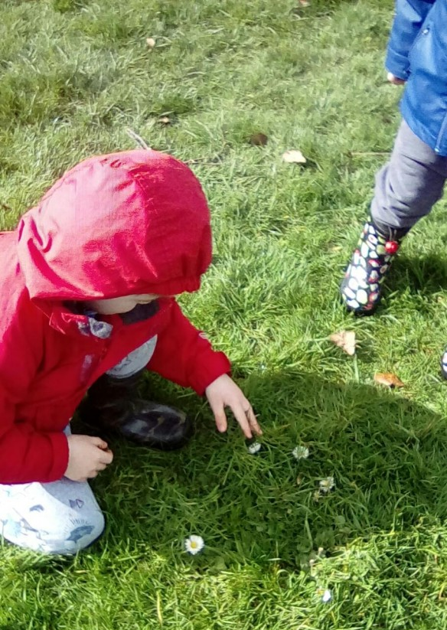
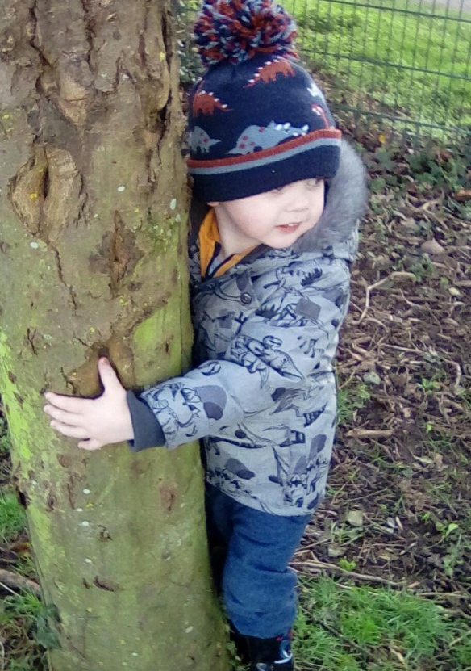

Slide 16
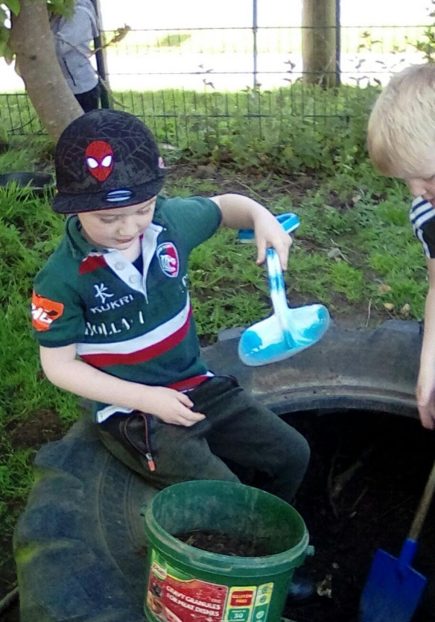
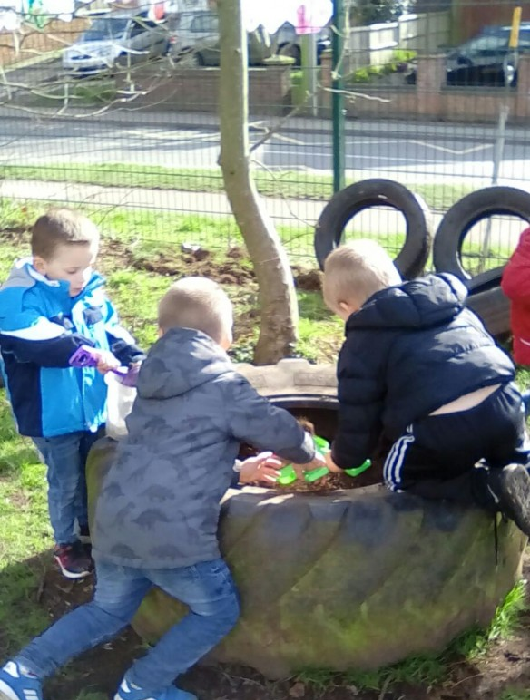
Let’s do some planting|!
Staff are highly trained, even taken/taking extra courses in various other areas to help, understand, provide, support and accommodate a variety of children’s different types of needs.
Communication and feedback to parents/carers is brilliant, always kept up to date and involve you as a family in part of your child's learning journey, as well as sharing your child's progress and the activities they will do/have done.

Slide 17
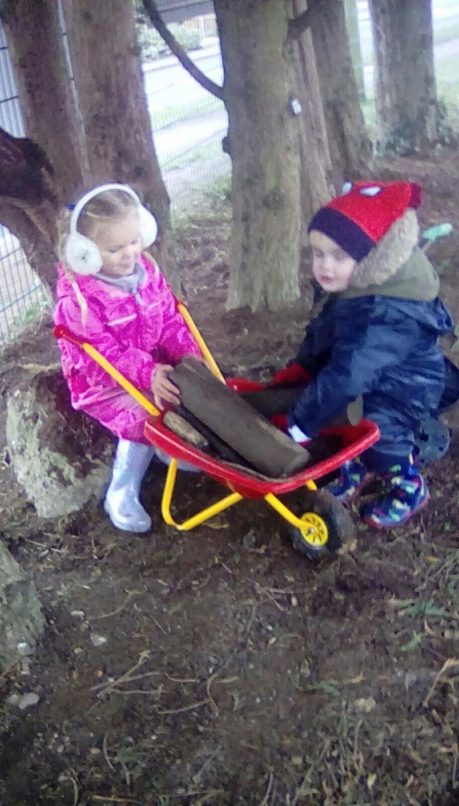
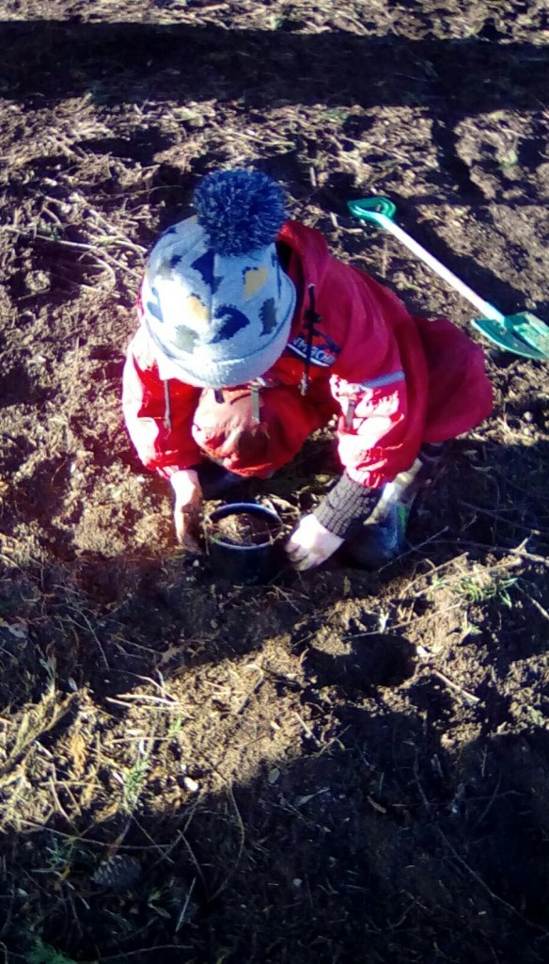
Loving the mud kitchen and even just the mud!

Slide 18
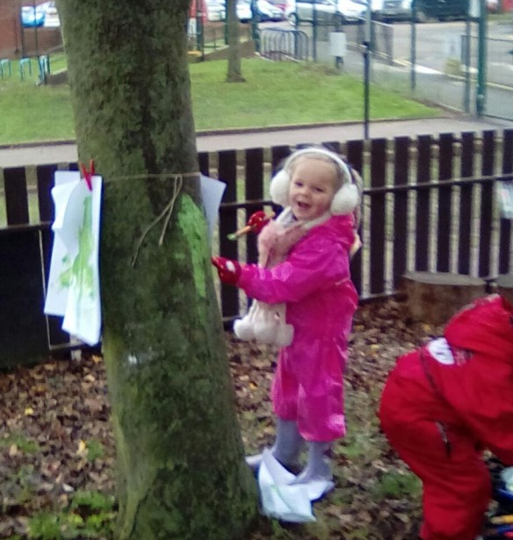
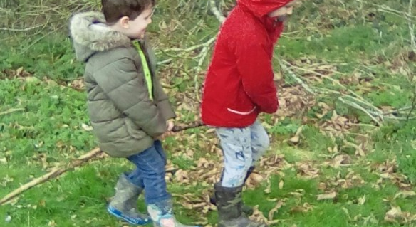
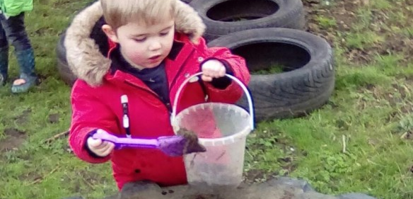

Slide 19
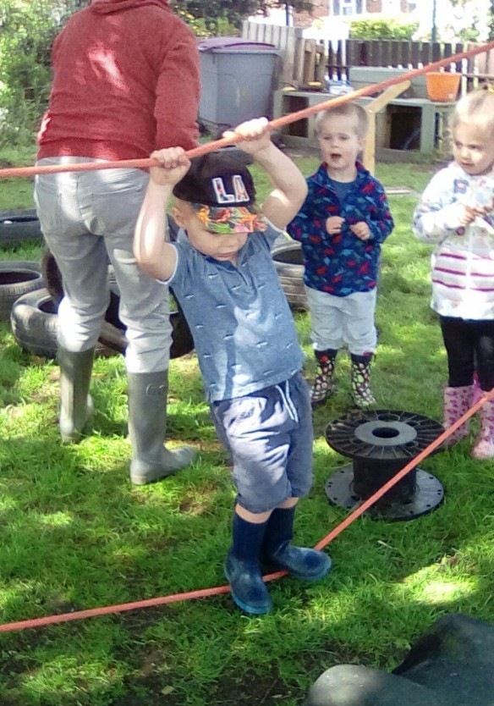
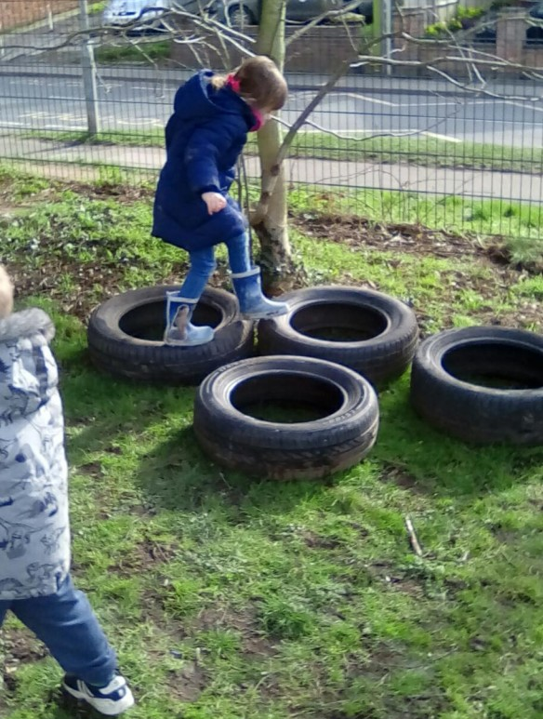
Let’s balance together!
You are all amazing there and I truly have no worries when I walk away after dropping him and that’s huge for any parent! Can’t thank you enough!
All the staff are so friendly and professional, and are happy to discuss any concerns that you may be having.
Lovely preschool. Your child will love being there.

Slide 20
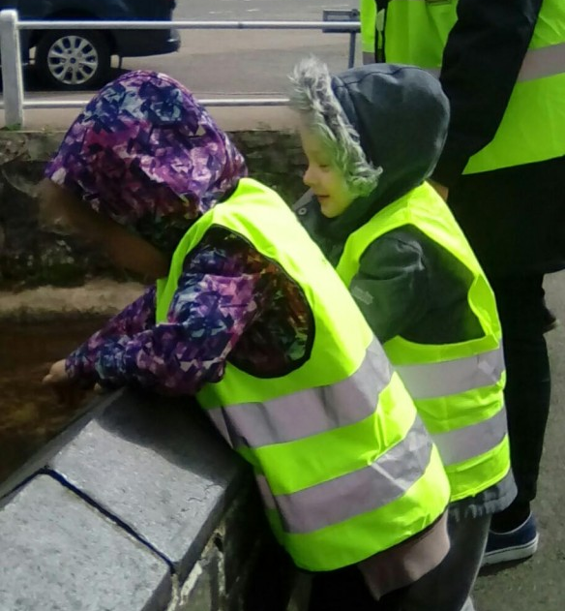
Where are those ducks?

Slide 21
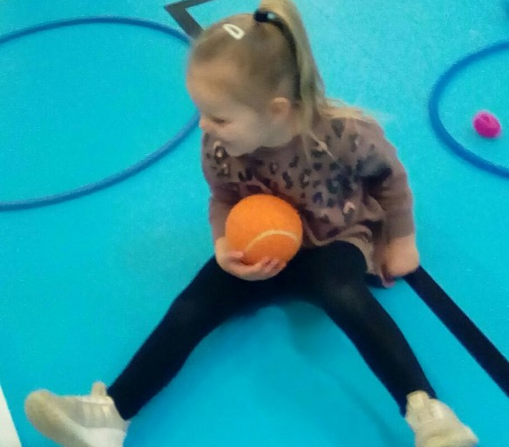
Off to the gym

Slide 22
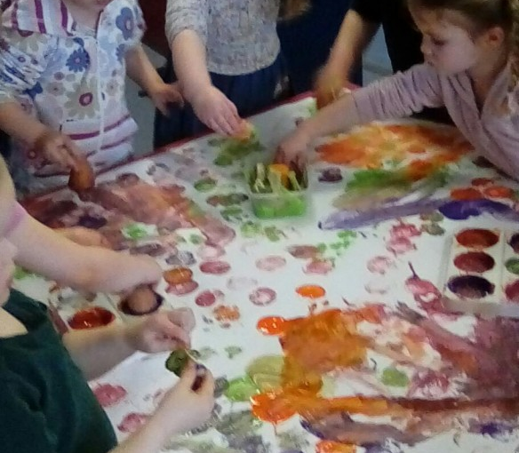
Just time to get messy before we go home!
The communication with the school is great, whether it be verbal, email or via Tapestry. It's great to see the photos of what the children have been upto during the day. I would highly recommend this pre school to all parents.

