Slide 1
Folding airplane wings using soft robotics ideas
Authors:
Dr. Saurabh Kwatra (Project Guide)
Sharun Arumugam
B.Tech Aerospace Engineering
B.S. Abdur Rahman Crescent Institute of Science and Technology

Slide 2
Objective:
Airplane model that can be folded and stored in a shuttlecock box and opened and flown without distortion.
Principle:
Variable rigidity achieved by using dynamic parts and fluid properties of non-compressible fluid.

Slide 3
Parts and Factors Involved:
Parts:
Wing structure
Folded airplane
Simple Hydraulic Piston Mechanism
Rubber Tubes
Non-compressible fluid
Factors:
Youngs modulus rigidity
High pressure
Elastic material distortion age
Structural damage
Safety measures

Slide 4
Problem:
As the wing structure is an elastic material, due to folding of the airplane structure and sudden opening of structure can cause distortion in the material.
Due this distortion occurred, the load applied on the wing during flight can cause the wing structure to lost its shape or loose its Youngs modulus rigidity.
Other factors such as high pressure, safety measure after failure, life of elastic material distortion can determine the rigidity of the airplane wing structure.

Slide 5
Solution:
Using simple hydraulic mechanism inside the elastic wing structure can make the wing more rigid and gain its shape even after several forces acted on it.
The high pressure on the atmosphere makes the surface of the wing structure rigid.
The non-compressible can withstand the structure load and high pressure without undergoing compression or bubble formation.
Additional safety measures can save the aircraft during failure of mechanism or damage in tube or distortion of elastic material due to long period of time.

Slide 6
Role of High pressure:
The area where the air pressure is high is known as high pressure. The high pressure surrounding the wing structure can make the hydraulic piston to move down and make the non-compressible fluid (Hydraulic oil) to fill the tube and swollen the tube to make the wing structure rigid.
Affecting factors - High pressure:
The high pressure can create distortion due to long period of time, where the material loses its elasticity. The tube inside the wing structure can be damaged due to high hydraulic pressure on the non-compressible fluid for more period of time.
Solution:
A maximum withstanding rubber tube can be used. Additionally, a hollow structure can be created near wing and fuselage joining area to change the tube whenever necessary. Moreover, the hollow structure wont damage the wing structure because hollow structure is rigid then solid structure.

Slide 7
Simple Hydraulic Piston mechanism:
This hydraulic mechanism with piston structure is responsible for making the wing structure rigid with relation to high pressure.
When the pressure increase on the surface the piston moves down.
This creates a high pressure inside the tube and makes the non-compressible fluid to swollen and rigid the structure.
The failure and maintenance of hydraulic piston is low. As lubricating the piston can be done periodically.
Non-Compressible Fluid:
The fluid which doesn’t undergo compression is known as non-compressible fluid. Hydraulic oil can be used. Low maintenance. Can be changed if needed. Responsible for swelling the tube for rigidity.

Slide 8
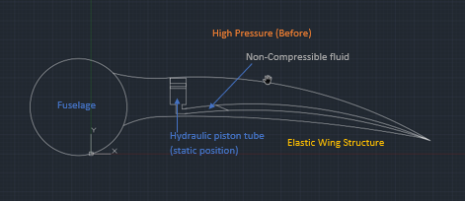
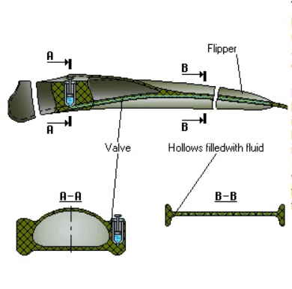
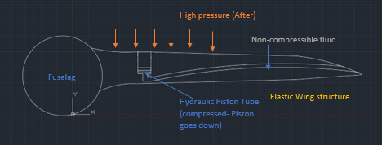
Structure:

Slide 9
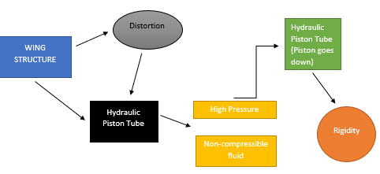
Flow Chart:

Slide 10
Working Principle:
When the High pressure is applied on the surface, the piston inside the wing structure goes down.
The piston tries to compress the non-compressible fluid. Which makes the fluid to travel through the pipe and makes the tube swollen up or bulge.
This bulge makes the wing structure rigid and does not affects its shape instead it retains its lost shape due to folding and other forces.

Slide 11
Safety measures:
What if the non-compressible fluid leaks during flight?
What if the wing material loses its elasticity in-between the flight ?
What if the rubber tube bursts during flight?
First safety precaution is to check all the factors before flight. If the fluid leaks or tube bursts or wing damages or loses its elasticity during flight, Try to do emergency landing as soon as possible, lower the altitude of the plane and look for grass or smooth are for landing, to reduce other structural major damages, Use the tail control surfaces to make the smooth landing.
Make sure to have small fire extinguisher near, suppose the battery explodes.
Change the damage part carefully without damaging other parts.
While unfolding the plane from shuttlecock box, do it slowly and handle with care, unnecessary speed and carelessness can damage the wing structure.

Slide 12
Thank you

