Slide 1

Train With Donadio
Obtaining Your Maryland Handgun Qualification License
Step By Step Instructions for the Online MSP HQL Application

Slide 2
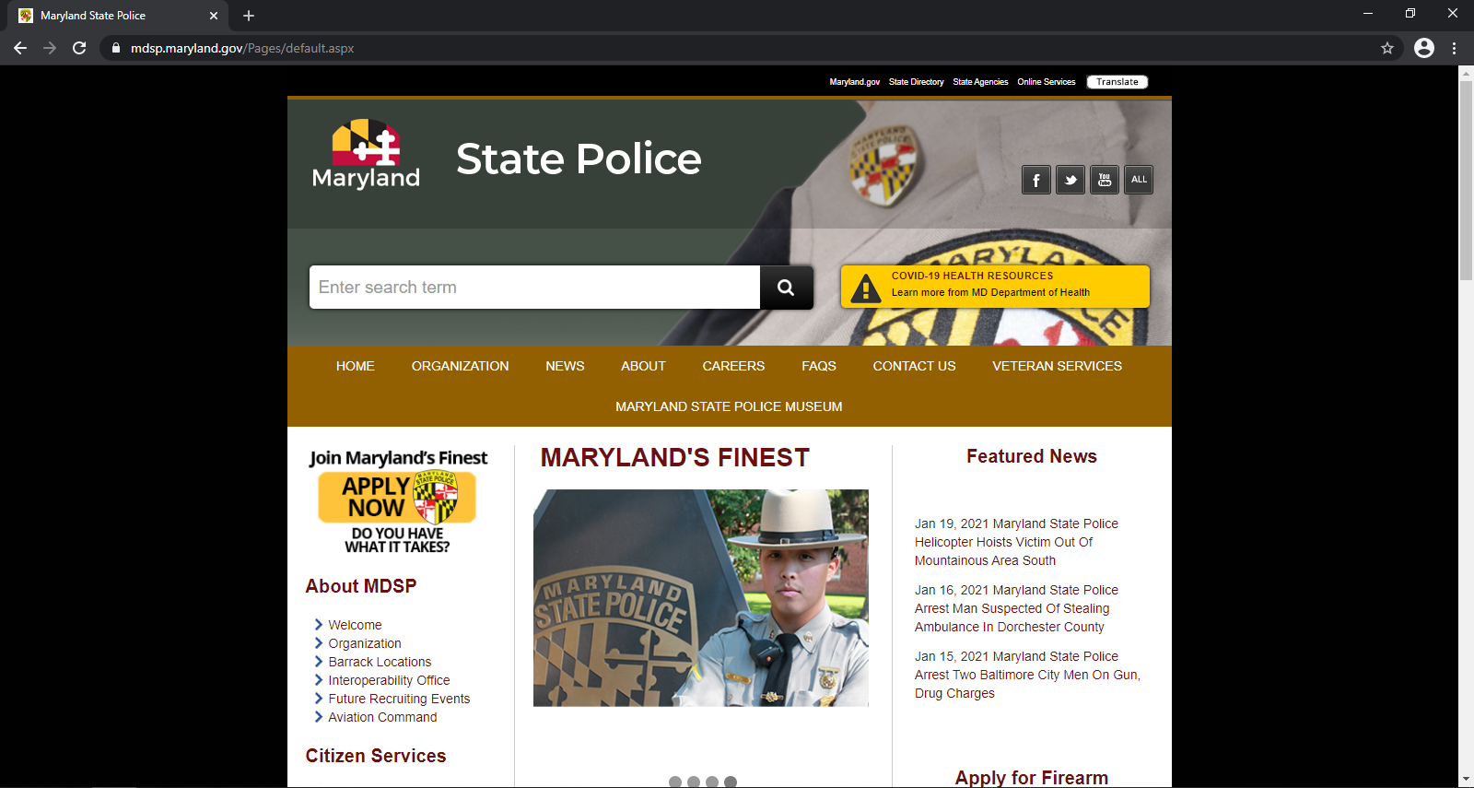
Step 1: Go to Maryland State Police Website.
https://mdsp.maryland.
gov/Pages/default.aspx

Slide 3
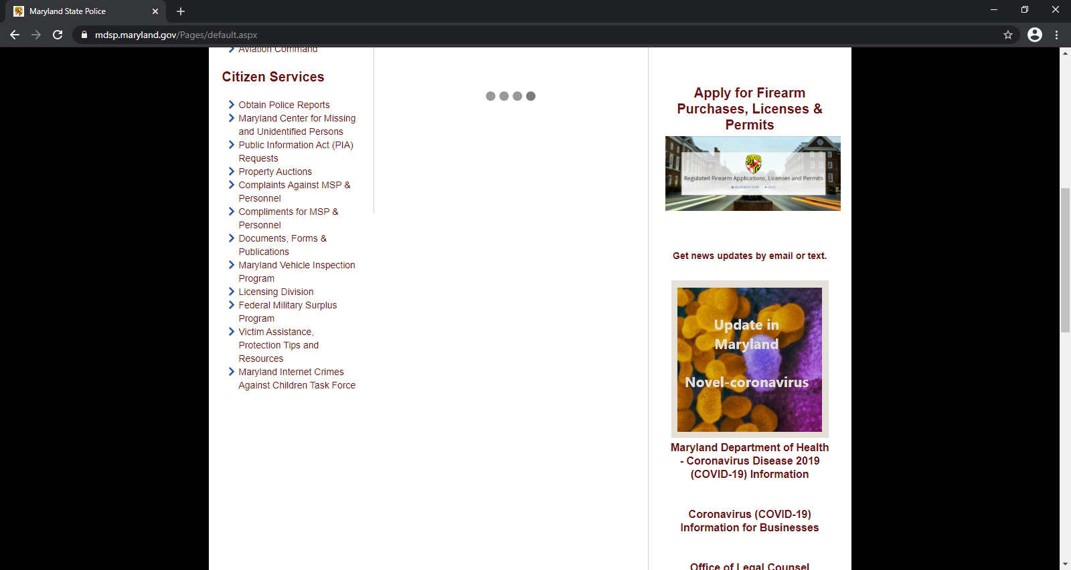
Step 2: Scroll Down and Select “Licensing Division”.

Slide 4
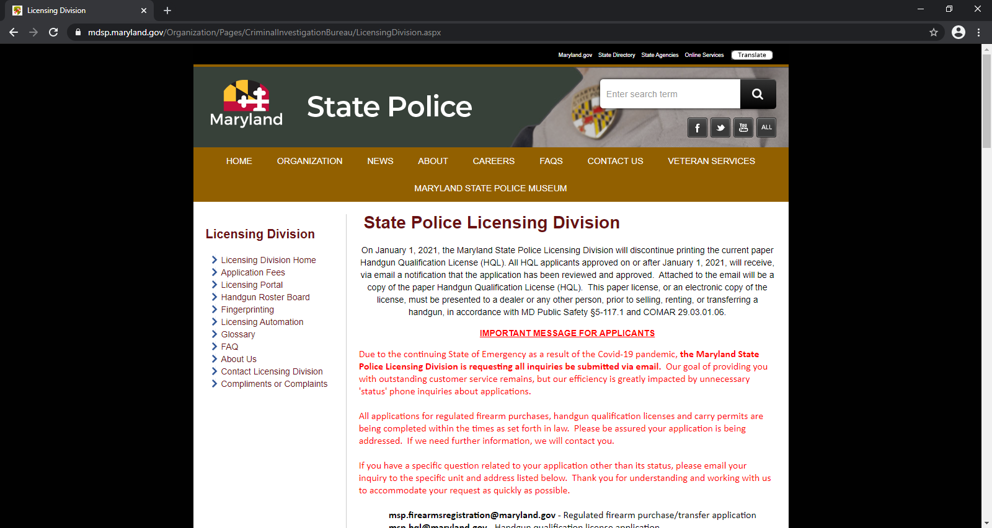
Step 3: Once you have arrived to this page, Scroll Down.

Slide 5
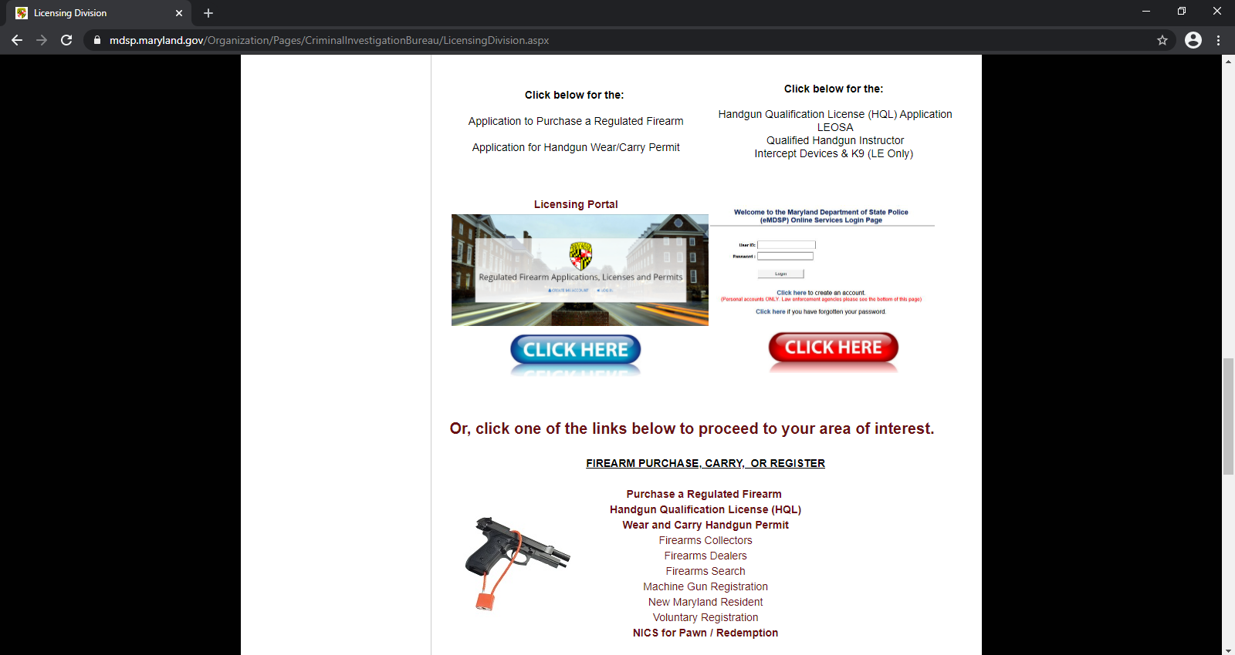




Step 4: Select the RED Link on the Right to fill out your HQL Application.

Slide 6
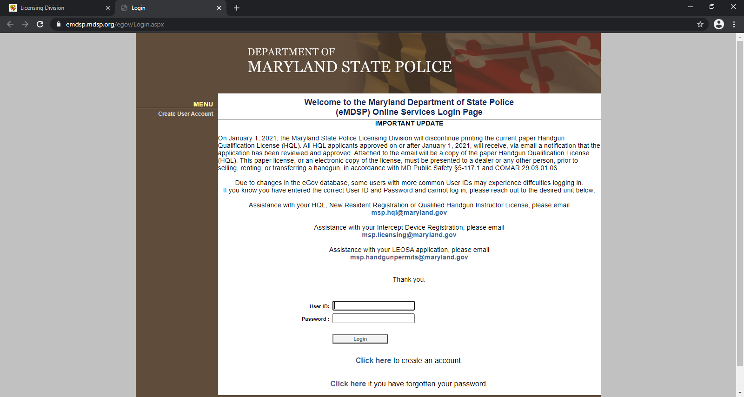


Step 5: You must now Create an Account if you do not already have one.
*Remember Your User ID & Password for the future reference.

Slide 7
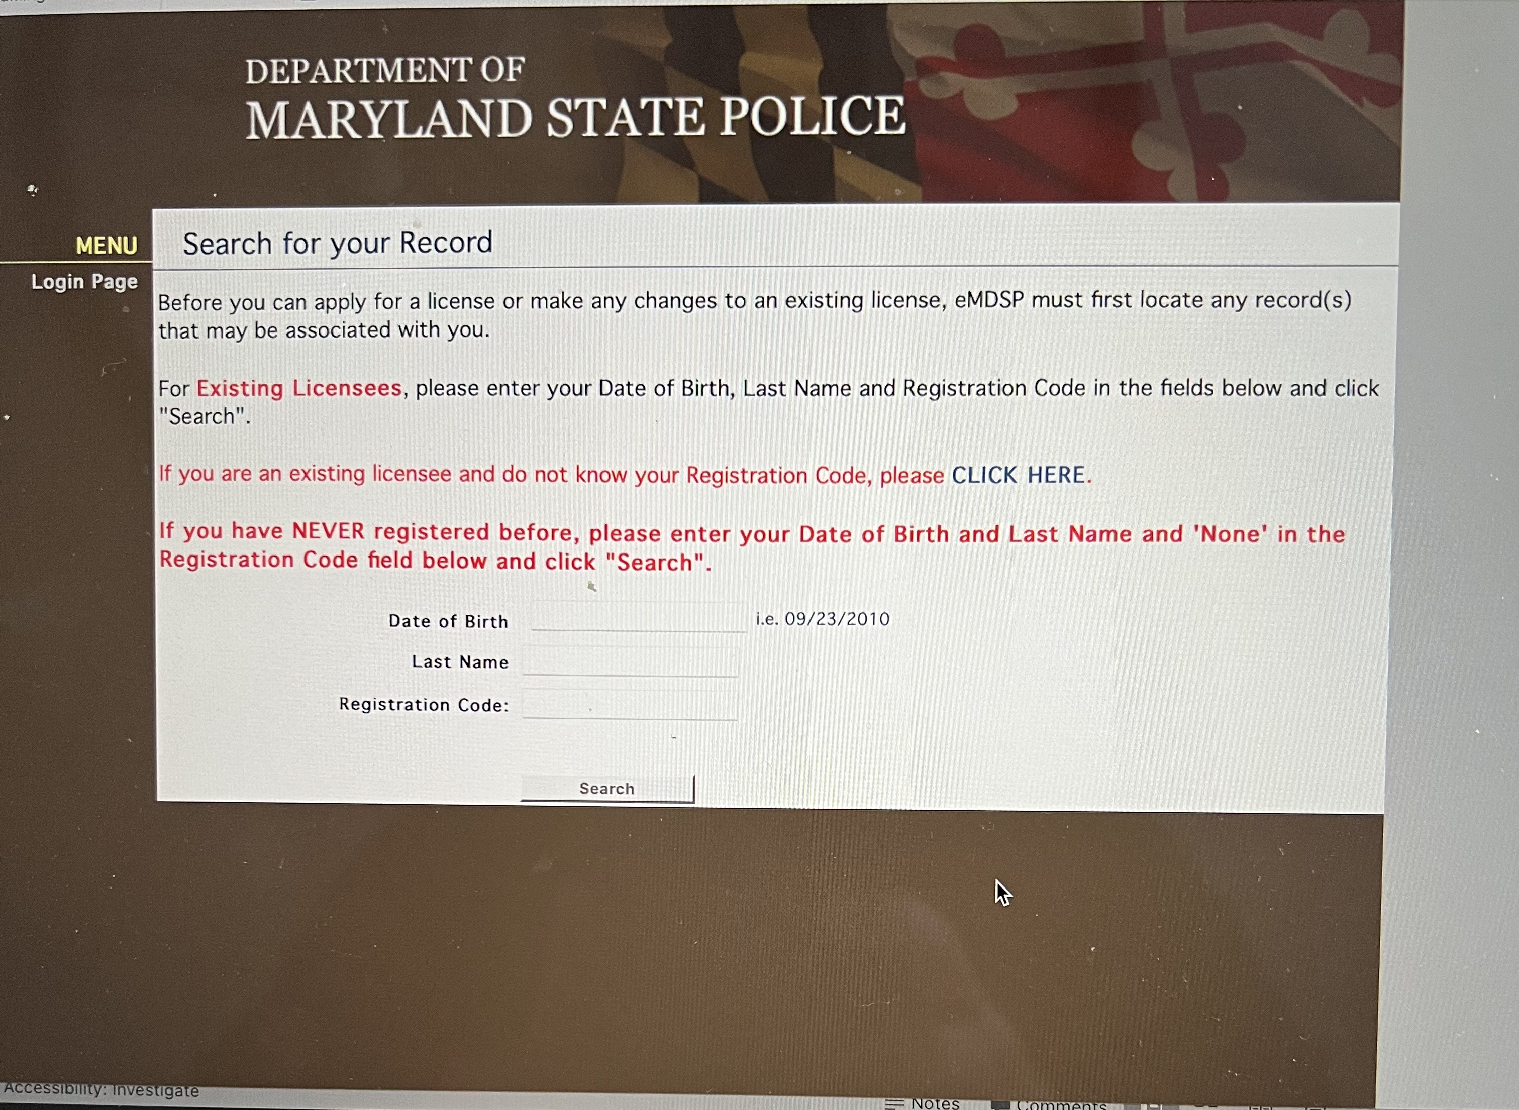

Step 6: Read yellow highlight. Follow website instructions to finish creating an account.

Slide 8
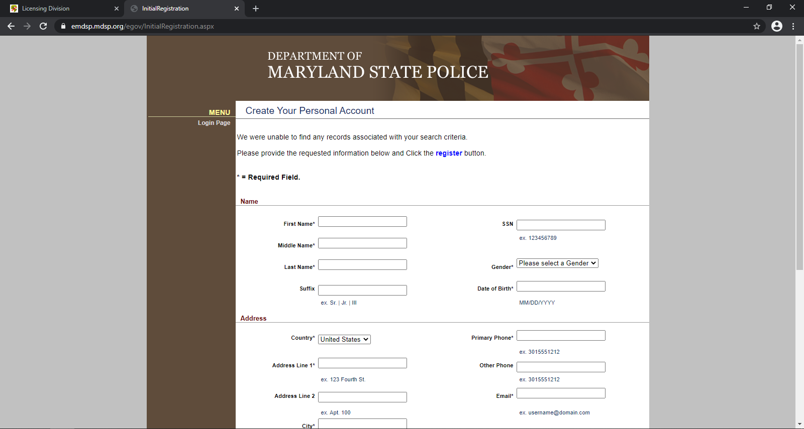
Step 7: Continue website instructions to create an account.

Slide 9
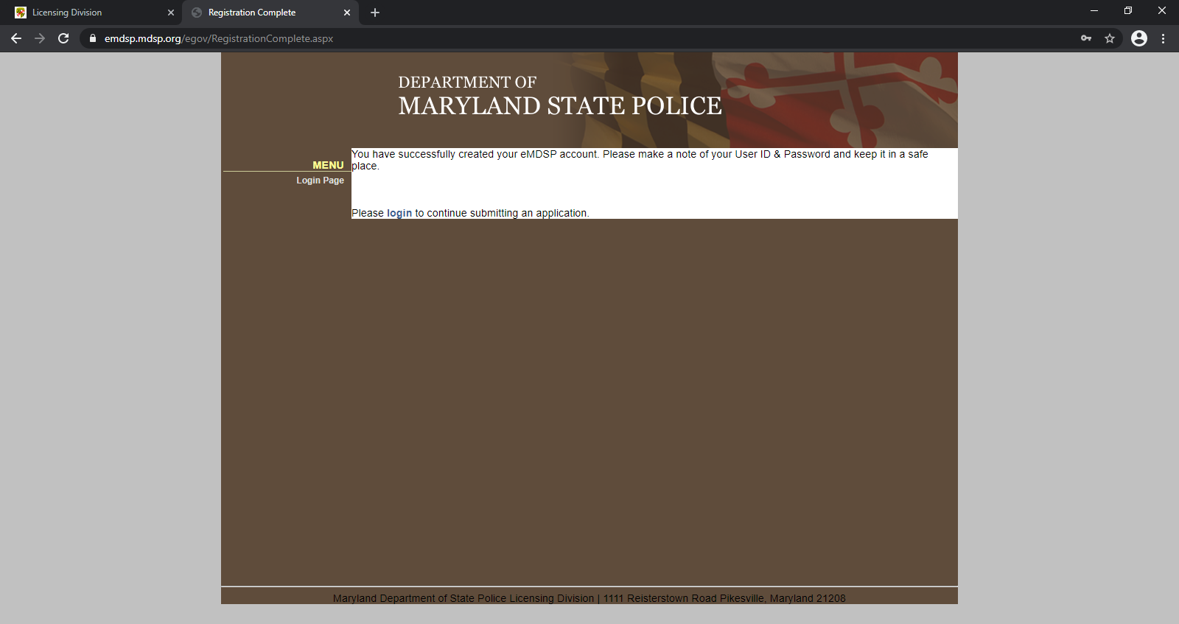
Step 8: Once you have successfully created an account, follow the link to officially Login to continue.

Slide 10
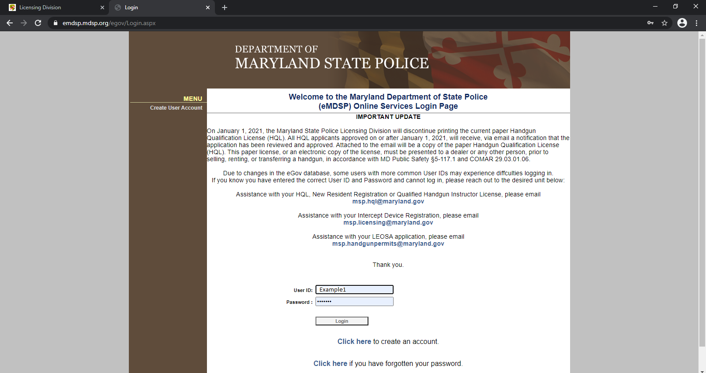
Step 9: Login to your account.

Slide 11
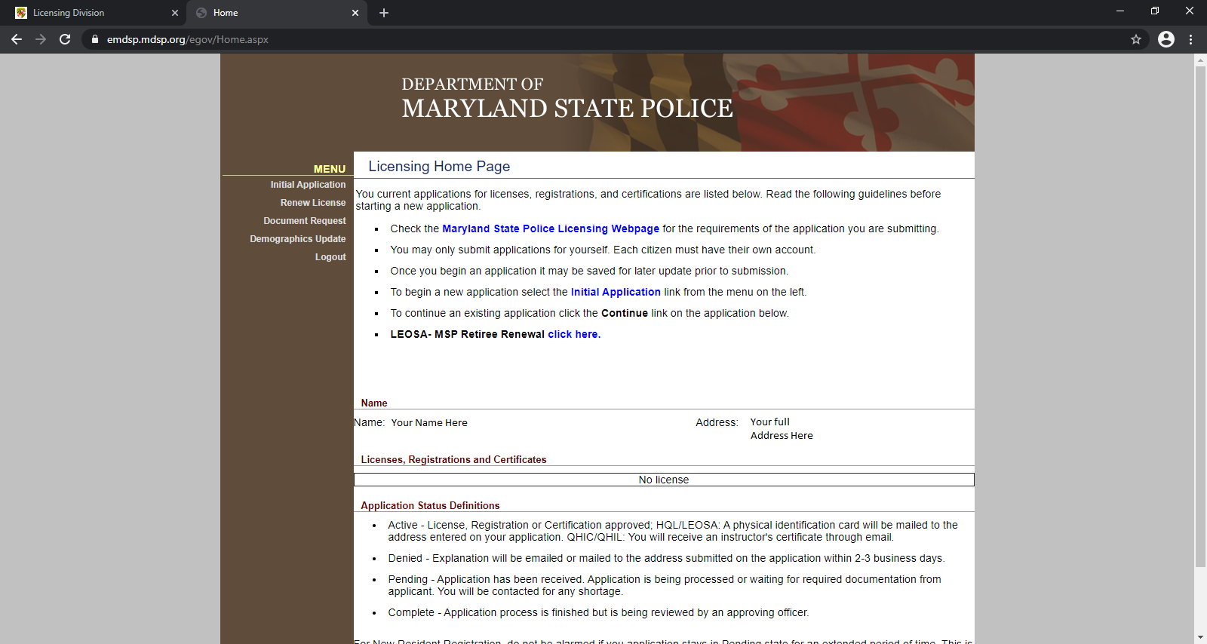

Step 10: Click on “Initial Application” link from Menu on left to begin new application.
*To continue an existing application, Click the “Continue” link on application below.

Slide 12
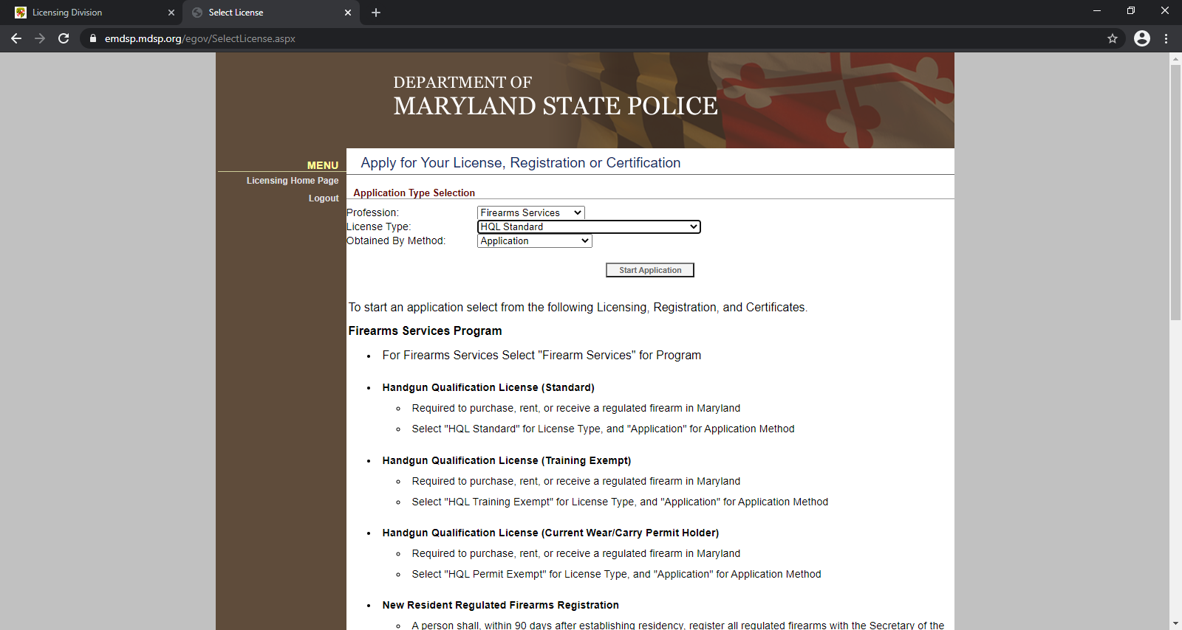
Step 11: Select under “Application Type Selection”-
Profession: Firearms Services
License Type: HQL Standard
Obtained By Method: Application
Click “Start Application”.

Slide 13
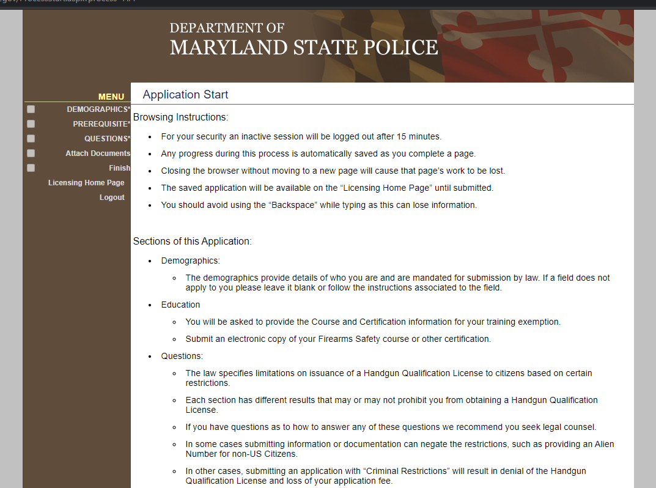
Step 12: Read the MSP HQL Application Instructions and when you are ready to start click on DEMOGRAPHICS.

Slide 14
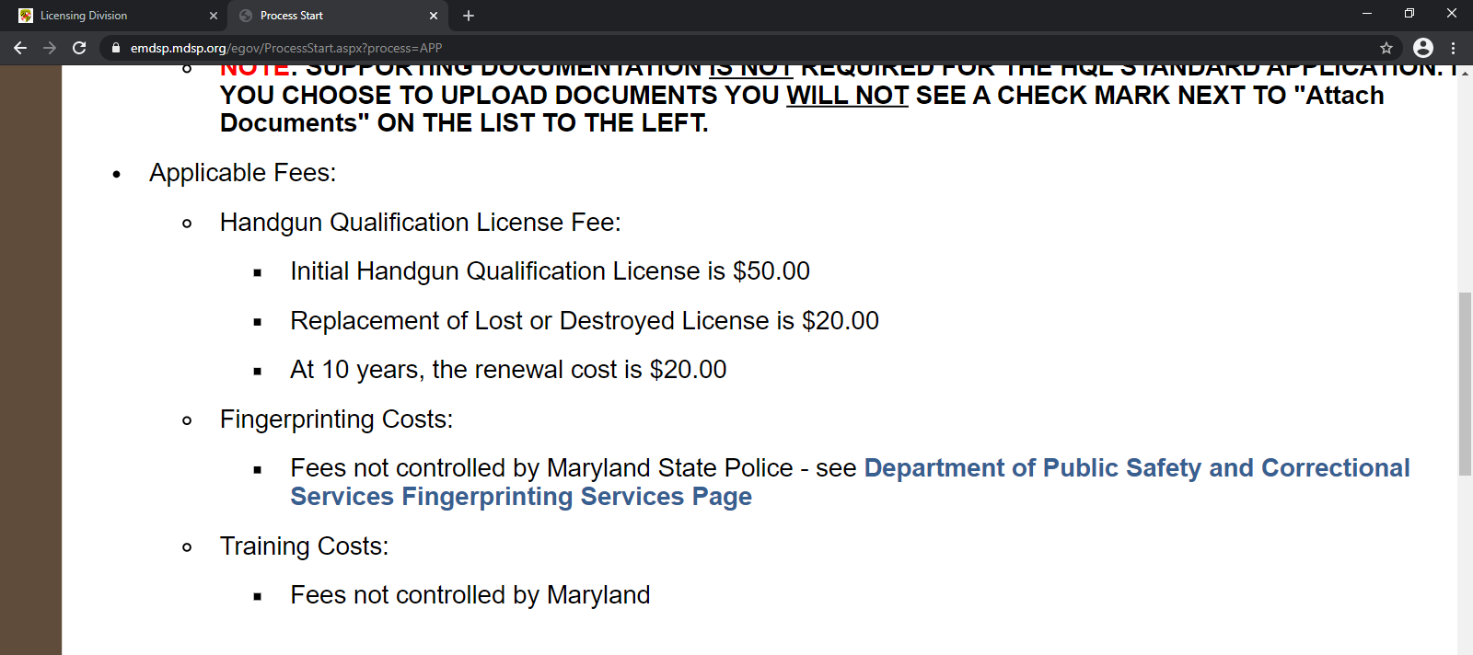
Step 13: Read the MSP HQL Applicable Fees.
*This is a separate fee charged by MSP that is not included in cost of the HQL Class you are attending.

Slide 15
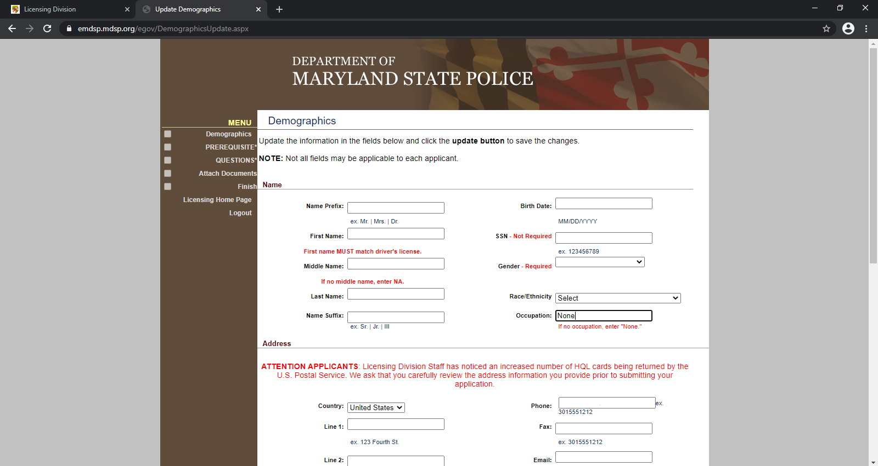
Step 14: Complete the Demographics section with all of your information.
*Each section will show a “Check Mark” in the box under Menu on Left when Completed.

Slide 16
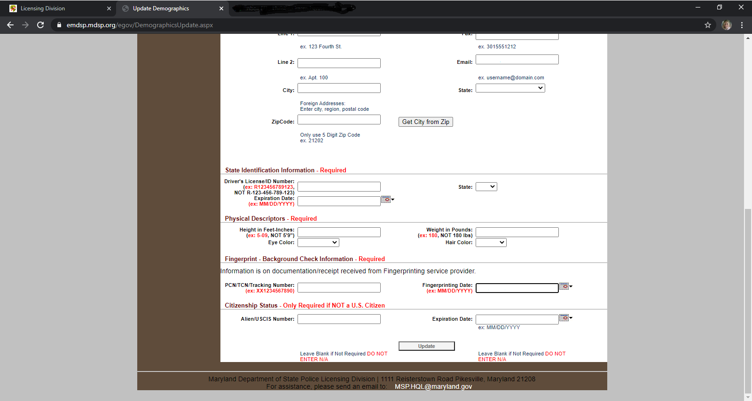
Step 15: On the Demographics page, you will need to have your Live Scan Fingerprinting Receipt to Complete. Please look at next 2 slides for examples of live scan receipt. Depending on where you go to do your fingerprints the examples may vary.

Slide 17
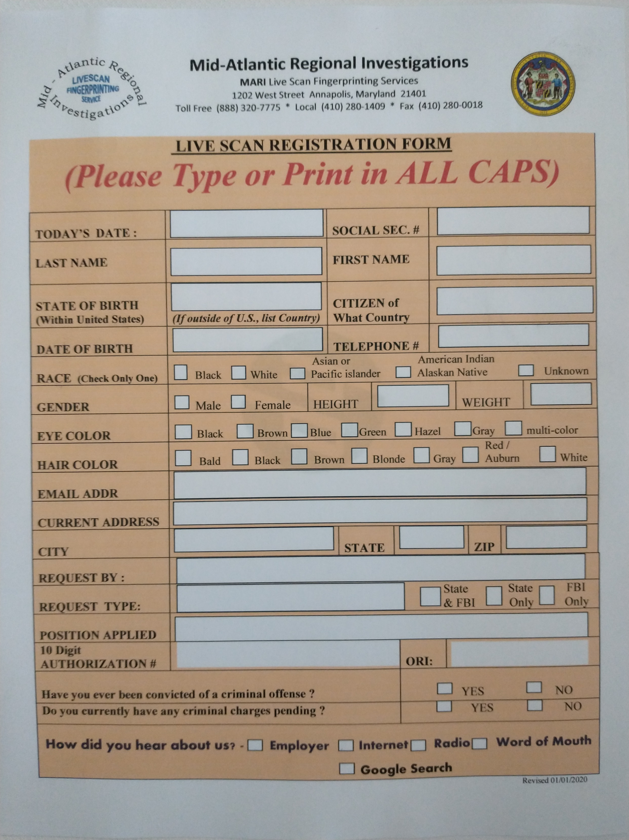
Step 16: This is an Example Registration Form for your Live Scan Fingerprints.
We recommend that you get your fingerprints done FIRST and complete the online MSP HQL application immediately afterwards. Do not wait or they may deny your application.
You can go to any Live Scan Fingerprinting facility however we recommend: Annapolis Fingerprinting, 108 Old Solomons Island Rd. Suite U3 Annapolis MD 21401.
Go to their website to make an appointment online, you will fill out a registration form when you get there.
EXAMPLE FORM

Slide 18
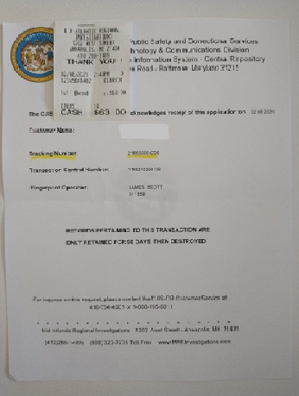
Step 17:This is an Example of your Live Scan Fingerprints Receipt.
Save this Receipt for future reference.
The price for Live Scan Fingerprints is about $65 charged by the Fingerprinting Facility and is not included with the cost of the HQL class you are attending.
Use highlighted Tracking Number to complete the Demographics section on your MSP HQL Application.

Slide 19
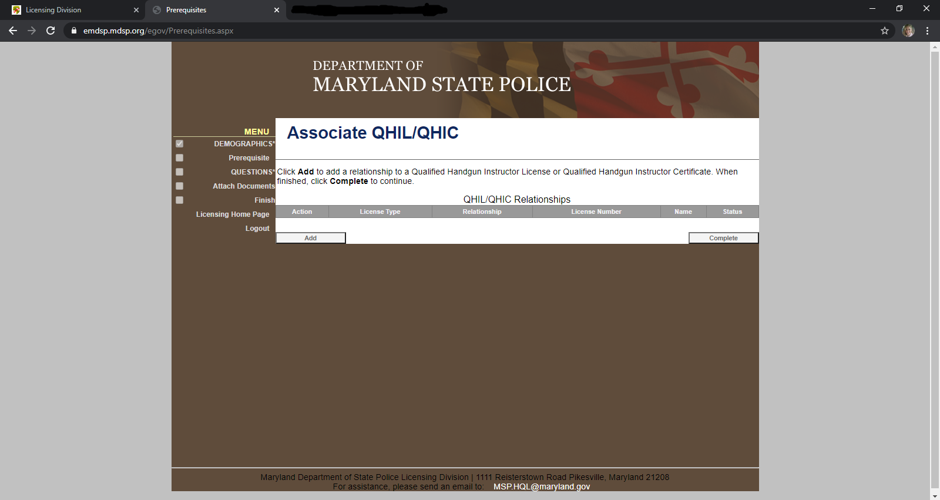
Step 18: Click “Add”.

Slide 20
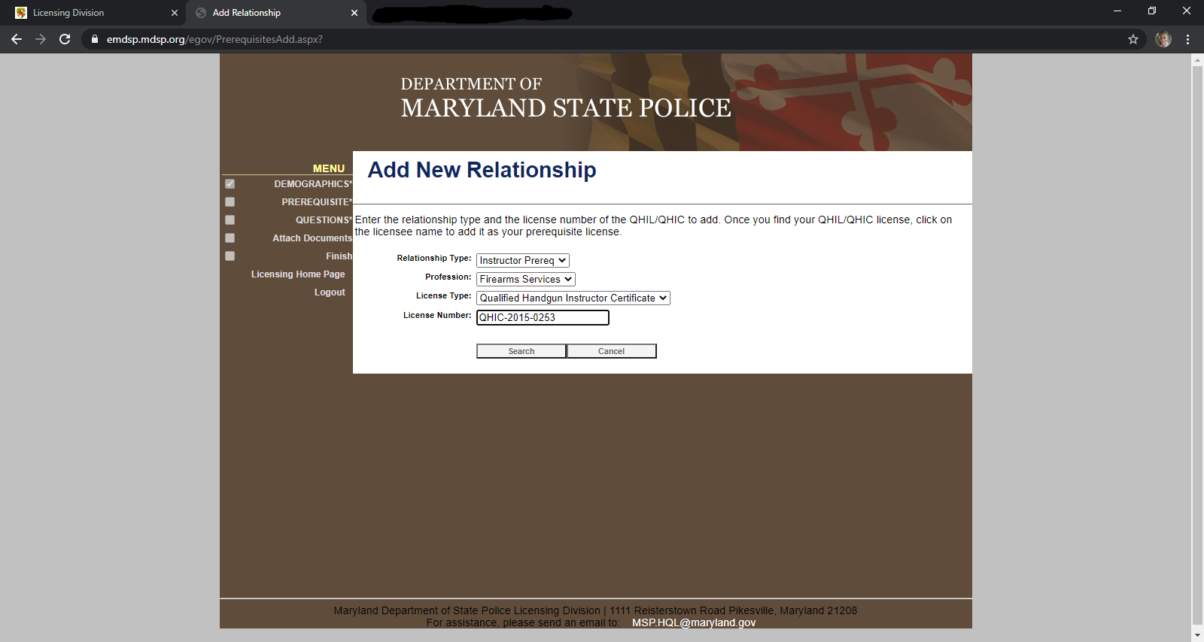
Step 19: Select under “Add New Relationship”-
Relationship Type: Instructor Prerequisite
Profession: Firearms Services
License Type: Qualified Handgun Instructor Certificate
License Number: QHIC-2015-0253
Click “Search”.

Slide 21
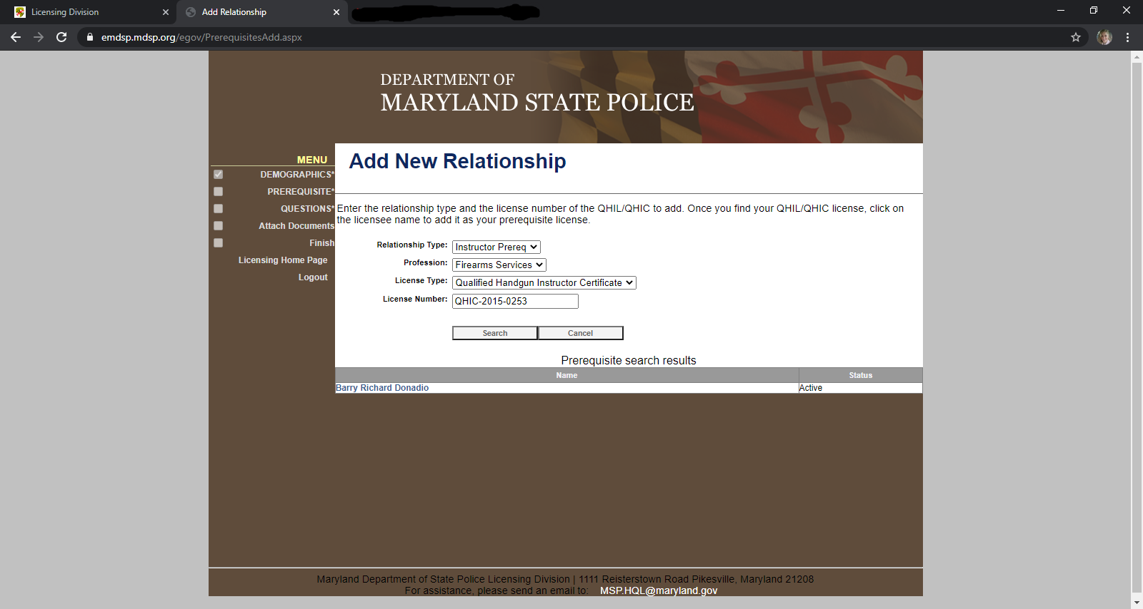
Step 20: Click on link for “Barry Richard Donadio” under Prerequisite Search Results to select.

Slide 22
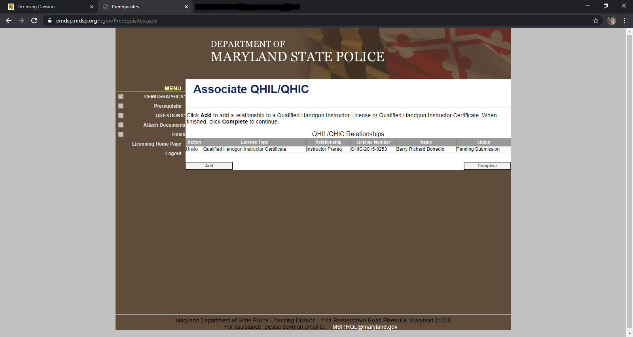
Step 21: Click “Complete”.

Slide 23
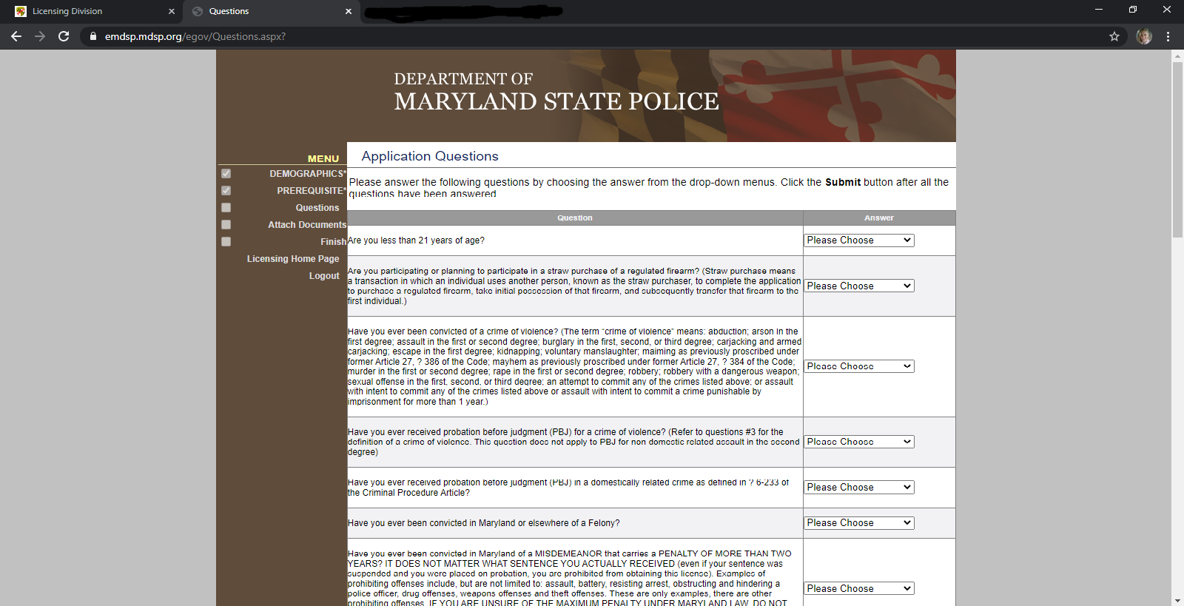
Step 22: Answer Application Questions.

Slide 24
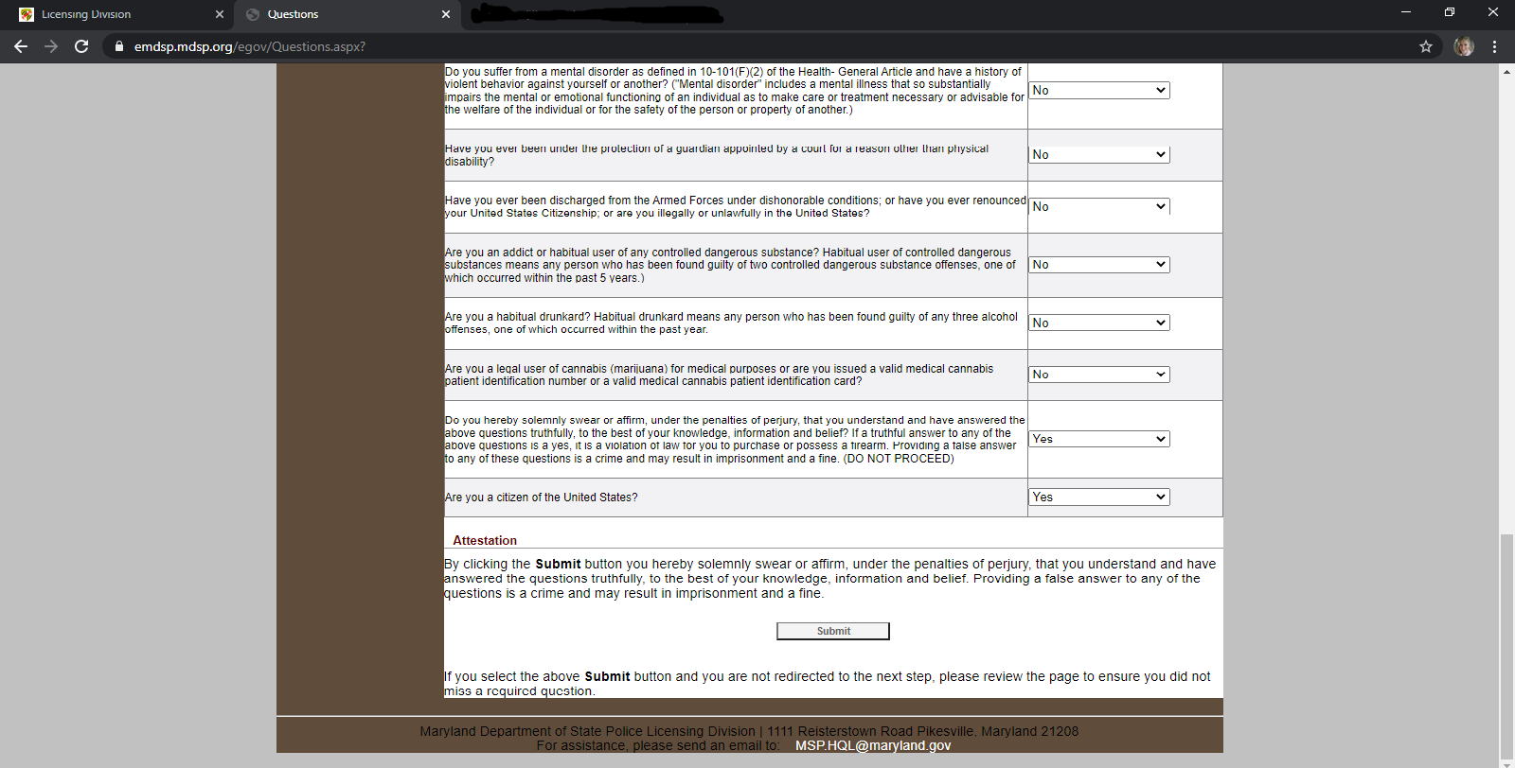
Step 23: When finished answering Application Questions, Click “Submit”.

Slide 25
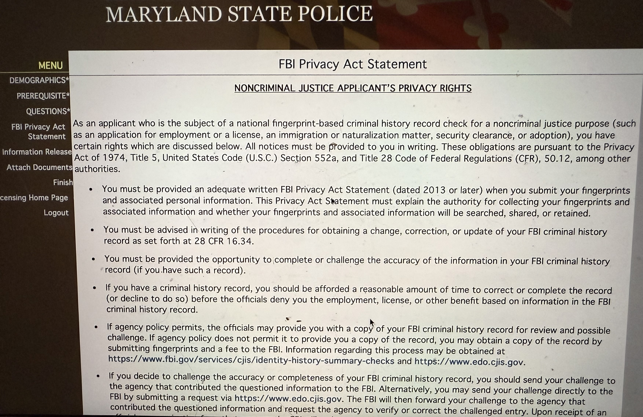
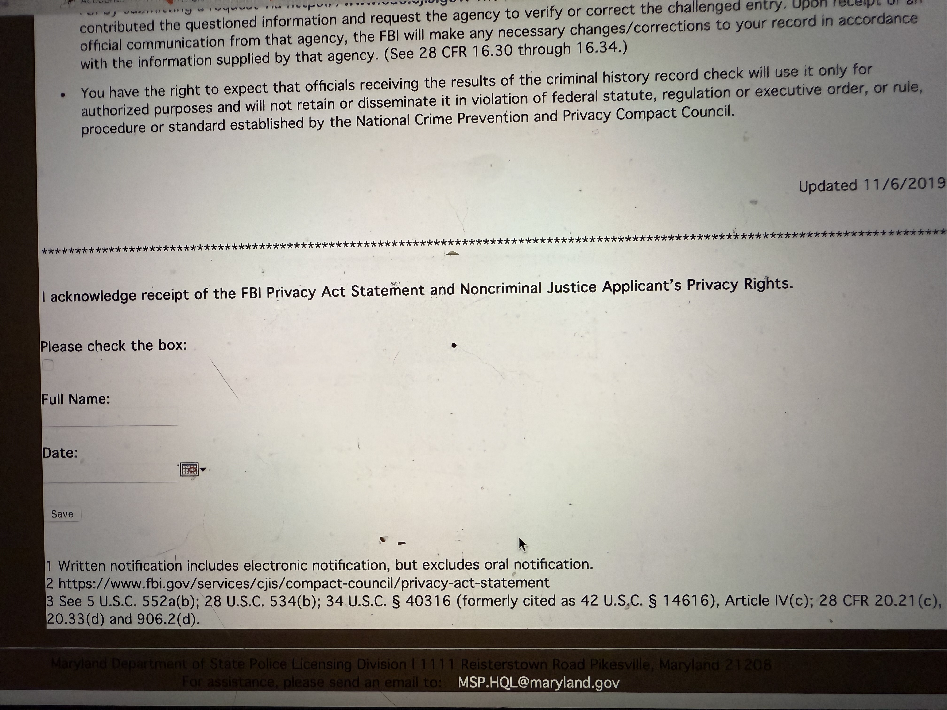
Step 24:Read the FBI Privacy Act Statement and sign it at the bottom, please make sure your name is exactly like it is in your demographics page.

Slide 26
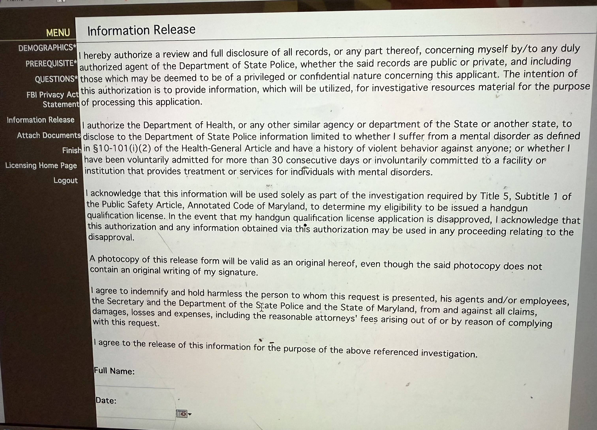
Step 25: Read, date
and sign Information
Release

Slide 27
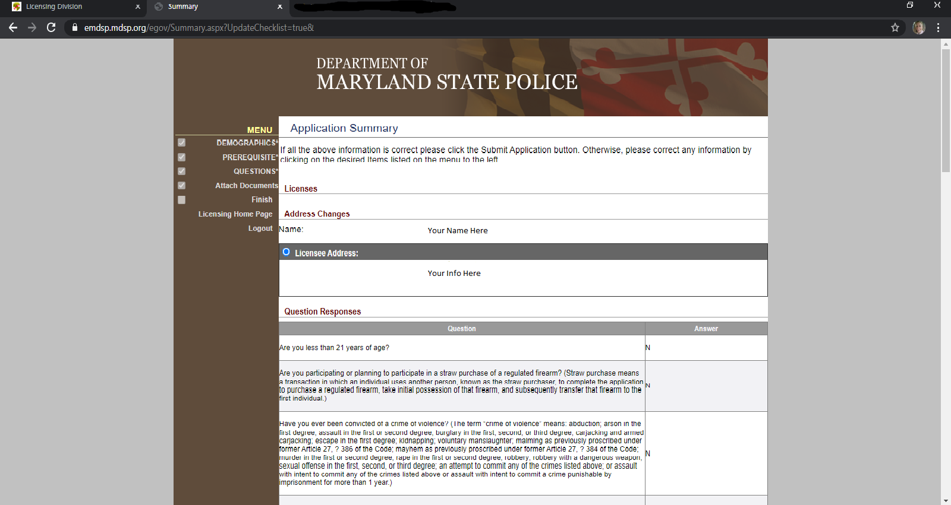
Step 25: Review your Application Summary.

Slide 28
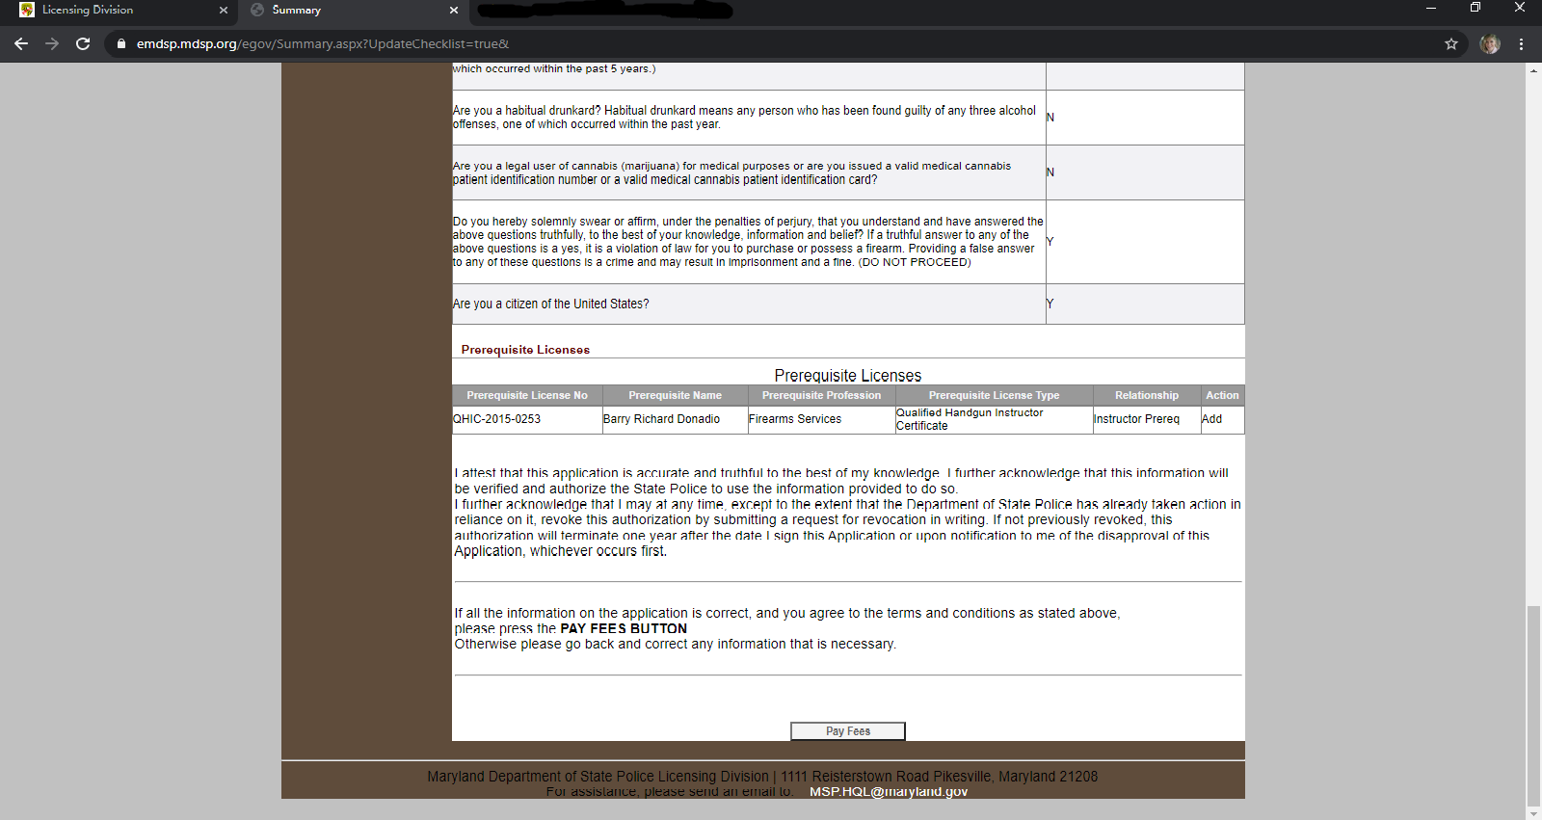
Step 26: Click “Pay Fees”.

Slide 29
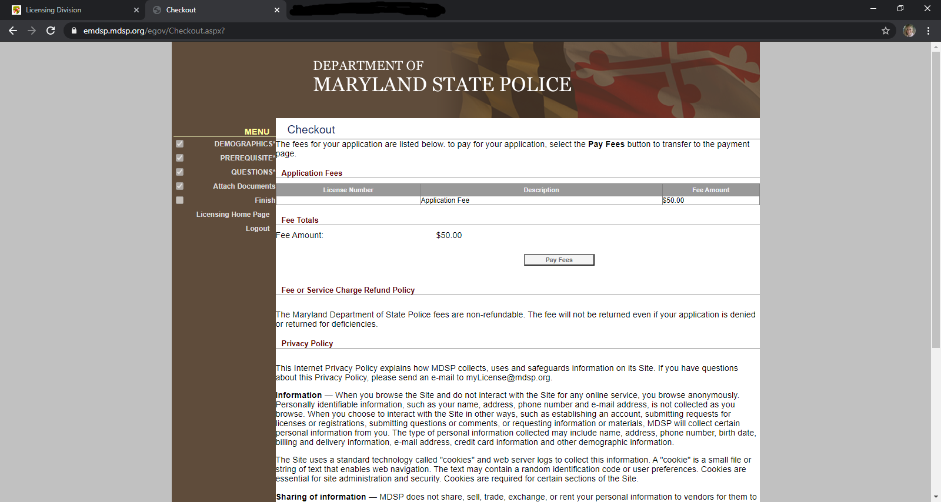
Step 27: Continue to Checkout. Click “Pay Fees”.

Slide 30
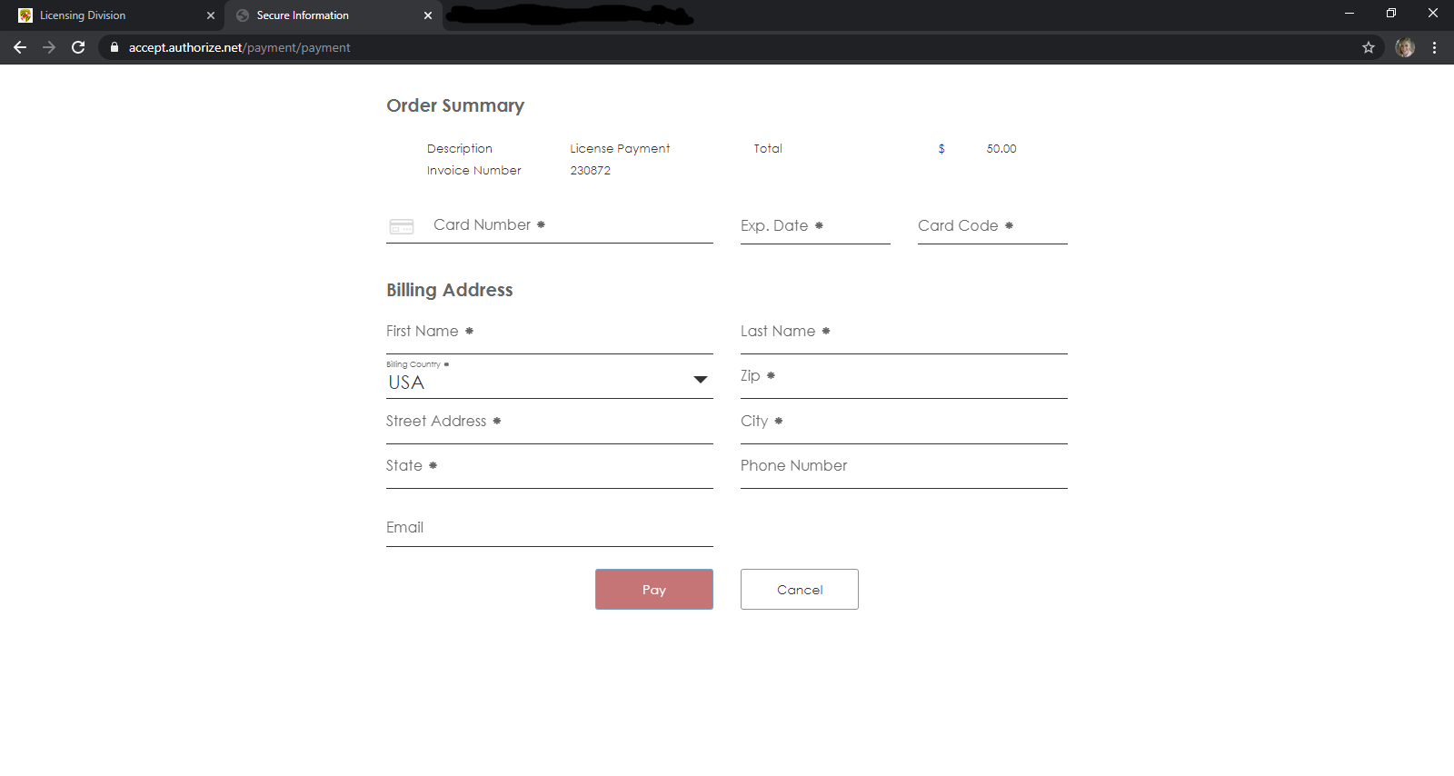
Step 28: Enter your payment information. Click “Pay”.
*Reminder: The cost is $50 for a New HQL Application. This is a separate fee charged by MSP not included in cost of this HQL Class.

Slide 31
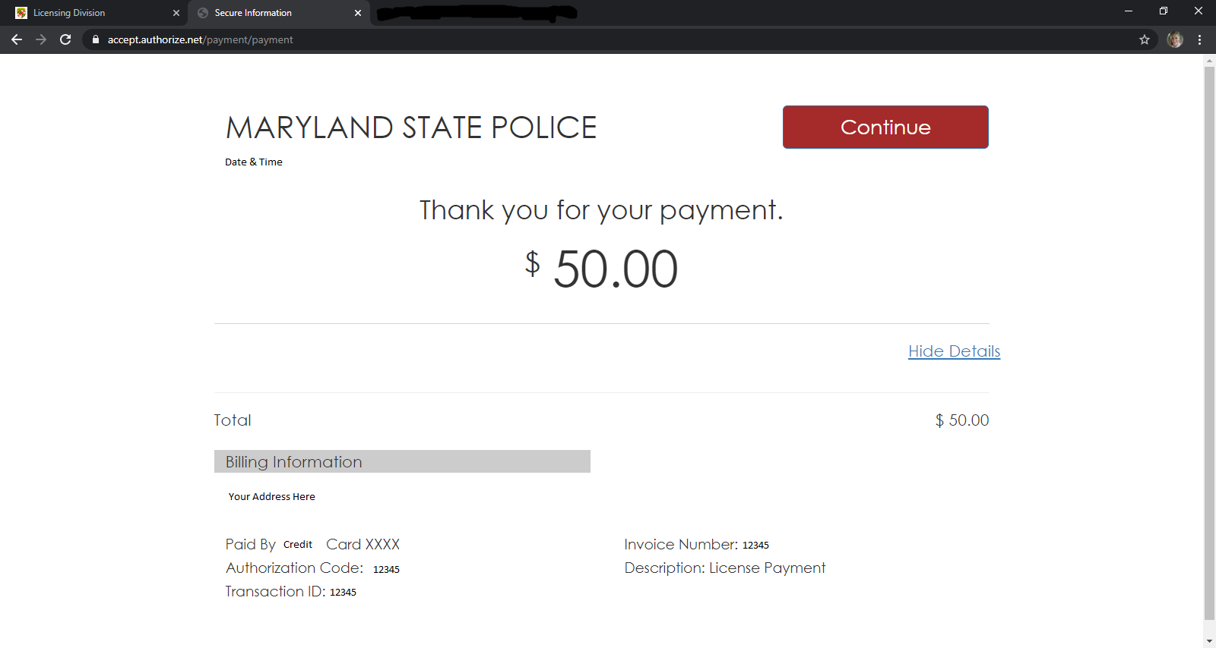
Step 29: Click “Continue”.
*A copy of this receipt will be emailed to the email you used to create your MSP account. Save for your records.

Slide 32
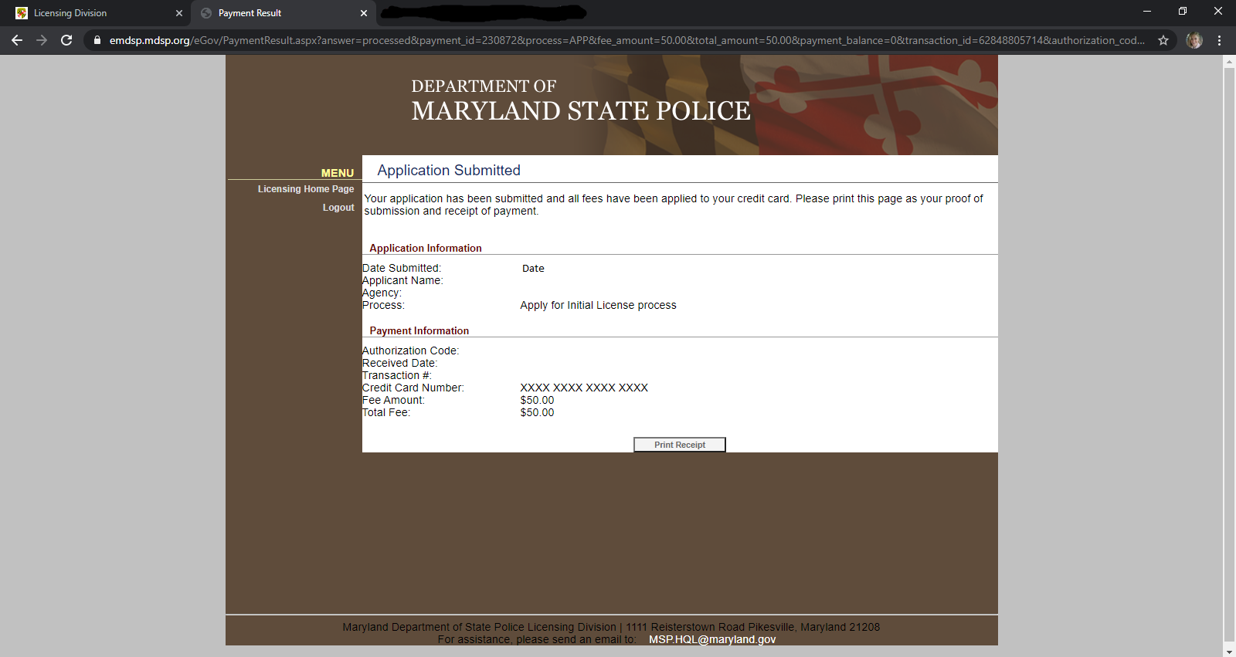
Your application is now Submitted. You may print your receipt for your records.

Slide 33
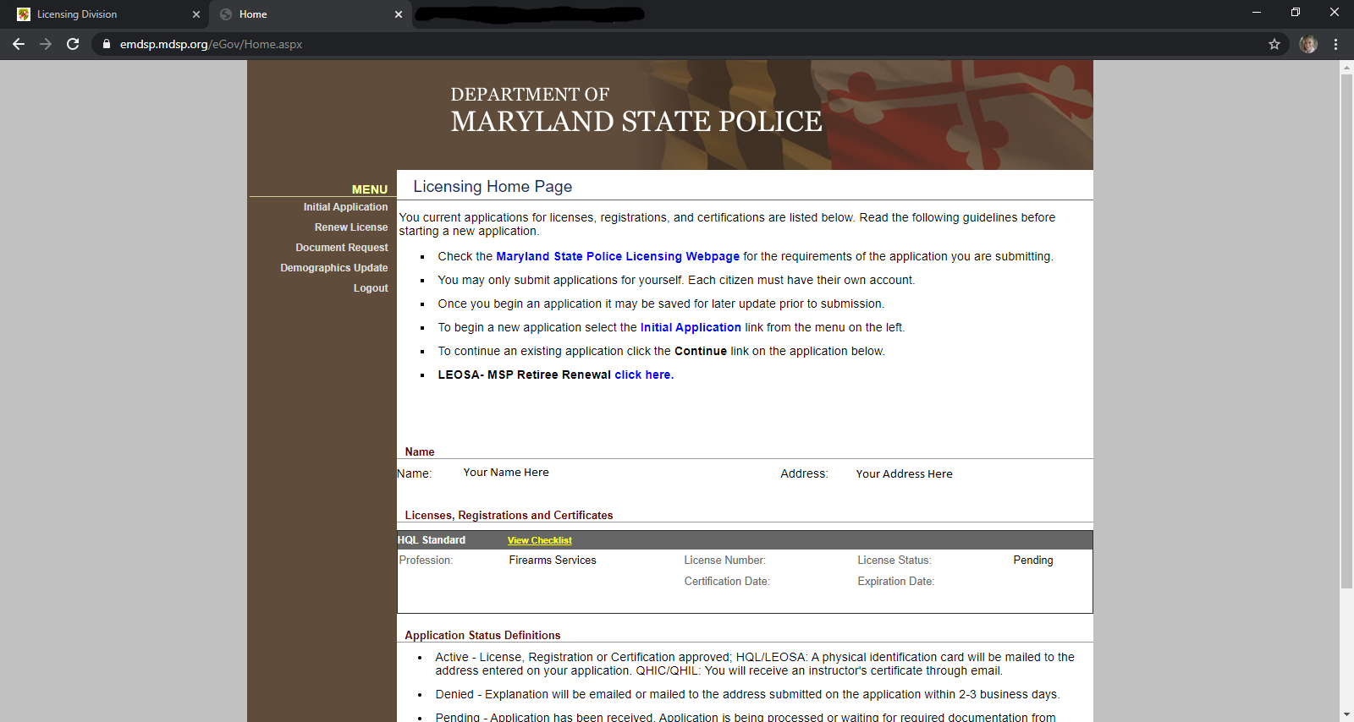
You may check the status of your application anytime by logging in to your MSP account using the User Name & Password you created at the beginning of the application.
Due to the increased number of HQL applications, expect a longer waiting period.

Slide 34

Step 30: Contact Barry Donadio via text with your Full Name, Date you attended HQL class and a Note that you have submitted your MSP HQL Application online.

Slide 35
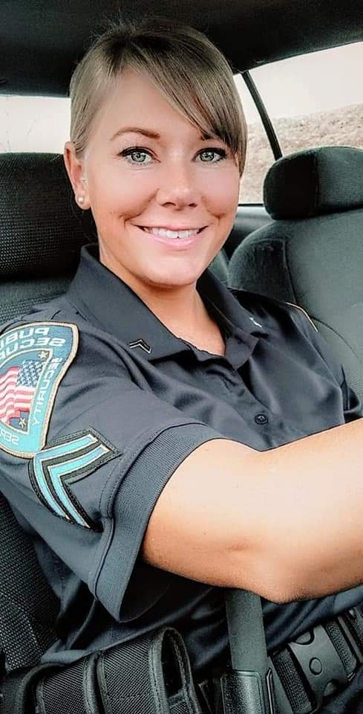
A very special thank you to Corporal Christina Bennett! She is Barry Donadio’s #1 employee at Public Security LLC. She created this amazingly “Blonde Proof” slideshow of Step-by-Step instructions for the MSP HQL online application.
The End.

