Slide 1

Train With Donadio
Obtaining Your Maryland Handgun Qualification License
Step By Step Instructions for the Online MSP HQL Application

Slide 2
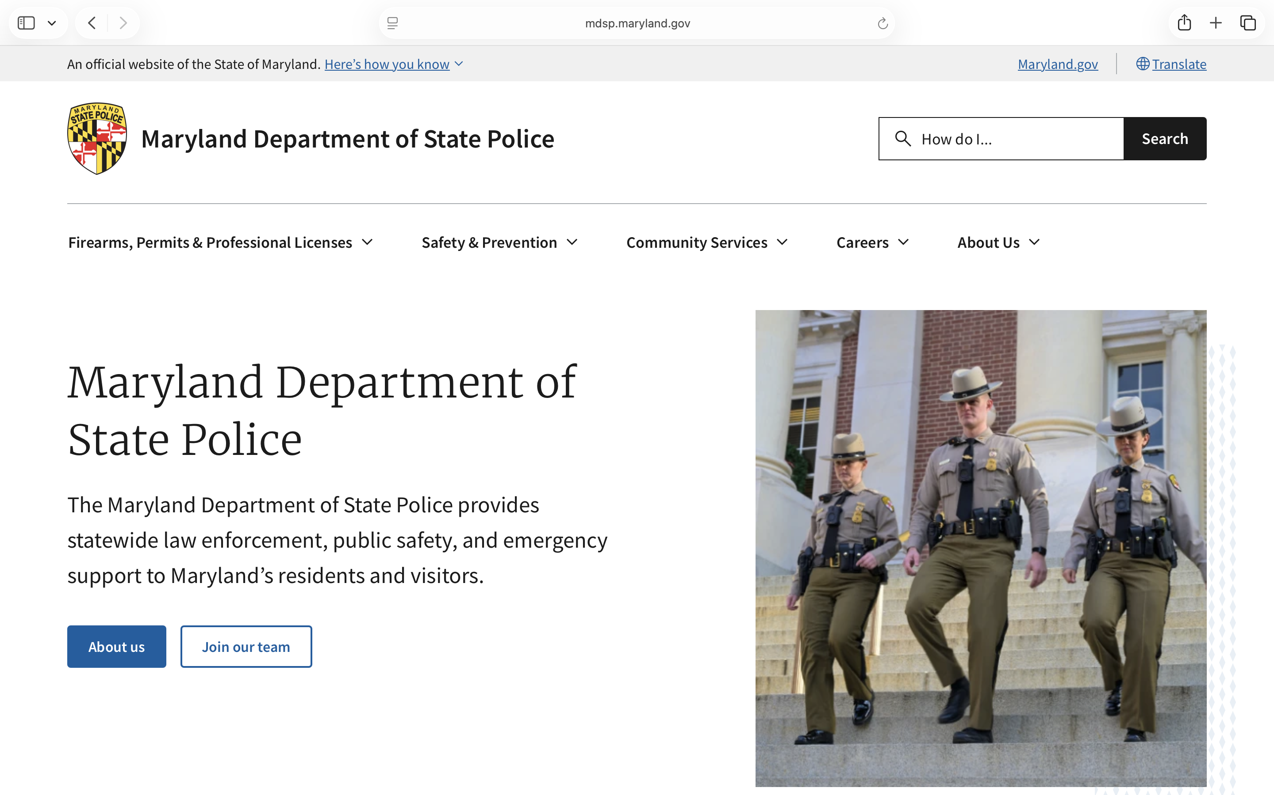

Step 1: Go to Maryland State Police Website.
https://mdsp.maryland.
gov
Click on firearms, permits & professional licenses

Slide 3
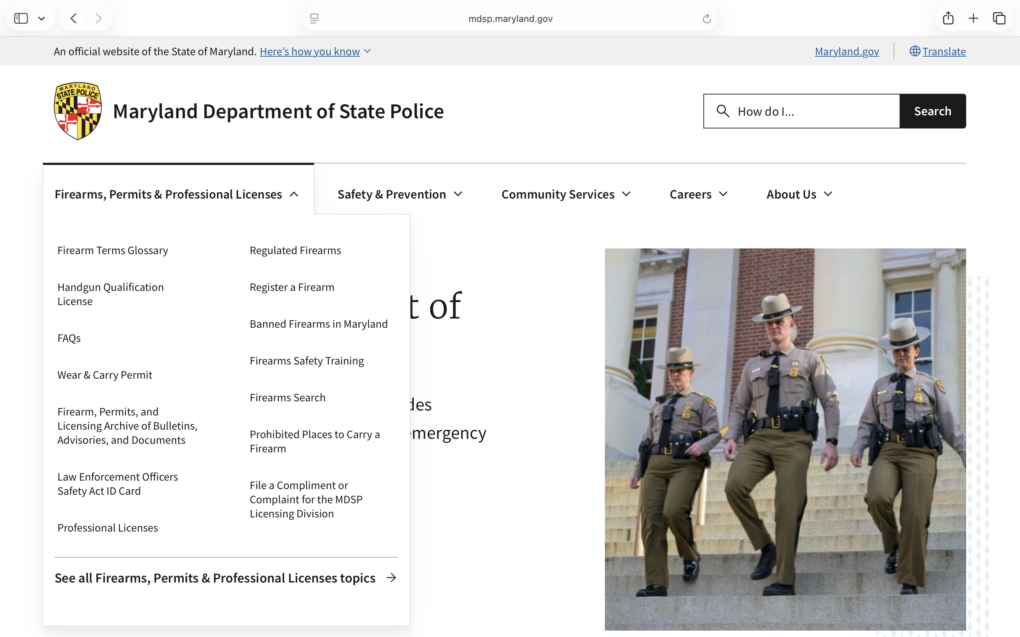
Step 2: Click on Handgun Qualification License.

Slide 4
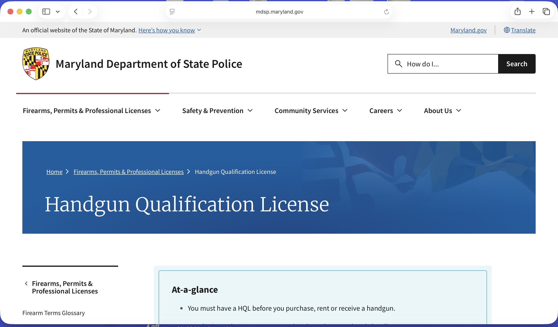
Step 3: Once you have arrived to this page, Scroll Down.

Slide 5
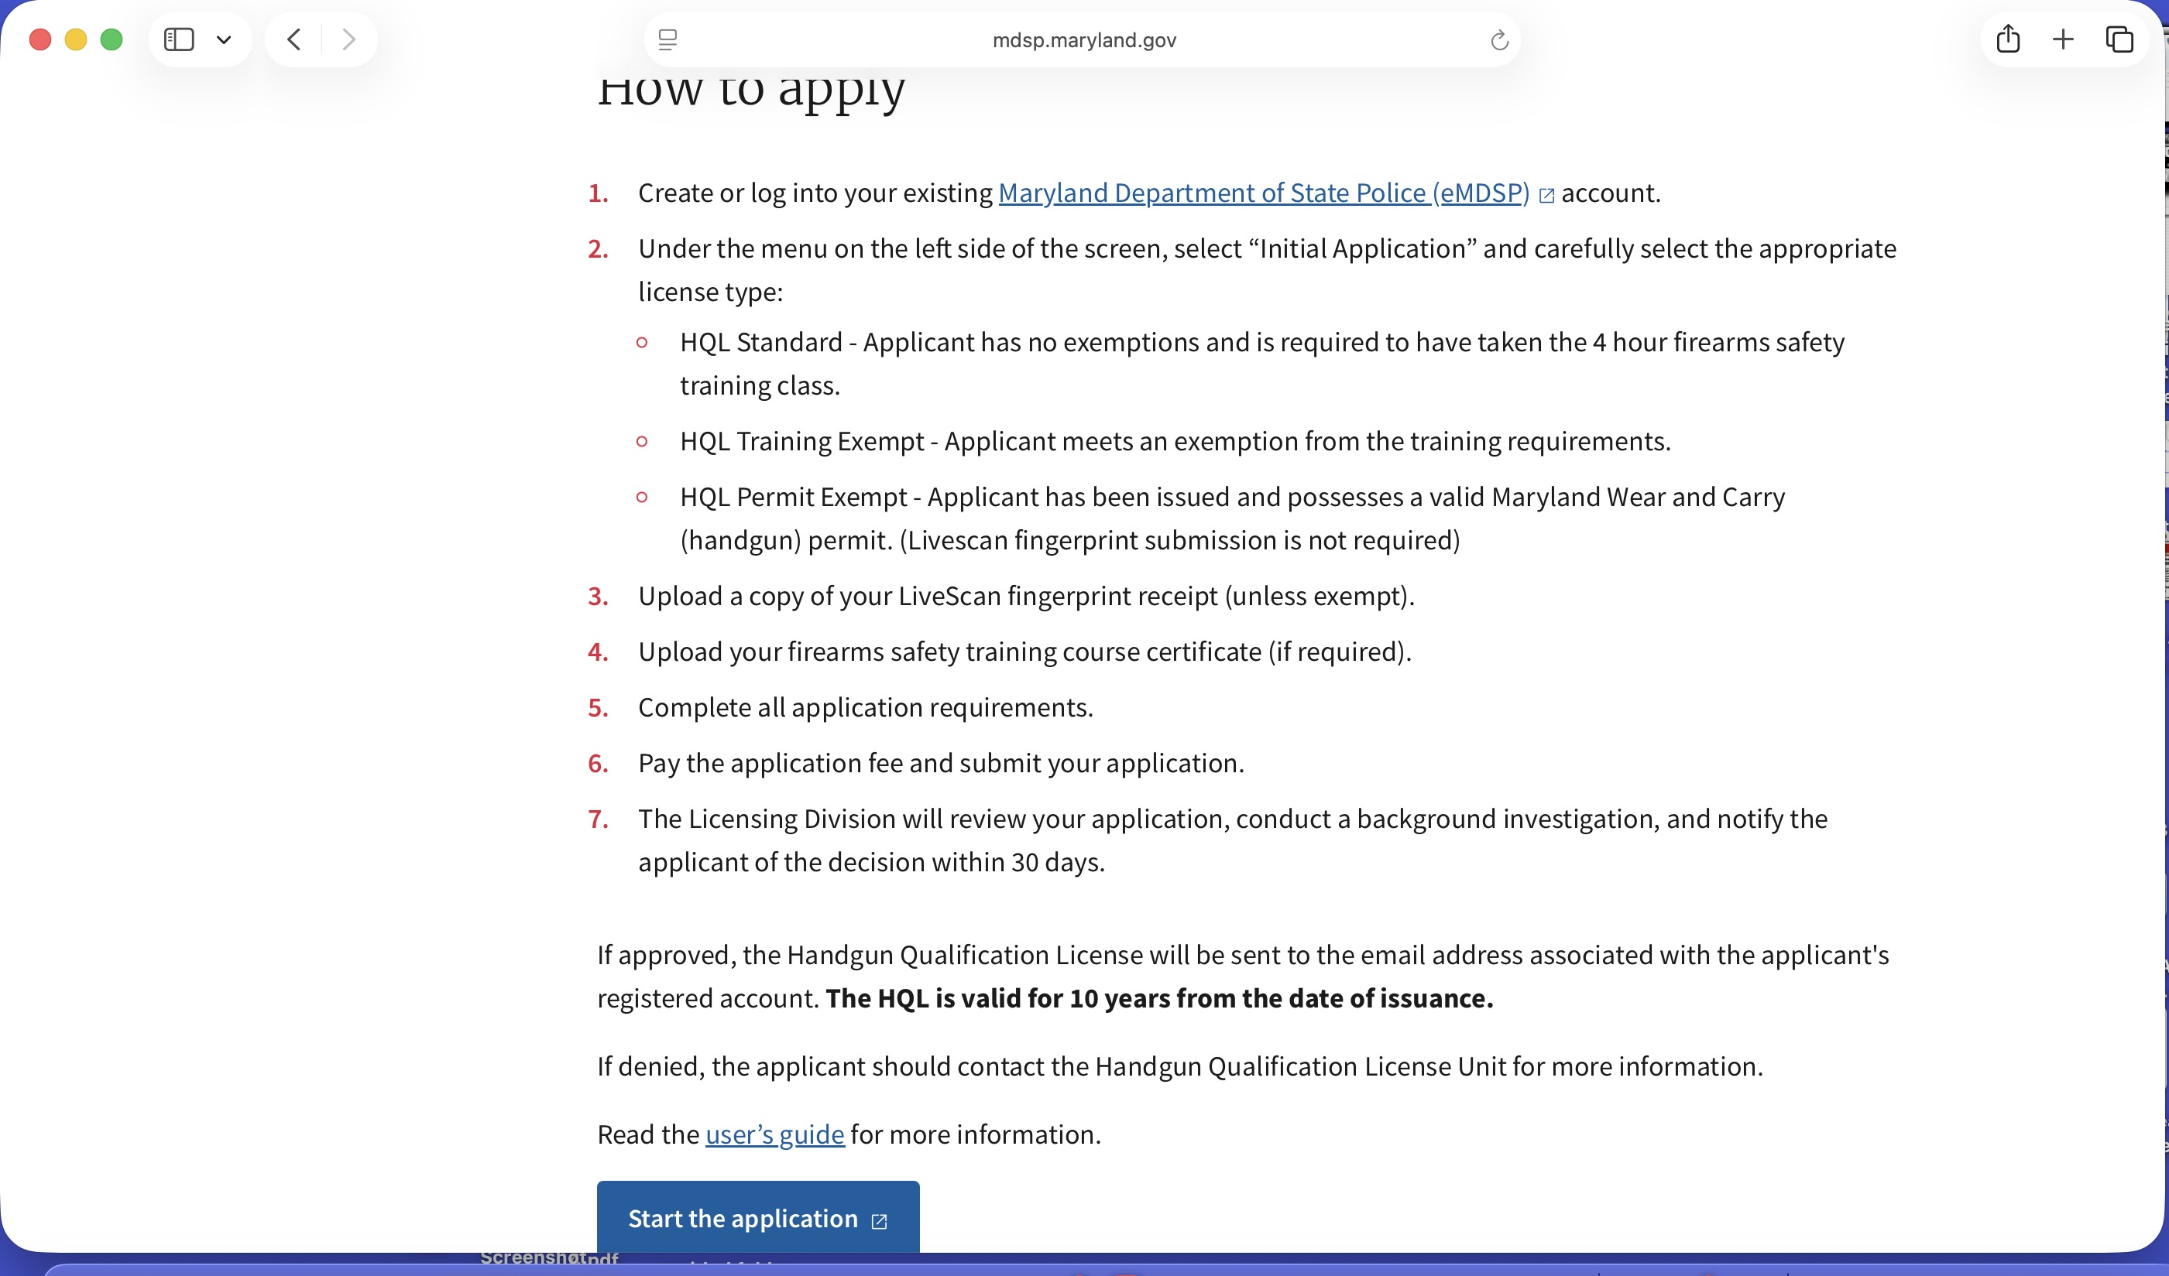


Step 4: Click on start the application.

Slide 6
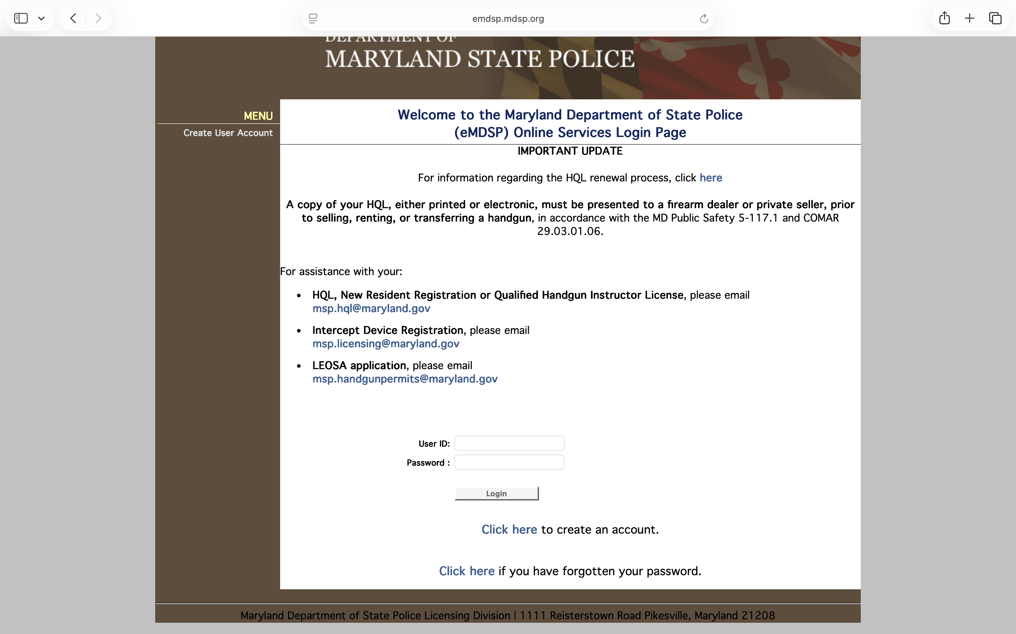
Step 5: You must now Create an Account if you do not already have one.
*Remember Your User ID & Password for the future reference.

Slide 7
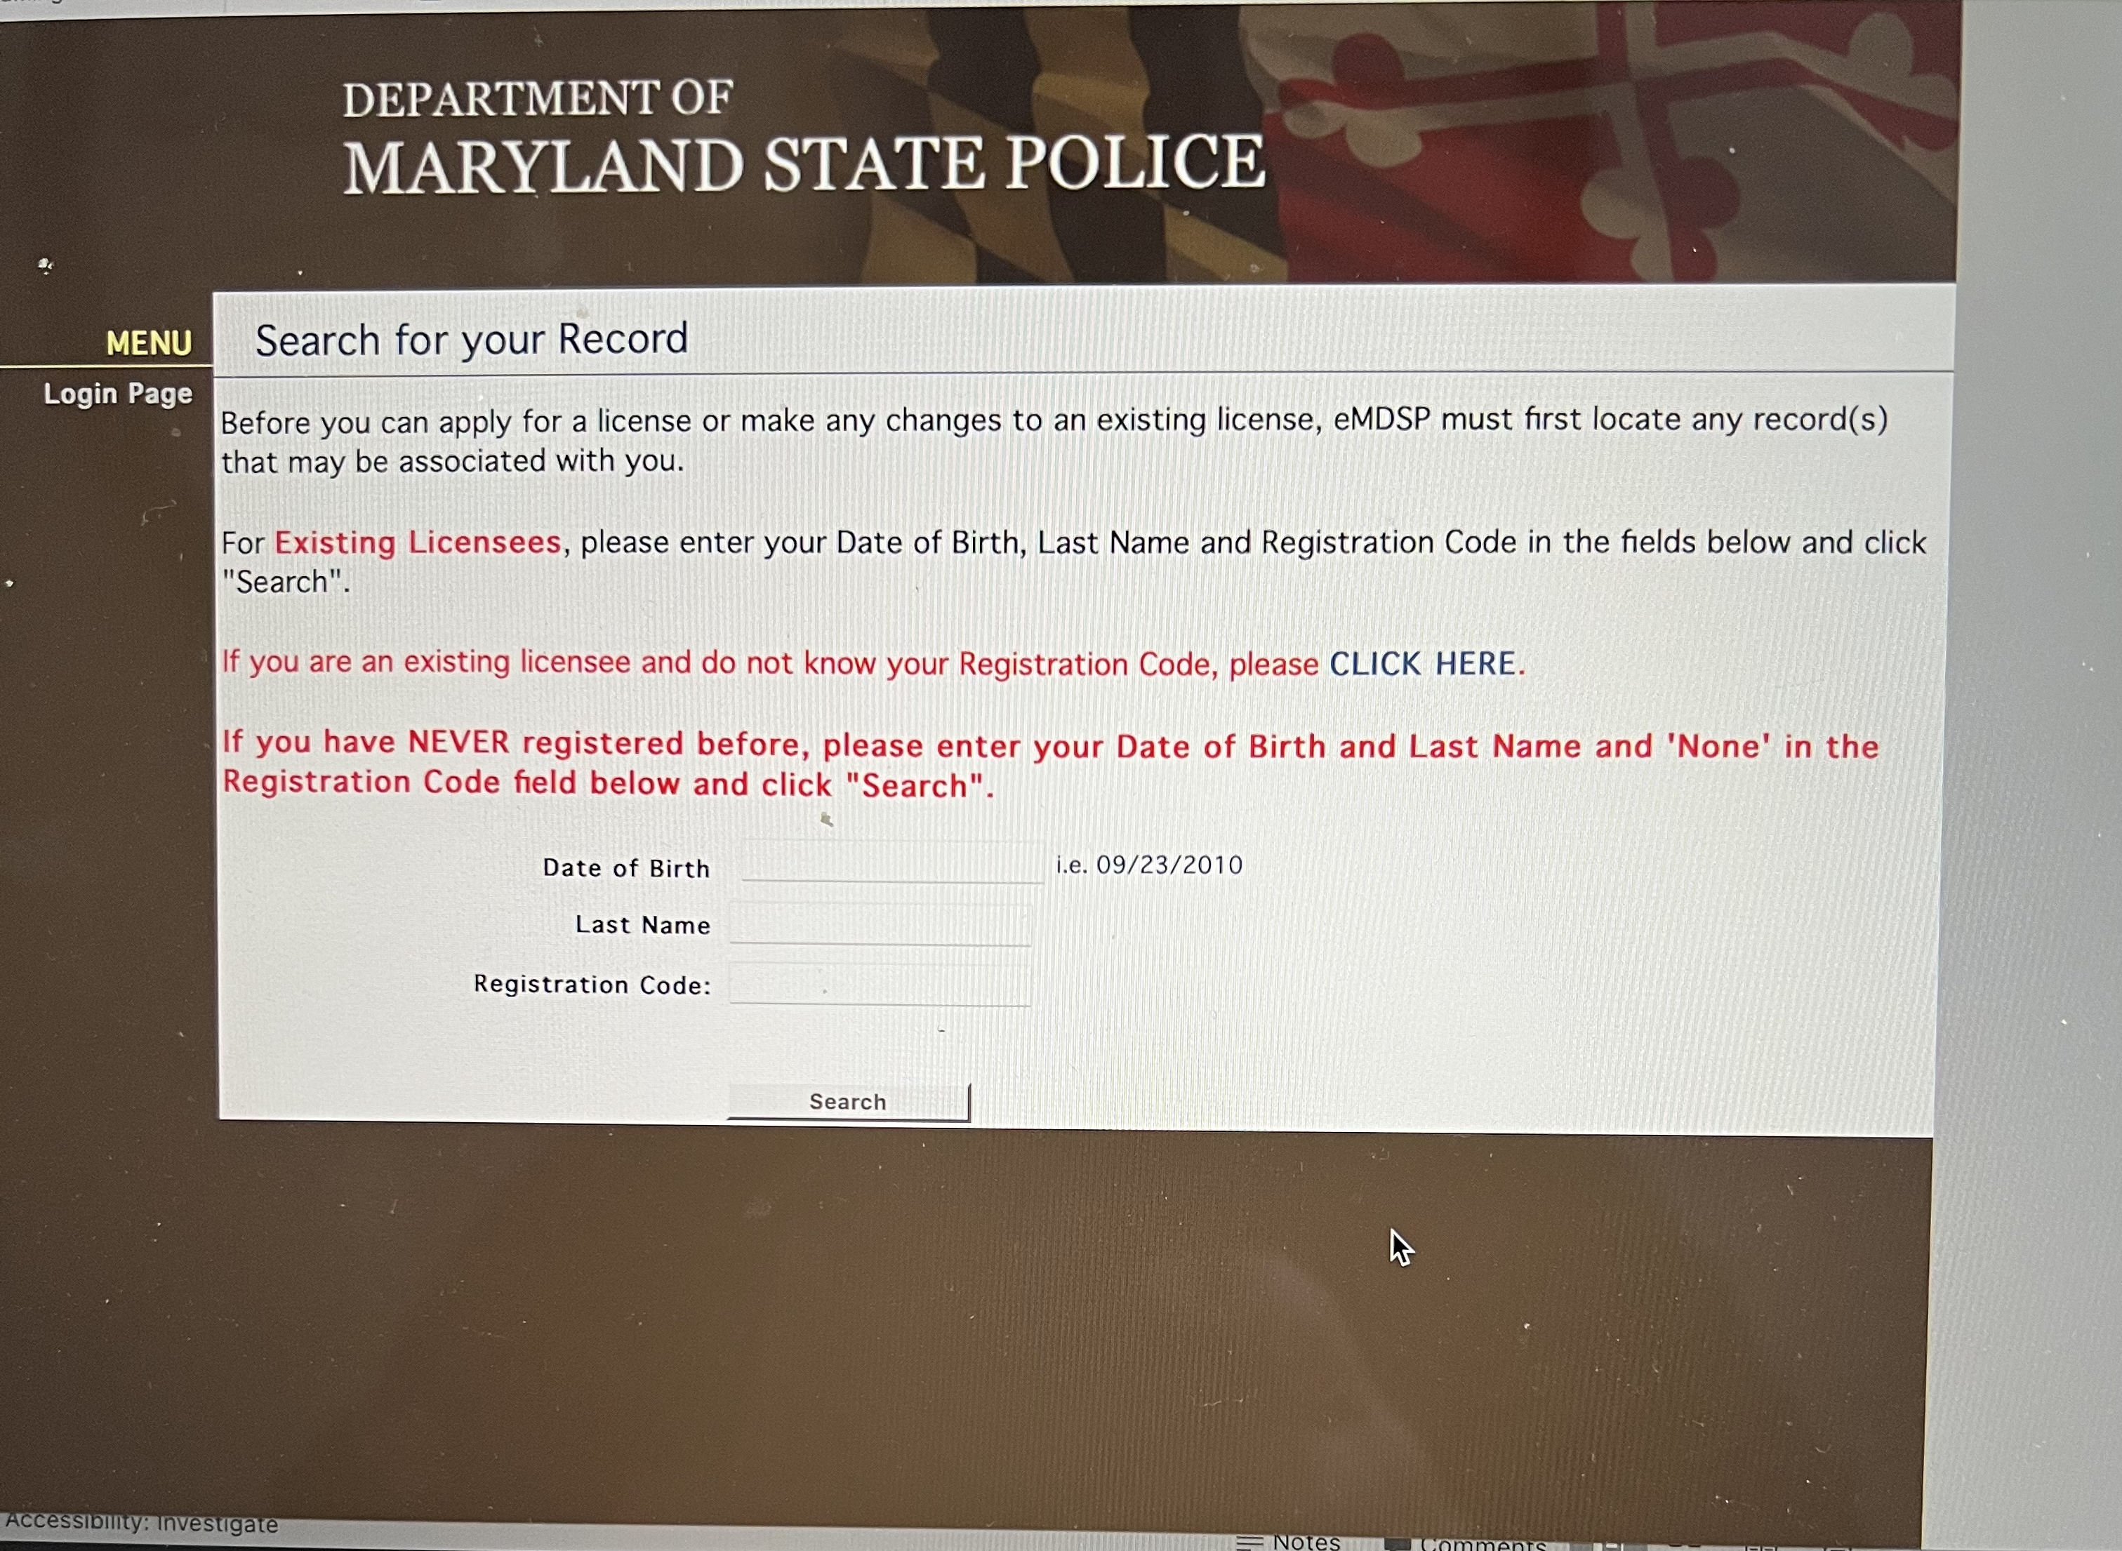

Step 6: Read yellow highlight. Follow website instructions to finish creating an account.

Slide 8
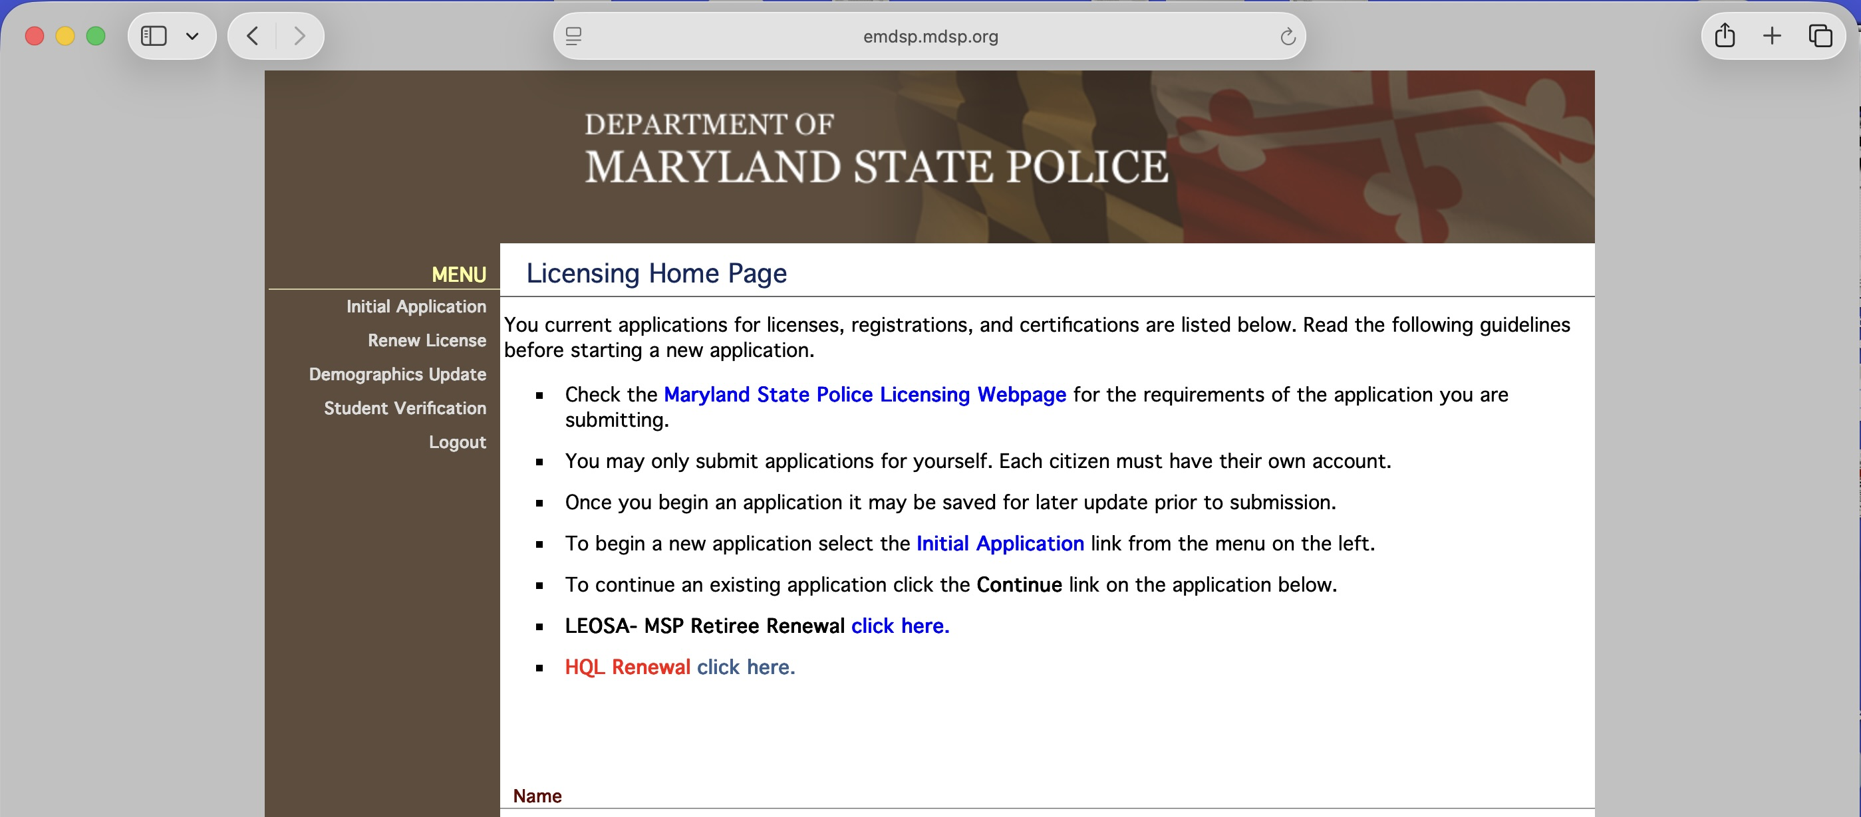

Step 7:Click on initial application.

Slide 9
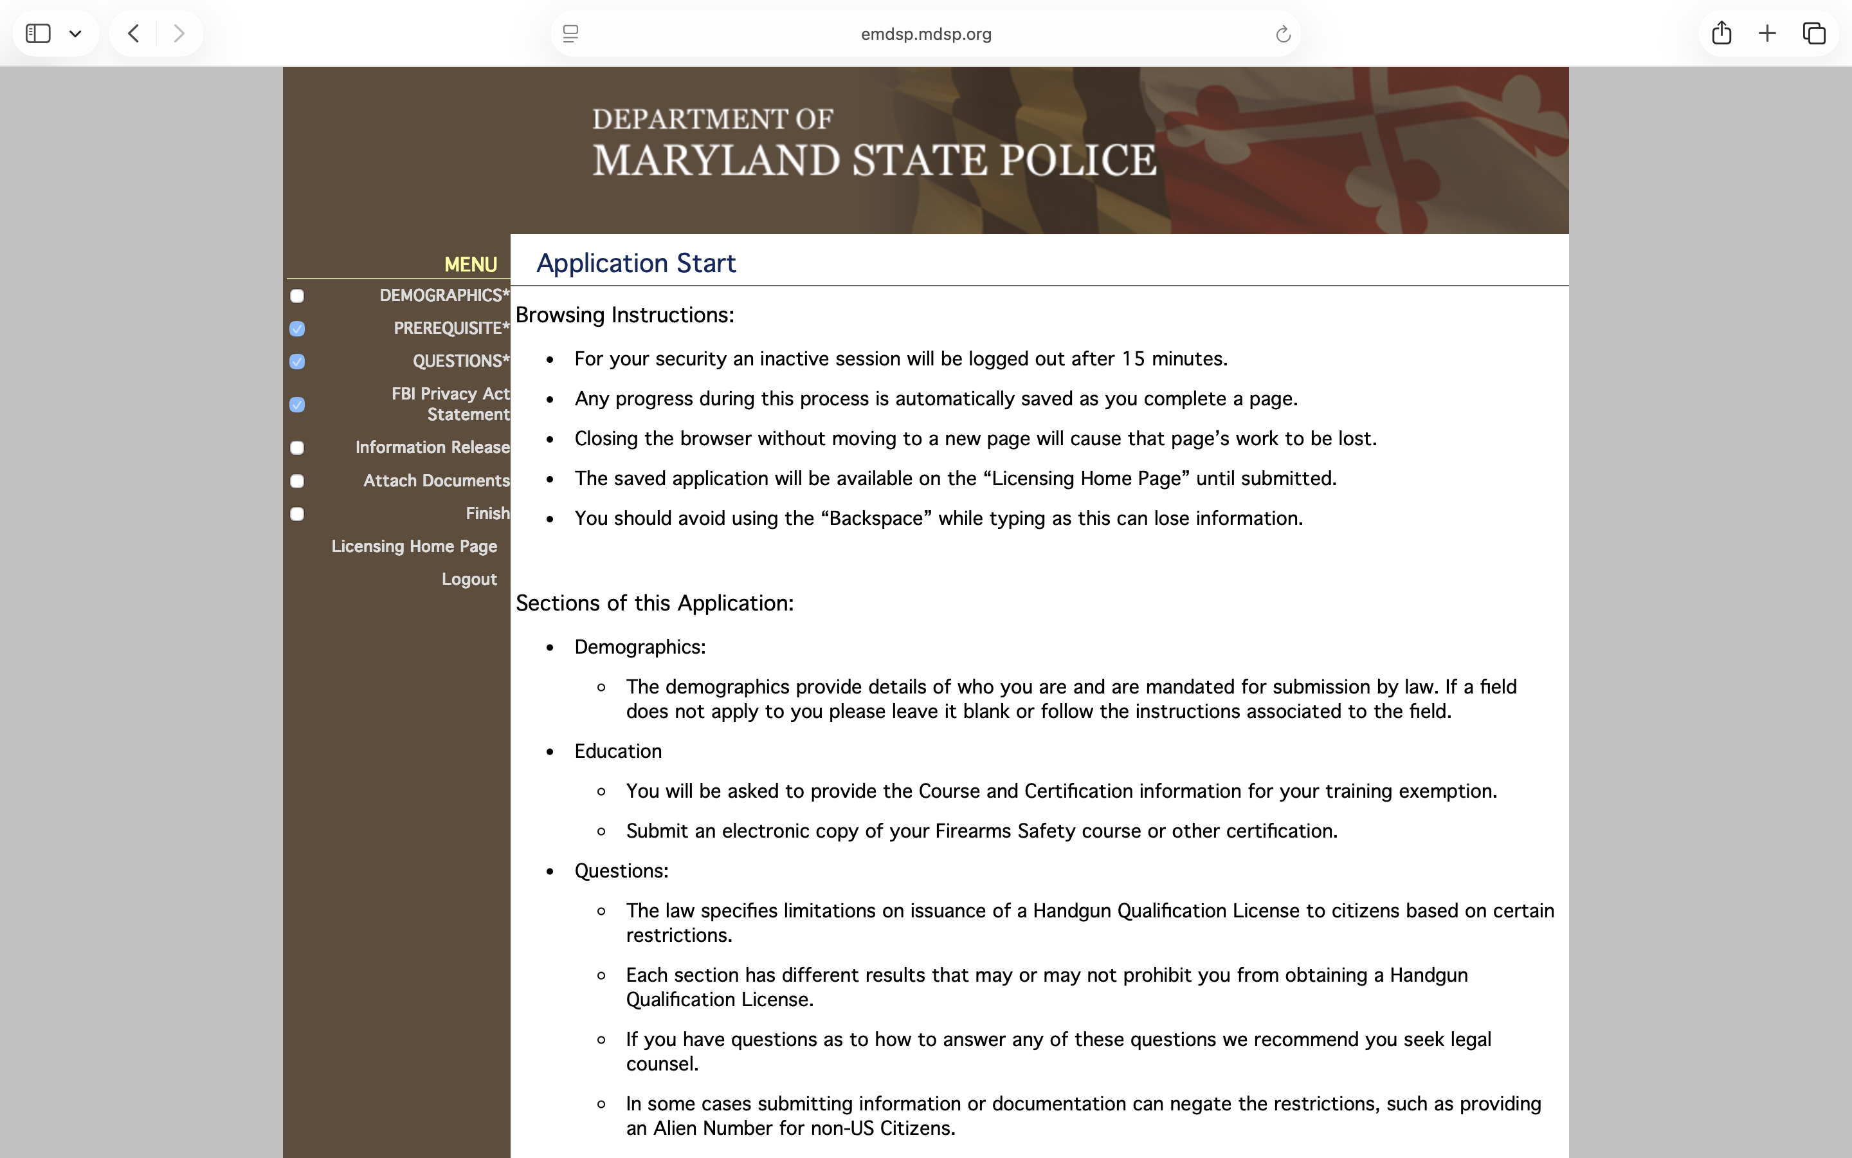
Step 8: Read the entire instructions and then click on demographics.

Slide 10
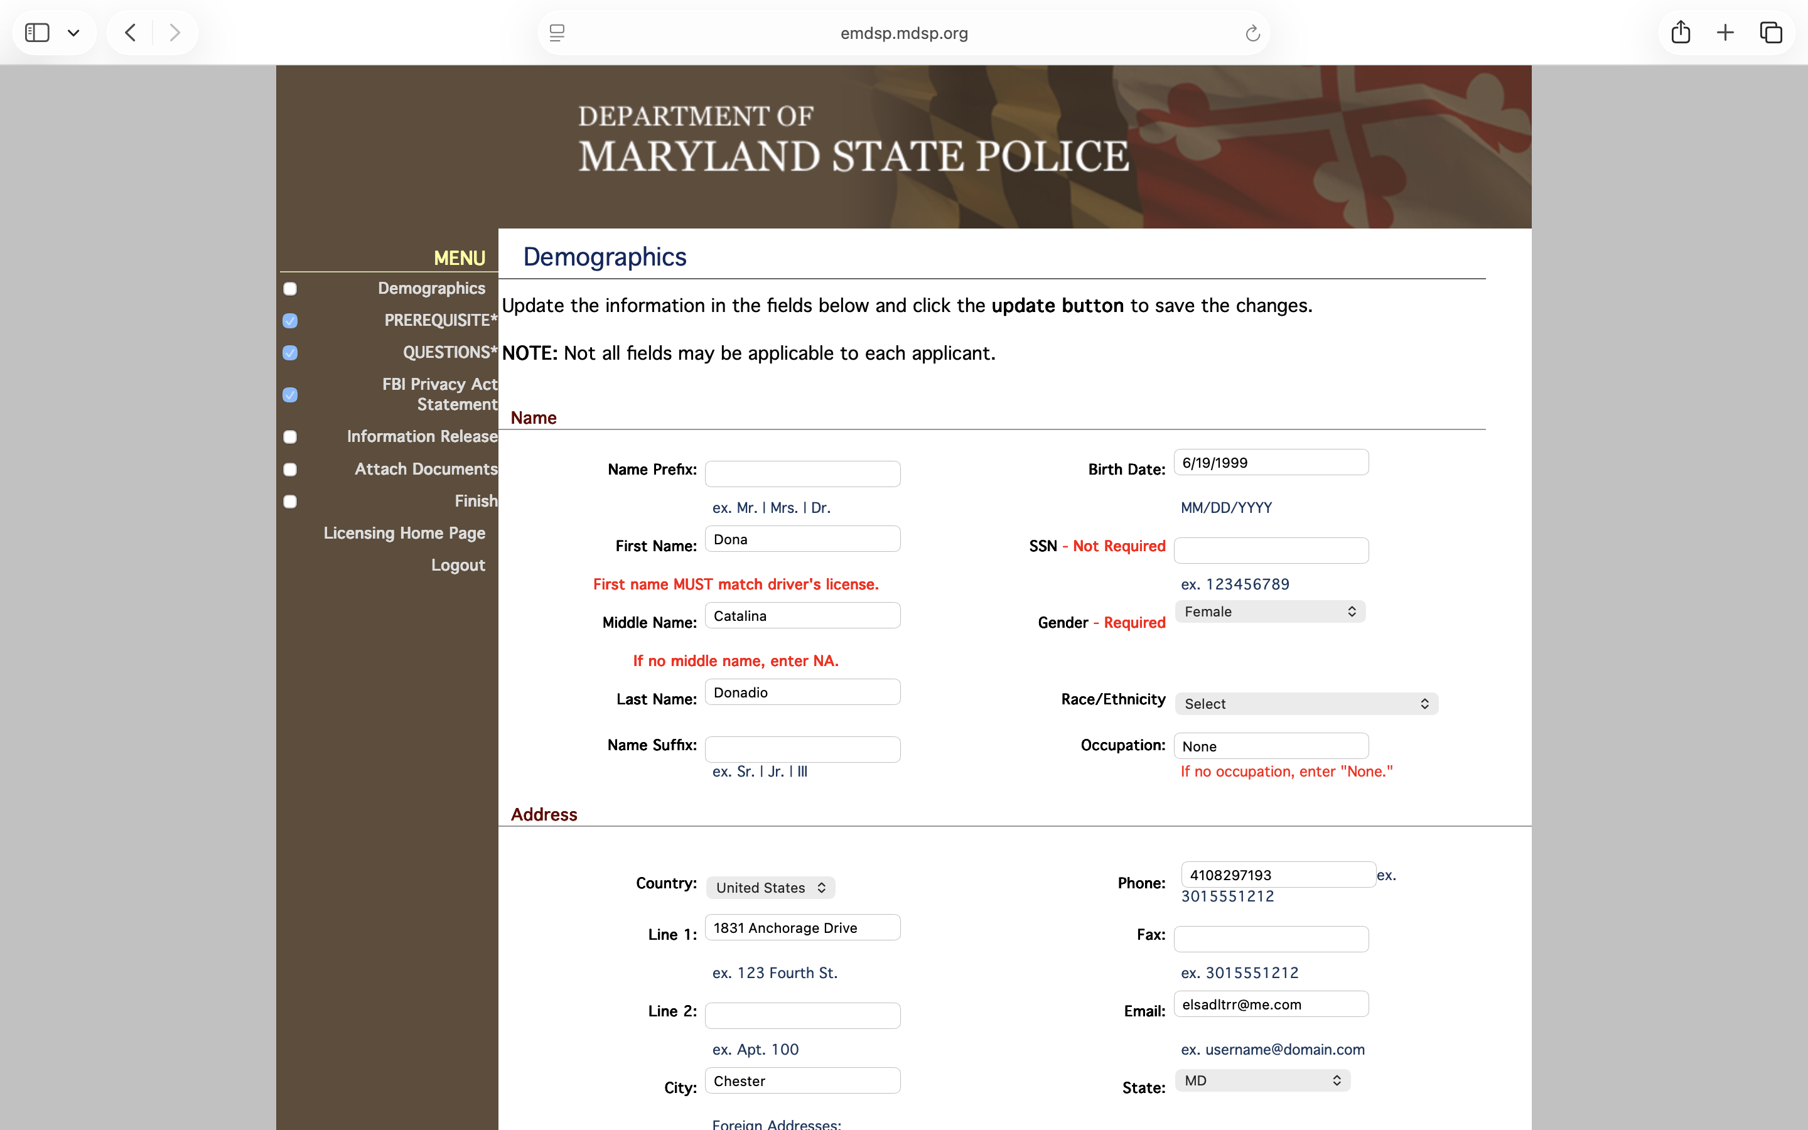
Step 9: Demographics
Fill out all the required fields.

Slide 11
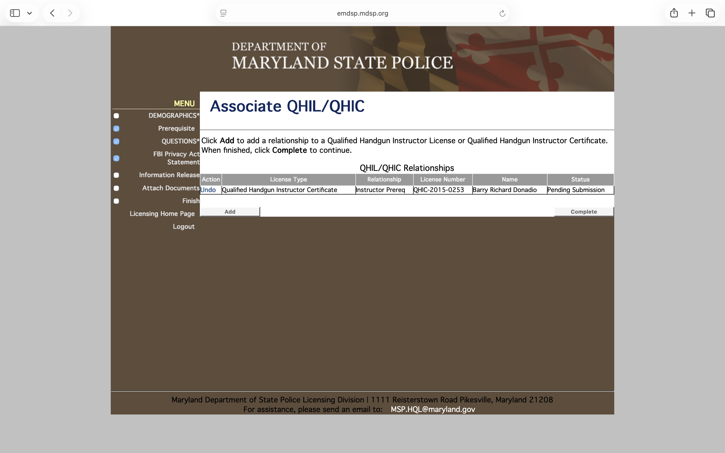
Step 10: Prerequisite. Click add to add instructor license number and make sure you click on Qualified Handgun Instructor certificate. Instructor license number QHIC-2015-0523

Slide 12
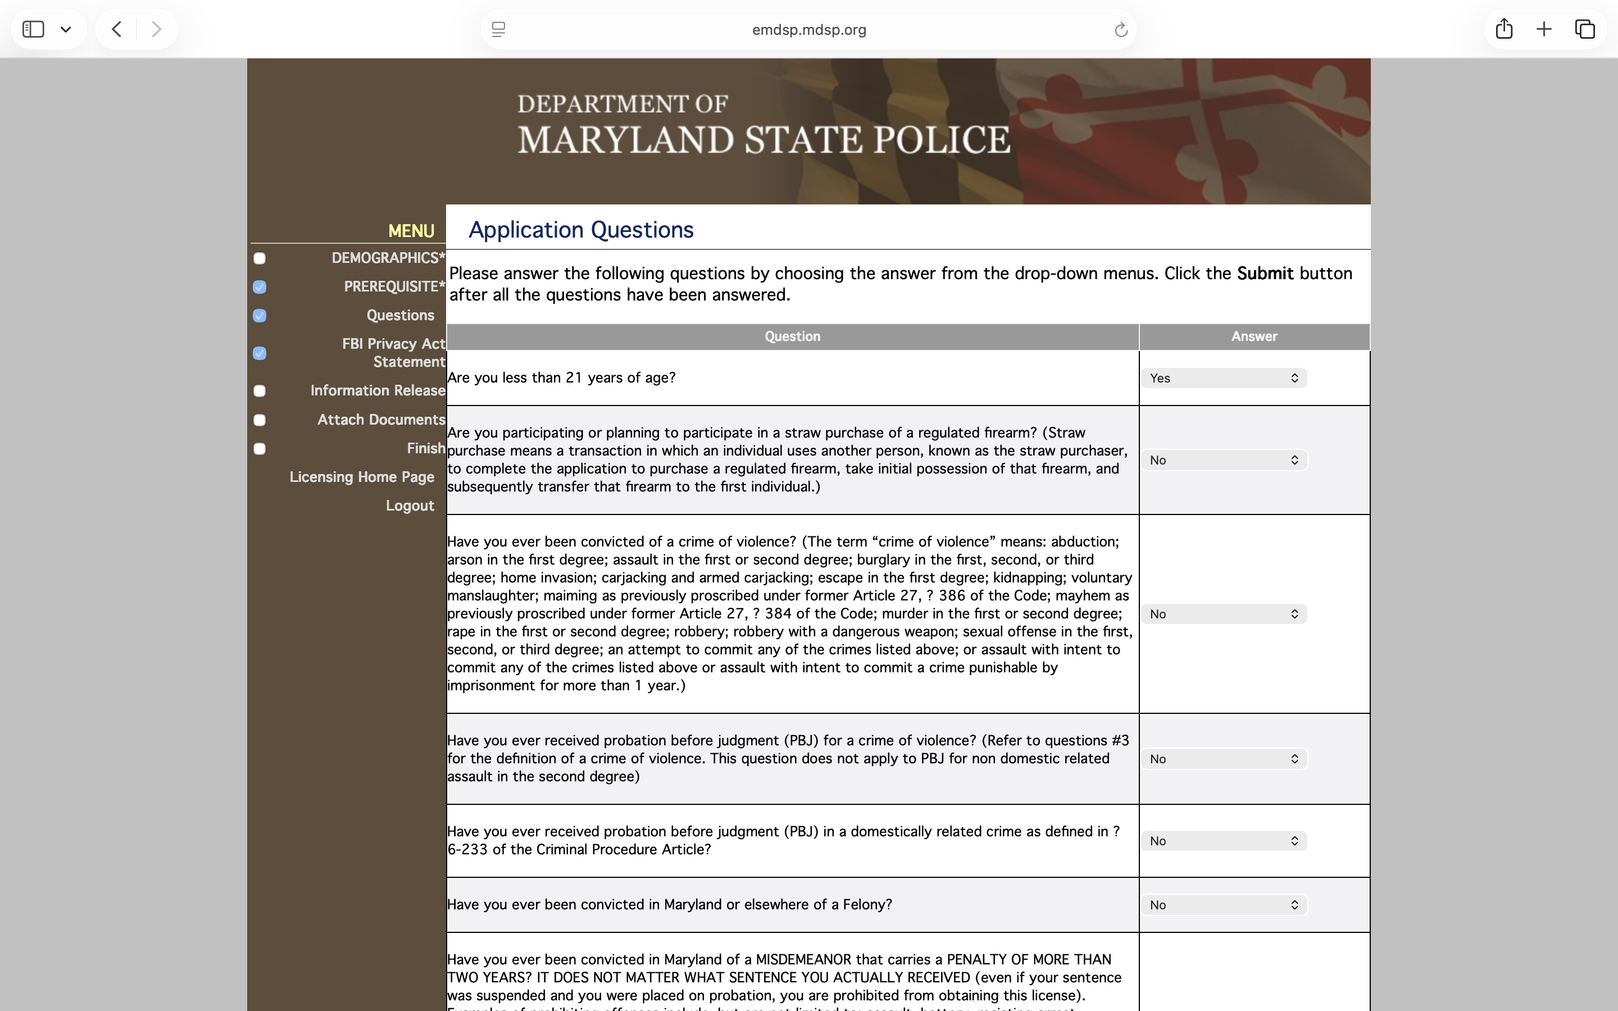
Step 11: Answer all the questions

Slide 13
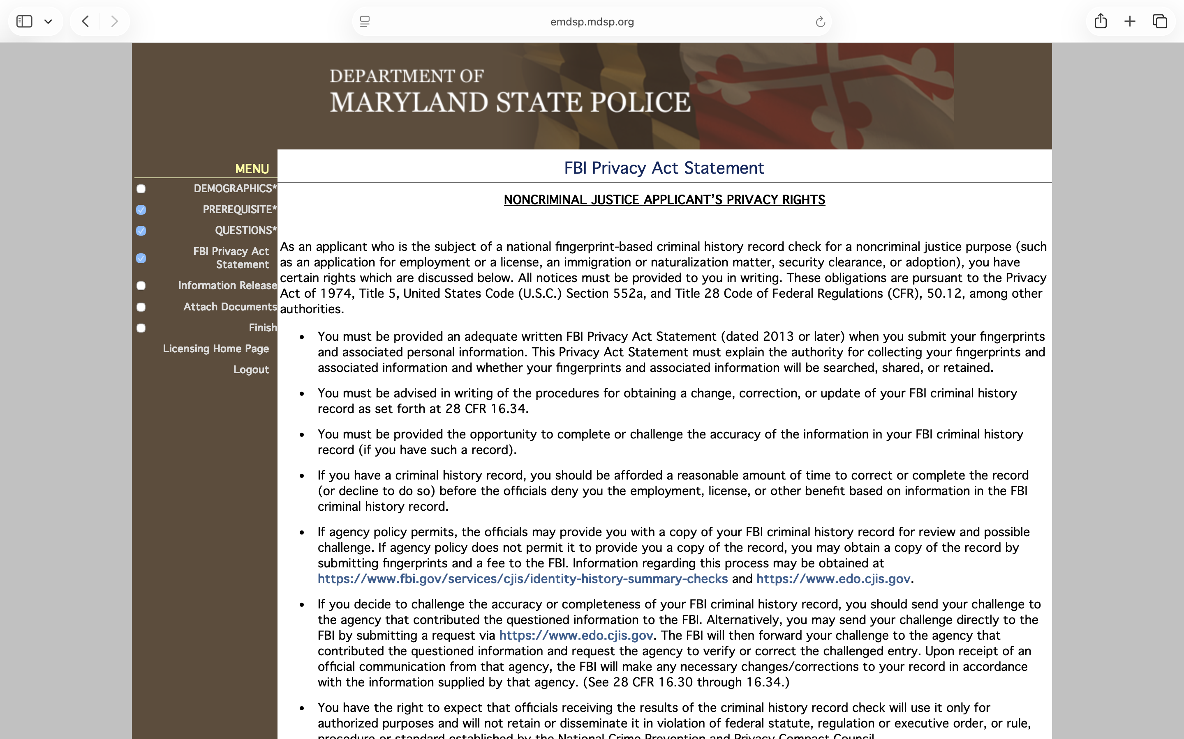
Step 12: Read the FBI Privacy Act Statement

Slide 14
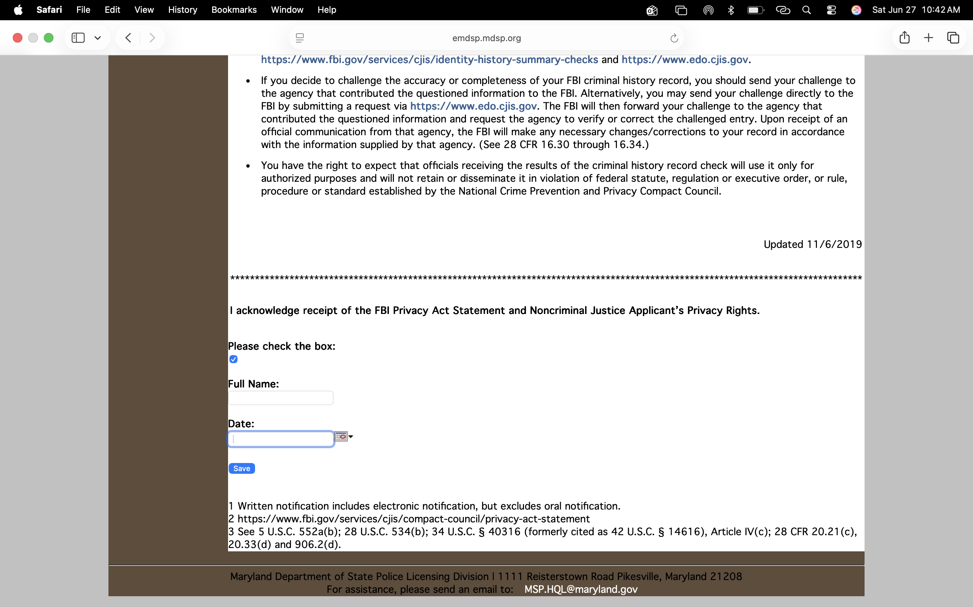
Step 13: At the bottom of the FBI Privacy Act write your name and date.
When your write your name Do not write Mr. or Jr. at the end of your name, the system does not like it and it will not let you advanced to the next page.

Slide 15
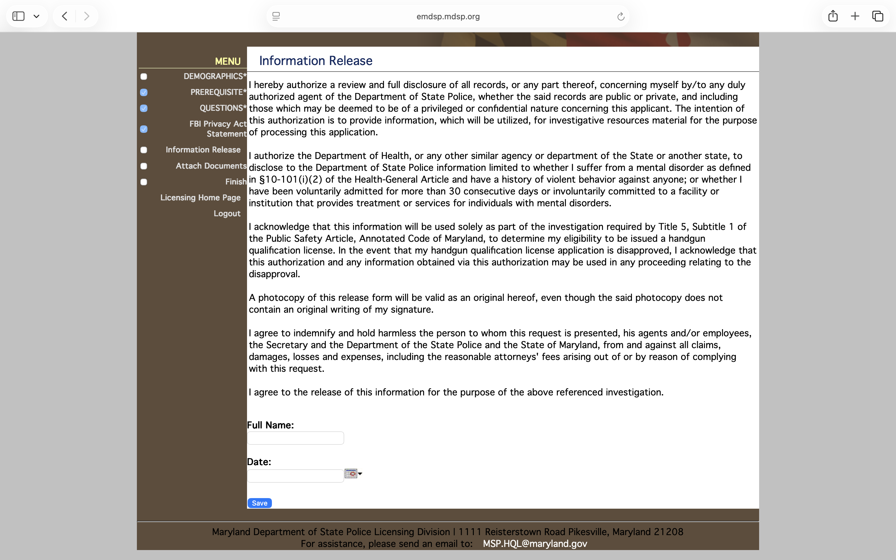
Step 14: Information Release. When your write your name Do not write Mr. or Jr. at the end of your name, the system does not like it and it will not let you advanced to the next page.

Slide 16
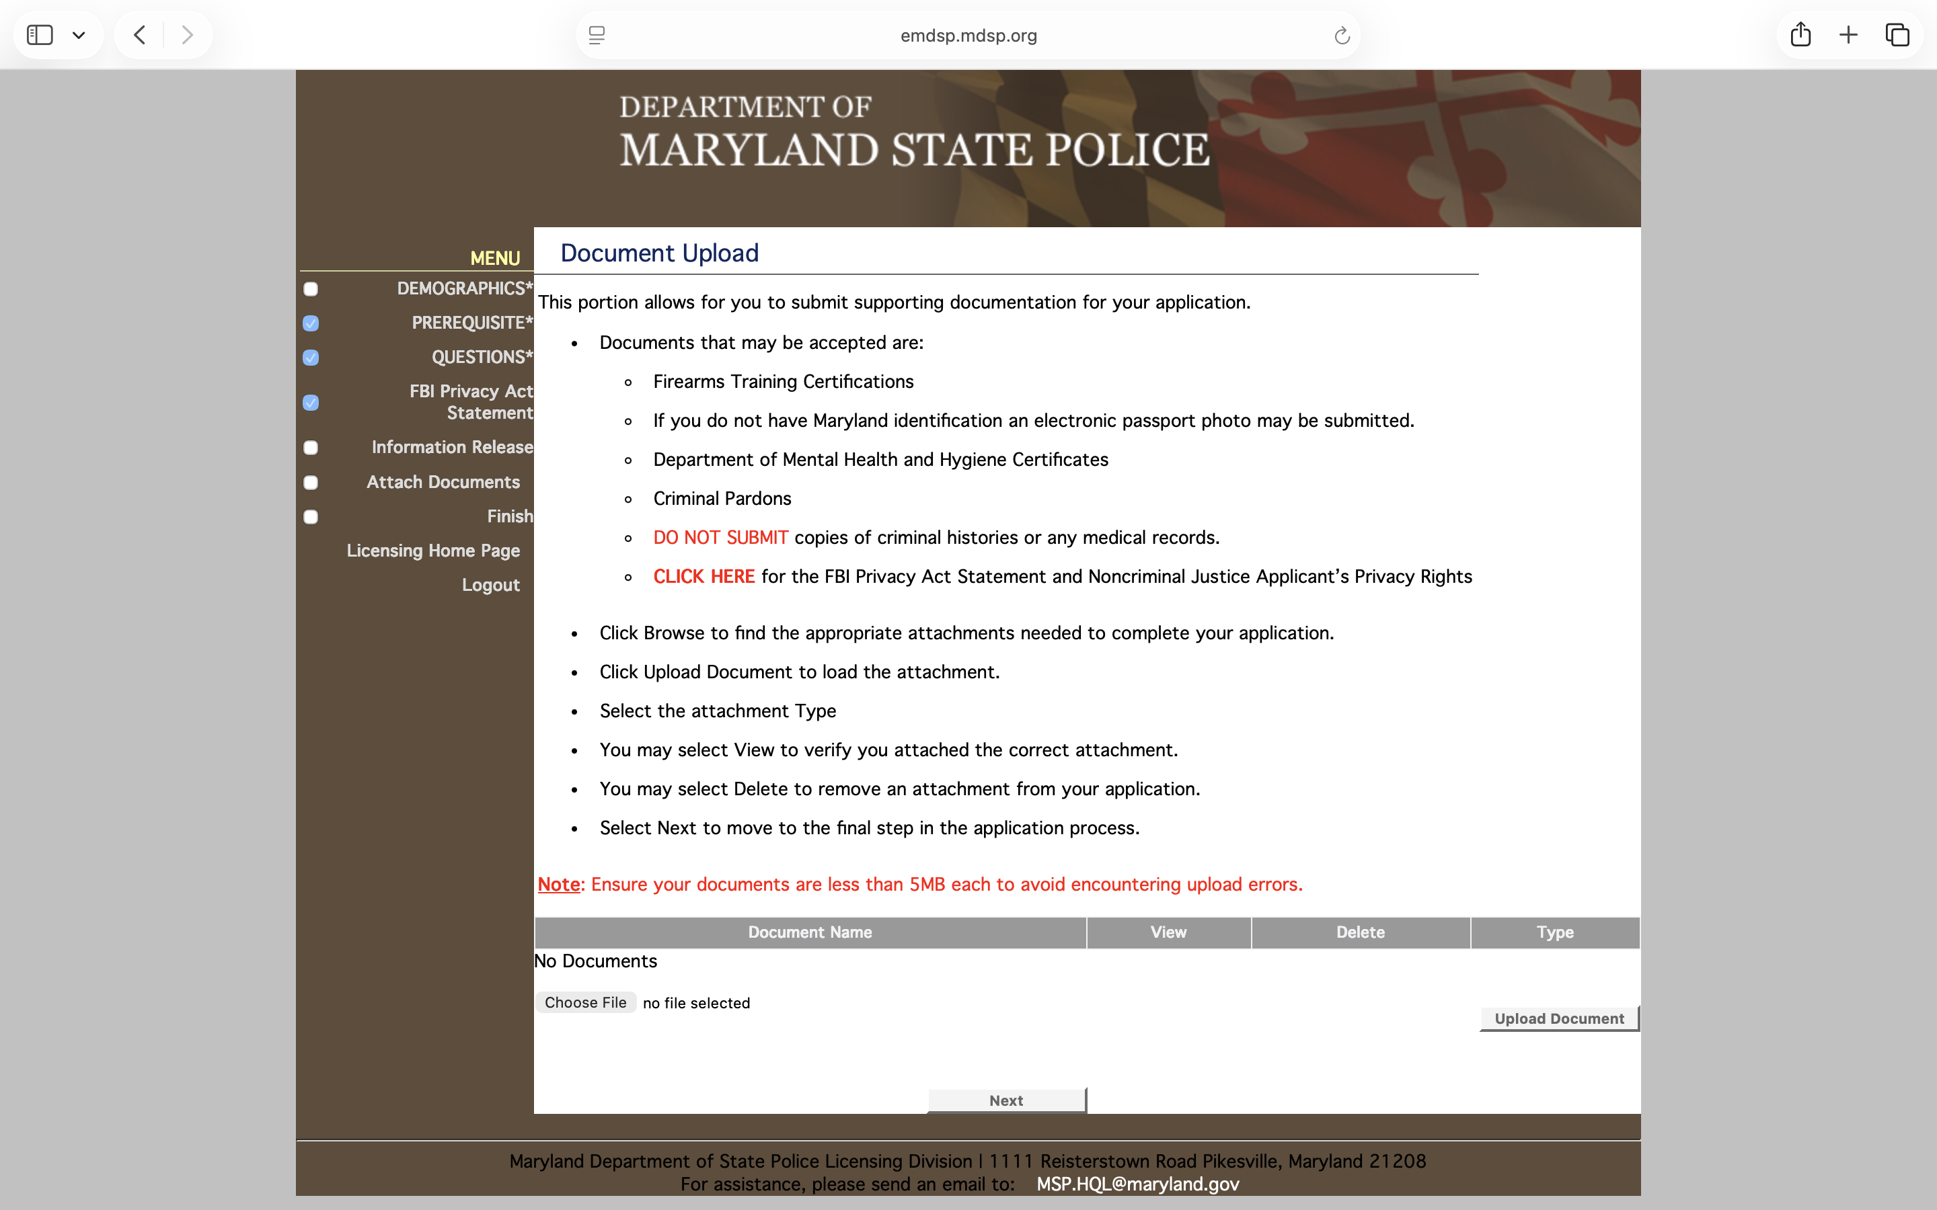
Step 15: Document upload.
Upload your HQL certificate here.

Slide 17
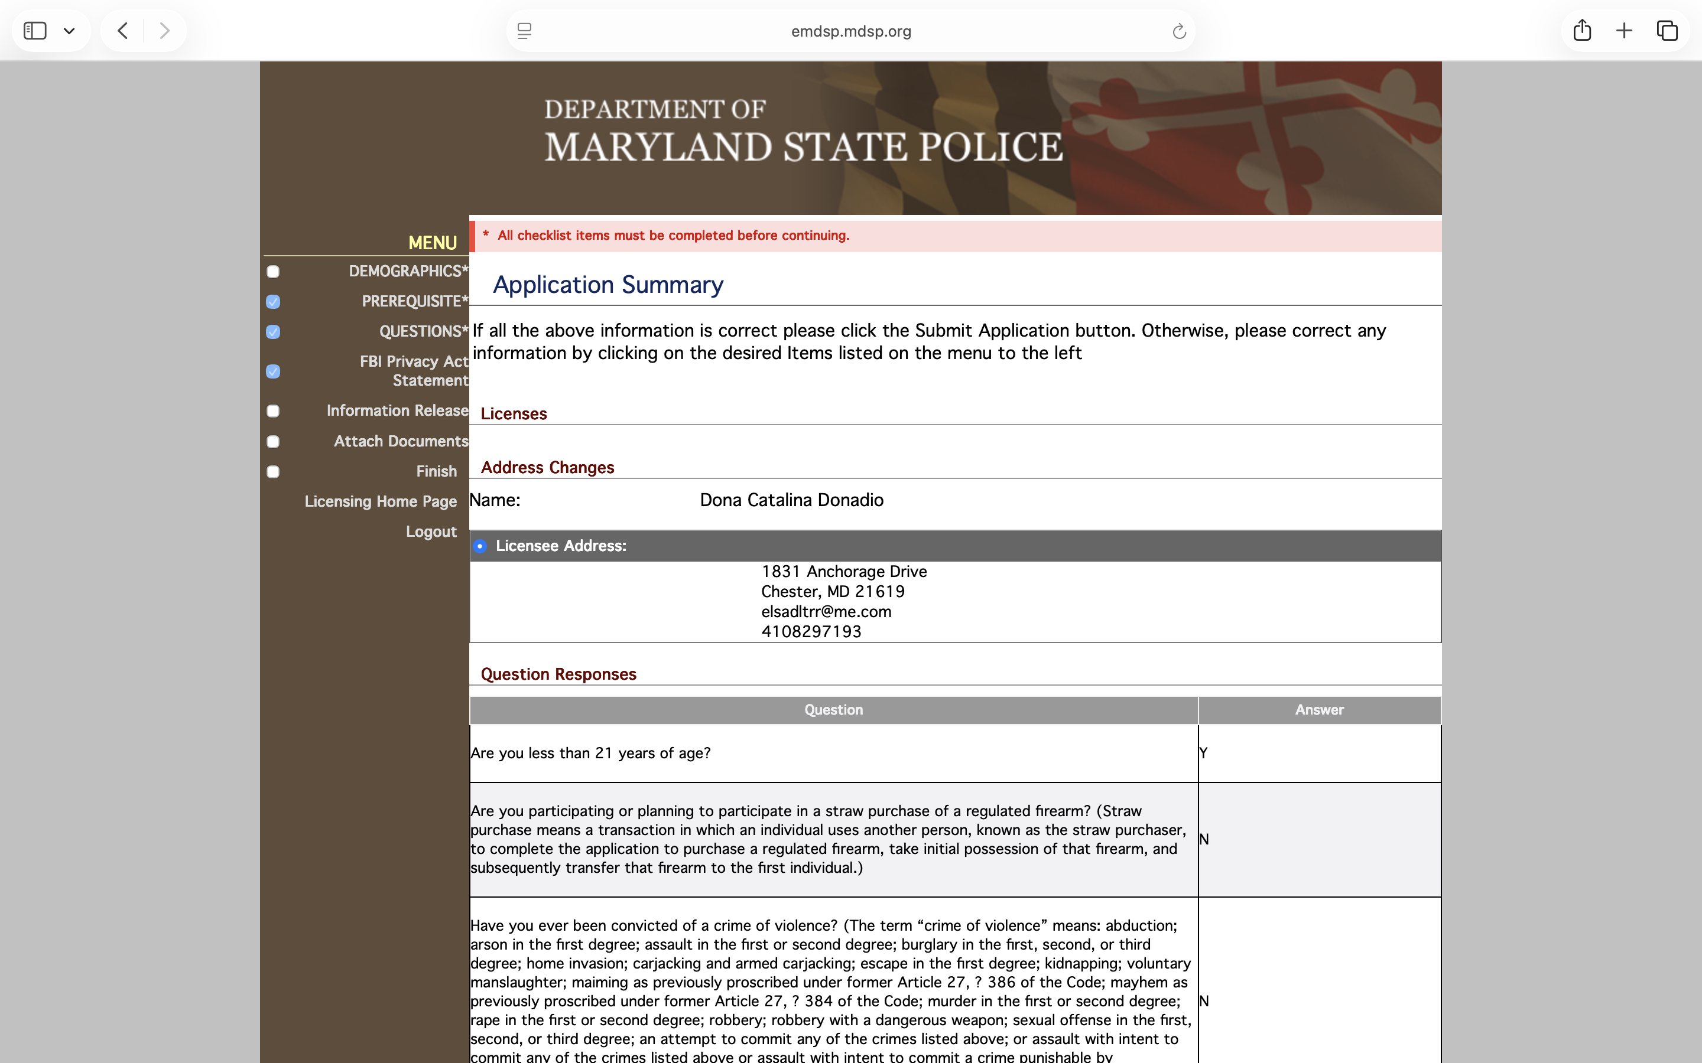


Step 18: Applicattion Summary. Scroll down
to pay fees.

Slide 18
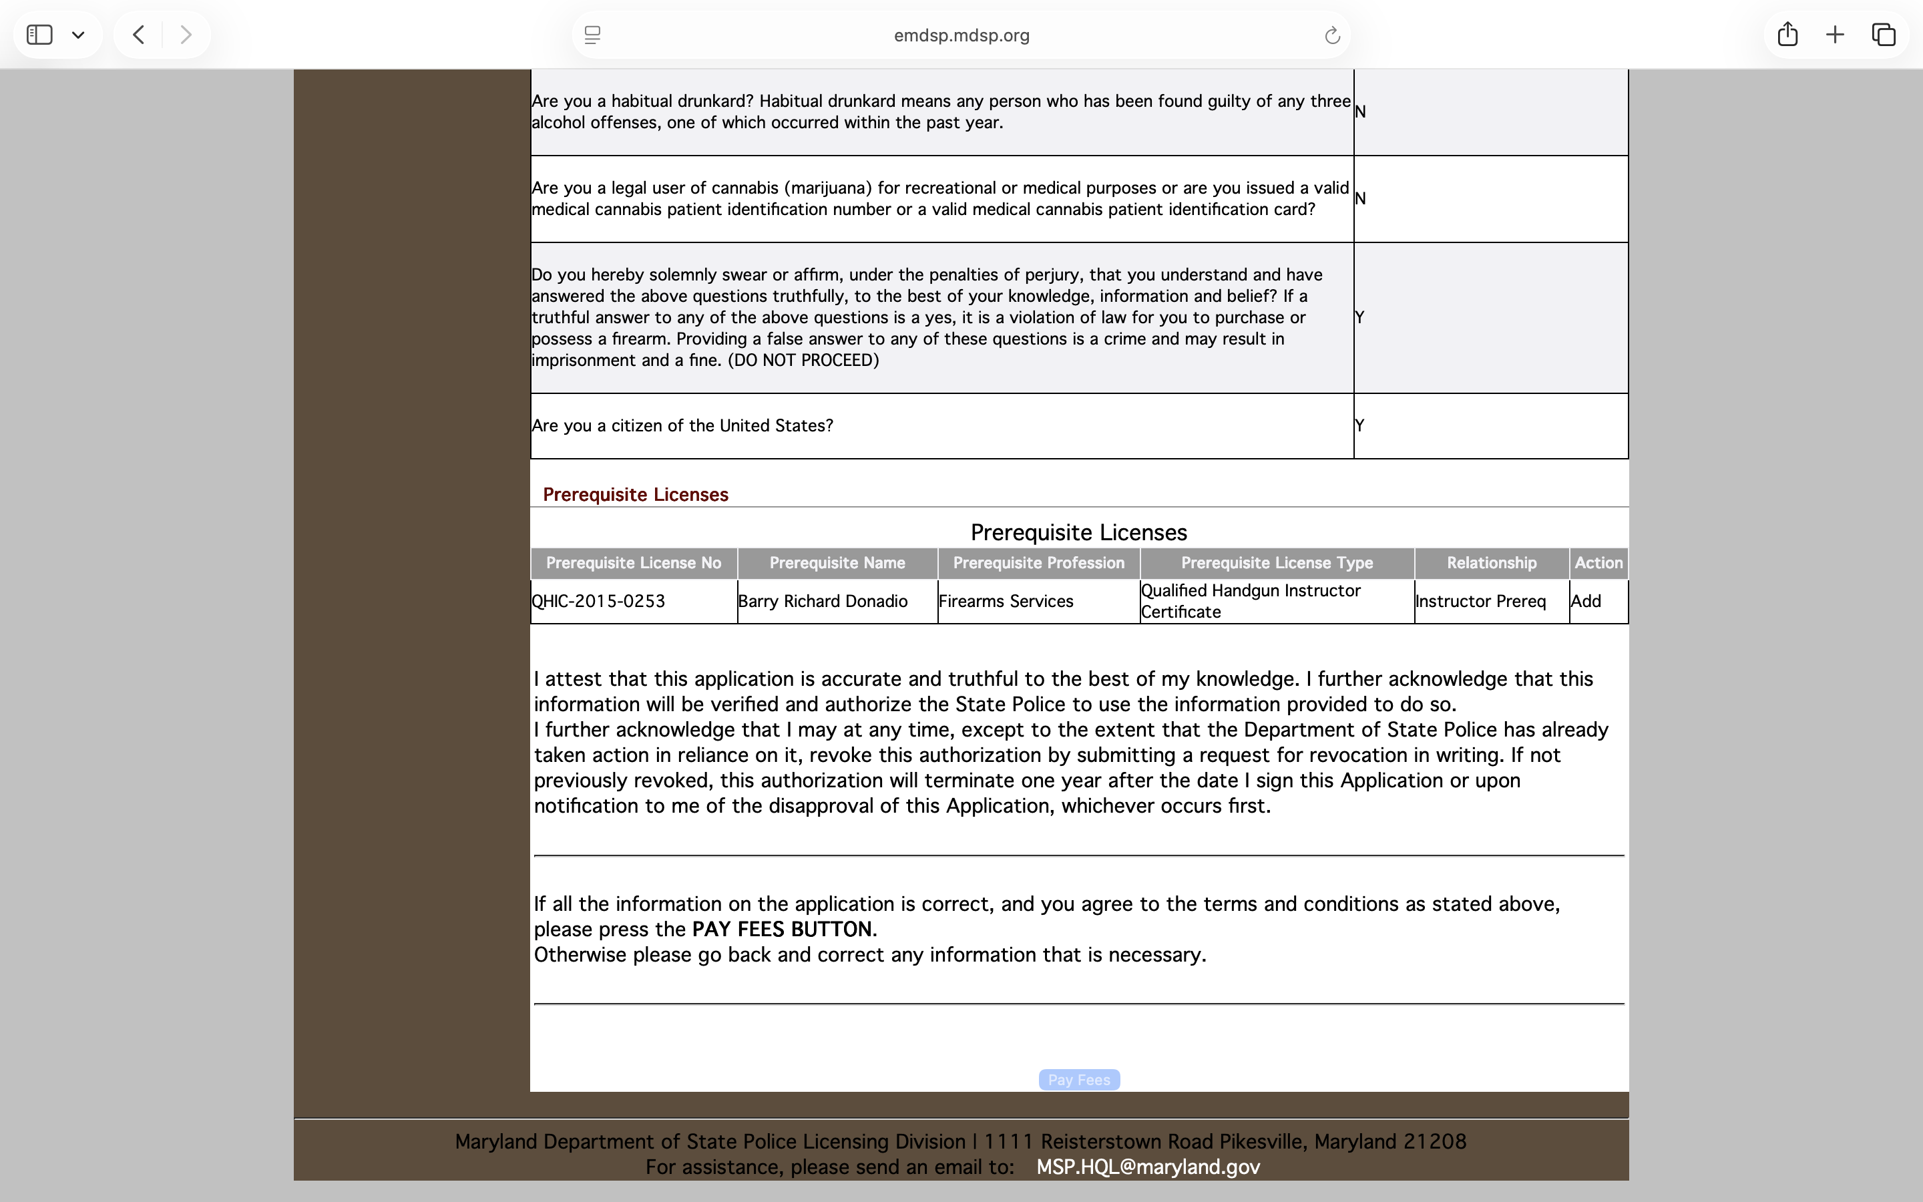

Step 19: Scroll down and pay fees

Slide 19
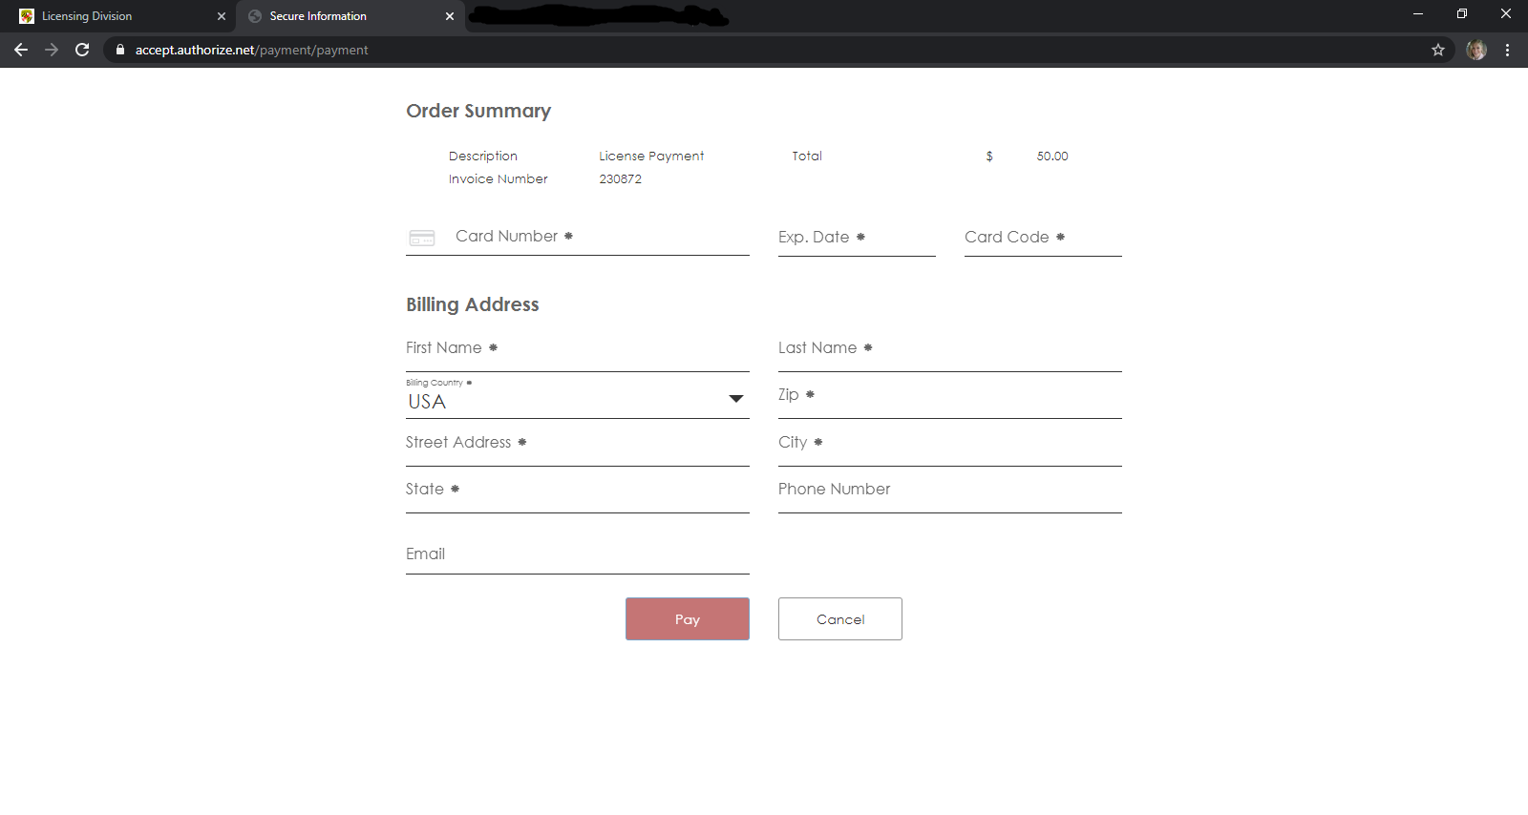
Step 28: Enter your payment information. Click “Pay”.
*Reminder: The cost is $50 for a New HQL Application. This is a separate fee charged by MSP not included in cost of this HQL Class.

Slide 20
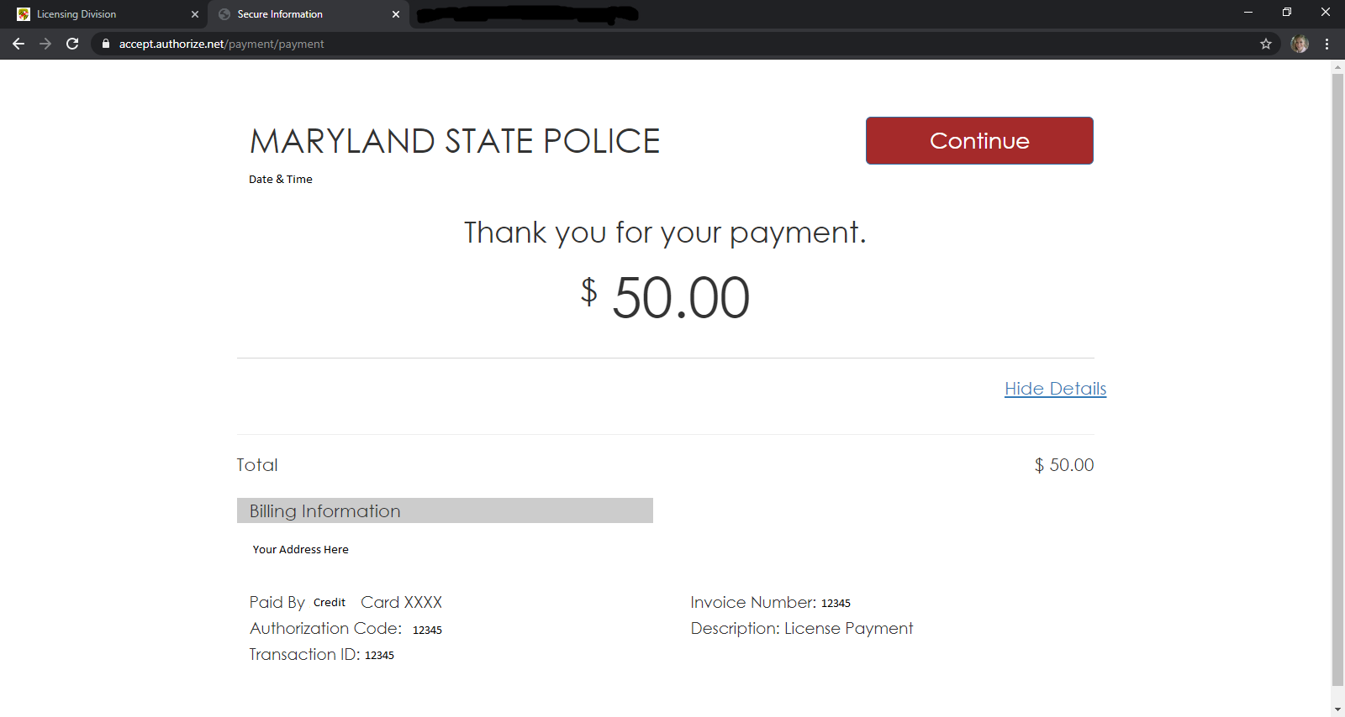
Step 29: Click “Continue”.
*A copy of this receipt will be emailed to the email you used to create your MSP account. Save for your records.

Slide 21
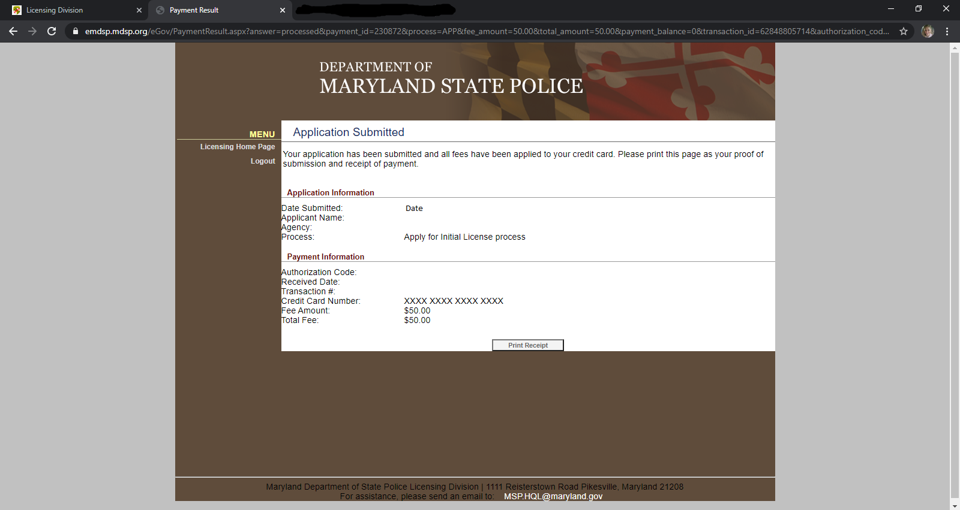
Your application is now Submitted. You may print your receipt for your records.

Slide 22
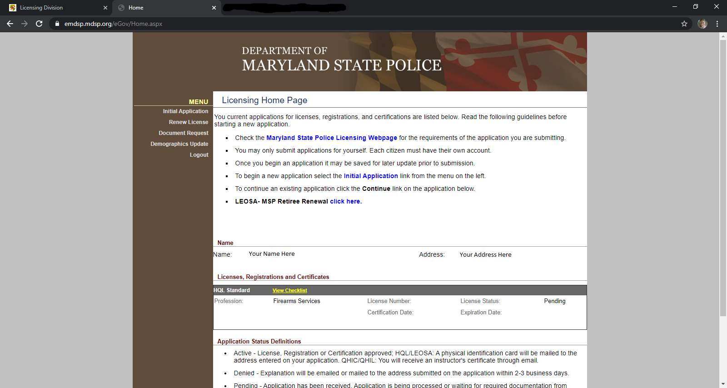
You may check the status of your application anytime by logging in to your MSP account using the User Name & Password you created at the beginning of the application.
Due to the increased number of HQL applications, expect a longer waiting period.

Slide 23

Step 30: Contact Barry Donadio via text with your Full Name, Date you attended HQL class and a Note that you have submitted your MSP HQL Application online.

