Slide 1

Normal-Like-Me Specialist
SEN Research Services Ltd
Janet Willicott – Director Normal Like Me
FRSPH FBII ACIEH MEHBEA MBESA MBHRC MUALL MBERA [PhD Student]

Slide 2

*FRSPH – Fellow of the Royal Society of Public Health
*FBII – Fellow of the British Institute of Innkeeping
(Food & Alcohol Sciences : Inspection)
*ACIEH – Affiliate Member of The Chartered Institute of
Environmental Health (Social Policy/Housing/Environment/Food)
*MEHBEA – Member of the European Human Behaviour and Evolution (Environmental Psychology – Education)
*MBESA – Member of the British Education Studies
(Educational Research-SEND)
*MBHRC – Member Bar Human Rights Committee
(Educational Research-SEND)
*MUALL – Member University Alliance for Lifelong Learning
(Health, Law and SEND-Education Research)
*MBERA – British Educational Research Association (SEND)
*PhD Student – Doctoral Research – Education Accountability Act - MDX
*NHS Networks
*HIFA & CHIFA (Health Information For All) – Research
*NIHR – National Institution for Health Research – Research Reviewer
*UKPHR Scheme Practitioner Pathway
*SETD 5 – CEO – Founder / Researcher
(Neuroplasticity/Rare Disease-PostDoc)
*NEU – National Education Union (Academic)
*LDE – Learning Disability England (Academic)
*NHS – CAMHS Panel – Service Review (13 Years)

Slide 3
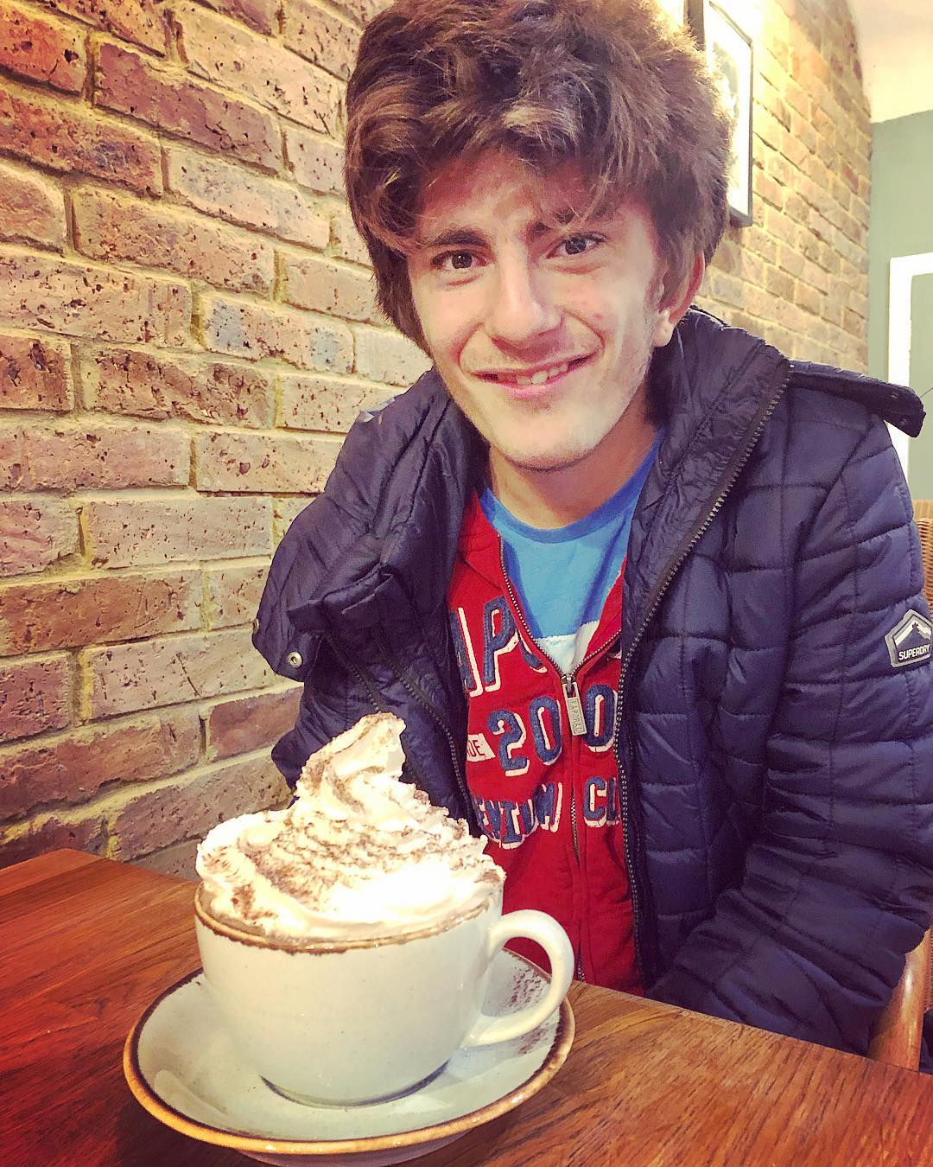


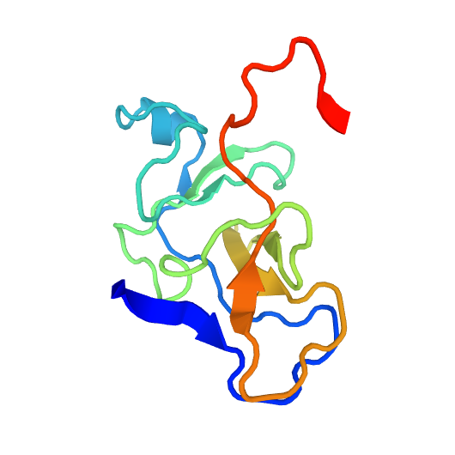

I am a SEND Parent and a Professional
BASTIAN
SETD5

Slide 4

SEND: YOUNG PERSON / ADULT TRANSITIONING 16+ / 18+

Slide 5

PLAN PLAN PLAN AND PLAN

Slide 6
Transitioning into Adulthood Reality
The Parents Next Steps
14+
16+
18+

Slide 7
QUICK GUIDE
14+ (Funding) (College, Alternative Provision, EOTAS, Home Education, School)
16+ (EHCP) College (Dual and or Split Placements) [Alternative Provision] (Funding)
Social Care Reports versus Mental Health Reports – KNOW THE DIFFERENCE

Slide 8
The Social Care Report – Transition into Adult Social Care Provision and Support
[The Care Act 2014 (as amended by interim legislation 2020) as reverted back to 2014]
The Mental Capacity Act 2005 (Assumption of Capacity) – Application to Court if not.
CAMHS  Adult Mental Health – Reports and Assessments (To Support Social Care Report)
Carers Assessment
Emergency Care Plan
WHAT DO YOU WANT / WHAT DOES YOUR YP WANT? SOCIAL CARE AND HEALTH CARE MUST KNOW THE DIFFERENCES IN REALTION TO EACH OTHER.

Slide 9
18+ The Reality
Planning / Guardians / EHCP / Appointee / Bank Accounts (Finances) / Enduring Power of Attorney / Deputyship-Capacity (Registration Court of Protection)
Your Will / Life Assurances / Finances
Transitioning (Accommodations Assisted Living / Supported Living)
Community Care
Deprivation of Liberty (You, Family and The Young Person/Adult)
Any other Reports
Updated Assessments / Chronological Age versus TROG (Test for Reception of Grammar (TROG-2)) / Capacity Age

Slide 10




OTHER SUPPORT
Informing the (Community) Police
Social Community Support (Temples, Churches, Synagogues)
RETAIL OUTLETS (Shopping)
TRANSPORT (Train Station Supervisor/ Bus Driver)
Training – You are the Expert – Train Them

Slide 11

PERSONAL BUDGETS
HEALTH BUDGETS
PiP
Universal Credit / Child Benefit

Slide 12
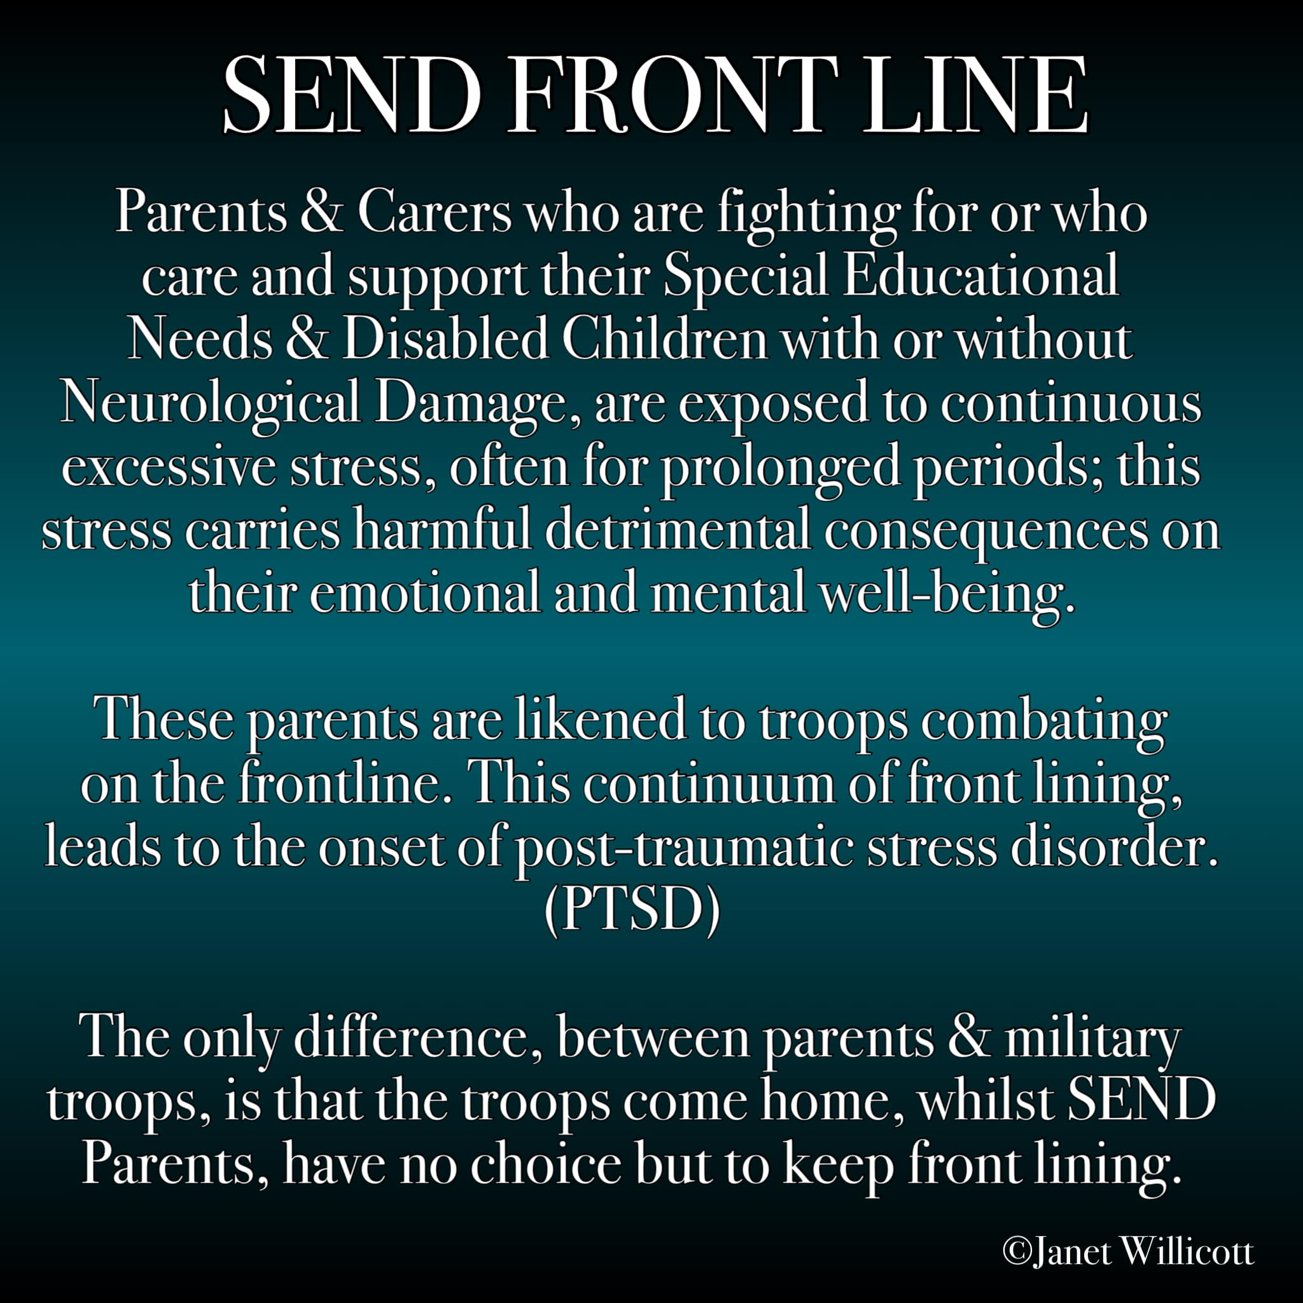
SEND FRONT LINE
Who is at breaking point and why?
Equality and Neurotypical Privilege / Empathy / Insight / Support and Breathing
SEND and Family Strain (Communication, Pain, Frustration, Anger, Passion)

Slide 13




Slide 14

NORMAL LIKE ME https://www.facebook.com/pg/NormalLikeMeSENDResearchServices/about/?ref=page_internal www.normal-like-me.com

Slide 15
BIO
Janet Willicott trading as Normal Like Me SEN Research Services was born out of legal necessity in 2015 and registered in 2016 when Janet Willicott was denied access to further legal recourse in UK Courts when trying to appeal against a corrupt and unlawful Local Government [London Borough of Barnet], the specialist SENDist Court’s and its decisions including being denied an appeal in High Court due to ‘the possible length of appeal and cost to the tax payer’ when seeking Suitable Education for her severe complex disabled son.
Janet Willicott - Human, Multi-lingual Woman and Mother, is a diverse, open, transparent & equality campaigner across all communities. Janet was brought up in a multi-ethnic, multi-religious home, born Jewish, is a Humanist and proudly Gay. Director of her non-profit global organisation SETD 5 Limited - Rare Neurological Disease Syndrome. Janet also set up her private research organisation [Normal Like Me - Specialist Legal, Health and Educational Research, to include Mediation and Dispute Resolution] to conduct a report for BWillicottvUK 2015, four years on, she is still an independent researcher in Specialist Legal, Health and Educational Research & Neurological Psychology working on Neuro-plasticity Models (Controlled Default Nurturing) to encourage independence in de novo loss brain damaged individuals with the scope to publish her postdoctoral model. Janet was invited to stand as an MP Candidate [2019]

Slide 16
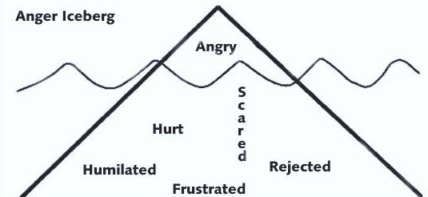
COMMUNICATION

Slide 17
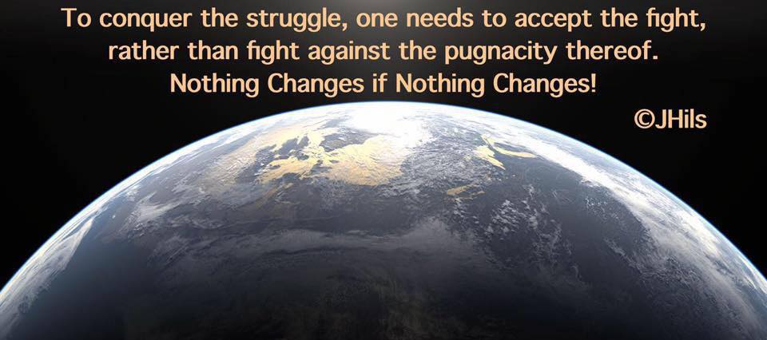
BREATHE FIGHT ON FOR OTHERS

