Slide 1
Facilitating Educational Change through an Effective Schools Structure: A Focus on Mission
The Inside and Outside Work we must do…
Bob Gerye
Ed Excellence Group

Slide 2
EQ’s for Today
What is mission and why is it important?
How does an effective school focus on mission?
What is my personal and professional mission?
What is my school’s mission?
How am I going to apply this when I get home?

Slide 3
Validation?
37% Hispanic; 30% Anglo; 15% Asian; 18% African-American
66%--FRL; 25%--ELL( 38 languages); 60%--Low SES
75% 4 year completion rate (CCSD average=62%)
86% attend post-secondary education
300 enrolled in AVID (17%)
$15M: Scholarships average=39,062/student
Mission Drives everything: All decisions made from this!
Developed two top schools in the USA.
…and I’ve done this longer than most of you are old!

Slide 4
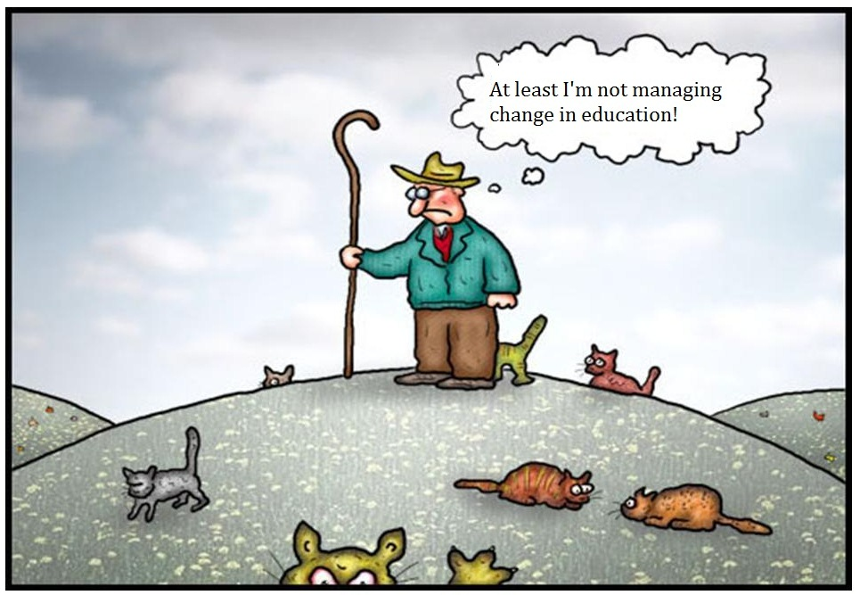

Slide 5
FOCUSED MISSION AND VISION
The First Generation:
  In the effective school there is a clearly articulated school
  mission through which the staff shares an understanding of and commitment to the
  Instructional goals, priorities, assessment procedures and accountability. Staff accept
  responsibility for students’ learning of the school’s essential curricular goals.
The Second Generation:
    In the first generation the effective school mission emphasized
    teaching for all
    Second Generation: Learning for All
    The two issues that surfaced were: Did this really mean all
students or just those with whom the schools had a history of reasonable success?
When it became clear that this mission was inclusive of all students especially the children of the poor (minority and non-minority), the second issue surfaced. It centered itself around the question: Learn what? Partially because of the accountability movement and partially because of the belief that disadvantaged students could not learn higher-level curricula,
the focus was on mastery of mostly low-level skills
© 1991 Lawrence W. Lezotte

Slide 6
Mission:Now or Future?
Mission =The “end result” but there is no end result:
Measureable/outcomes
Specific in nature
NOT current practice or the current state
DRIVES every decision made in the school

Slide 7
Strong vs. Weak
STRONG: It is the mission of XYZ school to prepare al students for post-secondary education through an interactive and engaging teaching methodologies
It is the mission of XZ school to complete instruction that guarantees graduation for each student in four years and a pathway plan for entry into the world of higher education, further training or the workplace.
WEAK: It is the mission of XYZ school to prepare students.
It is the mission of XYZ high school to develop students who can meet the rigors of a challenging world.

Slide 8
School Mission Drives All
School Mission
Personal and Professional Mission
Mission=Decisions
Review of all data and demographics
Align Mission and vision to school
Complete Needs Review

Slide 9
Instructional leadership
The First Generation:
  In the effective school the principal acts as an instructional leader
and effectively and persistently communicates that mission to the staff, parents, and
students.
The principal understands and applies the characteristics of instructional
effectiveness in the management of the instructional program.
The Second Generation:
Leadership will be viewed as a dispersed concept that
includes all adults, especially the teachers. With the democratization of organizations, especially schools, the leadership function becomes one of creating a "community of shared values."
© 1991 Lawrence W. Lezotte

Slide 10
The mission will remain critical because it will serve to give the community of shared
values a shared sense of "magnetic north," an identification of what this school
community cares most about.
The role of the principal will be changed to that of "a leader of leaders," rather than a leader of followers.
The broader concept of leadership recognizes that leadership is always delegated from the followership in any organization.

Slide 11
Instructional Leadership
Reflections:
How is your mission/vision communicated to all?
Why is the mission so important for your student population?
How is everyone focused on this? What things do you do on a regular basis to further your mission?
How often is this discussed in school?
How does it parallel your schools data? (completion rate? Test Data? SES data?
How does it drive your three/five year plan?

Slide 12
Self-Reflection
Table Tents:
  One side: Your personal mission statement
  Opposite side: your education mission statement (It is my educational mission to prepare ALL students for post-secondary education through challenging and engaging classroom instruction)
  Opposite side: Your school’s mission

Slide 13
Share out
Share these at your table/partners: Discuss educational mission.
Discuss and share your school’s mission.
One “Table Captain” to report out one each of the stellar educational and school missions!

Slide 14
LAUNCH FORWARD
What to consider, now:
  How will you evaluate your schools’ mission?
  How will you parallel your mission to your students and community?
  How will you involve all stakeholders to make sure mission parallels reality?
  Share at your table one take away that will go to work NEXT WEEK!

Slide 15


Slide 16
Resources
Effectiveschools.com
ASCD.org: Educational Leadership; ASCD SmartBrief
NASSP. Org/Principals.org
NAESP.org
Edweek.org
WSJ.com: usually an education article on p. 3
NYT.com: regular education editorials
Washingtonpost.com: education news and U.S. Department of Ed. Info as it happens
Flipboard (APP store: A++++++ compilation.
My Books: Collins: Good to Great;
        Gladwell,The Tipping Point
        Senge: The Dance of Change

Slide 17
EdExcellence Group:
Making Good Schools and Principals, GREAT!
Bob Gerye @bobgerye
702-498-9161
Edexcellencegroup.com (in rehab right now)
Educexcel@earthlink.net
Contact A+ Educators for Assistance from us!

