Slide 1
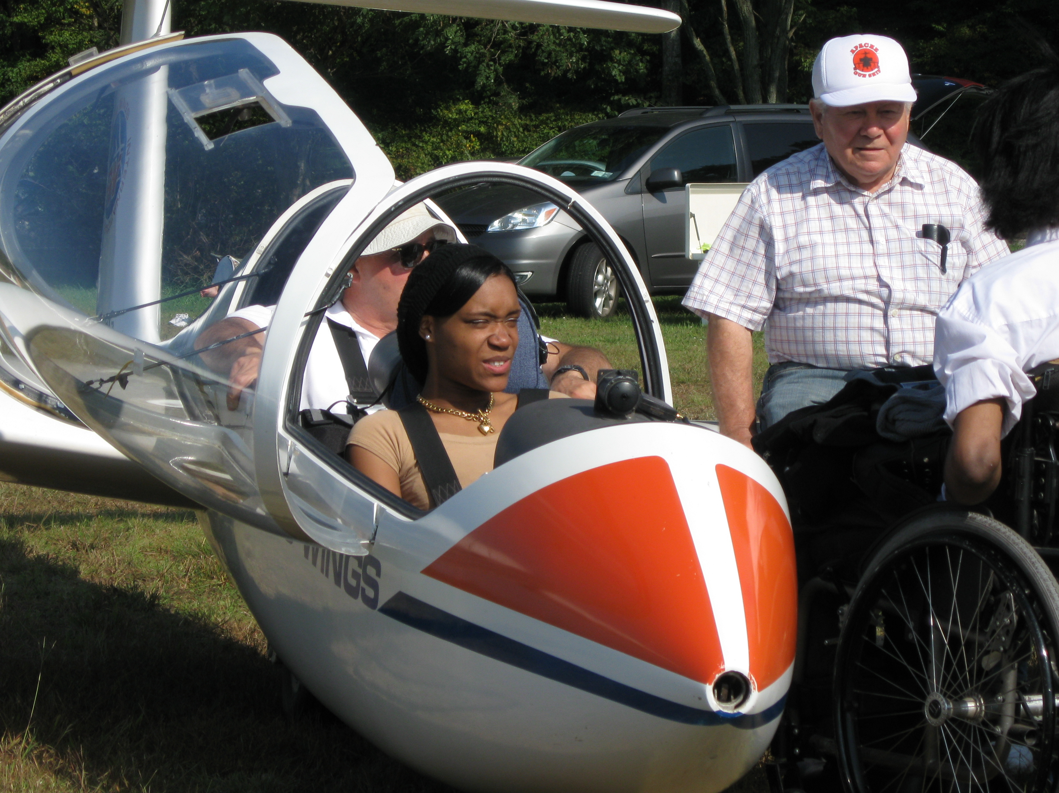
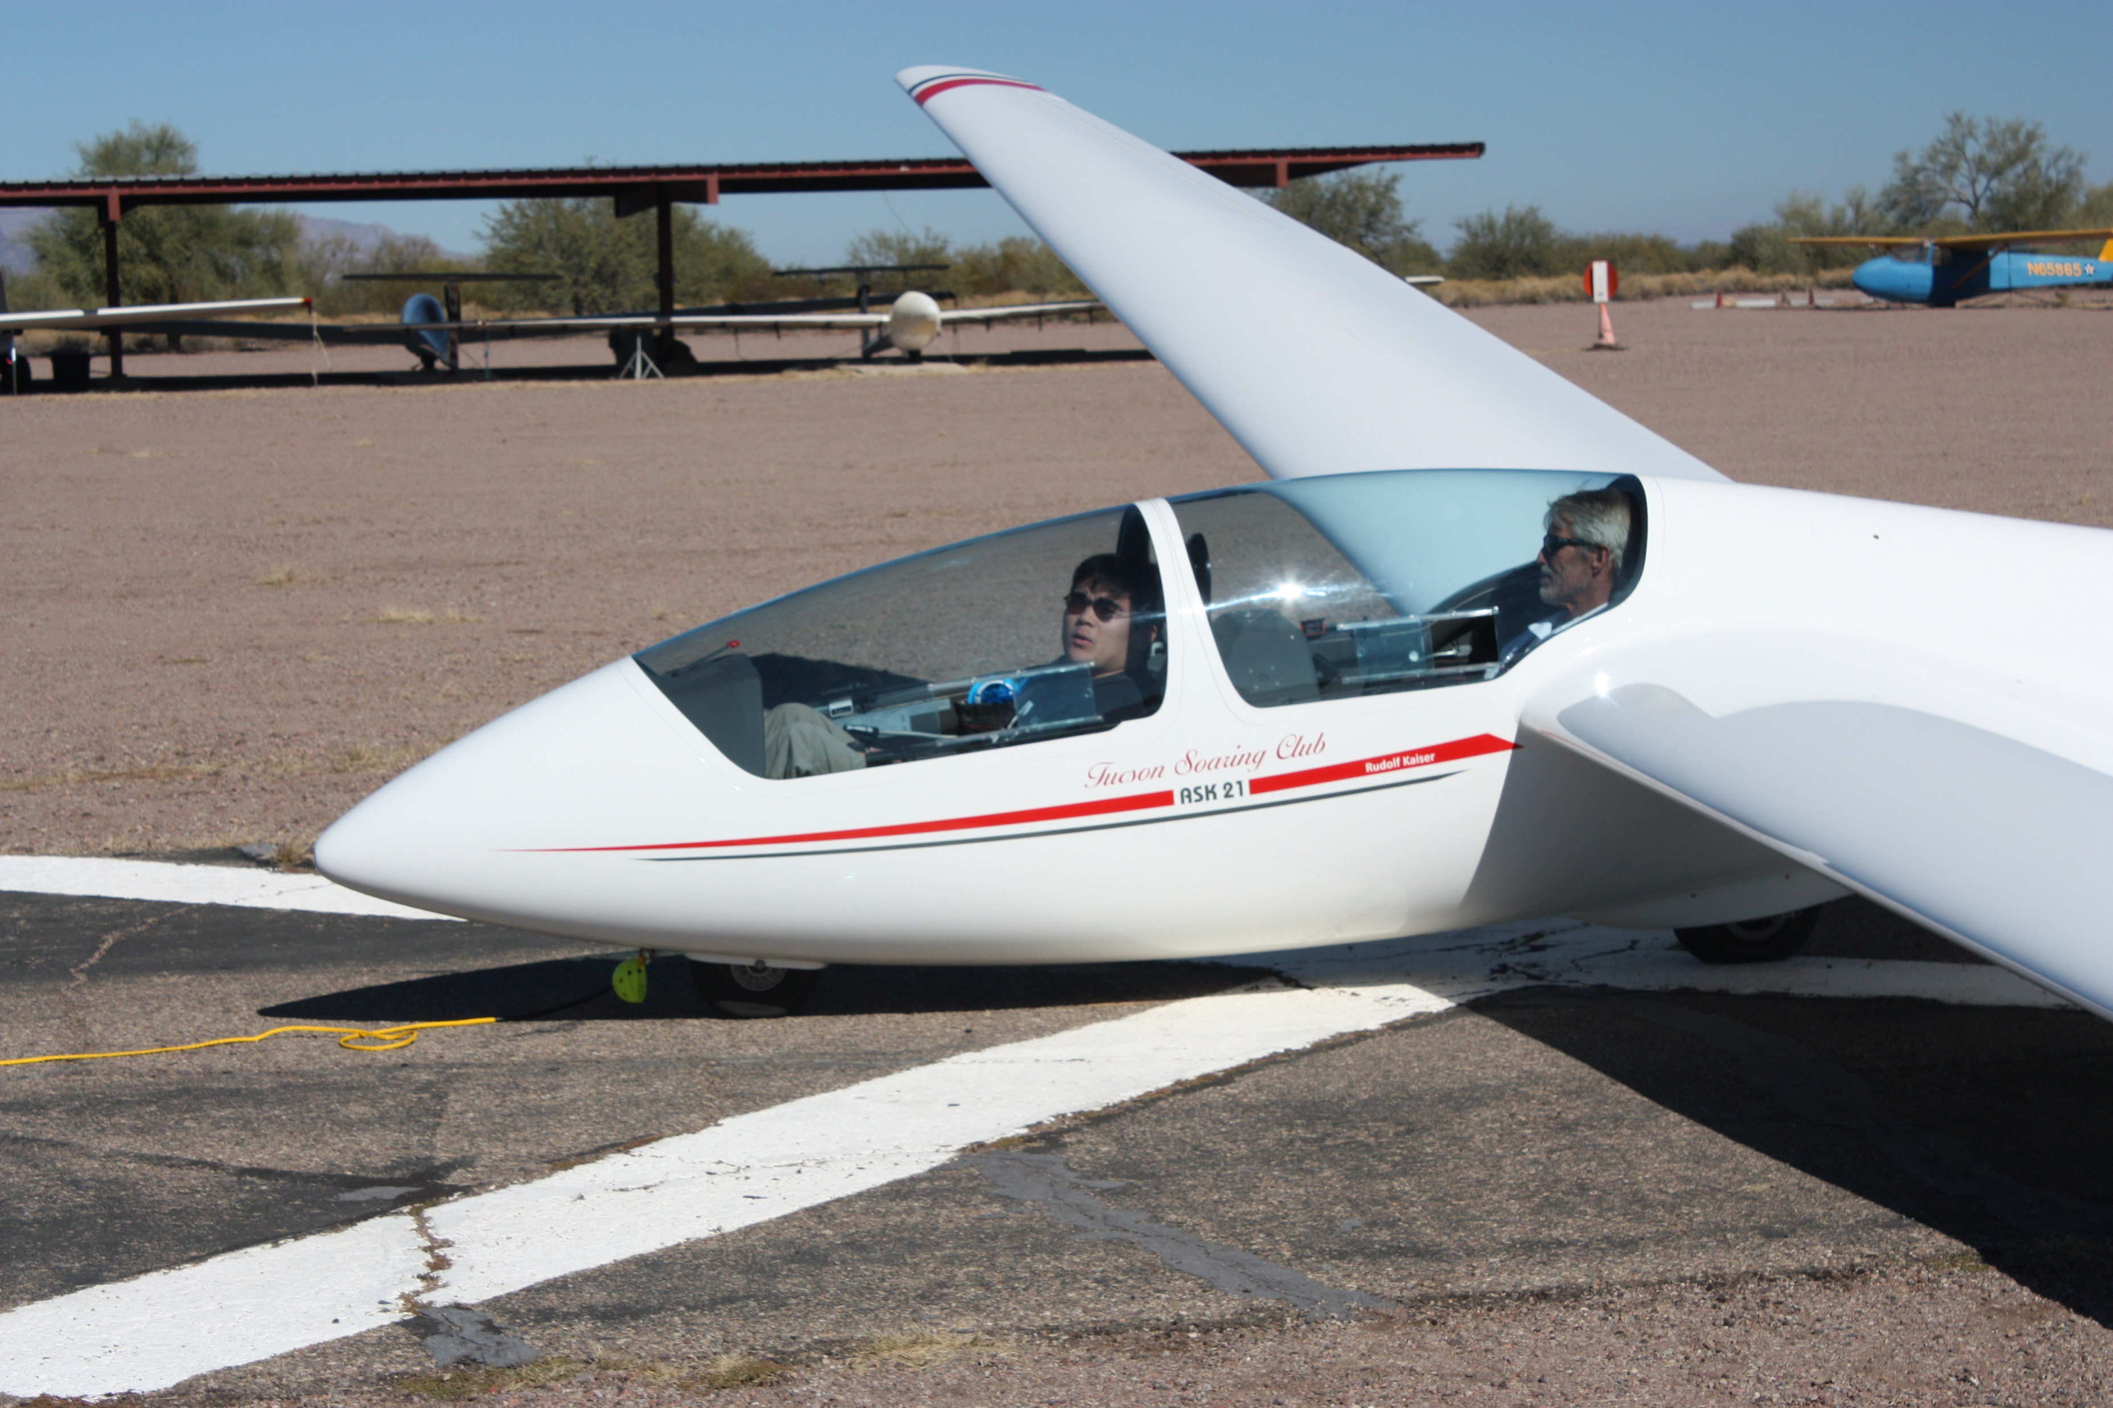
Freedom’s Wings Arizona
“Bringing inspirational flights in gliders to people with physical and developmental disabilities…”

Slide 2
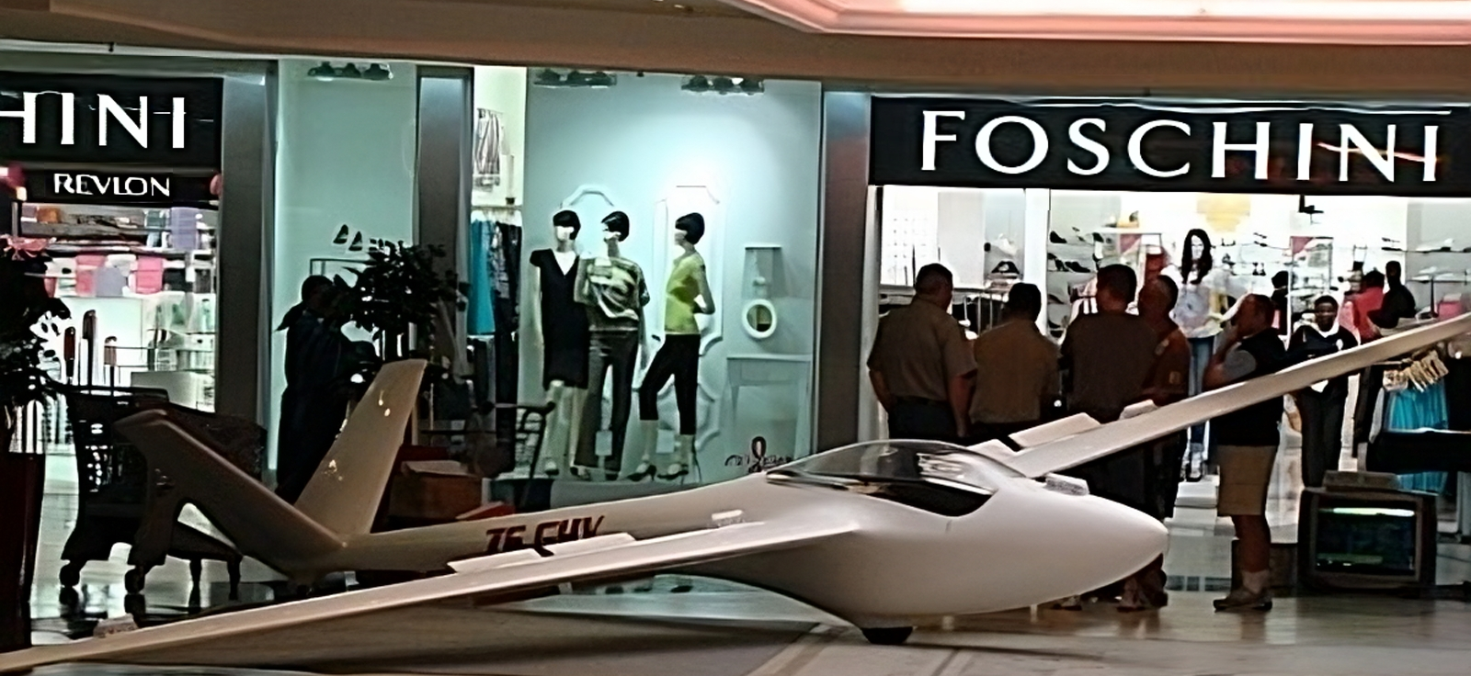
How We Came About
The Story about how Freedom’s Wings International was born
Irv and Mary Soble
Founded in 1980 – Serving Eastern Penn. and Western NJ
43 years of providing rides and flight instruction for people with disabilities
Most of their instructors also have physical disabilities
Both intro rides and a weekend glider club for people with disabilities
Notes:
Set the scene, it was 1980, Irv Soble was an ex-air force pilot, current United Airlines 747 Captain, and a member of a local glider club
Their glider club was displaying a glider at a local shopping mall.
Mary, Irv's wife, watched a young lady in a wheelchair nearby who was looking at the glider and went over to talk to her.
Mary asked her if she had flown before.
she responded that she had always wanted to learn to fly but was "stuck" in this wheelchair.
Mary invited her over to see and touch the glider, and when the lady got close she leaned over and almost caressed the glider.
At that point, Mary went over to Irv and said there has got to be a way to allow people with disabilities to learn to fly.
FWI was born
They then went to several glider/sailplane manufacturers and started asking if they could adapt their gliders for use by people with disabilities. Knowing that to get any modification/adaption approved by the FAA would be a huge task. The Grob corporation stepped up and added an optional additional stick to operate the rudders without the use of a person's legs.
Now there are several manufacturers both glider and power, which have made adaptions for people with disabilities.

Slide 3
Freedom’s Wings Arizona
“It’s quite an experience to be out of your wheelchair and look down at it and say I don’t need you, then continue on for another 3 1/2 hours, and see other gliders. We’re all equal up here, flying in the same airspace.”
Bob Kessler, Freedom’s Wings International

Slide 4
FWAz Founder’s Story
Ernie Hilborn
Started flying gliders as a Senior in High School
Went off to a small, fairly new, college and made friendships with several people with disabilities. Helped the college become more accessible.
Developed the dream to bring glider rides to people with disabilities
Prescott Area Soaring Club members would chat about ways to get more people involved in soaring and working with people with disabilities.
He found Freedom’s Wings International online and was introduced to Irv Soble
Began working to create Freedom’s Wings Arizona
Notes:
First glider ride Christmas break during my senior year of high school
Spent two years flying on Saturday, spending the night, and working all day Sunday to pay for my flights…
Private License in Gliders
I attended a small college, which had been in existence for less than 10 years but it was not accessible. I was part of a group that worked with the president of the college to make the campus more accessible. One day in a wheelchair, and I took him down the 13 steps into the dining room. An alternate pathway was created to bypass the stairs. Then another day, we blindfolded the president and he was able to experience that too.
Private SEL license
I got Married and moved to the midwest
I also worked with several churches to evaluate their accessibility (ADA) options.
During the years, I re-activated my flying but life got in the way.
My job took us to the Phoenix area, I joined a glider club in Prescott and started flying regularly
I had several discussions with other club members about ways to get more people involved in soaring, and it was mentioned that it might be possible to work with people with disabilities.
Then I started researching on the internet and found Freedom's Wings International.
Then I emailed the FWI general mailbox.
Met and talked with Irv Soble

Slide 5
People with Disabilities in AZ
1,583,650 People in Arizona have a disability
120,000 people in Arizona have a developmental disability, and of those 60,000 are children
We work with many groups, types of disabilities, and ages.
Cite Sourse

Slide 6
Freedom’s Wings Arizona
We are a non-profit corporation run by and for, people with physical and/or developmental disabilities.
Initially working with the UA Disability Resource Center, Tucson Veterans Hospital, and other organizations to offer glider rides as a therapeutic recreational activity.
Focused on exposing persons with disabilities, to the soaring experience, by providing demo flights at no cost to the individuals.

Slide 7
Freedom’s Wings Arizona
Our Mission:
Spreading the thrill of soaring like an eagle to many people in the State of Arizona.
Encouraging other clubs and commercial glider operations to equip some of their sailplanes with hand controls to spread the availability for persons with disabilities to soar.
Providing training for instructors, ground crew, and flight students on the best methods to include people with disabilities in their flights.

Slide 8
Freedom’s Wings Arizona What We Do
We provide rides for people with disabilities in gliders at various locations in AZ
We help individuals to “Defy Gravity – Defy Limitations – SOAR”
We hope to provide flight training in an adaptive glider or provide scholarships.
Spread the joy of soaring like an eagle to people with disabilities by giving them an experience they may have never dreamed about

Slide 9
Freedom’s Wings Arizona Partners with the Tucson Soaring Club
Where: El Tiro Gliderport, about 5 miles west of Marana, AZ
TuSC provides the Gliderport, glider, tow plane
FWA provides the funding, planning, and scheduling of participants

Slide 11
What it takes for a flight day
Glider and Gliderport
Towplane or Winch
Volunteer tow plane pilot
Volunteer instructors / commercial glider pilots
Ground crew and lift (3-5 volunteers)
Flight Safety and operations team (2-4 volunteers)
Typical cost is $1,000 per flight day for 10 participants
Scheduling and communications team
Board of Directors

Slide 12
How can you help?
Spread the word about who we are and what we do.
Follow us online: Webpage, Facebook, Instagram, Youtube.com
Share our posts online
Share your group’s membership lists with FWA
Volunteer to help, many ways to volunteer
Become a supporter (one-time or monthly)
Join our Board of Directors

Slide 13
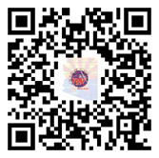
Freedom’s Wings Arizona
Contact Information:
Website: www.FreedomsWingsAZ.org
IRS 501(c)3 designated public charity
Donations after June 2021 may be tax deductible. EIN# 87-1307285
Email: info@FreedomsWingsAZ.org
Phone: +1-630-319-0202 – Ernie Hilborn
QR Code

Slide 14
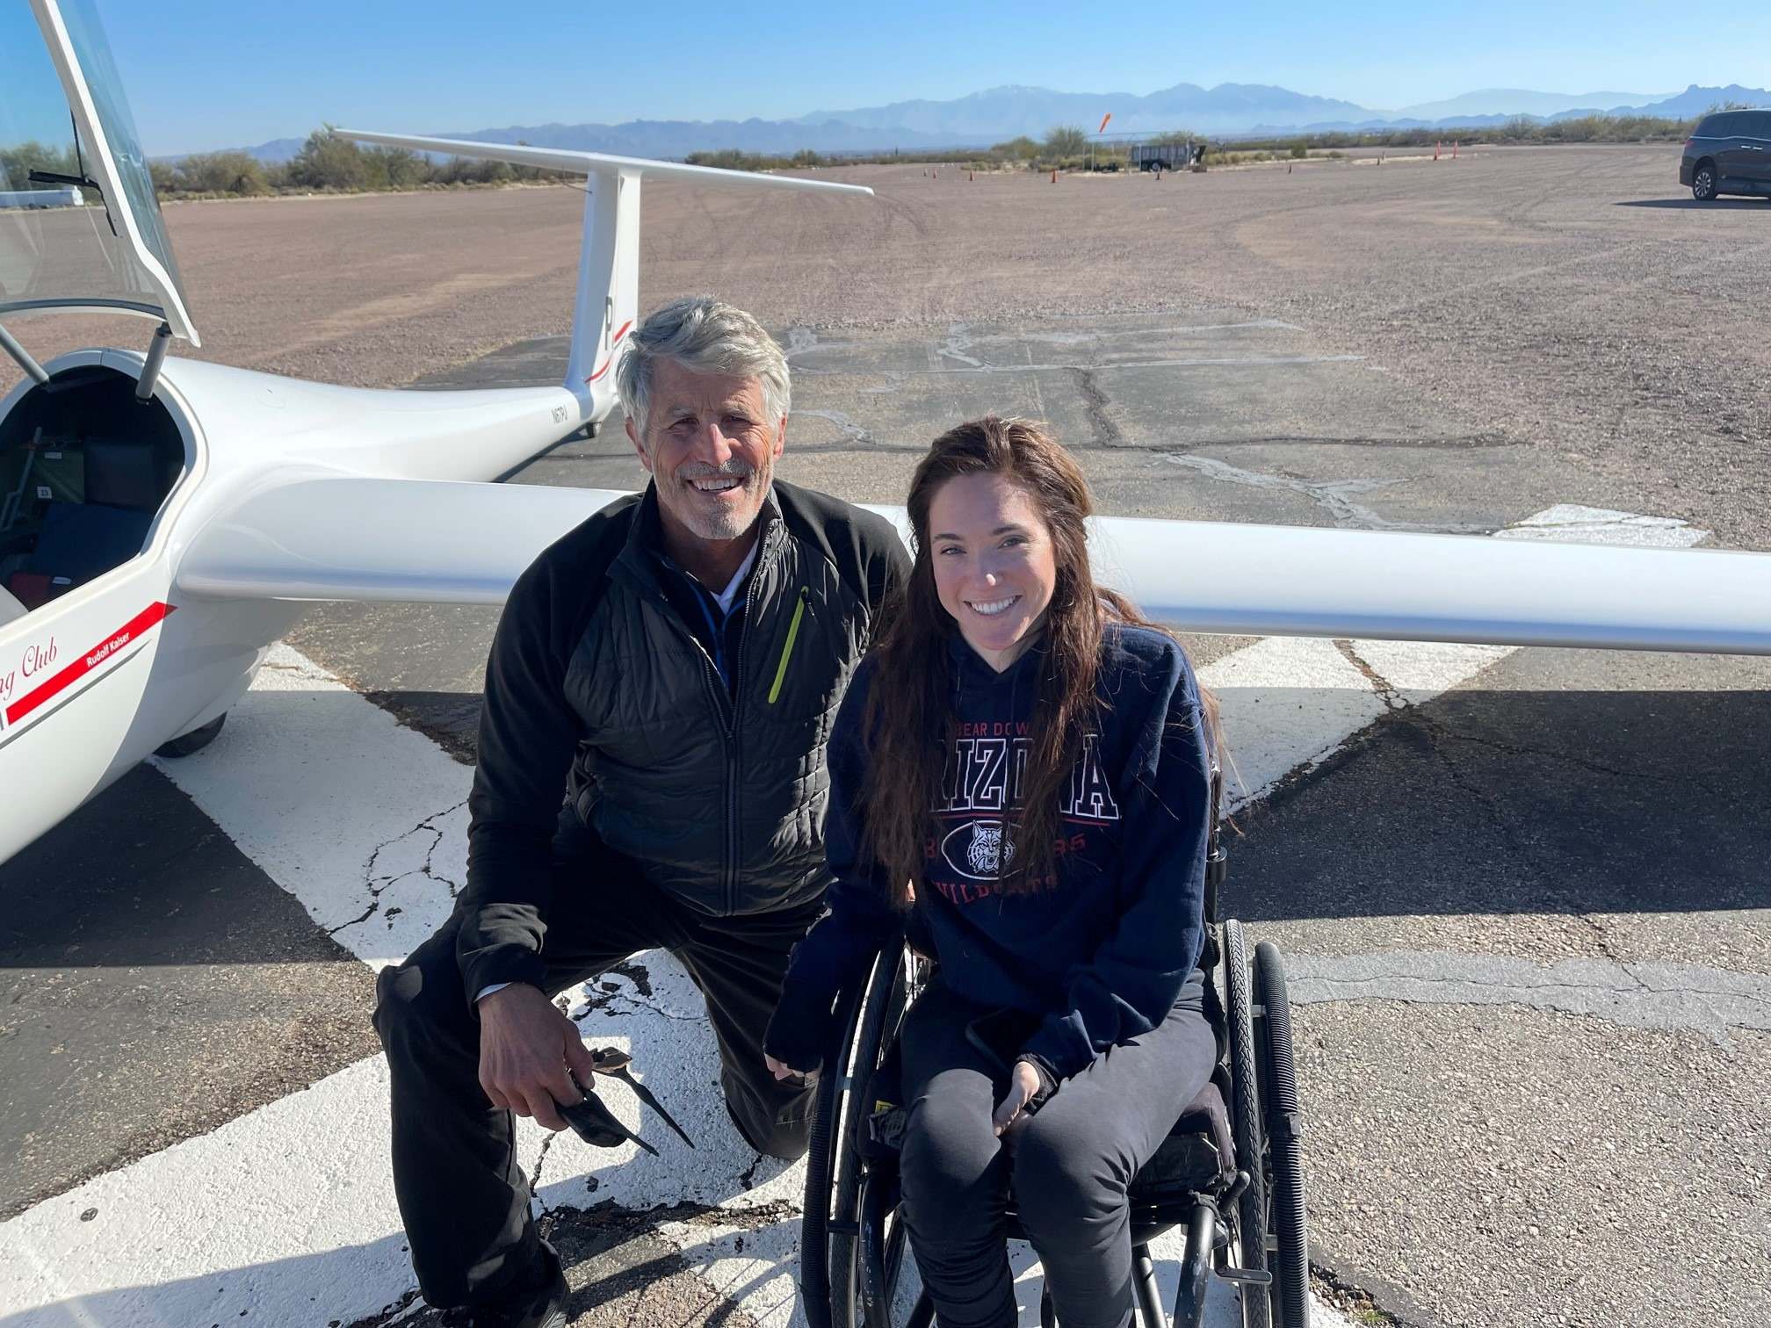
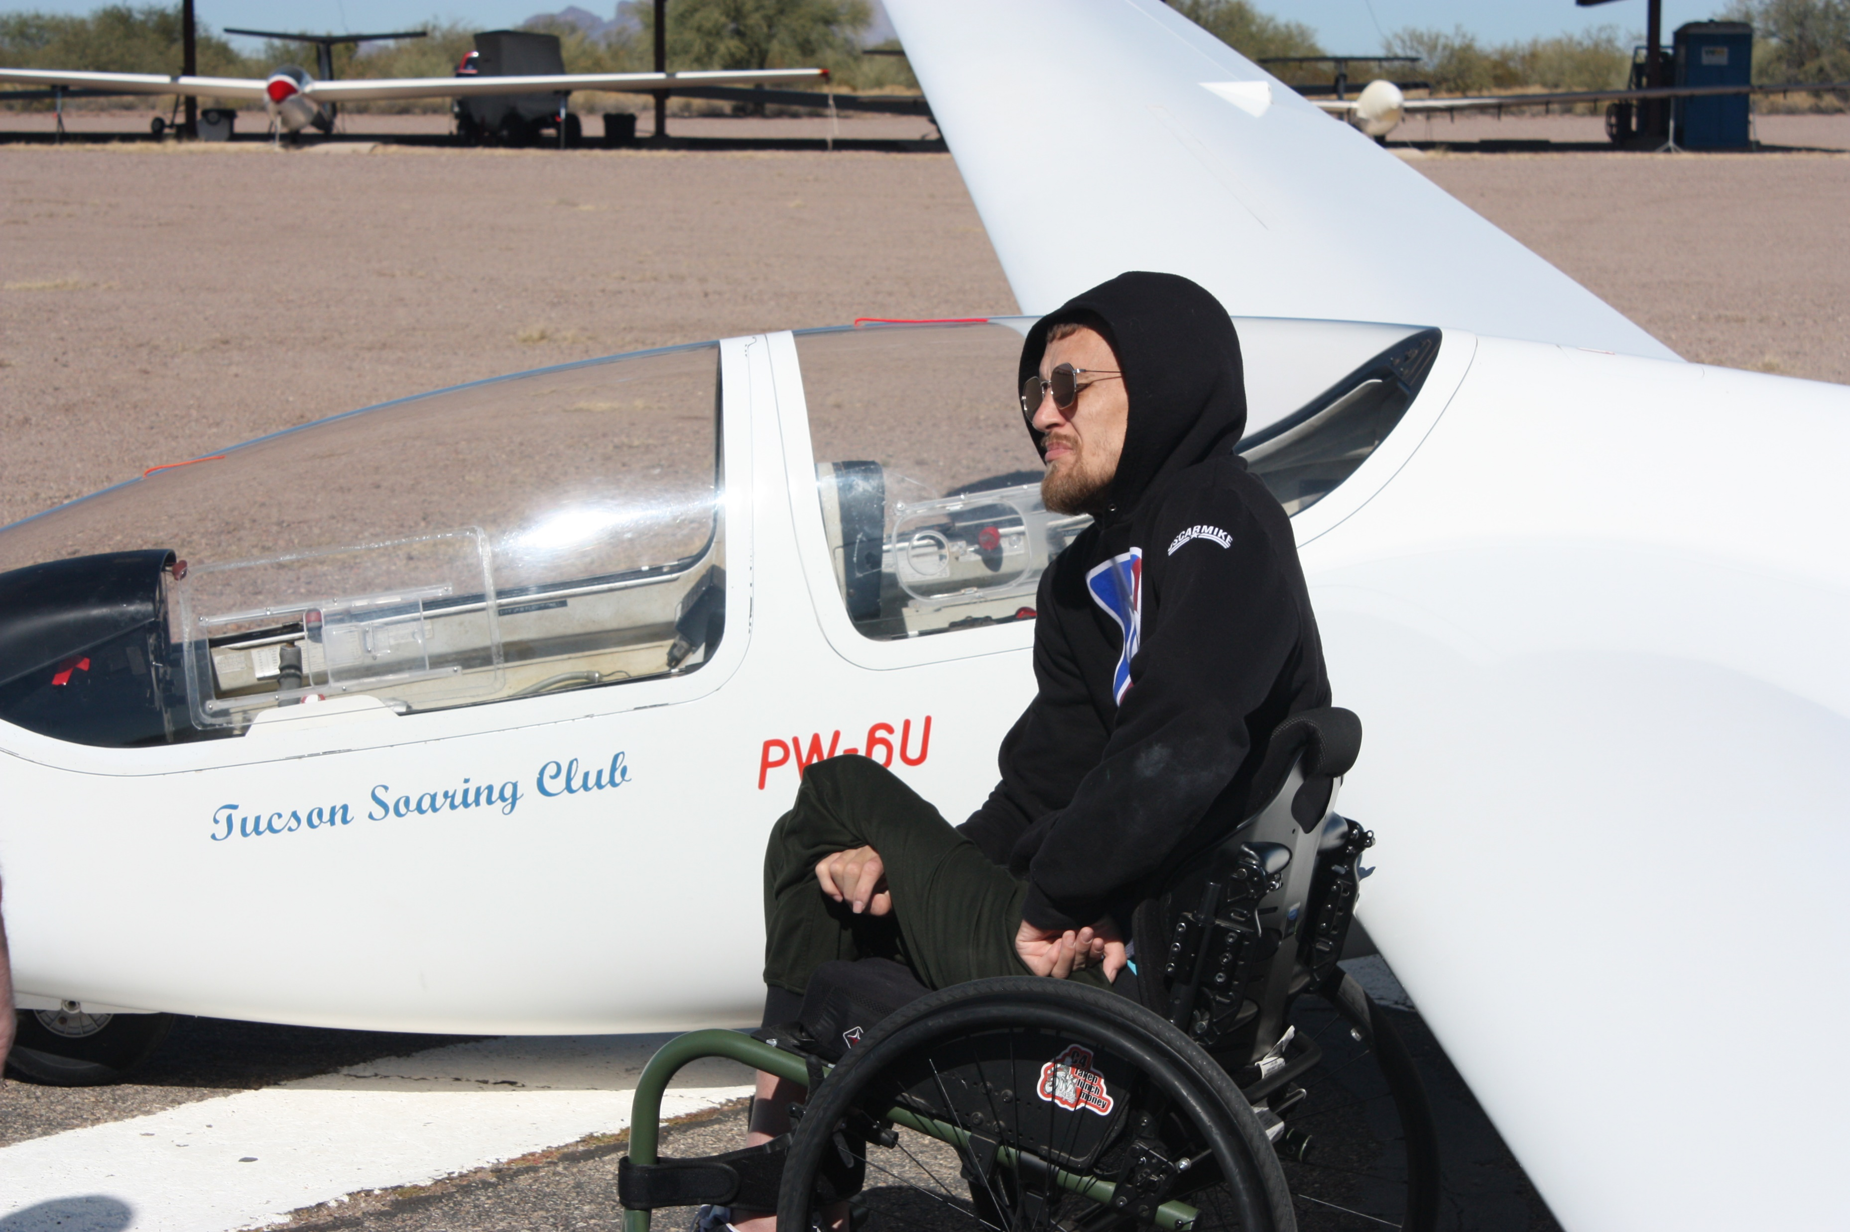
Freedom’s Wings Arizona
Thanks for taking the time to learn about Freedom’s Wings Arizona

Slide 15
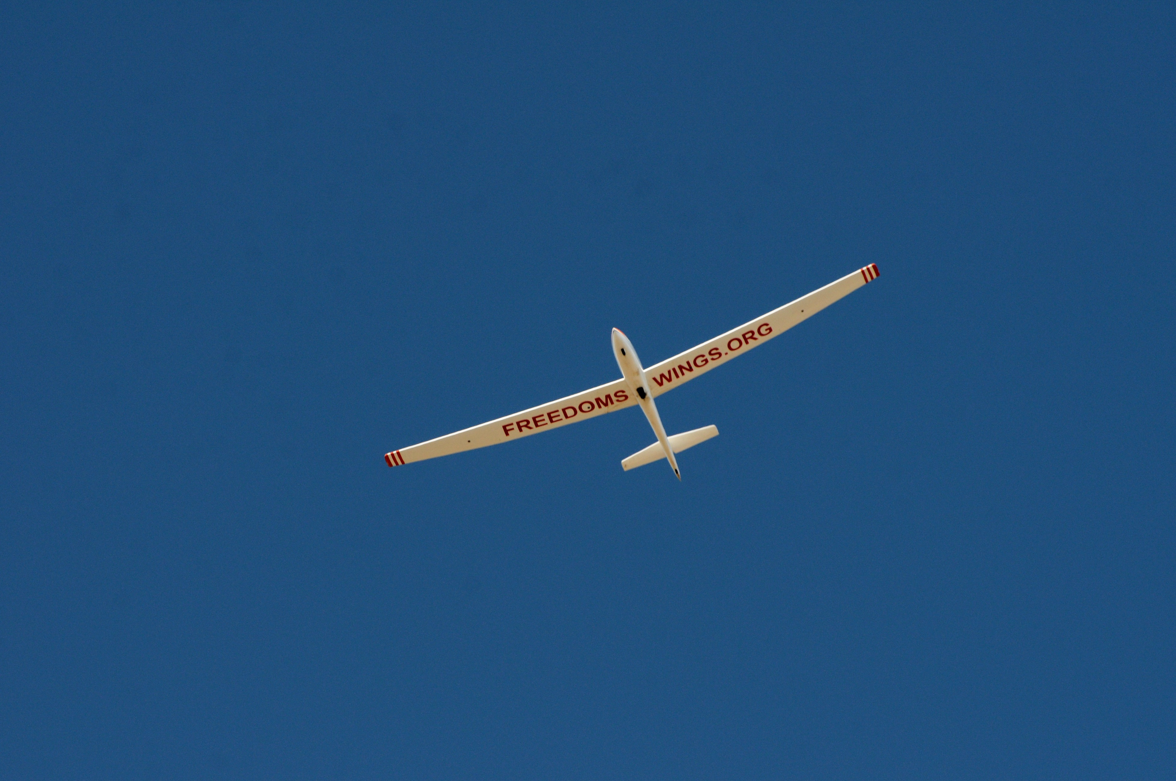
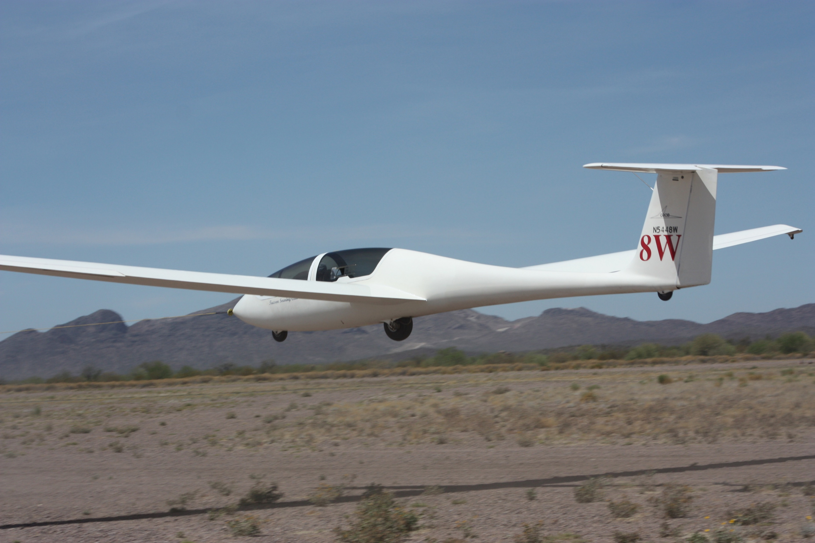
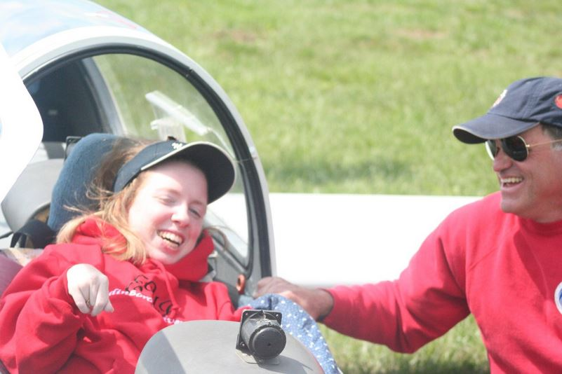
Freedom’s Wings Arizona

Slide 16
Freedom’s Wings Arizona
How does a glider fly?
A glider trades altitude for speed.
A glider coasts downhill, like a sled
If the glider finds rising air pockets (called Thermals) they can circle in the rising air, and if the air is going up faster than the glide is going downhill, you gain altitude.
How far can a glider fly without any rising air? Depending on the glider they range from 15:1 up to 45:1 ratio. So, if you are a mile up you can glide anywhere from 15-45 miles in perfect air… but plan for less for safety.
Glider pilots should not venture too far away from an airport or field until they know they can reach the next safe landing site.

Slide 17
Freedom’s Wings Arizona
What is the difference between flying a glider and soaring?
Flying a glider refers to piloting an engineless aircraft while soaring is the skillful use of natural sources of lift, such as thermals, ridge lift, and wave lift, to sustain and increase altitude during glider flights. Soaring is essential for glider pilots to extend their flight duration and explore long-distance cross-country flying.

Slide 18
Freedom’s Wings Arizona
How do you start your flights?
Aero tow – uses a power plane and a 200’ rope to tow you to altitude
An aero-tow launch method is a common technique used to launch gliders into the air. It involves using a powered aircraft, known as a tow plane to tow the glider lifting it to the desired altitude.
Winch Launch – uses a 5,000’ cable and an engine with a large fishing reel
A winch tow is another method used to launch gliders into the air. It involves employing a ground-based winch to rapidly reel in a cable attached to the glider, providing the necessary speed and lift to lift the glider off the ground.
Self-Launching – has an engine and stows it after launch
A self-launching sailplane, also known as a motor glider or a powered sailplane, is a type of glider that is equipped with its own propulsion system, typically a small engine. This allows the glider to launch itself into the air without the need for external assistance or a tow plane.

Slide 19
Freedom’s Wings Arizona
How long can you stay aloft?
The duration a glider can stay aloft depends on various factors, including weather conditions, pilot skill, glider performance, and available sources of lift. Gliders can remain airborne for extended periods, even more than 10 hours. However, it's important to note that typical glider flights may last between 1 to 6 hours.
How high can you get?
The altitude a glider or sailplane can reach depends on several factors, including the type of glider, the weather conditions, and the pilot's skill and intentions. While gliders can reach impressive altitudes, it's important to note that flying at extreme heights requires specialized training, experience, and consideration of safety factors
How far can you fly?
Distances commonly achieved in cross-country gliding range from tens to hundreds of miles. Exceptional XC flights can cover several hundred or even over 1,000 miles when flown by highly skilled pilots in optimal conditions.

Slide 20
Freedom’s Wings Arizona
Initial flight operations plan is to have one or two flight days per month, each with up to 10 flights.
One day for people with disabilities and the second day for Veterans and First responders who have had catastrophic injuries or their families.
Each Flight day costs about $750, thus the need for donations.
Future plans include developing STEM education programs using aviation as the theme and offering graduating students free glider rides.
Once funding is available, purchase a sailplane with hand controls to allow FWA to provide flight training and a club environment encouraging soaring for people with disabilities.

Slide 21
Freedom’s Wings Arizona
How Can You / Your Organization Support Us?
Help by spreading the word about FWA and our mission.
Volunteer in any way you can, either on flight days or anytime.
Provide a member list to FWA and allow for occasional email updates.
Direct financial assistance or in-kind donations.

