Slide 1

Directions for this Template
Use the Slide Master to make universal changes to the presentation, including inserting your organization’s logo and the appropriate protective marking (e.g., FOUO)
“View” tab > “Slide Master”
Replace placeholders indicated by yellow highlighted brackets [ ] with information specific to your workshop
Delete any slides that are not relevant for your workshop, including this slide.
Font size should not be smaller than 20 pt
Notes:
Jurisdictions/Organizations can modify and augment this briefing as needed.

Slide 2

Controller/Evaluator (C/E) Brief
Exercise Name
[Date]
Sponsor Logo

Slide 3

Welcome and Introductions
[Name]
[Title (e.g., Exercise Director or Lead Planner)]
[Jurisdiction/Organization]

Slide 4

Administrative Remarks
Safety and emergency information
Restrooms
Cell phone etiquette
Breaks and lunch
Microphones (if applicable)

Slide 5
Agenda
Overview
Communication
Safety and Security
Control
Evaluation
Sponsor Logo

Slide 6

Exercise Overview
[General description]

Slide 7

Exercise Schedule
Event | Date | Location (if needed)
Participant Registration | [Date] | [Location]
Participant Brief | [Date] | [Location]
Start of Exercise (StartEx) | [Date] | [Location]
End of Exercise (EndEx) | [Date] | [Location]
Hotwash | [Date] | [Location]
Controller/Evaluator Debrief | [Date] | [Location]
[*Evaluators should have completed IS-130: How to be an Exercise Evaluator prior to this briefing]

Slide 8

Scenario
[Scenario description]

Slide 9
Objectives and Aligned Capabilities
Objective: [Proposed Objective]
Aligns to: [Capability]
Objective: [Proposed Objective]
Aligns to: [Capability]
Objective: [Proposed Objective]
Aligns to: [Capability]

Slide 10

Exercise Participants
Participating Organization | Role | Extent of Play
[Participating organization] | [Role (e.g., Player, Observer)] | [Extent of play]
[Participating organization] | [Role (e.g., Player, Observer)] | [Extent of play]
[Participating organization] | [Role (e.g., Player, Observer)] | [Extent of play]
[Participating organization] | [Role (e.g., Player, Observer)] | [Extent of play]

Slide 11

Exercise Artificialities
Artificialities and constraints, such as the exercise assembly area, may detract from realism.
Some other artificialities include the following:
Exercise communication and coordination will be limited to participating exercise organizations, venues, and the Simulation Cell (SimCell)
Only communication methods listed in the Communications Plan will be available for players to use during the exercise
Participating agencies may need to balance exercise play with real-world emergencies. Real-world emergencies will always take priority
[List others, as appropriate]

Slide 12

Exercise Play
[Start and anticipated end timelines]
[Venue sites]
[Play will be restricted to the delineated areas surrounding exercise site]

Slide 13

Exercise Location and Area
[Insert Maps of exercise location/area here]
[Response route]

Slide 14

Exercise Communications
The C/E communications network enables controllers and evaluators to:
Report emergencies or safety issues
Report major timeline events
Acknowledge communication checks for timeline status
The primary means of communications will be [communications methods, e.g. radio, cellular phone, etc.]
[Key communication times]
A list of [phone numbers or radio call signs] can be found in the C/E Handbook
Notes:
Add a note about: For real emergencies, clearly state, “This is a Real-World Emergency.”

Slide 15

Safety
Safety is EVERYONE’S concern
Safety concerns override exercise execution
The safety officer for this exercise is [Name]
Actual emergencies will be identified by saying [“This is a Real-World Emergency”]
Report any injuries
Be aware that operating in an operations-based exercise environment is inherently dangerous

Slide 16
Safety
[Fire safety]
[EMS (real-world) area]
[Other exercise-related hazards]

Slide 17

Security
[Badges and/or hats/vests] identify authorized persons
Unauthorized persons are to be escorted out of the exercise play area
[Media policy/procedures]
[VIP/Observer procedures]
[Weapons policy]

Slide 18

Exercise Identification
Evaluators [red] badges
Support staff [green] badges
Players [blue] badges
Observers [gray] badges
Media [purple] badges
Actors [yellow] badges
Controllers/Facilitators [white] badges
VIP [black] badges
Safety Controller [orange] badges
Notes:
Some jurisdictions use vests and hats, in addition to or in lieu of badges. Modify this slide accordingly.
To change colors click the rectangle and fill to color choice.

Slide 19
Control Overview
Monitor exercise progression
Communicate exercise activities
Delivers injects
Controllers play an important role in ensuring that the exercise is a safe and secure environment.

Slide 20
Control Structure (Operations-Based)
[Lead Controller]
[MSEL Manager]
[SimCell Controller(s)]
[Ground Truth Advisor]
[Venue Control Cell Controllers]
[Observer/ Media Area Controller]
[Exercise Assembly Area Controller]
Refer to Figure 3.6, page 3-22 and Figure 4.2, page 4-4 of HSEEP Doctrine

Slide 21

Player Deployment
[For a drill or full-scale exercise, insert deployment information, as appropriate]
Emergency equipment located in and dispatched from the exercise assembly area will be released according to Incident Command
The deployment timetable is an estimate based on a real-time response to [incident site]
The deployment timetable can be found in the C/E Handbook

Slide 22

Documentation
C/E Handbook:
[Controller Instructions (COSIN) if applicable]
Communications Plan
Master Scenario Events List (MSEL):
Timeline
Injects

Slide 23

Master Scenario Events List (MSEL) Timeline
[High-level MSEL timeline information]

Slide 24

Controller Responsibilities
Lead Controller:
Monitor exercise progress and make decisions regarding any deviations or changes
Coordinate any required modifications
Controller:
Introduce, maintain, and coordinate exercise events in accordance with the MSEL
Observe and report exercise artificialities that interfere with realism
Additional information is listed in the C/E Handbook

Slide 25

Controller Guidelines: DO
Deliver injects promptly as listed in the MSEL or directed by the Lead Controller or Exercise Director
Coordinate activities with the Exercise Director, Lead Controller, SimCell, and other controllers in your area
Notify the Lead Controller of events or need for changes
Notify the Exercise Director and/or Lead Controller of ANY problems related to safety or scenario play
Begin and end all exercise communications with the statement, [“This is an exercise”]

Slide 26

Controller Guidelines: DO NOT
Hold personal conversations with players
Provide extra or advance information to players
Prompt players (unless directed by the Exercise Director or Lead Controller)

Slide 27

Final Controller Reminders
Safety comes first. Use the phrase [“Real-World Emergency”] when an emergency occurs
Know your role and responsibilities
Understand the scenario
Do not prompt or get in the way of players
Contact the Exercise Director and/or Lead Controller with any problems or questions

Slide 28
Evaluation Overview
The goal of exercise evaluation is to assess a jurisdiction’s/organization’s capabilities to accomplish a mission, function, or objective.
Evaluation is accomplished by:
Observing the event and collecting supporting data
Analyzing the data to identify strengths and areas for improvement
Reporting exercise outcomes in the After Action Report (AAR)

Slide 29

Evaluator Responsibilities
Understand the exercise objectives, capabilities, concept, and scenario
Familiarity with plans, policies, and procedures for the function or organization being evaluated
Use EEGs to document performance relative to exercise objectives, capabilities, capability targets, and critical tasks
Inform the Lead Controller of problems related to exercise design
Collect and submit all evaluation data, EEGs, and materials to the Lead Evaluator after the exercise
Additional information is in the C/E Handbook

Slide 30
Evaluator Guidelines: DO
Observe and record player activities
Focus on critical tasks and capability targets
Assign EEG capability target ratings
Document strengths and areas for improvement
Complete your EEGs either during or immediately after the exercise

Slide 31
Evaluator Guidelines: DO NOT
Leave your post at key times
Prompt players
Answer questions for players
Interfere with player actions

Slide 32
Evaluation Structure
[Lead Evaluator]
[Evaluator/Note Taker 1]
[Evaluator/Note Taker 3]
[As Needed]
[Evaluator/Note Taker 2]
Figure 5.2: Example of an Exercise Evaluation Team, page 5-2 of HSEEP Doctrine. Evaluation is a component of the overall Exercise Control Structure

Slide 33
Exercise Assignments
Venue | EEG | Position | Name
[Venue] | [EEG] | [Position] | [Name]
[Venue] | [EEG] | [Position] | [Name]
[Venue] | [EEG] | [Position] | [Name]
[Venue] | [EEG] | [Position] | [Name]
[Venue] | [EEG] | [Position] | [Name]
[Venue] | [EEG] | [Position] | [Name]
[Venue] | [EEG] | [Position] | [Name]

Slide 34
Documentation
C/E Handbook: Communication’s Plan
[Evaluation Plan (Eval Plan)]
Exercise Evaluation Guides

Slide 35
Evaluation Requirements
Evaluation requirements specify what will be evaluated during the exercise and how exercise play will be assessed
Evaluation requirements are documented in the EEGs
Capabilities
Capability targets
Critical tasks
Performance ratings

Slide 36
Exercise Evaluation Guides (1/3)
EEGs will be used to track evaluation of the objectives
[Plans to be evaluated]
The following evaluation requirements have been selected for this exercise:
Objective | Capability | Capability Target(s) | Critical Task(s)
[Insert exercise objective] | [Insert capability] | [Insert capability target(s)] | [Insert critical task(s)]
[Insert exercise objective] | [Insert capability] | [Insert capability target(s)] | [Insert critical task(s)]
[Insert exercise objective] | [Insert capability] | [Insert capability target(s)] | [Insert critical task(s)]

Slide 37
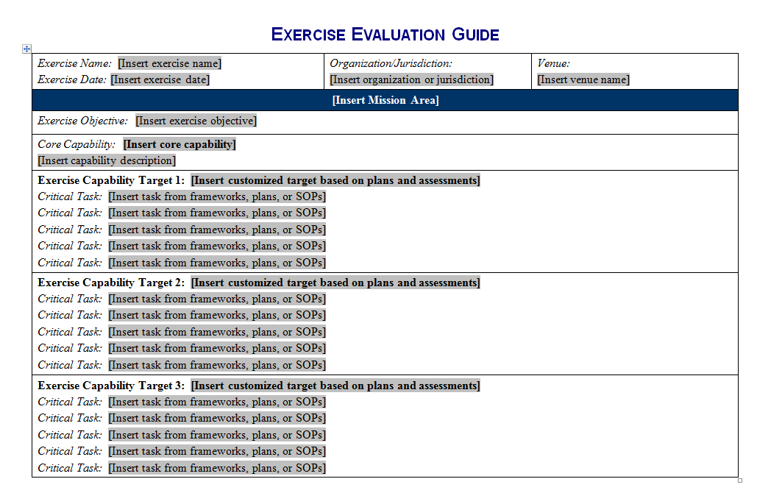
Exercise Evaluation Guides 2/3
Notes:
Screenshot of page 1 of the EEG with placeholders for exercise name, date, organization/jurisdiction, venue, objective, core capability, capability targets, and associated critical tasks.

Slide 38
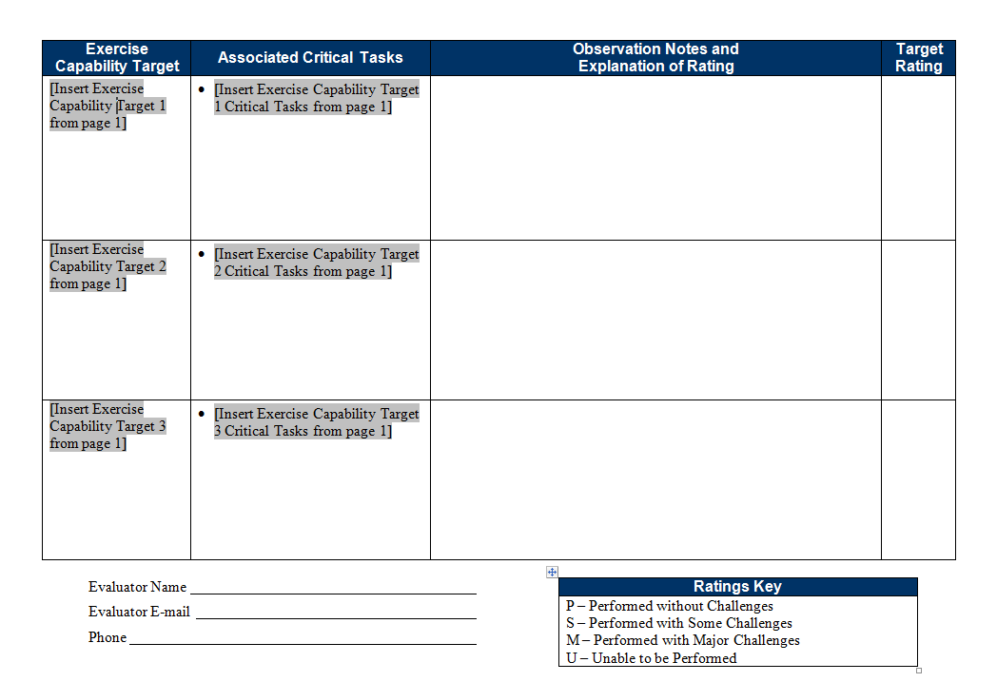
Exercise Evaluation Guides (3/3)
Notes:
Screenshot of page 2 of the EEG with placeholders for the exercise capability targets and associated critical tasks, observation notes/explanation of rating, and the target ranking. The evaluator's name, email, and phone number are included, as is a ratings key (P=performed without challenges; S=Performed with some challenges; M=Performed with major challenges; and U=unable to be performed).

Slide 39

Recording Observations
Actual time required for exercise players to complete the critical task(s)
How the target was or was not met
Decisions made and information gathered
Requests made and how they were implemented
Resources utilized
Plans, policies, procedures, or legislative authorities used or implemented
Any other factors contributing to the outcomes

Slide 40
Observation Examples
Area for improvement
The HAZMAT team did not arrive to the release site for (#) (time) which was not within standards. EOC personnel did not complete the critical tasks indicated in the SOP, which delayed the HAZMAT Team response.
Strength
The Public Information office created social media templates as part of a corrective action identified during a previous exercise. The templates allowed the public information office to provide public information and warning information to multiple demographics, in multiple languages, and on multiple platforms in (#) minutes; well under the expected time.

Slide 41

Capability Target Ratings
Evaluators assign ratings for each capability target listed on the EEG
Review notes and observations relating to EEG critical tasks, and assign one of four ratings for the capability target:
Performed without Challenges (P)
Performed with some Challenges (S)
Performed with Major Challenges (M)
Unable to be Performed (U)
Consult the ratings definitions page in the EEG to determine the correct rating for the capability target

Slide 42
Final Evaluator Reminders
Safety comes first. Use the phrase [“Real-World Emergency”] when an emergency occurs
Know your role and responsibilities
Understand the scenario
Do not prompt or get in the way of players
Contact the Exercise Director and/or Lead Evaluator with any problems or questions

Slide 43

Questions

