Slide 1
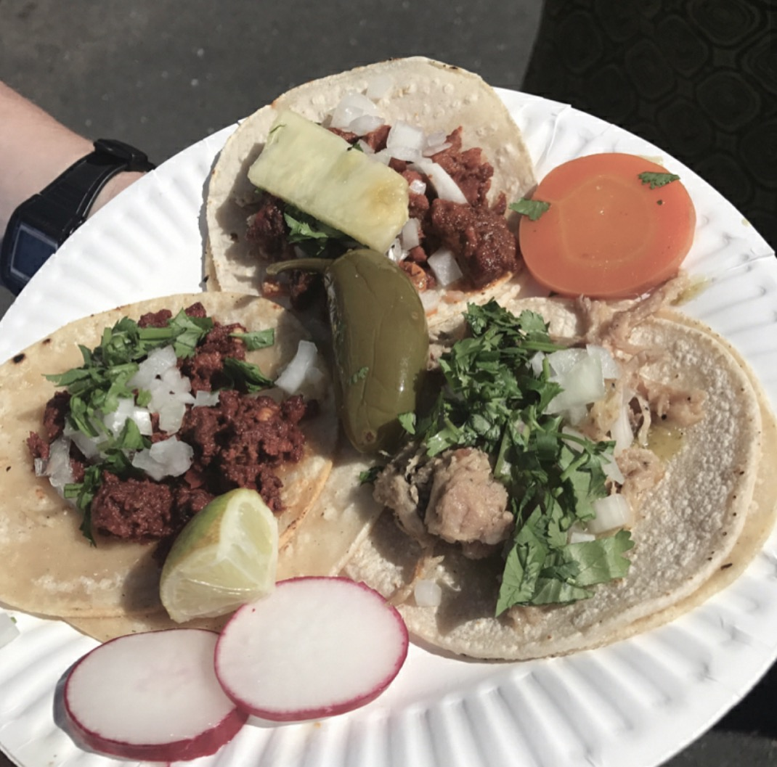
The 7th Annual
Sacramento
Taco Festival
™
www.sacramentotacofestival.com
Sunday, May 21, 2023
From 10:30 am to 5:30 pm
Del Paso Blvd
Old North Sacramento – 95815
SPONSORSHIP PACKAGE

Slide 2
Sacramento Taco Festival History
Established on October 12, 2012 to promote the arts and recognize national Taco Day, this event has become a street fair with a focus of promoting North Sacramento.
With thousands of people looking forward to attending the Sacramento Taco Festival each year since, locally and from out of town, it is the Vida De Oro’s Foundation’s largest event.
The Vida De Oro Foundation, whose mission is to promote the arts and enhance the community, works with the North Sacramento Chamber of Commerce, the Del Paso Boulevard Partnership, the City Councilmember and numerous local neighborhood associations and nonprofits to make this event possible.
Sponsorships are tax deductible. Contact us at taco@sactacofest.com or (916) 914-4665.

Slide 3
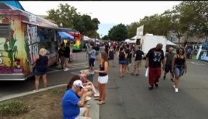
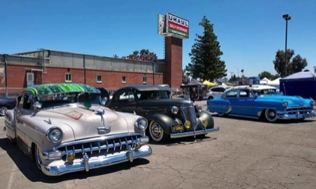
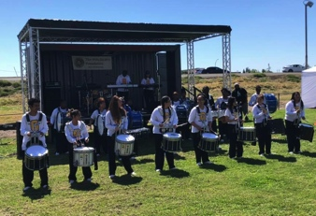
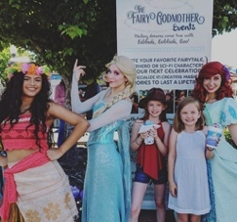
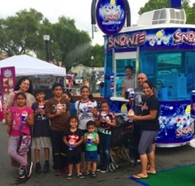
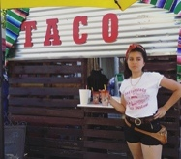
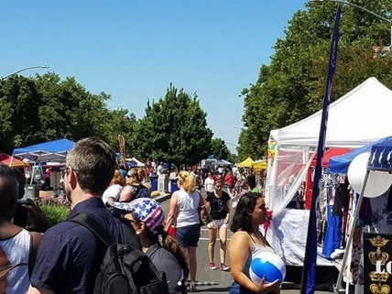
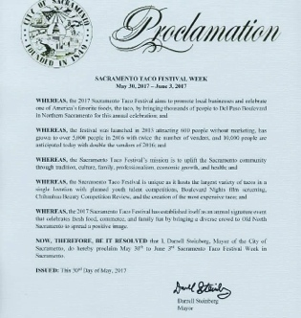
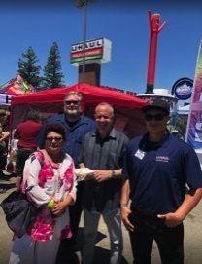
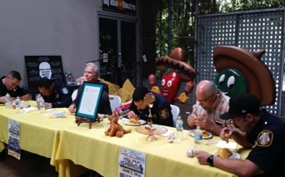
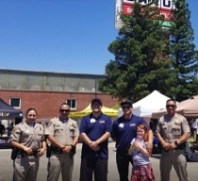
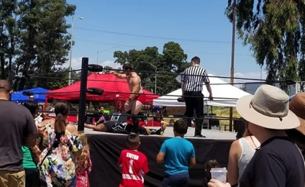
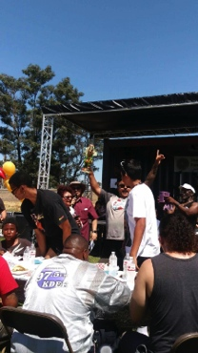
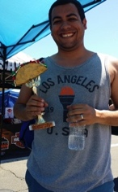
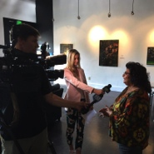
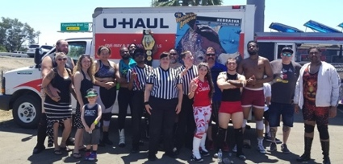
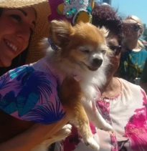
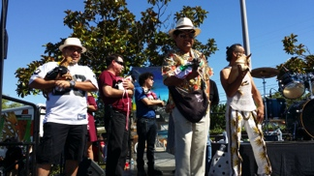
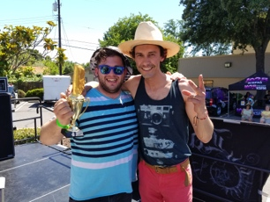
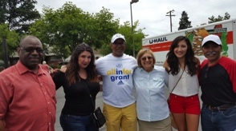
Northern California’s Premiere Event!
Selfie/Photo Opportunities
A Real Crowd Pleaser
Community Engagement
Lucha Libre
(Professional Wrestling)
Northern California’s
Chihuahua Beauty Contest
Media Event/Taco Eating Contests

Slide 4
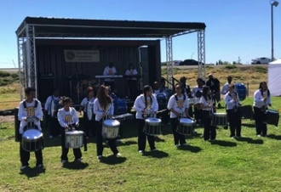
Promotional Opportunities
Branding – have your logo placed
On Our Collateral Materials
On All Our Social Media Outreach
On Our Merchandise
On the Banners at Entrances
Sponsorship Opportunities
Stage Sponsorship
Press Conference & Celebrity Taco Eating Contest
Chihuahua Beauty Contest
Professional Wrestling
Taco Eating Contest
Pie Eating Contest
Exhibitions
History of North Sacramento
Beer Garden/VIP Booths
Art Demonstrations and Displays

Slide 5
Advertising & Branding Pricing
Program Book Advertising
Put your logo on our:
Ad Size: | Price:
Half Page Color | $ 1,500
Full Page Color | $ 2,500
Two-Page Spread | $ 5,500
Inside Front Cover | $ 4,000
Outside Back Cover | $ 5,000
Opportunity: | Price:
Posters/Post cards | $ 250
Napkins | $ 350
Beverage Cups | $ 500
T-Shirts | $1,000
Hats/Caps/Visors | $1,250
Stage Banner | $1,500
Our Entrance Banner | $1,500
Taco Trail Map | $2,000
(All ads are due April 28, 2023 – print & digital formats – digital includes hyperlink to your website)

Slide 6
Sponsorship Levels
Partnership Level | Amount | Benefits:
Bronze | $ 2,000 | Logo on banners at: Press Conference and Celebrity Taco Eating Contest and at the event entrances; a display booth the day of the event.
Silver | $ 5,000 | The items listed above plus quarter page ad in program book (non-digital and digital with hyperlink).
Gold | $10,000 | The items listed on the top two above plus a half-page ad in program book and logo on all pre-marketing material.
Platinum | $15,000 | The items listed on the top three above plus logo on our merchandise, a ¾ page ad in program book and company banner on wrestling stage and entrances.
Diamond | $20,000 | The items listed on the top four above plus listed as a Co-Host, a full-page ad in program book, company banner on the back of the main stage and microphone time before each main event.

Slide 7
Sponsorship Agreement
COMPANY NAME/PHONE #: __________________________________________________________________________
FIRST and LAST NAME OF AUTHORIZED REPRESENTATIVE: __________________________________________________
ADDRESS: ___________________________________________ City: _________________ State/Zip: ______________
EMAIL ADDRESS: __________________________________ Company Website: ________________________________
LEVEL SELECTED: __________________________________________ Amount: $_______________________
Payment by Check: _____ Payment by Card:_____
CREDIT CARD NUMBER
EXP. MONTH/YEAR
SEC. CODE
AFFILIATED ZIP CODE
*Please list items to be sold or distributed: _____________________________________________________________
Signature of Authorized/Responsible Individual/Representative (Below):
___________________________________________________ Date: ___________________________

Slide 8
Sponsorship Agreement
Please Read Before Submitting Sponsorship Agreement:
This agreement is with the Vida de Oro Foundation, a public benefit 501 (c) (3) organization, EIN 46-2304644, which is endorsed by the City of Sacramento. All sponsors, vendors, and contributors will receive a formal invoice and W-9 Form for your records and deductible claims. NOTE: Agreements submitted without payment are deemed incomplete until payment is received. No refunds will be provided at anytime. For the safety, security and benefit of attendees, all sponsors and vendors must abide by the event rules and guidelines (mailed separately.) Unless negotiated/discussed and approved by the Vida de Oro Foundation prior to the event, no vendor/sponsor may sell or display alcohol, self-defense weapons, firearms, pornographic materials, narcotics, alternative medicines, nor any material or information that is offensive that promotes hate or discrimination toward any person or persons, or group. The signature provided is from an individual authorized to commit the above Sponsor/Vendor/Contributor to participate in this event. In addition, the signature also confirms the above Policies and Disclaimers have been read and understood, and authorizes the Vida de Oro Foundation to use images, logos, slogans, etc., in related marketing and sales material.
Please mail or email this Agreement/Payment to:
Vida de Oro Foundation
2213 Del Paso Blvd, #149
Sacramento, CA 95815
Email: vida@vidadeoro.com
Questions? (916) 914-4623
Make Checks Payable to: Vida De Oro Foundation

