Slide 1
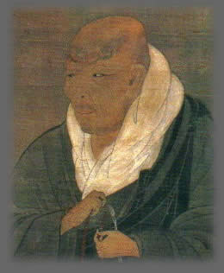
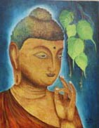
Buddhism to shin Buddhism
Shinran’s Path to a Fulfilling and Meaningful Life
Kevin Kuniyuki
Retired Minister, Honpa Hongwanji Mission of Hawaiʻi

Slide 2
Buddhist and Shin Buddhist Values and Beliefs
Goal of Buddhism: Relieve Suffering
World Reality: Dependent Origination
Middle Way
World Reality: Change
Wisdom and Compassion

Slide 3
Buddhist and Shin Buddhist Values and Beliefs
Goal of Buddhism: Relieve Suffering
World Reality: Dependent Origination
Middle Way
World Reality: Change
Wisdom and Compassion

Slide 4
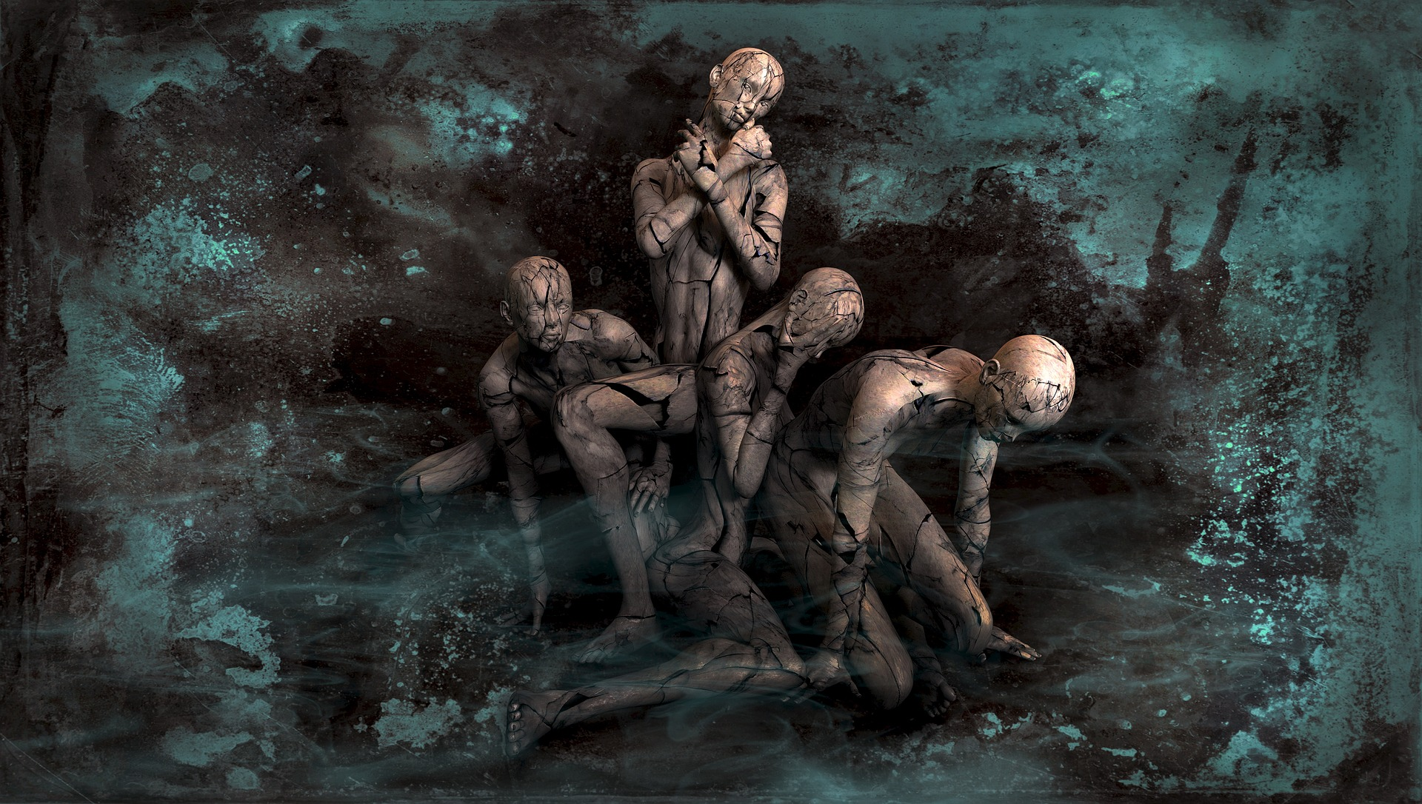
PAIN IS NOT SUFFERING. SUFFERING MOSTLY STARTS WITH PAIN.

Slide 5
Range of Suffering
Suffering
Unease
Distress
Agony
Discomfort

Slide 6
The Problem of Suffering was Addressed and Solved by Gautama Buddha

Slide 7
Buddhist and Shin Buddhist Values and Beliefs
Goal of Buddhism: Relieve Suffering
World Reality: Dependent Origination
Middle Way
World Reality: Change
Wisdom and Compassion

Slide 8
Dependent Origination Everything Exists in a Web Interdependence

Slide 9
Dependent Origination is a Web of Interdependent Causes and Effects
Cause
Effect
Cause
Effect →Cause
Effect →Cause
Cause
Effect →Cause
Effect →Cause
Effect →Cause
Effect →Cause
Effect
Effect
Effect →Cause
Effect
... so on …
... so on …
Effect
Effect →Cause
Effect
Effect

Slide 10
The “self” is Dependently Originated
Self
BODY
MIND
NURTURE
SOCIAL
ETC …..

Slide 11
Buddhist and Shin Buddhist Values and Beliefs
Goal of Buddhism: Relieve Suffering
World Reality: Dependent Origination
Middle Way
World Reality: Change
Wisdom and Compassion

Slide 12
Life is Like a River is Always Changing
Because of Interdependent Causes and Effects – Dependent Origination

Slide 13
Buddhist and Shin Buddhist Values and Beliefs
Goal of Buddhism: Relieve Suffering
World Reality: Dependent Origination
Middle Way
World Reality: Change
Wisdom and Compassion

Slide 14
Middle Way Seeking Wisdom with Balance and an Open Mind
Middle Way
Left Extreme
Right Extreme

Slide 15
Buddhist and Shin Buddhist Values and Beliefs
Goal of Buddhism: Relieve Suffering
World Reality: Dependent Origination
Middle Way
World Reality: Change
Wisdom and Compassion

Slide 16
Relieve Suffering becomes Relieve All Suffering because of Dependent Origination
Relieve All Suffering
Relieve Suffering
Wisdom-Compassion

Slide 17
To Effectively Relieve One’s Suffering is to also Address the Suffering of Others

Slide 18
Understanding Values and Beliefs is the Same as Understanding Love

Slide 19
The Problem of Suffering was Addressed and Solved by Gautama Buddha
FOUR NOBLE TRUTHS

Slide 20
Four Noble Truths as a Problem-Solving Process
Problem
01
Cause
02
Specify Solution
04
Address the Cause
03
Suffering in all its range of afflictions
Three Poisons or Blind Passions:
Greed
Anger
Ignorance
Blind Passions AKA Three Poisons
Eightfold Path
Living in balance and harmony with Dependent Origination

Slide 21
Four Noble Truths 1st Noble Truth: Suffering
Problem
01
Cause
02
Specify Solution
04
Address the Cause
03
Suffering in all its range of afflictions
Three Poisons or Blind Passions:
Greed
Anger
Ignorance
Blind Passions AKA Three Poisons
Eightfold Path
Living in balance and harmony with Dependent Origination

Slide 22
Suffering was previously explained above
Goal of Buddhism: Relieve Suffering
World Reality: Dependent Origination
Middle Way
World Reality: Change
Wisdom and Compassion
As a reminder: Below is the Diagram of Values and Beliefs

Slide 23
Understanding Values and Beliefs and four noble truths is the Same as Understanding Love
Thank you!

