Slide 1
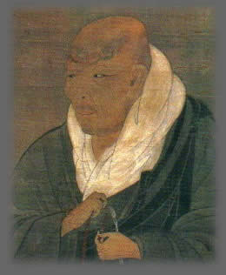
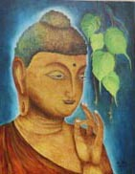
Buddhism to shin Buddhism
Shinran’s Path to a Fulfilling and Meaningful Life
Four Noble Truths
Kevin Kuniyuki
Retired Minister, Honpa Hongwanji Mission of Hawaiʻi

Slide 2
Buddhist and Shin Buddhist Values and Beliefs
REVIEW
Goal of Buddhism: Relieve Suffering
World Reality: Dependent Origination
Value:
Middle Way
World Reality: Change
Belief:
Wisdom and Compassion

Slide 3
The Problem of Suffering was Addressed and Solved by Gautama Buddha
FOUR NOBLE TRUTHS

Slide 4
Four Noble Truths as a Problem-Solving Process
Problem
01
Cause
02
Address the Cause
03
04
Specify Solution
Suffering in all its range of afflictions
Three Poisons or Blind Passions:
Greed
Anger
Ignorance
Blind Passions AKA Three Poisons
Eightfold Path
Living in balance and harmony with Dependent Origination

Slide 5
Four Noble Truths 1st Noble Truth: Suffering
Problem
01
Cause
02
Address the Cause
03
04
Specify Solution
Three Poisons or Blind Passions:
Greed
Anger
Ignorance
Eightfold Path
Suffering in all its range of afflictions
Blind Passions AKA Three Poisons
Eightfold Path
Blind Passions AKA Three Poisons
Living in balance and harmony with Dependent Origination
Living in balance and harmony with Dependent Origination

Slide 6
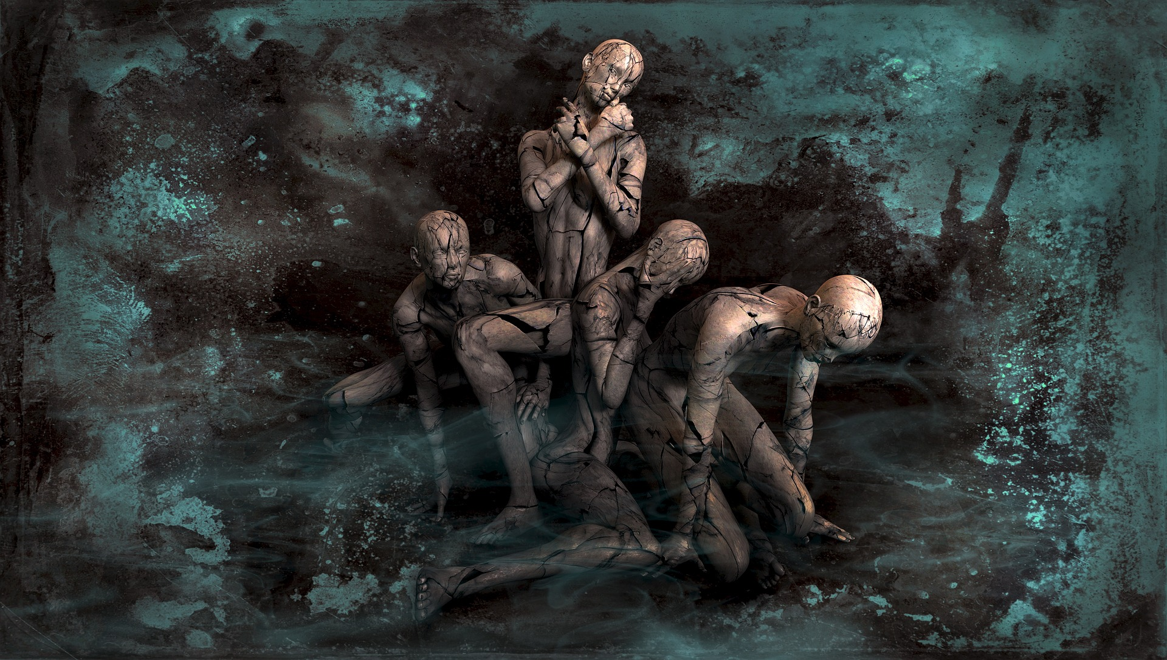
PAIN IS NOT SUFFERING. SUFFERING MOSTLY STARTS WITH PAIN.

Slide 7
Range of Suffering
AGONY
UNEASE
DISCOMFORT
DISTRESS

Slide 8
Four Noble Truths 2nd Noble Truth: Three Poisons
Problem
01
Cause
02
Address the Cause
03
04
Specify Solution
Three Poisons or Blind Passions:
Greed
Anger
Ignorance
Eightfold Path
Suffering in all its range of afflictions
Blind Passions AKA Three Poisons
Eightfold Path
Blind Passions AKA Three Poisons
Living in balance and harmony with Dependent Origination
Living in balance and harmony with Dependent Origination

Slide 9
Four Noble Truths Cause: Three Poisons AKA Blind Passions
Greed (Attachment in all forms: greed, jealousy, sadness from loss, etc.)
01
Anger (Aversion ranging from discomfort to dislike to hate)
02
Ignorance (Blind Ignorance, Prefer Ignorance, Indifferent)
03

Slide 10
Four Noble Truths Cause: Greed -Attachment
Greed (Attachment in all forms: greed, jealousy, sadness from loss, etc.)
01
Anger (Aversion ranging from discomfort to dislike to hate)
02
Ignorance (Not knowing, Not wanting to know, Unmotivated to learn)
03

Slide 11
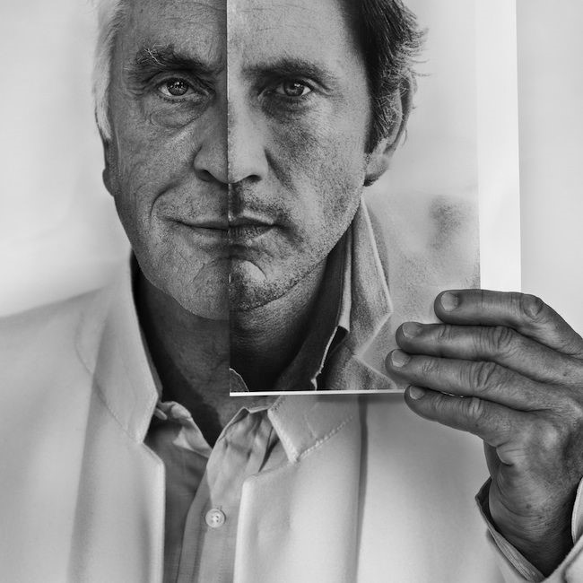
Greed - attachment
Attached to what we can’t have.
Attached to no change, no aging, …
Attached to no loss, no separation. …

Slide 12
Four Noble Truths Cause: Anger - Aversion
Greed (Attachment in all forms: greed, jealousy, sadness from loss, etc.)
01
Anger (Aversion ranging from discomfort to dislike to hate)
02
Ignorance (Blind Ignorance, Prefer Ignorance, Indifferent)
03

Slide 13
Anger – RANGE OF aversion
Discomfort
(Aversion/fear)
Dislike
(Aversion/fear)
Hate
(Aversion/fear)

Slide 14
Four Noble Truths Cause: Ignorance
Greed (Attachment in all forms: greed, jealousy, sadness from loss, etc.)
01
Anger (Aversion ranging from discomfort to dislike to hate)
02
Ignorance (Blind Ignorance, Prefer Ignorance, Indifferent)
03

Slide 15
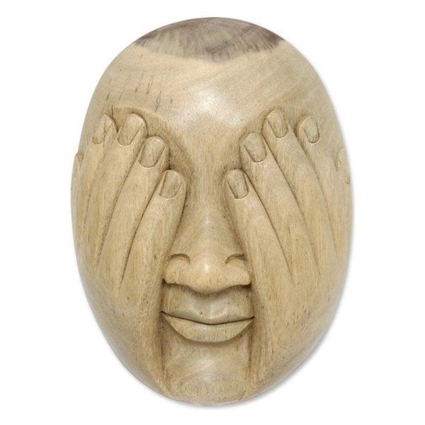
ignorance
Blind Ignorance
Prefer Ignorance
Indifferent

Slide 16
Four Noble Truths 3rd Noble Truth: Balanced Living
Problem
01
02
Address the Cause
03
04
Cause
Specify Solution
Three Poisons or Blind Passions:
Greed
Anger
Ignorance
Eightfold Path
Suffering in all its range of afflictions
Blind Passions AKA Three Poisons
Eightfold Path
Blind Passions AKA Three Poisons
Living in balance and harmony with Dependent Origination
Living in balance and harmony with Dependent Origination

Slide 17
3rd Noble Truth: Addressing the Cause is to
Live in balance and harmony with Dependent Origination

Slide 18
Four Noble Truths 1st Noble Truth: Suffering
Problem
01
Cause
02
Address the Cause
03
04
Specify Solution
Three Poisons or Blind Passions:
Greed
Anger
Ignorance
Eightfold Path
Suffering in all its range of afflictions
Blind Passions AKA Three Poisons
Eightfold Path
(how to do live in balance)
Blind Passions AKA Three Poisons
Living in balance and harmony with Dependent Origination
Live in balance and harmony with Dependent Origination

Slide 19
Eightfold Path Middle Path of Balance and Harmony
Right View
Right Thought
Right Speech
Right Action
Right Livelihood
Right Effort
Right Mindfulness
Right Meditation

Slide 20
Middle Path of Balance and Harmony Address: Consciousness - Conduct – Mental State
Right View
Right Thought
Right Speech
Right Action
Right Livelihood
Right Effort
Right Mindfulness
Right Meditation
CONSCIOUSNESS
CONDUCT
CONDUCT
MENTAL STATE

Slide 21
Middle Path of Balance and Harmony Address: Consciousness - Conduct – Mental State
Consciousness your point of view and what you are thinking
Conduct what you are doing and how you do it
Mental State what you are feeling and your attitude

Slide 22
Foundation for the Eightfold Path Right View Buddhist & Shin Buddhist Values and Beliefs What you value and how you see the world
Goal of Buddhism: Relieve Suffering
World Reality: Dependent Origination
Value:
Middle Way
World Reality: Change
Belief:
Wisdom and Compassion

Slide 23
Middle Path of Balance and Harmony Right View & Right Thought
Consciousness
Right View
Your Thoughts arise from your Point of View.
1-Right View
Right Thoughts
Your Thoughts also in turn, influence your Point of View
2-Right Thought
Conduct
Mental State

Slide 24
Middle Path of Balance and Harmony Consciousness - Right View & Right Thought
Consciousness
1-Right View
Your Conduct, what you do and how you do it, arises from your Consciousness. And the reverse is also true.
Your Mental State, what you are feeling and your attitude, arises from your Consciousness. And the reverse is also true.
2-Right Thought
Conduct
Mental State

Slide 25
Middle Path of Balance and Harmony Conduct – Right Speech, Right Action and Right Livelihood
Consciousness
Since Conduct, arises from your Consciousness. And the reverse is also true, Right Speech, Right Action and Right Livelihood, act on and acted on, by Right View and Right Thought.
1-Right View
2-Right Thought
And Conduct has same mutual condition with Mental State. And the reverse is also true.
Conduct
Mental State
3-Right Speech
4-Right Action
5-Right Livelihood

Slide 26
Middle Path of Balance and Harmony Mental State – Right Effort, Right Mindfulness and Right Meditation
Consciousness
Note that with Conduct and Mental State, Mental State has a greater effect on Conduct.
1-Right View
Mental State affect Consciousness. And the reverse is also true.
2-Right Thought
Conduct
Mental State
3-Right Speech
6-Right Effort
4-Right Action
7-Right Mindfulness
5-Right Livelihood
8-Right Meditation

Slide 27
Middle Path of Balance and Harmony Aspects of Consciousness, Conduct and Mental State work together Interdependently
Consciousness
1-Right View
2-Right Thought
Conduct
Mental State
3-Right Speech
6-Right Effort
4-Right Action
7-Right Mindfulness
5-Right Livelihood
8-Right Meditation

Slide 28
Understanding four noble truths is the Same as Understanding Love
thank you!

Slide 29
The Problem of road rage as it might be addressed by Gautama Buddha
FOUR NOBLE TRUTHS
In Everyday Living

Slide 30
Four Noble Truths In Everyday Living
Problem
01
Cause
02
Address the Cause
03
04
Specify Solution
ROAD RAGE
Three Poisons or Blind Passions:
Greed
Anger
Ignorance
Living in balance and harmony with Dependent Origination
Eightfold Path
Blind Passions AKA Three Poisons
Eightfold Path
Blind Passions AKA Three Poisons
Living in balance and harmony with Dependent Origination

Slide 31
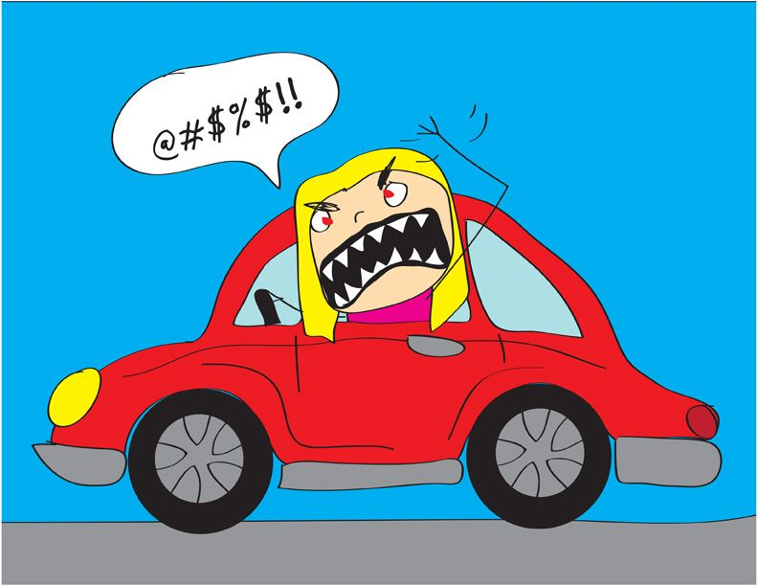
WHEN YOU ARE ANGRY YOU ARE SUFFERING AND CAUSE SUFFERING FOR OTHERS

Slide 32
RIGHT VIEW: THE GOAL IS FOR EVERYONE TO GET HOME SAFELY
Thinking in Harmony with dependent origination
MORE ON THE PROBLEM OF ROAD RAGE NEXT PRESENTATION.
PLEASE HAVE A SAFE AND PLEASANT JOURNEY HOME

