Slide 1
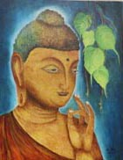
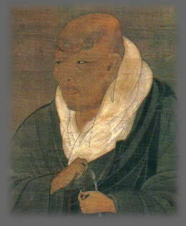

Buddhism to shin Buddhism
Shinran’s Path to a Fulfilling and Meaningful Life
A Life of Awareness and Gratitude
Kevin Kuniyuki
Retired Minister, Honpa Hongwanji Mission of Hawaiʻi

Slide 2
Buddhist and Shin Buddhist Values and Beliefs
REVIEW
Goal of Buddhism: Relieve Suffering
World Reality: Dependent Origination
Value:
Middle Way
World Reality: Change
Belief:
Wisdom and Compassion

Slide 3
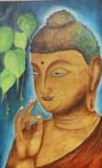
The Problem of suffering was addressed by
Gautama Buddha
FOUR NOBLE TRUTHS

Slide 4
Four Noble Truths
REVIEW
Problem
01
Cause
02
Address the Cause
03
04
Specify Solution
Suffering in all its range of afflictions
Three Poisons or Blind Passions:
Greed
Anger
Ignorance
Blind Passions AKA Three Poisons
Eightfold Path
Living in balance and harmony with Dependent Origination

Slide 5


Eightfold Path:
The Middle Path of Balance and Harmony
Consciousness
1-Right View
2-Right Thought
Conduct
Mental State
3-Right Speech
6-Right Effort
4-Right Action
7-Right Mindfulness
5-Right Livelihood
8-Right Meditation

Slide 6
SHINRAN SHŌNIN WAS ABLE TO RESOLVE THE PROBLEM OF HUMAN LIMITATION
LIFE IS A JOURNEY SUPPORTED BY AMIDA BUDDHA

Slide 7

LIFE CAN BE A FULFULLING JOURNEY DOWN A PATH OF SELF-DEVELOPMENT AND SPIRTUAL GROWTH
LIFE IS A JOURNEY SUPPORTED BY AMIDA BUDDHA

Slide 8

HOW DO WE DO THIS?

Slide 9
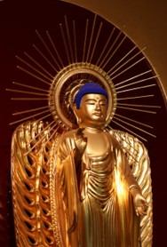
AMIDA IS SOMETHING THAT IS GREATER THAN US THAT IS PERFECT WISDOM/COMPASSION AND UNCONDITOINAL LOVE
LIFE IS A JOURNEY SUPPORTED BY AMIDA BUDDHA

Slide 10

Understanding THE JOUNERY OF life and amida is the Same as Understanding Love
Love is like a puzzle … hard to piece together, but beautiful when all the right pieces are put together
thank you!

