Slide 1
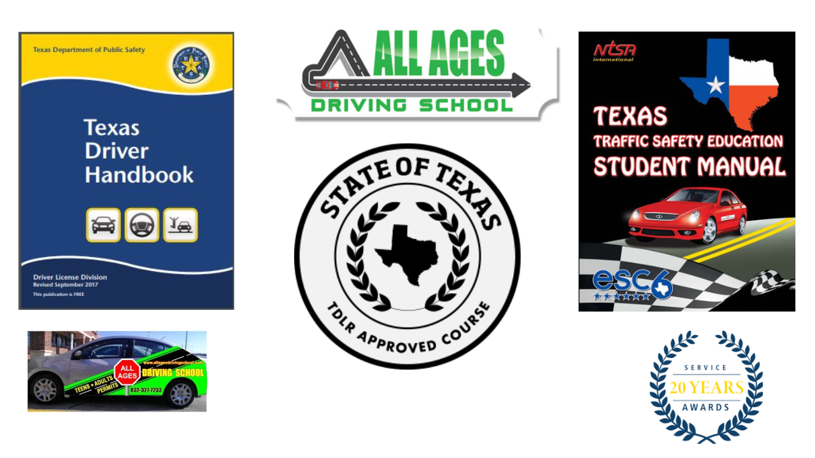
All Ages Driving School Day 1 Teen Drivers Education
Module #1
Created By: Mr. James Roden (Supervising Teacher) TDLR #: 4357

Slide 2
Rules of the Class
1. Be on time, if you are more then 10 minutes late you will not be admitted and must make up the class.
2. No Food or Drink (Water Bottle is allowed with cap)
3. No cell phone use (unless given permission by instructor for lesson)
4. Must use black pen on all official paperwork (In-car Log, Classroom Log)
5. Must bring pen and notebook to class everyday (laptops and tablets allowed for projects).
6. No writing on desk/chairs or destroying property ($50 fee if caught).
7. Be respectful to instructor, other students and to yourself.
8. Pick up all trash on and around your desk/chair/floor, keep things clean.
9. Respect restroom and wash hands.
10. Enjoy the class ☺

Slide 3
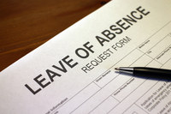
Contract Review (Absences)
1. Absences: a. All absences must be made up on same instructional day as absence. (For example: If you miss instructional day 13 you must make up that class when another session is on instructional day 13.) b. You can only miss up to 5 instructional days, on the 6th day of missed instruction you will be dropped form the course. c. When making up a class you must check in with the Office Manager and get your in-class log for the instructor to fill out. d. The cost for making up an absence is $10. e. If you must leave class early before dismissal it will count as an absence for that instructional day.

Slide 4
Contract Review (6 Month Time Limit)
You have 6 months starting from the first day of the Teen class to complete your teen driver’s education course. Which include the following. 1. Phase 1: 16 days (32 hours) of classroom instruction 2. Phase 2: 7 drive time lessons (14 hours – 7 driving/7 observing). 3. 30 hour Parent Log. 4. Any and all fee’s and balances.
Example: If the first day of class is January 1st then your contract will expire July 1st of that year. Failure to complete within 6 month time limit requires an extension to the contract in order to legally finish. A fee will be charged for a contract extension.

Slide 5
Contract Review (Fees)
Classroom Absence: $10 fee per absence
DE-964 Form Replacement: $40 fee per form
In-Car No Call/No Show: $35 fee (You must with minimum 24-hour notice) (showing up without your license is same as no show)
Writing on Desk/Chair $50 for each offense (cameras in class)

Slide 6
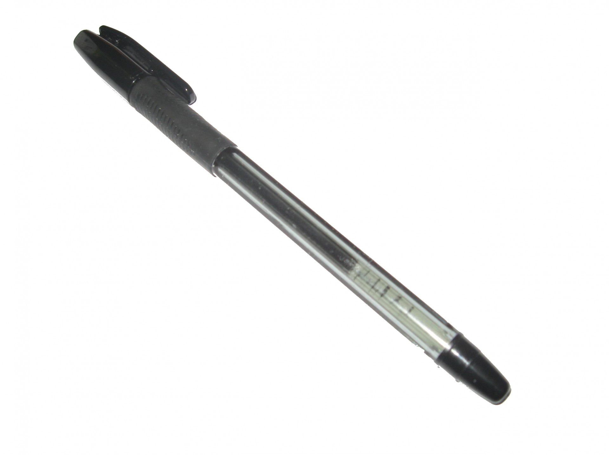
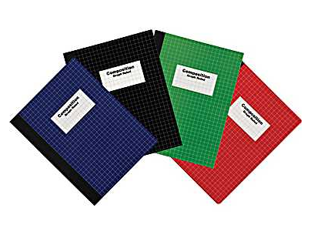
Materials Required and Optional
Required: 1. Black Pen 2. Notebook
Optional: 1. Laptop/Chromebook/Netbook 2. Tablet (iPad, Fire tablet..etc)

Slide 7
Important Contact Information and Business Hours
Location: 3809 Shaver St. #140, Pasadena Texas 77054
Phone Number: (713) 947-7322
Hours: Monday – Friday (2 p.m. – 6 p.m.) Saturday (9:30 a.m. – 2 p.m.) Sunday Closed
Owner: Asif Hassni (phone number and email upon request)
Instructor: Mr. James (Supervising Teacher License #4357)
Email: mrjamesdriversed@gmail.com
Website: www.allagesdrivingschool.com

Slide 8
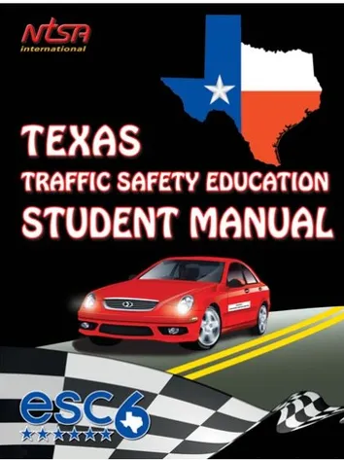
Resources in class
PDF copy on our website
PDF copy on our website

Slide 9
DPS Handbook 84 Questions
DPS Handbook 84 Questions (How to complete)
1.Write each question and answer completely in your notebook
2. Provide the page number of where you found the answer at the end of each answer.
3. Due Date: All 84 questions are to be completed and turned in no later then the last day of Phase 1 class.
Tip: Having all 84 questions completed by the 3rd day of class will help you prepare for the Permit Test (Road Sign/Road Rules Test).
Tip: Go to All Ages YouTube channel for assistance with DPS 84 questions.

Slide 10
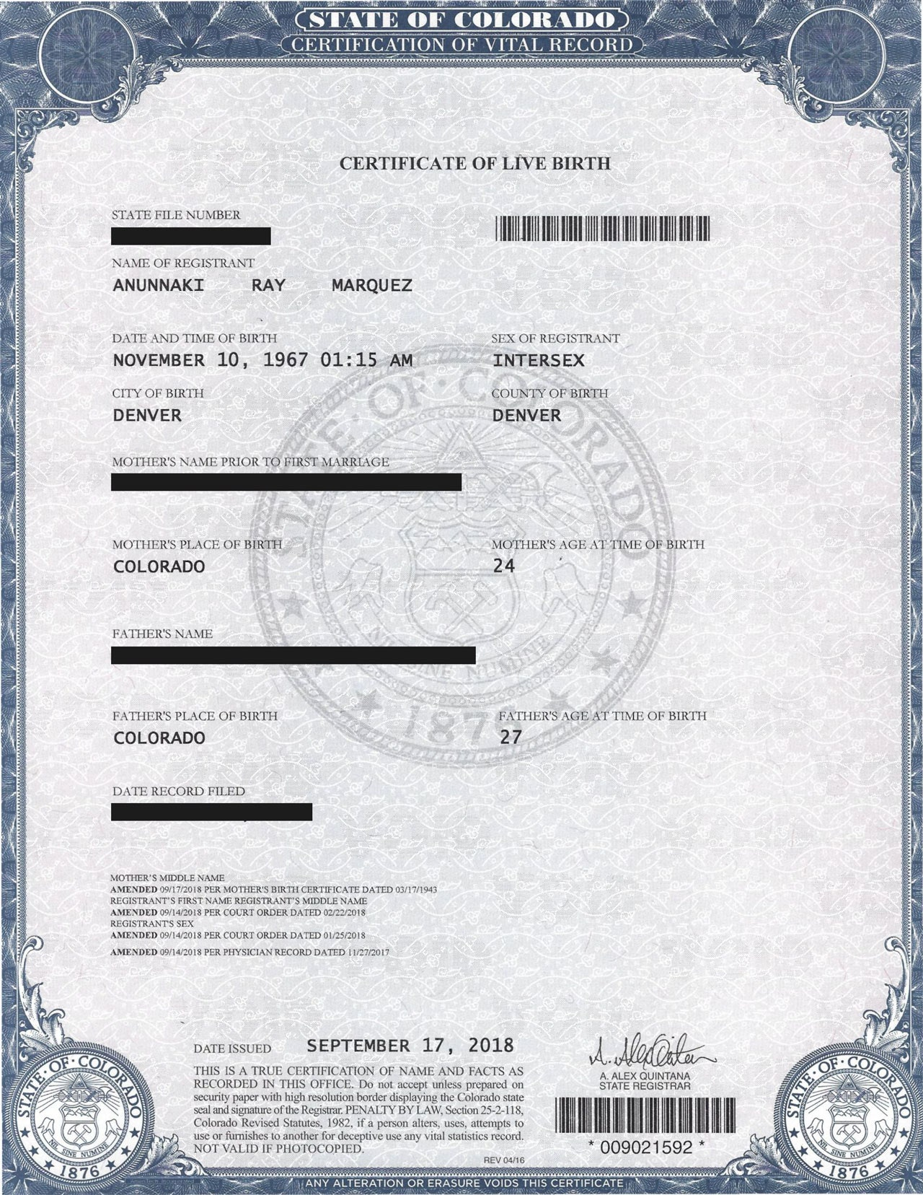
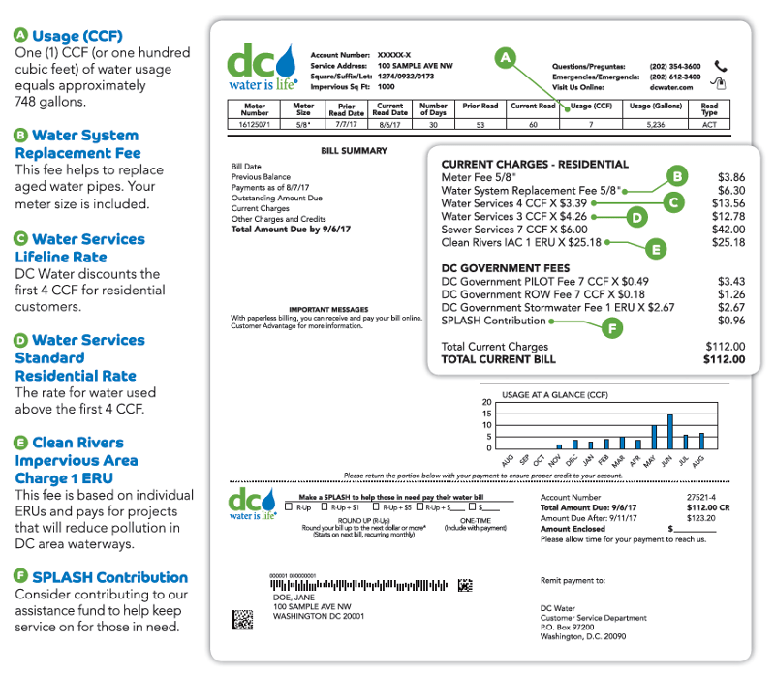
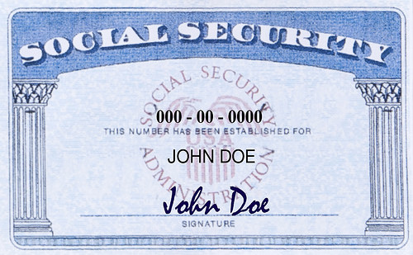
Documents you need to secure before getting Learner License.
1. VOE (Verification of Enrollment) from your high school.
2. Original Birth Certificate
3. Original Social Security Card
4. 2 forms of residency (electric bill, phone bill…etc. Most recent)
5. DE-964 Form (receive from instructor after passing Permit Test)
6. Go to DPS Scheduler on our resources page of All Ages Website to make appointment with DPS office near you.
7. Have parent or guardian accompany you to DPS office.
8. You must have Learners License prior to the start of Phase 2
9. You must hold that learners license for 6 months before eligible for road test. Sign up with office Manager for Road Test to avoid long wait times for driving test if you haven’t done so already.
10. If there is any issue with securing a document, speak with instructor after class to get alternative list of documents you can use to secure learner license.

Slide 11
DPS Permit Exam
Two Exams
1st Exam: Road Signs Test (20 questions multiple choice)
2nd Exam: Road Rules Test (20 questions multiple choice)
Study Tip: Road Signs Test (Chapter 5 of DPS Handbook)
Study Tip: Road Rules Test (All Chapters of DPS Handbook)
Study Tip: Download Mr. James Study Guide on All Ages website on Resource Page.
Must pass each exam with a 70% or better to receive DE-964 Form.
If you fail to pass one or both exam’s you must retake the failed exam the next class day.
This Photo by Unknown Author is licensed under CC BY-ND

Slide 12
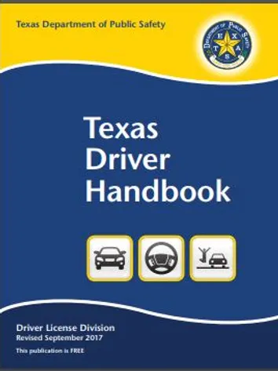
Module #1 Traffic Laws
In this module, the student will learn to responsibly perform safe driving practices on public roadways, also known as the Highway Transportation System (HTS) by accepting driving as a privilege with potential consequences; and by applying knowledge and understanding of Texas traffic laws including traffic control devices and right-of-way laws.

Slide 13
1.1.1. Introduction. The student recognizes the value of legal and responsible reduced-risk driving practices in the Highway Transportation System and accepts driving as a privilege with responsibilities, obligations, and potential consequences. The student is expected to:
(A) recognize how the Texas Driver Education and Traffic Safety Program provides a new driver with the foundation of knowledge, understanding, skills, and experiences necessary for the new driver to continue the life-long learning process of safe driving on the HTS;
(B) distinguish between a new and experienced driver;
(C) know that basic knowledge of traffic laws provides a driver the foundation to make informed, legal, and responsible decisions to reduce risk;
(D) recognize that driving on public roadways is a privilege with risk, responsibilities, obligations, and potential consequences requiring the knowledge, understanding, and application of legal and responsible safe driving practices;
(E) describe the importance of developing and sustaining a Driving Plan that that promotes safe driving practices; and
(F) explain how students can reduce risk by recognizing the value of legal and responsible safe driving practices in the HTS.

Slide 14
Chapter 1 DPS Handbook

Slide 15
VOE (Verification of Enrollment)

Slide 16
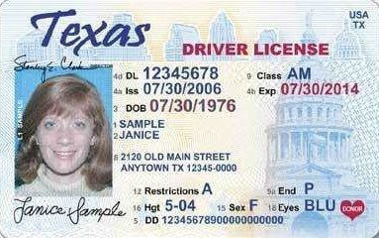
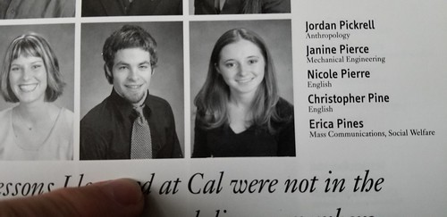
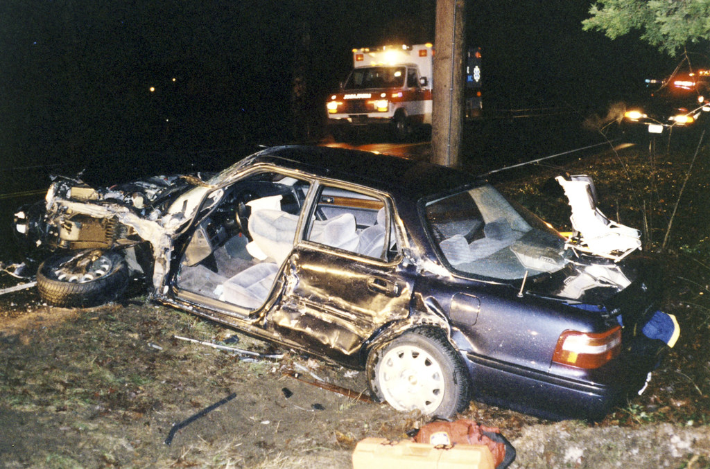
Graduated License Program in Texas to reduce accidents and deaths.

Slide 17
Phase 1 and 2 of GDL

Slide 18
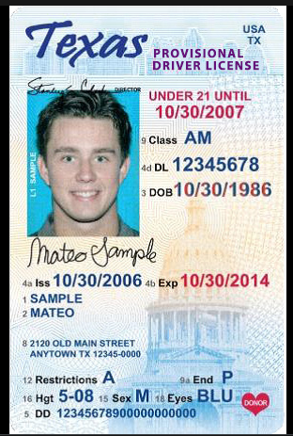
Provisional License

Slide 19
Class C Drivers License

Slide 20
Class B Drivers License

Slide 21
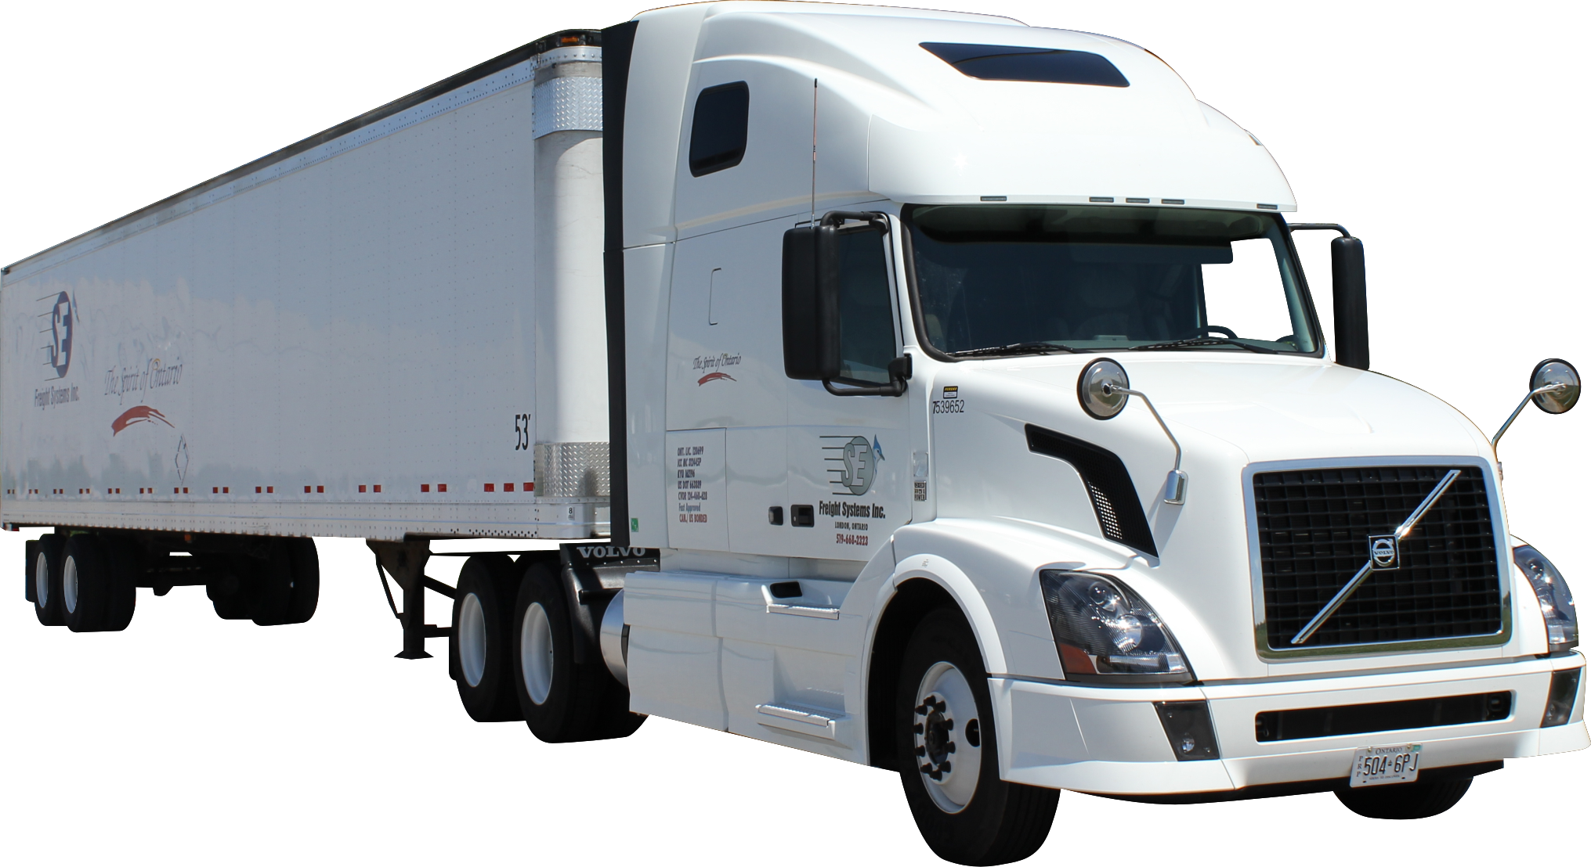
Class A Drivers License

Slide 22
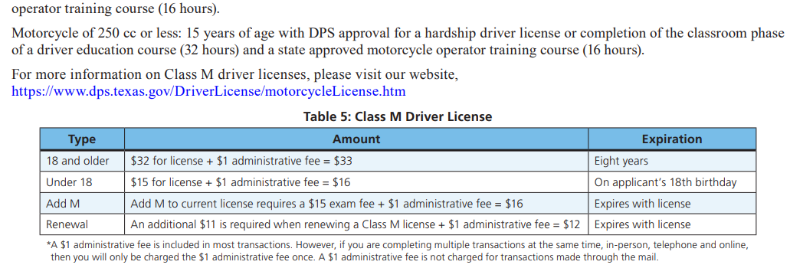
Class M Drivers License

Slide 23
Restrictions Commonly found on License
Restrictions: A = Must wear corrective lenses (glasses/contacts) B = A licensed driver 21 or older in front seat while driving (Learners License) F = Must hold valid learners license until MM/DD/YY (6 months)
For a complete List of Learners license see Appendix E in DPS Handbook. (Page 81).

Slide 24
How to obtain a Drivers License

Slide 25
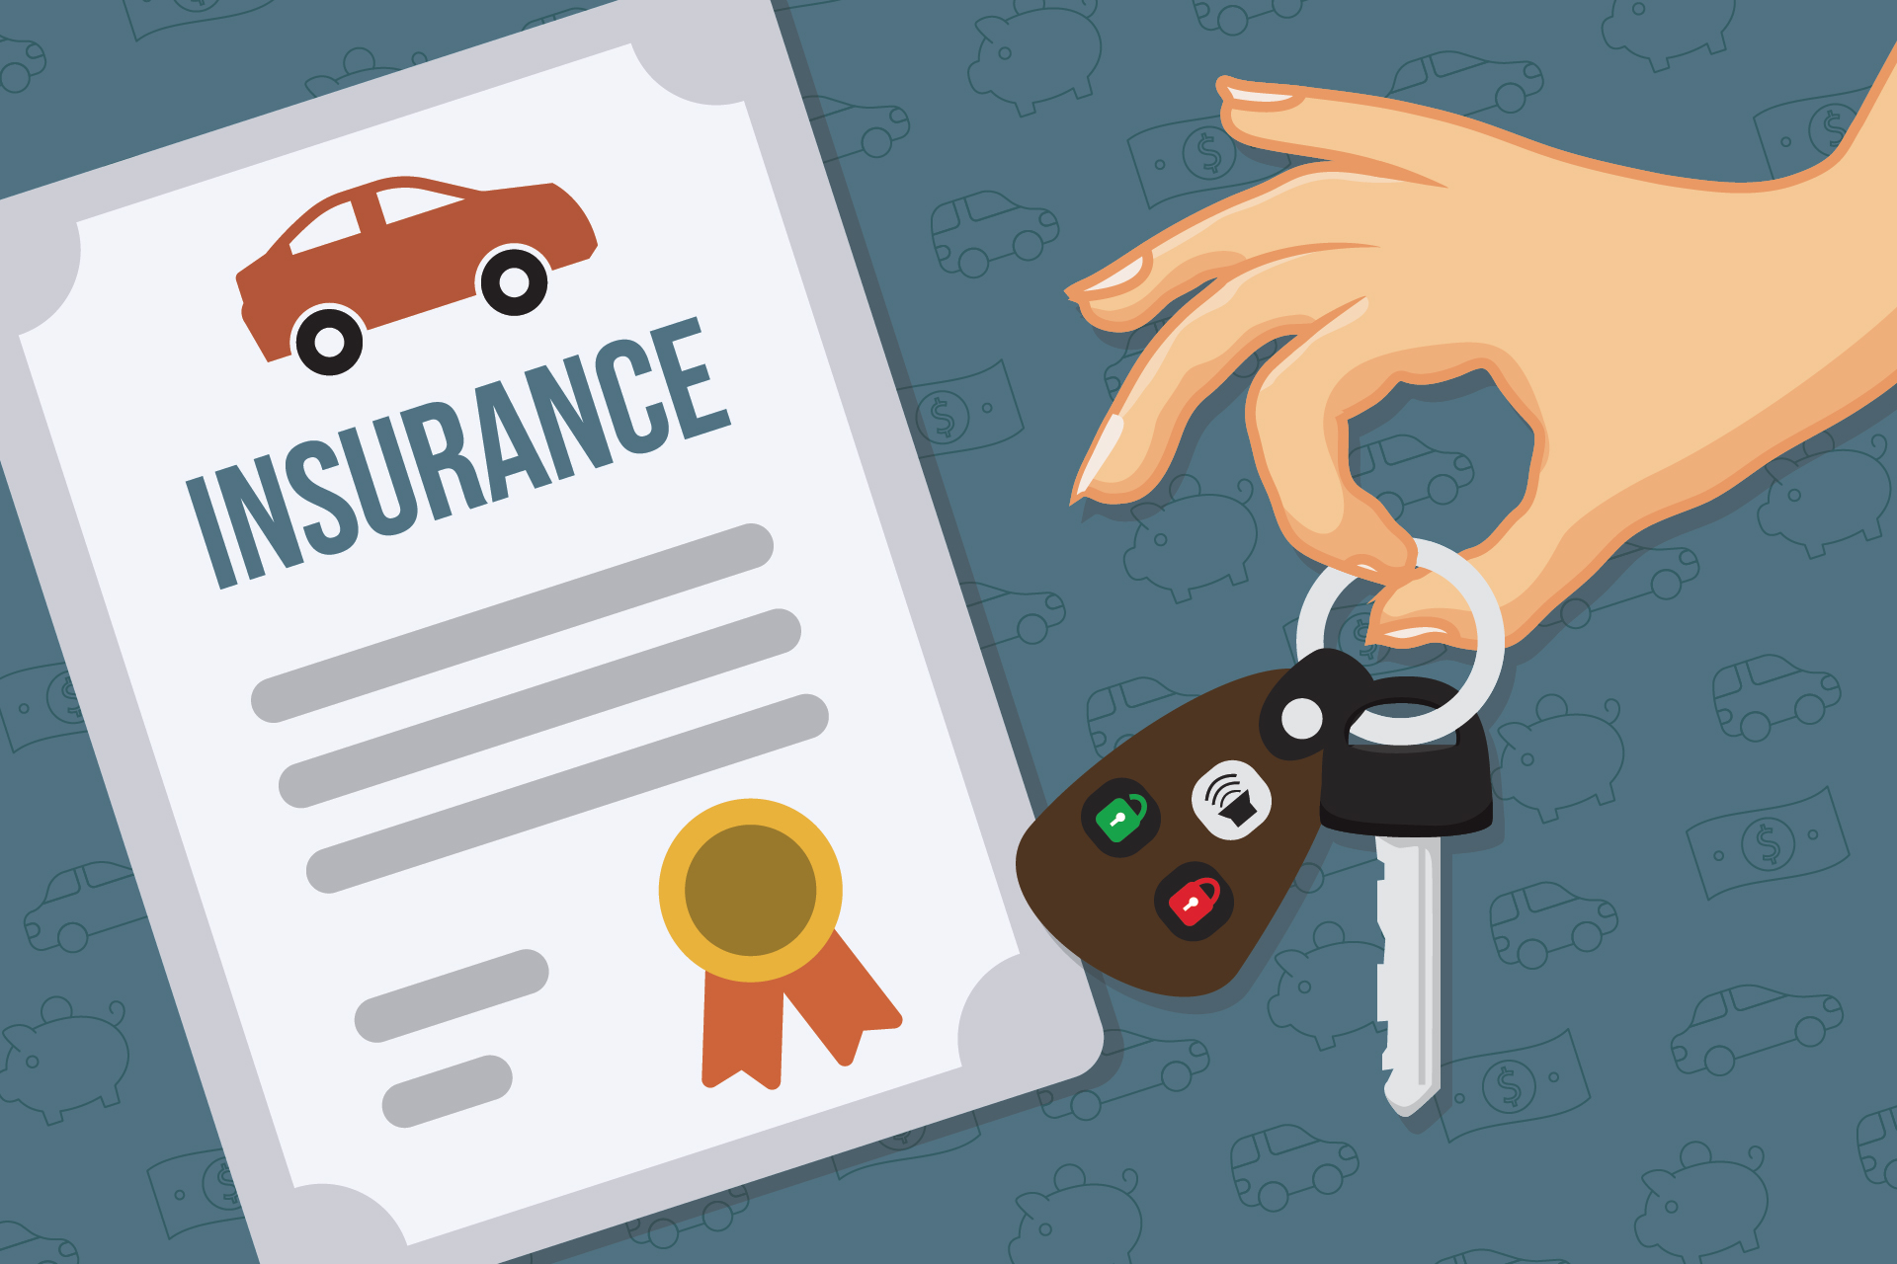
Driving Record and Financial Responsibility

Slide 26
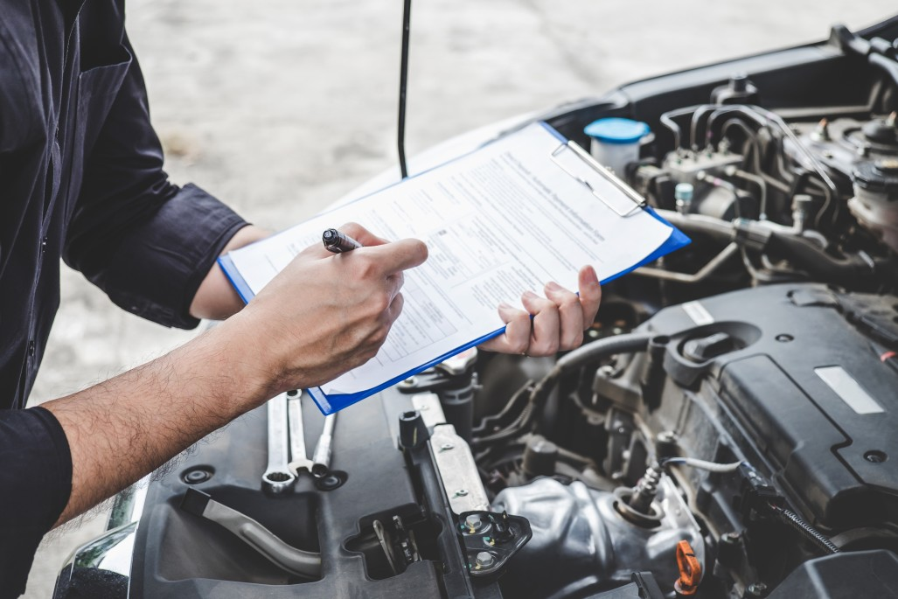
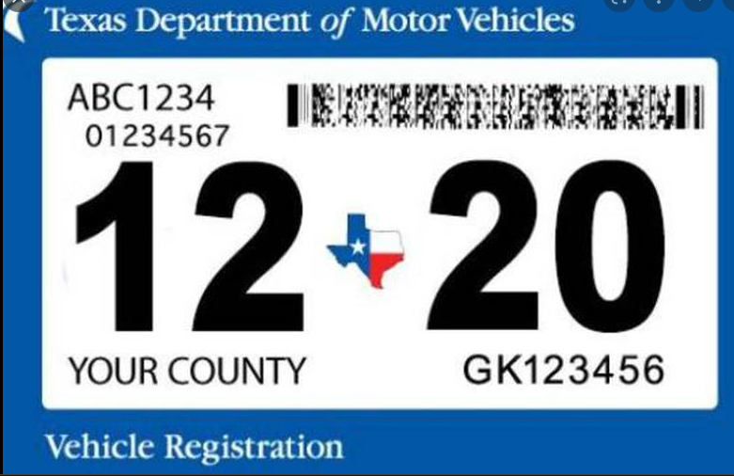
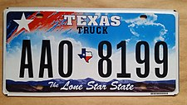
Vehicle Registration

Slide 27
Examinations

Slide 28
Examinations (Continued)
*All Ages Driving School is a licensed Third Party Skills Testing Site. Sign Up today for your Road Test, avoid long wait at DPS. Visit our website or speak with office Manager about scheduling your appointment.

Slide 29
Driver Education and Impact Video

Slide 30
Driving without a license and suspension

Slide 31
Replace lost or stolen license

Slide 32
Driving while license is invalid.

Slide 33
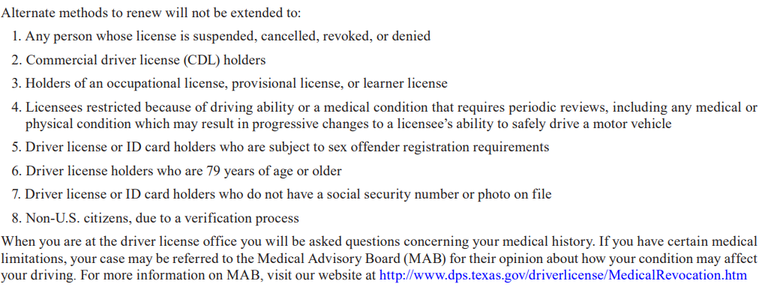
Renewal Process

Slide 34
Penalties for Non-Driving Alcohol related offenses by Minors

Slide 35
Essential Needs License

Slide 36
Questions related to Chapter 1 of DPS Handbook.
Questions 1, 2, 3, 5, 30, 40, 41, 75, 79

Slide 37
Question #1: What is the minimum age at which you can get a Class C driver license without either driver education or being a hardship case? (Chpt. 1)
Answer on Page 28
Age 25 is the minimum age at which you can apply for a drivers license without formal drivers education.

Slide 38
Question #2: How much is the maximum fine for a first conviction of driving without a license? (Chpt. 1)
Answer on Page 9 (Table 7)
$200

Slide 39
Question #3: What type of restrictions may be placed on your license? (Chpt. 1)
Answer on Page 81 (Appendix E)
A = Must wear corrective lenses
B = Must have a licensed operator in front seat age 21 or older
F = Must hold valid learners license until (Date, usually 6 months form issued)

Slide 40
Question #5. What action should you take if you fail to receive the renewal notice card reminding you that your driver license is about to expire? (Chpt. 1)
Answer on Page 9
It is your responsibility to renew your license regardless if a renewal notice is sent or not.

Slide 41
Question #30. Under what conditions may your driver license be suspended?(Chpt. 1)
Answer on Page 10
A license can be suspended for a number of different violations from continued reckless driving (point system) to mandatory suspension for violations considered a felony or dangerous. For example, DWI, drug offenses, racing on public roads, over taking a school bus.

Slide 42
Question #40. What qualifications must one have to teach a beginner to drive? (Chpt. 1)
Answer on Page 1
The licensed driver must be at least 21 years of age with at least one year of driving experience, must occupy the seat beside the driver, and cannot be intoxicated, asleep, or engaging in any activity that prevents observation and response to the actions of the driver.

Slide 43
Question #41. If the person is under 18, when does his provisional license expire? (Chpt. 1)
Answer on Page 3
A provisional license holders license will expire on their 18th birthday.

Slide 44
Question #75. What circumstances may lead to possible loss of your license? (Chpt. 1)
Answer on Page 12
A number of circumstances could lead to a possible lose of your license including anything deemed a felony under motor vehicle laws as well getting 6 points on your driving record within a three year period. Diagnosed medical conditions can also cause a loss of your license especially when your vision is effected to the point you can’t pass the eye exam.

Slide 45
Question #79. What are the different classes of licenses and age requirements for each? (Chpt. 1)
Answer on Page 4
Class A = 18 years old
Class B = 18 years old
Class C = 15 Hardship, 16 provisional, 18 standard
Class M = 15 Moped, 16 Motorcycle

