Slide 1
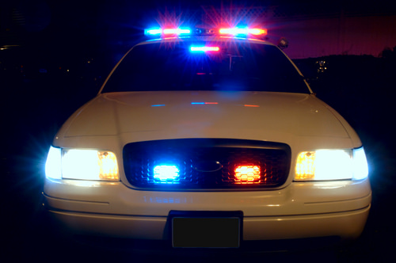

“FLASHING LIGHTS”
Notes:
Flashing Lights - Texas Community Safety Education

Slide 2
Copyright (C) Notice
community safety education ACT
Copyright (C) Notice. The materials are copyrighted (C), trademarked TM, and a trade secret as the property of the The Foundation for Safe Driving. Inc. and may not be reproduced without the express written permission of The Foundation for Safe Driving, Inc. , except under the following conditions:
Texas public schools, charter schools, licensed driver education schools, Parent Taught Program instructors, Texas Department of Licensing and Regulation, and Education Service Centers may reproduce and use copies of the Materials and Related Materials for the districts and schools' education use without obtaining the permission from The Foundation for Safe Driving, Inc.
The residents of the state of Texas may reproduce and use copies of the Materials and Related Materials for individual personal use only without obtaining written permission of The Foundation for Safe Driving, Inc.
Any portion reproduce must be reproduced in its entirety and remain unedited, unaltered and unchanged in any way.
No monetary charge can be made for the reproduced materials or any document containing them.
Private entities or persons located in Texas that are not Texas public school districts, Texas Education Service Centers, Parent Taught Program instructors, or Texas Charter Schools or any entity, whether public or private, educational or non-educational, located outside the state of Texas MUST obtain written approval from The Foundation for Safe Driving, Inc. and will be required to enter into a license agreement that may involve the payment of licensing fee or a royalty. For more information contact: The Foundation for Safe Driving, Executive Director, 929 Gessner Road, Houston, TX 77024 or e-mail njsaint@foundationforsafedriving.org.

Slide 3
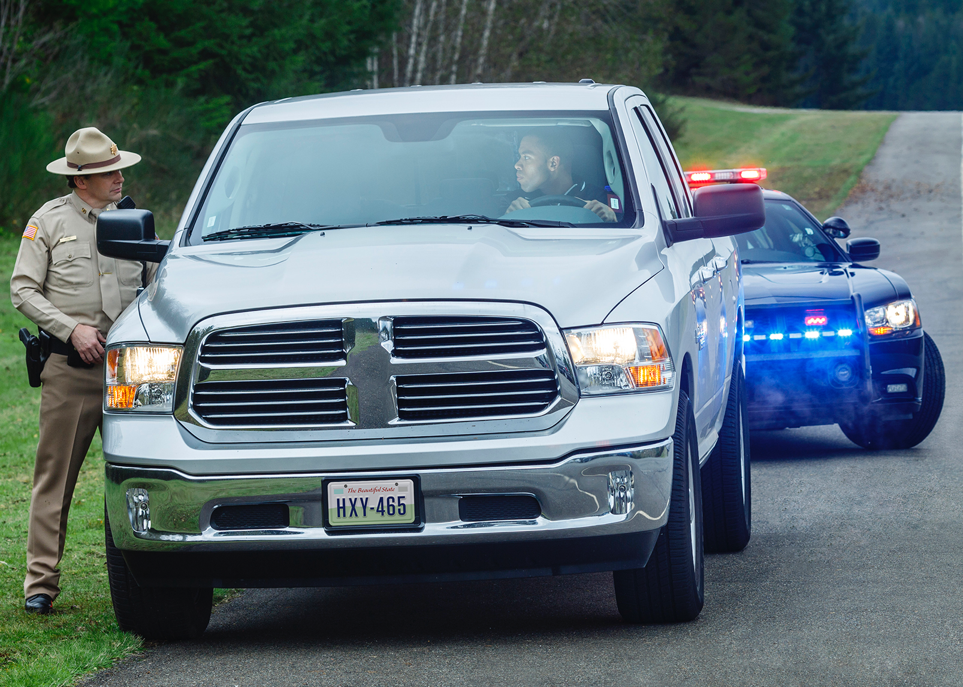
Creating Safe Interaction between citizens and law enforcement
Texas Community Safety Education Act

Slide 4

purpose and goal
community safety education ACT
The Community Safety Education Act, 2017.
Information for drivers, the public, students, and also training for members of law enforcement
Expectations that each should have during a contact between officers and motorists.
  Goal is to lessen tensions and anxieties that may arise during interactions between officers and citizens during traffic stops and other encounters that could lead to undesired outcomes.
Notes:
Community Safety Education Act’s Purpose and Goal
The Community Safety Education Act was passed by Texas State Legislature in 2017. Authors included Authors: Senator Royce West and Senator John Whitmire; Co-Author: Jose Rodriguez; and, Sponsors: Representative Senfronia Thompson and Representative Garnet F. Coleman
The purpose of the Community Safety Education Act is to provide information to drivers, the public, and students, and also training for members of law enforcement, on the expectations that each should have during a contact between officers and motorists.
The goal of the authors is to lessened tensions and anxieties that may arise during interactions between officers and citizens during traffic stops and other encounters that could lead to undesired outcomes.

Slide 5
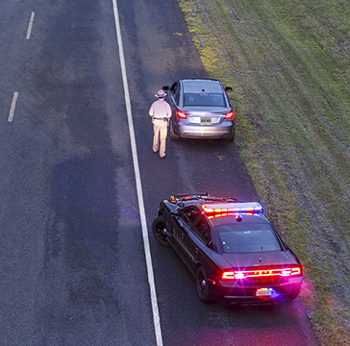
Educational goals
community safety education ACT
Instructional Objective:
Interact responsibly with law enforcement officers to provide a safe environment for both the public and law enforcement during a traffic stop and other in-person encounters.
Knowledge and Skills:
To safely and responsibly show proper behavior and actions for civilians during interactions with law enforcement during traffic stops and other in-person encounters.
Notes:
Community Safety Education Act
Instructional Objective: The student will interact responsibly with law enforcement officers to provide a safe environment of both the public and law enforcement during a traffic stop and other in-person encounters.
Knowledge and Skills: To safely and responsibly show proper behavior and actions for civilians during interactions with law enforcement during traffic stops and other in-person encounters.
Student Expectations: The student is expected to:
A. Identify reasons that a law enforcement officer will conduct a traffic stop and other in-person encounters;
B. Describe drivers and passengers inappropriate actions to traffic stops and other in-person encounters with law enforcement;
C. Identify the proper action and responsibilities of driver and passengers to take during a traffic stop and other in-person encounters;
D. Know the jurisdictional laws concerning the drivers and passengers’ responsibilities at the scene of a traffic stop and other in-person encounters;
E. Recognize proper behavior and actions for civilians and law enforcement officers during interactions;
F. Understand the role of law enforcement and the duties and responsibilities of officers;
G. Know persons’ rights concerning interactions with aw enforcement officers;
H. Understand the laws regarding questioning and detention by law enforcement officers;
I. Know the law requiring a person to present proof of the identity to law enforcement officers;
J. Understand the consequences for persons or officers’ failure to comply with these laws; and
K. Know how and where to file a compliment on behalf of or complaint against a law enforcement officer.

Slide 6
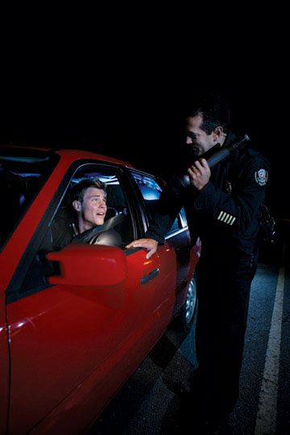
WHY?
community safety education ACT
Keep You Safe.
To get you home safely.
Notes:
The reason for this program is to keep the persons being stop by law enforcement safe by them following the procedures outlined in this presentation.

Slide 7
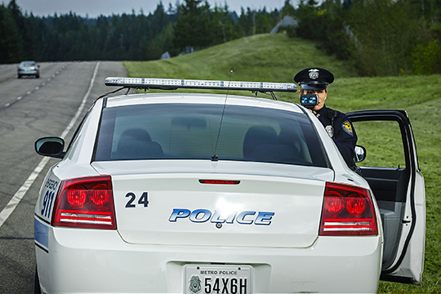
reasons for traffic stop?
community safety education ACT
Traffic Violation
  Speeding
  Tailgating
  Improper Turn
  Weaving in Your Lane
  Unsafe Passing
  Unbuckled
  Cell Phone Use/Texting
Notes:
Reasons for Traffic Stop
Traffic Violation:
Speeding
Tailgating
Weaving in your lane
Improper turns
Unsafe passing
Unbuckled
Cell phone use

Slide 8
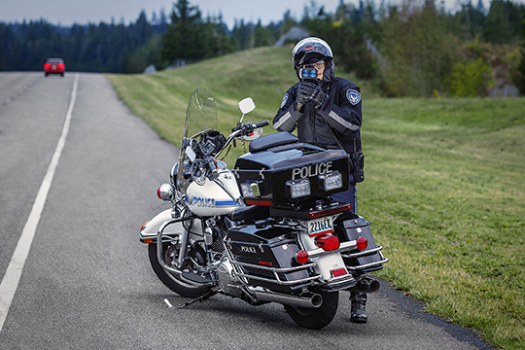
reasons for traffic stop?
community safety education ACT
Vehicle Malfunction(s)
  Taillight Out
  Headlight Out
Low Tire
Brake Light Out
State Requirements
Registration Expired
License Plates Missing
Notes:
Reasons for a Traffic Stop, Continued
Vehicle Malfunction
Taillight
Headlight
Low tire
Vehicle State Requirements:
Registration Expired
License Plates Missing

Slide 9
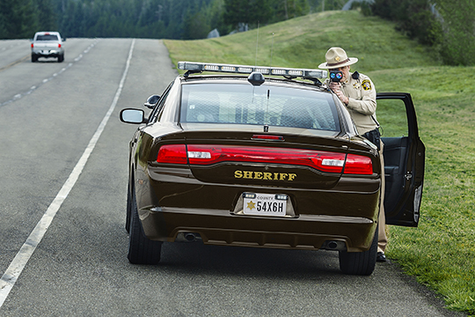
reasons for traffic stop?
community safety education ACT
You fit the description of a person who committed a crime.
Vehicle fits the description of a vehicle used in a crime.
Safe Driving.
Your vehicle used in and/or you committed a crime.
Notes:
Reasons for a Traffic Stop, Continued
Your vehicle fits the general description of a vehicle used in a crime.
You fit the general description of someone that has committed a crime.
Safe driving.
Your vehicle was used and/or you committed a crime.

Slide 10
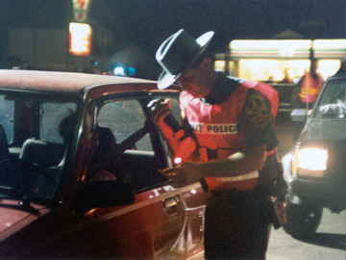
reactions to being stopped?
community safety education ACT
Fearful
Nervous
Angry
Targeted
Frustrated
Inconvenienced
Anxious
Surprised
Edgy
Happy
Panicked
Amused
Traffic stops may be an emotional event for you, but it is not an emotional event for the officer.
Notes:
Drivers’ Reactions to Being Stopped
Fear
Angry
Scared
Inconvenienced
Surprised
Targeted
Happy
Frustrated
Anxious
Nervous
Edgy
Amused
Panicked
A traffic stop is not an emotional event for the officer.

Slide 11
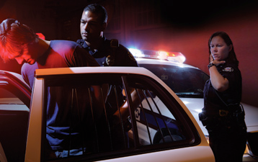
The law
community safety education ACT
Driver to immediately stop when approached by an authorized emergency vehicle.
  Arrested if you do not stop.
(
If you stop in an unsafe location, (bridge or a high traffic roadway), an officer may direct you over the public address speaker to move to a safer location.
Follow the officer’s directions.
Notes:
The Law
State law requires a driver to immediately stop when approached by an authorized emergency vehicle.
You may be arrested if you do not stop immediately.
If you feel the area is unsafe to stop immediately or if you have concerns the vehicle is not a real police vehicle, you can take the following steps to minimize the risk of being arrested or charges being filed against you: turn on your hazard lights and drive slowly and carefully below the posted speed limit; you may call 9-1-1 and remain on the phone with the operator while you stop and verify the officer’s identity; you may drive to a nearby well-lighted, populated place to stop.
It is important to understand that law enforcement jurisdictions overlap and a local 9-1-1 call center operator may not be able to immediately determine what officer is working in that area at that time.
If you stop in an unsafe location, such as on a bridge or a high traffic roadway, an officer may direct you over the public address speaker to move to a safer location.
Follow the officer’s directions.
Another law enforcement vehicle may arrive at the scene.

Slide 12
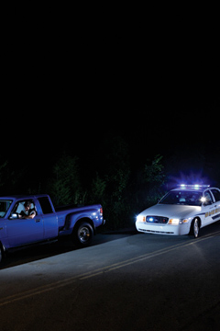
Proper actions & responsibilities
community safety education act
Slow down
Park your vehicle to the right of the road and to the right main traffic lane:
  Park on the right shoulder, if available,
  On a nearby well-lighted side street,
  Or parking lot,
  Away from high volume traffic, if shoulder unavailable.
Notes:
Proper Actions and Responsibilities
Slow down and move the vehicle safely to the right of the road.
Park your vehicle as far to the right of the main traffic lane as possible.
If available, park on the right shoulder; or,
If unavailable, park on a nearby well-lighted side street or parking lot away from high volume traffic.

Slide 13
Proper actions & responsibilities
community safety education ACT
Place the vehicle in a parking position:
  Set emergency brake;
  Turn the engine off; and
  Activate the hazard warning lights.
If at night, turn on the interior dome light.
Notes:
Proper Actions and Responsibilities, Continued
Place the vehicle in a parking position, set the emergency brake, turn the engine off, and activate the hazard warning lights.
If at night, turn on the interior dome light.

Slide 14
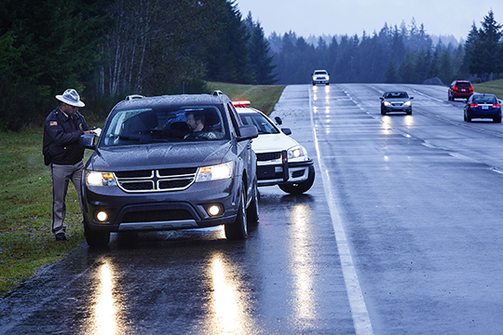
proper actions & responsibilities
community safety education ACT
Remain in the car:
  Lower the driver’s window;
  Keep both hands clearly in sight on the top of the steering wheel; and
  Wait for law enforcement officer to give you instructions.
An officer may approach from either side of the vehicle.
Notes:
Proper Actions and Responsibilities, Continued
Remain in the car.
Lower the driver’s window.
Keep both hands clearly in sight on the top of the steering wheel.
Wait for the law enforcement officer to give you instructions.
An officer may approach from either side of the vehicle.

Slide 15
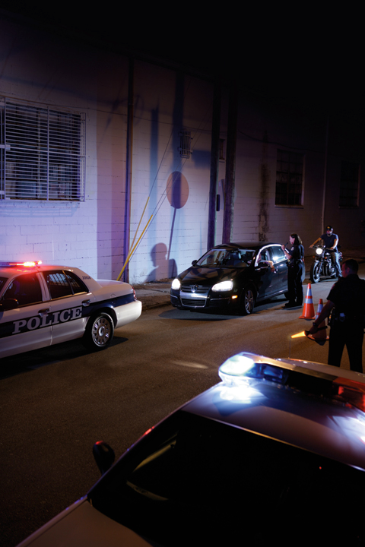
hands empty
community safety education ACT
  You should have nothing in your hands, including a cell phone.
  Anything in your hands may appear to be a handgun to the officer.
Notes:
You should have nothing in your hands, including cell phone.
Anything in your hands may appear to be a handgun to the officer.
Do not escalate the situation.
Do not escalate the situation.

Slide 16
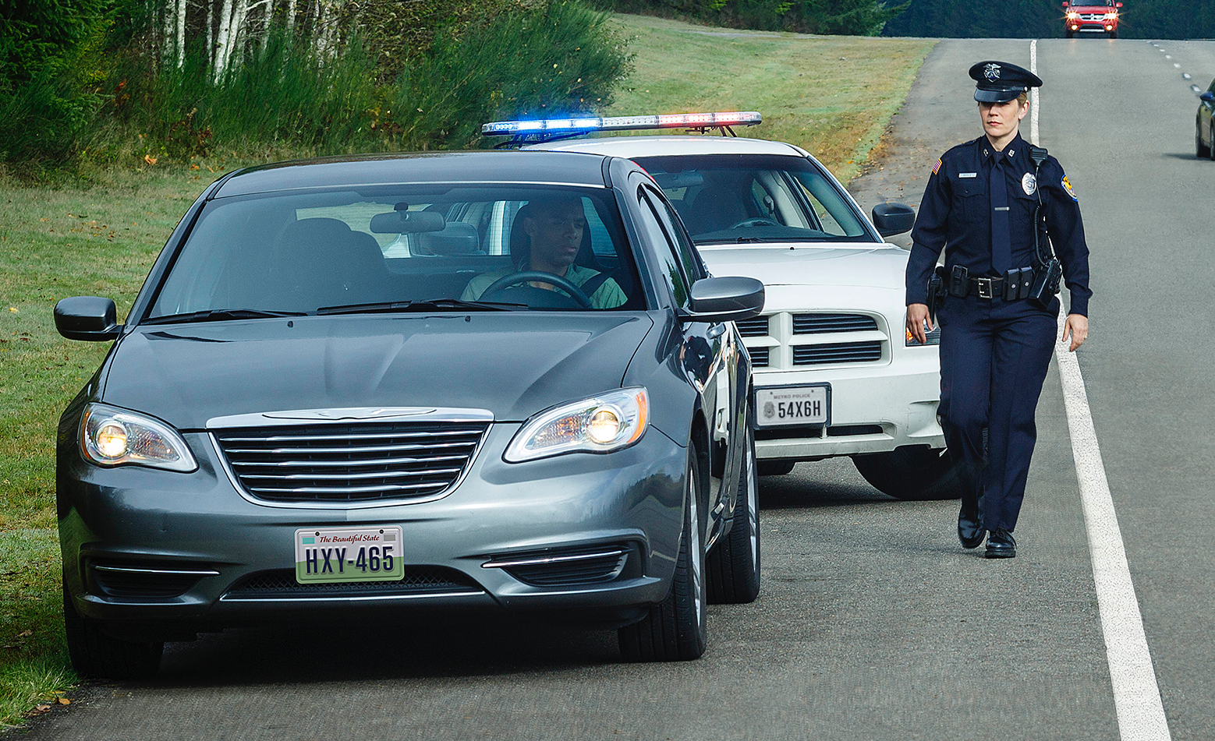
Proper behaviors
community safety education ACT
For Drivers and Passengers:
  DO NOT Reach, dig, or search for their license or insurance documents before or while an officer is approaching.
Tell the officer if you are transporting any type of weapon - keep both hands on top of the steering wheel.
Drivers who transport handguns in their vehicles are encouraged to keep them in a separate location from license and insurance documentation.
Notes:
Proper Behaviors, Continued
Drivers and passengers inside a vehicle should not attempt to reach, dig, or search for their license or insurance documents before or while an officer is approaching.
Tell the officer if you are transporting any type of weapon - keep both hands on top of the steering wheel.
Drivers who transport handguns in their vehicles are encouraged to keep them in a separate location from license and insurance documentation.

Slide 17
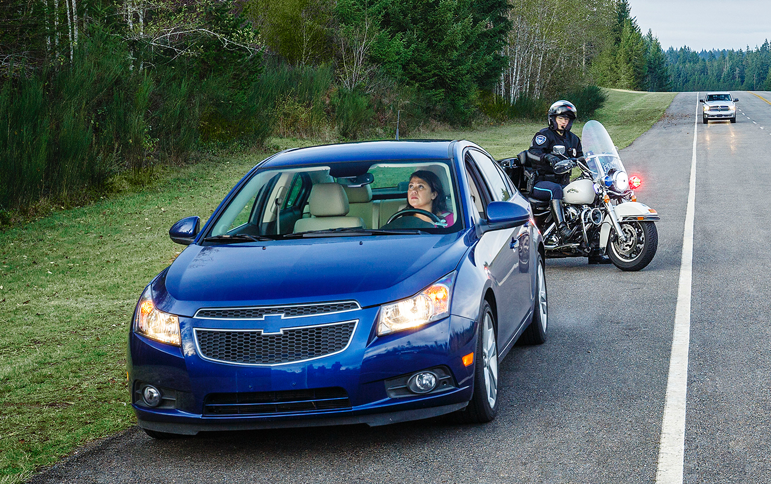
Proper actions & responsibilities
community safety education ACT
Before reaching into your glove box or under the seat to retrieve your proof of insurance or driver’s license:
Inform the officer of where the items are located; and
Follow the officer’s directions.
If stopped for a violation, law enforcement may ask you to exit for any reason.
If asked to exit the vehicle, check for passing vehicles to exit safely.
Notes:
Proper Actions and Responsibilities, Continued
Before reaching into your glove box or under the seat to retrieve your proof of insurance or driver’s license, inform the officer of where the items are located and follow the officer’s directions.
If asked to exit the vehicle, check for passing vehicles to exit safely.

Slide 18
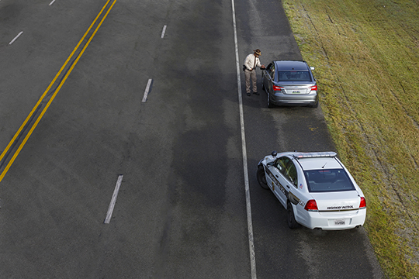
Proper behavior
community safety education ACT
Law enforcement officers, drivers, and passengers should respond with courtesy during traffic stops and other officer/citizen interactions.
Drivers and passengers should not exit the vehicle unless asked to do so.
  Exiting your vehicle may be perceived as aggressive behavior; and
  A threat to the officer’s safety.
Notes:
Proper Behavior
Law enforcement officers, drivers, and passengers should respond with courtesy during traffic stops and other officer/citizen interactions.
Drivers and passengers should not exit the vehicle unless asked to do so.
Exiting your vehicle may be perceived as aggressive behavior and a threat to the officer’s safety.

Slide 19
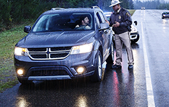
proper actions & responsibilities
community safety education ACT
Advise passengers to remain in the car unless other instructions are given by the law enforcement officer.
Advise passengers to behave and be courteous to the officer.
At the conclusion of the traffic stop:
  When the officer releases you, the officer will wait for you to move your vehicle first.
  Give the appropriate signals; and
  Safely return to the proper lane of traffic when released by the law enforcement officer.
Notes:
Proper Actions and Responsibilities, Continued
Advise passengers to remain in the car unless other instructions are given by the law enforcement officer.
Advise passengers to behave and be courteous to the officer.
At the conclusion of the traffic stop, give the appropriate signals and safely return to the proper lane of traffic when released by the law enforcement officer.
When the officer releases you, the officer will wait for you to move your vehicle first.

Slide 20
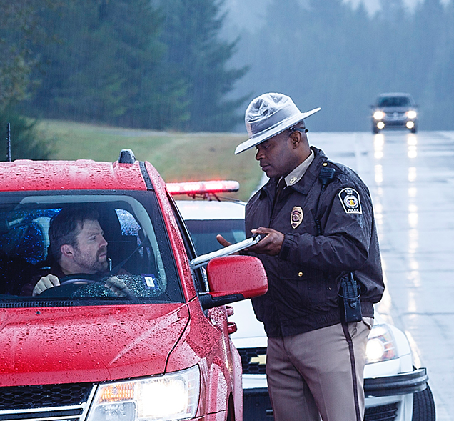
proper behaviors
community safety education ACT
Refrain from arguing the charge during the traffic stop or detention.
Signing a citation is not admitting guilt.
If you wish to contest the charge, you should argue your case before:
  A judge; or
  Request a jury trial.
Notes:
Proper Behaviors, Continued
Drivers should refrain from arguing the validity of a charge during the traffic stop or detention.
Signing a citation is not admitting guilt. It simply confirms your promise to pay the fine or contact the court.
If you do not agree with the charge brought against you and wish to contest it, you should argue your case before a judge or request a jury trial and acquire the services of an attorney to represent you.

Slide 21
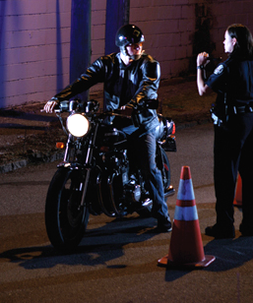
role of law enforcement
community safety education ACT
Provide assistance to Texas’ citizens.
Enforce the State’s traffic laws.
Ensure you make it home safely and law enforcement makes it home safely.
Notes:
Role of Law Enforcement
Provide assistance to Texas’ citizens.
Enforce the State’s traffic laws.
Ensure you make it home safely and law enforcement makes it home safely.

Slide 22
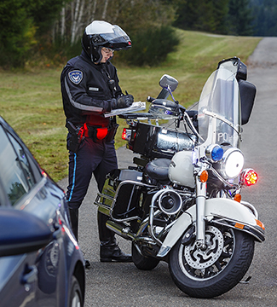
your rights
community safety education ACT
Right to remain silent, except for truthfully identifying themselves.
Right to refuse to have vehicle searched.
  However, if an officer has reason to believe that vehicle contains evidence of a crime, the vehicle can be searched without consent.
If an officer suspects a weapon, the officer may conduct a pat-down search.
Notes:
Your Rights
Drivers and passengers should be instructed that although it is lawful for them to remain silent during a traffic stop, they are required by law to truthfully identify themselves when asked to do so by an officer. A driver or passenger can be arrested for giving false identify information to an officer
Drivers should be instructed that if they are placed under arrest, it is an offense to refuse to identify themselves, to not proved their address, or refuse to give their date of birth to an officer
A driver should be instructed that although they have the right to remain silent, it may be beneficial to verbally provide identifying and address information to an officer they cannot present their license
A person who is a passenger in a vehicle should receive instructions advising them that they can be asked questions by an officer while they are being detained. However, a passenger can ask an officer if they are being detained or if they are free to leave and have the right to leave if they are not being detained.
A driver should receive instruction advising them of their right to refuse to have their vehicle searched if asked by an officer. However, a drive must also be instructed that if an office has reason to believe that the vehicle contains evidence of a crime, the vehicle can be searched without the driver’s consent
A driver should receive instruction that if an officer suspects that a weapon is on their person, the officer may conduct a pat-down search of their clothing. A driver may not physically resist the search, but has the right to notify the officer that they do not consent to any further search. Instructions should include that consent to search my later be used in court.
Drivers and passengers should also be advised that an officer may conduct a non-consensual search based on an officer’s observation that the subject detained has responded in a way to make the officer believe that the subject has engaged in a criminal act or is about to engage in a criminal act.

Slide 23
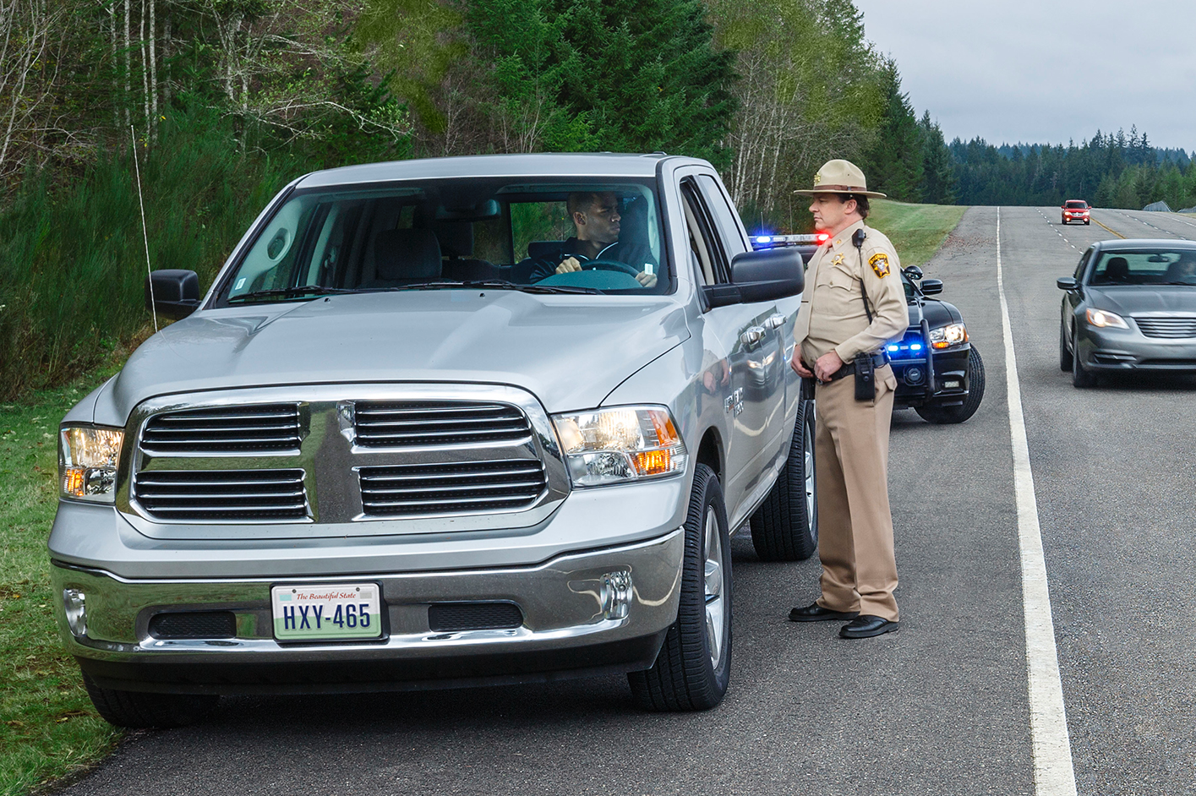
Show Driver’s License
community safety education ACT
Required to show driver’s license.
If you do not show driver’s license, tell officer your:
  Name;
  Address; and
  Date of birth.
Commit an offense if you give a false or fictitious name.
Notes:
Proof of Identity
Required to show driver’s license.
If you do not show driver’s license, tell officer your name, residence address and date of birth.
False Identification Offense: A person commits an offense if he/she gives a false or fictitious name to a law enforcement officer who has lawfully arrested or detained the person.

Slide 24
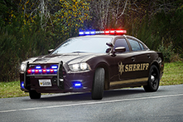
Feel unsafe
community safety education ACT
If you feel the area is unsafe to stop immediately or if you have concerns the vehicle is not a real police vehicle, you can take the following steps to minimize the risk of being arrested or charges being filed against you:
  Turn on your hazard lights and drive slowly and carefully below the posted speed limit;
  You may drive to a nearby well-lighted, populated place to stop.
Notes:
Your Rights
If you feel the area is unsafe to stop immediately or if you have concerns the vehicle is not a real
police vehicle, you can take the following steps to minimize the risk of being arrested or charges being filed against you:
Turn on your hazard lights and drive slowly and carefully below the posted speed limit;
You may drive to a nearby well-lighted, populated place to stop; and
Last resort call 9-1-1 to verify the officer’s identity.
It is important to understand that law enforcement jurisdictions overlap and a local 9-1-1 call center operator may not be able to immediately determine what officer is working in that area at that time.

Slide 25
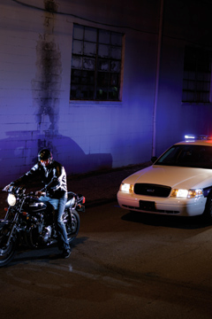
evading arrest or detention
community safety education ACT
Offense - intentionally fleeing from a law enforcement officer;
  Subject to higher penalties if using vehicle or watercraft to flee or evade arrest; and
  Subject to higher penalties if you cause injury to another person.
Notes:
Failure to Comply - Evading arrest or detention.
A person commits an offense if he intentionally flees from a person he knows is a law enforcement officer or federal special investigator attempting to lawfully arrest or detain him. You will be subject to higher penalties if you use a vehicle or watercraft while evading arrest or cause injury to another person.
Questioning and Detention
During a traffic stop, the driver and any passengers are subjected to an investigative detention, which may only last for a reasonable amount of time.

Slide 26
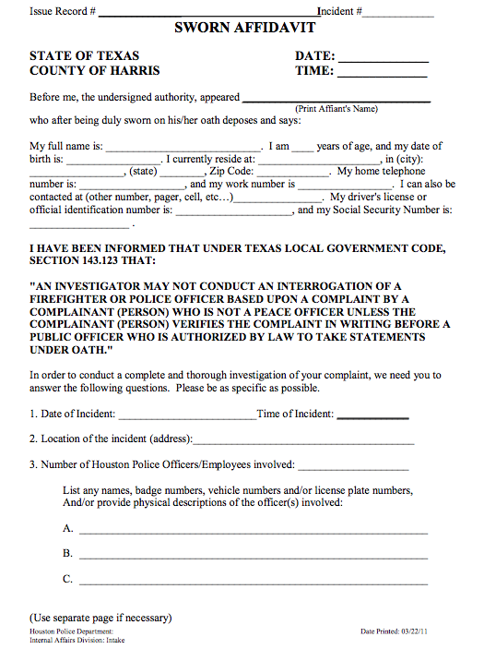
to file Complaint or compliment
community safety education ACT
To file a complaint or compliment, you may follow agency guidelines for submitting complaints or compliments.
Information you need to file is on the citation (ticket).
Notes:
File a Compliment or Complaint
To file a complain or compliment, you may follow agency guidelines for submitting complaints or compliments.
The information you need for filing the complaint or compliment is on the citation (ticket).

Slide 27
curriculum committee
community safety education ACT
  Texas Commission on Law Enforcement (TCOLE)
  Texas Department of Licensing and Regulation (TDLR)
  Texas Education Agency (TEA)
  Austin Police Department
  Dallas Police Department
  Houston Police Department
  Texas Department of Public Safety (TXDPS)
  Travis County Constable Precinct 1
  Williamson County Sheriff’s Office
  Texas Police Chiefs Association (TPCA)
  Austin Community College, Criminal Justice Department and C.J. Club
  Teen and Police Services Academy (TAPS), Everette B. Penn, Ph.D., Director
  Project Unity
  SafeWay Driving
  Sheriff’s Association of Texas (SAT)
  Foundation for Safe Driving, Inc.
Notes:
Special thanks to:
The Citizens of Texas
Texas Commission on Law Enforcement
Texas Department of Licensing and Regulation
Texas Education Agency
Dallas Police Department
Houston Police Department
Texas Department of Public Safety
Travis County Constable Precinct 1
Williamson County Sheriff's Office
Austin Community College Criminal Justice Department and C.J. Club
Everett B. Penn, Ph.D.- Director, Teen and Police Services (TAPS) Academy
Project Unity
SafeWay Driving
Sheriff's Association of Texas

Slide 28



Resources
community safety education ACT
National Highway Traffic Safety Administration (NHTSA) Image Library
SafeWay Driving Systems, Inc.
Austin Community College, Criminal Justice Department and C.J. Club
Teen and Police Services Academy (TAPS), Everette B. Penn, Ph.D., Director
The Foundation for Safe Driving, Inc.
Texas Driver Handbook, Texas Department of Public Safety

