Slide 1
All Ages Driving School
84 Questions from the DPS handbook presented by Mr. James

Slide 2
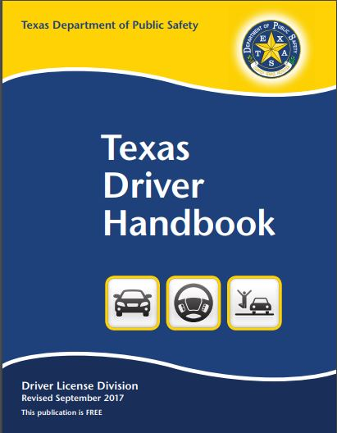
All Ages Checklist
1. You will need a pen or pencil
2. You will need notebook with paper
3. A Texas Drivers Handbook (Revised September 2017) Edition
4. A copy of the 84 Questions
5 Feel free to pause anytime during this presentation to copy of seek further explanation.

Slide 3
Question #1: What is the minimum age at which you can get a Class C driver license without either driver education or being a hardship case? (Chpt. 1)
Answer on Page 28
Age 25 is the minimum age at which you can apply for a drivers license without formal drivers education.

Slide 4
Question #2: How much is the maximum fine for a first conviction of driving without a license? (Chpt. 1)
Answer on Page 9 (Table 7)
$200

Slide 5
Question #3: What type of restrictions may be placed on your license? (Chpt. 1)
Answer on Page 9 (Table 8)
A = Must wear corrective lenses
B = Must have a licensed operator in front seat age 21 or older
F = Must hold valid learners license until (Date, usually 6 months form issued)

Slide 6
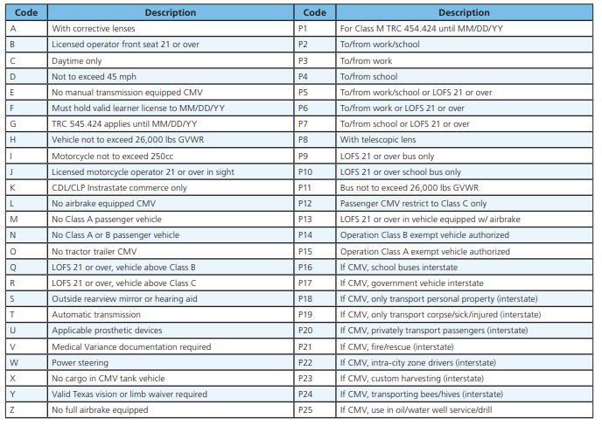

Slide 7
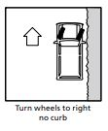
Question #4. In what direction should you turn your wheels when parking uphill without a curb? (Chpt. 7)
Answer on Page 47
Turn wheels to the right.

Slide 8
Question #5. What action should you take if you fail to receive the renewal notice card reminding you that your driver license is about to expire? (Chpt. 1)
Answer on Page 10
It is your responsibility to renew your license regardless if a renewal notice is sent or not.

Slide 9
Question #6. On a one-way street, what color is the broken lane marker? (Chpt. 5)
Answer on Page 36
The color of a one way street lane marking is WHITE.

Slide 10
7. Describe the “Yield” sign. (Chpt. 5)
Answer on Page 34
Red and White upside down triangle with the words “YIELD” in the middle.

Slide 11
Question #8. What does a “Narrow Bridge” sign look like, and how should the driver react when he sees one? (Chpt. 5)
Answer on Page 31
It’s a yellow diamond shaped sign and one should slow down and proceed with caution.

Slide 12
Question #9. What is the shape of a “Keep Right” sign, and how should the driver react when he sees one? (Chpt. 5)
Answer on Page 30 and 33

Slide 13
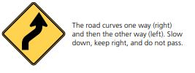
Question#10. Which sign tells you to slow down because you are approaching a double curve? (Chpt. 5)
Answer on Page 30

Slide 14
Question #11. What does a “Do Not Pass” sign mean? (Chpt. 5)
Answer on Page 33

Slide 15
Question #12. Which sign tells you to keep in the right-hand lane when driving slow? (Chpt. 5)
Answer on Page 33

Slide 16
Question #13. What does “Yield Right-of-Way” mean? (Chpt. 4, 5)
Answer on Page 23 and 34
Yield Right of Way means you must slow down or stop if necessary and give way to other drivers already occupying a space or road.

Slide 17
Question #14. Describe the equipment required on passenger cars by state law. (Chpt. 2)
Answer on Page 18 (Table 13)
Brakes, Lights, Horns, Muffler, Exhaust System, Safety Glass, License Plate, Windshield Wiper, Rearview Mirror, Safety Belts, Tires, Fuel Cap.

Slide 18
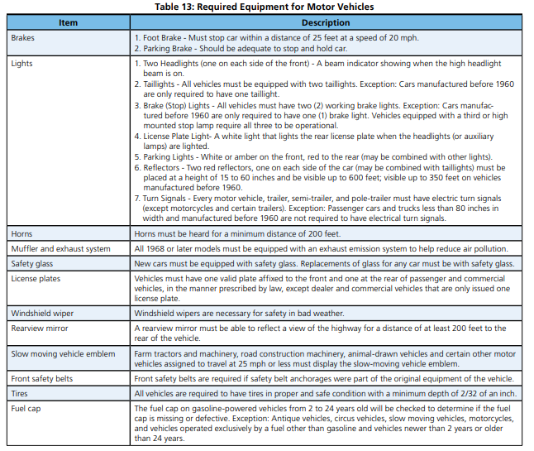

Slide 19
Question #15. What is the purpose of an exhaust emission system? (Chpt. 2)
Answer on Page 18
To reduce pollution.

Slide 20
Question #16. Describe the types of equipment that Texas state law specifically forbids on passenger cars driven within the state. (Chpt. 2)
Answer on Page 19

Slide 21
Question #18.How should you react when a traffic officer tells you to do something that is ordinarily considered to be against the law? (Chpt. 5)
Answer on Page 28
Always follow the directions of a Traffic Officer

Slide 22
Question #18. Once the brakes have been applied, about how many feet does a car which was going 70 mph travel before it comes to a stop? (Chpt. 8)
Answer on Page 48
233 Feet

Slide 23
Question #19. When is it necessary to stop before proceeding when you overtake a school bus loading or unloading children? (Chpt. 4)
Answer on Page 26
When red lights are flashing and stop sign is showing.

Slide 24
Question #20. About how many feet will the average driver going 50 mph travel from the moment he sees danger until he hits the brakes? (Chpt. 8)
Answer on Page 48
110 feet

Slide 25
Question #21. Within how many feet of a crosswalk may you park, when parking near a corner? (Chpt. 7)
Answer on Page 45
Within 20 feet of a crosswalk at an intersection.

Slide 26
Question #22. What is the state speed limit for automobiles in urban districts? (Chpt. 8)
Answer on Page 49 (Table 24)
30 MPH (Miles Per Hour)

Slide 27
Question #23. Does a posted speed limit of 55 mph mean that you may drive 55 mph on that highway under all conditions? (Chpt. 8)
Answer on Page 48
Speed Limit sign is for normal driving conditions. However, under adverse conditions (rain, heavy traffic, limited visibility and reduced traction) you must go slower then the posted speed limit.

Slide 28
Question #24. You should never drive on the left half of the roadway when you are within how many feet from an intersection, bridge, or railroad crossing? (Chpt. 6)
Answer on Page 41
100 Feet

Slide 29
Question #25. What should you do if you discover you are in the wrong lane to make a turn as you enter an intersection? (Chpt. 6)
Answer on Page 42
Continue straight and find a safe turn around further up the road or detour.

Slide 30
Question #26. When two cars meet at the intersection of a two-lane road with a four-lane road, which one must yield the right-of-way? (Chpt. 4)
Answer on Page 23
Two-lane road must yield to a four-land road.

Slide 31
Question #27. If you are driving and hear a siren coming, what should you do? (Chpt. 4)
Answer on Page 25
Simply yield, depending where the emergency vehicles is coming from. For example if it is behind you pull over to the right of the shoulder to let it pass.

Slide 32
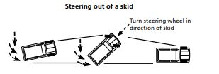
Question #28. What is the first thing that should be done when a car starts to skid? (Chpt. 9)
Answer on Page 52
Do not hit the brakes suddenly or hard. Take foot off the gas.

Slide 33
Question #29. At what time of the day should your headlights be turned on? (Chpt. 9)
Answer on Page 50
You must use your headlights beginning 30 minutes after sunset and ending 30 minutes before sunrise, or anytime when individuals or vehicles cannot be seen clearly for at least 1,000 feet.

Slide 34
Question #30. Under what conditions may your driver license be suspended?(Chpt. 1)
Answer on Page 12
A license can be suspended for a number of different violations from continued reckless driving (point system) to mandatory suspension for violations considered a felony or dangerous. For example, DWI, drug offenses, racing on public roads, over taking a school bus.

Slide 35
Question #31. What is carbon monoxide, and how may it be harmful to drivers? (Chpt. 14)
Found on Page 71
Carbon Monoxide is a deadly gas. When exposed to Carbon monoxide make sure to find fresh air and ventilation. Symptoms include dizziness and sleepiness, over exposure leads to death.

Slide 36
Question #32. Describe what you should do if you have a blowout while driving. (Chpt. 9)
Answer found on Page 52
Do not hit the breaks suddenly or hard
Take foot off gas and break gently
Steer straight ahead to stop.

Slide 37
Question #33. What should you do when driving down a steep grade in a car with standard transmission? (Chpt. 9)
Answer on Page 52
When driving down a steep hill, you can shift your car into a low gear to help slow your vehicle. Never coast in neutral or for cars with a standard transmission, never coast with your foot on the clutch.

Slide 38
Question #34. What should you do if you damage an unattended vehicle? (Chpt. 11)
Answer on Page 63
Locate the operator or owner of the unattended vehicle and give your name and address
Securely attach a written notice in a visible way, to the unattended vehicle providing: • Your name and address • A statement of the circumstances of the collision

Slide 39
Question #35. When are crash reports required? (Chpt. 11)
Answer on Page 62
If you are involved in a crash that is not investigated by a law enforcement officer and the crash has not resulted in injury or death of a person or damage to property of $1,000 or more, you must make a written report of the crash and file it with the Texas Department of Transportation (TxDOT) no later than the 10th day after the date of the crash. The written report must be on a TxDOT specified form.

Slide 40
Question #36. If you are required to show proof of financial responsibility for the future, how many years must such proof be kept up? (Chpt. 3)
Answer on Page 22
2 years

Slide 41
Question #37. What type of sign warns you to watch right and left for cross traffic? (Chpt. 5)
Answer on Page 30 and 31

Slide 42
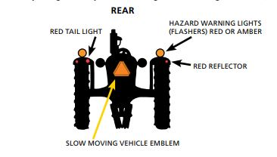
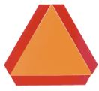
Questions #38. Describe the emblem that identifies vehicles which travel at speeds of 25 mph or less. (Chpt. 5)
Answer on Page 40
Orange Triangle.

Slide 43
Question #39. In which gear should you drive when going down a steep hill? (Chpt. 9)
Answer on Page 52
When driving down a steep hill, you can shift your car into a low gear to help slow your vehicle. Never coast in neutral or for cars with a standard transmission, never coast with your foot on the clutch.

Slide 44
Question #40. What qualifications must one have to teach a beginner to drive? (Chpt. 1)
Answer on Page 1
The licensed driver must be at least 21 years of age with at least one year of driving experience, must occupy the seat beside the driver, and cannot be intoxicated, asleep, or engaging in any activity that prevents observation and response to the actions of the driver.

Slide 45
Question #41. If the person is under 18, when does his provisional license expire? (Chpt. 1)
Answer on Page 3
A provisional license holders license will expire on their 18th birthday.

Slide 46
Question #42. When parked parallel, your curb side wheels must be no more than how many inches from the curb? (Chpt. 7)
Answer on Page 47
Do not park more than 18 inches from the curb or edge of the road.

Slide 47
Question #43. When following another car, what is a good distance at which you should follow behind? (Chpt. 8)
Answer on Page 48
You should keep a safe distance between your car and the one in front of you. The faster you drive, the greater the distance you should keep from the car ahead of you. For speeds 30 mph or less, the minimum time between your car and the one in front of you is 2 seconds with good road conditions. For speeds above 30 mph, maintain a 4 second gap between cars during good road conditions. During periods of poor road conditions, allow more time. Using a four-second following interval is the best practice for a beginning or less experienced driver.

Slide 48
Question #44. To what agency and within what time period must a change of address be reported for driver licensing purposes? (Chpt. 1)
Answer on Page 10
A change of name or address must be reported to DPS within 30 days. A license expiring in less than 12 months, or in less than 30 days for a provisional license, should be renewed not duplicated.

Slide 49
Question #45. What effects does the use of marijuana and amphetamine have on driving? (Chpt. 10)
Answer on Page 58
Marijuana can affect concentration, judgment, and sensory and perceptual skills.
Amphetamine makes a driver less coordinated, edgy, and is more likely to be involved in a car crash

Slide 50
46. What is the penalty for being convicted of driving while intoxicated? (Chpt. 10)
Answer on Page 61 (Table 33)

Slide 51
Question #47. What does a green arrow showing with a red light mean? (Chpt. 5)
Answer on Page 28
A green arrow displayed at the same time as a red light means the driver can proceed carefully in the direction of the arrow after yielding the right-of-way to other vehicles and pedestrians.

Slide 52
Question #48. How should you react to a flashing red light? (Chpt. 5)
Answer on Page 28
Stop completely before entering the crosswalk or intersection, then proceed when you can do so safely. Vehicles on the intersecting road may not have to stop

Slide 53
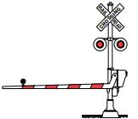
Question #49. Which sign tells you to watch out for a train? (Chpt. 5)
Answer on Page 35

Slide 54
Question #50. Describe the sign that warns you to slow down for a winding road. (Chpt. 5)
Answer on Page 30

Slide 55
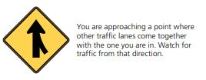
Question #51. What sign indicates that the road that you are on merges with another? (Chpt. 5)
Answer on Page 31

Slide 56
Question #52. What kind of sign warns you that the highest safe speed for the curve ahead is 35 mph? (Chpt. 5)
Answer on Page 33

Slide 57
Question #53. Describe the sign that tells you to watch for cross traffic ahead. (Chpt. 5)
Answer on Page 30

Slide 58
Question #54. What type of sign warns you that you should slow down for a sharp rise in the roadway? (Chpt. 5)
Answer on Page 32

Slide 59
Question #55. Describe the type of sign that would let you know that you were on a short state highway in a city or urban area. (Chpt. 5)
Answer on Page 35

Slide 60
Question #56. What is the maximum number of inches you may lawfully allow an object to extend beyond the left fender of your car? (Chpt. 2)
Answer on Page 19
No more than three inches beyond the left side of the body, running board, or fenders of your car.

Slide 61
Question #57. Under what conditions must you always stop? (Chpt. 5)
Answer on Page 28
Red Light, Flashing Red Light, Stop Sign, Officer instructs you to stop, when yielding to oncoming traffic on a left turn, any and all pedestrians on a crosswalk or road.

Slide 62
Question #58. What should you do when coming onto a street from a private alley or driveway? (Chpt. 4)
Answer on Page 23
When entering or crossing a road, street, or highway from a private road, alley, building, or driveway, you must stop prior to the sidewalk and yield the right-of-way to all approaching vehicles and pedestrians.

Slide 63
Question #59. If a child runs into the road 45 to 50 feet ahead of your car, what is the highest speed from which you can stop with good brakes without hitting him? (Chpt. 8)
Answer on Page 48
30 MPH (Miles Per Hour) has a braking distance of 43 feet.

Slide 64
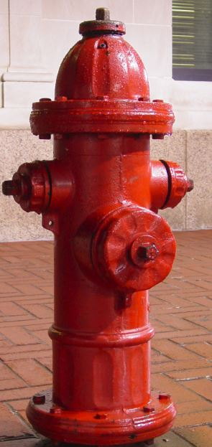
Question #60. How close to a fireplug may a vehicle lawfully park? (Chpt. 7)
Answer on Page 45
No closer then 15 feet

Slide 65
Question #61. What does a posted speed limit of 55 mph mean? (Chpt. 5)
Answer on Page 33

Slide 66
Question #62. What is the maximum speed limit for passenger cars on a Texas Highway numbered by this state or United States outside an urban district? (Chpt. 8)
Answer on Page 49
70 MPH (Miles Per Hour)

Slide 67
Question #63. Under what circumstances should you never attempt to pass a car ahead of you? (Chpt. 6)
Answer on Page 41
Pavement markings or signs prohibit driving on the left (a “No Passing Zone” or solid lane lines)
There are two or more traffic lanes in each direction
Within 100 feet of or crossing an intersection or railroad crossing
On a hill, curve, or any other place where vision is limited
Within 100 feet of a bridge, viaduct, or tunnel

Slide 68
64. Under what conditions are overtaking and passing to the right not permitted? (Chpt. 6)
Answer on Page 42
When there are parked cars on road, when there is no paved shoulder, when driving on a multilane road and there is no blocked traffic.

Slide 69
Question #65. When a driver is waiting to make a left turn, what is the procedure he should take when the light turns green? (Chpt. 5)
Answer on Page 28
You can turn left on a green light. However, you must yield the right-of-way to all traffic that is approaching from the opposite direction before turning.

Slide 70
Question #66. What precautions should a driver take at uncontrolled intersections? (Chpt. 4)
Answer on Page 23
When approaching this type of intersection, yield the right-of-way to any vehicle that has entered or is approaching the intersection on your right. If the road to your right is clear or if approaching vehicles are far enough from the intersection to make your crossing safe, you may proceed. Since there are not any traffic controls at this intersection, make sure there are no approaching vehicles from the left. You may legally have the right-of-way but be sure the other driver yields to you before you proceed.

Slide 71
Question #67. What regulations should a bicycle rider observe? (Chpt. 13)
Answer on Page 65
Any person who operates a bicycle is subject to the same penalties for violating a traffic law as a person operating a motor vehicle. All traffic convictions will be placed on the individual’s driver record, regardless if the conviction was for an offense committed on a bicycle or in a motor vehicle.

Slide 72
Question #68. Under what conditions should headlights be used? (Chpt. 9)
Answer is on Page 50
Driving in fog, heavy rain, sleet, snow, or dust
At night or in a tunnel
Anytime visibility is reduced.

Slide 73
Question #69. You should dim your lights when you are within how many feet of an approaching car? (Chpt. 9)
Answer on page 50
Within 500 feet of an approaching car.

Slide 74
Question #70. What type of lighting should cars use when parked on the highway at night? (Chpt. 9)
Answer on Page 50
If you must park on an unlighted highway at night, leave your parking lights or low beam headlights on.

Slide 75
Question #71. Which lights should you use when you are driving in a fog? (Chpt. 9)
Answer on Page 50
Low beam headlights.

Slide 76
Question #72. When are you required to show proof of financial responsibility? (Chpt. 3)
Answer on Page 21
Every owner or operator of a motor vehicle in Texas is required to furnish evidence of financial responsibility to a law enforcement officer upon request or to another person involved in a crash.

Slide 77
Question #73. When needed, how may one show proof of financial responsibility? (Chpt. 3)
Answer on Page 21
A physical standard insurance policy issued by an insurance company.
An image displayed on a wireless communication device that includes the information required in a standard insurance form. (Not acceptable for license issuance and examination)

Slide 78
Question #74. What sign warns you that you must slow down? (Chpt. 5)
Answer on Page 30
Many of the diamond shaped signs require you to slow down for safety. For example Speed advisory sign you must slow down to recommended speed limit and wet roads sign you MUST slow down below speed limit to navigate safely.

Slide 79
Question #75. What circumstances may lead to possible loss of your license? (Chpt. 1)
Answer on Page 12
A number of circumstances could lead to a possible lose of your license including anything deemed a felony under motor vehicle laws as well getting 6 points on your driving record within a three year period. Diagnosed medical conditions can also cause a loss of your license especially when your vision is effected to the point you can’t pass the eye exam.

Slide 80
Question #76. In addition to mufflers, what new equipment is required on all cars manufactured in 1968 and after? (Chpt. 2)
Answer on Page 18
All 1968 or later models must be equipped with an exhaust emission system to help reduce air pollution.

Slide 81
Question #77. Why are seat belts important? (Chpt. 14)
Answer on Page 67
Safety belts help keep you:
From being thrown from your car. Your chances of being killed are five times greater if you are thrown from your car
From hitting the dashboard too hard
Whatever your reason for not wearing safety belts, it is dangerous and violates state law.

Slide 82
Question #78. What is meant by “defensive driving?” (Chpt. 14)
Answer on Page 67
Stay alert and keep eyes moving to keep track of what is happening at all times
Look for trouble spots developing all around
Have a plan of action
Know that the law requires drivers to protect each other from their own mistakes

Slide 83
Question #79. What are the different classes of licenses and age requirements for each? (Chpt. 1)
Answer on Page 4
Class A = 18 years old
Class B = 18 years old
Class C = 15 Hardship, 16 provisional, 18 standard
Class M = 15 Moped, 16 Motorcycle

Slide 84
Question #80. When is a bicyclist not required to ride to the right of the roadway? (Chpt. 13)
Answer on Page 8
A person operating a bicycle who is moving slower than the other traffic on the road shall ride as near as possible to the right curb or edge of the road unless:
a. The person is overtaking and passing another vehicle proceeding in the same direction
b. The person is preparing for a left turn at an intersection or onto a private road or driveway
c. There are unsafe conditions in the road such as fixed or moving objects, parked or moving vehicles, pedestrians, animals, potholes, or debris, or
d. The person is operating a bicycle in an outside lane that is: - Less than 14 feet in width and doesn’t have a designated bicycle lane adjacent to that lane; or - The lane is too narrow for a bicycle and a motor vehicle to safely travel side by side.

Slide 85
Question #81. When are bicyclists allowed to ride two abreast in a traffic lane? (Chpt. 13)
Answer on Page 65
Individuals riding two abreast on a “laned” road must ride in a single lane and not impede the flow of traffic.

Slide 86
Question #82. What are the three most common motorist caused car-bicycle crashes? (Chpt. 9)
Answer on Page 56
The most common car-bicycle crashes caused by a motorist are:
1. A motorist turns left in front of oncoming bicycle traffic. Oncoming bicycle traffic is often overlooked or its speed misjudged.
2. A motorist turns right across the path of the bicycle. The motorist should slow down and merge with the bicycle traffic for a safe right turn.
3. A motorist pulls away from a stop sign and fails to yield the right-of-way to bicycle cross traffic. At intersections, the right-ofway rules apply equally to motor vehicles and bicycles.

Slide 87
Question #83. What are the penalties for minors (persons under the age of 21) convicted of Driving Under the Influence of Alcohol? (Chpt. 10)
Answer on Page 60 (Table 31)

Slide 88
Question #84. What are the penalties for minors (persons under the age of 21) convicted of non-driving alcohol-related offenses? (Chpt. 10)
Answer on Page 59 (Table 28)

