Slide 1
Final Exam Review
All Ages Driving School Teen Course

Slide 2
Final Exam What does it look like?
The Final exam is a 120 question exam.
It has multiple choice (A, B, C, D)
It has True or False
It has Fill in the Blank ____________
It has Short Answer Essay (define, describe, articulate)
It takes about 2 hours to complete.

Slide 3
HTS = Highway Transportation System
The purpose of the HTS (Highway Transportation System) is to move people, vehicles and goods in a safe and efficient manner. President Eisenhower conceived the Interstate System.
It was authorized for designation by the Federal-Aid Highway Act of 1944, with the initial designations in 1947 and completed in 1955 under the 40,000-mile limitation imposed by the 1944 Act.
Source: Traffic Safety Education Student Textbook Chapter 1 pages: 1.1 to 1.4

Slide 4
Regulation of the Highway Transportation System
Regulation of the HTS is done by a group of laws known as traffic laws.
Source: Traffic Safety Education Student Textbook Chapter 1 pages: 1.1 to 1.4
This Photo by Unknown Author is licensed under CC BY

Slide 5
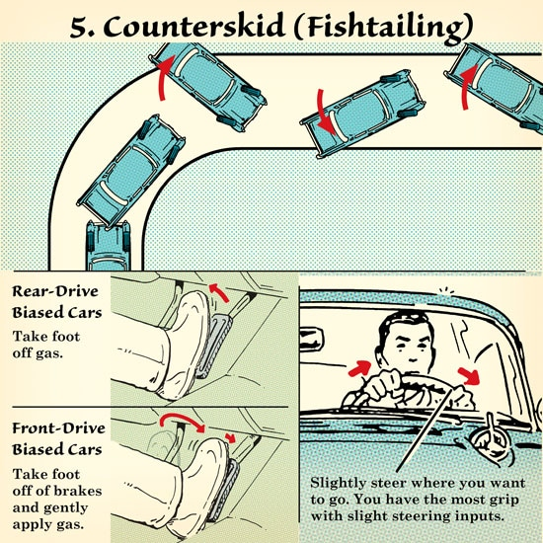
How to get out of a skid
1. Take your foot off the gas
2. Slightly steer in the direction you want to go.
Source: Traffic Safety Education Student Textbook Ch. 21 pages 21.9 to 21.10

Slide 6
Your attitude will determine how safe of a driver you will become.
Use Defensive Driving strategies to stay safe for yourself and others.
Use positive strategies to control anger and anxiety while driving.
Respect the laws that regulate the HTS
Avoid using alcohol and drugs, especially when driving.
Keep distractions to a minimum, don’t text and drive, keep your hands free of electronic devices and focus on the task of driving.
Source: Traffic Safety Education Student Textbook Ch. 13, 14, 18 and 19

Slide 7
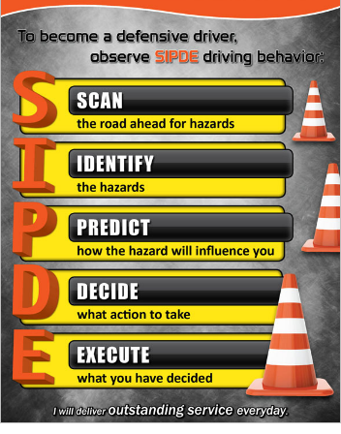
SIPDE
S = Search
I = Identify
P = Predict
D = Decide
E = Execute
Source: Traffic Safety Education Student Textbook Chapter 11

Slide 8
Cruise Control
It allows you to maintain speed while taking your foot off the accelerator/gas. Source: Traffic Safety Education Textbook Chapter 9 page 9.14

Slide 9
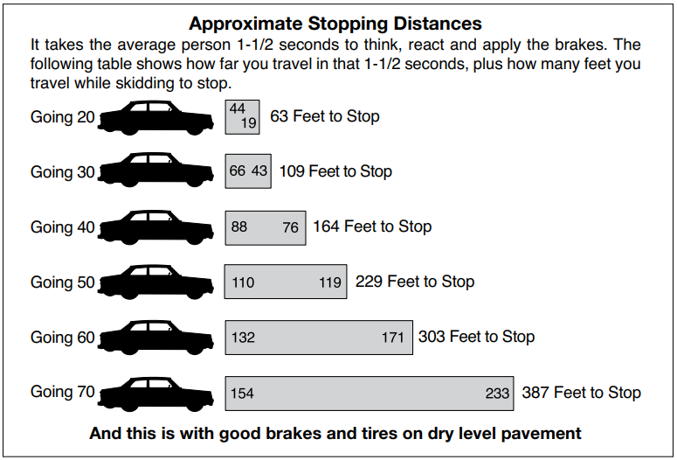
Breaking Chart (Know it!)
For each speed there is a bar, inside the bar are two numbers
First number: Refers to reaction time, the distance you travel when you first see the hazard to the moment you apply the break.
Second number: Braking distance, how far you travel the moment you apply the brakes until you come to a complete stop.
Final Number to the far right of the graph is the total distance when combining the two numbers inside the bar graph.
Source: DPS Handbook Chapter 8 pg. 48

Slide 10
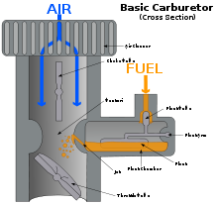
Choking the Engine
Choking the Engine refers to controlling the amount of air an engine receives.
In an internal combustion engine, a choke valve modifies the air pressure in the intake manifold, thereby altering the ratio of fuel and air quantity entering the engine. Choke valves are generally used in naturally aspirated engines with carburetors to supply a richer fuel mixture when starting the engine

Slide 11
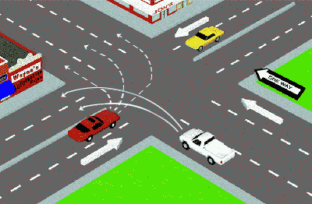
Turning left from a 3 Lane One Way street
When turning left on a 3-lane one-way street you want to be in the far-left lane.
Source: Safety Education Textbook Chapter 4 pages 4.4 to 4.5

Slide 12
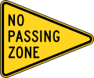
Pennant Shaped sign Source: DPS Handbook Chapter 5
Passing is illegal:
Within 100 feet of intersection (city)
100 feet of a railroad track
100 feet of curve
100 feet of hill
100 feet of tunnel
*Sight becomes shorter*
When being passed its illegal to speed up

Slide 13
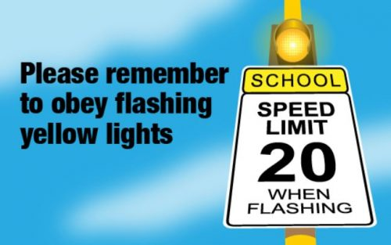
Flashing Yellow Light
When you approach a flashing yellow light you MUST SLOW DOWN! Do not confuse it with a solid yellow light which means CAUTION.
Source: DPS Handbook Chapter 5

Slide 14
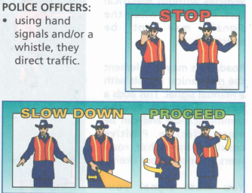
Traffic Officer
When a traffic Officer is at an intersection with a traffic control light, the officer is in control. The officer controls the flow of traffic.
Palm facing you means STOP!
Source: Traffic Safety Education Textbook Chapter 3 page 3.19

Slide 15
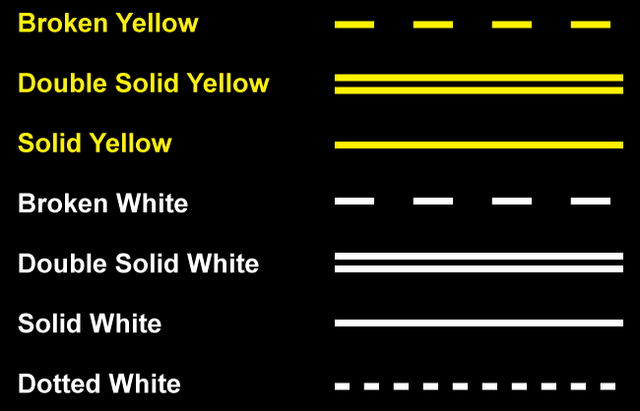
Markings Lanes of Traffic
White = One way (Same direction)
Yellow = Two way (Opposing direction)
Dashed = Passing is permitted(allowed).
Solid = Passing is prohibited (not allowed)
Double Solid = Both sides are prohibited from crossing over (passing).
Source: DPS Handbook Chapter 5

Slide 16
Non-Driving related offense of possession or consumption of alcohol by a minor. Source: DPS Handbook Chapter 10 page 59.
The Texas Zero Tolerance law established penalties for minors who commit offenses under the non-driving alcohol-related offenses. A minor may not purchase, attempt to purchase, falsely state he/she is 21 years of age or older, or present any document indicating he/she is 21 years of age or older to a person engaged in the selling or serving of alcoholic beverages. A minor may not consume, or possess an alcoholic beverage. Persons who purchase, furnish, or sell alcohol to a minor can be fined of up to $4,000 and/or confined in jail for up to one year. MIP stands for “Minor in Possession”

Slide 17
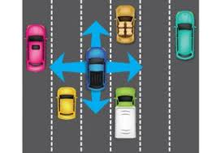
Leaving yourself an “OUT”
5 Rules of the Smith System: 1. Aim High 2. The Big Picture 3. Keep your Eyes Moving 4. Leave yourself an OUT 5. Make sure they see you
The fourth principle of the Smith System states to leave yourself a way out. This means ensure. that other drivers do not box you in while selecting their lanes. Do not tailgate other vehicles too closely, and always anticipate other drivers moves.
“Out” is the open area you should keep around your car. Its to avoid collisions

Slide 18
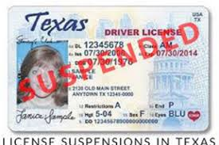
Suspended License
Operating a motor vehicle is a privilege. If this privilege is abused, it may result in a driver license suspension or revocation.
Habitual Reckless Driving will lead to you getting your license suspended.
Source: DPS Handbook Chapter 1 page 11.

Slide 19
Maximum and Minimum Stopping distances at Railroad Tracks
Maximum is 50 feet and minimum is 15 feet when stopping at railroad tracks.
Source: DPS Handbook page 36

Slide 20
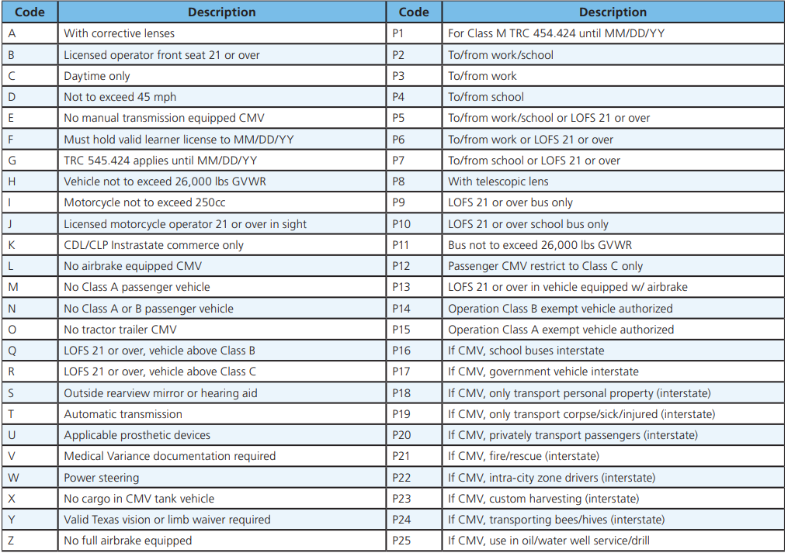
Restrictions on Drivers License Most common for Teens
A = Must wear corrective lenses
B = Licensed operator front seat must be 21 or over
F = Must hold valid learners license until MM/DD/YY (6 months)
Source: DPS Handbook Chapter 1 page 9

Slide 21
How to signal a turn
How to Signal
You may either use turn signal lights or hand and arm signals. If using hand signals, extend your hand and arm well out of the car window as shown below. Always make sure your signals can be easily seen by others, and signal in plenty of time. Hand and arm signals are usually difficult to see during non-daylight hours, so it is important to make sure your signal lights are working properly. When signaling a stop, pump your brakes a few times to attract attention. Signal continuously for at least 100 feet before turning or stopping and be sure to turn off your signal lights once your turn is complete. Your unintended signal still means “turn” to other drivers.
Source: DPS Handbook Chapter 6 page 41
Left hand signal will be on test.

Slide 22
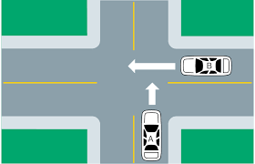
Uncontrolled Intersection
An uncontrolled intersection is a road intersection where no traffic lights, road markings or signs are used to indicate the right-of-way. They are found in either residential neighborhoods or in rural areas. While the intersection itself is unmarked, warning signs or lights may be present to alert drivers to it.
Test Insight: Driver on the left must yield to driver on the right if arrived at same time.

Slide 23
Choosing the proper driving speed
Deciding how fast to depends on a number of factors. 1. Condition of the weather (slow down in rain, snow, sleet, fog) 2. Traffic conditions, if heavy traffic slow down, create distance between you and the driver in front of you. Don’t Tailgate (following too closely) 3.Road conditions: Wet, icy, potholes, bump, deep (slow down) 4. Condition of the car: Bald tires, worn break pads, cracked windshield (slow down and fix your car ASAP!) 5.Condition of Driver: sleepy, intoxicated, under the influence of drugs, sick, heart condition, poor vision, anger management issues. SLOW DOWN! Stay Safe
Speed limit: This is the speed most drivers are going, however conditions must be ideal.
Speed Minimum: Under ideal conditions this is the slowest you can go on a state or federal highway or interstate.
*Highlighted means test question
This Photo by Unknown Author is licensed under CC BY-NC

Slide 24
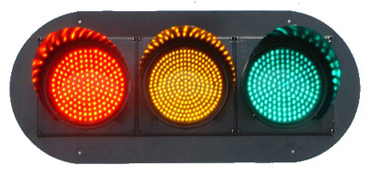
Signal Lights
Green: Means Go (Stale Green light is when a light has been green for a while or you did not observe the light go from red to green so you must assume it is about to change yellow soon). Green on left turn must yield to opposing traffic.
Yellow: Caution
Flashing Yellow: Always Slow Down
Red: Must stop at or behind the stop line
Flashing Red: Must stop and treat it like a stop sign and properly yield.
Green Arrow: Protected left turn
Flashing Yellow Arrow: Must yield to opposing traffic prior to turning.
A colorblind person can tell which color is red because red is on the right and green is on the left. Also, generally the green and red colors have a bit of orange and blue in them, so where most colorblind people can still tell the difference.

Slide 25
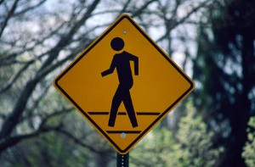
13 Rules of Right of Way (Yield)
1. AT CONTROLLED INTERSECTIONS YIELD TO SIGNS AND SIGNALS.
2. ROADS WITH FEWER LANES YIELD TO ROADS WITH MORE LANES.
3. UNPAVED ROADS YIELD TO PAVED ROADS.
4. AT UNCONTROLLED INTERSECTIONS YIELD TO CARS ON YOUR RIGHT.
5. WHEN TURNING LEFT YIELD TO ONCOMING TRAFFIC.
6. PRIVATE ROADS, ALLEYS AND DRIVEWAYS YIELD TO CARS ON PUBLIC ROADS.
7. AT T-INTERSECTIONS YIELD TO THRU TRAFFIC. SPECIAL MERGING SITUATIONS
8. ON A FRONTAGE ROAD, YIELD TO CARS ENTERING AND EXITING THE CONTROLLED ACCESS HIGHWAY.
9. ON A MULTIPLE-LANE ROADWAY, WHEN TWO CARS ARE ENTERING THE SAME LANE, THE CAR ON THE RIGHT MUST YIELD TO THE CAR ON THE LEFT. OTHER ROADWAY USERS
10. YIELD TO TRAINS AND RAILROAD CROSSINGS.
11. YIELD TO EMERGENCY VEHICLES BY PULLING TO THE RIGHT AND STOPPING. (Test question)
12. YIELD TO SCHOOL BUSES WITH FLASHING RED LIGHTS.
13. YIELD TO PEDESTRIANS….ALWAYS! (Test question)
Right of Way is defined: the legal right of a pedestrian, vehicle, or ship to proceed with precedence over others in a particular situation or place.

Slide 26
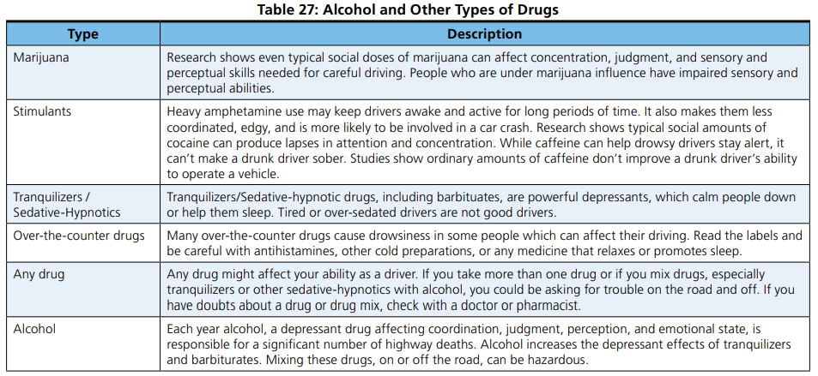
Alcohol and Drug effects on driving
Test tip: Pay attention to alcohol and Stimulants. P.I stands for Public Intoxication

Slide 27
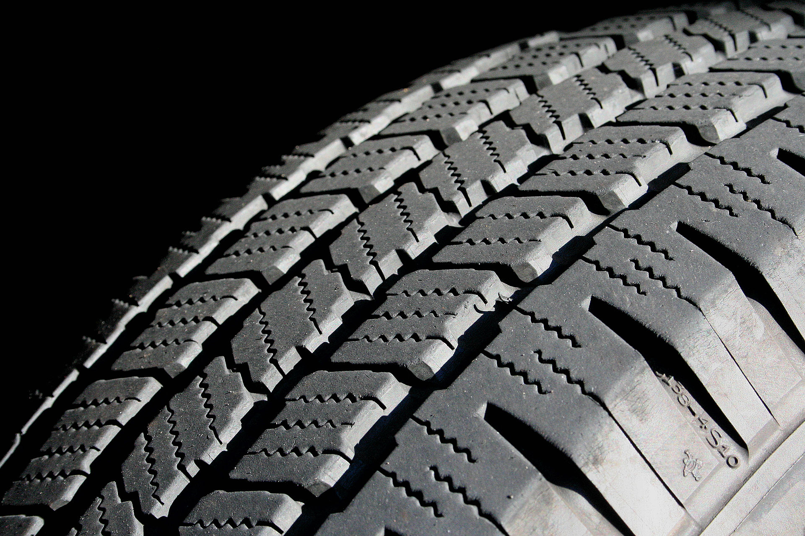
Blow Out and Flat Tire and Traction
Blow Out: A sudden complete loss of Air Pressure destroying the tire
Flat: A leak of air causing the tire to flatten (can possibly be repaired with a patch)
Traction: Tires grip on the road. Check your tread to avoid a blow out.
Changing Tire: Make sure the area is level when changing a tire.

Slide 28
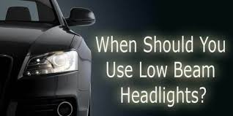
Headlights
Must be turned on 30 minutes after sunset
May be turned off 30 minutes before sunrise
Must be turned on when visibility is less then 1000 feet (fog, rain, snow, sleet)
Low Beam Headlights are to be used in the following cases: 1. Fog 2. In the City in well lite areas 3. Rain 4. Within 500 feet of an approaching car at night or within 100 feet of a car in front of you (to avoid glare).
Daytime Running Lights: It is recommended that lights be used during the day because it’s a safety feature allowing other cars to see you better.
Over Drive Your Headlights: When your stopping distance is greater than the lights that illuminate the road ahead. Best way to avoid overdriving your headlights is to slow down and don’t speed.

Slide 29
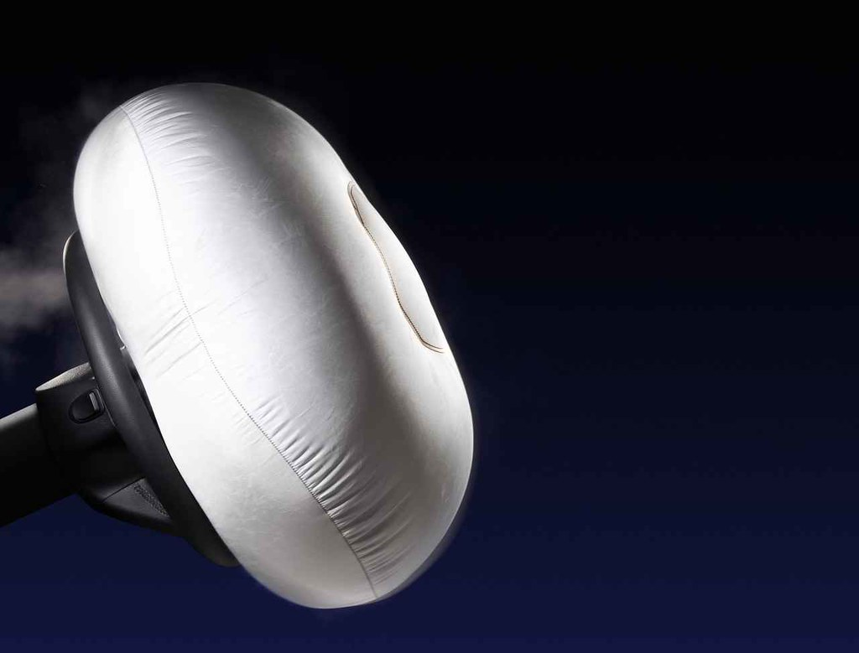
Passive and Active Restraint
A passive safety feature is a system that does not do any work until it is called to action. These features become active during an accident, and work to minimize damage and reduce the risk of injury during the time of impact. These systems are air bags, and the construction of the vehicle.
The active restraint system needs an extra effort by human to activate or use them. For example: a seat belt must fasten by the passenger to protect them from any crash.
Child Safety Seats: They are required in Texas up to the age of 8…(On test choose 2 years).
Active Restraint
Passive Restraint

Slide 30
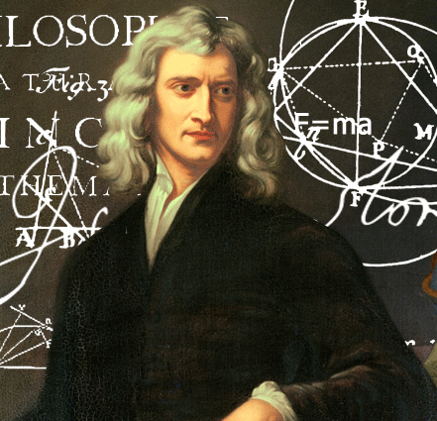
Overcoming Gravity and Inertia
Gravity: the force that attracts a body toward the center of the earth, or toward any other physical body having mass.
Test Tip: When driving uphill you are overcoming the force of gravity
Inertia: a property of matter by which it continues in its existing state of rest or uniform motion in a straight line, unless that state is changed by an external force.
Test Tip: When you approach curves your car has a tendency to want to go straight, the only way to overcome the force of inertia is to SLOW DOWN!
Covering the Break: When your foot rest on or above the break. (Downhill driving, shift into lower gear)
If you enter a curve too fast…break GENTLY.

Slide 31
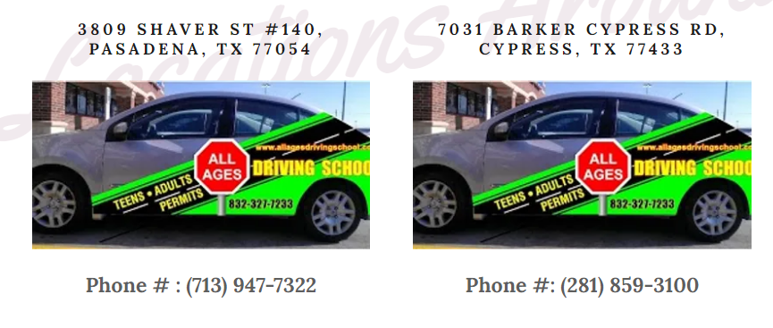
Who should you call to schedule a drive time?
To schedule a drive time it depends on location: www.allagesdrivingschool.com
Test Tip: Write the correct phone number for your location

Slide 32
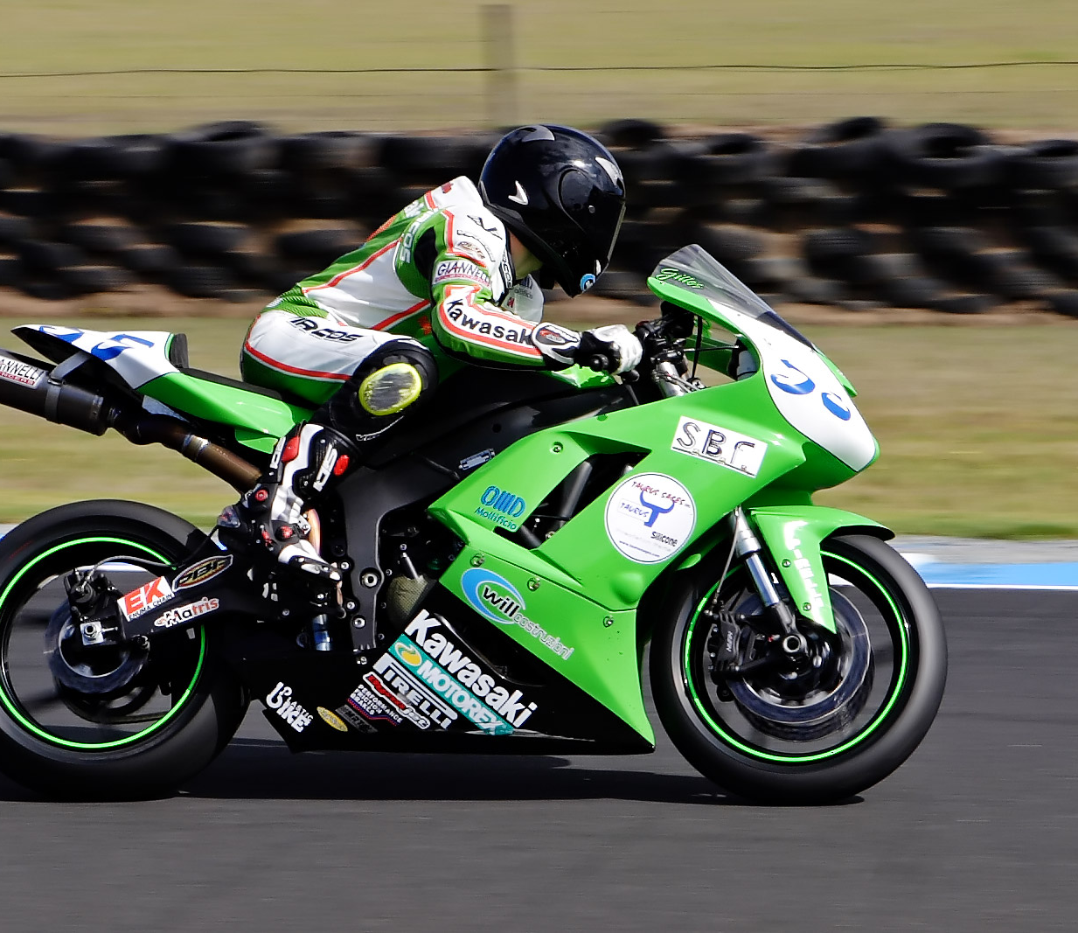
Motorcyclists
Motorcyclist are hard to see because of their small size.
What protects a motorcyclist from head injury is a helmet.
The smaller the vehicle the less distance it takes to stop. For example a bicycle can stop more efficiently then a Motorcycle.
Motorcyclists should ride staggered with the left motorcyclist ahead of the first.
This Photo by Unknown Author is licensed under CC BY-SA

Slide 33
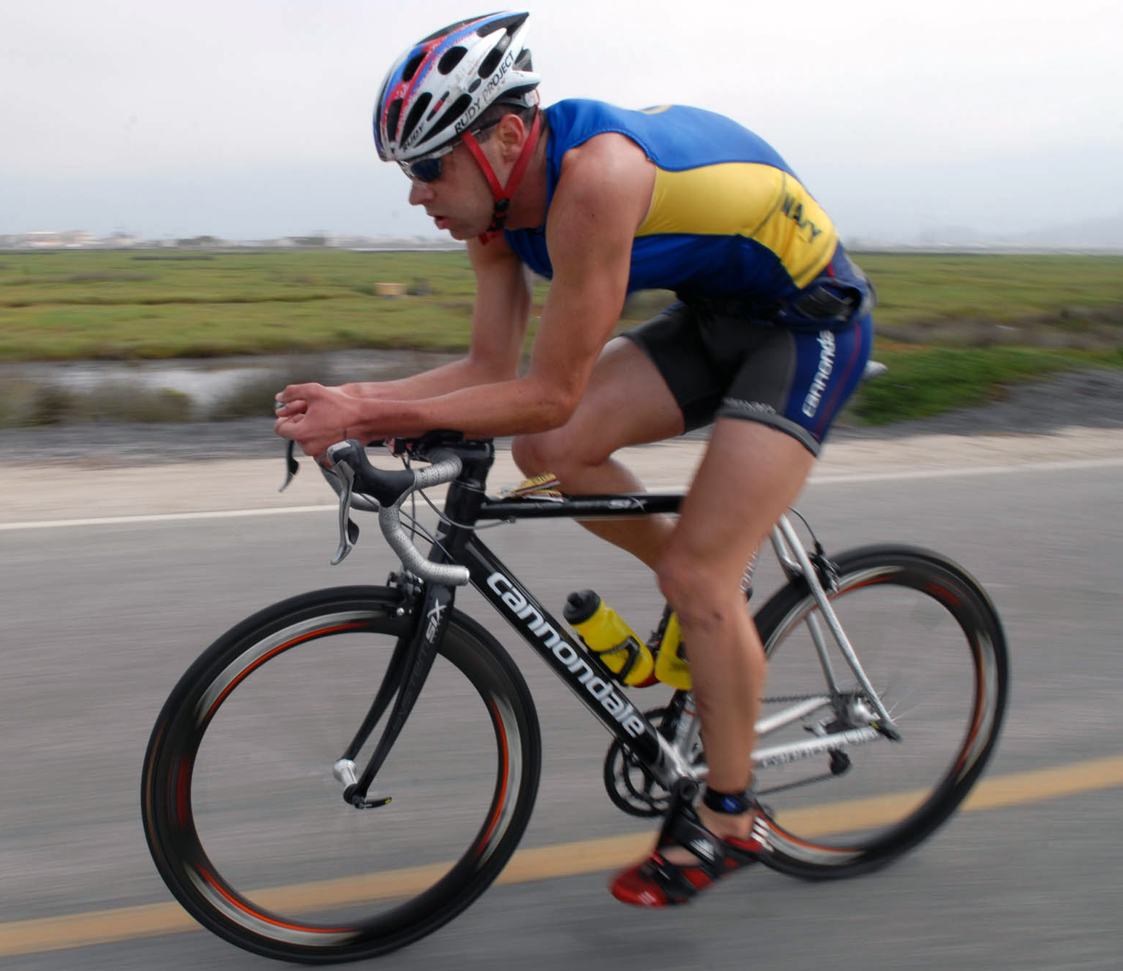
Bicyclist
A bicycle is a vehicle. Any person riding a bicycle has the same rights and responsibilities that apply to a driver operating a vehicle unless these cannot, by their nature, apply to a person operating a bicycle. Any person who operates a bicycle is subject to the same penalties for violating a traffic law as a person operating a motor vehicle. All traffic convictions will be placed on the individual’s driver record, regardless if the conviction was for an offense committed on a bicycle or in a motor vehicle.
Bicyclist should ride on the right side of the roadway. Test Tip
This Photo by Unknown Author is licensed under CC BY-SA

Slide 34
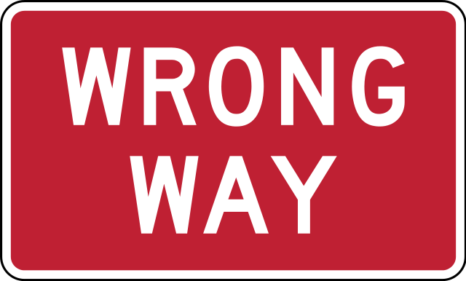
Wrong Way Driver
If you encounter a wrong way driver you must do the following:
1. Slow down
2.Steer to the right
3. Sound your horn

Slide 35
SMOG: How to change lanes
When performing a lane change
Signal: Turn on your blinking signal light(blinker) for the direction you are changing lanes. This lets everyone around you know what your intentions are.
Mirror: Check your mirrors, first your rear-view mirror and then the side mirror of the lane you want to change to.
Over the Shoulder: Check your blind spot by looking over the shoulder, this will allow you to see the area in which your mirrors can not see.
Go: If everything is clear and it is safe to change lanes you simple execute the maneuver. GO! Trust your eyes and execute the maneuver to avoid hazards in front of you.

Slide 36
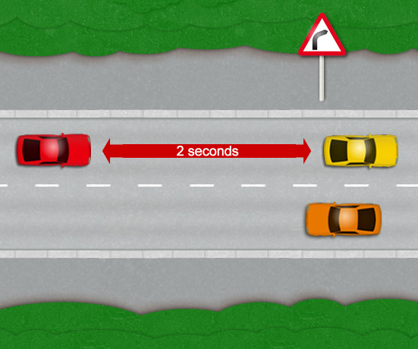
Following distance
HOW TO DO THE 2 SECOND RULE
You are driving along a relatively straight road. To estimate the minimum and safe following distance, allow the car in front (the yellow car) to pass a fixed object. This can be any object that is easy to distinguish such as a road marking or lamp post, although in this case in the diagram, it’s a road sign.
As the rear of the car in front roughly lines up with your chosen reference marker, count to 2 seconds. If before you have reached 2 seconds your vehicle has passed the same reference marker, you will need to increase your following distance and try again. The 2 second rule isn’t just for the car in front however. If a car is driving too close behind you (tailgating), you will also need to take their thinking distance into account by leaving a sufficient and safe distance between yourself and the car in-front.
Teens are encouraged to use 4 seconds under ideal conditions 6 seconds under adverse conditions.
Major Cause of Freeway collisions is following to closely.

Slide 37
Causes of collisions (crashes)
1. Distracted driving: Texting, talking, music, other passengers, eating, reading.
2. Driving While Intoxicated (DWI) and Drugs (DUI): Texas legal limit is .08 for teen its called DUIA (Driving Under the Influence of Alcohol by a minor)
3. Speeding: Faster you go the deadlier the crash *The single most important factor*
4. Reckless driving. Drivers that are speeding well over the limit, changing lanes too quickly, or driving aggressively.
5. Tailgating: Following to closely, you need a safe distance between you and the car in front of you. The more space you have the less likely you will be involved in an accident with that vehicle.
Most dangerous type of collision is Head On Collision.
If you can’t avoid being hit from behind release your foot from the break.
This Photo by Unknown Author is licensed under CC BY-NC-ND

Slide 38
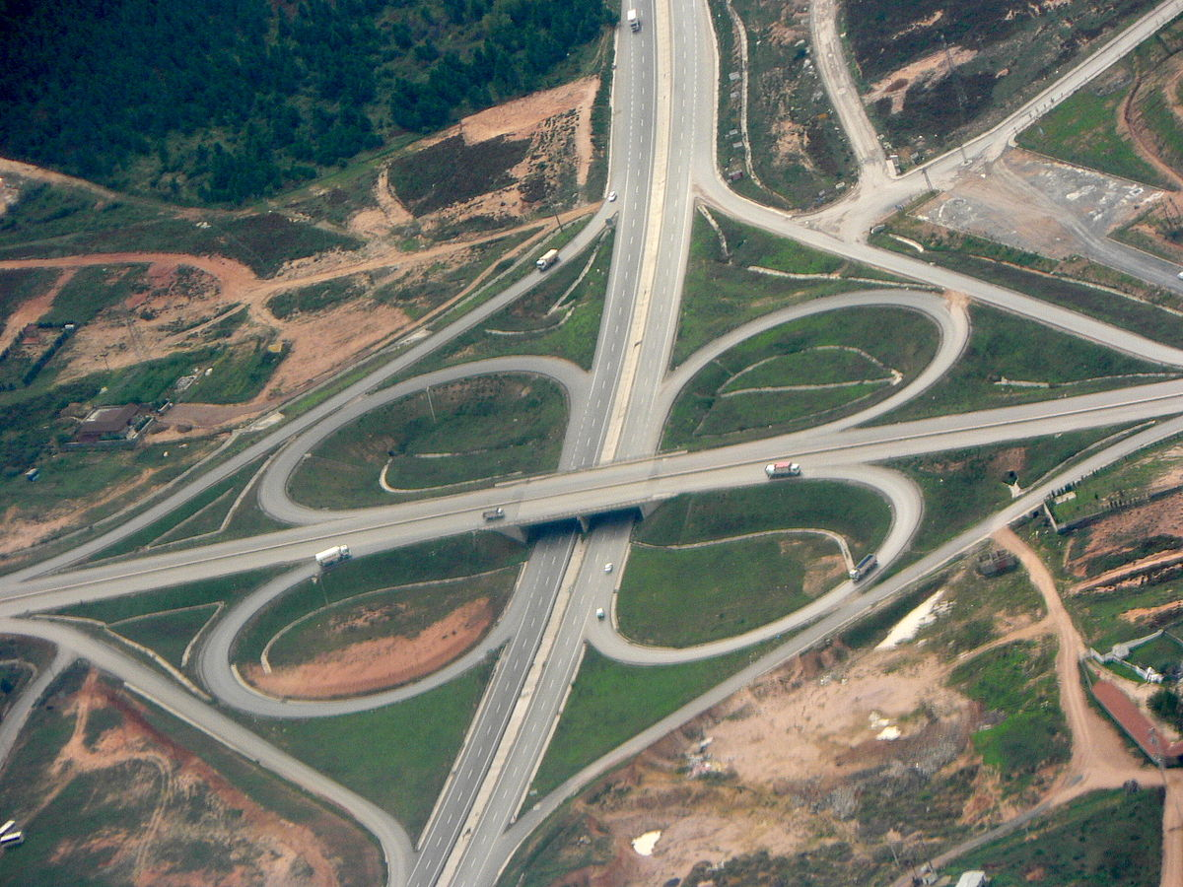
Interchanges & Feeder road
An interchange were designed to allow cars to move from one freeway/highway/interstate to another without having to get off or stop. For example when traveling north on I-45 and want to get on I-10 west you simply use the I-45/I-10 interchange.
There are several types of interchange. The most common is Diamond and Cloverleaf interchanges.
Feeder Road: Runs parallel to the freeway/interstate. Its purpose is to feed traffic on and off the freeway. Sometimes referred to as Frontage Road.
Acceleration lanes allow cars to enter a freeway, and exit lanes allow cars to exit the freeway onto the feeder road.
While on the freeway if you are constantly being passed on the right you should change lanes to the right.

Slide 39
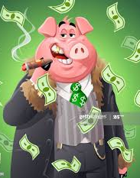
No Show Policy at All Ages Driving School
When you are scheduled for a drive time it is recommended to show up at least 5 minutes prior to your scheduled drive time.
Canceling Drive Time: You must give no less then 24 hour notice when canceling a drive time.
If you fail to report or fail to cancel with at least 24 hour notice you will incur a $35 no-show fee.
If you owe a balance such as a no-show fee you will not be able to schedule a drive time until the fee/balance is clear
If you show up to your drive time without your drivers permit, it will be considered a no-show because it is illegal to drive without a license on your person.

Slide 40
Wolf Pack
A wolf pack is a group of vehicles (6-9) in close proximity on the road.

Slide 41
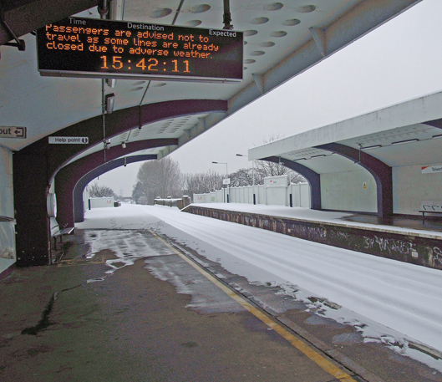
Adverse Conditions
Adverse Conditions effect vision and traction. We usually don’t have much control over adverse conditions, and many are acts of God.
1. Rain (affects traction, wet roads and vision, use low beam headlights)
2. Snow (affects traction, icy roads and vision, use low beam headlights and tire chains to improve traction)
3. Fog (affects vision, use low beam headlights, if fog is to heavy get off roadway)
4. Smoke (usually caused by fire and or pollution, affects vision)
5.Glare (Driving with sun in your eyes or high beam headlights from another car, affects vision)
6. Night (When the sun goes down visibility is reduced, reduce speed)
7. Water on Road: Affects traction. Avoid Hydroplaning by driving in the tracks of the car in front of you. Check your breaks by pumping them after going through deep water. If water is too deep turn around don’t drown. If car is sinking, escape through the window or door.
Best way to address adverse condition is to SLOW DOWN! Use 6 second Rule!
Test Tip: Ruff areas built in roadway to warn drivers of imminent danger are called….”Rumble Strips”
When making long road trips stop every 100 miles or every 2 hours. Stretch your legs ☺
This Photo by Unknown Author is licensed under CC BY-SA

Slide 42
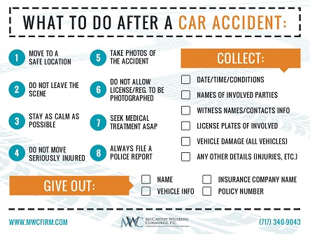
When involved in an Accident
If anyone is hurt Call 9-1-1. If no one is injured and damage is less $1,000 no crash report is required
If hitting a parked car: Attempt to find the owner, if the owner can’t be found leave a visible note giving contact information and brief explanation of what happened.

Slide 43
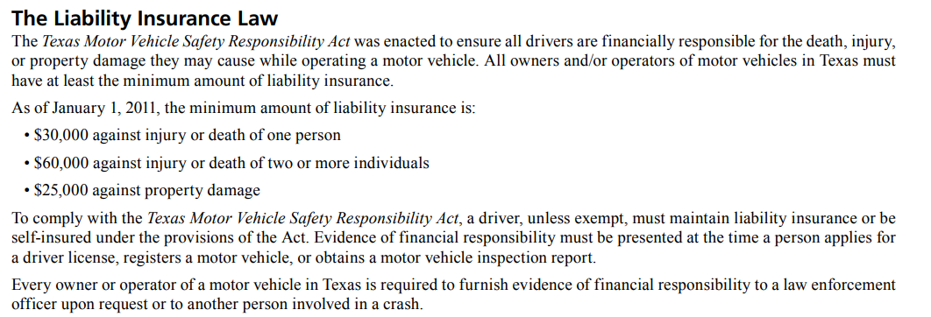
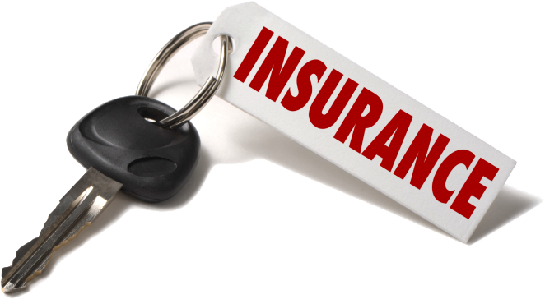
Insurance Liability Texas

Slide 44
Defensive Driving

Slide 45
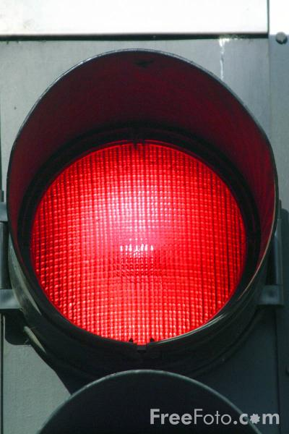
Right Turn on Red

Slide 46
What Now?
What happens after I finish Phase 1? You start Phase 2 where you begin your 7 drive times.
How do I schedule a Drive Time? We encourage you to call your local All Ages Driving School to Schedule a drive time that best fits your schedule.
What if I don’t have my permit yet? You can not start Phase 2 without a permit. When you get your permit you will need to bring it to your All Ages Location so we can make a copy and begin scheduling drive times.
How long will Phase 2 take? Each Drive Time lesson we encourage students to practice between each lesson. If you lack progress you may need additional practice that can be provided by the school (for a fee) or by your parents. You have six months from the date of the first class of Phase 1 to finish the entire Drive Education Course (Phase 1 & 2), if you fail to finish within that time frame you may have to apply for an extension (fee) or start the program over(Full Price). Avoid this situation by making sure you get your permit ASAP, make up any Phase 1 classes you may have missed, practice your driving skills between lessons and make sure you call to schedule your Drive Times.

Slide 47
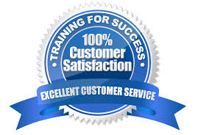
If you have any questions, please use the following contacts
Mr. James (Distant Learning and Pasadena Instructor): mrjamesdriversed@gmail.com
Mr. Asif (Owner and operator of All Ages Driving Schools) ajh0786@yahoo.com
Or contact any of our Driving School Locations:
Katy: (281) 665-7662
Kirkwood: (832) 327-7233
Sugarland: (281) 232-7787
Pasadena: (713) 947-7322
Cypress: (281) 859-3100

