Slide 1
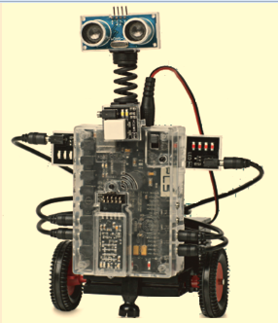
Intro to Robotics Week 4 - Today’s Activities
Learn about procedures, calls, and new commands – REPEAT, LOOP, IF, IF ELSE, AND SENSOR
Build a robot
Write a program (if you have not done so previously)
Program A robot (if you have written and executed a program previously)

Slide 2
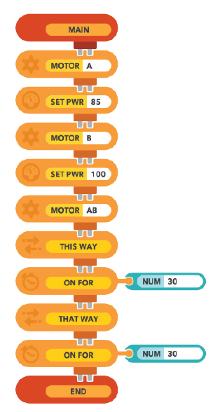
Example program
Last week in review….
What does “set pwr” mean?
What does this “way way mean?
Who can tell me what this program does?
If you have not written and executed a program, try writing this one
Journal questions
What did the robot do?
How would you make the robot go straight?

Slide 3
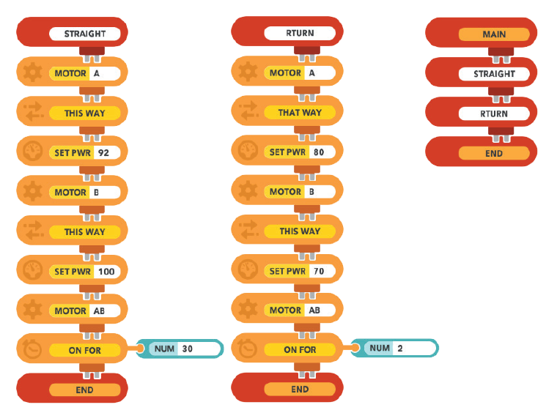
Procedures and calls
A name you give the procedure
How you “call” the procedure
What will the robot do?
Journal your answer.

Slide 4
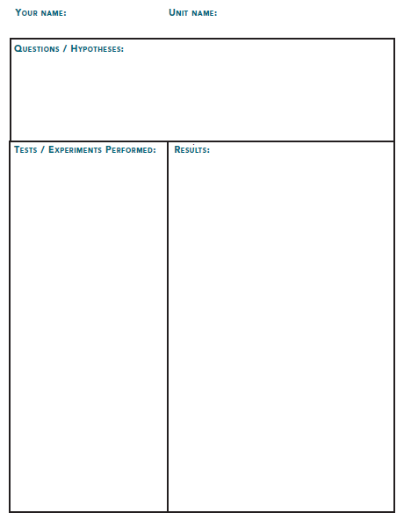
Journaling
How do PROCEDURES and CALLS work?
How do REPEAT and LOOP commands work?
How do IF, IF ELSE, and SENSOR COMANDS work?

Slide 5
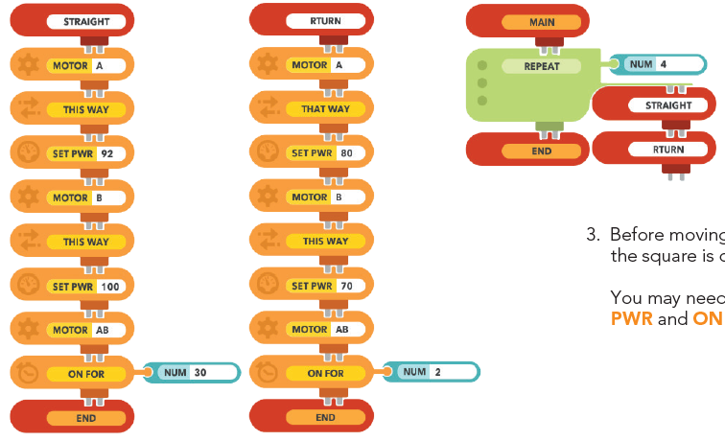
REPEAT command
Procedures
What does this program do?

Slide 6
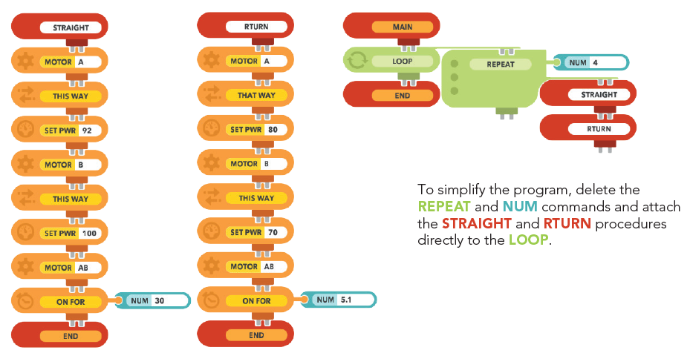
LOOP command
LOOPs repeat the attached code infinitely until a BREAK command is reached or the user stops the program.

Slide 7
If, If ELSE, and Sensor commands
These commands allow the robot to act based on a sensor
If
If the SENSOR is a touch sensor,
What do you think this program will do?
Journal your answer.

Slide 8
Today’s learning points
Procedures and calls allow you to use the same code over and over again in a program without retyping it saving you a lot of effort
The REPEAT and LOOP commands allow you execute the same code many times up to forever
The IF, IF ELSE and SENSOR commands allow you to take action on a sensor input such as changing direction it touching or getting close to something.

