Slide 1
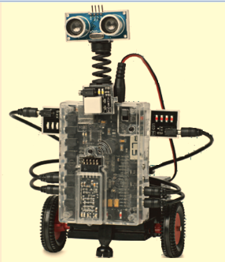
Intro to Robotics Week 5
Sensors and Sensor Commands

Slide 2
Last week’s learning points
Procedures and calls allow you to use the same code over and over again in a program without retyping it saving you a lot of effort
The REPEAT and LOOP commands allow you execute the same code many times up to forever
The IF and IF ELSE allow you to take action on a sensor input such as changing direction.

Slide 3
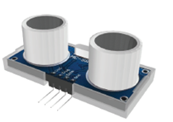
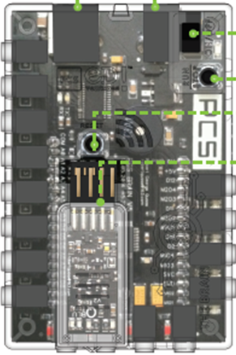
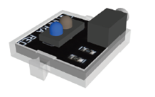
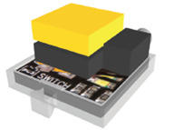
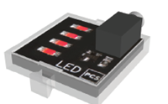
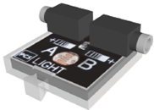
Sensors & LEDs
Ultrasonic – for “seeing” distance
Infrared – looks for reflected IR – can be used to follow a line
Touch sensor
LEDs – this is an output
Light sensor - looks for light and can make robot move towards or away from light

Slide 4
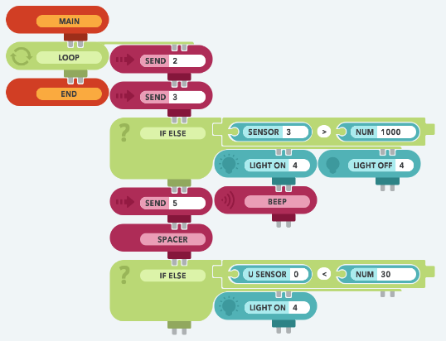
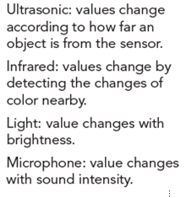
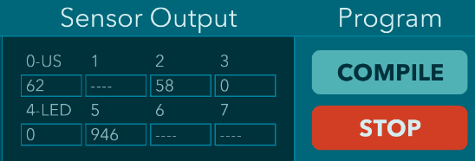
Reading sensor values
Based on the electrical connections on the previous slide…
Infrared reflection, port 2, 0-1024 (most reflection, i.e. white surface)
Touch switch, port 3, ~0 or ~1024
Ultrasonic
0-200 (farthest)
Light sensor, port 5, 0-1024 (most light)

Slide 5
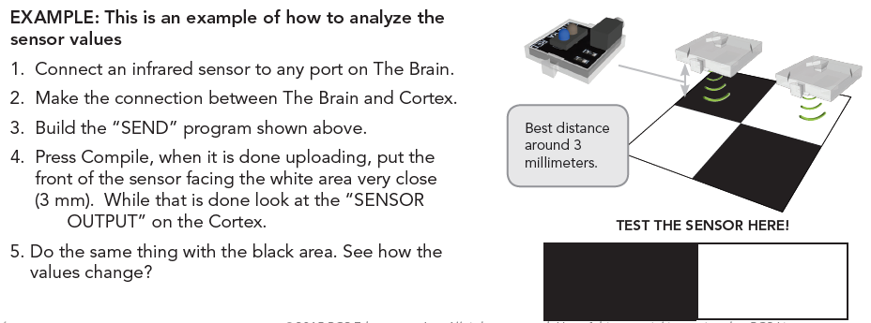
How to analyze sensor values
Example of how to analyze infrared sensor values….

Slide 6
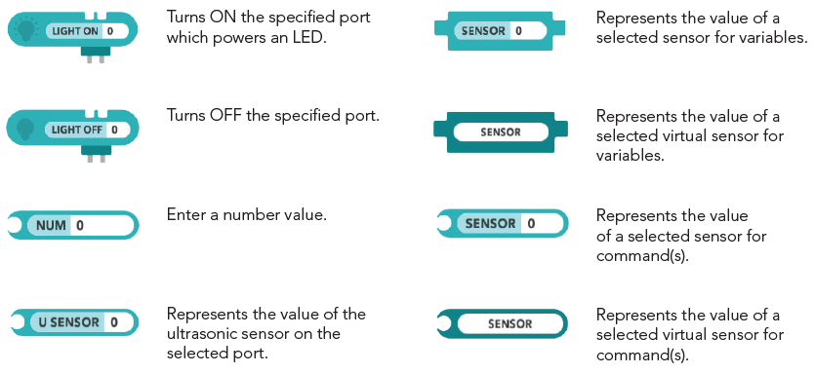
Sensor Commands

Slide 7
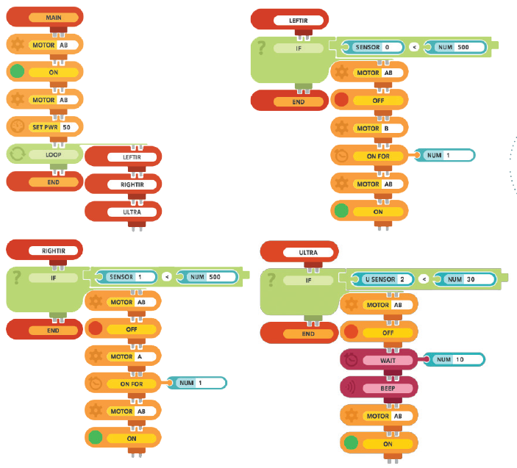
Program to follow a line and stop if something gets in the way Uses two Infrared Sensors and the Ultrasonic Sensor

Slide 8
Today’s and next week’s Program Challenge
Write and execute a program that runs a robot around the path shown at least 4 times in 3 minutes or less.
Bonus points if robot stops if an obstacle is put in its path and robot restarts if object is removed
Contest will be held beginning 30 minutes into your next week’s class
Today – Develop and write on journal forms your overall strategy to win the challenge assumptions, questions and tests you need to perform to ensure your strategy & program works
Winning group(s) gets choice of snacks
4’
3’
4’
3’
Start – finish line
What can be done with proper planning and teamwork:
The two hour house
Pharmadule
Pharmadule project pics

Slide 9
Program Challenge Scoring
Today’s strategy and journaling session worth up to 30 points. Elements judged include:
Approach to programing and team organization (up to 15 points if written clearly and program should work)
List of people on the team and their roles and responsibilities (5 points)
Things you need to test to ensure success and how you will test them (10 points)
Write a program that runs a robot around the path shown at least 4 times in 3 minutes or less. Total possible: 60 points
-15 points for each lap less than 4
-2 point each time the robot completely crosses either the inside or side boundary marked with blue painter’s tape
- 1 point for each 10 seconds longer than 3 minutes
Bonus points - Robot stops if an obstacle is put into its path and restarts if object is removed –20 points
4’
3’
4’
3’
Start – finish line

Slide 10
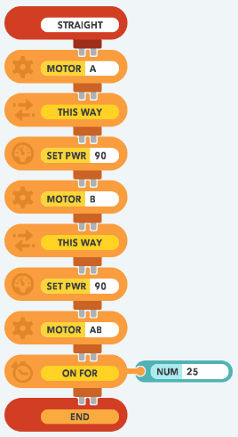
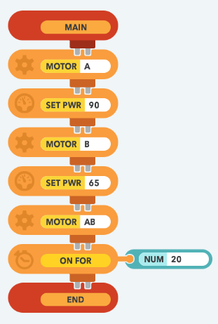
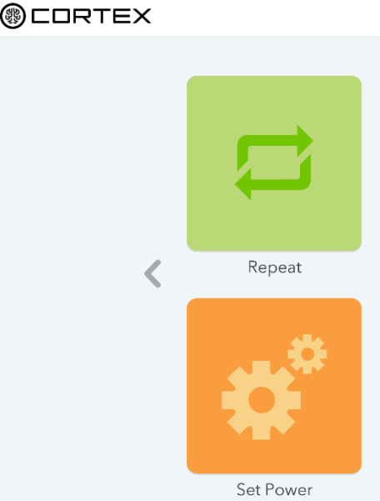
Program to run robot in a straight line
Your new RunStraight program
Choose “Set power”
program from your library
in your account
Add “this way” element and
save as “RunStraight”
How do you adjust how far the robot goes?
How to you adjust if robot veers right or left?

Slide 11
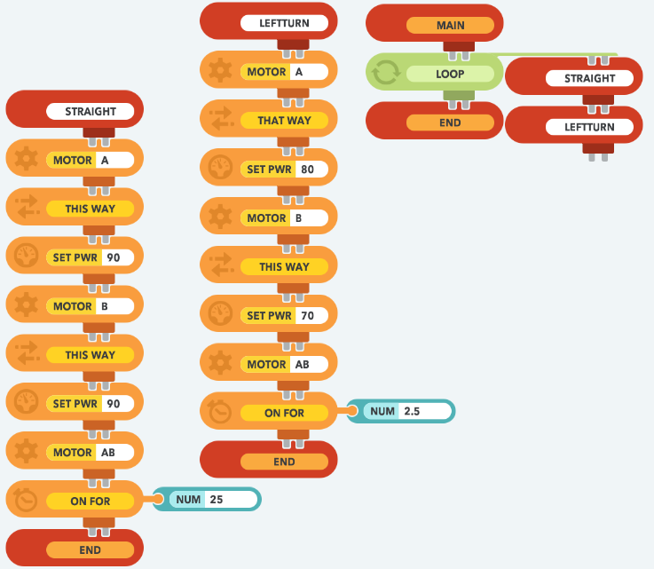
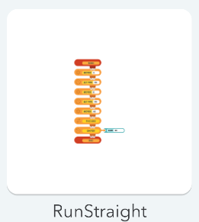
Program to run robot in a polygon route many times
Save as your new “RunPolygon” program
Choose your “RunStraight”
program from your library
in your account
How do you change the size of the polygon?
How do you change the type of polygon?
Disconnect “main” block and add “procedure” block ther modifications and then add RightTurn procedure and rest of program & save as “RunPolygon”

Slide 12
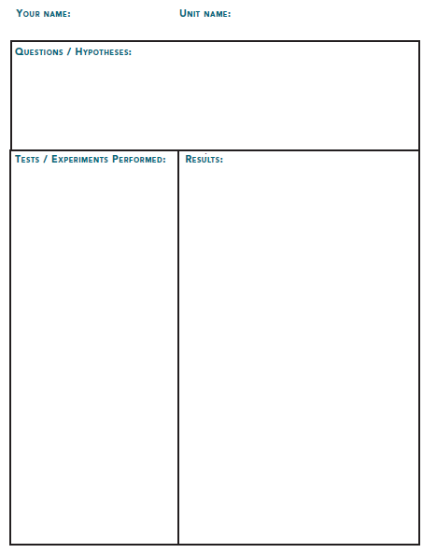
Strategy Statement & Journaling
Strategy to win
Approach to programing (e.g. How will you program to meet the criteria?)
How will you organize and perform work to maximize your success?
List of people on the team and their roles and responsibilities
Considerations …..
Of the programs you have seen or written, what elements would you use in your program to win the competition?
How due you adjust if robot veers right or left?
If using Polygon program - How do you change the type of polygon to a square?
If using Polygon program - How do you change the size of the polygon to operate in the path?
Good Luck!

