Slide 1
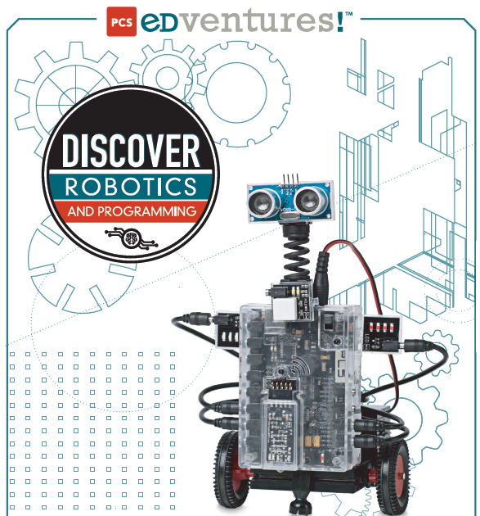
Intro to Robotics
Week 3

Slide 2
Key learning points from last week
You now know how to…
Write and save programs using Cortex software
Compile and up-load programs to the “brain”; then run them
Know several motor control commands and how to use them
11th /12th Grade - Know how to adjust for differences in motor speed using software so that both motor run the same actual speed

Slide 3
Today’s Activities
Anyone who has not used Cortex software to write, compile, and upload motor control programs needs to write a program that runs motor A for 3 seconds and then reverses motor A for 3 seconds
Any group who has not used the motor command “set power” needs to write a program to run motor A exactly 3 revolutions and then motor B exactly 3 revolutions. Is the value that was used for motor A lesser (<), greater (>) or equal (=) to the value used in motor B for the same result? Write your answer in your journal.

Slide 4
Today’s Activities
Learn to program with the “this way” and “that way” commands
Start building a robot (pages 51-64 of the student guide)

Slide 5
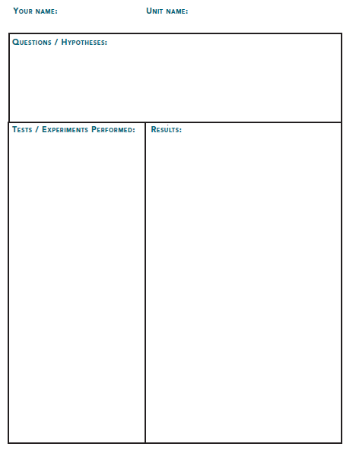
Don’t forget to Journal!
An example of a possible journal entry:
Your question might be “what number do I input to get 3 seconds of run time?”
State your assumption / hypothesis, e.g. 3 ,30, ?
Your experiment might be to enter your assumption into the program you write
What was your results?
It is an expectation of this class that you will keep a journal with daily updates

Slide 6
Project 2 – Using “this way”, “that way” and “set power” commands
Motors default to:
the direction known as “this way”
100% power. (As you found out in the last challenge, that amount of rotation might vary between motors.)
SET PWR, THIS WAY, & THAT WAY are all global commands.
This means that once you use them, they are true for the rest of the program unless otherwise stated.
All other commands are known as local commands because once they are used in a program, they are no longer true.
For example, if BEEP or WAIT are part of a program, once they perform their function (or that moment of the program has passed) they no longer play a role in that program.

Slide 7
Program using “this way” and “set pwr”

Slide 8
Program using “this way” and “that way”

Slide 9
Challenge 2
Using the motor testing station, create programs to do the following:
Program 6 - Make motors A and B simultaneously run THIS WAY for 5 seconds and then run THAT WAY for 5 seconds.
Program 7 - Make motors A and B simultaneously run in opposite directions for 5 seconds and then both switch for another 5 seconds.
Program 8 – create a program to run both motor in the same direction and experiment with the SET PWR command on motors A and B. Adjust the percentage of power until both motors to run at the same speed.
Be sure to Journal what you found out!

Slide 10
Key learning points from today
You now know how to…
use the power command to change motor speed
adjust for differences in motor speed using software so that both motor run the same actual speed
use the “this way” and “that way” commands

Slide 11
Back-up slides

Slide 12
Key learning points from week 1
STEM careers can lead to high paying jobs
Lots of students are enjoying building robots and competing
Journaling and Peer Assisted Reflection is a normal STEM expectation and is required for this class
The Robot’s “Brain” is a computer that has inputs to collect sensor information (like how close it is to an obstacle) and outputs to drive things like motors
Programing can be very simple using graphical images linked together in a sequence to make an robot behave in a certain way
Programs are developed and compiled on a laptop or tablet and uploaded to the “brain” via Bluetooth
DC motors can go forward or reverse based on polarity and they can speed up or down based on voltage
Servo motors are used for things like arm movements.

