Slide 1
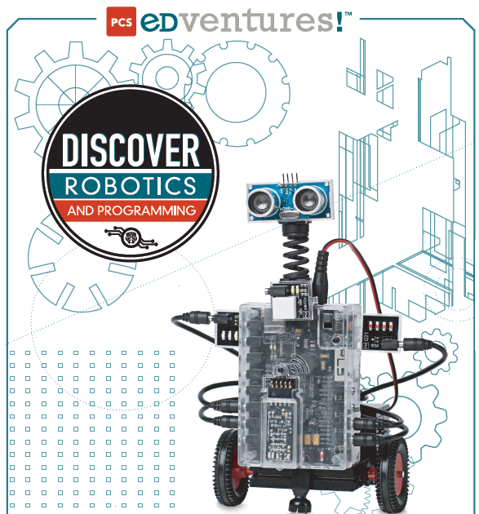
Intro to Robotics
Week 2

Slide 2
Key learning points from last week
STEM careers can lead to high paying jobs
Lots of students are enjoying building robots and competing
Journaling and Peer Assisted Reflection is a normal STEM expectation and is required for this class
The Robot’s “Brain” is a computer that has inputs to collect sensor information (like how close it is to an obstacle) and outputs to drive things like motors
Programing can be very simple using graphical images linked together in a sequence to make an robot behave in a certain way
Programs are developed and compiled on a laptop or tablet and uploaded to the “brain” via Bluetooth
DC motors can go forward or reverse based on polarity and they can speed up or down based on voltage
Servo motors are used for things like arm movements.

Slide 3

Today’s Activities
Build a motor control station
Use Cortex software to write, compile, and upload motor control programs
Programs to be written and executed by each group include:
  Running motor A for 3 second
  Running motor A for 3 seconds and then reverse motor A for 3 seconds
  Run motors A & B for 3 seconds
  Run motor A for 3 seconds and then motor B for 3 seconds
You will write and execute other programs (Challenges 1 & 2) as time permits. For the challenges, you will build on the programs above, but you will not have an example to copy…you will have to figure out the changes required!

Slide 4
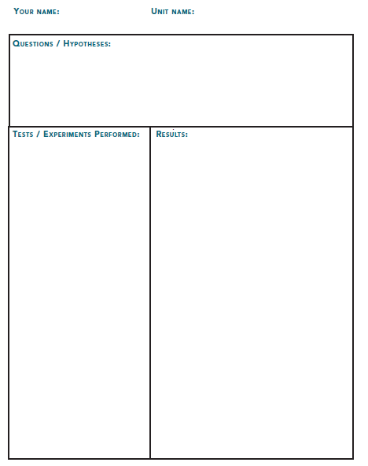
Don’t forget to Journal!
An example of a possible journal entry:
  Your question might be “what number do I input to get 3 seconds of run time?”
  State your assumption / hypothesis, e.g. 3 ,30, ?
  Your experiment might be to enter your assumption into the program you write
  What was your results?
It is an expectation of this class that you will keep a journal with daily updates

Slide 5
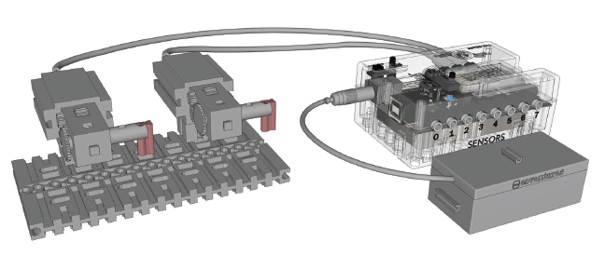
Motor Control Station Construction
Build station using instructions found on pages 32- 39 of the Brain and Cortex handout.
When it is complete, it should look like:

Slide 6
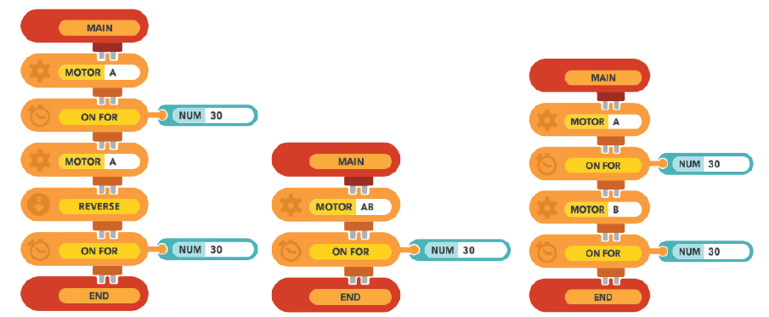
Programming
Each group will create a folder for programs with their user name.
Each person will create and upload to the motor control station a program below and run their program
Programs are on page 42 of your handout and include:
Program 1
Program 2
Program 3

Slide 7
Challenge 1
Using the motor testing station, create programs to do the following:
Modify your program 3 to make motor A run for 10 seconds and motor B run for 5 seconds. Save as program 4.
Modify program 1 to make motor B run for 5 seconds and then reverse for 8 seconds. Save as program 5
Modify program 5 to make motors A and B run simultaneously for 5 seconds and then reverse simultaneously for 5 seconds.
Using program 2, adjust the value of NUM such that the flag attached to motor A spins around exactly 3 times and stops from where it started. Write your number in your journal.
Try the same challenge for motor B. Write your number in your journal. Is the value that was used for motor A lesser (<), greater (>) or equal (=) to the value used in motor B for the same result? Write your answer in your journal.

Slide 8
Project 2 – Using “this way”, “that way” and “set power” commands
Motors default to:
  the direction known as “this way”
  100% power. (As you found out in the last challenge, that amount of rotation might vary between motors.)
SET PWR, THIS WAY, & THAT WAY are all global commands.
  This means that once you use them, they are true for the rest of the program unless otherwise stated.
All other commands are known as local commands because once they are used in a program, they are no longer true.
  For example, if BEEP or WAIT are part of a program, once they perform their function (or that moment of the program has passed) they no longer play a role in that program.

Slide 9
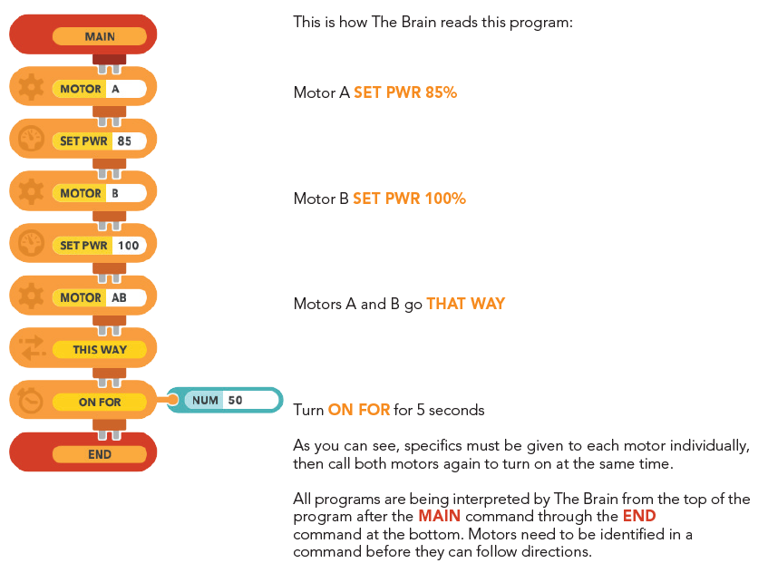
Program using “this way” and “set pwr”

Slide 10
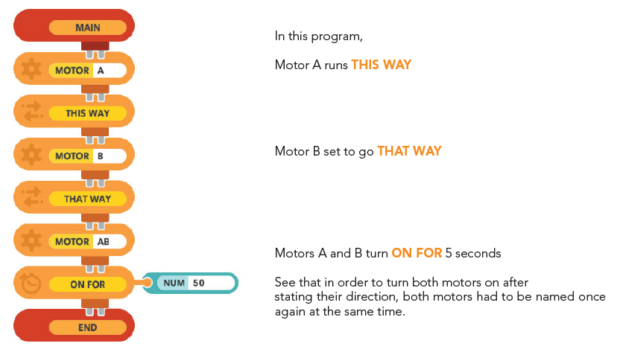
Program using “this way” and “that way”

Slide 11
Challenge 2
Using the motor testing station, create programs to do the following:
  Program 6 - Make motors A and B simultaneously run THIS WAY for 5 seconds and then run THAT WAY for 5 seconds.
  Program 7 - Make motors A and B simultaneously run in opposite directions for 5 seconds and then both switch for another 5 seconds.
  Program 8 – create a program to run both motor in the same direction and experiment with the SET PWR command on motors A and B. Adjust the percentage of power until both motors to run at the same speed.
  Be sure to Journal what you found out!

Slide 12

Key learning points from today
You now know how to…
  Write and save programs using Cortex software
  Compile and up-load programs to the “brain”; then run them
  Know a number of motor control commands and how to use them
  Know how to adjust for differences in motor speed using software so that both motor run the same actual speed

