Slide 1
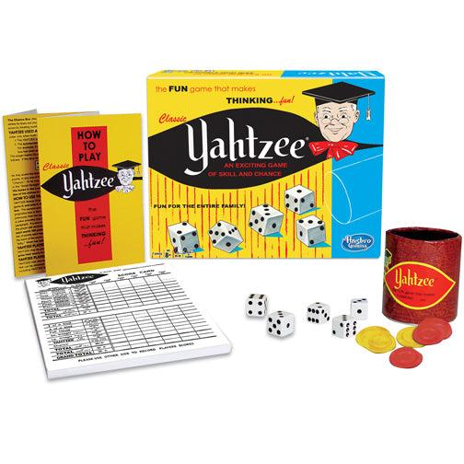
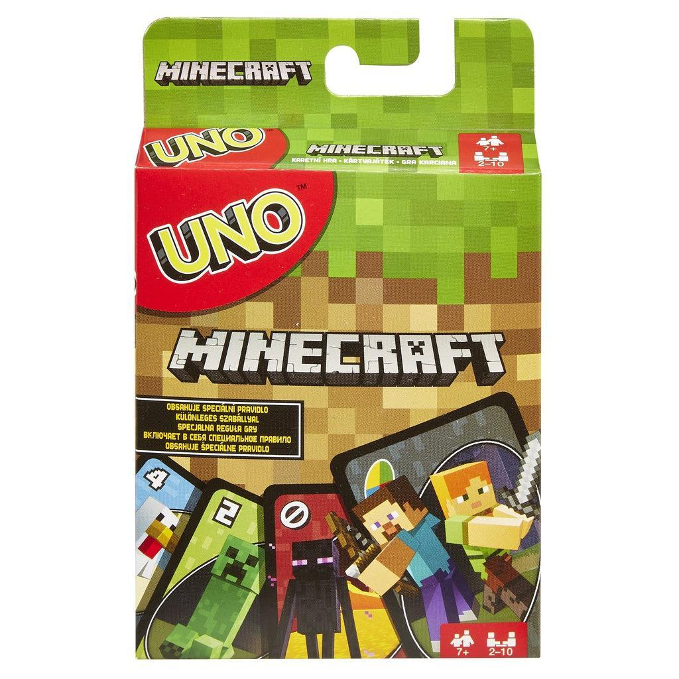
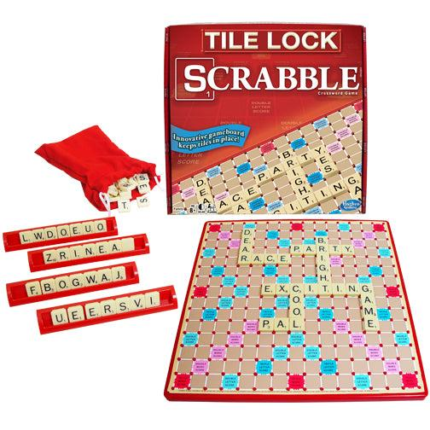
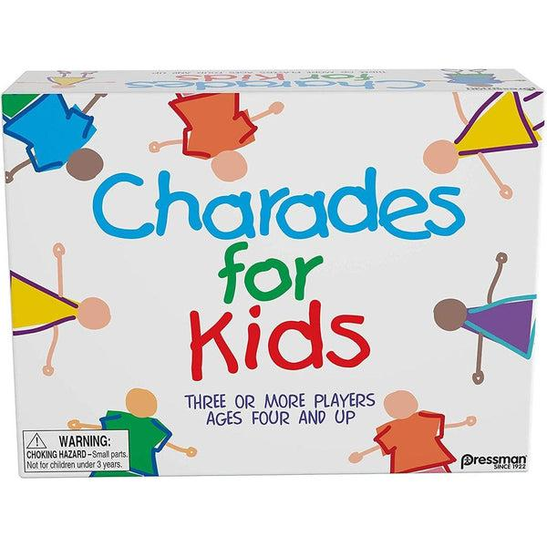
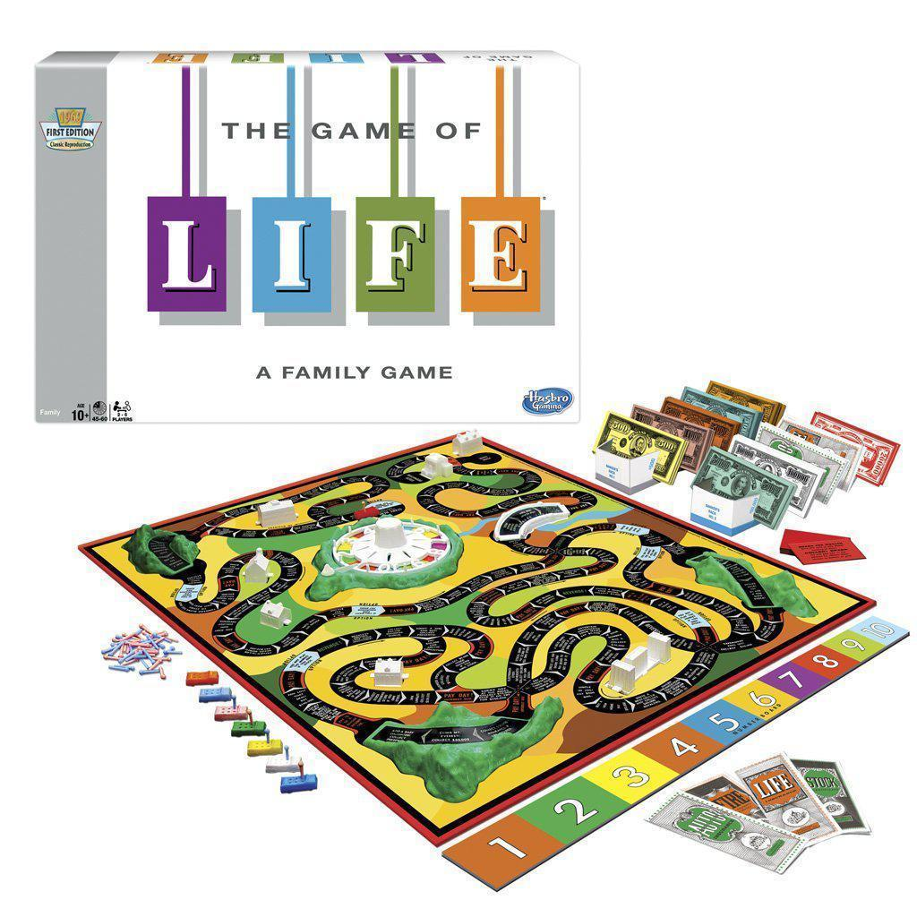
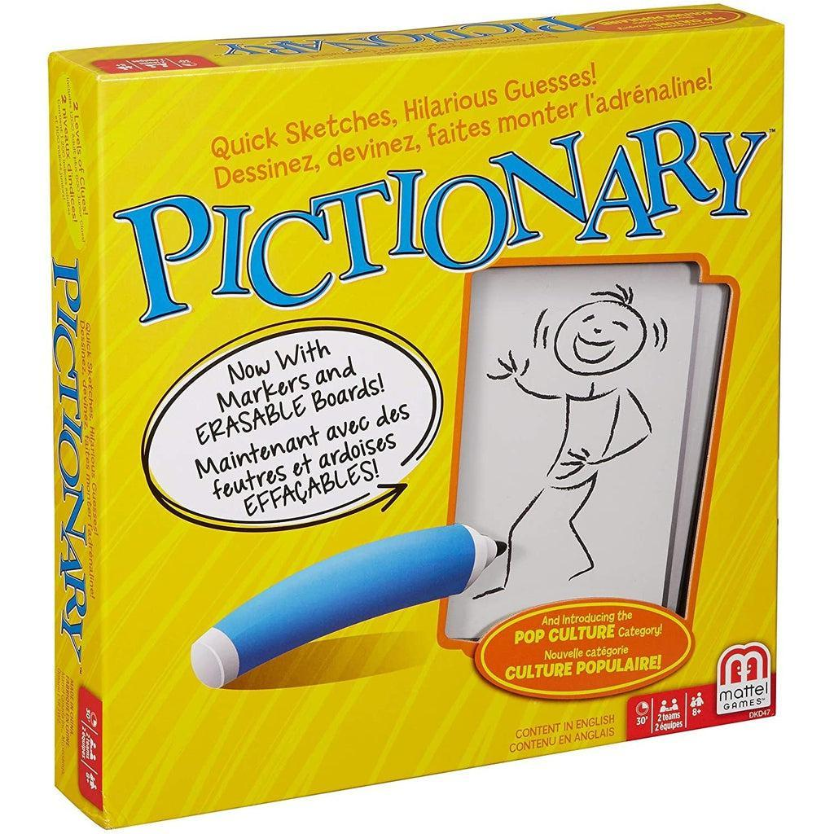
DATE
Dear Parents/Guardians,
It is time to celebrate! We will be having our class party on DATE at TIME, and need a little help to make this the best celebration ever!
During our class party, students will get the opportunity to rotate and play board games with friends, socialize and enjoy a snack in the classroom. This is a great time for our class to learn how to play a new game, or get to enjoy the fun of a familiar classic, all in all, it is an amazing way to have some low tech fun with friends!
If you are able to help by sending in an item, please visit insert link here to sign up to bring one of the following:
Board Game
  Be sure to write First and Last Name on the game box
  Double check that all pieces are in the game box.
  The game should be able to have between two and four players.
Drinks
  Individually packaged
  NO soda/cans
Sweet Snack
  Store bought
  Individually packaged
  Nut free
Salty Snack
  Store bought
  Individually packaged
  Nut free
Paper Plates
Napkins
Thank you so much for your help and support in making our class party a success! Please have students bring in games and snacks by DATE.
If you have any questions, please don’t hesitate to reach out, thank you again!
Teacher Name
Email Address
Phone Number

Slide 2

Class Party Schedule
8:30-8:50 | Independent Activity
8:50-9:00 | Class Meeting/Prep for Rotations
9:00-9:20 | Rotation 1
9:20-9:40 | Rotation 2
9:40-10:00 | Rotation 3
10:00 | Snack Time!
10:20-10:40 | Rotation 4
10:40-11:00 | Rotation 5
@teachingintherealworld.com

