Slide 1
THE FORENSIC PSYCHOLOGY CLUB:
FIRST GBM

Slide 2
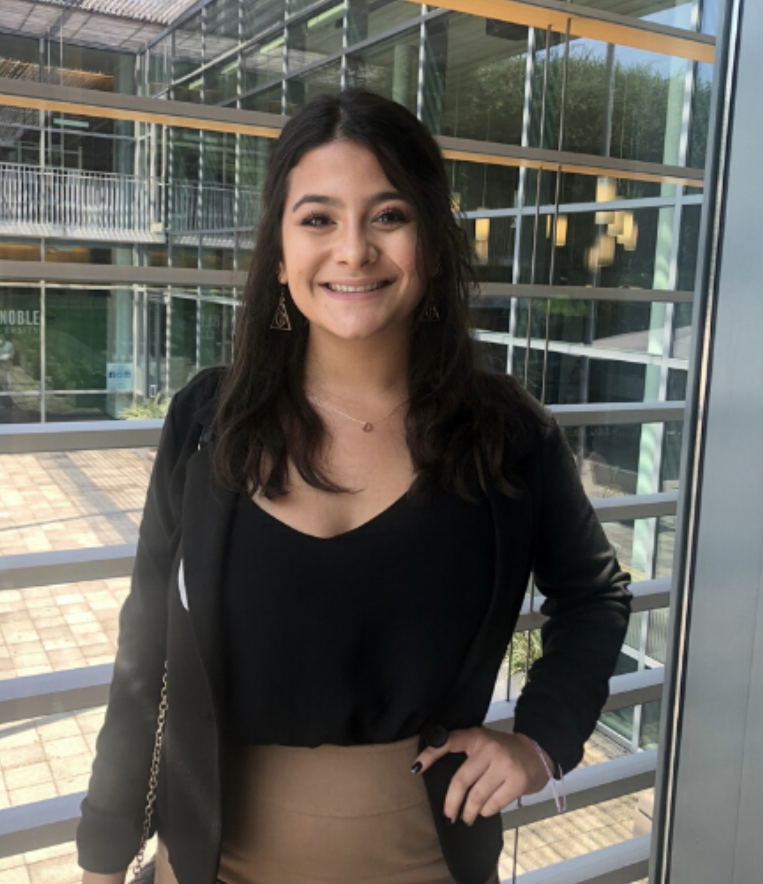
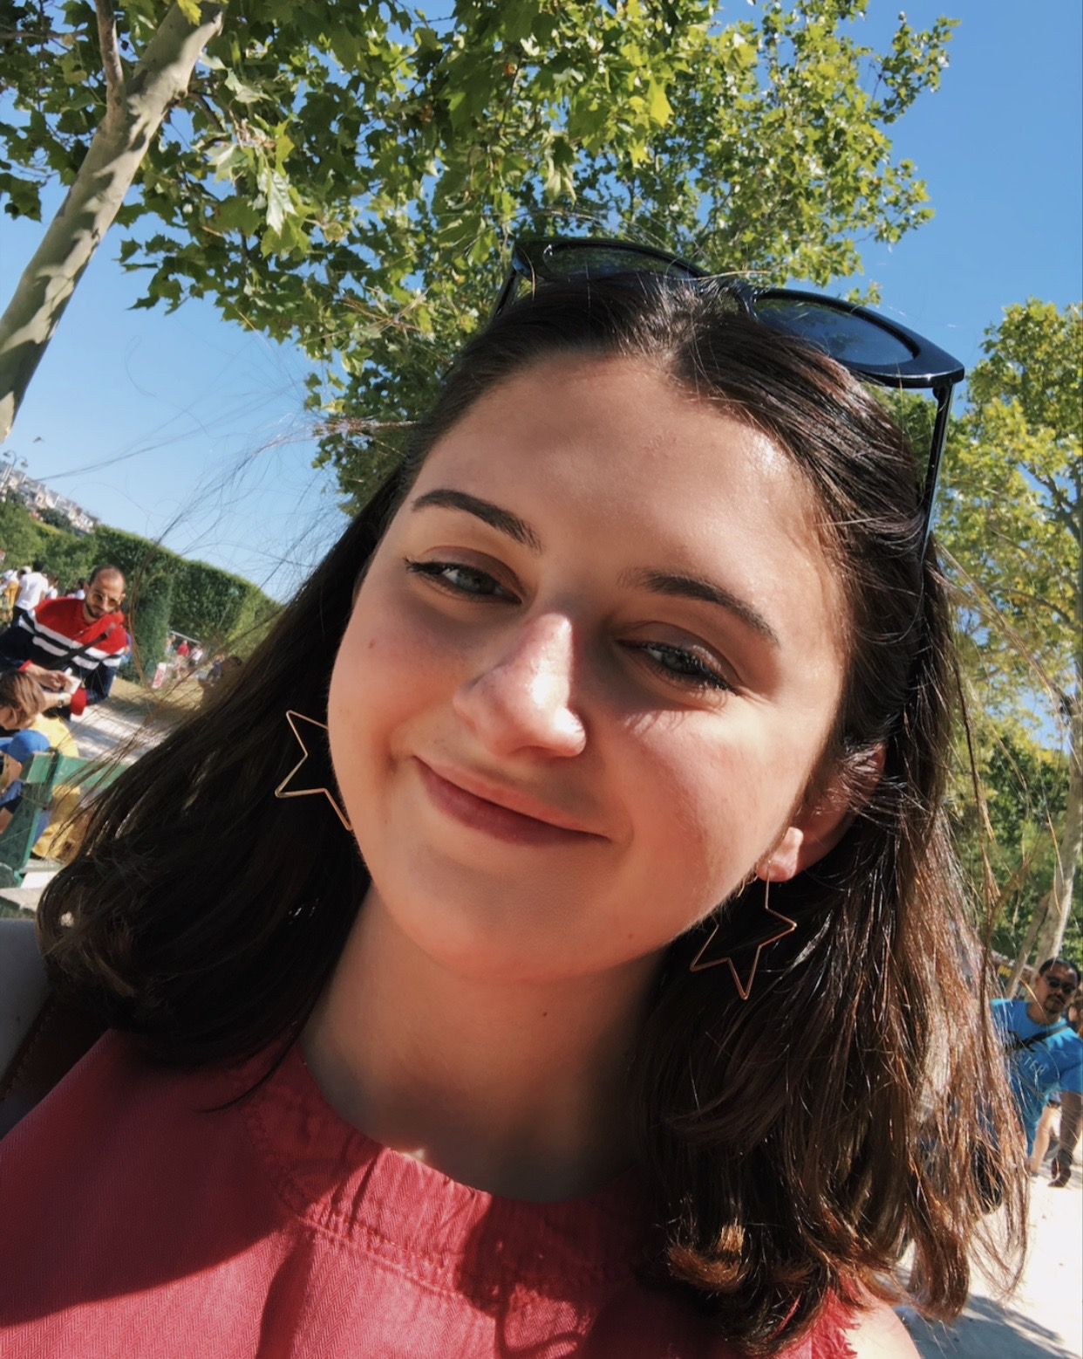
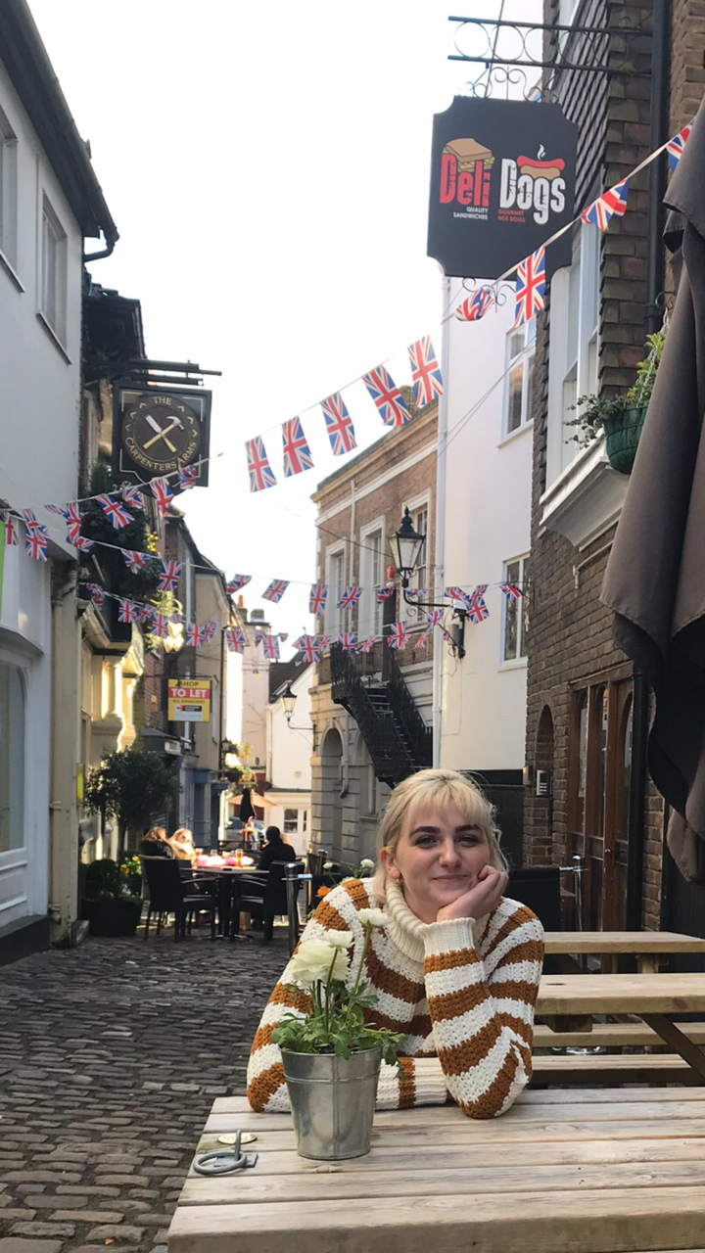
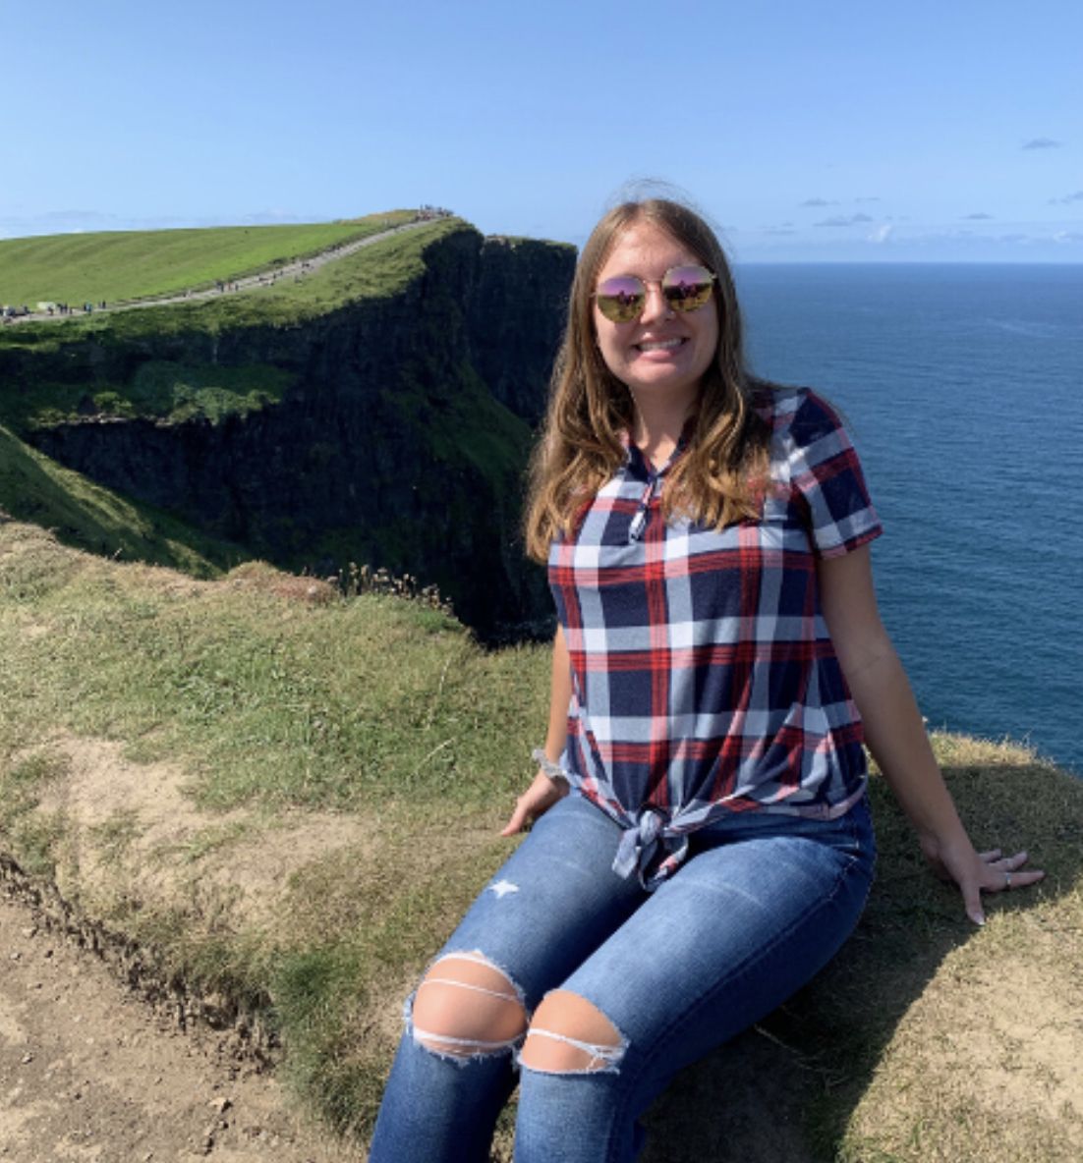
Meet your E-Board Members!
Vanessa Gomez….. President
Casey Brucato….. Vice President
Kayla Woodhouse….. Treasurer
Faith Hunt….. Secretary

Slide 3
What is Forensic Psychology?
APA definition: Application of clinical (psychological specialities) to the legal arena
In other words, applying your psychological knowledge to legal issues
The term “forensic” refers to anything pertaining or potentially pertaining to law, both civil and criminal
Forensic scientists participate in the investigation of major crimes
Not necessarily only violent crimes!

Slide 4
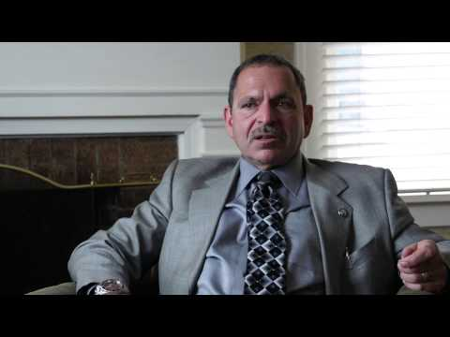
If you were a forensic psychologist...

Slide 5
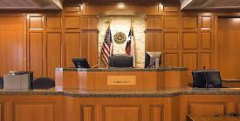
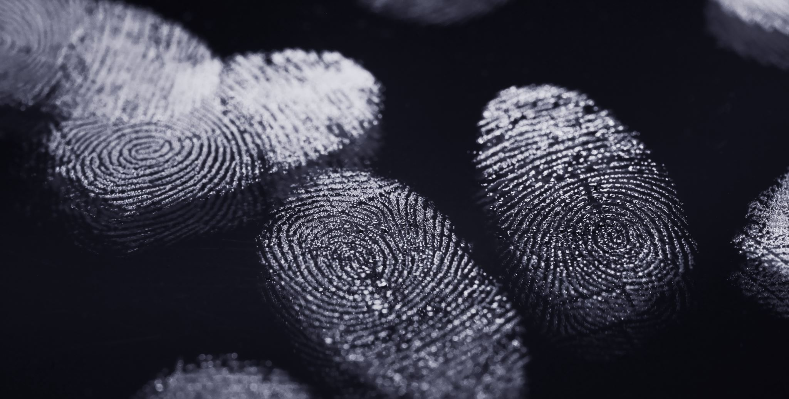
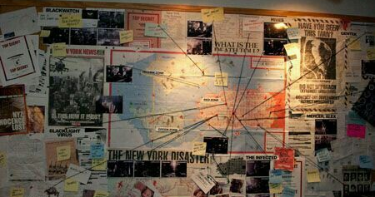
Common Misconceptions of Forensic Psychology
The key component to Forensic Psychology is criminal profiling
Criminal profiling is an indirect assessment of an unknown subject, while forensic psychology directly assesses offenders, witnesses, and victims
Forensic Psychology is the same as Forensic Science
A career in Forensic Psychology Requires a Law Degree
You need a Forensic Psychology degree to be a Forensic Psychologist
Notes:
Criminal profiling- indirect assessment of unknown subject (M.O., victimology, examination of BX, crime scene etc.) to connect BX to crime
Forensic psychology- Directly assess offender, witness, or victim, in order to determine their reliability in a court setting. Determine state of mind at the time of the crime, and current mental status.

Slide 6
What qualities should a Forensic Psychologist possess?
Abilities | Knowledge | Skills | Work Values
Oral Comprehension | Psychology | Active Listening | Achievement
Written Comprehension | Therapy and Counseling | Critical Thinking | Independence
Deductive Reasoning | English Language | Social Perceptiveness | Relationships
Problem Sensitivity | Customer and Personal Services | Complex Problem Solving
Oral Expression | Law and Government | Speaking

Slide 7
What are the Education and Training Requirements of the
Forensic Psychologist?
Doctorate
Typically, this will be a Clinical Psychology PhD
Licensure
This varies from state to state, but most will require:
Doctorate degree
A passing grade on the Professional Practice of Psychology exam
Relt work experience
Board Certification
Notes:
Each state oversees its own licensing requirements, but most states will require a doctorate degree, passing the Examination for Professional Practice of Psychology and having a certain amount of relevant experience.

Slide 8
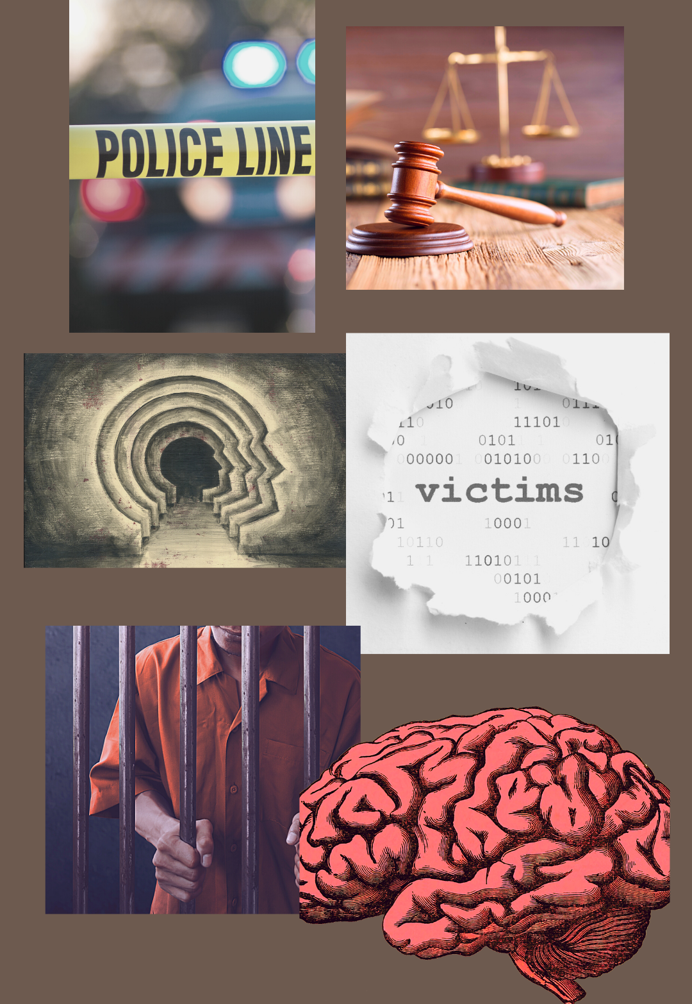
Six Specialties of Forensic Psychology
Police and Public Safety
Legal Psychology
Psychology of Crime and Delinquency
Victimology and Victim Services
Correctional Psychology
Abnormal Psychology

Slide 9
Criminal Profiling Activity!
For this activity you are a criminal profiler. Discuss factors about the killer in each case..
Gender (male or female)
Ethnicity ( African-American, Caucasian, Asian, etc.)
Age
I.Q. (how smart do you think they are?)
Type of killer (organized or disorganized?)
Personality
Relationships with women
WARNING: These involve real cases and cover sensitive material

Slide 10
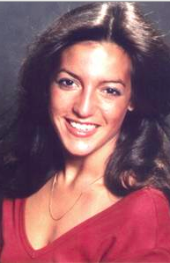
Victim: Elena Semander
She was 20 years old
She was stalked by the suspect
They followed her back to her apartment.
She was strangled her with her shirt
She was found the next morning tied up in a dumpster

Slide 11
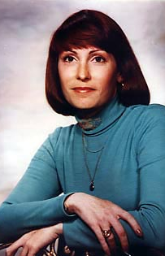
Victim: Edith “Anna” Ledet
She was 34 years old.
She was stabbed to death while walking home from a graduation party.
Her body was left in a walkway near some apartments.
She was to have graduated later that day from the University of Texas.

Slide 12
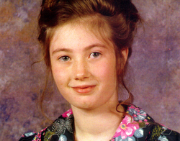
Victim: Emily LaQua
She was 14 years old.
She had just become a waitress at a diner near her house.
She was strangled on her way to work.
Her body was not found until 5 months after stuffed in a Culvert.

Slide 13
Victim: Suzanne Searles
She was 25 years old.
She was strangled and her head was held in a flowerpot full of water.
The suspect buried her.
According to the suspect she was targeted because of her “evil eyes.”

Slide 14
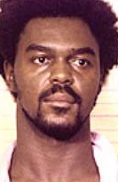
Carl “Coral” Eugene Watts
He is known as the Sunday Morning Slasher.
His span of crimes were committed from 1974 to 1982.
The age range of his victims were 14-44 years old.
He was convicted of 2 murders and sentenced to 60 years in prison.
His number of victims is estimated to exceed 80.
He died in prison from cancer in 2007 at age 53.

Slide 15
On a piece of paper…
What you hope to get out of this club
What you want to learn about related to the field?

Slide 16
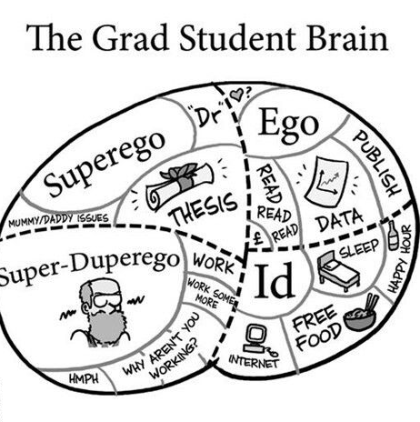
In our next meeting, we will discuss...
CV Workshop
How to Apply to Graduate School
Letters of Recommendation
How to Get Involved with Research
Conferences, D.I.S., etc.
Get excited for a few guest speakers who have a plethora of knowledge on these subjects!! BRING QUESTIONS!

Slide 17
Final Notes…
Keep an eye out for our first Newsletter!!
Summarizes what we discussed in this meeting, as well as links to relevant materials and websites
Follow us on Instagram: @fsufpc
Follow us on Twitter: @fsu_fpc
Join the Facebook Group: FSU Forensic Psychology Club
Our next meeting will be held on 9/14/2020 at 7 P.M. via Zoom! See you all there!

Slide 18
ARE THERE ANY QUESTIONS?

