Slide 1
THE FORENSIC PSYCHOLOGY CLUB:
LAST GBM OF THE SEMESTER

Slide 2
Recap and Reminders…
Remember to check out our November Newsletter!
We hope everyone had a great Thanksgiving Break ☺
This will be a short meeting, seeing as exams are coming up in a couple weeks
Today, we will introduce you to your Spring 2021 board members!

Slide 3
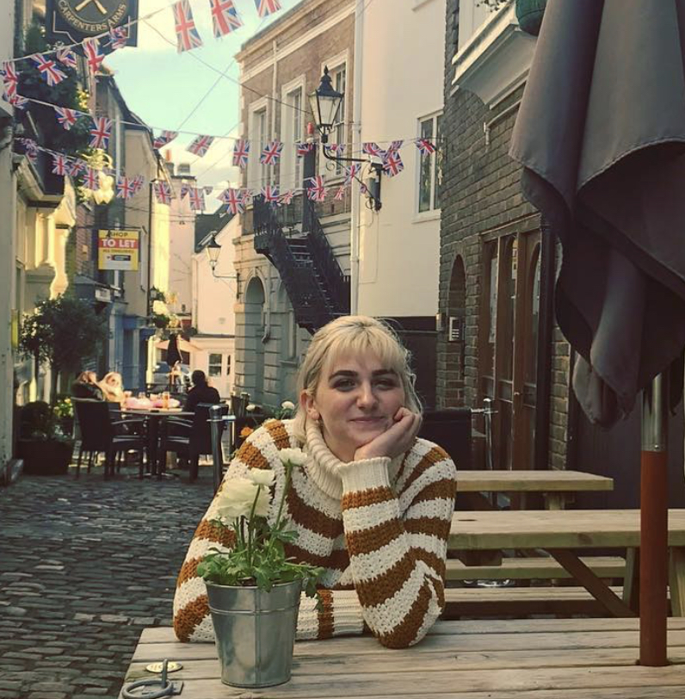
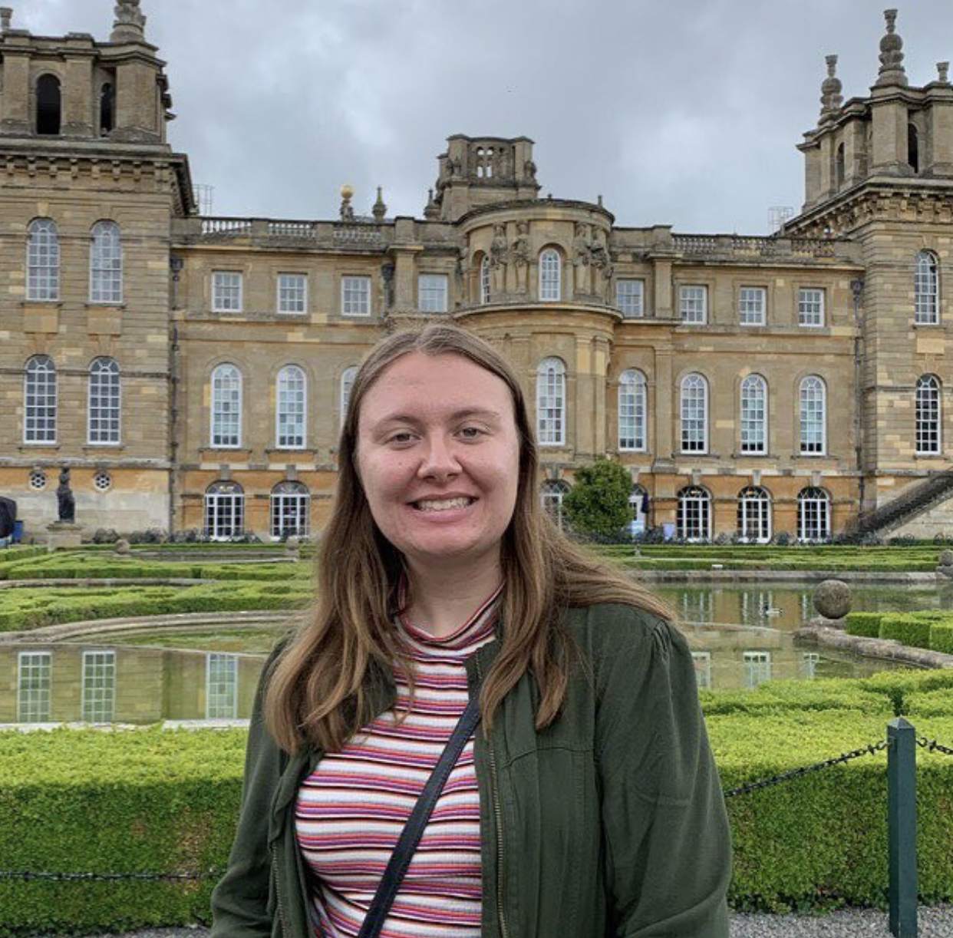
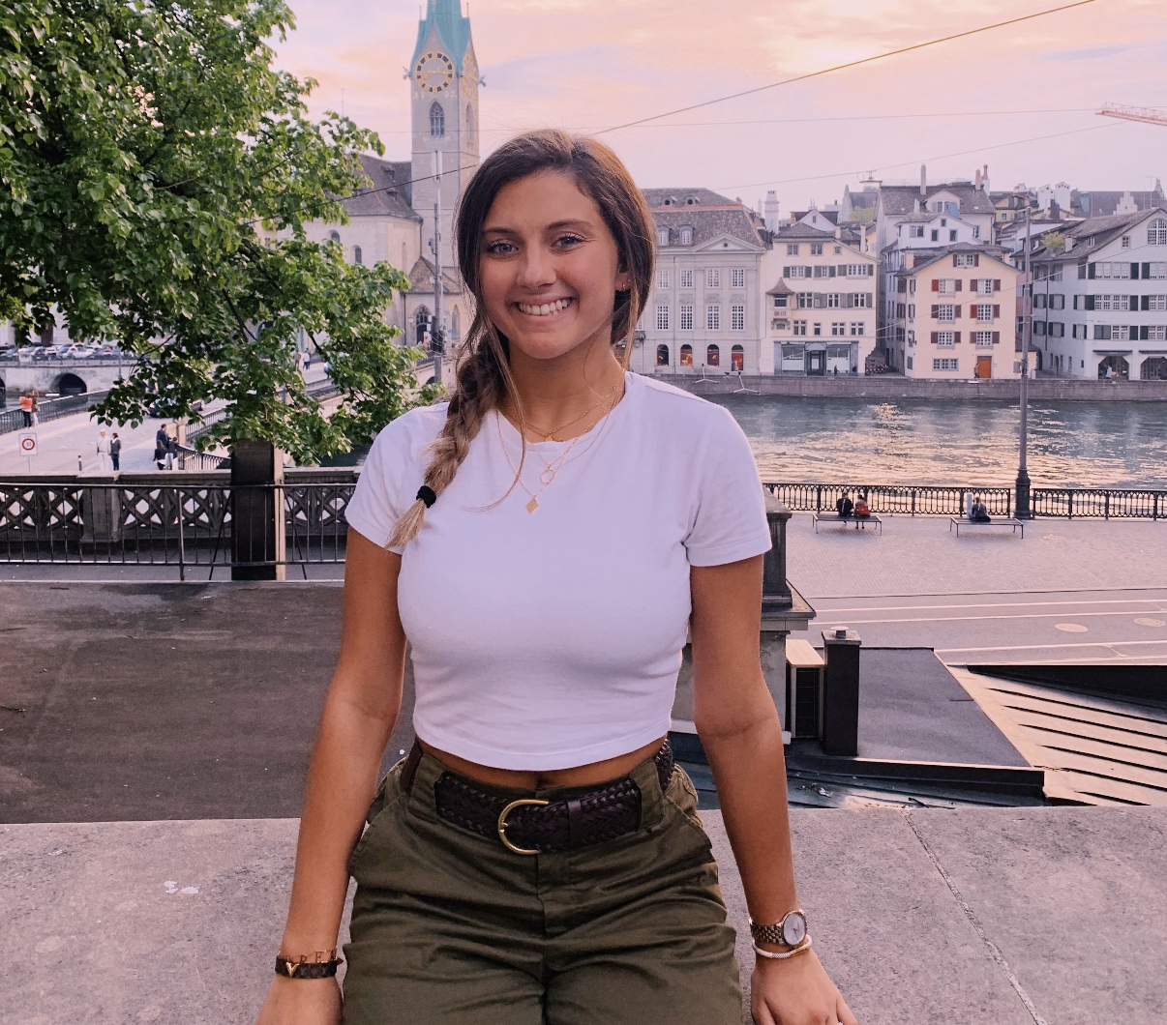
Meet the Spring 2021 Board!
President… Casey Brucato
Vice President… Faith Hunt
Treasurer… Samantha Goldman
Secretary… Kayla Woodhouse
Social Media… Victoria Borque

Slide 4
Resources
As we have seen, the field of forensic psychology is expansive, and through our meetings this semester we covered a lot of material, but there is still a lot we didn’t get to discuss!
Books:
Whoever Fights Monsters by Robert Ressler
The Psychopath Test
The Mask of Sanity
Movies/ TV Shows:
Manhunt: Unabomber
Mindhunter
Forensic Files
Podcasts:
True Crime all the Time
My Favorite Murder
Somebody

Slide 5
In the Zoom chat or out loud…
What was your favorite thing that you learned about this semester?
What do you wish you had learned more about?

Slide 6
Final Notes…
Keep an eye out for our December Newsletter!
We have loved being your board for this past semester, and we hope that you enjoyed the material discussed, as well as the activities offered
We recognize that it has been strange, holding club meetings remotely, but we appreciate all of you for your commitment to this club and the subject matter!
Have a GREAT winter break everyone! Stay safe, and the new board hopes to see you again in the Spring

Slide 7
Are there any questions?

