Slide 1
The forensic psychology club: graduate school round table

Slide 2
Options for Graduate School
Master’s Program
PsyD/ PhD Program
Not a significant time commitment
Typically, not funded → students pay out of pocket for these programs
Hands- on experience through internships and coursework
Not as intensive as a PhD or PsyD
Because of COVID- 19, a lot of schools are waiving the GRE requirement for Master’s programs (FSU included)
PsyD:
Less competitive than a PhD program
No funding → very likely you’d go into debt
Less research- focused, more practice- oriented
Less likely to be APA accredited
PhD:
Very competitive, more likely to be APA accredited
State- funded → students are typically paid to be in these programs
Research- focused
A variety of concentrations and tracks within a general program

Slide 3
How do I apply to these programs?
Every program will require a basic resume or a CV (curriculum vitale)
Writing a statement of purpose or personal statement
Usually, you will follow prompts that ask why you are interested in the program and/ or the field
Most programs will require three letters of recommendation
Reach out to past professors, principal investigators, and relevant employers
More often than not, these people will be happy to write you a letter of recommendation!
Unless otherwise specified, all programs listed require a passing GRE score
For master’s and PsyDs programs, these scores can be between 140 and 160
For a PhD program, impressive scores tend to be 160+

Slide 4
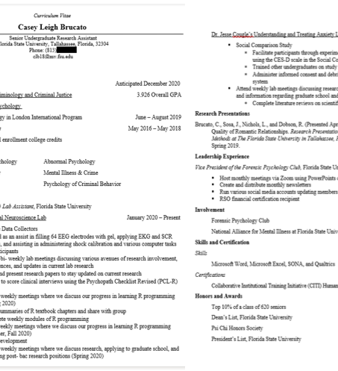
Why is a CV so important?
Whichever graduate program you apply to, a CV is typically required
Short for Curriculum Vitale
Academic, research- focused resume
Typically, at least 2 pages long
Research experience goes at the top and relevant work experience/ skills goes under that

Slide 5
What if I want to be a Forensic Psychologist?
To specifically be a forensic psychologist, you are required to go into a clinical psychology PhD program
Within clinical programs, there are concentrations and tracks
Not many schools offer forensic concentrations/ tracks, which both narrows your options and makes it easier to apply than if you just applied to a broad program
After you complete the PhD program, you are required to complete a year- long internship in your area of interest
Following this, you will take a comprehensive exam → Passing this and getting licensed certifies you as a forensic psychologist!

Slide 6
What are my other options?
Not everyone has the desire or time to commit to a six- year PhD program and the subsequent licensure, and that is completely understandable! There are a lot of things you can do within the field of forensic psychology without necessarily being a licensed forensic psychologist
With a master’s degree in criminology/ criminal justice:
Crime scene investigator, police officer, probation officer, forensic analyst
https://www.topuniversities.com/student-info/careers-advice/what-can-you-do-criminology-masters
With a master’s degree in social work:
Social worker, substance abuse counselor, juvenile justice case worker
https://www.mswguide.org/careers/criminal-justice-social-work/
With a master’s degree in forensic psychology:
Victim advocate, jail supervisor, correctional counselor, forensic social worker
https://www.thechicagoschool.edu/insight/career-development/career-options-masters-degree-forensic-psychology/

Slide 7
What about with a bachelor’s degree?
With a Bachelor’s in criminology:
Corrections officer, forensic science technician, loss prevention specialists, police officer
https://www.thebalancecareers.com/what-can-you-do-with-a-criminology-degree-974613
With a Bachelor’s in social work:
Mental health assistant, caseworker, family service worker
https://www.waldenu.edu/online-bachelors-programs/bachelor-of-social-work/resource/what-careers-can-you-enter-with-a-bsw-degree
With a Bachelor’s in psychology:
Polygraph examiner, child welfare placement worker, criminal investigator, probation/ parole officer
https://www.apa.org/ed/precollege/psn/2018/01/bachelors-degree

Slide 8
How can I get involved while I’m still an undergraduate student?
Directed Individual Study
Especially important for clinical psychology PhD candidates (look for labs that align with your interests!)
https://psy.fsu.edu/php/undergraduate/undergraduate.php?_tr=1#
Internships
http://criminology.fsu.edu/careers/
https://psy.fsu.edu/php/undergraduate/undergraduate.php?_tr=7_1
Within forensic psychology specifically:
Public Defender’s office, State Attorney’s office, law firms,
The prison system , The Innocence Project, the FBI
The Florida State Hospital Forensic Unit, rehabilitation centers

Slide 9
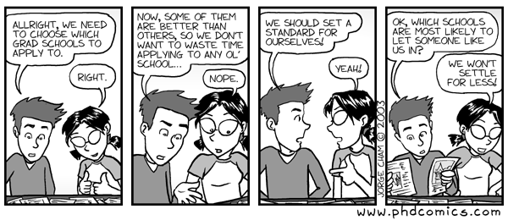
Are there any questions?

