Slide 1
THE FORENSIC PSYCHOLOGY CLUB:
WELCOME BACK

Slide 2
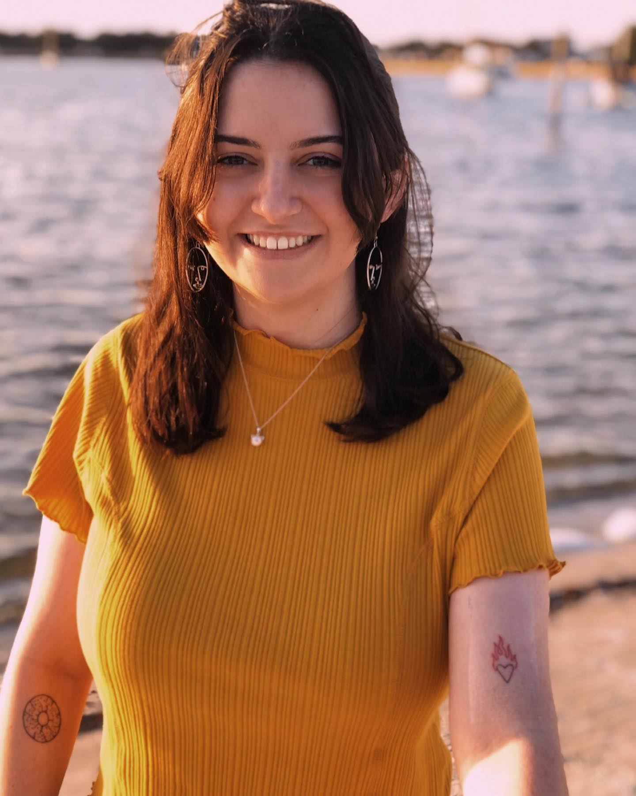
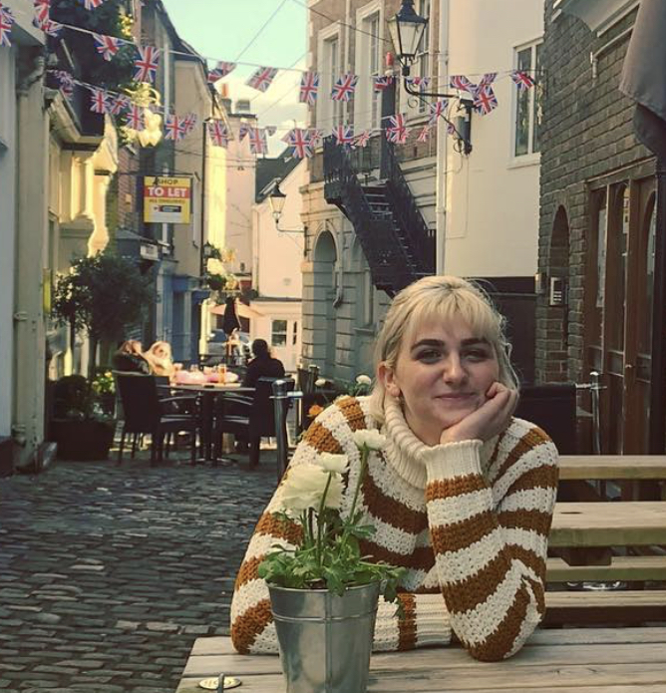
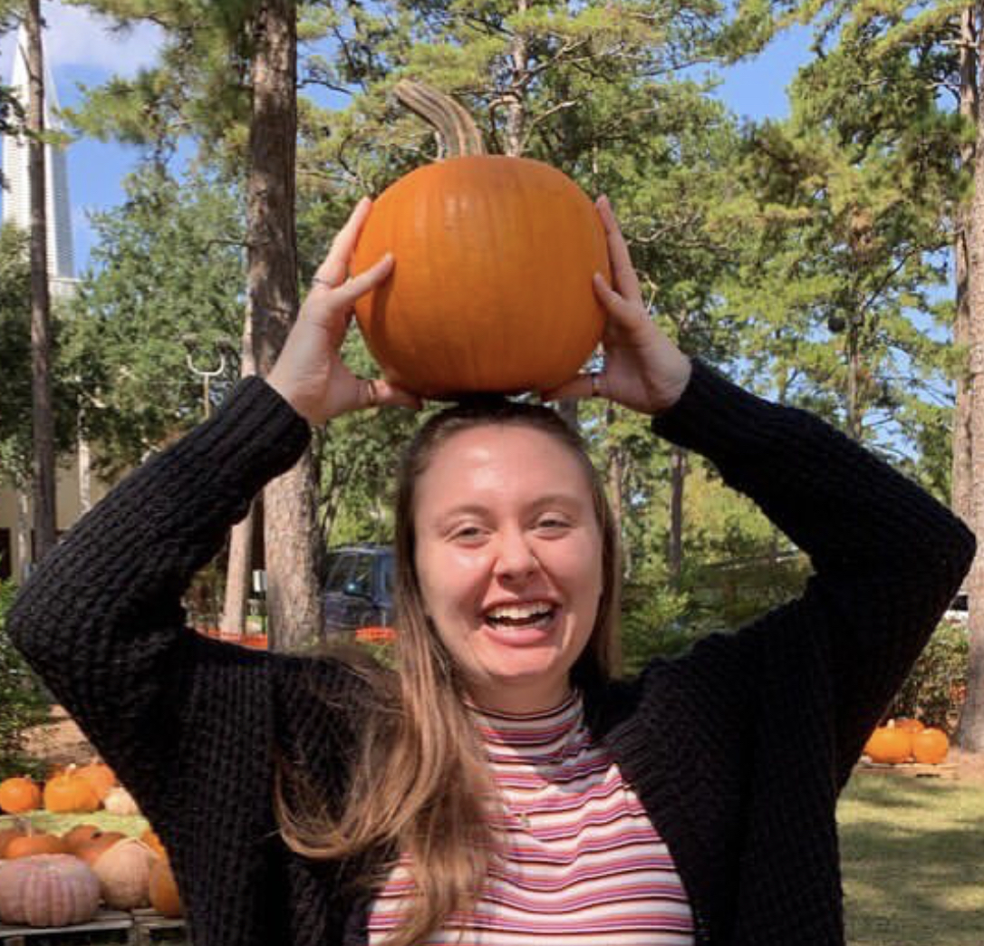
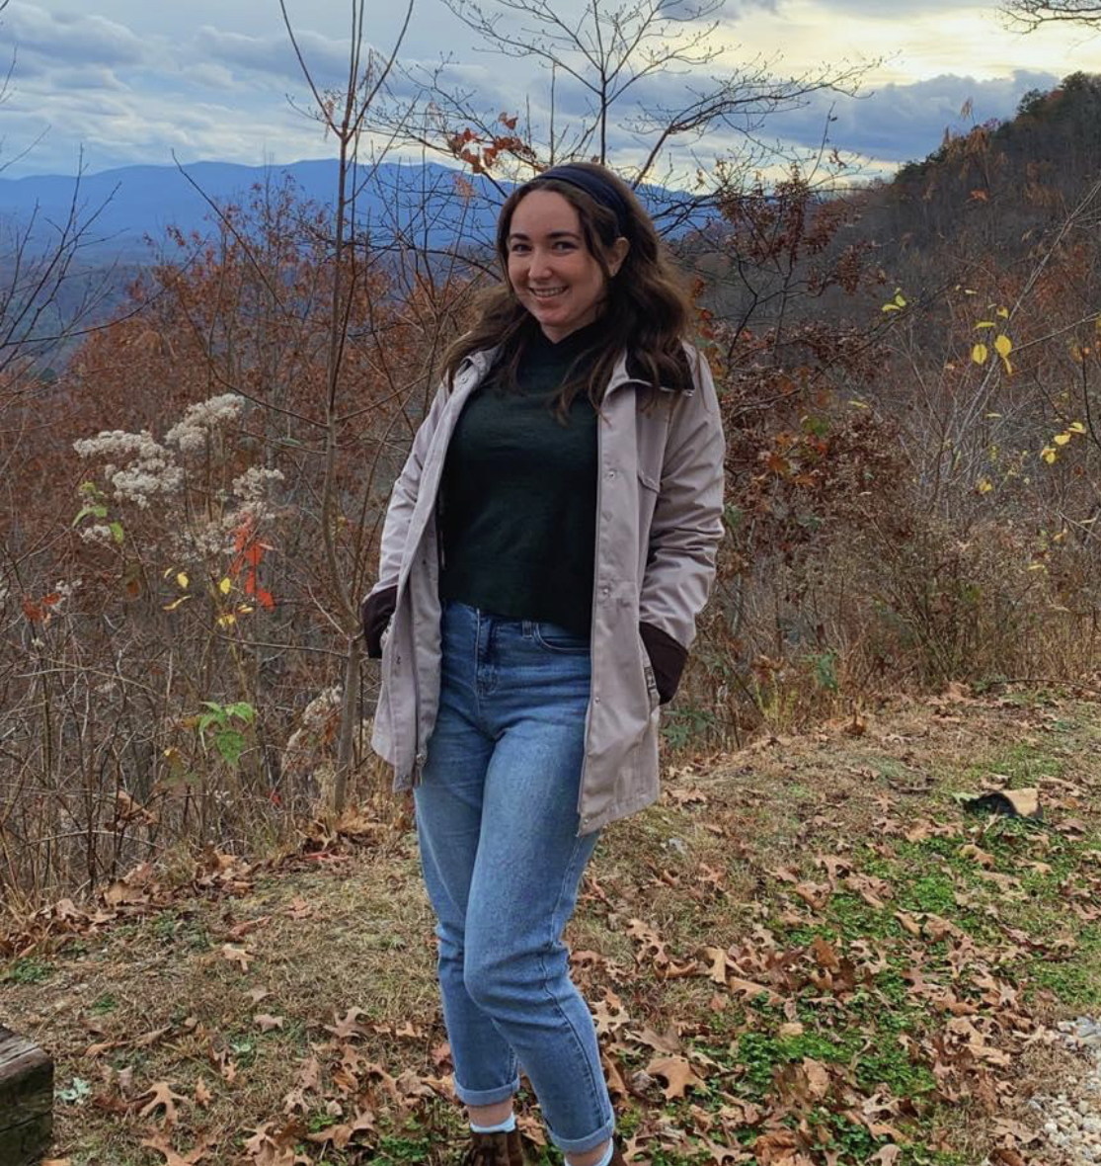
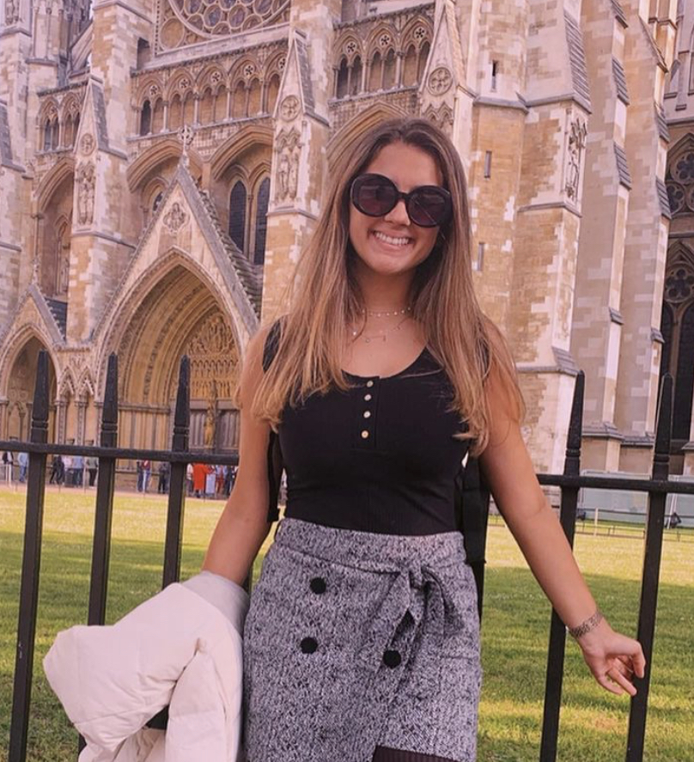
Meet your E-Board Members!
Casey Brucato….. President
Faith Hunt….. Vice President
Kayla Woodhouse….. Secretary
Samantha Goldman….. Treasurer
Victoria Borque….. Social Media Chair

Slide 3
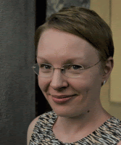
A little bit about our club advisor…
Dr. Siennick studies criminal offending and mental health problems. Specifically, she focuses on these subjects within the context of the life course, kinship, and friendship relations.
Currently, she is doing a study on the prevalence and predictors of recidivism among juveniles
If you are interested in Dr. Siennick’s research or any future courses she may be teaching, you can reach out to her at her email, ssiennick@fsu.edu
In the past, she has also examined:
The association between solitary confinement and mental health
The association between substance use and peer problems among adolescents with depression

Slide 4
GBM Incentive Program!
Starting this semester, we are implementing an incentive program to increase attendance at meetings and socials!
Each meeting will be worth 1 point
Each social event will be worth 2 points
Each point you earn will equal the number of times you are entered in our end- of- the- semester raffle!
You can enter this raffle for a chance to win a FREE club t- shirt, gift cards to local Tallahassee restaurants and cafes, or a serial killer- themed coloring book!

Slide 5
What is Forensic Psychology? A Quick Recap…
APA definition: Application of clinical (psychological specialities) to the legal arena
In other words, applying your psychological knowledge to legal issues
The term “forensic” refers to anything pertaining or potentially pertaining to law, both civil and criminal
Forensic scientists participate in the investigation of major crimes
Not necessarily only violent crimes!

Slide 6
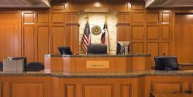
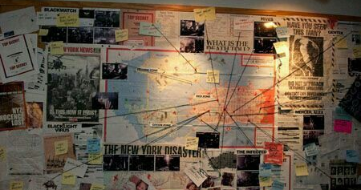
Common Misconceptions of Forensic Psychology
The key component to Forensic Psychology is criminal profiling
Criminal profiling is an indirect assessment of an unknown subject, while forensic psychology directly assesses offenders, witnesses, and victims
Forensic Psychology is the same as Forensic Science
A career in Forensic Psychology Requires a Law Degree
You need a Forensic Psychology degree to be a Forensic Psychologist
Notes:
Criminal profiling- indirect assessment of unknown subject (M.O., victimology, examination of BX, crime scene etc.) to connect BX to crime
Forensic psychology- Directly assess offender, witness, or victim, in order to determine their reliability in a court setting. Determine state of mind at the time of the crime, and current mental status.

Slide 7
What are the Education and Training Requirements of the
Forensic Psychologist?
Doctorate
Typically, this will be a Clinical Psychology PhD
Licensure
This varies from state to state, but most will require:
Doctorate degree
A passing grade on the Professional Practice of Psychology exam
Real work experience
Board Certification
Notes:
Each state oversees its own licensing requirements, but most states will require a doctorate degree, passing the Examination for Professional Practice of Psychology and having a certain amount of relevant experience.

Slide 8
We want to hear from you!
Please, if you haven’t already, turn on your cameras! We want to get to know our members, old and new. For the rest of the meeting, we’d love to hear from you about what you’d most like to get out of this club.
Some things to think about:
What topics in forensic psychology would you like to learn more about?
Are there any social events we could do remotely that you would be interested in attending?
Any other ideas?

Slide 9
Final Notes…
Keep an eye out for our January Newsletter!!
Summarizes what we discussed in this meeting, as well as links to relevant materials and websites
Follow us on Instagram: @fsufpc
Follow us on Twitter: @fsu_fpc
Join the Facebook Group: FSU Forensic Psychology Club
Join the club on Nole Central by searching Forensic Psychology Club
Our next meeting will be held on February 10, 2021 at 7:00 P.M. on Zoom

Slide 10
ARE THERE ANY QUESTIONS?

