Slide 1
THE FORENSIC PSYCHOLOGY CLUB:
THE INSANITY DEFENSE

Slide 2
Recap and Reminders…
We are now accepting applications for new board members for Spring 2021!! Please send your applications to fsu.fpc@gmail.com
If you haven’t already, check out our October Newsletter
We will be discussing the Insanity Defense today
We will have a guest speaker discussing her experiences with forensic evaluations for the state of Georgia
Follow us on Social Media!
Instagram: @fsufpc
Twitter: @fsu_fpc
Facebook: FSU Forensic Psychology Club
Request to join our Nole Central page if you aren’t already on the roster!

Slide 3
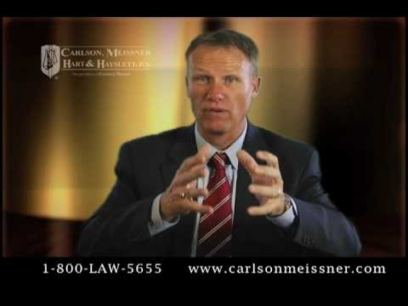
The Insanity Defense Explained…

Slide 4
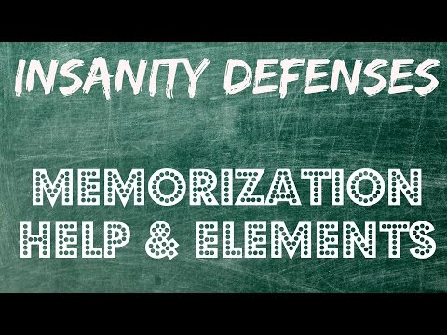
Watch this video for a simplification!

Slide 5
The History of the Insanity Defense
1843: M’Naghten Rule
Measures the ability to know right from wrong
1887: Irresistible Impulse Test
As a result of mental disease or defect, the defendant could not resist the impulse to commit the crime of which they are accused
1954: Durham Rule
Not criminally responsible if the unlawful act was the product of mental disease or mental defect
1964: American Law Institute Standard
Consolidated the M’Naghten Rule and the Durham Rule
1984: Insanity Defense Reform Act
Toughened by Congress to not only measure the ability to know right from wrong, but also places the burden of proof on the defendant
Notes:
Image: ResearchGate

Slide 6
Competency to Stand Trial and the Insanity Defense
There are two main questions we’re concerned with, regarding mental illness & criminality:
Insanity Defense
Competency to Stand Trial

Slide 7
What does Not Guilty by Reason of Insanity mean?
Actions require two elements to be considered “crime”
Mens rea: guilty mind
Actus reus: guilty act
When a defendant is found NGRI, this means they cannot be held mentally responsible for the crime they have committed
NGRI denies mens rea
“An act does not make a person guilty unless (their) mind is also guilty” ~ Edward Coke, English judge and politician

Slide 8
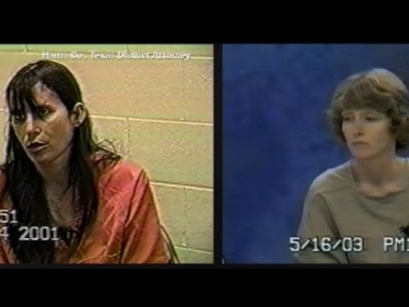
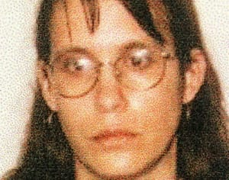
Famous Example of a Successful NGRI Case: Andrea Yates
Killed her 5 children + history of mental illness (Psychosis & PPD)
Deemed CST
1st trial = NGRI (Insanity plea); failed & found guilty
2nd trial = NGRI; successful & transferred to mental facility

Slide 9
How and When is the Insanity Defense Used?
Used when the defendant does not know the severity of the crime at hand due to mental impairment or diseased mind
The Insanity Defense is overrepresented due to media sensationalization
In reality, it’s only used in about 1% of the cases in the U.S.
Moreover, it is only successful less than 25% of cases
Versions of the Insanity Defense vary from state to state
Kansas, Montana, Idaho, and Utah do not allow the Insanity Defense
Florida uses the M’Naghten Rule
Guilty but Mentally Ill is an alternative option
Typically used by the states that don’t allow the Insanity Defense

Slide 10
Guilty but Mentally Ill
Usually additional alternative verdict to guilty, not guilty, and NGRI
Permitted in 20 states
Also known as GBMI
Used when there is clear evidence of a lack of defendants’ appreciation for wrongfulness OR consequences of their actions
Defendants who meet both criteria often opt for the NGRI plea, the GBMI plea is reserved for those who meet only one criterion
Treatment is delivered up until the defendant is deemed sane
Once this has happened, they will be moved to a prison to serve out their sentence

Slide 11
Comparing NGRI and GBMI
 | NGRI | GBMI
Responsibility for Crime | Not Responsible | Responsible
Where Committed? | Forensic Hospital | Prison
Given Sentence? | No | Yes
When Released? | When no longer a danger and mentally ill | End of sentence, but could be committed civilly if dangerous and mentally ill
Treatment Given? | Yes | Possibly

Slide 12
Competency
Evaluation of defendants in criminal cases are typically done by Forensic Psychologists
Defendants can be deemed ITP (Incompetent to Proceed)
75% of ITP defendants were deemed competent within 6 months
Legal standard
Dusky v. United States (1960) : A defendant must have “sufficient present ability to consult with his attorney with a reasonable degree of rational understanding and a rational as well as factual understanding of proceedings against him”.
The modern version of this requires only that a defendant understands the proceedings against them

Slide 13
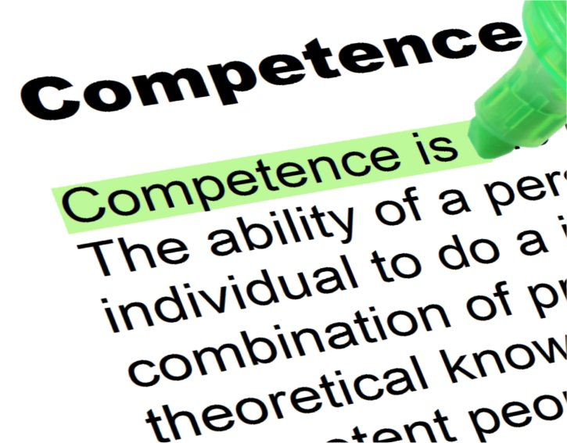
How do we know who is eligible for competency evaluations?
No mental illness at the time of the trial
Able to understand charges brought upon them
Able to appreciate possible penalties of crime
Able to understand adversarial nature of legal process
Able to work with/assist attorney
Exhibit appropriate courtroom behavior
Testify relevantly

Slide 14
What happens once a defendant is found ITP?
If you are found ITP, the legal proceedings are brought to a halt
A mentally ill individual deemed incompetent is then subject to treatment until they are deemed “restored to competence”, and then they return to court to be tried on the charges.
Common reasons for ITP:
Low intelligence or dementia impairs understanding of trial process
Depression and self-defeating behavior limit motivation for trial’s best outcome
Mania impairs ability to act appropriately in courtroom
Paranoid delusions impair ability to work with defense counsel
Disorganized thinking impairs concentration and attention
Delusions, disorganized thinking, low intellect, or dementia result in irrational decision-making about defense
Hallucinations distract from paying attention to the trial

Slide 15
What is “Malingering”?
Intentional production or exaggeration of psychological symptoms, motivated by motivated external incentives (escaping charges, financial compensation)
How can we catch those who malinger?
M-FAST: Miller Forensic Assessment of Symptoms Test
SIRS: Structured Interview of Reported Symptoms
Often obvious, if a skilled professional is doing their job correctly
Look for:
Reported vs observed symptoms
Unusual hallucinations
Not typical course of symptom

Slide 16
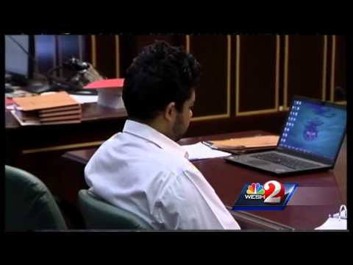
Video Example of Malingering:

Slide 17
Final Notes…
This month’s newsletter will be released before Thanksgiving!
Remember to submit your applications for open board positions to fsu.fpc@gmail.com
If anyone is particularly interested in what our guest speaker discussed today, please reach out to the Vice President (clb18@my.fsu.edu) and she will connect you with our guest speaker to answer any questions!
We will be announcing the new board in our next meeting
Our next meeting will be on 11/30/ 2020
Have a safe, happy Thanksgiving with your loved ones! We will see you after the break ☺

Slide 18
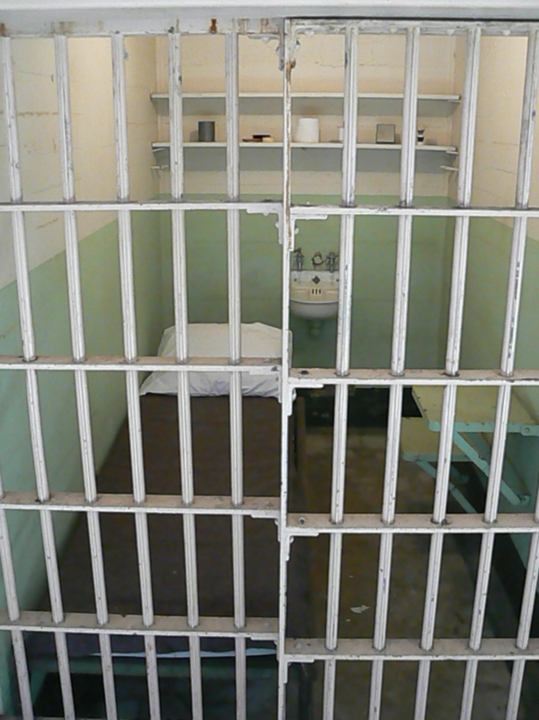
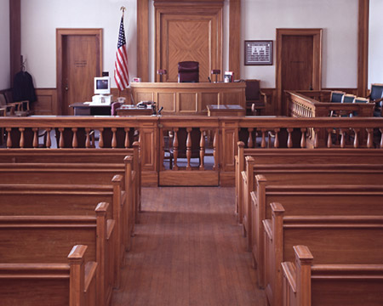
Are there any questions?

