Slide 1
THE FORENSIC PSYCHOLOGY CLUB:
THE PSYCHOLOGY OF CRIMINAL INVESTIGATION

Slide 2
Recap and Reminders…
Check out our September Newsletter
Follow us on Social Media!
Instagram: @fsufpc
Twitter: @fsu_fpc
Facebook: FSU Forensic Psychology Club
Request to join our Nole Central page if you aren’t already on the roster
Today we will be talking about the psychology of the investigation of crime

Slide 3
Background
Policing is the practice of protecting the populace and preventing crime
Detection is the systematic investigation of crimes
Has a much shorter history than policing
There are various approaches to criminal investigation,
1: The investigator holds certain personal characteristics that lend something to the investigation process
2: The tasks and actions of the investigator clarify the purpose and process of the investigation
Forensic psychologists can play several roles in criminal investigation
May be asked to act as a criminal profiler
Profiling is simple logic and a sound knowledge of how to apply statistical and scientific techniques

Slide 4
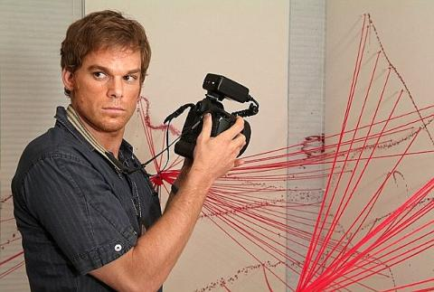
Criminal Profiling
This can involve a variety of skills
Crime scene analysis
Understanding human behavior, motivation, and pathologies
There is an established classification system which falls into two types
Typologies: conceptual form of separating items on a set of predetermined dimensions
Taxonomies: classification is based on measurable characteristics and are more likely to be found in biological sciences
A profile is an analysis of the extent to which something exhibits various characteristics
Closer to a typological classification than a taxonomic one
Today, criminal profiling encompasses crime scene analysis, the interpretation of geographical data, victimology, and crime linkage

Slide 5
The FBI Method of Criminal Profiling
The FBI was the first agency to develop a form of profiling in order to detect and classify the personality and behavioral characteristics of an offender based on the crimes committed
Stages of profiling:
Assimilation: gathering information from the crime scene, victims, witnesses, etc.
May include photographs, post- mortem reports, victim profiles, police reports, and witness statements
Classification: integration of data into a framework
Allows the offender to be labeled as “organized” or “disorganized”
Great deal of the FBI method concentrates on this stage
Identification: an attempt to construct the behavioral sequence of the crime
Includes the steps the offender went through in order to commit the crimes, as well as any behavior that was not necessary to the offense
The last step is the generation of the profile
May contain demographic characteristics, family characteristics, education, personality, etc.

Slide 6
Organized Versus Disorganized
The Organized Offender:
Assumed to have some form of cunning, which may or may not manifest itself as the ability to plan
Fixation with the condition of a crime scene and its aftermath
Offender will signal this through the way the murder is approached, the condition of the body and its clothes, the way the body is disposed, etc.
Antisocial, but presents the façade of normality
Has the ability to maintain relationships, friendships, etc.
More likely to be forensically and procedurally aware
Typically has a preferred type of victim
More evident for a murderer or rapist
Improve techniques between each murder
The Disorganized Offender:
Sexual murderers are more likely to fit into this category (necrophiliacs, etc.)
Killing for sexual gratification
Sexual element could have more to do with power and control
Cannot maintain social interaction and does not plan their crimes
Impulsive behavior and an inability to adapt to unexpected events
Not forensically aware and demonstrates little planning
Leaves a lot of evidence, such as fingerprints, body fluids, etc.
Killing/ crime may seem more frenzied and occurs early in the whole set of actions
Victim may be depersonalized by mutilation or sexual humiliation

Slide 7
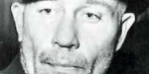
Problems with these typologies:
No crime scene will exhibit organized or disorganized characteristics exclusively
Most offenders fall in the “mixed” category
Especially if there is more than one offender
Can make motivations unclear or difficult to ascertain
First photo: Ed Gein
Classic example of a “mixed” killer
Second photo: Howell Donaldson III (*current case: Seminole Heights serial killer*)
Example of a “disorganized” killer
Third photo: Dennis Rader
Example of an “organized” killer

Slide 8
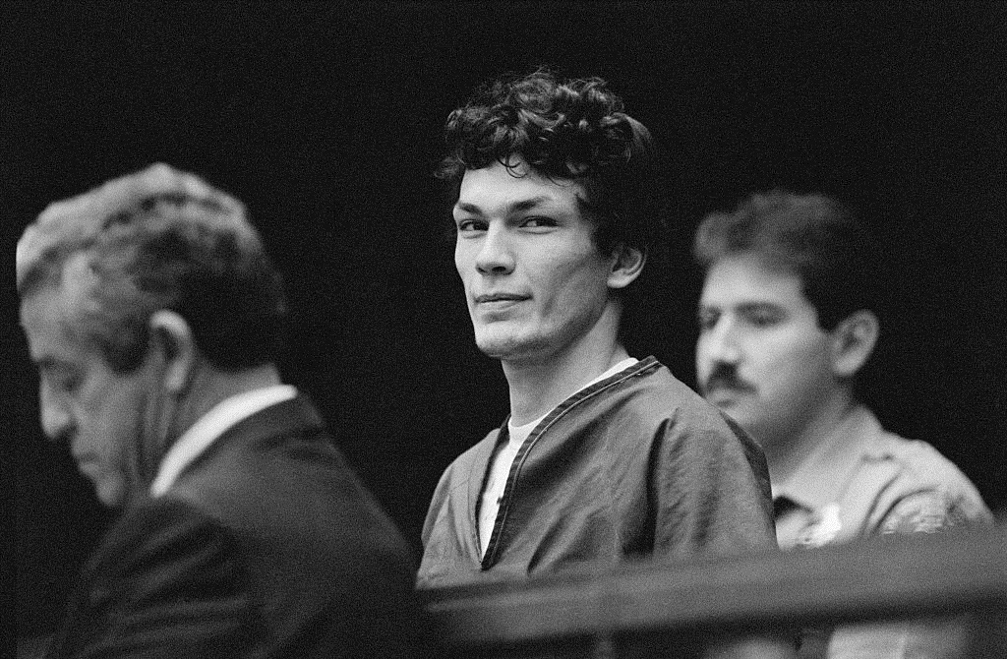
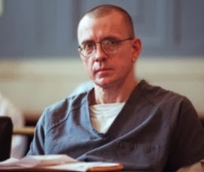
Motivations
Visionary:
Suffer from psychotic breaks with reality
Sometimes believe they are another person or are compelled to murder by entities such as the Devil or God
Example: Richard Ramirez frequently left pentagrams at the crime scenes, and when arrested, he is quoted as saying he was “a minion of Satan sent to Earth to carry out atrocities for the devil”
Mission- Oriented:
Believe they are cleaning up the world
Believe that they have a mission to get rid of certain types of people
Typically, the targets of this type of killer are sex workers
Example: Joseph Paul Franklin killed 12 young black males because they were in interracial relationships with white women

Slide 9
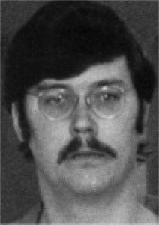
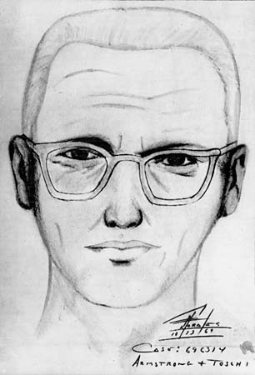
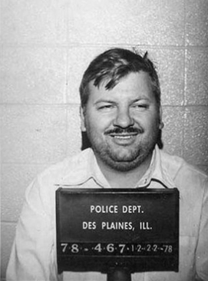
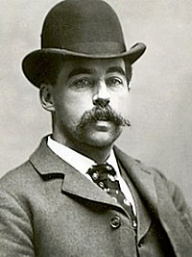
Motivations (continued)
Hedonistic:
Kill as a means of gaining thrills and pleasure; people are expendable to this type of killer
Several subtypes
Lust killers: sex is the primary motive (necrophilia is common with this type of killer)
Edmund Kemper killed co- eds and would return to the dump site to have sex with their corpses
Thrill killers: seek to inflict pain or fear and receive a thrill from hunting and capture, and possibly torture
The Zodiac Killer was infamous for saying “man is the most dangerous animal of all to kill”
Comfort/ profit killers: kill to maintain a comfortable lifestyle
H.H. Holmes murdered people during the late 19th century for life insurance policy settlements and related inheritance gains
Power/ Control:
Kill to gain control over victims
Most likely to have been abused as a child, leaving them feeling powerless
In cases of rape, power over victims is typically not sexually- motivated
Example: John Wayne Gacy murdered at least 33 young men and boys due to his desire to dominate

Slide 10
The Psychological Autopsy:
What does it include?
Biographical information
Age, marital status, occupation
Personal information
Relationships, lifestyle, alcohol/ drug use, sources of stress
Secondary information
Family history, police records, diaries
Medical history , sexual history, dietary history
Military history, employment history, educational history
Fantasies, thoughts, dreams, premonitions, fears, or phobias of the victim
Socio- emotional mood swings, mental status examination, IQ, concentration and judgement abilities
Timeline of events leading up to the day the victim’s death

Slide 11
Psychological Elements of Crime Scenes and Witnesses:
Examination of a crime scene reveals behavior that an offender or offenders have carried out
Modus operandi:
Also known as the method of operation, often shortened to “MO”
All the actions necessary to carry out the crime
Crimes can be classified in terms of MO so that a pattern of criminal habits can be maintained to track offenders and crimes
MO will typically evolve as offenders can learn from experience, which makes it a dynamic concept

Slide 12
Psychological Elements of Crime Scenes and Witnesses (continued):
Signature:
A combination of behaviors that is not needed to successfully execute the crime, but is something that the offender must do
May even be the reason that the crime is carried out
Seen as a compulsion to express part of the offender’s personality
Includes behavior such as wound patterns, verbalizations, sex acts, ways of controlling victims, the taking of souvenirs, or ways of destroying evidence
Ritual behavior:
Fundamentally unusual behavior
May be based on the psycho- sexual or emotional needs of the offender
While ritual may evolve, its themes are consistent throughout a series of offenses
May be additional elements that are designed to taunt

Slide 13
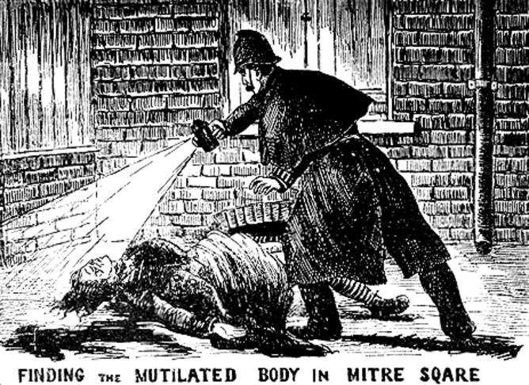
Example of a Profile: Jack the Ripper
Jack the Ripper was a serial killer in Whitechapel, England during the late 1800s
Sex work was a major industry in Whitechapel in the 1800s, so the concept of male strangers seeking out female sex workers was not an uncommon scenario
The Ripper murders are famous worldwide since the killer was never apprehended
The killer also made a name for himself in the press, by writing letters to police and the media detailing his murders
Generally described as a lust murderer, because the killer attacked the sexual organs and/ or genitalia of the body
There were five confirmed victims
Mary Nichols, Annie Chapman, Elizabeth Stride, Catherine Eddowes, Mary Kelly
All the victims were under- nourished, but had reputations for drinking heavily
It is suspected that they supported this habit, as well as the need for food and lodging, through sex work

Slide 14
Example of a Profile: Jack the Ripper (continued)
Lust murderers are overwhelmingly male
Jack the Ripper was most likely white
Serial murders typically do not cross racial lines with their chosen victims
Jack the Ripper was most likely in his mid- to- late twenties
The crimes include high levels of violent psychopathology, which has a typical onset in the mid- to- late twenties
The killer was also able to engage his victims and blend into the environment
Highly likely that he had domination, cruelty, and mutilation of women
Most likely worked in an occupation that did not bring him into a lot of contact with many people, but also followed a normal work pattern
The murders occurred on weekends
It is likely that the killer had experience with anatomy
Does not necessarily mean he was a doctor, he could’ve been a butcher or mortician
Jack the Ripper most likely lived alone, as any roommate would notice late- night movements or suspicious blood stains

Slide 15
Final Notes…
To celebrate spooky season, the club will be hosting a Netflix Watch Party!!!
We will take a vote via our Instagram story, and the winner will be played later this month
After the Netflix Watch Party, the club will be hosting a PCL- R rating of characters from the movie
What is the PCL- R?
The Psychopath Checklist- Revised is a research measure used during clinical interviews to determine whether a subject is a diagnosable psychopath
Scale of 0, 1, or 2 (0= not applicable, 1= possibly applicable, 2= definitely applicable)
Remember to check out our monthly newsletter, which will be released at the end of October
Our next meeting will be held on 11/2/2020 at 7 P.M. via Zoom! See you all there!

Slide 16
PCL- R Factor 1 Items
Superficial
Glib, insincere, charming, a "story- teller"
Example of a 2: using lots of gestures to distract, describes self as charming, or a flirt
Grandiose
Appears as cocky, self- centered, inflated sense of self and abilities, self- assured, blames others for bad circumstances, sees self as a victim
Example of a 2: bragging about sexual conquests, feelings that others don't acknowledge their talents, stating that they are superior to others
Deceitful
Commonly lie, deceive, and manipulate others for their own personal goals, may use fake IDs, lies when truth is easily verifiable
Example of a 2: using aliases, admitting enjoying lying to others, stating one thing and then contradicting it through words or behavior
Lacks Remorse
Lack of regrets for actions that hurt or distress others, lack capacity for guilt, appear to have no conscience, can't appreciate severity of harmful actions
Example of a 2: blaming others for their bad/ harmful behaviors, or minimizing the harm they did to the victim
Lacks Empathy
Unable to experience a normal range and depth of experience causing them to appear cold and callous, shallow, selfish, unable to appreciate consequences of their actions on others, may describe self as loner, traumatic experiences don’t seem to faze them
Example of a 2: equates emotional experiences to physical experiences, not understanding or caring how their actions may make others feel
Doesn't Accept Responsibility
Rationalizes behavior, greatly minimizing consequences, or even denying actions altogether, tends to blame others or circumstances, may describe self as a victim
Example of a 2: "wrong place, wrong time", "I barely touched the guy", "everybody goes through their drug dealing phase", "I did it because I was drunk/ high"

Slide 17
PCL- R Factor 2 Items
Impulsive
Behavior is unplanned, lacking in forethought, likely to be sensation seekers, short attention span, easily bored
Example of a 2: quitting a job without having another one, driving fast, breaking and entering, for the "thrill of it"
Poor Behavioral Controls
Anger and overt aggressive behavior, angry outbursts, not being able to control temper and is often exacerbated by drugs or alcohol, quick to react aggressively
Example of a 2: described as hot- headed, loses it easily, short- tempered
Lacks Goals
Lacks realistic long- term goals that they can achieve, relies excessively on others for financial support, plans may seem unfocused, unrealistic, or unachievable
Example of a 2: thinking they will be famous and rich as an actor or attorney, but currently going to school for nursing, "get rich"
Irresponsible
Habitually fails to honor obligations, including those to friends, family, work, school, society, etc. without good reason, untrustworthy with money
Example of a 2: drunk driving, not using protection during sex, buying items they know they can't afford
Adolescent Antisocial Behavior
Under the age of 17 they will have exhibited caried, persistent, and frequent conduct problems not limited to one social context (school, home, etc.)
Conduct problems are not the result of childhood neglect or abuse, and may have caused issues with the law
Adult Antisocial Behavior
After the age of 18, frequently violating the norms and rules of society, which may result in problems with the law resulting in charges and/ or convictions
Example of a 2: arrested multiple times for different violations

Slide 18
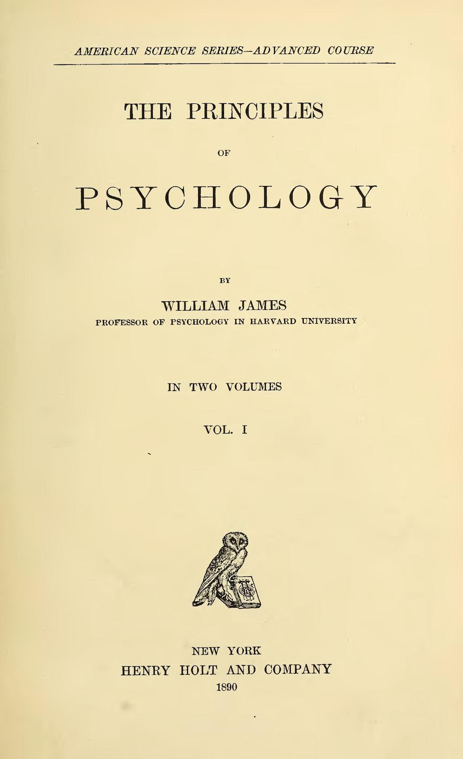
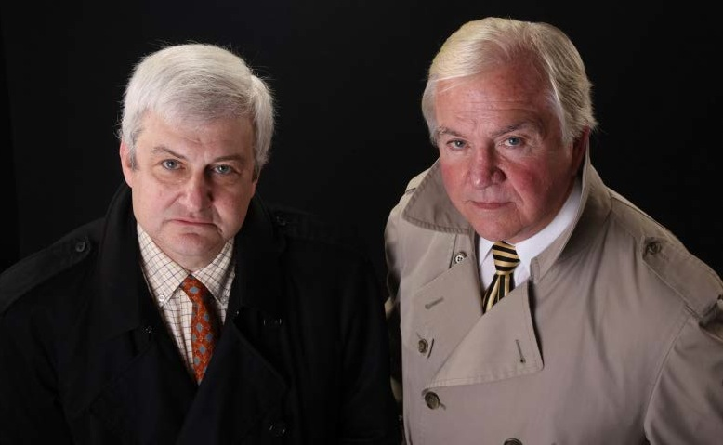
Are there any questions?

