Slide 1
The forensic psychology club: graduate school round table

Slide 2
Recap and Reminders…
Follow us on Social Media!
Instagram: @fsufpc
Twitter: @fsu_fpc
Facebook: FSU Forensic Psychology Club
Join the Nole Central page if you aren’t already on the roster
Today we welcome several guest speakers for a round table discussion on graduate school
Various programs and degrees
How to apply
Etiquette for getting letters of recommendation
What is a CV?
We will also discuss how to boost your CV and gain experience/ knowledge that will benefit you when you apply to graduate school
Going to research conferences
Getting involved with coding

Slide 3
Why are we covering this topic?
If you are interested in forensic psychology and want to go into this field, often you will need to go to graduate school
Because it is such a broad field, you can go into any range of programs, from master’s to doctorate
However, if you want to be a forensic psychologist specifically, you must go into a PhD program (preferably clinical psychology)
Our guest speakers are all graduate students who have been through the application process in various programs, and they are here to tell you about it and explain the benefits of their chosen programs
The application process includes forming your CV, as well as reaching out to your teachers, lab directors, previous employers, etc. for letters of recommendation

Slide 4
Master’s Programs
If you want to go into this field but aren’t exactly sure of where you fit in, a master’s program is a great alternative to a doctorate program
Social work and criminology are two programs that are well- suited to give you the hands- on experience you need
Get to work with various populations
Gain communication skills
Interacting with different people
Gain invaluable experiences through various internships
How is it different from a PhD program?
Not as much of a time commitment
More likely you will have to pay for this degree
PhD programs are often funded, which make them much more competitive to get into

Slide 5
Doctorate Programs
These programs are well- suited for those of you who know where you want to be within the field and have no trouble committing to a much more time- consuming program
Programs range from 5 to 7 years
Completion of an internship in the last year of the program
Unless you decide to do a PsyD (more to come), research is a big factor in these programs!
You will choose a lab director within the schools you apply to, and that person will be your guru throughout your program
As previously stated, most forensic psychologists will complete a clinical psychology doctorate program
After this program, you would complete an allotted number of training hours and then take a 200- question exam
If you pass, you become certified in forensic psychology!
This is a very lengthy process, and it can be overwhelming to think about, but it doesn’t have to be! Take it one step at a time ☺

Slide 6
Doctorate Programs (continued)
Within clinical programs, there are concentrations and tracks
Not many schools offer forensic concentrations/ tracks, which both narrows your options and makes it easier to apply than if you just applied to a broad program
If a school you are interested in doesn’t have a forensic concentration/ track, don’t freak out!
Look into possible clinical placements available in that area and see what kind of research the program conducts (there are a LOT of aspects of psychology that relate back to crime!)

Slide 7
What is a PsyD?
PsyD programs are essentially PhD programs, without the research aspect
Typically, these programs are not funded, so you are very likely to go into debt if you choose to do this program
However, once you finish, you can start working immediately, which means paying off these debts is not impossible!!
PsyD programs are less likely to be APA accredited, which is crucial to any psychology graduate program
PsyD programs are much less competitive than PhD programs
Due to the lack of funding they receive (when you’re paying your own way, programs become much less competitive)
Viable option if you have absolutely no interest in research and are only interested in the clinical/ treatment side of psychology

Slide 8
How to apply to these programs:
For 99.9% of graduate school programs, you will apply the fall BEFORE you wish to begin to the program
For all programs:
You MUST take the GRE
Most programs require a score between 140 and 160
PhD programs are much more competitive (within the realm of 160+)
GPAs vary, but generally, 3.5 and above is always a good place to be ☺
CV/ Resume

Slide 9
How to apply to these programs (continued):
For Master’s programs:
No research experience necessary
Typically, you will be asked to answer prompts about “why you want to be in this program?”
2 letters of recommendation
For PhD programs:
Research experience is a MUST
You can get this through DIS positions, research assistantships, volunteering, etc.
3 letters of recommendation
Preferably from teachers and lab directors
Personal statement
This should convey your interests, how they relate to the program you are applying to, and the ways in which you would be a good fit for your chosen program

Slide 10
Etiquette for Letters of Recommendation
You should ask teachers/ faculty, etc. that you have good relationships with
Avoid asking teachers in large classes, unless you really connected with them, it is likely they won’t remember you well enough to write an effective letter
If you studied abroad, DEFINITELY ask those teachers! Even if it was only for a short period of time, you bond with your study abroad teachers in ways that just aren’t possible on a regular college campus
Don’t get intimidated! It can seem scary or awkward asking a previous teacher or employer for a letter of recommendation, but 9 times out of 10, they will be more than happy to write one for you!

Slide 11
Etiquette for Letters of Recommendation (continued):
Choose wisely!
Pick teachers whose class you succeeded in
Bonus points if their class is one that directly applies to the program you are applying to!
I.e. Forensic Psychology, Psychology and the Law, Mental Illness and Crime, etc.
If you are in a DIS/ RA position, you will automatically get a letter of recommendation from your lab director
Fair warning: your lab director will typically be too busy for you to really connect with them, so we suggest you focus your energy on your graduate students and lab managers! These people are the ones who will give opinions and input to the lab director when they are writing your letter ☺!

Slide 12
What is a CV?
A CV is essentially an academic resume
Focus should be on your academic and research achievements
Work experience is typically only included if it relates to the program you are applying to
I.e. If you worked at a daycare and now you are applying for a child psychology- focused clinical graduate program
Research experience should go above any work experience or school involvement
Brag on yourself! Don’t be afraid to make yourself look REALLY good by including anything and everything of relevance that you have done in your academic career

Slide 13
What is a CV? (continued)
CVs are different from resumes in that CVs are encouraged to be more than 1 page long
If you’re REALLY impressive, your CV can be 5 to 7 pages long! Don’t be discouraged if it isn’t, we aren’t all superhumans
High school is usually not included
Unless you did significant work such as dual enrollment, participated in research, or went above and beyond by going to conferences
The next slide will have an example of what your CV should look like!

Slide 14
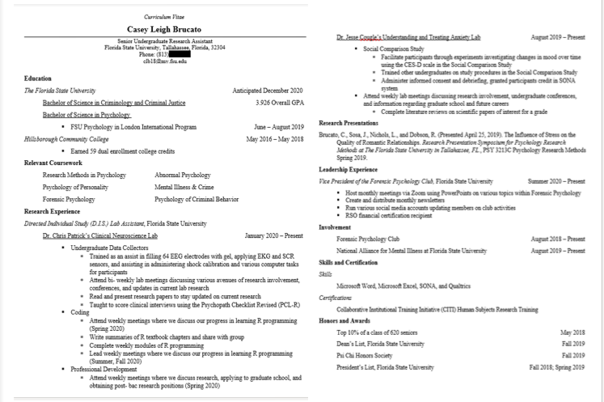

Slide 15
How to boost your CV:
There are many, many ways to do this ☺
Getting involved in research:
Check our August newsletter for links to DIS opportunities at FSU
Once you are involved in research:
Don’t be afraid to reach out to graduate students and speak up when you find something you’d like to look into further
Get on projects that interest you! !
Conferences:
Gives you invaluable experience doing research
From developing a question to running analyses to getting your results
Presenting posters to like- minded people
Potential for a future research paper!!!
Coding:
Knowing statistics and how to run analyses is often forgotten about, but these are skills that could really give you a leg- up when applying to graduate programs
Common programs are SPSS, R, Jamovi, and Python

Slide 16
Final Notes…
This was a lot of information, so if you have any questions you can always reach out!
We will consolidate this information into our September Newsletter, so keep an eye out for that later this month
Make sure you’re up to date with our social media accounts so you don’t miss out on any information!
Let’s thank our guest speakers for talking with us today!
Our next meeting will be held on 10/ 5/ 2020 at 7 P.M. via Zoom! See you all there!

Slide 17
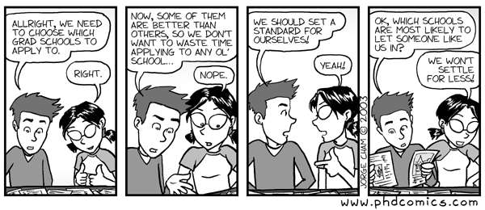
Are there any questions?

