Slide 1
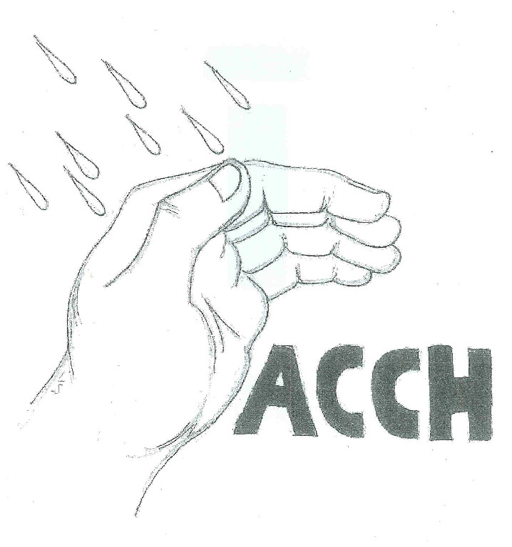
Ashe County Coalition for the Homeless
Providing shelter in life’s storms

Slide 2
ACCH Vision and Mission
vision
To provide shelter in life’s storms.
mission
To provide shelter and service for the homeless and those at risk of becoming homeless.

Slide 3
Topics of Discussion
Images of homelessness
Causes of homelessness
Misconceptions of homelessness
Ashe County Coalition for the Homeless
Ending homelessness

Slide 4
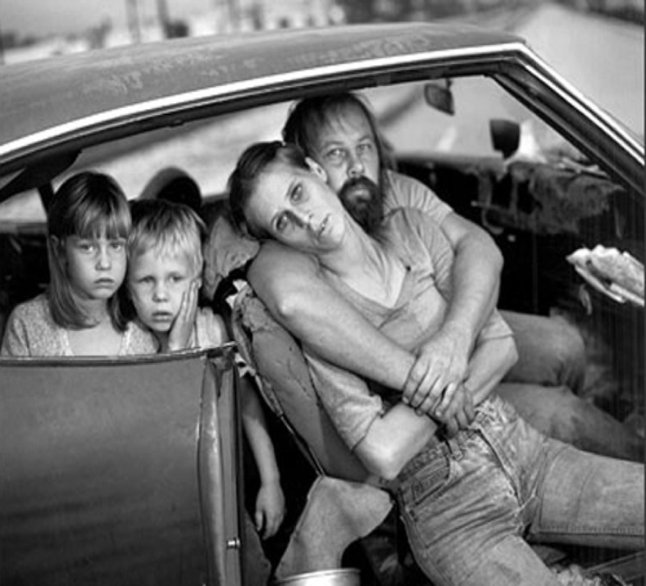
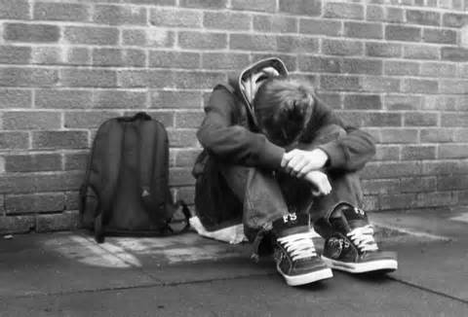
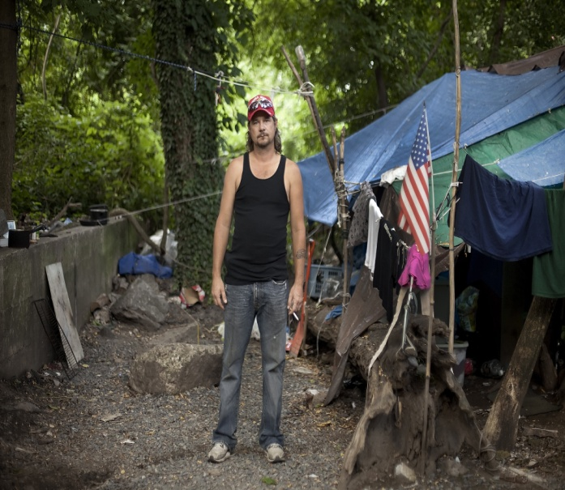
Images of Homelessness
There is no one face of homelessness. The number of those living without permanent housing include families with children, youth, single parents, couples and seniors.

Slide 5
Statistics on Homelessness
3 million men, women and children annually in the U.S.
60% single head of households
40% children > age 6
NC has the 3rd highest rate of homelessness children ages K-12
610,042 homeless any given night in the U.S.
550,000 unaccompanied young adults up to age 24 who experience a homeless episode of longer than one week a year
380,000 are under the age of 18

Slide 6
Ashe County Homelessness

Slide 7
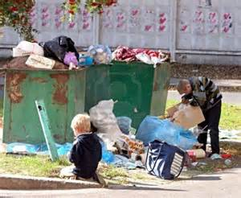
Impacts of Homeless Children
Symptoms
Same as abuse
and neglect
More physical illness
Mental disorders
Developmental
delays
Poor cognitive
development

Slide 8

Chronic Homelessness
Chronic homelessness - an individual with a disabling condition, continuously homeless for a year or more, or has had at least four episodes of homelessness in the past three years.
80% of those who are homeless are homeless only once
10% are homeless more than once
10% are chronically homeless

Slide 9
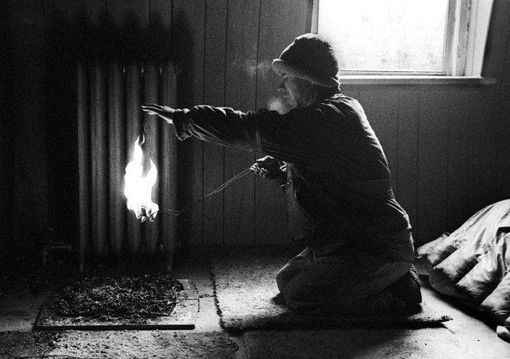
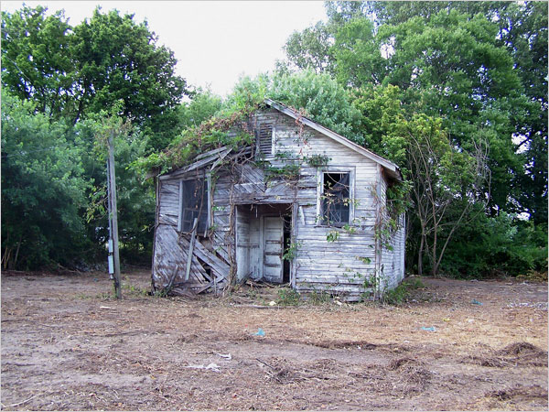
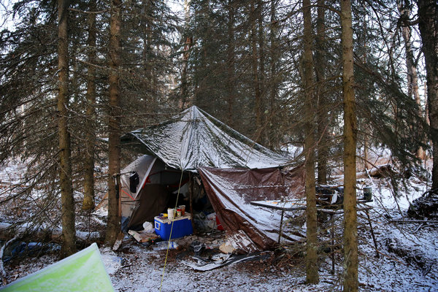
Causes of Homeless
“Home is a notion that only nations of the homeless fully appreciate and only the uprooted comprehend.”
― Wallace Stegner, Angle of Repose

Slide 10
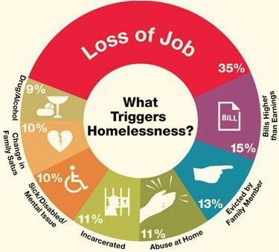
What triggers homelessness
Some are homeless due to life situations and need temporary assistance to re-stabilize their lives.

Slide 11
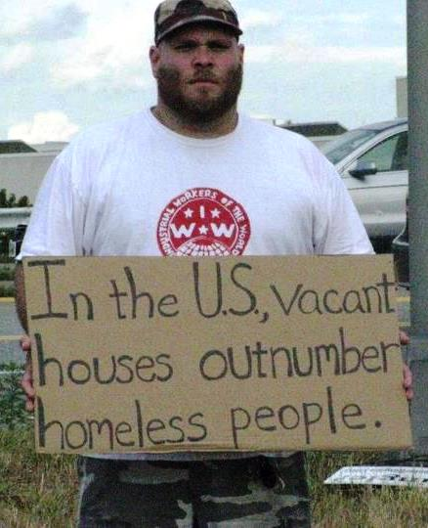
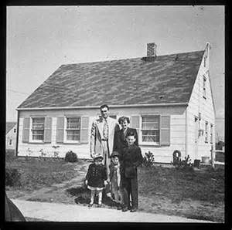
Lack of Affordable Housing
Affordable housing - paying no more than 30% of income for housing.
Fewer than 30% of those eligible for low-income housing receive it.
A family with one full-time worker earning minimum wage cannot afford the local fair-market rent for a two-bedroom apartment anywhere in the U.S.
Lack of affordable housing causes neglect in basic needs, such as nutrition, health care or saving for the future.

Slide 12

Low Wage Jobs
Many people become homeless despite having full time jobs.
25% of the families in emergency shelters earn too much to qualify for public assistance.
Lagging incomes for the poorest Americans have not kept pace with rising housing and medical costs.
A missed paycheck, a health crisis, or an unpaid bill can push individuals and families over the edge into homelessness.

Slide 13
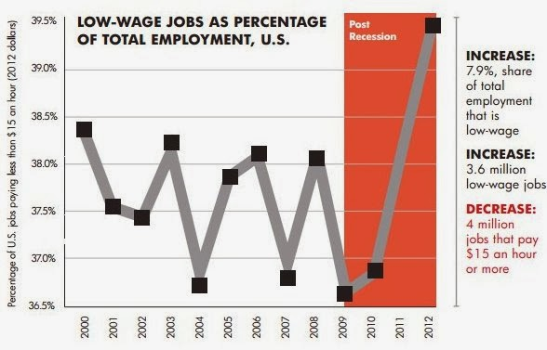
Low Wage Jobs

Slide 14
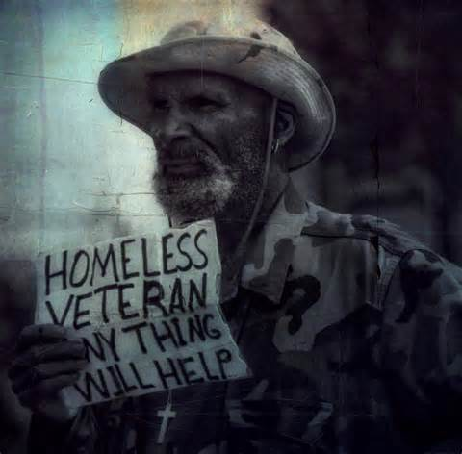
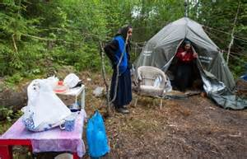
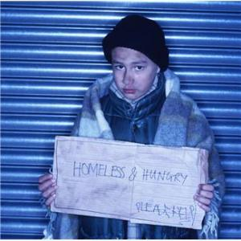
Misconceptions of Homelessness
“Sometimes it's easy to walk by because we know we can't change someone's whole life in a single afternoon. But what we fail to realize it that simple kindness can go a long way toward encouraging someone who is stuck in a desolate place.”
― Mike Yankoski

Slide 15
Local Homeless Population
People who are homeless fall into two broad categories:
Short term homelessness
Long term homelessness
Have deep ties to community.
Natives to Area
Family is here
Don’t want to leave
Often severely disabled
Work everyday to stay alive and know how to do that here
Not attractive to move somewhere else looking for services
Don’t know how to avoid danger in a new place

Slide 16

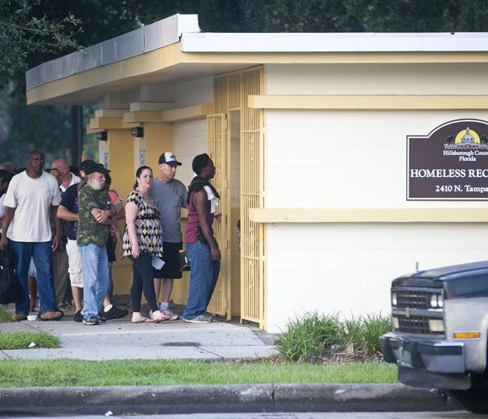
Won’t the government take care of the homeless?
Cuts at the federal level hurt the ability of local agencies to meet increasing need.
Government funding/support?

Slide 17
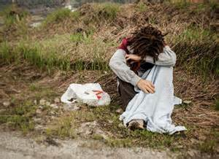
Isn’t this a big city problem?
uRBan Areas
Rural areas
Collectively, have highest rate of homelessness
About 29 people in 10,000
Two of the highest rates of homelessness in the country are in rural communities.
About 14 people in 10,000
Lack emergency shelters and resources commonplace in urban areas.

Slide 18
Costs of Homelessness
Less expensive and more humane to provide housing than emergency response services.
Homelessness leads to
  Lost education
  Low productivity
  Long-term health problems.
Significant financial burden

Slide 19
Local Costs for Treating Homelessness
Cost per person per night
Hospitality House Provides:
shelter
3 healthy meals
shower
washer & dryer
case management
on-site mental health and
substance abuse counseling
bible study
health screenings
computer room
Cooking Matters classes
on-site parenting classes
after school program

Slide 20

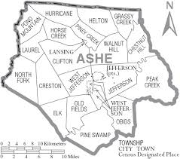
Homelessness in Ashe County
Statistics
Stories
47 Documented Homeless
(2018 Point in Time Survey)
53% Under Age 18
79% Women and Children
Client 1
Client 2
Client 3

Slide 21
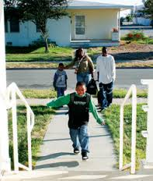


Ending homelessness
“We think sometimes that poverty is only being hungry, naked and homeless. The poverty of being unloved, unwanted and uncared for is the true poverty.”
Mother Teresa

Slide 22
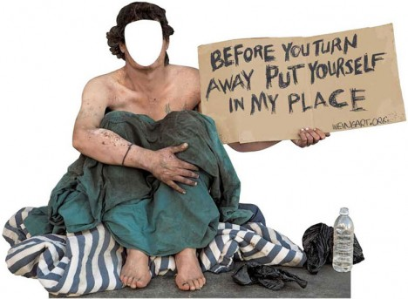
Ending Homelessness
Ending homelessness
Preventing homelessness
Find stable and long term housing
Support services
We don’t leave them in shelters.
***80% of those who are homeless are homeless only once***

Slide 23
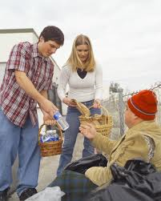
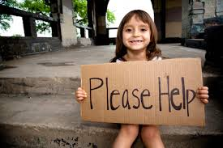
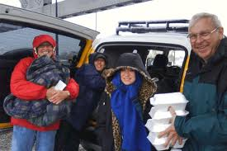
The Ashe County Coalition for the Homeless
Is it not to share your bread with the hungry and bring the homeless poor into your house; when you see the naked, to cover him, and not to hide yourself from your own flesh? - Isaiah 58:7

Slide 24
ACCH Vision and Mission
vision
To provide shelter in life’s storms.
mission
To provide shelter and service for the homeless and those at risk of becoming homeless.

Slide 25

ACCH Core Goals and Action Steps
Core Goals
Action steps
Provide (Safe) Shelter
Provide Immediate/short-term assistance
Offer Hope
Provide Safety
Link to Resources
Offer Compassionate Services
Healthy Community
Serve the Whole Person
Collaborate with Community
Assess People’s Needs
Link/Connect People
Provide Shelter
Refer People
Educate the Community
Involve the Community

Slide 26
ACCH Partnerships and Collaboratives
Law Enforcement
Mental Health Providers – Daymark Recovery Services, Local Private Providers
Medical Services
  Hospital(s)
  Free Medical Clinic
Domestic Violence
  A.S.H.E.
Housing
Habitat for Humanity
Hospitality House (Boone, NC)
Department of Social Services (DSS)
Food Services: ARC, Sharing Center, Ashe Outreach Ministries (AOM), Jefferson UMC
School System
Faith Community: Churches and Para-church groups
Employment Security Commission

Slide 27
Contact ACCH
Website: http://ashehomelesscoalition.org/
Officers of the ACCH Board
~ David Blackburn, Chairman
~ Michael Lea, Vice Chairman
~ Lori Watts, Secretary
~ Amanda Marze, Treasurer
Phone : 336-846-5719 (ask for Amanda Marze)
Donations are
tax-deductable and can be mailed to
ACCH
PO Box 331
West Jefferson, NC 28694
Volunteer to help with one of our committees. You can leave a message telling us of your interests, either on this web site in our Guest Book, or by sending an email to us at this address:
info@ashehomelesscoalition.org

Slide 28
REFERENCES
NC Continuum of Care reporting form: NW Homeless Count – January 29, 2014
National Alliance to End Homelessness
Committee to End Homelessness
ShelterCare
High Country Hospitality House
Dr Dennis Culhane of the University of Pennsylvania
US Department of Education

Slide 29

Ashe County Coalition for the Homeless
There are 135 Homeless each year in Ashe County
Who will house them, who will feed them?
~ You are invited!~

