Slide 1

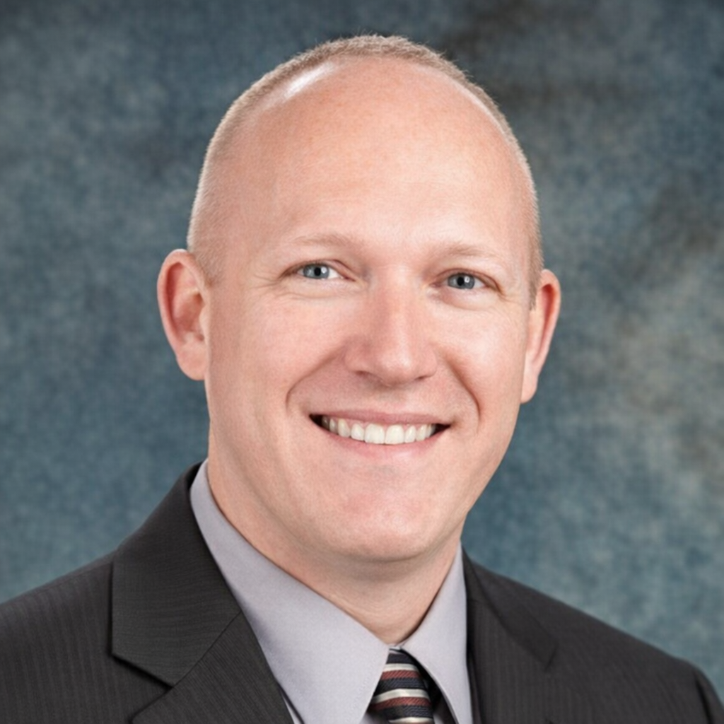

Professional Biography
Progressive leadership background directing enterprise-wide governance, compliance, and AI‑driven innovation across the global Microsoft 365 and Power Platform ecosystems; leading large‑scale technology deployments while maintaining a strong commitment to quality, compliance, and user experience.
Established compliance frameworks, and operational best practices while serving as a SharePoint Online authority, directing cloud migrations, taxonomy design, and governance.
Execute large‑scale administrative changes as a Global Administrator, and partner directly with Microsoft on roadmap planning and release readiness.
Lead cross‑functional deployment efforts and conduct root‑cause analysis to ensure long‑term stability across platforms and services.
Click: Resume - Demos

Slide 2
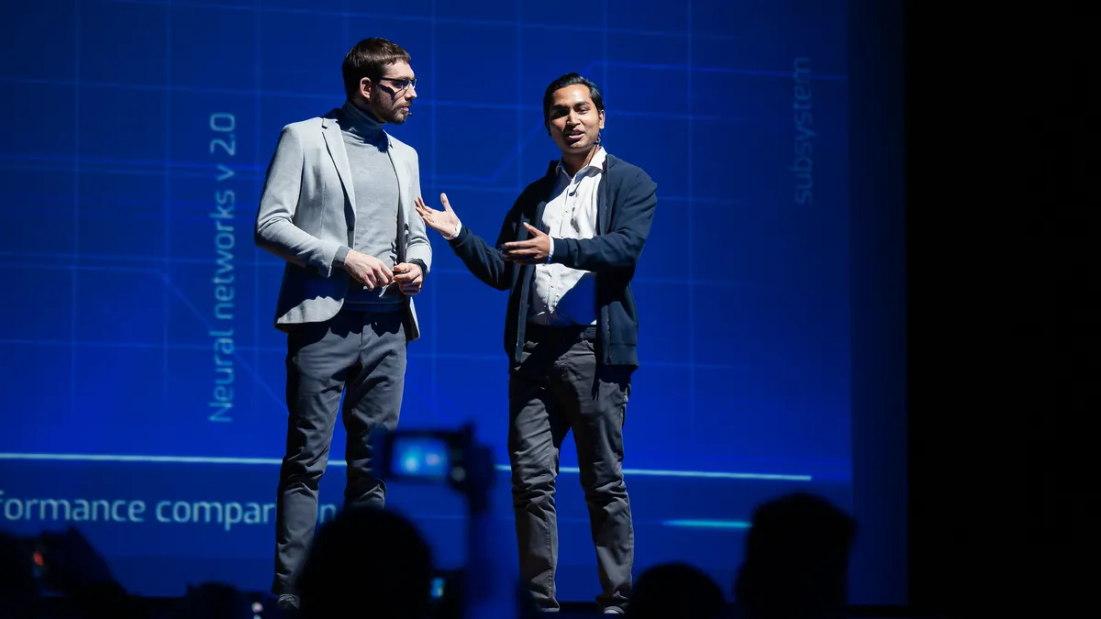

Professional Biography
High-Visibility Deployments
Global - Power Platform Coe Enablement
Global - SharePoint Online Migration
North America - PC Deployment
Europe - PC Deployment
Europe - Power Platform Overview Training
Canada - Microsoft Teams Deployment
North America - National Sales Meetings Training Lead
North America - Mobile Technology Deployment
Specialized Development
Power Platform: x12
Focus: Development, Administration and Governance
Topic: Full Stack Including Copilot, Artificial Intelligence, PowerApps, Power Automate, Dataverse, Power BI, AI Builder.
Microsoft Ignite: x8
Focus: Microsoft Roadmap - Full Microsoft Stack
Yearly 2018 - 2025
SharePoint Online: x2
Focus: Migration, Development, Administration and Governance
SharePoint On-premise: x2
Focus: Development and Administration

Slide 3
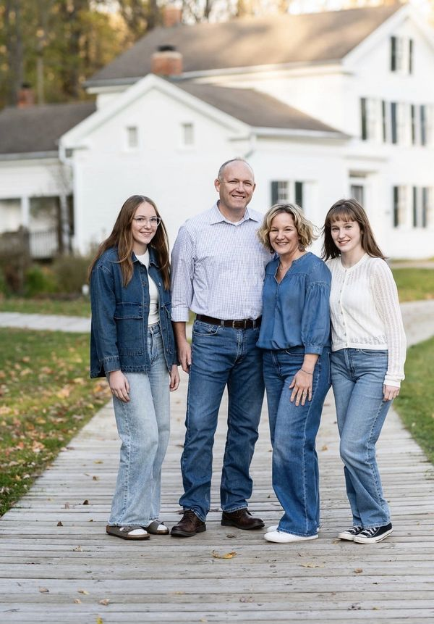
Personal Biography
Hi, I’m Tom Wood. I’m a dedicated technical lead who loves seeing hard work turn into real results.
I was born and raised in Battle Creek, Michigan, and at my core, I’m all about family. My wife, Sarah and I, stay busy keeping up with our two daughters. One is in high school, the other is gearing up for college, and you can usually find me cheering them on at volleyball games or dance recitals.
When I’m not wrapped up in family time, I dive into the things I enjoy most: Exploring new technology, seeing how things work, watching movies, binging real‑crime documentaries and going all‑in on Halloween.
I’ve got a soft spot for refurbishing old arcade machines, discovering new places across the U.S., and spending time in the world of technical theatre—especially lighting, sound, and set building.
And when I get the chance, I love a good camping trip to reset.
At the end of the day, I’m someone who loves learning how things work, creating memorable experiences, and making the people around me smile.

Slide 4

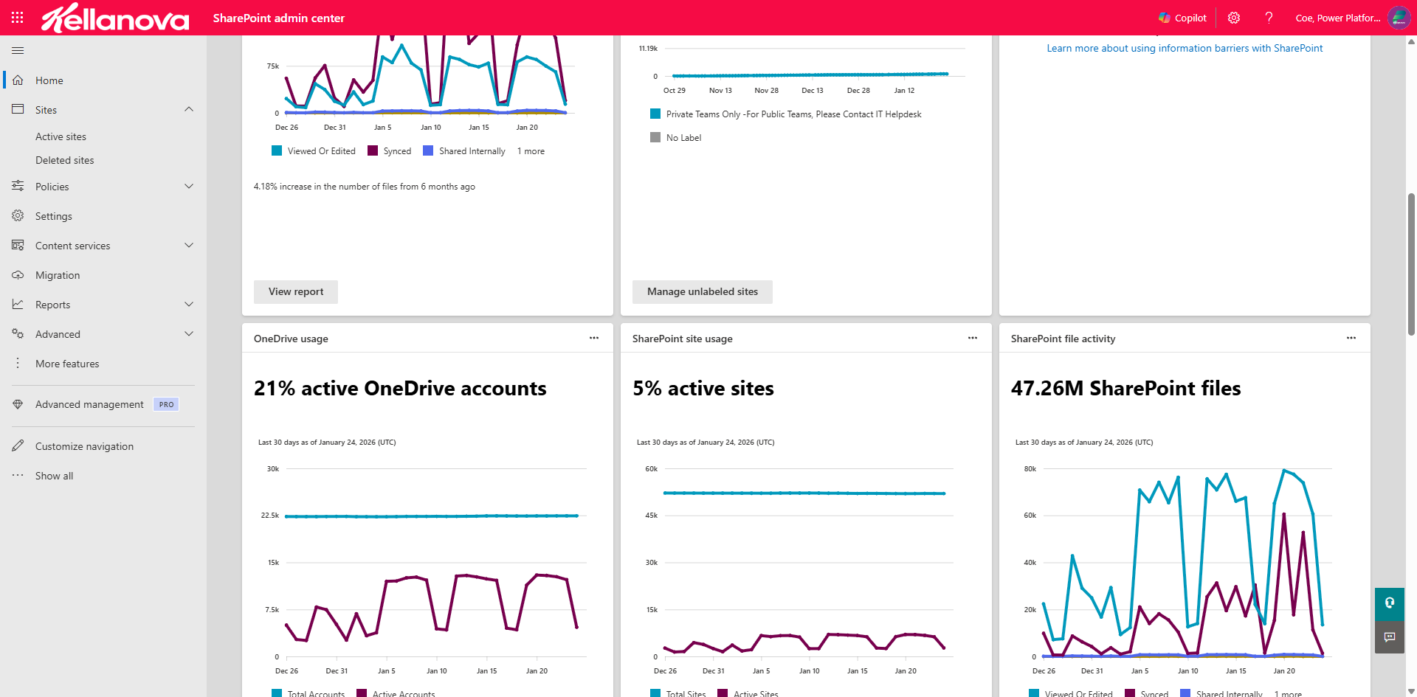
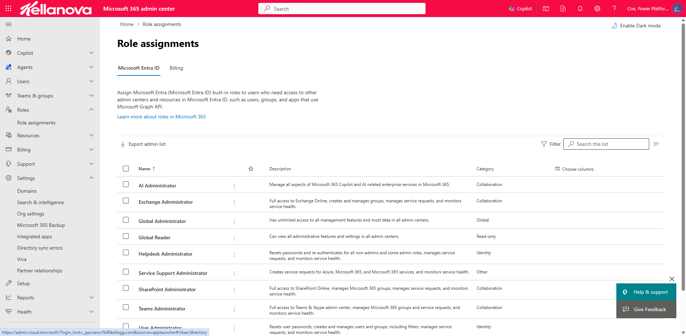
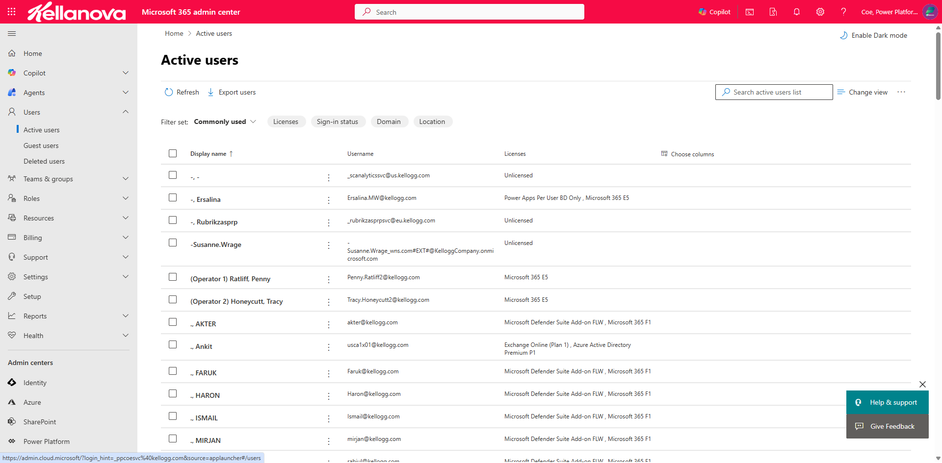

Global Administration
Notes:
Slide Message:
There’s a ton of resources available.
Communication lines are available.
https://kelloggcompany.sharepoint.com/sites/GBL-IT-PowerPlatform

Slide 5
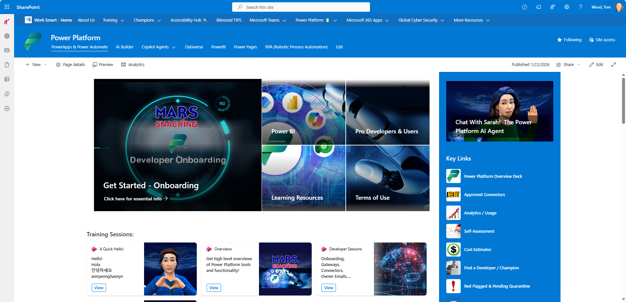
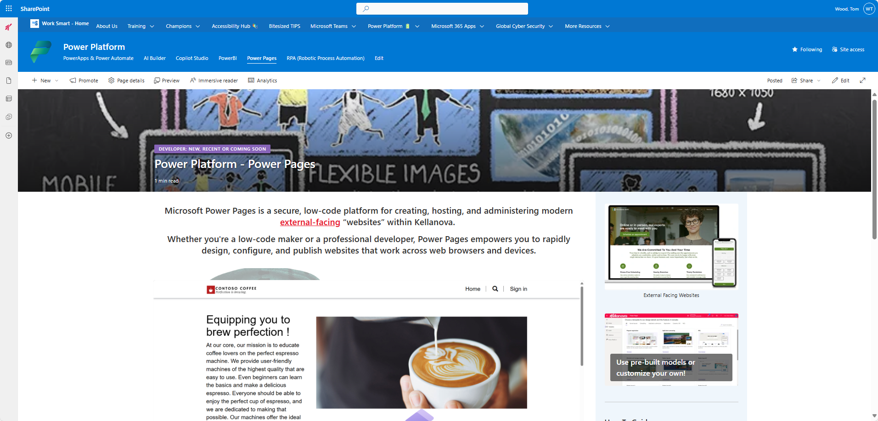
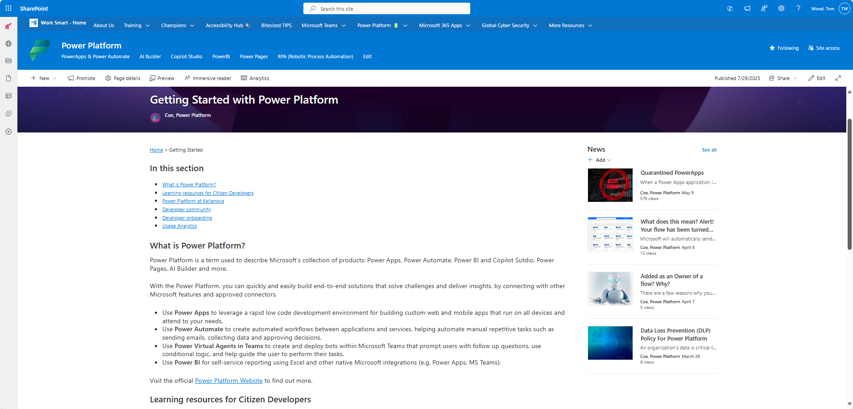
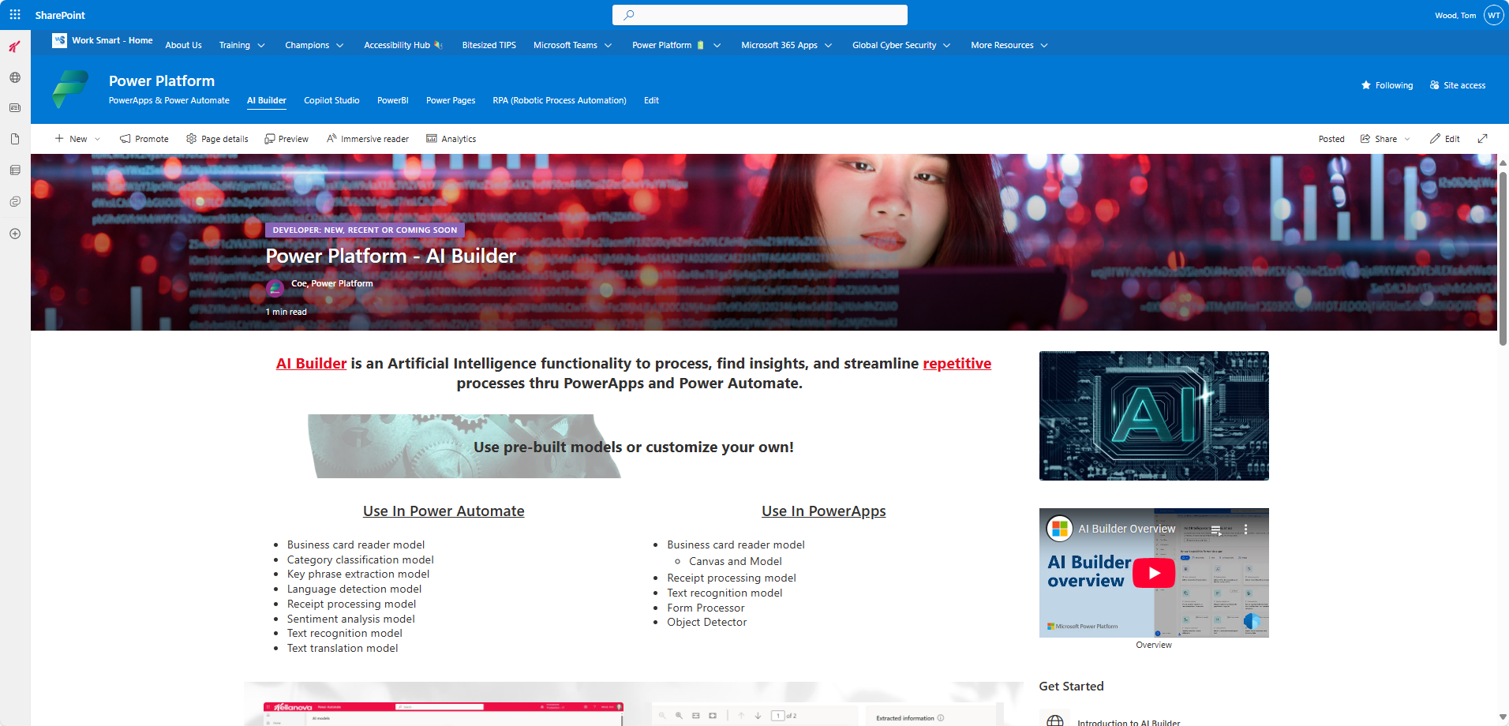
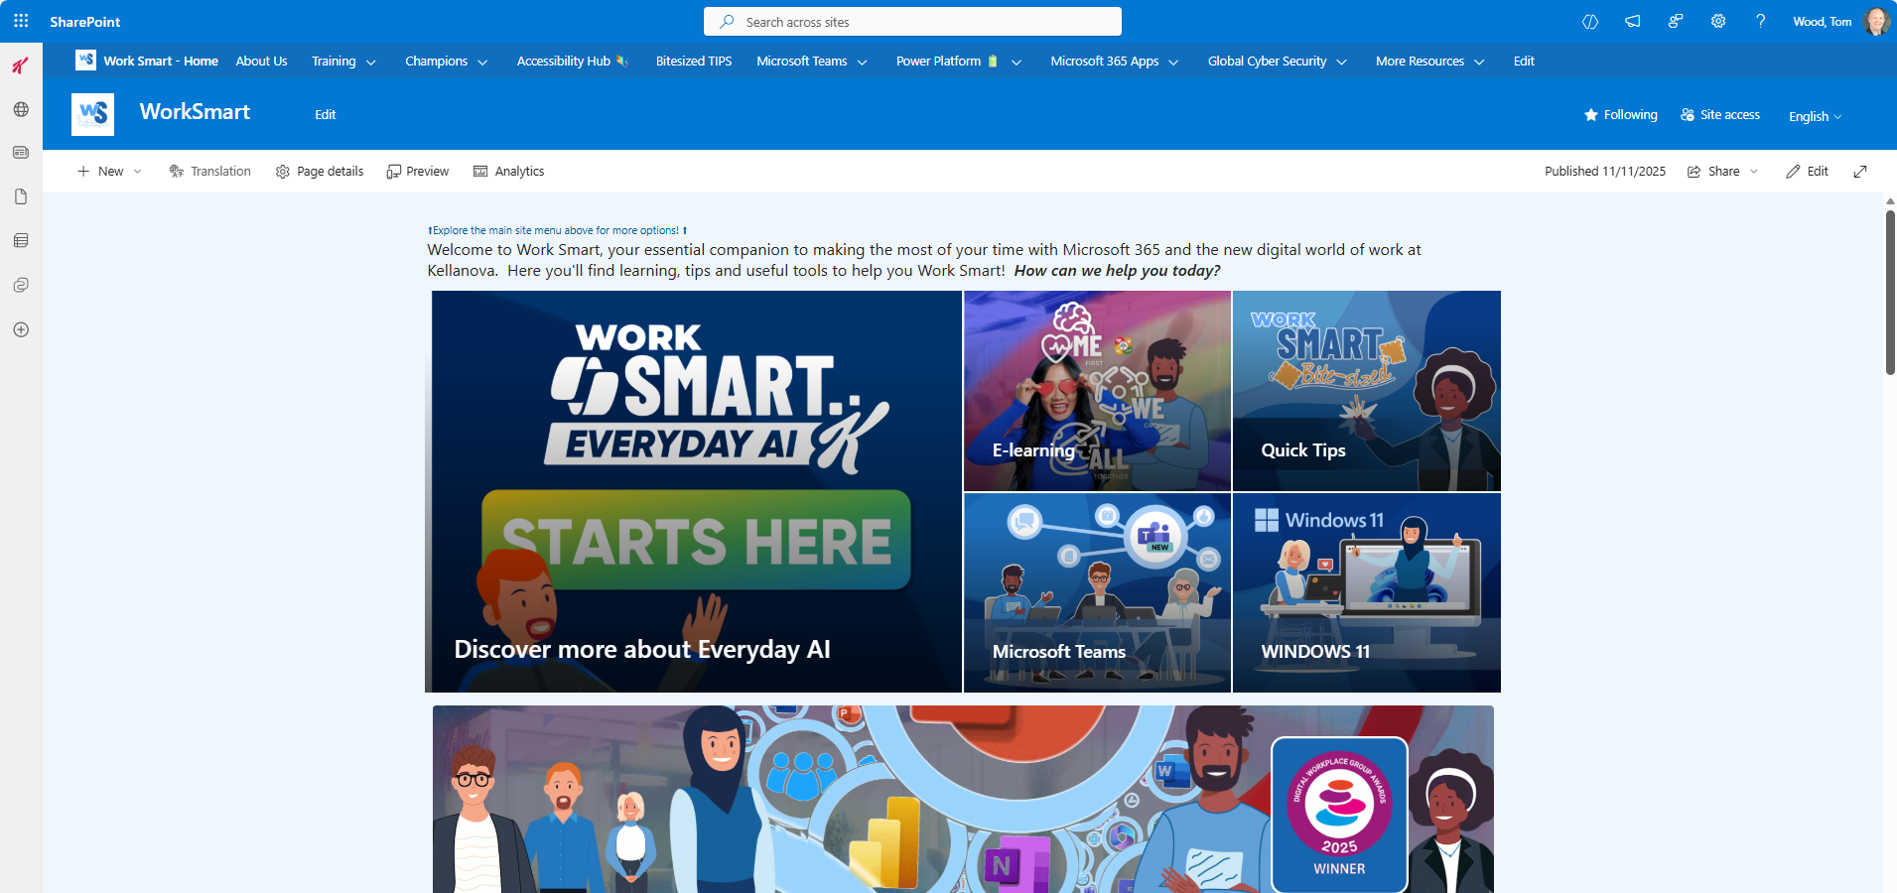
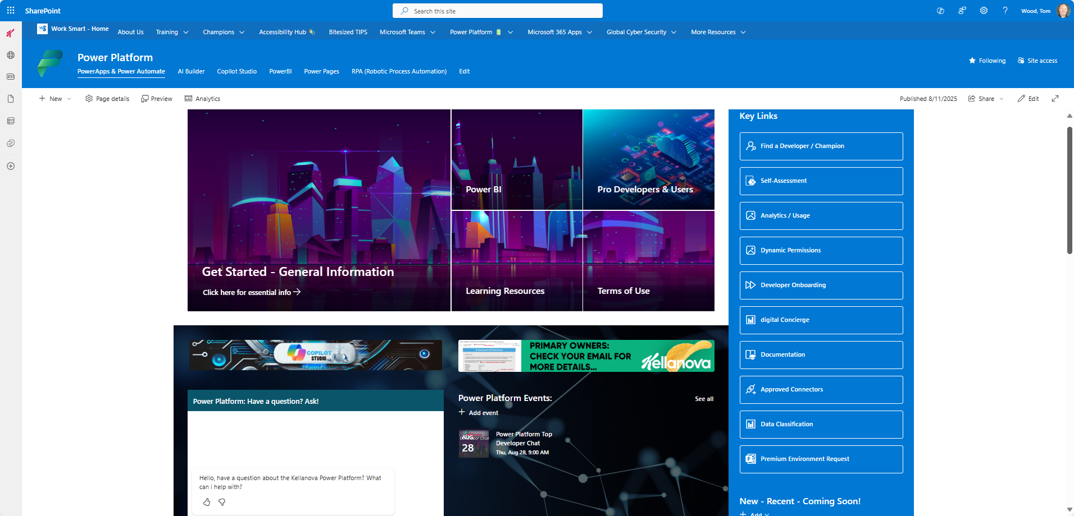
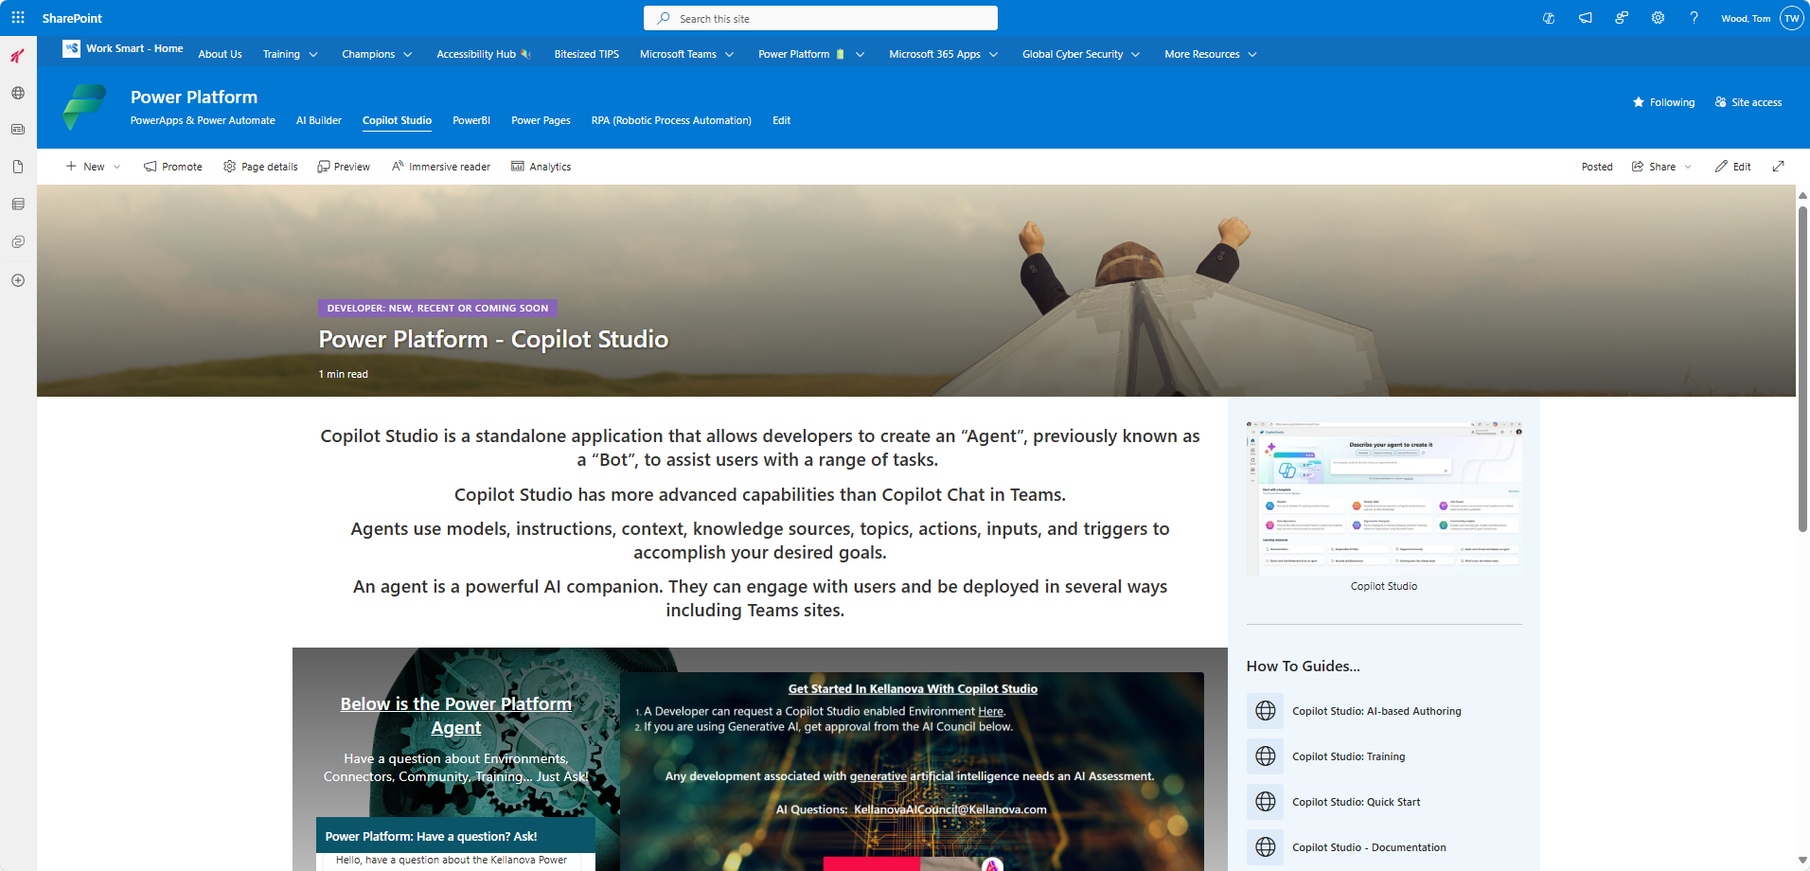
Custom SharePoint Sites
Notes:
Slide Message:
There’s a ton of resources available.
Communication lines are available.
https://kelloggcompany.sharepoint.com/sites/GBL-IT-PowerPlatform

