Slide 1
The Toulmin Model
Helpful to both Proposition and Opposition in thinking through the various elements of an argument and the possible rebuttals

Slide 2
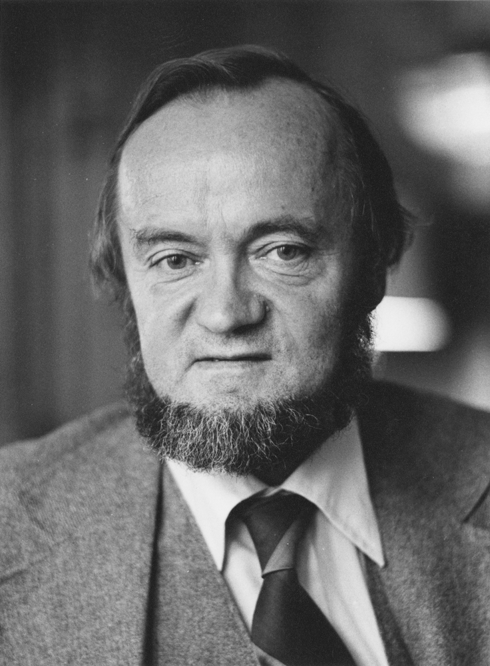
The Toulmin model is a framework for analyzing and constructing arguments. It was developed by British philosopher Stephen Toulmin in the 1950s and has since become a widely used tool in many fields, including rhetoric, communication studies, and law.
Stephen Toulmin, professor in the Committee on Social Thought, the department of Philosophy, and the Divinity School at the University of Chicago.
University of Chicago Photographic Archive, apf7-01437, Hanna Holborn Gray Special Collections Research Center, University of Chicago Library.

Slide 3
The Toulmin model consists of six components:
Claim/motion: The main point or thesis that the argument is trying to make.
Grounds/premises: The evidence, data, or reasons used to support the claim.
Backing: Evidence that supports the warrant. There are mainly 3 types: empirical (studies, statistics, numbers and figures), authoritative (expert voices/quotes) and narrative (examples, anecdotes).
Warrant: What connects the grounds to the claim (if the grounds are true, why does that compel the audience to vote for the motion?)
Rebuttal: “But not if...” - what are the exceptions to the above?
Qualifier: A statement that indicates the degree of certainty or scope of the argument (how certain can we be about the above claim?)

Slide 4
By identifying and analyzing these components, the Toulmin model helps people to better understand the strengths and weaknesses of arguments and to construct more effective and persuasive arguments themselves.

Slide 5
An argument constructed after the Toulmin model
Claim: We should eat more fruit
Grounds (why should we eat more fruit?): (Because) Eating more fruit is beneficial for human health
Backing: Scientific studies (make sure to quote the ones you use) show an improvement in those humans’ health who consume fruit and examples (anecdotal evidence) of people who feel better after changing their diets.
Warrant: Better health is desirable and eating more of it would contribute to an improvement in our health
Rebuttal: (But not if...) There are other factors that are more important, fruit is just one of several factors contributing to better health. Not all people want better health. Some do not like fruit and for them to eat it would be unpleasant and not worth it just for a marginal improvement in their health. Also, those who are allergic would get worse health by eating fruit.
Qualifier: How certain are we? Based on the studies and anecdotal evidence, we are fairly certain everything else being equal. Of course eating fruit would not balance out other non-beneficial changes, such as taking up smoking, eating sugar to excess or taking no exercise.

